Slide 1
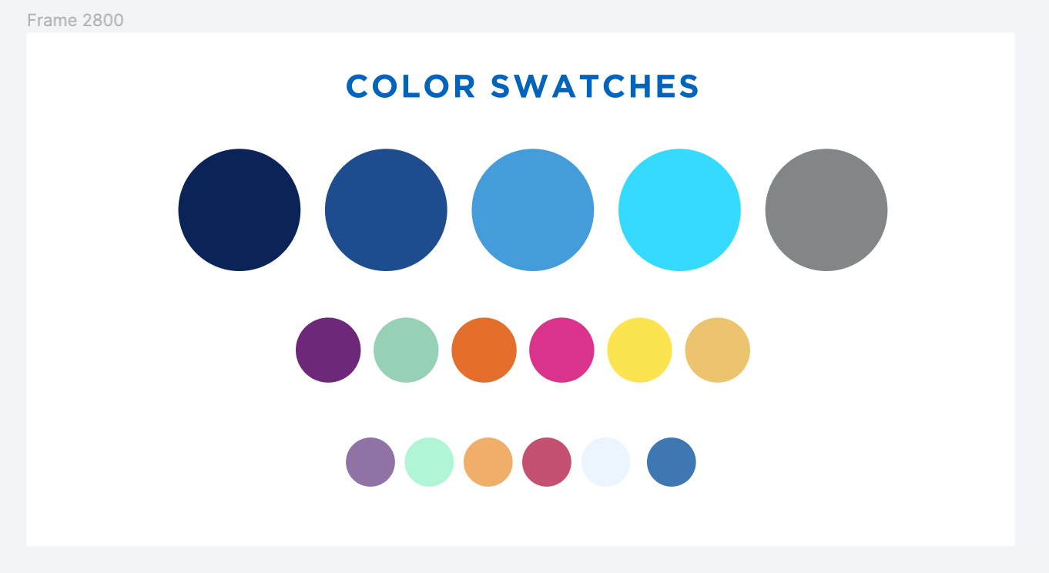
DSpace: Item Submission Workflows
Scholarly Communications Community of Practice
February 22, 2024

Slide 2
What is a workflow in DSpace?
A workflow adds one or more steps between submission and archiving of a new item
Workflows are an optional and not well-advertised feature of DSpace that allow for different types of submission processes, such as for journal submissions or assignment submissions

Slide 3
Anatomy of a Workflow
Workflows are created at the collection level
Four major components:
Submitters
Reviewers
Editors
Final Editors

Slide 4
Anatomy of a Workflow
Submitters: Those in the submitters group may submit items to the collection
Reviewers: can accept the item or reject the item
Editors: can edit the metadata of an item and either accept or reject it
Final Editors: can edit the metadata of a submitted item before archiving, but are unable to reject

Slide 5
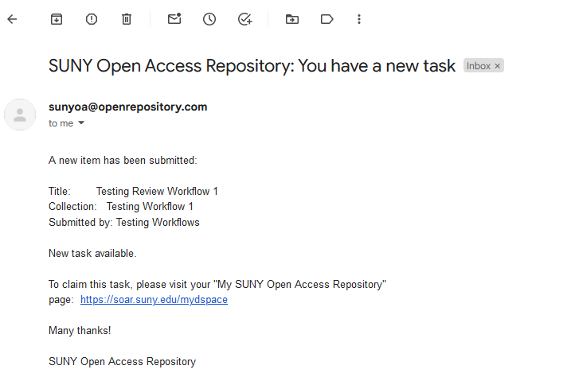
Example of a Basic Workflow: Dspace 6.x
Submitter submits an item, Editor receives an email notification

Slide 6
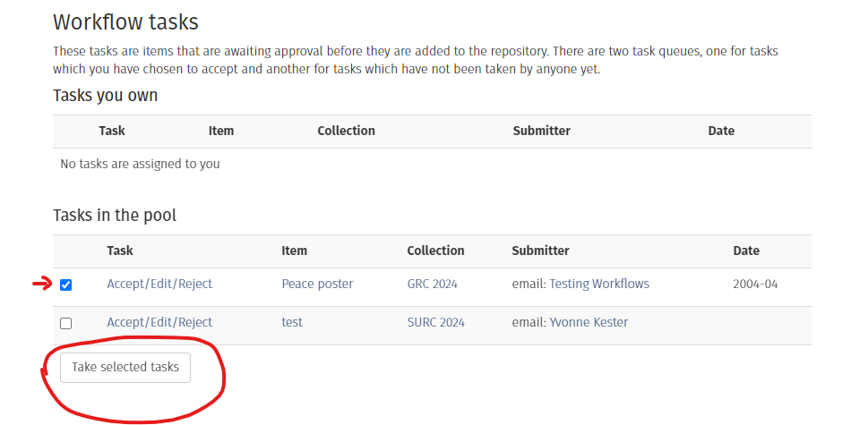
Example of a Basic Workflow : Dspace 6.x
Editor clicks on link to MyDspace to open Submissions and Workflow tasks – scroll to bottom to Workflow tasks Select the item and click “Take selected tasks”

Slide 7
Example of a Basic Workflow : Dspace 6.x
Item is added to “Tasks you own.” The task owner clicks on item link to open the item for review. The reviewer in this example is an “Editor” and has the option to approve, reject, or edit the item’s metadata

Slide 8
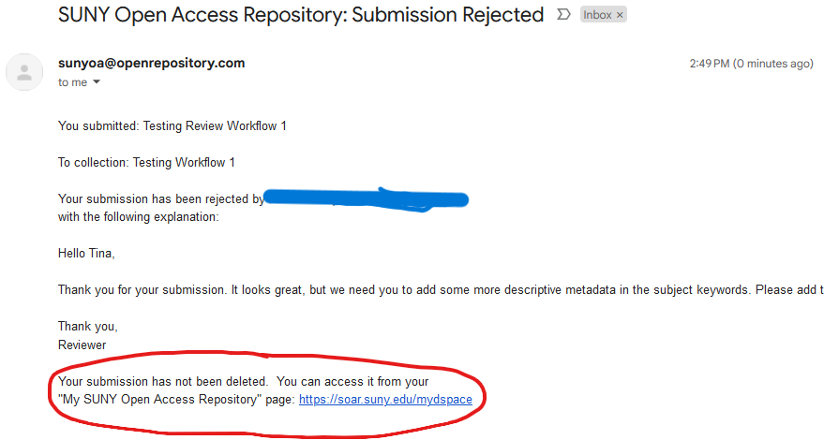
Example of a Basic Workflow : Dspace 6.x
If you Approve the item, the submitter will get an email notifying them. If you Reject the item, the submitter will get an email notifying them and giving them access to their incomplete submission for editing.

Slide 9
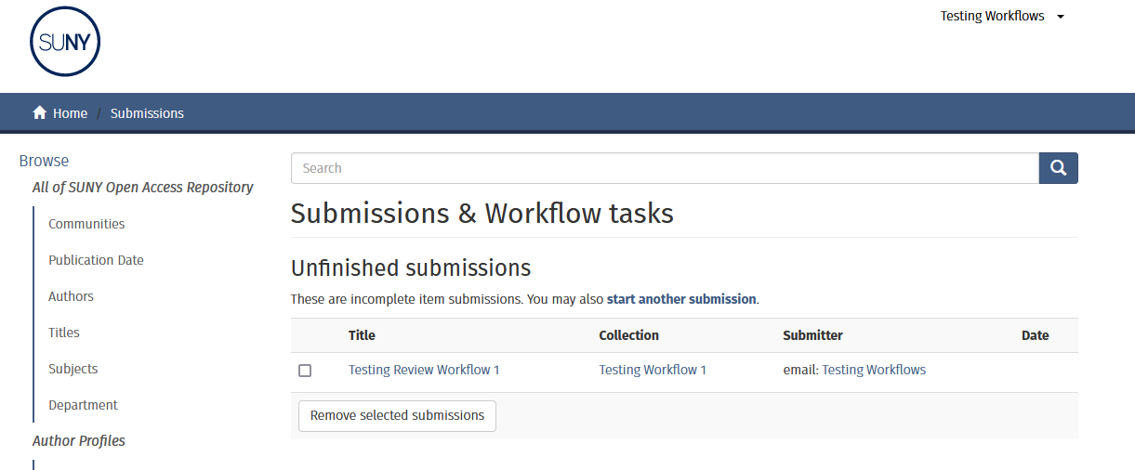
Example of a Basic Workflow : Dspace 6.x
Submitters may go to MyDSpace and edit the item, then resubmit.

Slide 10
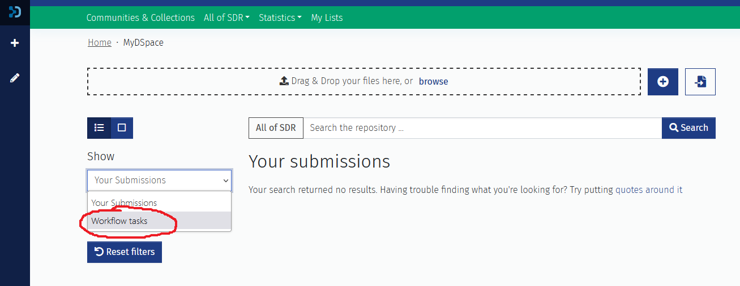
Dspace 7.x Differences
The differences in Dspace 7.x are mainly visual, although the manual submission is now one page. In MyDSpace7, you can find Your Submissions and Workflow tasks.

Slide 11
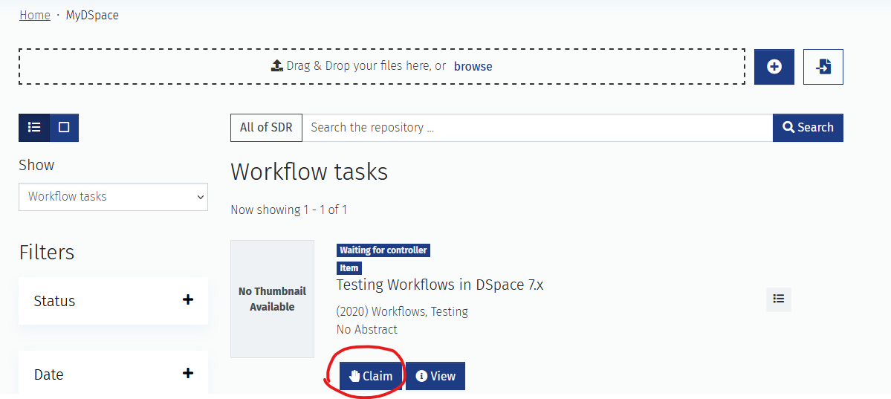
Dspace 7.x Differences
In MyDSpace7, either claim the task or view the item. Viewing the item does not affect the workflow.

Slide 12
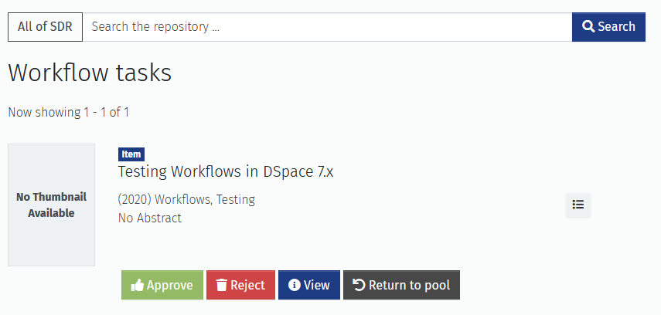
Dspace 7.x Differences
Showing the options for a basic Reviewer: Approve, Reject, View, or Return to the pool.

Slide 13
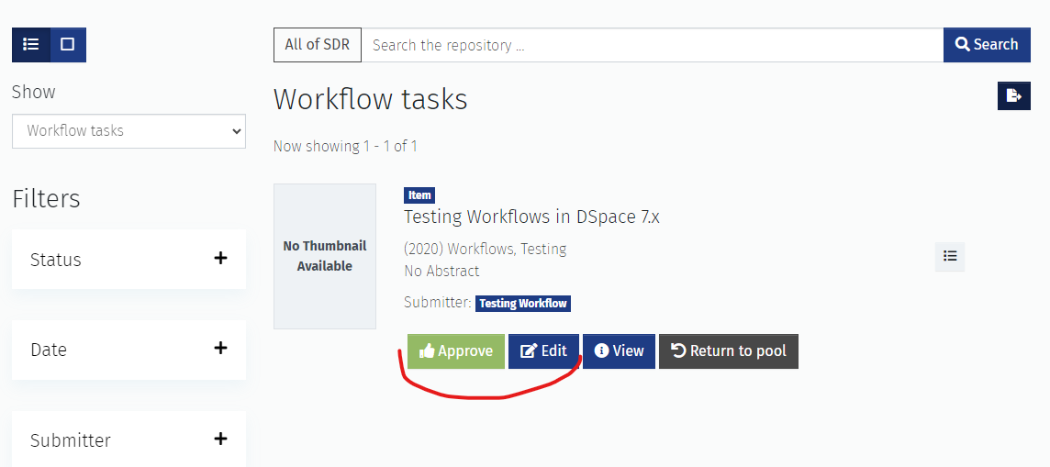
Dspace 7.x Differences
Showing the options for a Final Editor: Approve or Edit, View, or Return to the pool.

Slide 14
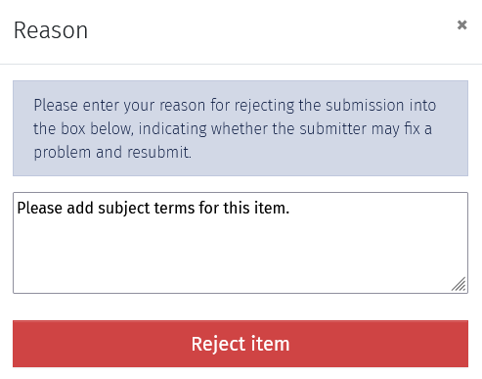
Dspace 7.x Differences
Whether in Dspace 7.x or Dspace 6.x, the rejection step involves giving a reason for the rejection, so the submitter can rectify it.

Slide 15
Questions?
Thank you! Yvonne.Kester@suny.edu info@sunyolis.libanswers.com

