Slide 1
CUNY Cutover Migration
Data Review and Acceptance
Andrea Bainbridge, Implementation Consultant | July 7, 2020

Slide 2
Cutover Migration Refresher
  Process
  Tools
Alma Data Review
  What is “acceptable” data?
  ExL’s Data Checks (What Not to Worry About)
  CUNY’s Data Checks (Site Expertise)
Resources & Tips
Timeline
Q & A from the live discussion

Slide 3
Cutover Migration Referesher

Slide 4
Process
Aleph data extracted & loaded to Alma on ExL’s internal server.
ExL reviews data; approves copy to Production (“live” Alma).
ExL delivers Alma to CUNY via Salesforce cases, including migration reports.
Assigned CUNY staff review Alma data on Production.
CUNY provides data acceptance or flags migration issues within 3 days, via Salesforce cases.
ExL provides support for required/desired data clean-up after Go Live.

Slide 5
Tools
One Salesforce (SF) case per CUNY IZ
One for Network Zone
Already assigned to CUNY staff
Salesforce = Place of record
  Alma delivery
  Questions about your IZ
  Official Data Acceptance
Basecamp for general questions
  Process, timelines, etc.

Slide 6
Alma Data Review

Slide 7
What is “acceptable” data?
In general, if the following are true you should accept your data.
Migration changes requested by CUNY have been implemented.
The number of each record type in Alma is expected (i.e. the number of bibs Baruch had in Aleph matches the number of bibs in Alma).
Records migrated as specified (e.g. PO lines link to same vendors as in Aleph; physical items are in the expected locations; note and identifiers fields migrated as expected).
ExL has acknowledged and provided a plan for any issues you identify.

Slide 8
What Not to Worry About --ExL’s Data Checks
Compare Alma IZs against Migration Statistics
Were the proper elements retained?
  Courses and Reading Lists
  Staff User Roles
Did all within migration scope migrate?
  Inventory, Acquisitions, Fulfillment, P2E, SFX
IZ → NZ linking
Sanity check record contents (do invoices have the usual invoice data? do patron records look like patron records?)
Spot-check data linkages (do loans link to an item and patron, and vice versa)?

Slide 9
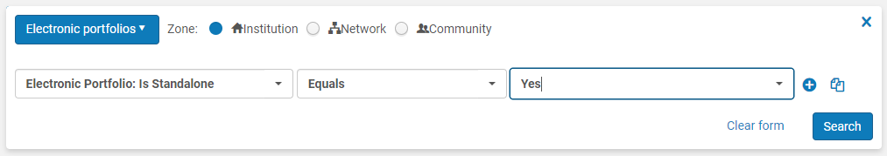
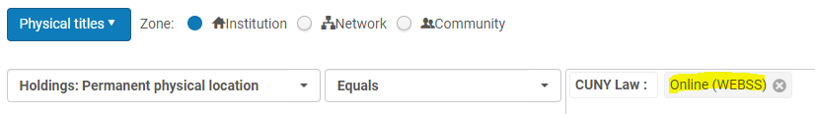
What to Check--CUNY’s Data Checks
I. Focus on changes from TL—what should be different this time?
P2E
  More local e-resources switched from physical to electronic; the number of portfolios created should be comparable…
  But there will be fewer Physical Titles in electronic/web locations
Tip: Do these searches in Alma now, and compare numbers when new data is delivered.
Notes:
Not mutually exclusive processes, but each is a distinct element

Slide 10
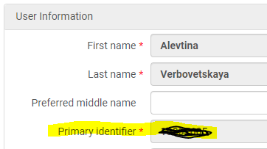
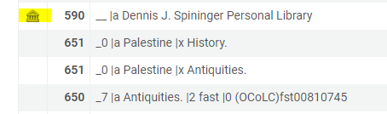
What to Check--CUNY’s Data Checks
I. Focus on changes from TL
User Primary ID
  Should match EMPLID (Aleph ID 07)
Aleph fields transformed
  001 → 952; OWN → 975; STA → 976; 946 → 956; 949 → 959; 910 → 990
Local fields retained in IZ
  Will not be overwritten by NZ record
  590, 952, 956, 959, 970, 971, 975,
  976, 990, 991
Notes:
Not mutually exclusive processes, but each is a distinct element

Slide 11
What to Check--CUNY’s Data Checks
II. Sanity-check against Aleph & SFX Data
Patron Example: Choose three or four individual patrons in Aleph and verify in Alma
  Contact info is correct
  Is User Group correct? Are they correctly marked internal vs. external?
  Did blocks/fines migrate as specified?
  Did notes migrate as expected? Are internal notes still internal (i.e. invisible to the patron)?
Repeat this spot-checking process for other record types
Notes:
Not mutually exclusive processes, but each is a distinct element

Slide 12
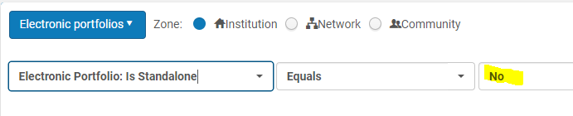
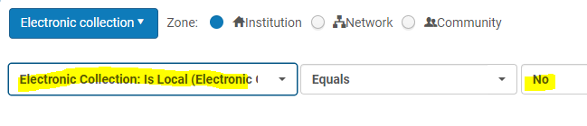
What to Check--CUNY’s Data Checks
II. Sanity-check against Aleph & SFX Data
Verify the number of SFX activations for your IZ
Did the expected activations migrate to your IZ?
Notes:
Not mutually exclusive processes, but each is a distinct element

Slide 13
Resources and Tips

Slide 14
Resources and Tips
TL Data Review Slides
  https://3.basecamp.com/3765443/buckets/15146002/documents/2461220624
  Helpful searches
For reference see the Aleph to Alma Migration Guide.
Gather examples now from Aleph to be used in data-checking.

Slide 15
Resources and Tips
Gather record counts from Aleph for bibs, patrons, PO lines, etc. so you can compare totals in Alma.
If it looks weird, double-check it in Aleph or SFX first. You may have found an outlier.
Ask! Share questions/comments about your data to your Communications Committee representative. They will route to ExL.

Slide 16
Timeline

Slide 17
Alma Delivery and Data Review Timeline
Alma delivered to CUNY by July 26
  Rolling delivery
Data Acceptance Due by EOD July 28
  All sites have at least two full business days to review (Mon., July 27 and Tues., July 28)
  ExL will monitor SF cases over the weekend (July 25-26) for data review questions if some CUNY staff are able to check data on Saturday or Sunday.
  If site is delivered early, you are welcome to review/accept your data early
See CUNY’s internal timeline at https://guides.cuny.edu/LSPImplementation/Timeline

Slide 18
Q & A from the live discussion

Slide 19
Questions Raised During the Meeting
Q: Whose servers are data loaded on?
  A: Ex Libris
Q: Do we use our CUNY logins for Alma data-checking?
  A: Yes. Use your CUNYFirst credentials.
  Please test your log-in now.
  http://ols.cuny.edu/alma/
  New employees may need to be added manually to Alma.
Q: Should only one person be doing the checking? Or several people?
  From OLS: “"Takes a village", and why not enjoy the benefit have having several skilled campus people checking things in their area of expertise?”
  Only one staff member per site will have access to the SF case, but others are encouraged to help with data-checking.
For checking migrated Fines (per Kevin): “For fines, please keep in mind that many fines were exported to excel and then removed from Aleph. So, look for UNreturned loans for fees and such”

Slide 20
Questions Raised During the Meeting
Q: Will the production environment be available right up to July 22nd if we want to test these and familiarize with what to do? Is the production environment going to be down?
  While new data is being loaded, until you accept data, no changes should be made to Alma.
  Alma will be available until approx. July 24
  We are delivering Alma on a rolling basis, so lockout may begin a few days earlier for some sites
  ExL will alert CUNY sites when “lockout” begins via a SF comment, and we will alert OLS.
  From OLS: “The Sandbox will be available for training and Alma Alma orientation purposes. One can also still have a look in Alma for review / search purposes. We should just not be entering new data or new changes.”
From OLS: “Electronic records that had STA=PCI were removed, so this will lower your overall number of electronic records.”
From OLS: “nbl [new book list] will be retired with Aleph. There is a search that one can do to see the date that items are added to Alma”

Slide 21
Thank you!
CUNYAlma@exlibrisgroup.com

