Slide 1
Resource Management: Work Orders
Shared Library Services Platform Project
Maggie McGee

Slide 2
What are Work Orders?
Work Orders are internal requests that route the item to a department within a library for internal processing of physical inventory
The item is no longer available on the shelf
The item is processed based upon work order type statuses
Work Orders can be used to replace pseudo-patrons
Work Orders can be used to replace process types that are not available in Alma
Work Orders are manually updated as the item is moved through the work order process
Work Orders are performed at the item level

Slide 3
Things to Consider When Creating Work Orders
Work Orders should mirror the physical reality of the library
Consider staff workflows and job responsibilities when setting up work order types and departments
Use a single Work Order type if a single person is going to carry out several functions
Use different Work Order types when different departments carry out different functions
Work Orders can only be associated with one department
Statuses within a Work Order Type should be used instead of creating a new Work Order Type when one department manages many processes
i.e., Technical services
Work Order departments can be associated with one or more library
Work Orders prevent Purchase Orders (POs) from being relinked

Slide 4
Work Orders and Request Priority Levels
Work Orders are considered requests in Alma
Requests are prioritized by the “Request Priority” configurations in Alma
Fulfillment TOUs (Terms of Use) and
Request Priorities
The Work Order will move ahead of a patron request if the Work Order priority is higher than a patron’s request priority
The Work Order priority should be changed to the lowest priority in order to avoid this
Request priorities will be assigned in the order the request is received if the Work Order and the TOU has the same Request Priority level

Slide 5
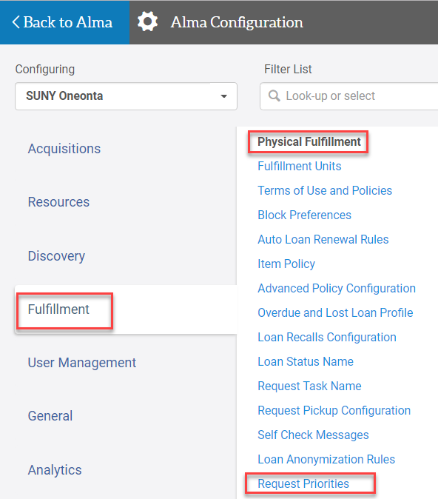
Work Orders Request Priority Configuration
Go to Configuration>Fulfillment>Physical Fulfillment>Request Priorities
Work Order
Click Customize to change the priority level
Choose the priority level from the drop down menu
Click Save

Slide 6
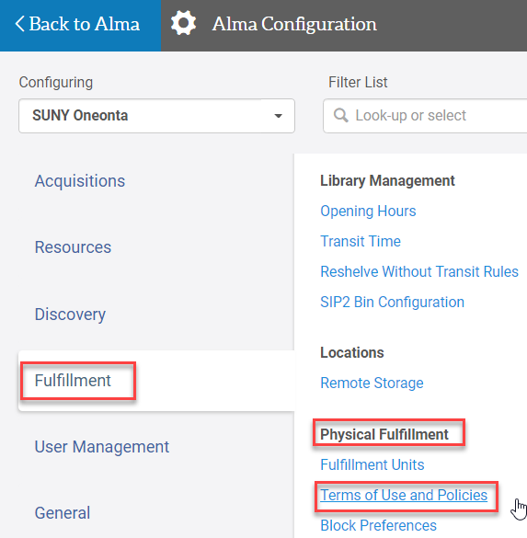
TOUs Request Priority Configuration
Go to Configuration>Fulfillment>Physical Fulfillment>Terms of Use and Policies
Select Edit from the ellipses TOU Policy Request type
Request Priority: [change the priority level]
Click Next
Click Save

Slide 7
Creating a Work Order
Role Required to Create Work Order types, departments, and statuses:
General System Administrator
Create a Work Order Type
Best practice is to create these at the Institution Level
If you only have one library they can be created at the library level
The type identifies the library process that is to be carried out on an item
Create a Work Order Department
The Work Order department is the physical location where the work will be processed
Items are not owned by the department, but the items are moved to the department in order to complete a specified library process
Create Work Order Statuses (optional)
Work Order statuses are the steps within a work order type
Work Order statuses also identify the work that needs to be done on the item

Slide 8
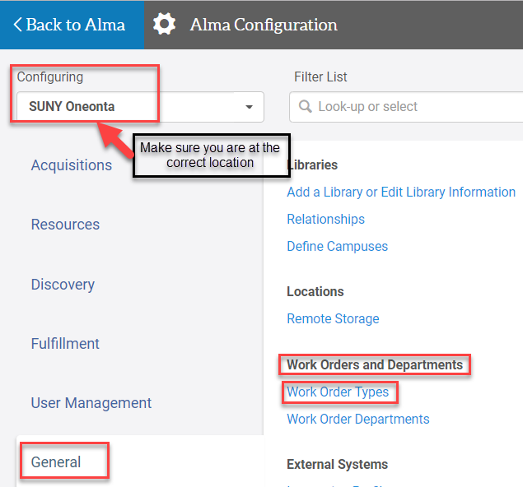
Configuring Work Orders
Go to Configuration>Work Orders and Departments>Work Order Types

Slide 9
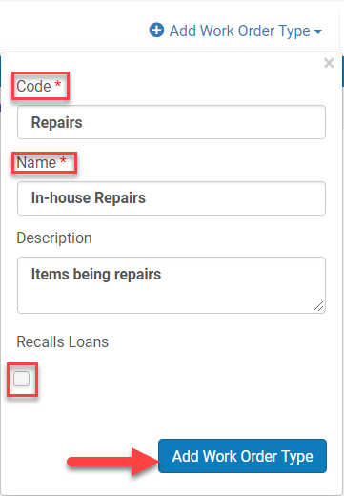
Configuring Work Orders
Click Add Work Order Type
The Add Work Order Type pop-up box appears
Code: [mandatory]
Name: [mandatory]
Description: [optional]
Recall Loans: [uncheck the box unless a recall for this work order type is necessary]
Click Add Work Order Type

Slide 10
Configuring Work Orders
Click Manage Departments from the Work Order Type ellipses
Click Add Department

Slide 11
Configuring Work Orders
The Add Department 4 page wizard opens
Department Details screen
Code: [mandatory]
Name: [mandatory]
Description: [optional]
Work Time (days): [informational only]
Default printer: [not available if they are configured at the library level]
Necessary for being able to Print Slips
Map: [allows a URL of a map to the department]
Click Next

Slide 12
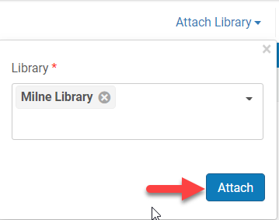
Configuring Work Orders
The Add Department 4 page wizard opens continued
Served Library screen opens
The Institution Level Library is associated with the Department
Click Attach Library to add additional libraries to be served by this Work Order department
Select Library
Click Attach
Click Next

Slide 13
Configuring Work Orders
The Add Department 4 page wizard opens continued
Contact Information screen opens (optional)
Click Add Address
Click Add Phone Number
Click Add Email Address
Click Next

Slide 14
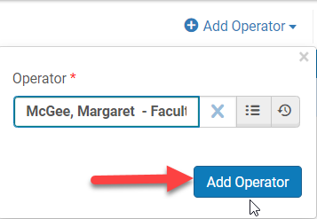
Configuring Work Orders
The Add Department 4 page wizard opens continued
Operators screen opens
Click Add Operator
Add the operators of those who need access to this work order
Search for the User (operator)
Click Add Operator
Click Save
Click Back

Slide 15
Configuring Work Orders
Click Manage Statuses from the ellipses of the Work Order
Click Add Status

Slide 16
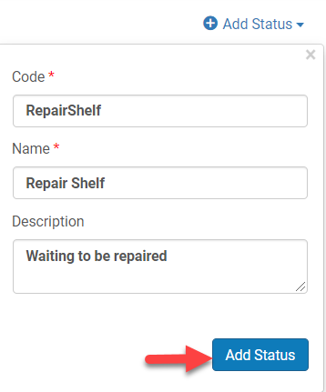
Configuring Work Orders
Add Status pop-up screen opens
Code: [mandatory]
Name: [mandatory]
Description: [optional]
Click Add Status
Click Back after all the statuses have been added

Slide 17
4 Steps in Initiating and Processing a Work Order
Identify the item in Alma
Initiate the Work Order
Check-out
Check-in
Repository search for a Physical Item
The Work Order department moves the item through the statutes
The Work Order is marked as Done and the item is returned to its location/owning library

Slide 18
Creating a Work Order Upon Check-out
Scan item out to patron from Fulfillment
Click Work Order from the ellipses of the item that was checked out

Slide 19
Creating a Work Order Upon Check-out
Select the process type
Once a process type is selected the rest of the Place item in Process screen opens
Do not pick from shelf: [keep checked if the item is in hand]
Note: [optional, but useful]
Managing Department: [auto-populates from the Work Order type chosen]

Slide 20
Creating a Work Order Upon Check-out
Select the process type
Click Submit
Pop-up message confirming the work order was submitted appears

Slide 21
Creating a Work Order Upon Check-In
Scan in the item from Fulfillment
Click Work Order from the ellipses of the item being returned

Slide 22
Creating a Work Order Upon Check-in
Select the process type
Once a process type is selected the rest of the Place item in Process screen opens
Do not pick from shelf: [keep checked if the item is in hand]
Note: [optional, but useful]
Managing Department: [auto-populates from the Work Order type chosen]

Slide 23
Creating a Work Order Upon Check-in
Select the process type
Click Submit
Pop-up message confirming the work order was submitted appears

Slide 24
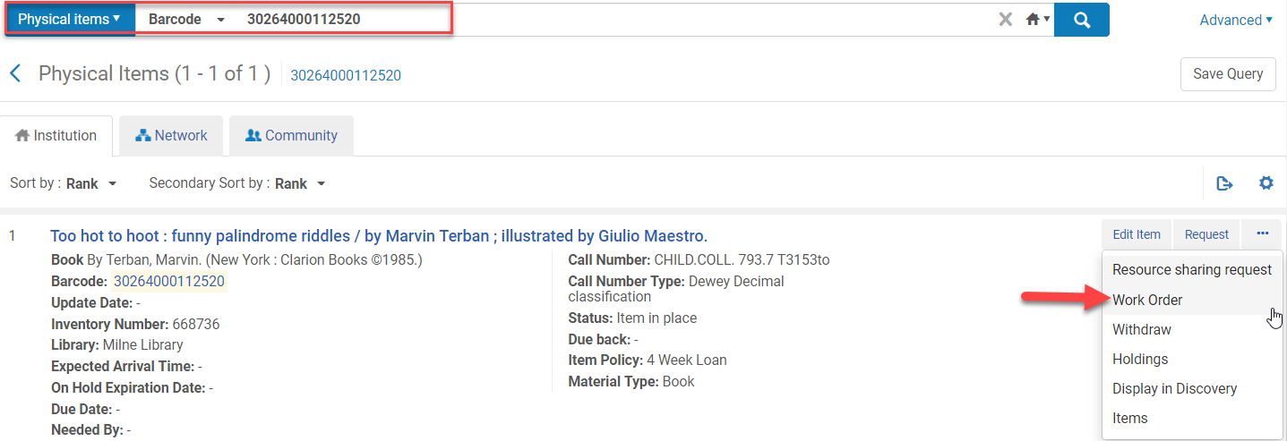
Creating a Work Order from a Repository Search
Perform a repository search for a Physical Item
Click Work Order from the ellipses of the item

Slide 25
Creating a Work Order from a Repository Search
Select the process type
Once a process type is selected the rest of the Place item in Process screen opens
Do not pick from shelf: [keep checked if the item is in hand]
Note: [optional, but useful]
Managing Department: [auto-populates from the Work Order type chosen]

Slide 26
Creating a Work Order from a Repository Search
Select the process type
Click Submit
Pop-up message confirming the work order was submitted appears

Slide 27
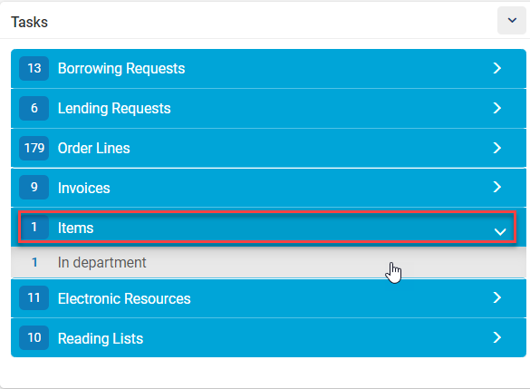
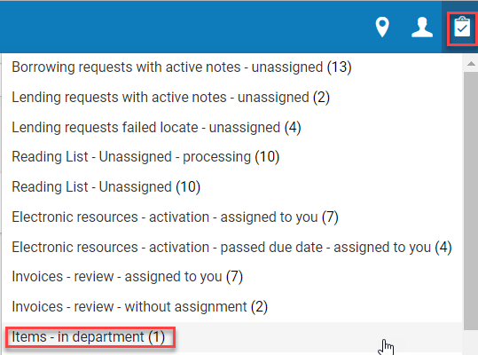
Item Arrives in the Work Order Department
Select the Work Order department location
Go to the task list and click on items
Widget or
Task list icon

Slide 28
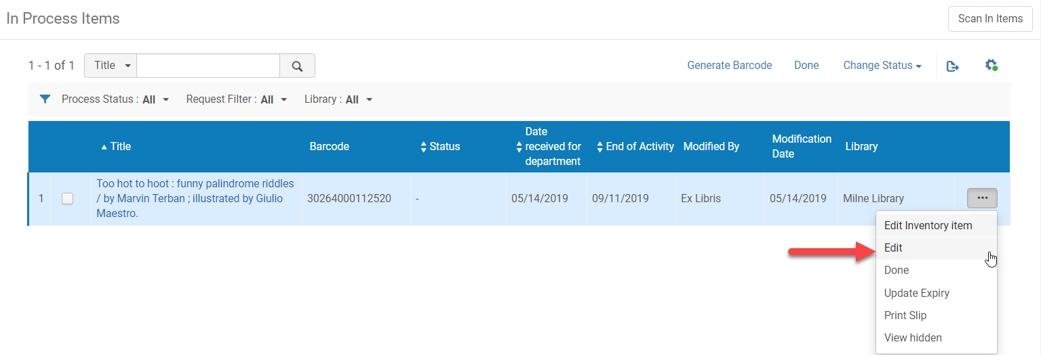
Item Arrives in the Work Order Department
Click Edit from the ellipses to move the item through the Work Order statuses
Or click Done (Step ) if the Work Order process is complete and the item will be moved to its permanent location

Slide 29
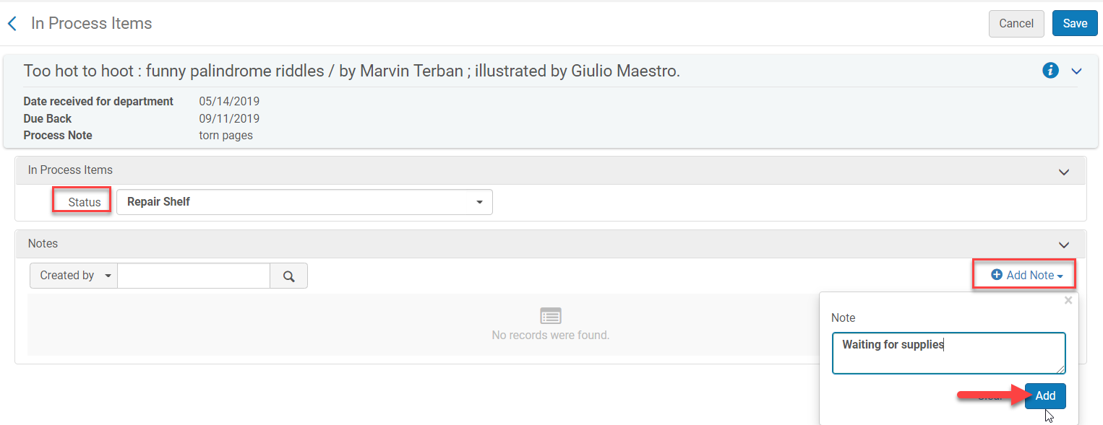
Item Arrives in the Work Order Department
In Process Items screen opens
Status: [select the work order status for the item]
Add Note: [if applicable]
Click Save

Slide 30
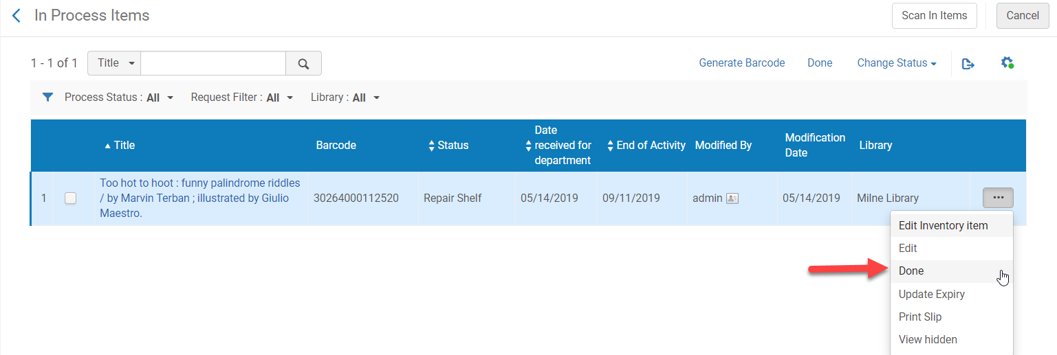
Item Arrives in the Work Order Department
Repeat steps 3 and 4 until the Work Order statuses for the Work Order type are complete
Click Done from the ellipses of the item when all Work Order statuses have been complete
The pop-up message confirming the work order is complete appears

Slide 31
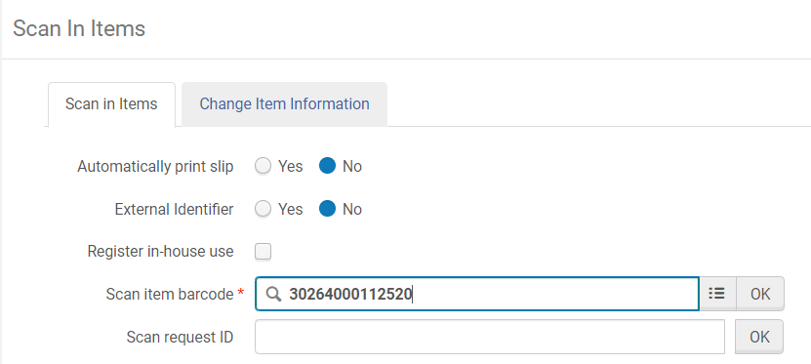
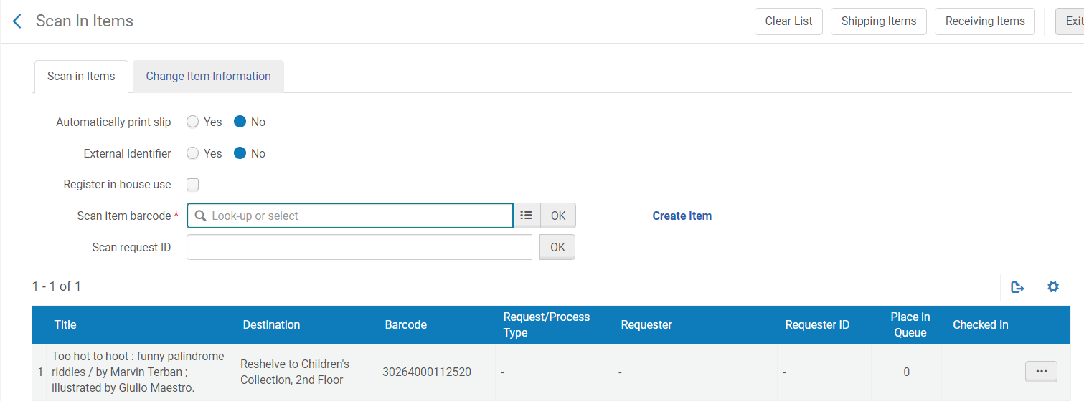
Item Arrives in the Work Order Department
The item needs to be scanned back into the reshelving desk otherwise the Process Type will stay “Transit”

Slide 32
Checking in an Item that has a Work Order
Scan in the item being returned
A pop-up message appears saying the item’s destination is the work order department
Click Ok
The Next Step appears after the item has been returned

Slide 33
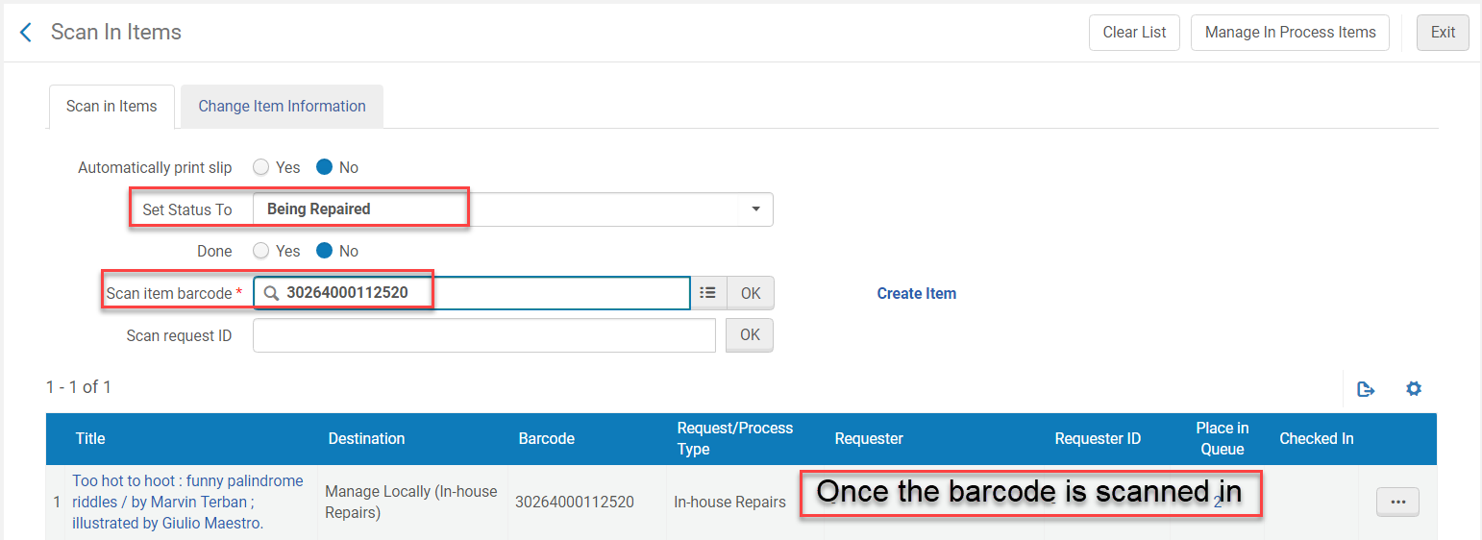
Checking in an Item that has a Work Order
The item needs to be scanned into the Work Order Department
Go to Fulfillment>Resource Requests>Scan in Items
Select the location
Select a status
Scan in the item barcode

Slide 34
Item Arrives in the Work Order Department
Now the item will appear in the task list
Click on items link from the Tasks Widget or Task list icon

Slide 35
Troubleshooting Work Orders
If a Work Order is created by accident for an item:
Mark the Work Order as Done from the ellipses
Have the circulation desk (or desk assigned to do this) scan in and reshelve the item
If you accidentally click Done, but the Work Order is not finished:
Change the location to the Work Order department
Go to Fulfillment>Resource Requests>Scan in Item
Select the appropriate status
Scan in item barocde

Slide 36
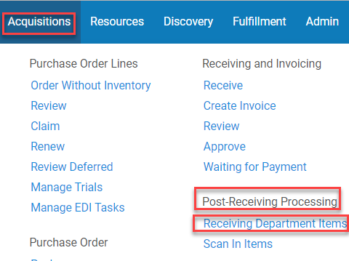
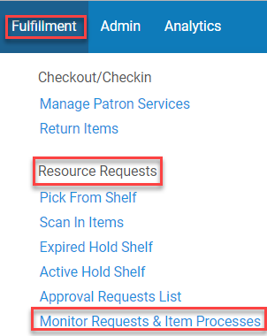
Other Ways to View Work Orders
To view Work Orders you need to be in the Work Order Department location
Go to Acquisitions>Post-Receiving Processing
Go to Fulfillment>Resource Requests>Monitor Requests & Item Processes

Slide 37
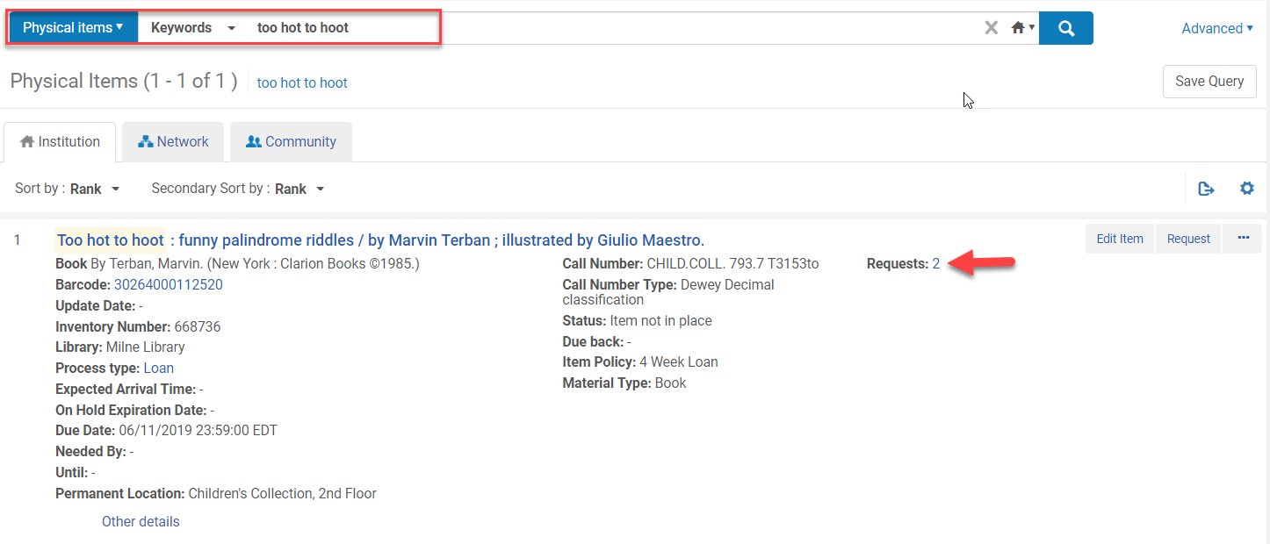
Viewing the Order of Requests
Perform a repository search for the physical item
Or go to Fulfillment>Resource Request>Monitor Requests & Item Processes
Click on the number next to Requests

Slide 38
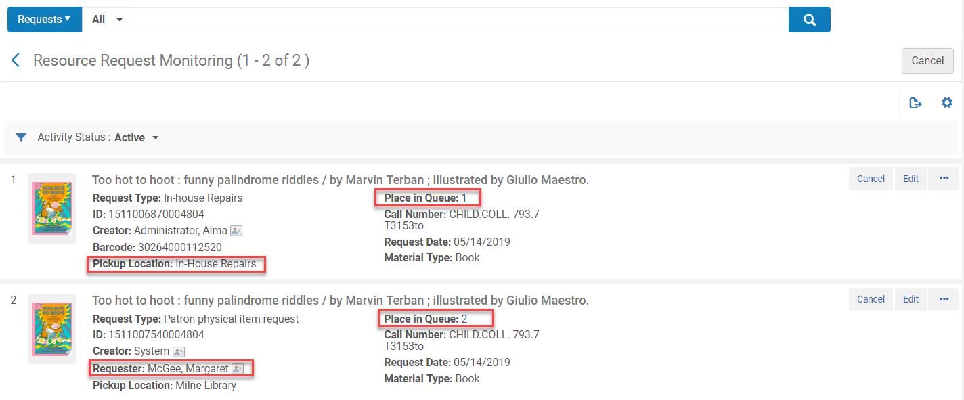
Viewing the Order of Requests
The Resource Requests Monitoring Screen opens
Place in Queue: [displays the number of where the item is in the Queue]
*Work Orders take precedent over patron requests unless it is configured differently

Slide 39
Viewing the Order of Requests
Requests can also be view by performing a repository search for Requests:All:[leave blank to view all]
Requests can also be searched by other criteria

Slide 40
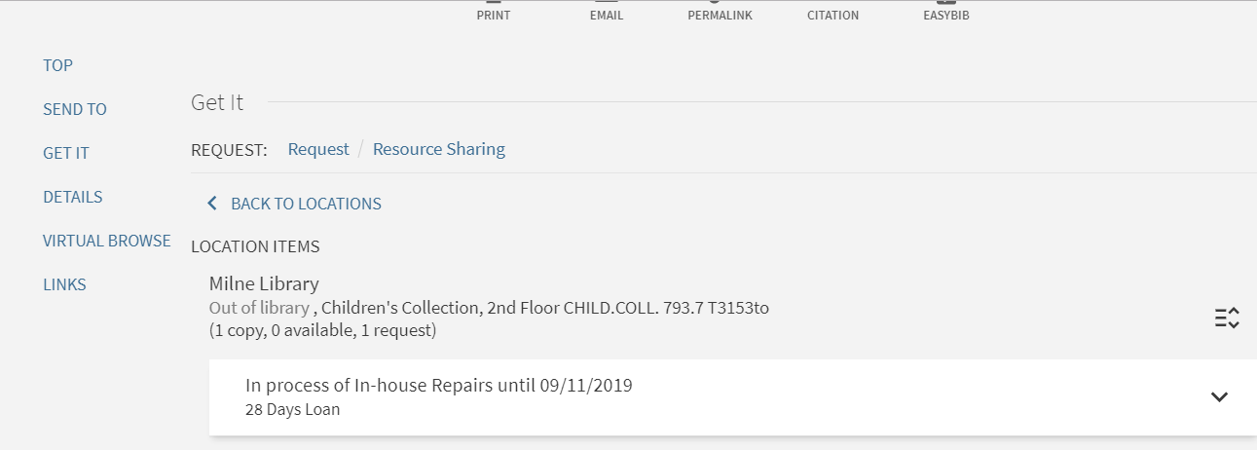
PrimoVE View of an Item in a Work Order

