Slide 1

George Mason District
Roundtable
March 9, 2023

Slide 2

Pledge

Slide 3
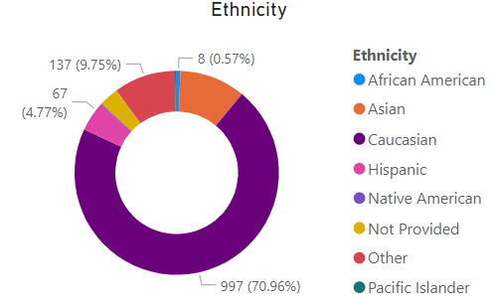
Council Update
Non-Unit Charter Renewal (MBC)
  Still not processed; except Jim Miller, Patrick Murray, and Craig Thor (Nova Counselor)
  Scoutbook – Check MBC list
Fund Raising - Right-Response First Aid Kits!
Membership
  Units:
    Renewed: 923/982 (94% retention)
    Dropped: Club (1), Crew (7), Lab (2), Pack (19),
    Post (6), Ship (1), Troop (23)
  Council: 33,437 (Growth: 2.84%; Market Share: 3.45%)
    Retention: 80.63%
    Ethnic Diversity: 35.48%
    Female: 11.9%
  George Mason District: 1,405 (Market Share: 0.14%)
    Ethnic Diversity: 26.80%
    Female: 8.75%

Slide 4

Council Update (cont.)
Cub Camping 2022:
Dates:
  Resident Weekend: 4; 6/22-6/25, 6/29-7/2, 7/6-7/9, 7/13-7/16
  Day Camp: 2; 6/27-6/30, 7/10-7/14
  Scout Specialty Week: 7/16-7/22
Provisional: Can send individual or small numbers of scouts; still need appropriate adult supervision.
Camperships Available: 50% off camp attendance fee

Slide 5
Youth Protection and Adult Leadership Update
Effective September 1, 2023 – Two registered adult leaders, 21 years of age or over, are required at all Scouting activities, including all meetings. There must be a registered female adult leader, 21 years of age or over, in every unit serving females. A registered female adult leader, 21 years of age or over, must be present for any activity involving female youth or female adult program participants.
Notwithstanding the minimum leadership requirements, age and program-appropriate supervision must always be provided.
All adults staying overnight, in connection with a Scouting activity, must be currently registered in an adult fee required position as listed or as an adult program participant. Limited exception below for Cub Scout overnight Programs. Registration as a Merit Badge Counselor does not meet this requirement.

Slide 6
Youth Protection and Adult Leadership Update (cont.)
Cub Scout Program – Overnight Exception: Cub Scout parents or legal guardians taking part in an overnight Cub Scout program with their own child or legal ward are not required to register as leaders. All adults must review the “How to Protect your Children from Child Abuse: A Parent’s Guide” that can be found in the front of each Cub Scout Handbook. In addition, the parent or legal guardian must be accompanied by a registered leader at any time they are with youth members other than their own child/ward. All other overnight adults must be currently registered in an adult fee required position.

Slide 7
Follow-up:
MBC don’t have to be in a paid position if not staying overnight.
Parents of Scout BSA youth that stay overnight on a campout or summer camp must be registered leaders. No more 72-hour rule.
Lion Adult Partner/Tiger Cub Adult are not paid registered positions. However, Partners is exempt as is a family campout.
Merit Badge Counseling requires two registered adults – However, the parent or legal guardian of the Scout may serve as the second adult. This parent or legal guardian does not have to be a registered leader.
An adult program participant is any person 18 but not yet 21 years of age who registers to participate in a program in which youth members also participate; obligates himself or herself to regularly attend the meetings; fulfills a member’s obligation to the unit; subscribes to the Scout Oath; and participates in an approved program based on the current guide-lines of the Boy Scouts of America. Adult program participants are subject to the same guidelines as adult Scouters when required by policies and guidelines. They cannot be on Committees.
How is a MBC different from a Registered adult – they both submit paperwork, take YPT and get a background check? Still working to get information about this.

Slide 8
Aquatics Committee (https://ncacbsa.org/aquatics)
2023 Training Schedule
Pre-Camp Swim Tests (Camp Snyder, Haymarket, VA) - https://scoutingevent.com/082-68909
  Sunday, June 4th (9am-5pm) – hourly slots
Paddle Craft Safety (Still – Camp Snyder/Silver Lake; Moving – Riley’s Lock, MD)
  May 20 - Still Water Safety - Class Size 12
  May 21 - Moving Water Safety - Class Size 12
  Sept 23 - Still Water Safety - Class Size 12
  Sept 24 - Moving Water Safety - Class Size 12
Canoe Paddling Instruction (Silver Lake, Camp Snyder)
  June 9-11
Scuba (Pool – TBD; Open Water – Fredericksburg, VA)
  Pre-class, computer-based training
  08/12/23 – 08/13/23 – Pool work
  08/19/23 – 08/20/23 – Open Water
Aquatics MB Completion (only for those that are missing a few requirements from camp)
  TBD (likely early Sept)

Slide 9

Big Rock:
What Can Your Commissioner Do For You?
Rus Pittman, GM District Commissioner

Slide 10
Commissioners
OUR MISSION
  As Commissioners, we share the BSA’s mission: “To prepare young people to make ethical and moral choices over their lifetimes by instilling in them the values of the Scout Oath and Law.”
OUR VISION
  Every member of the BSA has a great Scouting experience.
OUR CULTURE
  Be the Heart: Scouting’s units are its heart; its success is dependent upon them; they deliver its programs to youth. Commissioners Support unit leaders in developing a safe, welcoming environment and delivering Scouting’s programs effectively. We exist to support Scouting’s heart.
  Build Relationships: Commissioners must develop relationships with unit leaders we serve based on mutual respect, candor, and trust. Without that, the communication and collaboration required to effectively support units is impossible.
  Change Lives: Scouting changes lives – of the youth it serves and the adults who support it (both volunteers and professionals). As they adopt Scouting’s values, they become engaged citizens who strengthen our communities, nation, and world.

Slide 11
Commissioners – All volunteers
District Commissioner: Rus Pittman
Assistant District Commissioners (3):
  Pat Berney
  Justine Podolny
  Mark Serfass
RT Commissioners (2): Steve Banowit (Cubs), Brian Summers (Scouts BSA)
Unit Commissioners (13): Past Unit Commissioners:
  Eric Assur
  Steve Banowit
  Pat Berney
  Jerry Driscoll
  Hunter Jonsson
  Julia Lesko
  Tom McMillen
  Jim Miller
  Rus Pittman
  Justine Podolny
  Mark Serfass
Brian Summers
Hector Uranga
  Matt Burns
  Roy DeLauder
  Christian Griggs

Slide 12
Unit Commissioner Responsibilities
Help each unit achieve Journey to Excellence and continually improve
Help each unit Help each unit understand the Scouting Program
Encourage all direct-contact Leadership to complete basic leader training
Visit unit meetings and with unit leadership
Work to assure effective and active unit committees
Know the neighborhood in which your units are located
Know the District and Council and work with professional staff
Help the CC to successfully complete charter renewal
Identify resources and scheduled events that can help the unit

Slide 13
Roundtable Commissioners
Recruit and train a staff qualified to put on quality roundtables for unit personnel
Plan monthly roundtable programs
Make all arrangements for roundtables including meeting places, equipment, and supplies
Conduct regular critiques to determine how roundtables can be improved

Slide 14
Assistant District Commissioner
A district may have one or more assistant commissioners. Each is responsible for an assigned share of the units in the district and the unit commissioners who serve those units. Assistant district commissioners are often assigned a geographic or specialty area of the district. They work closely with the district commissioner and district executive.

Slide 15
District Commissioner
The district commissioner leads the commissioner staff of the district, guiding and measuring the district’s unit service program. Major responsibilities include:
Recruit and train a full staff of commissioners
Oversee the commissioner training program
Work with the district chairman and district executive as a member of the district's Key 3
Plan and preside at the monthly meeting of the district commissioner staff
Attend district committee meeting to report on conditions of units and to secure specialized help for units
Represent the district as a member of the council commissioner's cabinet

Slide 16
Start, Stop, Continue
What do you want us to do that we are not?
What should we stop doing?
What parts of Commissioner Service are serving you well?

Slide 17


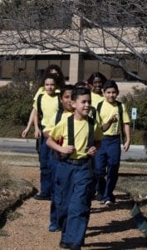

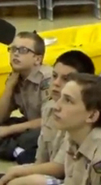


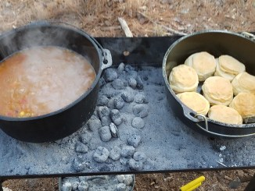
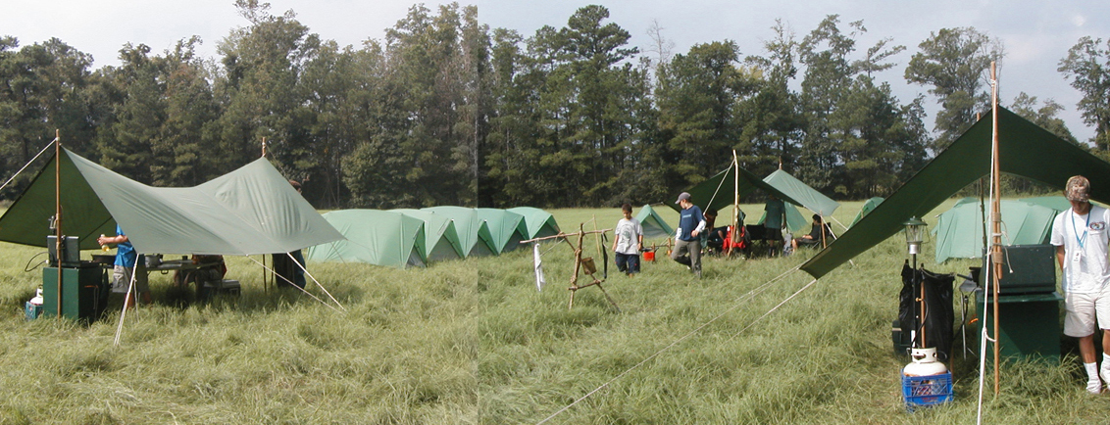
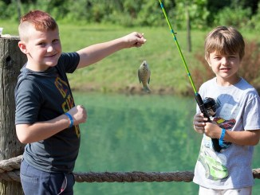
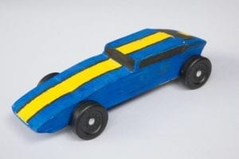
George Mason Program
John Drisco, Vice Chair Program
Matt Burns, Deputy Vice Chair Program
George Mason District

Slide 18

Current 2023 George Mason Calendar
March 25, 2023 – Pinewood Derby at Fairfax Presbyterian Church
April 13, 2023 – District COH (before April RT)
April 28-30, 2023 – Tri-Chapter Ordeal
May 5-7, 2023 – Spring Camporee Theme: Canoeing at Antietam
May 13, 2023 – Jamboree on the Trail
May 13, 2023 – District Hike-O-Ree
May 13-14, 2023 – Patriot/GMD BALOO/IOLS
May 25, 2023 – Elks Youth Recognition Dinner for 2022 GM Eagles
May 29, 2023 – Flags In

Slide 19
STEM
03/12/23 – STEM Trek, Washington, DC
03/17/23 – Fluid Dynamics & Sky Diving (iFly), Gaithersburg, MD
04/22/23 – Girls STEM/STEAM Conference, Bowie, MD
05/13/23 – Techstravaganza 2023, Alexandria, VA
Anytime – DC STEM Trek- Showcases 24 government agencies, private organizations and monuments related to the tenets upon which STEM is based. Two hikes - 10.57 miles, or 4.75 miles

Slide 20
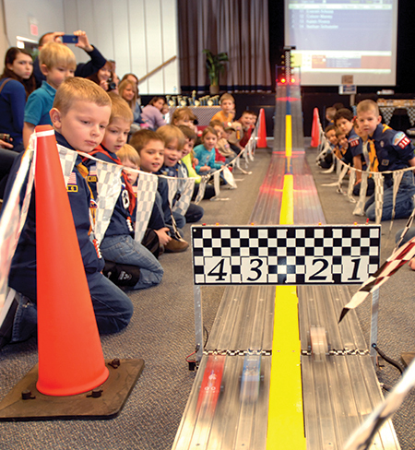
2023 George Mason Pinewood Derby
Race Day is March 25, 2023
All Packs wanting to participate in the 2023 Pinewood Derby MUST hold their Pack Pinewood Derbies by March 9, 2023.
One unit winner from each age bracket (Lions, Tigers, Wolves, etc.) regardless of gender.
Pack winners must register (and pay) on Council website. $15.00 per entry. No money collected at door on day of race. Must register by 3/16/23.
Registration is open.
Race will be held at Fairfax Presbyterian in Fairfax.
For questions, contact Pat Berney.

Slide 21
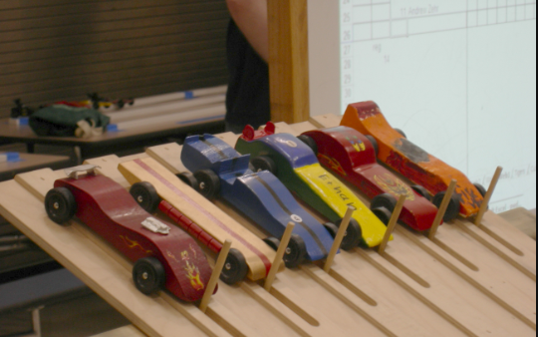
Race Day (March 25, 2023) Schedule
Where: Fairfax Presbyterian Church, 10723 Main St., Fairfax, VA 22030
View: Via Zoom: https://us02web.zoom.us/j/83494626805?pwd=Y3RLcTdMYldwcHNoVHNnWEFYYjN2Zz09
When: Pit Crew (Adults and Scouts BSA) arrive at 8am
Schedule:
  08:30am – 09:00am: Lions, Tigers, Wolves arrive, check-in and car inspections
  10:00am – 10:30am: Bears, Web1 and AOL arrive, check-in, and car inspections
  Races:
    Lions 09:30am – 09:50am
    Tigers 09:50am – 10:10am
    Wolves 10:10am – 10:30am
    Bears 10:30am – 10:50am
    Web1 10:50am – 11:10am
    AOL 11:10am – 11:30am
Grand Championship and Awards: 11:30am
Note:
  Pre-registration is required - https://scoutingevent.com/082-67201
  If all registrants for a rank race are checked in early, the Pit Boss will start the race early
  The 20 minutes allowed per rank race may vary, depending on the number of entrants
  Early check-in is encouraged
  Bring your own repair kits/parts
  No Graphite allowed in the Fellowship Hall – apply in the prep area
  No refreshments will be provided

Slide 22

District Court of Honor
To recognize adults who served/are serving at the unit level.
Two awards:
  Unit Commissioner’s Unit Scouter Award – 1 per unit
  Unit Appreciation Award – Maximum 8 per unit.
Please provide a sentence or two describing the individual’s service.
Submit Unit Commissioner’s Unit Scouter Award to Unit Commissioner.
Unit Appreciate Award to gm.adultrecognition@gmail.com
Must have all submissions by no later than March 22, 2023.
Will confer awards at District COH/April Roundtable.

Slide 23


2023 Spring Camporee
George Mason District
May 5 to May 7, 2023

Slide 24
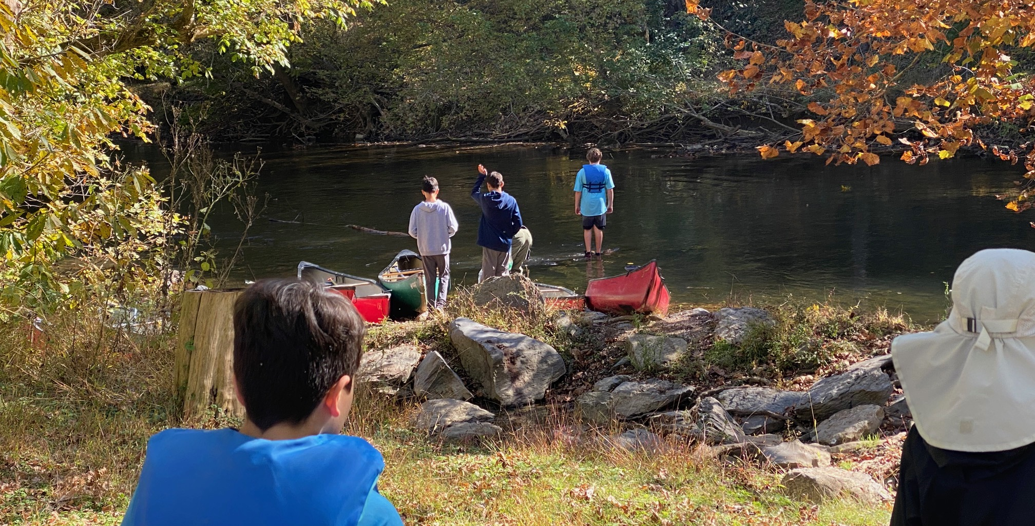
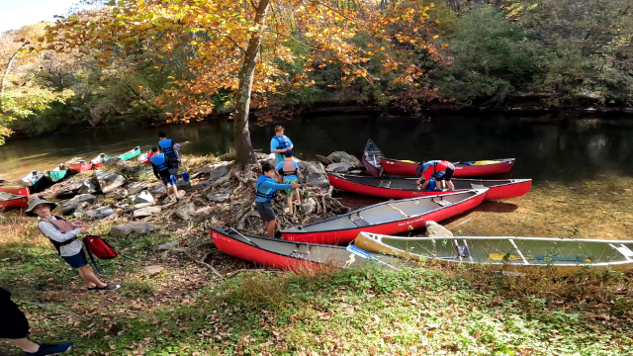
Spring Camporee
2023: Antietam creek canoeing

Slide 25
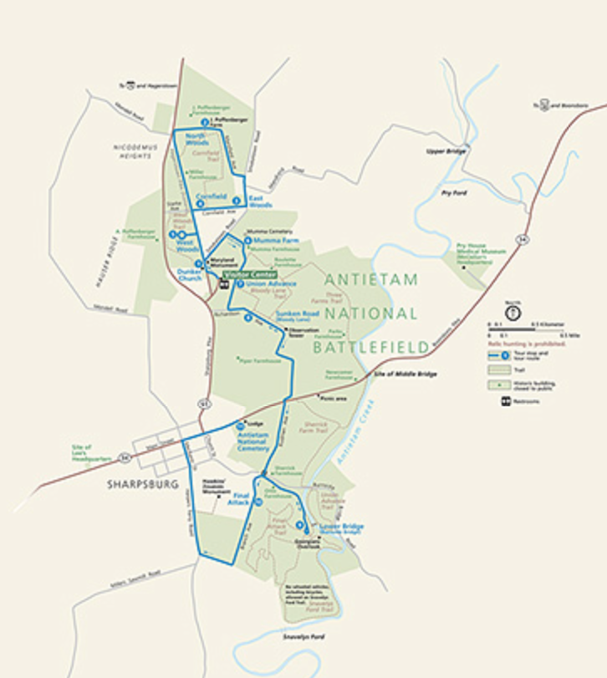
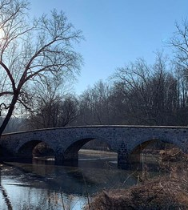
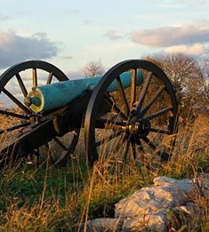
Spring Camporee 2023: Antietam Park
Hiking Through History

Slide 26
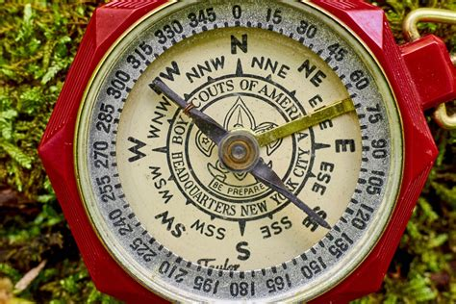
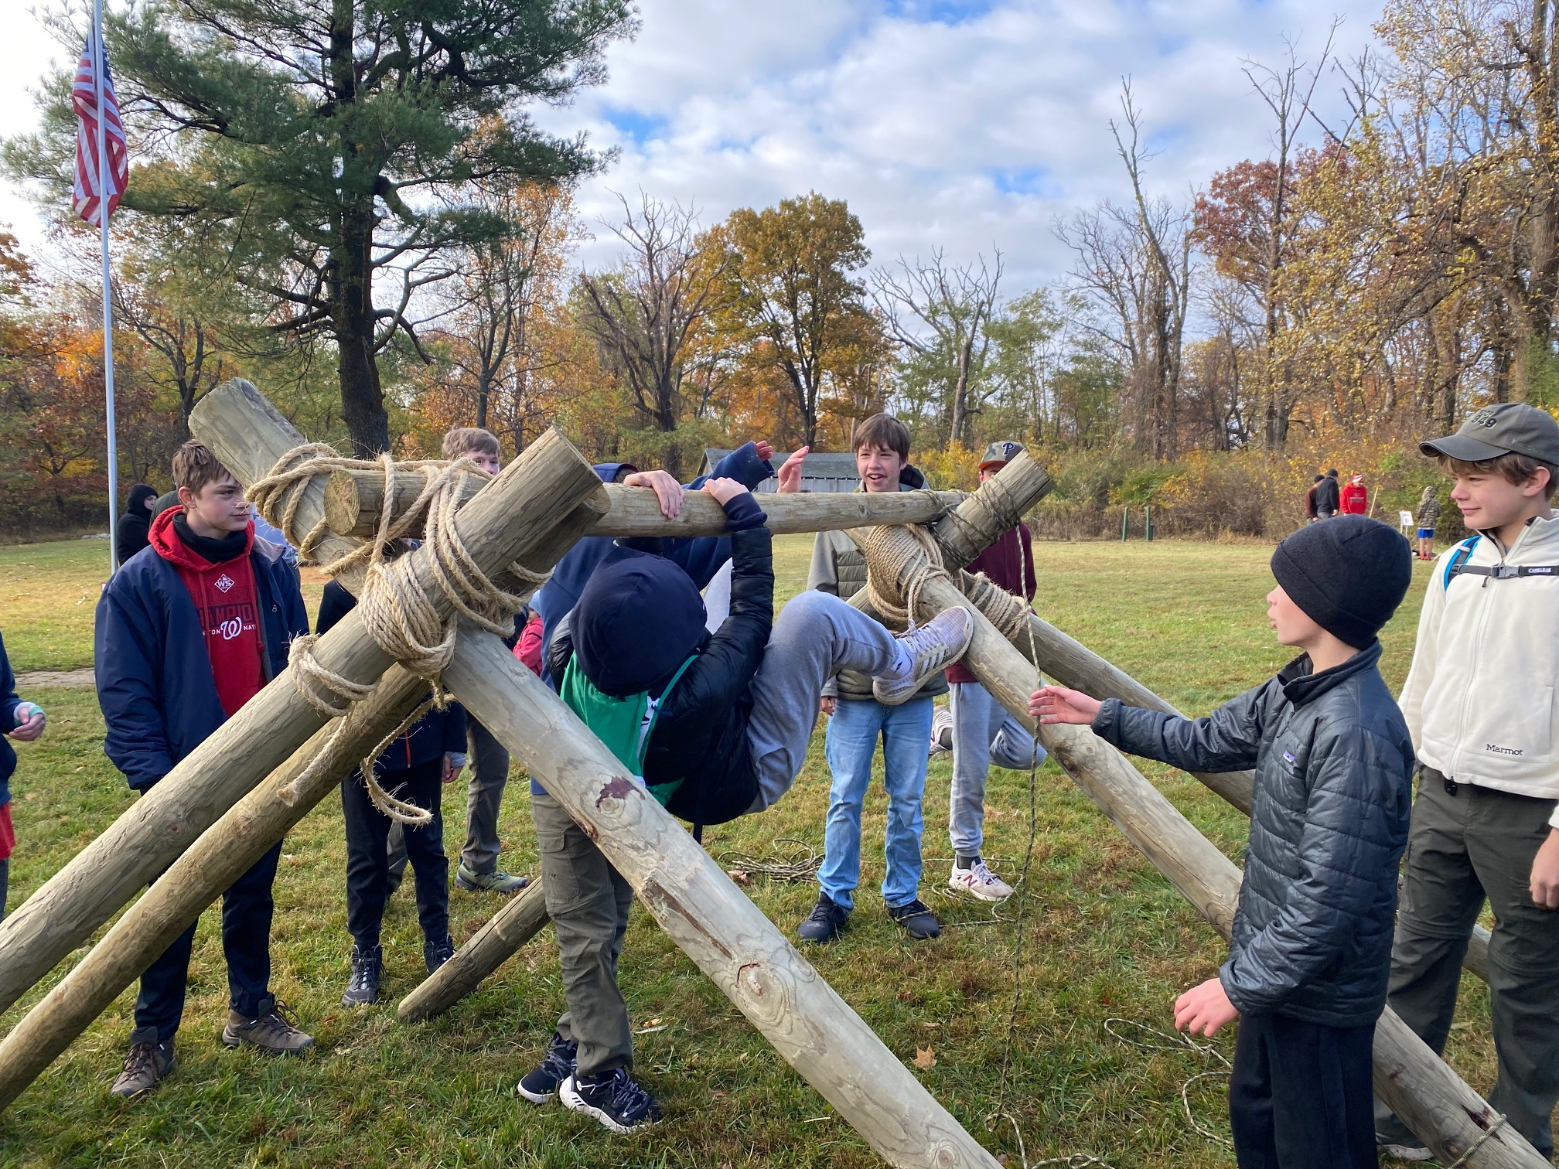
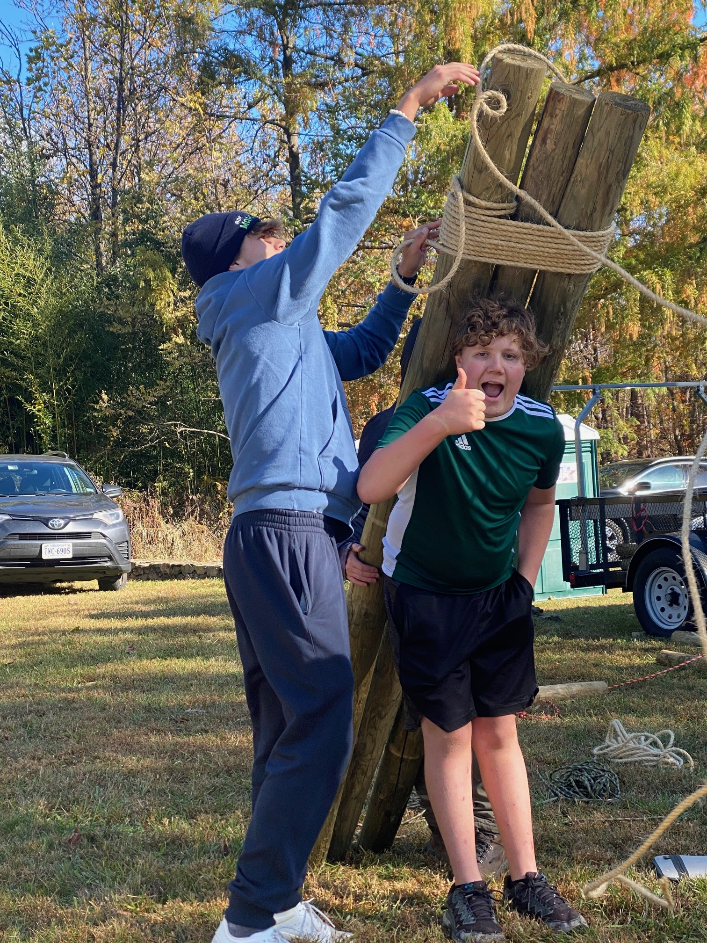
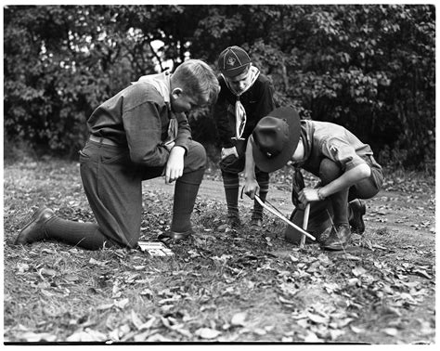
Spring 2023 Camporee: Scoutcraft
Trustworthy
Helpful

Slide 27
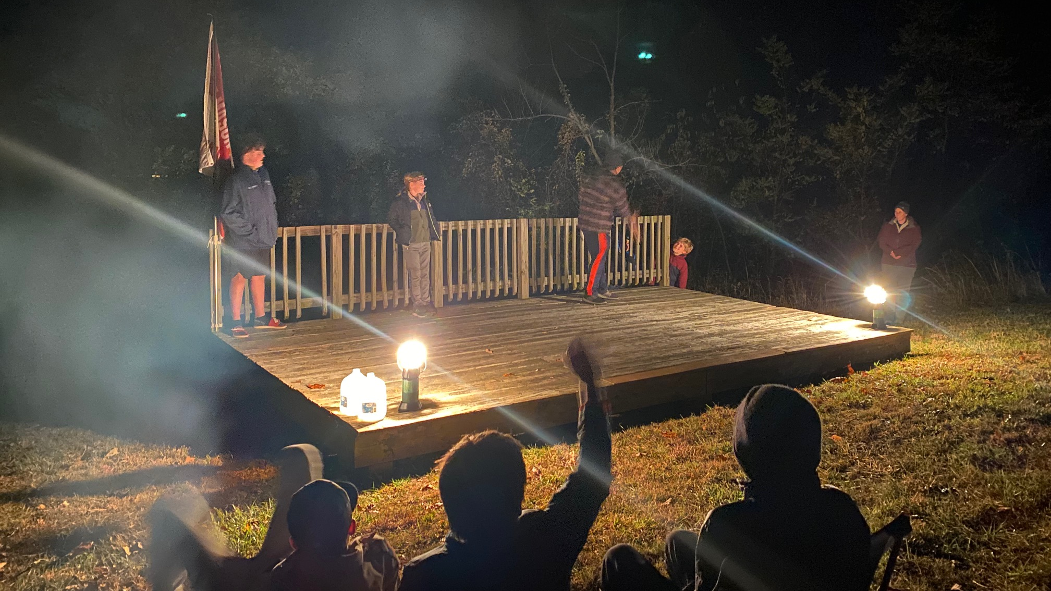
Spring 2023 Camporee: Campfire

Slide 28
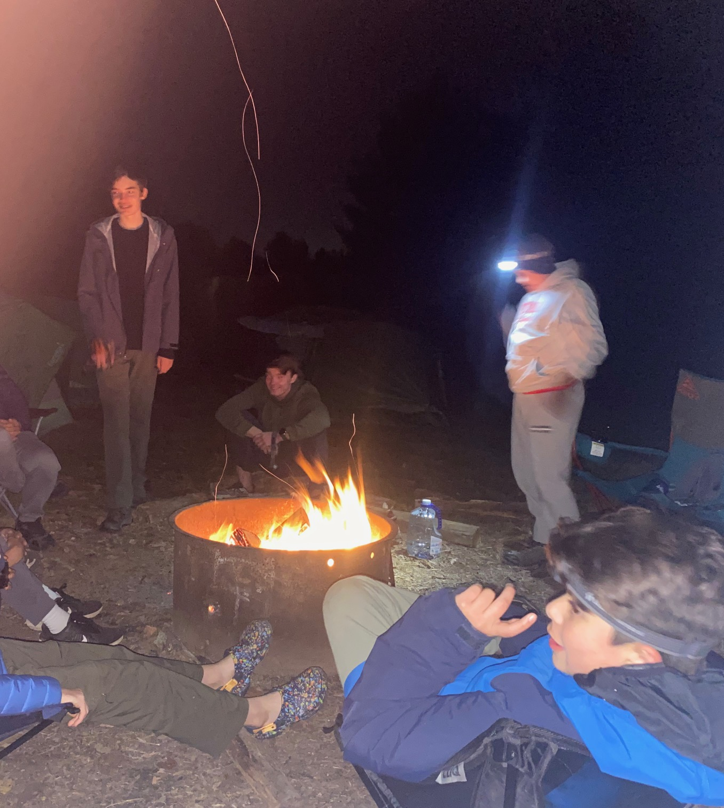
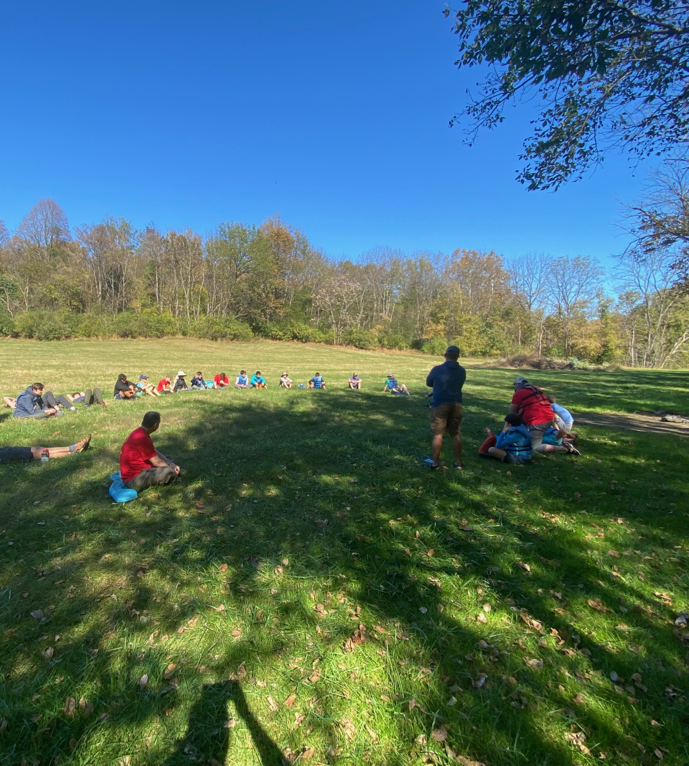
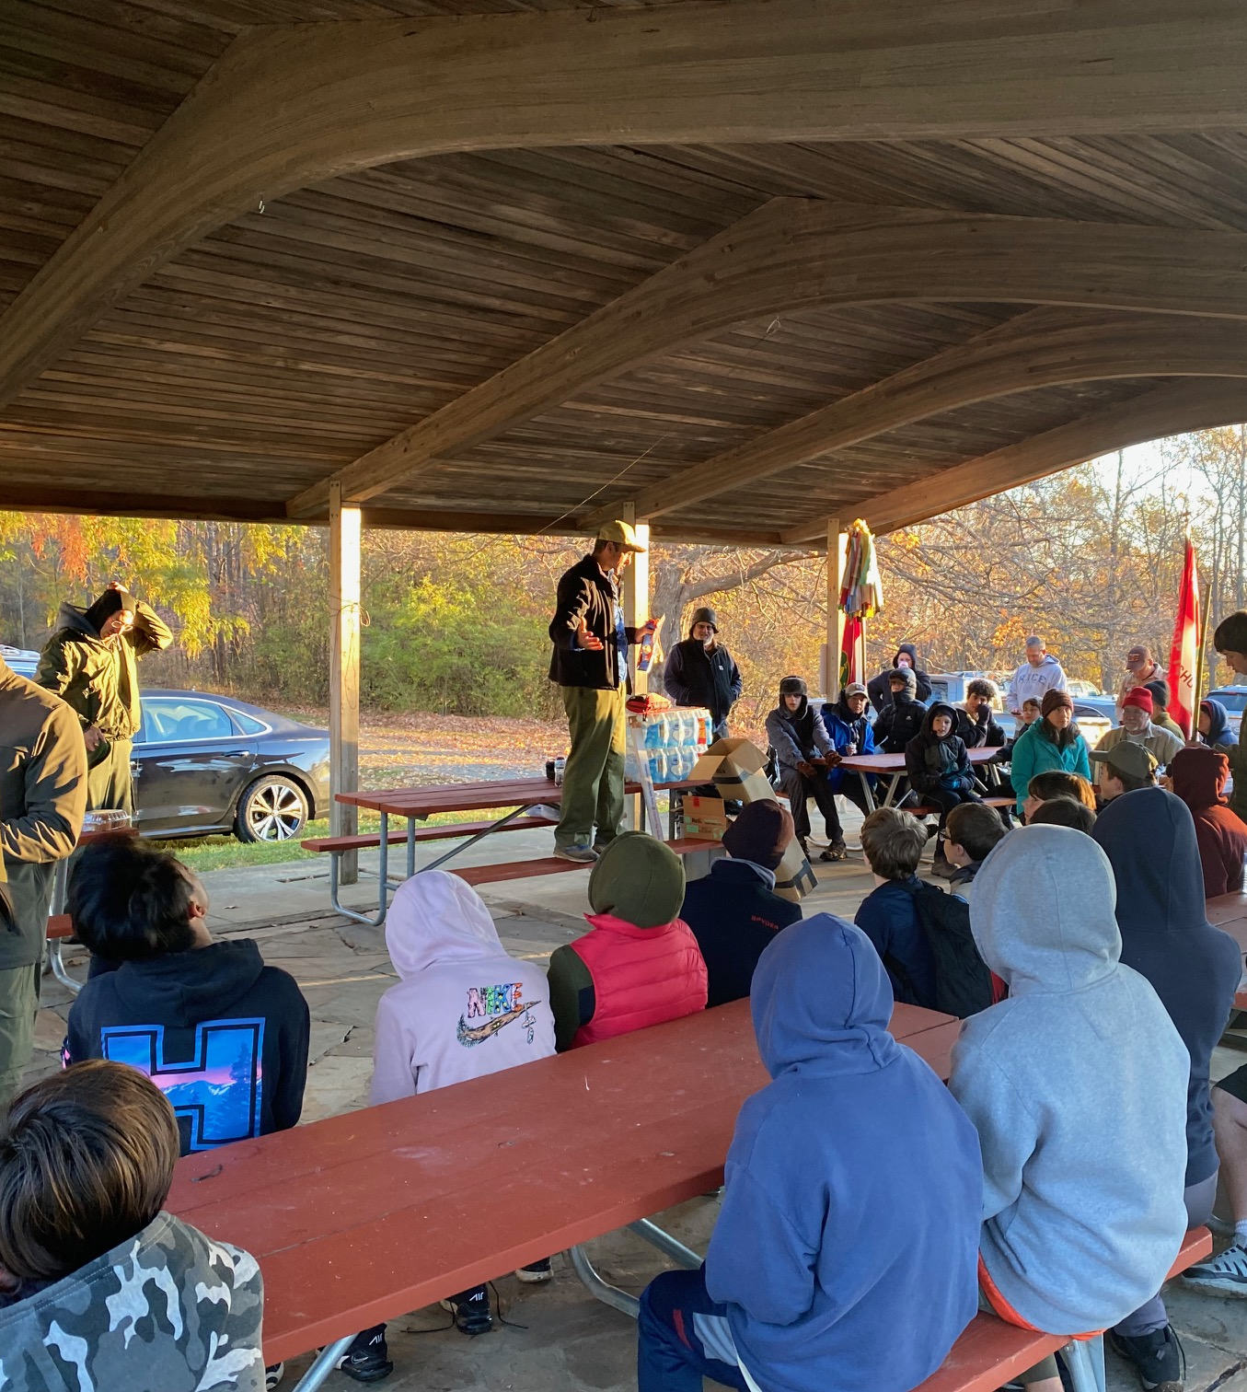
Spring 2023 Camporee:
Friendship & Fellowship

Slide 29

NCAC George Mason District
Spring 2023 Camporee: May 5-7

Slide 30



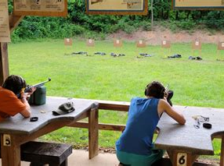
Fall 2023: Rock Enon, Oct 20-22, 2023
Shooting Sports
Merit Badges
Scoutcraft
Friendly Competition
Friendship & Fellowship
Campfire

Slide 31
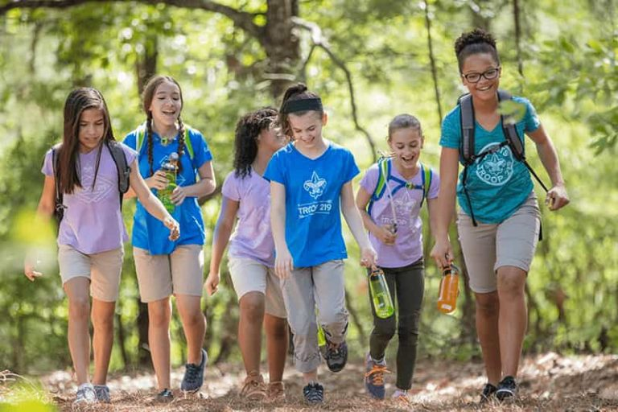
George Mason Hike-O-Ree
3rd Annual GM Hike-O-Ree – Open to all (Cubs, Scouts BSA and Venturing Scouts), families and friends.
Two options to participate:
  Hike with the District on Saturday, May 20
  Hike at ANY time between May 12 and May 21.
Participants in both options will receive patches.
Any age, any place and any appropriate grouping – just keep track of how far you hiked.
Challenge – District Scouts, Scouters and families hike 2,023 miles.
Total the miles for each unit and notify Matt Burns at Burnsmj509@gmail.com. We’ll see how big a total we reach.

Slide 32
District Hike on May 20 – Option 1
Hike around Lake Mercer – gentle 4.3 miles.
Limited to first 99 registrants
Starting from South Run Recreation Center NLT 9:00 a.m. and finishing by 11:30 a.m.
YPT in effect – Every unit must have two registered, YPT current adults on hike.
Participating units must supply a third adult to help staff event.
Units must use the buddy system and account for all participants at start and end of hike – stay together!
Scouts working on Second Class can hike an additional piece of the trail to complete a five-mile hike.
Cost is $5.00 per person.
Register at: https://scoutingevent.com/082-67922

Slide 33
Unit or Personal Hiking During 2 Weeks – Option 2
For individuals or units that have a conflict and can’t attend the District Hike on Saturday, May 20
Hike at ANY time during the May 12 to May 21 time period.
Hiking can be done with a unit, with family or with friends.
Hiking can be done anywhere – national/state park, local park, neighborhood, etc.
There is no upper or lower limit on distance.
Remember to report results to burnsmj509@gmail.com.
Register to receive a patch. Cost is $5.00 per patch.
Register at: https://scoutingevent.com/082-68269

Slide 34

Jamboree on the Trail
May 13, 2023
An international event
The only requirement is to get out and hike.
Inaugural hike was in 1998.
Scouts of all ages can hike.
Register by March 31 to be certain of getting patches by May 13.
Register at: https://jamboreeonthetrail.org/registration/

Slide 35

2023 Elks Youth Recognition Dinner
For youth that earned Eagle in 2022 (i.e. their Eagle Board of Review was held in the 2022 calendar year) and their Scoutmasters.
Thursday, May 25, 2023
Elks Lodge 2188, 8421 Arlington Blvd., Fairfax, VA.
Will need unit leader help in contacting Scouts and obtaining an RSVP.
Scoutmaster are invited at no cost to them.

Slide 36
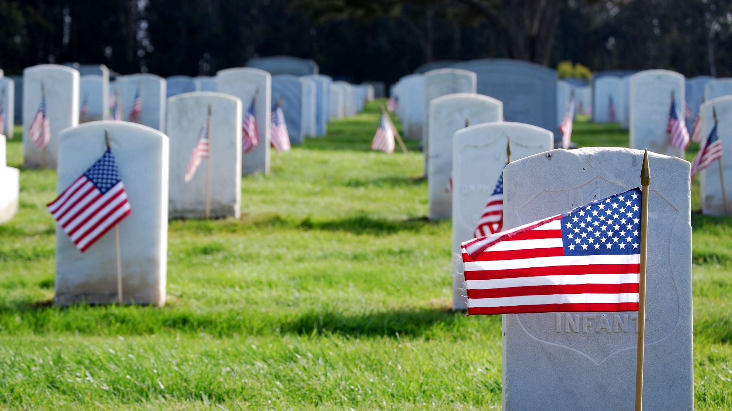
Flags In
May 29, 2022 (Memorial Day Monday)
Start at 10:00am – Pizza is available!
Social distancing – bring a mask.
National Memorial Park,
7482 Lee Highway, Falls Church
All Scouts, including Girl Scouts, are welcome.
Class A Uniforms
For more info, contact Russell Pittman at ruspittman@gmail.com.

Slide 37


Merit Badges
Every merit badge counselor needs to be on the District Charter. The time for action is NOW!
The online Merit Badge Counselor registration works for all Scouters who do not already hold another District position.
New Merit Badge Counselors must complete online merit badge counselor training, in addition to YPT. Be sure the counselor uses his/her legal name – no nicknames.
Merit Badge Counselors, or the unit Dean/Leader, also need to scan and send Margee the Merit Badge application form listing the badges the counselor is applying to teach and providing a justification of his/her qualifications.
Youth Protection Training is the essential first step. Don’t hit “send” on the application without it!
Contact Margee if you have questions at GM.MB.Dean@hotmail.com.

Slide 38

Training (https://www.ncacbsa.org/george-mason/training/)
Cub Scout Den Leader Specific (C42)
  03/25/23 – Alexandria, VA
  04/29/23 – Alexandria, VA
  05/06/23 – Herndon, VA
  05/20/23 – Alexandria, VA
  06/10/23 – Alexandria, VA
Scoutmaster Position Specific Training (S24)
  03/25/23 – Alexandria, VA
  04/29/23 – Alexandria, VA
  05/20/23 – Alexandria, VA
  06/10/23 – Alexandria, VA
Cub Leader Position Specific (C40)
  03/25/23 – Alexandria, VA
  04/29/23 – Alexandria, VA
  05/06/23 – Herndon, VA
  05/20/23 – Alexandria, VA
  06/10/23 – Alexandria, VA
Basic Adult Leader Outdoor Orientation (BALOO;C32)
03/03/23 – 03/04/23 – Stafford, VA
03/25/23 – 03/26/23 – Boyce, VA
04/15/23 – 04/16/23 – Camp Snyder, Haymarket, VA
04/15/23 – 04/16/23 – Spotsylvania Courthouse, VA
05/12/23 – 05/13/23 – Huntingtown, MD
05/12/23 – 05/13/23 – Camp Snyder, Haymarket, VA
06/17/23 – 06/18/23 – Lorton, VA
Introduction to Outdoor Leadership Skills National Youth Leadership Training (NYLT; S78)
    Mental Health First Aid https://www.fairfaxcounty.gov/hscode/ereg/Registration.aspx?groupID=47
        Stop the Bleed – Fairfax Fire Rescue Academy 04/15/23 (12 years old and above)
        Wilderness First Aid (N02) Wood Badge (A90) - https://www.ncacbsa.org/wood-badge/
  03/25/23 – 03/26/23 – Boyce, VA
  05/12/23 – 05/13/23 – Huntingtown, MD
  05/12/23 – 05/13/23 – Camp Snyder, Haymarket, VA
  06/17/23 – 06/18/23 – Lorton, VA
        06/18/23 – 06/23/23 – Session 23-2 – Camp Snyder, Haymarket, VA
        06/25/23 – 06/30/23 – Session 23-3 – Camp Snyder, Haymarket, VA
        07/23/23 – 07/28/23 – Session 23-4 – Camp Snyder, Haymarket, VA
        07/23/23 – 07/28/23 – Session 23-5 – Camp Snyder, Haymarket, VA
03/31/23 – 04/02/23 & 04/22/23 – 04/23/23
05/05/23 – 05/07/23 & 06/03/23 – 06/04/23
09/08/23 – 09/10/23 & 10/07/23 - 10/08/23
        03/31/23 – 04/02/23 & 04/22/23 – 04/23/23
        05/05/23 – 05/07/23 & 06/03/23 – 06/04/23
        09/08/23 - 09/10/23 & 10/07/23 – 10/08/23

Slide 39
Leave No Trace/Outdoor Ethics
BSA Leave No Trace Trainer Course - Outdoor Ethics
  03/20/23 (Zoom) & 03/25/23 - Germantown, MD
  10/16/23 (Zoom) & 10/21/23 – Haymarket, VA
Outdoor Ethics Orientation Courses (Scouts and Cubs)
  06/10/23 – Brandywine, MD
  09/09/23 – Brandywine, MD
  12/03/23 – Brandywine, MD
Outdoor Ethics Newsletter
  Sign up here.

Slide 40

GM High Adventure
NCAC High Adventure Committee (HAC) updates and announcements
High Adventure Crew Trek Availability
  - Northern Tier
  - Limited crew slots still open for Summer 2023 / 2024 reservations open
  - Philmont
  - 2023 a few Crew slots are available / 2024 Lottery is over - Most Crew slots are full
  - Sea base
  - Some 2023 availability / 2024 Reservations open
  - Summit
  - Limited 2023 crew slots available / 2024 registration is open now
  High Adventure Opportunities for Individuals in 2023
    - NCAC has contingent crew trips to Philmont, Sea Base, Northern Tier,
    James River Canoeing, and Lenhok’sin
    - Several NCAC Units have space available for individuals in their crews
  Training
              - Northern Tier Classroom Training (email: BSA2XS@gmail.com)
    04/01/2023 – VFW, Occoquan, VA & 04/22/2023 - Virtual
    - Philmont
    03/12/23 & 03/18/23 – Philmont Advisor Hikes (email: wcdubi@gmail.com)
    03/25/23 – Skills Training (Zoom)
    04/01/23 – Skills Training (In-Person, Ashburn, VA)
March 2023

Slide 41
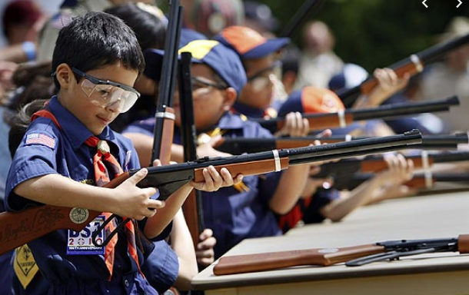
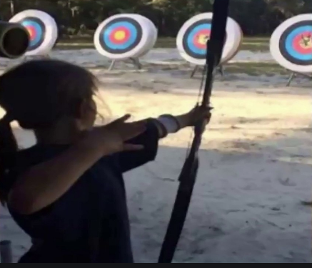
Shooting Sports
Requests for Shooting Events – Lead Time!
  50+ scouts - 6mos
  Less than 50 scouts - 3mos
Shooting on private land:
  Requirements
  Permissions/protocols
Shooting Sports web page
Shooting Sports Instructor Classes:
  Rifle/Shotgun
  Archery – USA Archery Level 1 Instructor Class, 04/01/23
  Camp Snyder, Haymarket, VA

Slide 42
Environmental Student Creativity Contest!
To celebrate Earth Day, the Town of Vienna Conservation and Sustainability Commission (CSC) announce its 3rd annual Environmental Student Creativity Contest!
  This is an opportunity for students to express thoughts on the environment and share imagination and art/writing skills.
  All students within the Madison Pyramid are invited to participate.
  The selected winners will receive a prize and have their essay/artwork featured at this year’s Green Expo.
  Flyer, requirements, and artwork/essay release form or Vienna's CSC web page.
  All questions and entries can be sent to CSC@viennava.gov.
  Entries are due by 5 PM on Friday, March 31, 2023.
  Winners will be announced on Tuesday, April 18, 2023.
Vienna’s Green Expo, Vienna Community Center, 120 Cherry St SE, on Thursday, April 20 from 7-9 PM.
  Visit with local exhibitors offering information on sustainable practices, such as clean water, native plants, local wildlife, green landscaping, recycling, composting, zero waste and green living, and energy efficiency, citizen science, and other volunteer opportunities, sustainable businesses in Vienna, and much more.
  Opportunity to win a free rain barrel or composter. Kids can grab a passport and visit exhibitors, learn about the environment, and earn a prize.

Slide 43
Short Hikes with Bird Watching – what a great pairing!
Huntley Meadows Park (3701 Lockheed Blvd., Alexandria, VA; 1.8 miles)
Pick up a bird-watcher’s guide at the visitor center, then begin your easy hike on leisurely boardwalks suspended over freshwater lowlands, one of the rarest habitats left in Fairfax County. Huntley Meadows has more than 200 species of birds and the best viewing angles are from the observation tower. Check the event schedule, because naturalists often conduct bird-watching tours.
Occoquan Bay National Wildlife Refuge (13950 Dawson Beach Rd., Woodbridge, VA; 3-mile loop)
It’s one of the largest open areas remaining in Northern Virginia and home to hundreds of species of birds and wildlife, plus 55 species of butterflies. Operated by the U.S. Fish and Wildlife Service, the easy, 3-mile gravel loop trail has interpretive signage to help guide your explorations. Watch the nature show from the Marumsco Creek photo blind or the observation platform overlooking Occoquan Bay.
Mason Neck State Park (7301 High Point Rd, Lorton, VA; 2.4 miles)
Bayview Trail-Wilson Spring-Kane’s Creek) - six easy-to-moderate hiking trails. Mason Neck hosts an Eagle Festival every May. In addition to eagles, the marsh is alive with ducks, geese, migratory songbirds, herons, and egrets. This hike offers a varied landscape of scenery, from wide-open views of Belmont Bay, wetlands filled with cattails, woodsy forests, sandy beaches, and boardwalks crossing over swamps. In addition to the variety of paths, there’s a playground, a picnic area, and a paved route for people with mobility issues.
Kingman and Heritage Islands Park (575 Oklahoma Ave. NE, Washington, DC; 0.7 or 0.5 miles)
Over 100 species of birds call these isles home over the course of the year, including bald eagles, ospreys, and snowy egrets. There are two quick hikes, the 0.7-mile Kingman Island Trail and the 0.5-mile Heritage Island Trail. Both have great river views and offer multiple opportunities for avian sightings. For the best results, bring along a pair of binoculars.

Slide 44
Orienteering
Orienteering is a great sport for Cub Scouts and Scouts BSA! Puts into practice how to read maps and use a compass.
Lake Fairfax (beginner; 23-points) - the Lake Fairfax Park Orienteering Course was constructed in the Park’s open areas as a low-environmental impact course at the request of the Fairfax County Park Authority. This makes the course well-suited for visitors, especially families and youths, looking to learn how to use a compass and pace count, or GPS to navigate between points. Course guide is online.
Burke Lake (beginner; 10-points/intermediate; 15-points/advanced; 12-points (wilderness)) – Burke Lake Orienteering Course has a variety of difficulty levels available for those interested in Orienteering. A safety bearing of 360º or (0º or “N”) can be used anywhere on the course. This bearing will bring one to a park road or to the open area behind the Park Information Building. Course guides are available online.
Fountain Head Regional Park (2 beginner; 9 posts/1 intermediate; 11 posts/2 advanced; 11 or 12 posts) - The beginner courses can be completed while remaining almost exclusively on well-marked trails. Intermediate courses may also use trails, but more adventurous racers will find opportunities for shortcuts if they leave the trails. Advanced courses will generally not use trails, and racers will need to rely on more subtle terrain features for navigation. (Note: a compass is highly recommended for intermediate or advanced courses.)
Runnymede Park-Herndon (beginner/intermediate; 10 posts; 1.75miles) – Each post has a QR code for easy access to the map and trail information. Paper copies of the maps are online and stoked in kiosks throughout the park. This course was an Eagle Scout project in 2016.
Hemlock Overlook Regional Park (Scouts BSA level; run by Quantico Orienteering Club) – First class advancement and Orienteering Merit Badge Counselors available.
Baltimore Area Council Orienteering Day (10/28/23; Upper Marlboro, MD) - A one-day event; however, camping, modern rest rooms are available Fri-Sun. right at the event site. “Orienteering is meant to be a cross-country race with map and compass through unknown terrain, a kind of treasure hunt for strategically placed markers. In 2022, 440 Scouts and leaders, from 40 units, orienteered - half of the attendees camped one or both nights.

Slide 45
Other Activities (for units, Dens/Patrols, or families)
Sundays (8am) – Dyke Marsh Bird Walks, Alexandria, VA
03/11/23 – Second Saturday Sungazing (11am), Chantilly, VA
03/11/23 – 03/12/23 – Model Train Show and MB (10am), Woodbridge, VA
04/01/23 – Into the Woods at Frying Pan Farm Park, Herndon, VA
04/08/23 – Second Saturday Sungazing (11am), Chantilly, VA
04/22/23 – National Park Week Kickoff (free admission), Great Falls, VA
04/29/23 – Stargazing at the Udvar-Hazy Center, Chantilly, VA
04/30/23 – Scout Days at National Park (Nats vs Pirates), Washington, DC
Apr – Nov – Park Habitat Restoration Work Days , Vienna, VA
05/06/23 – Around the World Embassy Tours (10am-4:30pm), Washington, DC
05/06/23 – 05/07/23 – Revolutionary War Weekend, Mt Vernon, VA ($)
05/13/23 – EU Open House Embassy Tours (10am-4:30pm), Washington, DC
05/19/23 – 05/20/23 – McLean Days, McLean, VA ($)
05/20/23 – 04/016/23 – National Cherry Blossom Festival, Washington, DC
05/27/23 – 05/30/23 – Viva Vienna, Vienna, VA ($)
05/29/23 – Falls Church Memorial Day Parade (1pm), Falls Church, VA
06/01/23 – 06/04/23 – Herndon Festival, Herndon, VA ($)
June/July/Aug (Tues, 10am) – Kids on the Green, Vienna, VA

Slide 46
Order of the Arrow
  2023 Dues can be paid online: https://wipit470.org/dues.html
  04/14/23 - 04/16/23 – Spring Fellowship*
  04/28/23 – 04/30/23 – Tri-Chapter Ordeal*
  05/05/23 – 05/07/23 – District Camporee
  05/12/23 – 05/14/23 – Lodge Service Weekend at Goshen
  05/19/23 – 05/21/23 – Section Conclave at Rodney Scout Res.*
  06/18/23 – 07/01/23 – GOAT
  * Registrations open online https://wipit470.org/index.html under “Events”

Slide 47
Other Topics
General Announcements
District Executive Minute
District Chair Minute
District Commissioner Minute
Minutes and slides available on the GMD web site (District Resources, Roundtable). Password is “GMDRT”
Next meeting – April 13, 2023, at Thoreau MS
  7:00pm – District Court of Honor
  8:00pm – Roundtable

