Slide 1
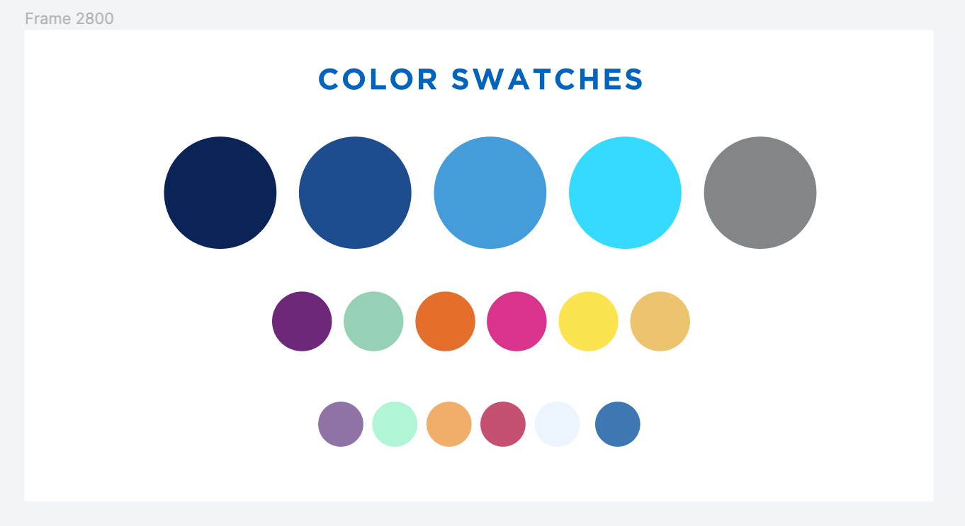
Alma Resource Sharing – Physical Borrowing Workflows
April 24, 2024

Slide 2
Alma Physical Resource Sharing – Borrowing Workflows
Topics to be covered:
Creating Borrowing Requests (Primo & Alma)
Sending Requests to Other Libraries
Cancelling Requests
Receiving Items from Other Libraries
Sending Renewal Requests
Sending and Responding to General Messages
Returning Items

Slide 3
Alma Physical Resource Sharing – Other Training Resources
Additional Training Sessions:
Physical Lending
Tuesday, April 30 at 11:00am
Registration: https://sunyolis.libcal.com/calendar/training/physicalRSlending
Digital Borrowing and Lending
Thursday, May 2 at 11:00am
Registration: https://sunyolis.libcal.com/calendar/training/digitalRS
Alma Resource Sharing Training Guide: https://sunyolis.libguides.com/training-resource-sharing

Slide 4
Alma Physical Resource Sharing – Roles Needed
Roles Needed to Process Borrowing Requests:
Circulation Desk Operator - scoped to library & circulation desk
Fulfillment Services operator - scoped to library
Requests Operator - scoped to library & circulation desk

Slide 5
Alma Physical Resource Sharing – Borrowing Workflows
Submitting Requests
Majority of requests are submitted by users via Primo
Library staff can manually create requests for users in Alma
Best to create requests from a Network Zone record
Can fill out blank request form if need be
Sending Requests
Alma automatically compiles a rota and sends the request
Rotas are managed by SLS in the Network Zone
Rotas configuration based on geographic location ELD service days
Goal is to distribute requests as evenly as possible while keeping turnaround times low

Slide 6
Alma Physical Resource Sharing – Borrowing Workflows
Cancelling Requests
Users can cancel their requests via Primo
Requests will be automatically cancelled on both borrowing and lending end if user cancels before item is shipped
If user cancels request after item is shipped, the request will immediately be updated to returned when it is received at the borrowing library
Receiving Items
Temporary item records are created when items are received
We recommend you use the barcode on the borrowed item as the temporary barcode
Item is either placed on hold or put in transit to pickup location once it is received

Slide 7
Alma Physical Resource Sharing – Borrowing Workflows
Sending Renewal Requests
Users can submit renewal requests via Primo
Library staff can also submit renewal requests via Alma if need be
Can be done from Borrowing Requests list or Manage Patron Services
Renewal request response has been automated on lending end, so renewal request will be approved immediately
General Messages
Can be used by both borrowing library and lending library to communicate with each other about requests
Can be monitored from Borrowing Requests list or Tasks widget
Many libraries have not been responding to General Messages

Slide 8
Alma Physical Resource Sharing – Borrowing Workflows
Returning Items
Requests are updated to returned as soon as items are checked in unless your library is using a stand-alone resource sharing library
If your library uses a stand-alone resource sharing library, items are placed in transit to resource sharing library when returned, and the request is updated to returned once the item is scanned in at the resource sharing library
If a user returns part of a multi-volume set, a return slip will be printed, but the request won’t be updated to returned until all volumes have been checked in
Borrowing requests remain active until the requested item arrives back at the lending library

