Slide 1

CDI Best Practices
August 20, 2020
Michelle Eichelberger
Michelle.Eichelberger@suny.edu

Slide 2
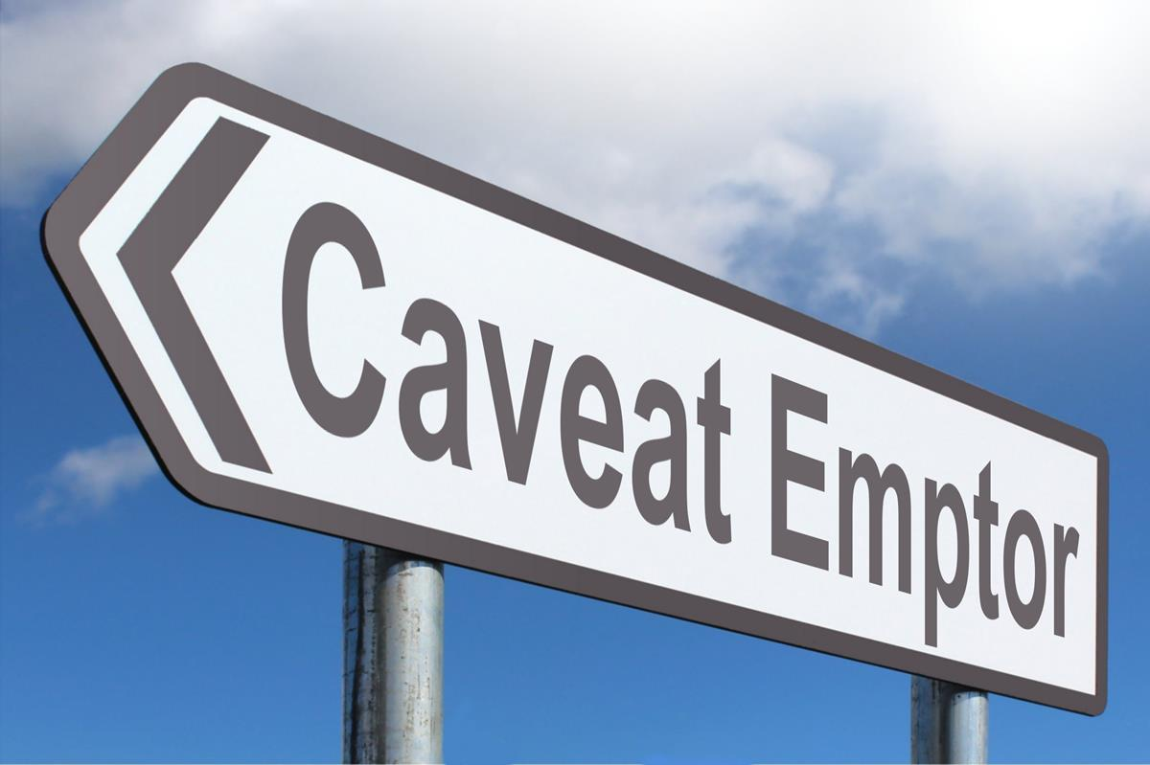
Snapshot not a Comprehensive Review
System is evolving:
  Known Gaps and Issues list
  Two major changes in past two weeks: linking behavior, link in record activation
Troubleshooting is challenging:
  Merged search record is good for users, but difficult to support because record id doesn’t correlate to active collections – can’t easily identify and deactivate problem collections
  Collection names don’t show consistently for link in record links
System is complicated:
  Many moving pieces: publishing, indexing, activating, each campus at different points in clean-up process
  We’re all still learning
https://www.picpedia.org/highway-signs/c/caveat-emptor.html
www.suny.edu

Slide 3
Biggest Pain Points
In general, system is working: patrons are doing searches and getting results. But, there’s room for improvement.
Campus problem reports focus areas:
  eBook collections
  Resource Types & Facets
  Link in Record collections
  Missing links
www.suny.edu

Slide 4
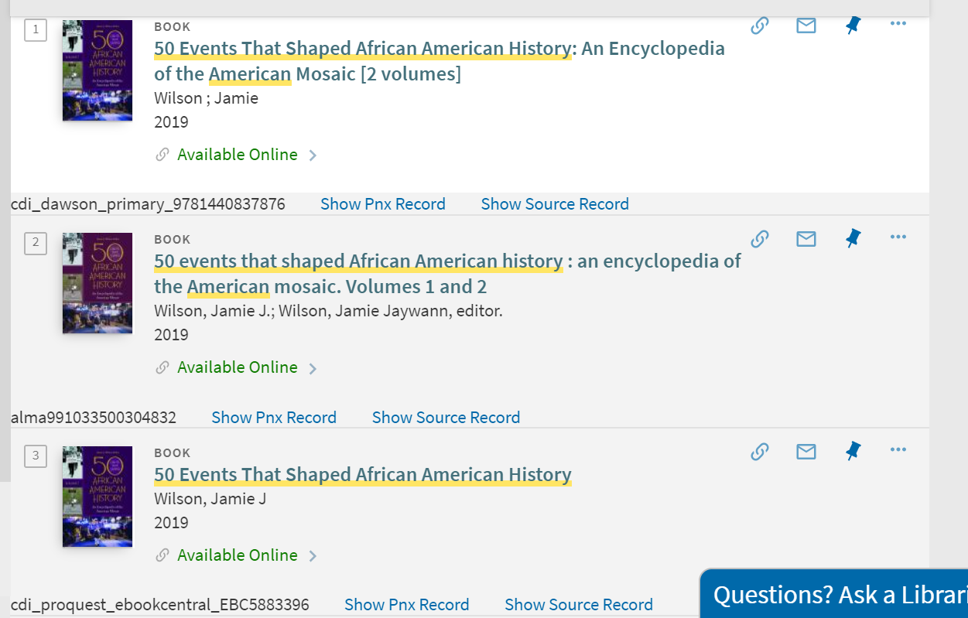
Why am I getting duplicate results for eBooks?
Active collection searching in the CDI is default = yes, unlike the PCI where the default was no and you had to choose to turn on searching.
If you’re getting two results for a single title activated in Alma, chances are good that one record is coming from Alma and one is coming from the CDI.
How can you tell where the records are coming from? Record id bookmarklet
www.suny.edu

Slide 5
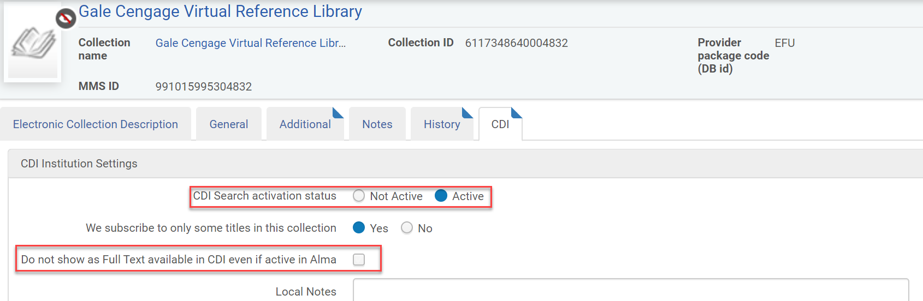
Why am I getting duplicate results for eBooks? Cont.
What can you do about this?
Mark the “do not show as full text available” checkbox
Good practice to also turn CDI searching off so that you don’t end up with unrequestable ebooks in your expanded search
www.suny.edu

Slide 6
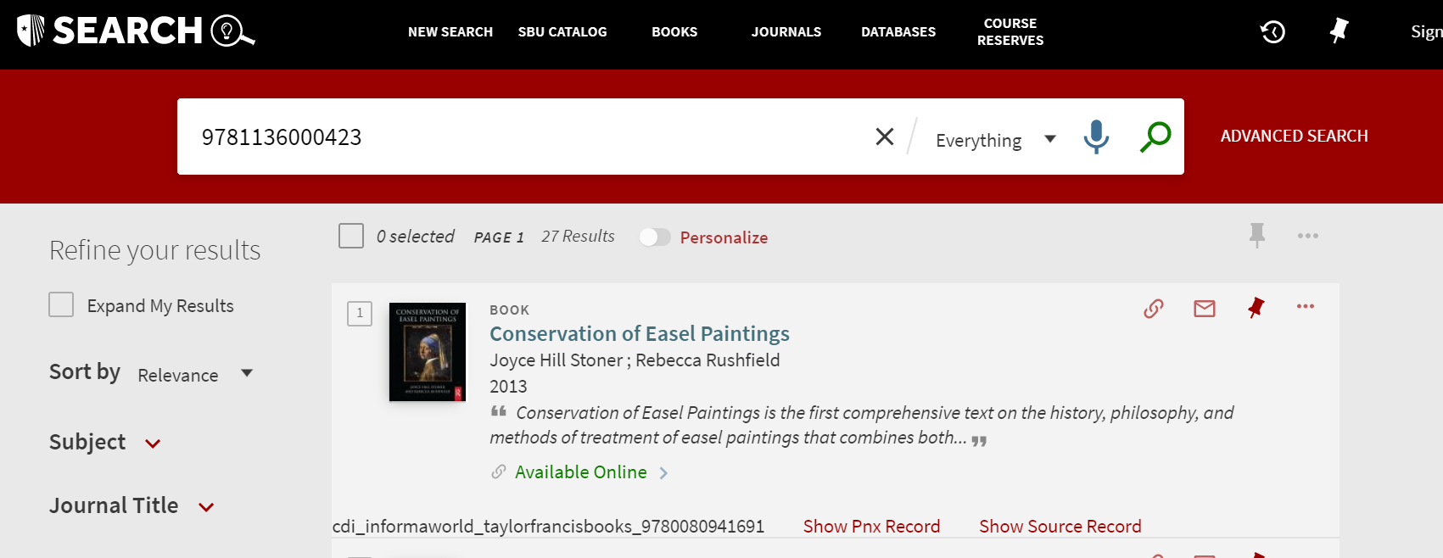
I deleted my eBook collection and the content is still showing in Primo. Why?
This could be a timing issue. If you had the collection active for search in the CDI, any changes to CDI searching can take up to 72 hours to get out of your Primo.
Can tell if record is coming from Alma or CDI by using Record ID:
www.suny.edu

Slide 7
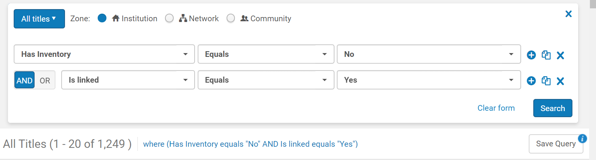
I deleted my eBook collection and the content is still showing in Primo. Why? Cont.
If it's an Alma record, and you can't find it in an IZ search, it's possible that you deleted a collection but didn't delete the bib records for the portfolios. They might still be getting published as available.
To find these, do an advanced search for All Titles, for "Has Inventory" select Equals and "No", for "Is Linked" select Equals and "Yes". Then you can delete the set.
www.suny.edu

Slide 8
Why am I getting available eBook results for titles that we don’t own?
Why does this happen?
  A collection that includes these is being published as available but you don’t really have it.
  Could be a selective collection that’s publishing the entire collection as available in CDI.
www.suny.edu

Slide 9
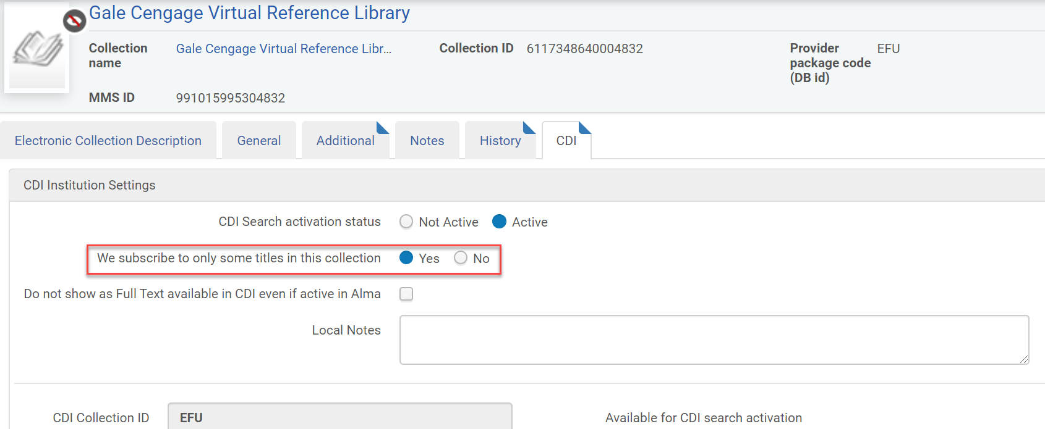
Why am I getting available eBook results for titles that we don’t own?
Most likely problem: If the collection is selective, make sure that “we subscribe to only some titles” on the collection CDI tab is marked yes
www.suny.edu

Slide 10
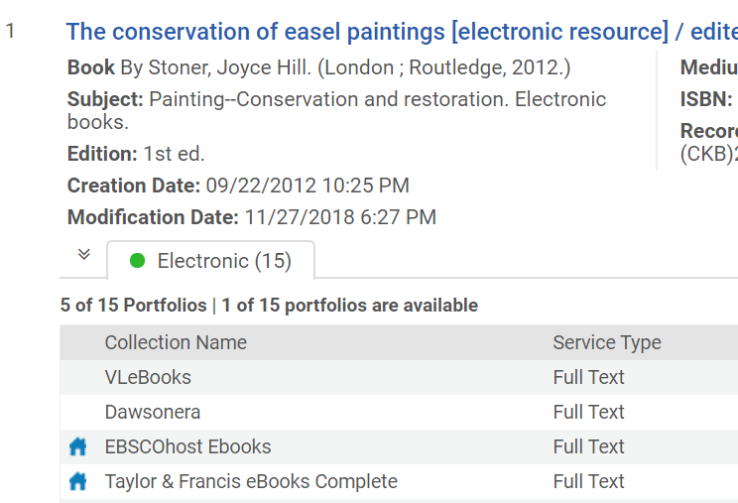
Why am I getting available eBook results for titles that we don’t own? Cont.
If the record is coming from the CDI and if it doesn’t go away in 72 hours, it could be coming from another collection that Primo thinks you have active.
Because of the merged records in the CDI, the collection that you see in "Record id" is usally NOT the collection in your IZ that's causing the record to be published as available.
Troubleshooting tip:
Grab the ISBN from a problem record and look it up in the CZ
Check to see if you have any collections active that contain that title, even if that title isn’t active in your IZ
Check each of the active collections to make sure that the selective option is marked yes
Worst case, check the do not show full-text checkbox
It requires a lot of trial and error to figure out where content is coming from
www.suny.edu

Slide 11
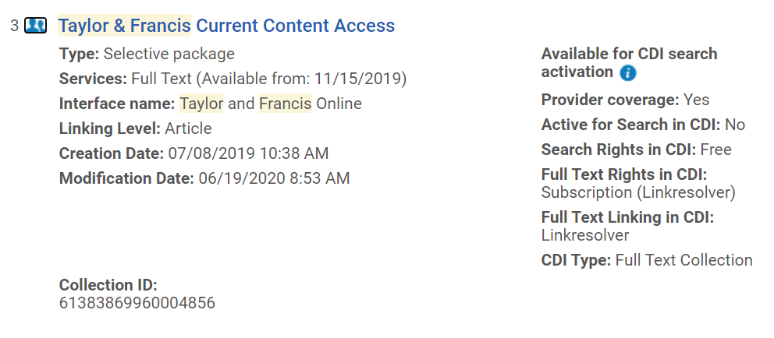
Why am I getting available eBook results for titles that we don’t own? Cont.
When we browsed for any Taylor & Francis collections in STB's site, we found Taylor & Francis Current Content Access with the bib record unsuppressed. Deleting this got rid of the easel painting title. No obvious connection – a shot in the dark. Could try it because the 71 titles in this collection were covered in another T&F collection. Probably entire collection was published as available because the bib record was unsuppressed and selective wasn't marked yes.
www.suny.edu

Slide 12
Where are all of these reference entries coming from?
Anything activated for full-text in Alma is automatically searchable in the CDI for title-level searching as well as anything affiliated with the title: articles, chapters, reference entries, etc.
If there’s indexing for each reference entry in an encyclopedia, that’s going to come up as a result if you have that encyclopedia active, and if you don’t turn off the CDI searching for that collection.
What can you do about it?
Deactivate CDI searching and “show as full-text” checkbox for any collections that include dictionaries, encyclopedias, etc.
You’ll lose chapter-level searching for that collection – it’s a judgment call
You’ll still get search results from the Alma records
www.suny.edu

Slide 13
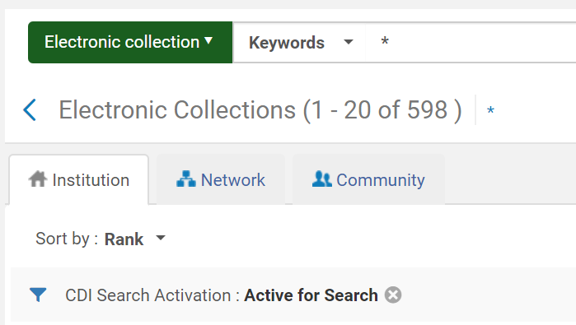
Where are all of these reference entries coming from? Cont.
Makes an important case for cleaning up collections that you don’t need for search.
Ex Libris didn’t do us any favors by activating hundreds of OA collections in the PCI.
All of that content was migrated to the CDI, and some of it is becoming a mix of OA and subscription, and is causing problems. E.g. Datacite
~150 collections is reasonable for search, depending on your campus
Clean it up!
www.suny.edu

Slide 14
Why am I getting non-journal results when I limit to journals?
Material & Resource types in the CDI are much shakier than the PCI.
Example:
Case 00850991“When we select the journal facet in our Primo VE searches, some of the results have the resource type of journal, but they are actually articles.”
Ex Libris answer: “It looks like what's happening is that on the backend and in the raw data we've received from vendors for those records, the article-like records are designated as "Newsletter." However, "Newsletter" is not one of Primo's supported content types so under current design "Newsletter" is displayed as "Journal.“”
May have been happening with PCI too, but seems more problematic in CDI.
Many, many issues like this. A lot more data in the CDI and more of it is sketchy. Report to Salesforce.
www.suny.edu

Slide 15
Why isn’t the OA filter giving me only OA content?
Lots of discussion within SUNY and Primo-L about OA/non-OA problems.
Articles flagged as OA but they’re not, have to report each one to Salesforce
One case on Primo-L: “EXL replied to you that this was correct behavior because while the collection was OA, not every journal/article found in it was OA.”
Impacts whether or not proxy is used, you probably don’t have stanzas for non-OA articles, nor do you subscribe.
“My current impression is that there is a widespread problem with correct OA handling in CDI from several angles.” Stacey van Groll
www.suny.edu

Slide 16

Link in Record Collections in the CDI: New Prominence
Existed in PCI but easy to ignore, links showed up in View Online list along with any fulfillment links from Alma (subscription portfolios, OA portfolios, etc.)
Usually OA but can also be subscription like Films on Demand or Britannica, and there can be OA/non-OA mix (Datacite)
SUPER problematic in CDI
https://www.thumbtack.com/va/grottoes/house-cleaning/time-to-shine/service/299111773195804845?project_pk=
www.suny.edu

Slide 17
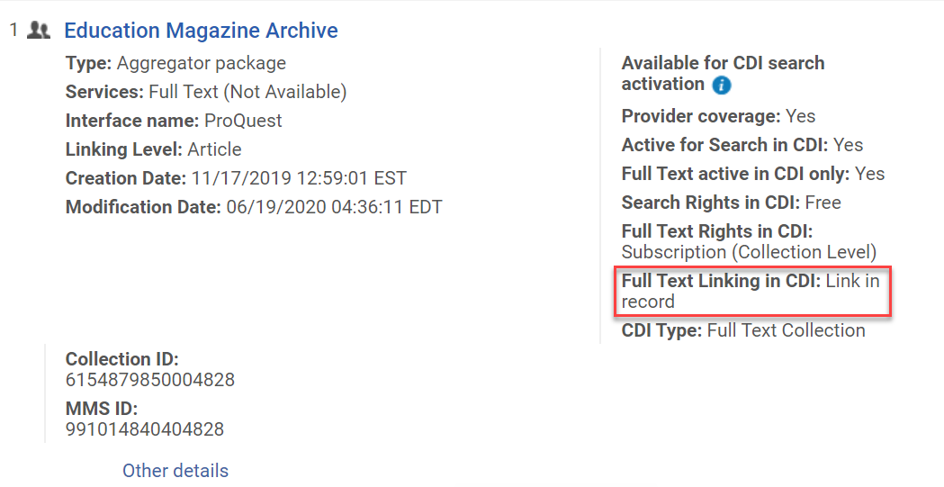
What the heck’s a Link in Record collection?
It's CDI content where the View Online link lives on the search record instead of in a portfolio in Alma = the link is in the record, like an 856 on a bib record
Content only lives in the PCI/CDI, can't search for the titles in Alma
It’s usually content that doesn’t exist as portfolios in CZ – maybe vendor will send search records but not records for CZ – but it can also overlap CZ collection
Link in record content does not exactly match same package in CZ
Because they live in Alma now, you can have active collection with portfolios AND link in record on same collection
www.suny.edu

Slide 18
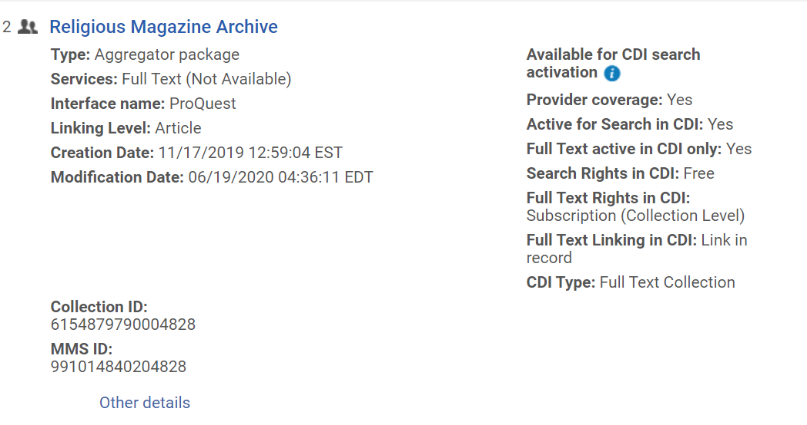
Anatomy of a Link in Record Collection
Provider coverage: Are the records from the vendor?
Active for Search in CDI: Will these CDI records be searched in your expanded search?
Full Text active in CDI only: Will these records show up as available in an unexpanded search?
Search Rights in CDI: Do you need a subscription even to search? (e.g. Artstor: need to be logged into Primo to search)
Full Text Rights: Do you need a subscription for the links to work?
Full Text Linking in CDI: Is it Link in Record (links come from CDI) or link resolver (links come from Alma link resolver)
www.suny.edu

Slide 19
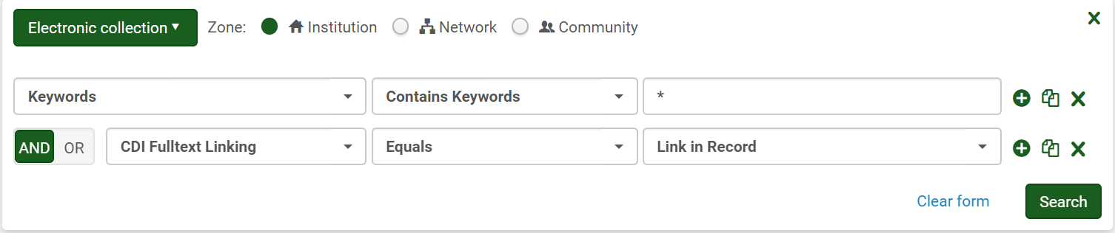
How did they get into your system and how do you find them?
If you don’t recognize them, and didn’t activate them yourself, then they were activated by Ex Libris for you in the PCI at go-live. They needed to be manually cleaned up (delete them).
You can find them in your Alma IZ by doing an advanced electronic collection search:
www.suny.edu

Slide 20
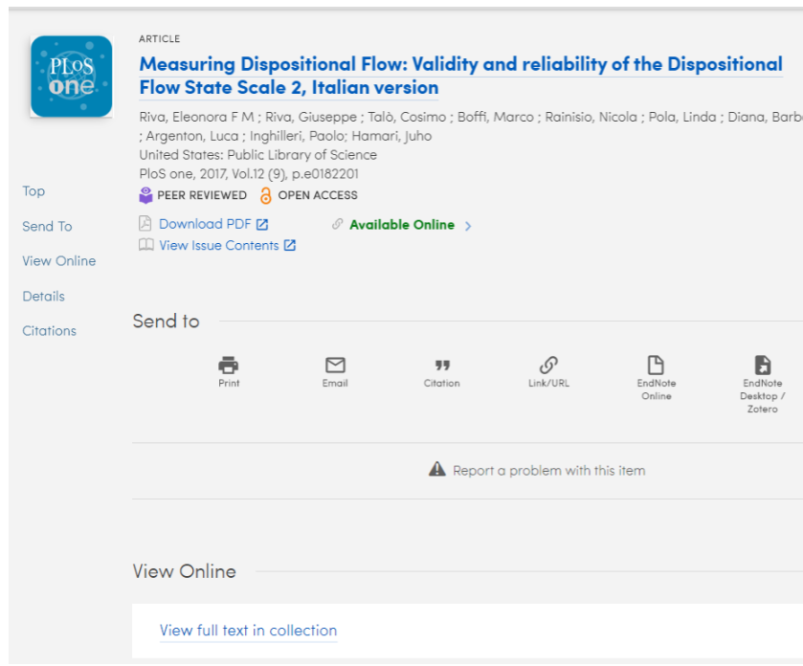
How do Link in Record collections work in Primo?
Patron does a search and the link in record records, like other CDI search records, match on the search and come up in the results list
Link in record collections, because they include links, are automatically considered available, and will come up in your unexpanded search
When you open the record, the live Alma look-up happens and the system sees both the link in record link AND any matching Alma portfolio links
What happens next is . . . .
www.suny.edu

Slide 21
Link in Record Collections and the CDI: Yikes.
Linking dominance:
Immediately after go-live, campuses started reporting that they were missing View Online links from known packages like Sciencedirect
Looking at the CTO for the article in question, you could see the Sciencedirect links, but they weren’t showing in Primo
Ex Libris rolled out CDI so that if there was a link in record fulfillment link and a link resolver (Alma portfolio) fulfillment link, the link in record link took precedence over the Alma link, and ONLY the link in record link would show
www.suny.edu

Slide 22
Link in Record Collections and the CDI: Linking
Because of the many complaints about this (why would you choose to hide subscription links in favor of possibly bad links from a link in record collection?!), Ex Libris changed how this works on August 5th:
  “Based on feedback from many customers, we are changing the following link rule in the merged record:
    From: If the library has access to at least one of the collections that use the link in the record, those collections will be given precedence over the collections that use OpenURL. Links that use a document ID will be given priority over metadata links.
    To: If the library has access to at least one of the collections that use the link in the record and that link is not for an open access item, those collections will be given precedence over the collections that use OpenURL. Links that use a document ID will be given priority over metadata links. If the "link in the record" collection is open access, then the OpenURL link will be given precedence. [Translation: if the link in record collection is for a subscription package or article, it will still override your Alma links]
  For more information on linking rules, see Linking and the Merged Record.”
Linking seems better, but we still have concerns. They say they’re exploring going back to showing all of the links like in the PCI.
www.suny.edu

Slide 23
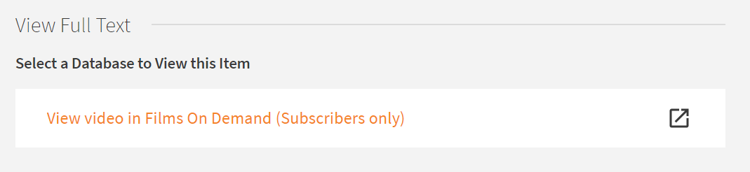
Link in Record Collections and the CDI: Linking
Example of subscription link in record still overriding Alma link resolver link: https://suny-new.primo.exlibrisgroup.com/discovery/fulldisplay?context=PC&vid=01SUNY_NEW:01SUNY_NEW&search_scope=online_resources&tab=online_resources&docid=cdi_infobase_filmsondemand_47712&displayCTO=true
NEW has Films on Demand link in record collection active, and that's overriding Sage link resolver link because FOD is a subscription service.
www.suny.edu

Slide 24
Link in Record Collections and the CDI: Other Issues
Link name:
  Supposed to show name of collection that it’s coming from, supposedly fixed in May, but still says “view full text in collection” most of the time. Requests for clarification in EL Basecamp and on Primo-L have gone unanswered
  Can’t remove problematic collection if you can’t tell what it is (CrossRef discussion on Primo-L)
Contents:
  Unlike Alma collections with portfolios, you have no idea what’s contained in a link in record collection
  We think it’s close to what’s in the equivalent CZ collection, but it’s not one-to-one, makes it hard to figure out where links are coming from
Link functionality:
  Linking not fully baked – UB has had to work hard to fix linking for special Gale collections and others since go live
  Links won’t show up in a link resolver record coming in from outside of Primo because it's only searching Alma, not the CDI, for View Online
www.suny.edu

Slide 25
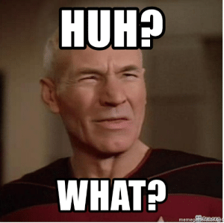
Link in Record Collections and the CDI: Activating
Great deal of trial and error trying to get the link in record collections to work
Ex Libris changed activation methodology (August 9) after customer complaints
Frustrating to troubleshoot because changes take at least 72 hours to implement
https://me.me/i/huh-what-memegeneratorget-huh-what-picard-says-what-c8c0dc7a690345a18933a5798aff95bb
www.suny.edu

Slide 26
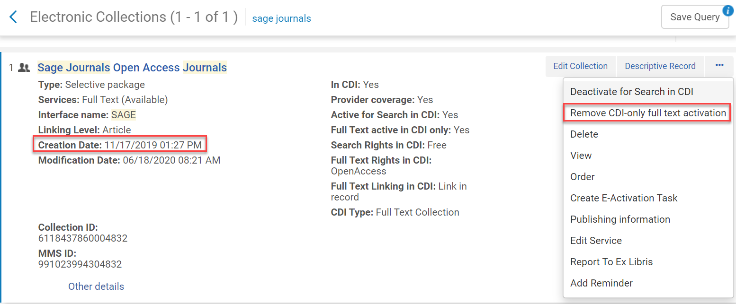
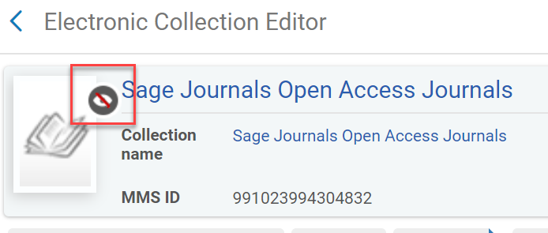
Migrated Link in Record collections
Link in Record needs two activations:
  Active for Search – makes records show in expanded search
  Active for full-text availability – makes records show in unexpanded search and makes links appear in View Online
Special “CDI-only full text activation” tag was applied by Ex Libris in order to publish availability correctly
Were supposed to work even if collection bib record was suppressed (black CZ icon), which is recommended
www.suny.edu

Slide 27
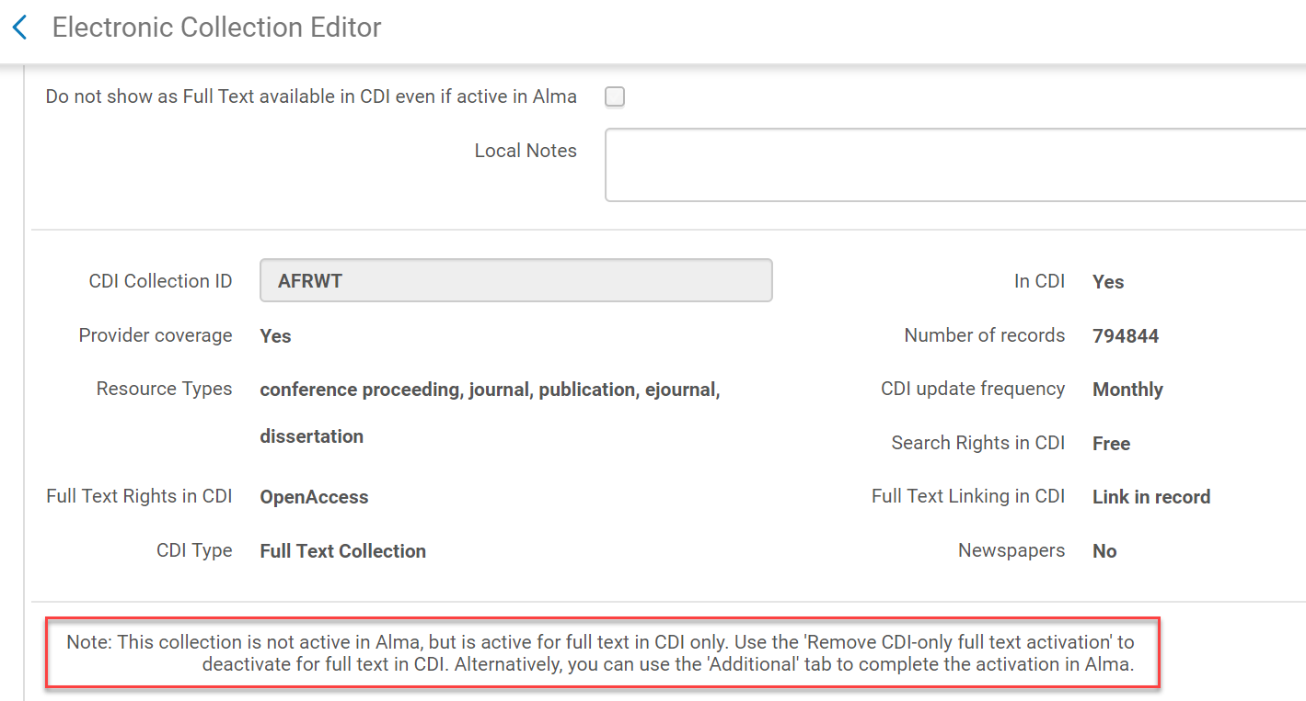
Migrated Link in Record collections, cont.
www.suny.edu

Slide 28
New Link in Record activations
Post-migration: activate for CDI search AND publish collection bib so that the availability would be published correctly
Problems with this:
Different workflow/appearance for migrated collections vs newly activated collections
Many institutions don’t want the database bib record showing up in Primo. Comment from Primo-L:
“... it is a madness if we have to publish all those undesired records, it is a nonsense. I hope Ex Libris consider changing it as soon as possible.” -System Librarian, Spanish National Research Council Library Network
Change made on August 9^{th:}
Ex Libris changed the activation option to let you keep database suppressed but use a new full-text flag to publish for full-text availability
Doesn't impact migrated collections: “Just to clarify - this issue does not apply to database type full text collections that are already flagged as “active for full text in CDI only”. For databases that already have that flag you can already use the suppress option for the bib record independently.”
Can use either publishing option: unsuppress bib or use full text flag. Flag is recommended.
www.suny.edu

Slide 29
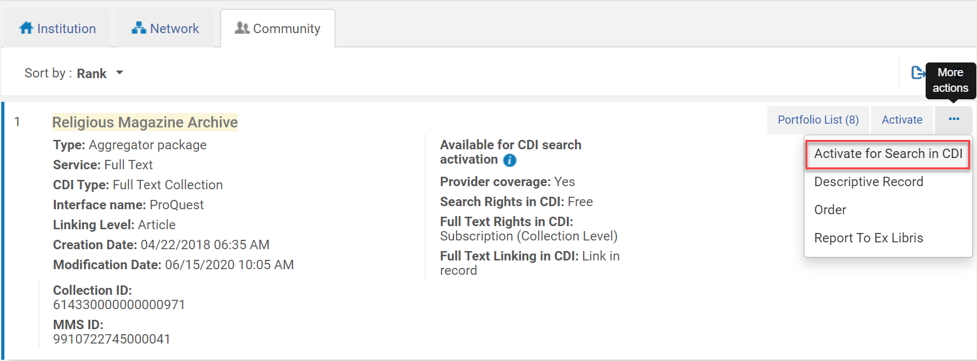
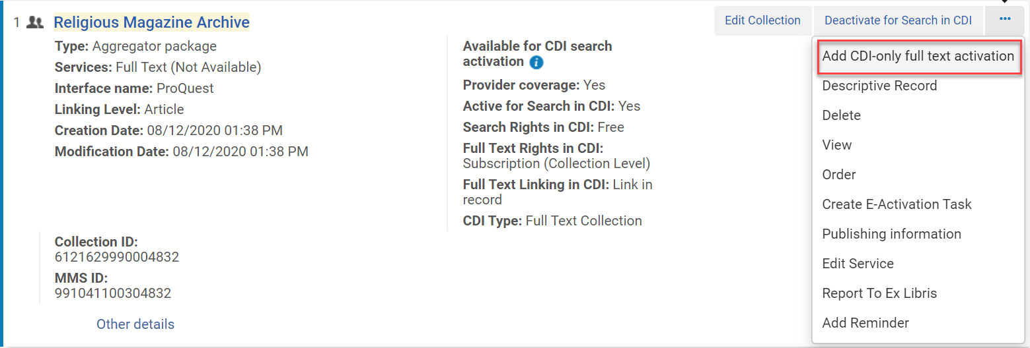
Link in Record activation how-to
Find collection in the CZ
Make sure you have CDI operator role
Choose Activate for Search in CDI
Go to IZ and choose Add CDI-only full text activation
Database bib record comes in as suppressed (which is good)
www.suny.edu

Slide 30
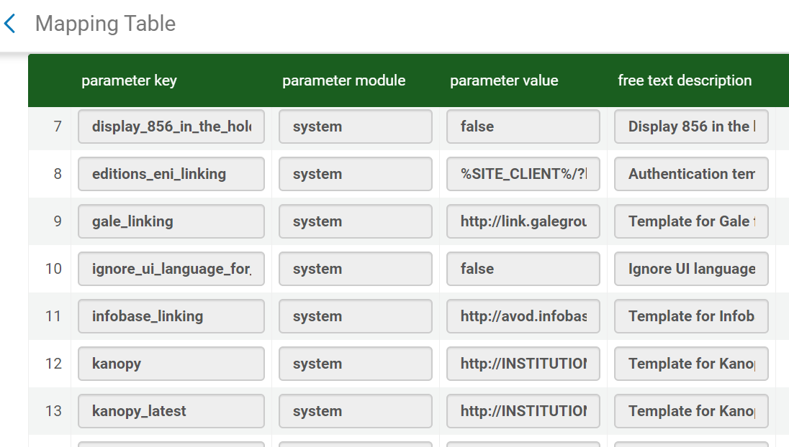
Link in Record Subscription Collections: Customer Settings
In Alma, when you activate a subscription collection, you have a place in the edit service linking tab where you can enter your customer id and say yes/no to proxy
Link in record collections don’t let you make any of these adjustments on the collection
Often need special code in Discovery Config->Other->Customer Settings
www.suny.edu

Slide 31
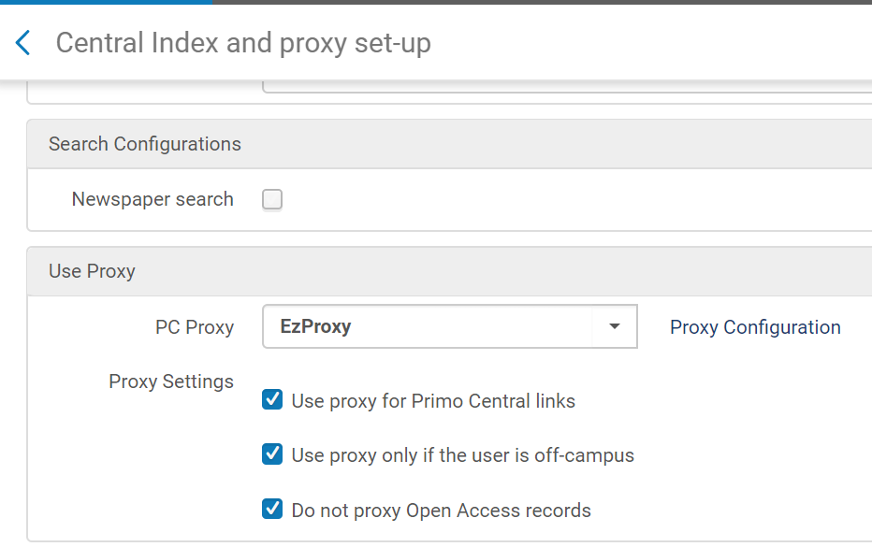
Link in Record Subscription Collections: Proxy
There are two places to adjust your proxy in Alma/Primo:
  You create your proxy entry in the General->External Systems->Integration Profile area, and you can tell it to be used selectively or always (not recommended)
  You adjust how your proxy is used with Primo searching in Discovery config->Other->Central Index and Proxy Set-up
  Use proxy for Primo Central links means use proxy for link in record links. If you choose this because you want to proxy your Link in Record subscription packages, make sure to also mark “do not proxy OA records” because you don't want everything from the CDI proxied.
www.suny.edu

Slide 32
Problems we’re still exploring
Bad links:
Gale – using metadata document id instead of article id for linking
Incorrect metadata in search record (wrong date, etc.) - have to report to Salesforce one at a time
Missing links:
We can see fulfillment look-up results in the CTO but they’re not showing in the View Online
Fulfillment look-up isn’t working great when there's no identifier on portfolio in Alma (e.g. Kirkus Reviews), fulfillment for link resolver searches identifier first, then title, but title has to be EXACT, won't ignore indicators like "The"
www.suny.edu

Slide 33
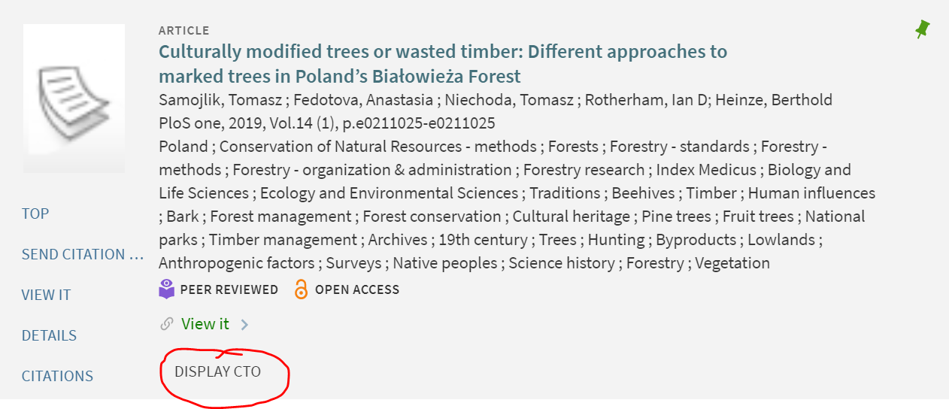
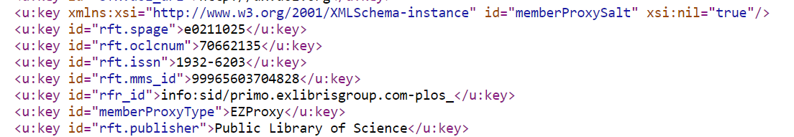
Troubleshooting in Primo: Old Faithfuls
Add &displayCTO=true to full record URL:
Will show you metadata and the fulfillment links that are found.
Handy to help identify ISSN or ISBN to use in further investigation in CZ
Won’t show link in record links, so can’t be used to figure out source of link in record
www.suny.edu

Slide 34
Troubleshooting in Primo: Old Faithfuls, cont.
Show Record ID:
Set it up in your browser bookmarks
FAQ: Record id bookmarklet
Alma number is the MMSid
CDI collection is where the search record is coming from, but it’s NOT the collection that you have active in Alma. Merged search records means any collection that has that item can be used for search record.
www.suny.edu

Slide 35
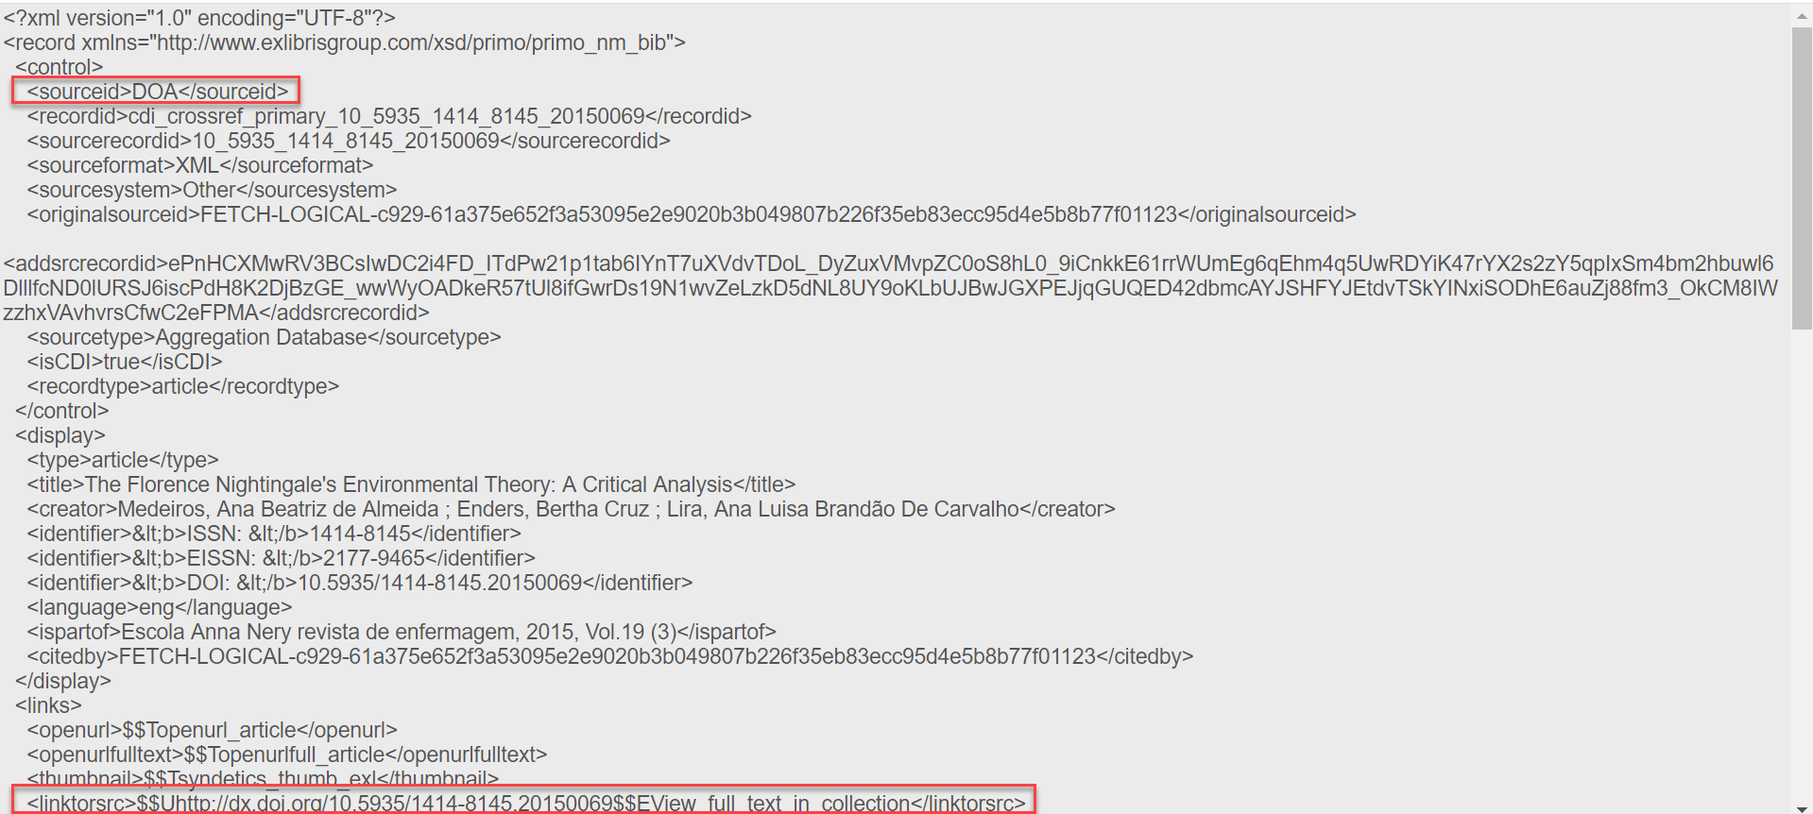
Troubleshooting in Primo: Old Faithfuls, cont.
Show PNX:
Add &showPnx=true to full record URL
https://knowledge.exlibrisgroup.com/Primo/Product_Documentation/020Primo_VE/008Primo_VE_User_Interface/Display_PNX_Record_in_Primo_VE
Can be useful to try to identify the source of a link in record collection but not foolproof
Note: can find the sourceid, but can’t search by this id in Alma ☹
www.suny.edu

Slide 36
Troubleshooting in Primo: search by CDI collection
It can be challenging to tell if content from a specific collection is publishing correctly and displaying in Primo. This is especially true for link in record collections because you don’t know what content is included, so you can’t search for a specific title.
Ex Libris let us know that you can search Primo by your CDI collection ID (even though you can’t search Alma by this id). The structure is:
https://search.lib.buffalo.edu/discovery/search?query=DBID,contains,X5O&tab=OnlineResources&search_scope=OnlineResources&vid=01SUNY_BUF:everything&offset=0&pcAvailability=true
www.suny.edu

Slide 37
Questions?
The SLSS is offering a new CDI Audit service to help you review your collections. Please submit a ticket to info@slcny.libanswers.com if you're interested
www.suny.edu

