Slide 1
Asthma Essentials ECHO® Session Topic: Patient and Family Education Considering Lower Income/Vulnerable Population
Facilitator: Pat Flanagan, MD
Faculty Presenter(s): June Tourangeau
Case Presenter(s): Mio Alsina
Date & Time: February 8th, 2023
PLEASE NOTE: Project ECHO case consultations do not create or otherwise establish a provider-patient relationship between any clinician and any patient whose case is being presented in a project ECHO setting
Care Transformation Collaborative of RI
Prepared by Care Transformation Collaborative of RI

Slide 2
Welcome
This session will be recorded for educational and quality improvement purposes
Please do not provide any protected health information (PHI) during any ECHO session
Mute your microphone when not talking.
Limit distractions as best as possible.
Use reactions & the raise hand feature.
Engage and turn your camera on if you are able.
Use the chat to ask introduce yourself, ask questions and share resources.
Engage - ask questions, offer feedback, provide support.

Slide 3
Agenda
Time | Topic | Presenter
7:30 – 7:35 AM | Welcome/Announcements | Pat Flanagan, MD
7:35 – 8:00 AM | Didactic Presentation | June Tourangeau, Certified Asthma Educator
8:05 - 8:25 AM | Case Presentation & Discussion | Miosotis Alsina, Program Manager Community Asthma Programs, Lifespan
8:25 – 8:30 AM | Wrap up; Evaluation; Announcements | Michelle Mooney, MPA

Slide 4
Today’s Faculty
Please include brief bio: Attended Southeastern University of Massachusetts and RI Jr College. Certificate: License Practical Nurse and a Certified Asthma Educator. Was employed at former St. Joseph Hospital/ Health Center for 42 years. LPN position in the Emergency Department/ Walk in, Psych Department, Lead and asthma clinic and home educator. Part of the design team for Lead and Asthma home outreach programs. Expert witness RI lead trail to represent child and families to share experiences through clinic and home visiting. One of the Team leaders for a Federal Grant focusing on Asthma Home Visiting. Currently AE-C consultant for CTC of RI.

Slide 5
Disclosures
Session presenters have no financial relationships with a commercial entity producing healthcare-related products used on or by patients. If CME credits are offered, all relevant financial relationships of those on the session planning committee have been disclosed and, if necessary, mitigated.

Slide 6
Learning Objectives
Discuss barriers & strategies when helping patients achieve asthma self management goals
Describe Asthma team members and roles
Show every encounter with an asthmatic is a teachable moment and an opportunity to build a trusting relationship
Notes:
3 Learning Objectives that are very specific and measurable

Slide 7
Barriers & Strategies
Education:
Amount of information and time allotted
Using interpreters
Level of education, learning and physical disabilities
Strategies:
Use picture tools such as AAP (asthma action plan); pick and choose visual aids
Ensure information is available in other languages
Use open communication, try to avoid yes or no questions, motivational interviewing
Reinforce, Reinforce, Every Encounter is a teachable moment

Slide 8
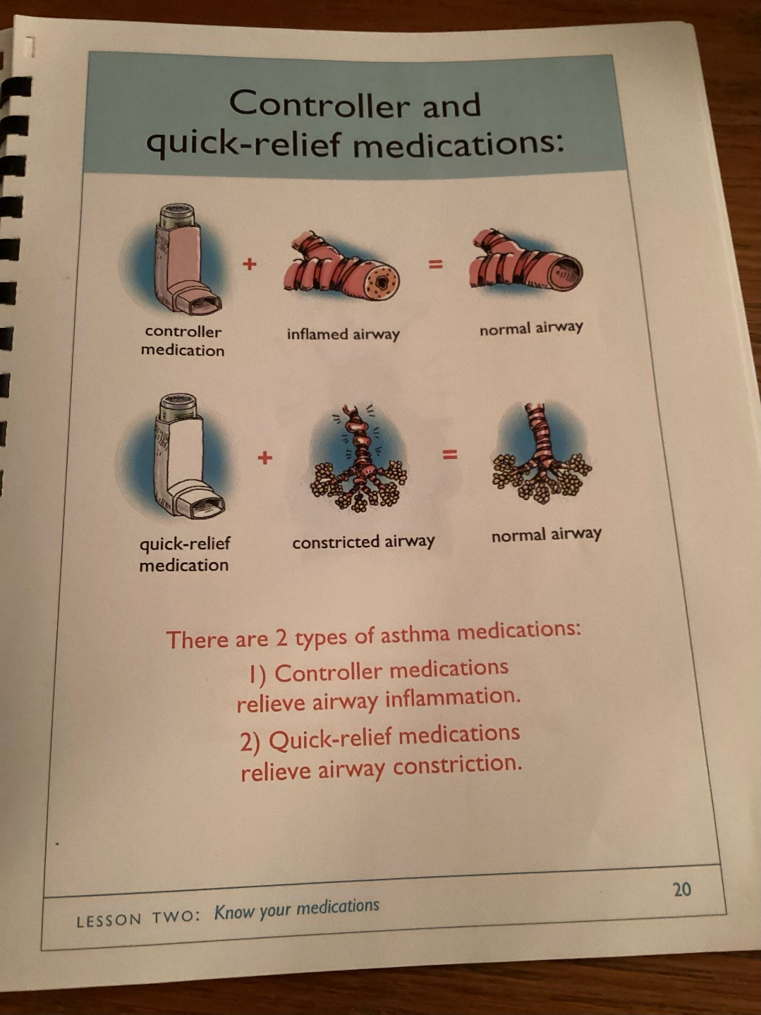
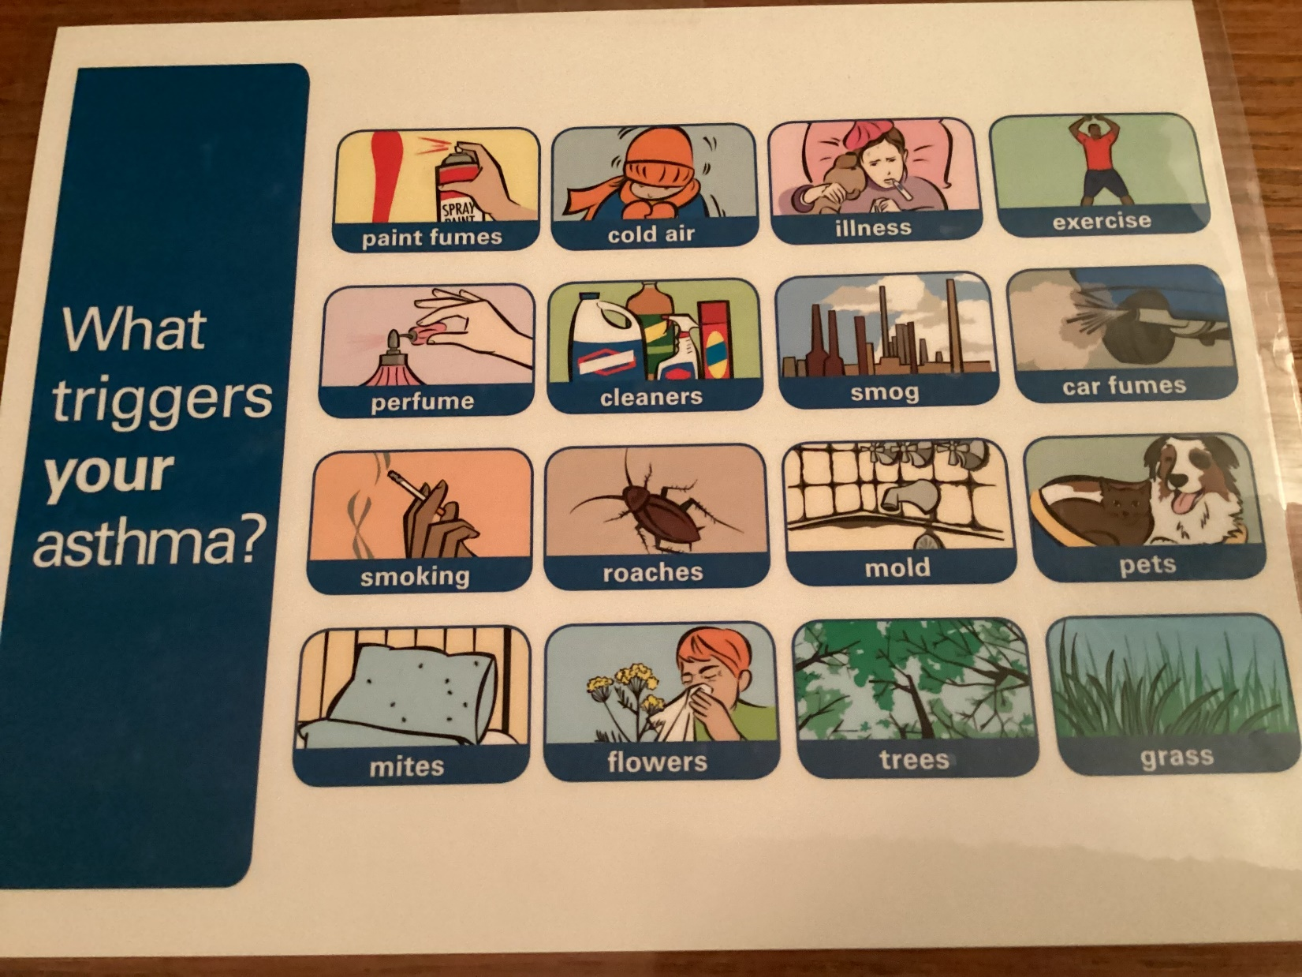

Slide 9
https://www.holyokepediatrics.com/resource-center

Slide 10
https://allergyasthmanetwork.org/news/inhalers-at-a-glance-posters-resources/

Slide 11
Using Motivational interviewing
Don’t argue, finger -wave, or cheerlead
Ask permission first
Ask fewer questions, listen to what they have to say and offer
Roll with resistance
Empower person and caregivers, small changes and end with big results
Use wiggle words as: “one option is, you might consider, here’s a thought what do you think”
Offer menu of options, use patient centered goals
Avoid information overdose, behavior change is about Motivation not information
Set goals that match persons readiness, identify strengths and potential barriers.
Summarize and affirm and ask important info to be repeated

Slide 12
Psychosocial, Socioeconomic, and Cultural Issues
When working with vulnerable and low income populations, you may run into more psychosocial, socioeconomic, and cultural barriers
Know up to date resources, this will help develop a trusting relationship
Follow up with asthmatic and referral partner
If unable to help with psychosocial, socioeconomic issues, will have a hard time helping with medical issues

Slide 13
Barriers & Strategies
Socioeconomic
Limited or no insurance: refer, how to apply, sliding scale PCPs
Lack of transportation : Insurance., teach how to use bus
Missing work and income: can appointments be combined, imp. of tx
Deteriorating housing and unable to afford changes: resources: Housing applications, HARP, Breathe easy at home
Use of ED and no continuity of heath care: PCP referrals, imp. of f/u
Unable to purchase meds or pay co pay : drug co., asthma team

Slide 14
Barriers & Strategies
Psychosocial
Level of family support , other ill family members, parenting difficulties
Domestic abuse , Alcohol, drug abuse
Unemployment/low income
Psychological illness/ depression
Lack of social service support

Slide 15
Barriers & Strategies
Cultural
Understanding of another person’s culture and learn from them.
Their understanding and interpretation of the diagnosis: fears, denial of disease
Home remedies ex. Onions, tree growing
Fear of meds and side effects
Use of ED vs PCP
Share cultural awareness with other asthma team members

Slide 16
Asthma Self Management Education Definition
Asthma self management is a fundamental component of asthma management guidelines. Self management education should include the provision of information, self monitoring, regular medical review and the provision of written asthma management plan. Examples of SMG;
Self monitoring to access level of Asthma control and signs of worsening asthma. Use of updated AAP, peak flow, rules of 2
Be able to identify and control environmental triggers in the home, be able to identify triggers at school and or work and relay information to appropriate person
Agree on treatment goals (sleep thru night, decrease missed school/ work days, ED visits etc.) and address concerns reaching
Taking all med correctly, bring meds to all medical appointments, demo how use etc.
Involve all members of your team to provide reinforcement of education, and assistance to obtain resources for social economic needs.

Slide 17
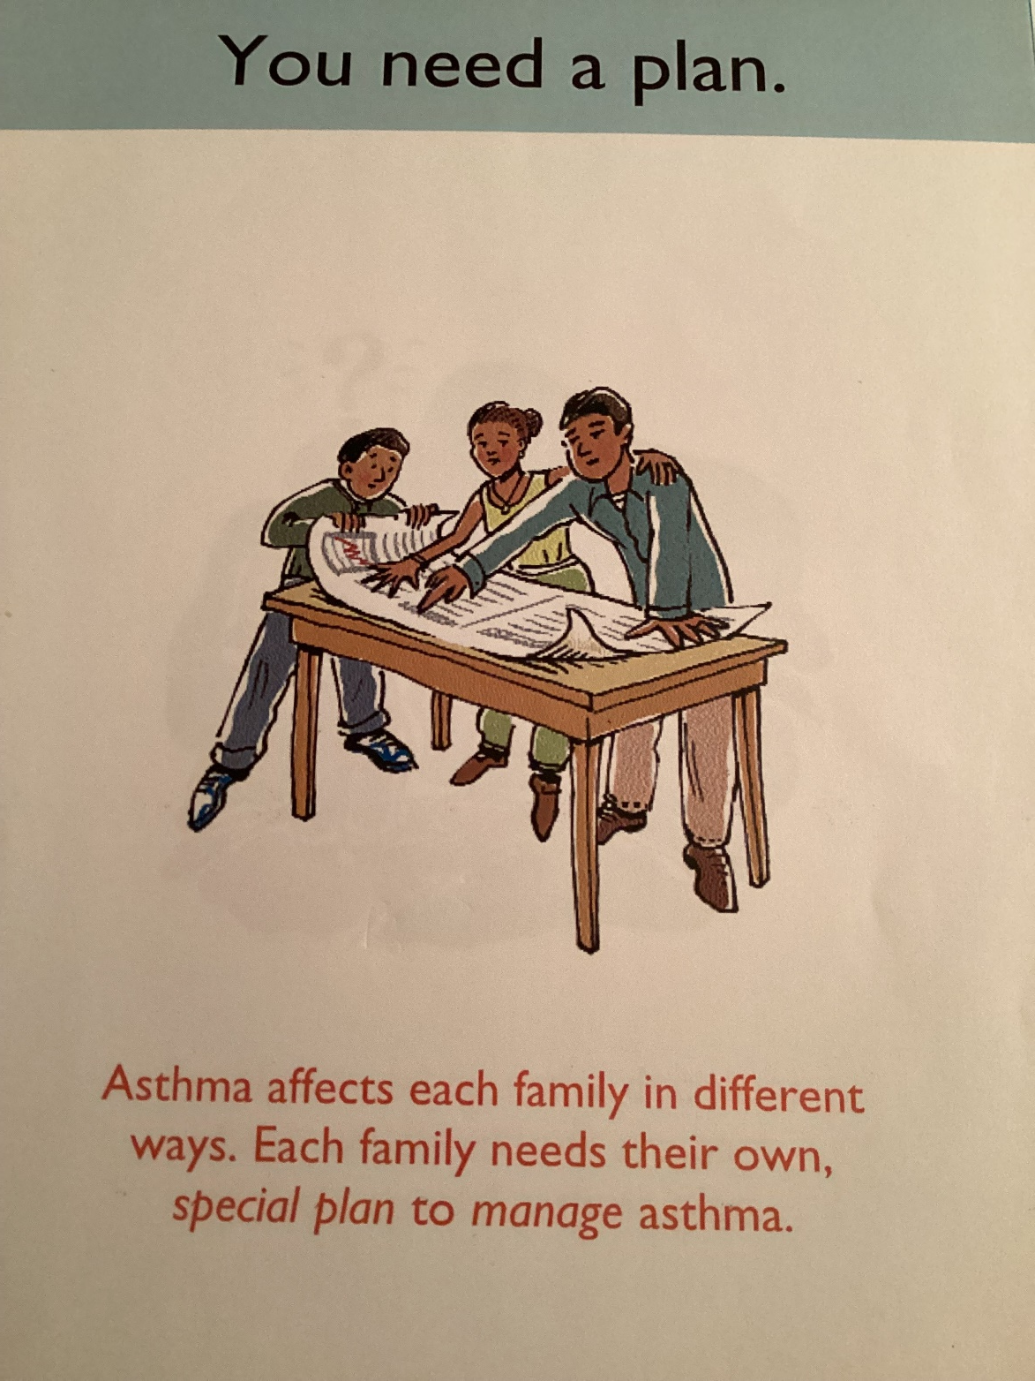
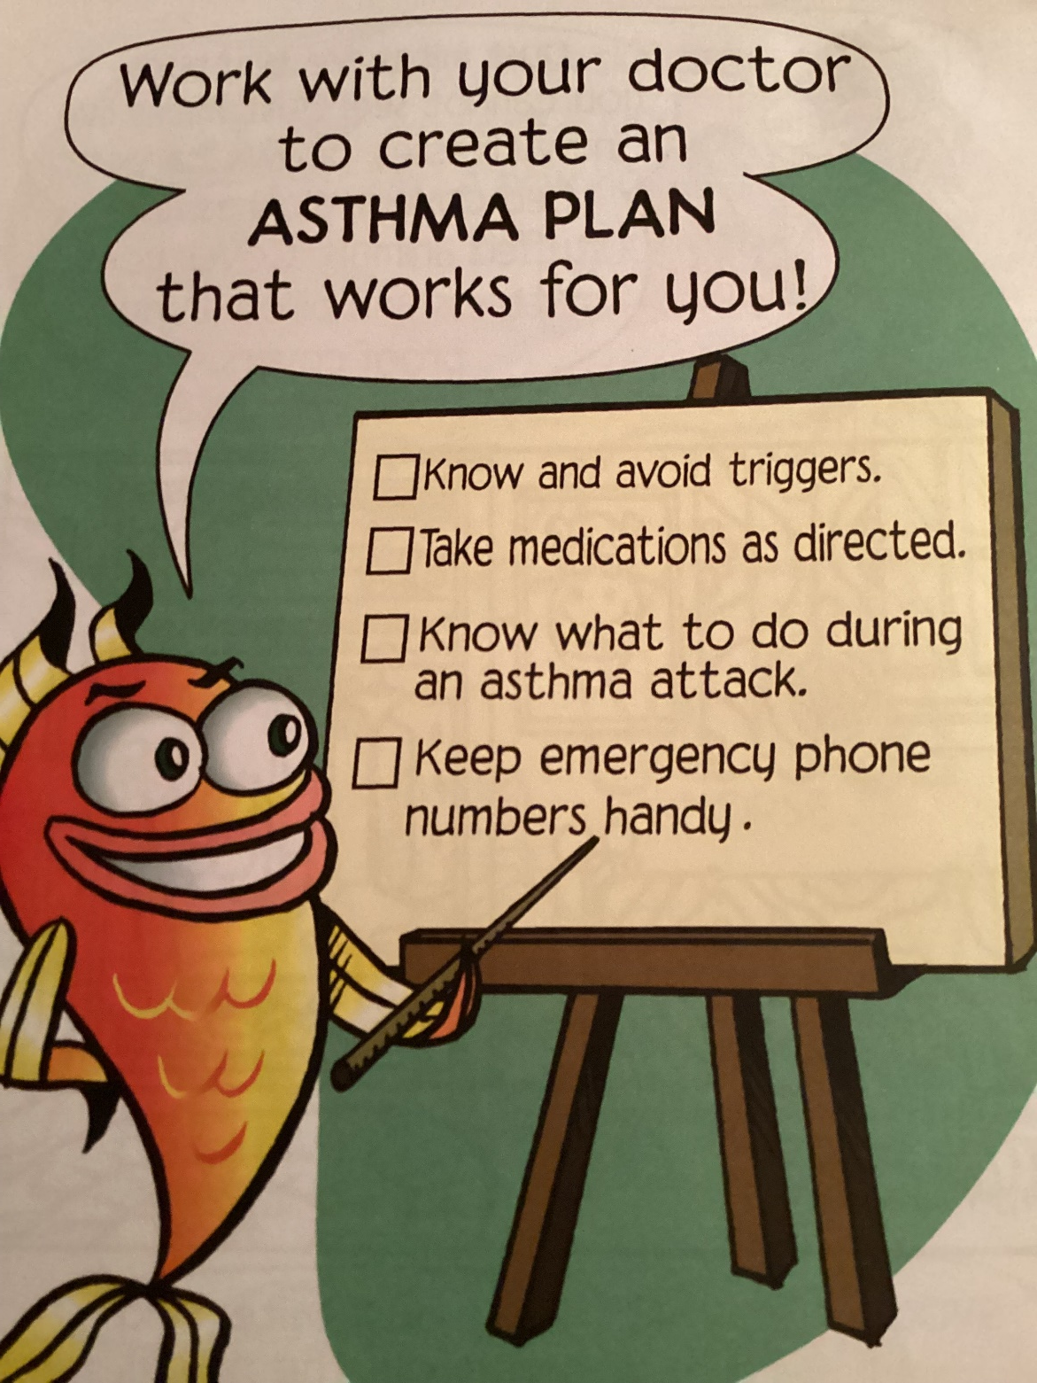

Slide 18
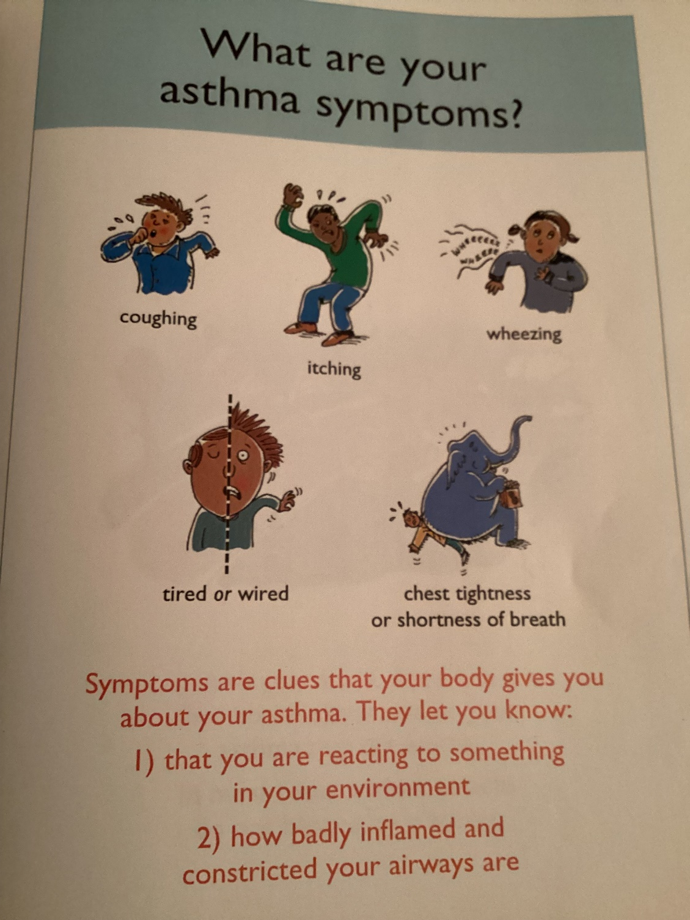

Slide 19
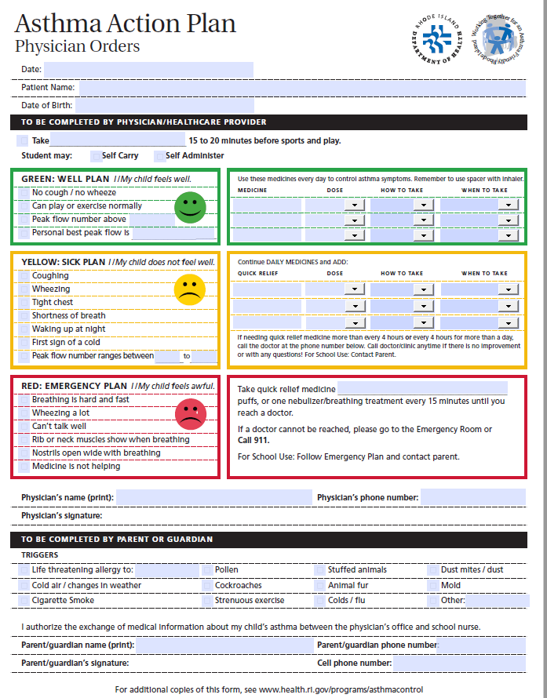
https://health.ri.gov/publications/actionplans/Asthma.pdf

Slide 20
Asthma Team & Their Roles
Asthmatic:
understanding the diagnosis, and SMG, as following AAP, let someone know when you are having symptoms, know how to use meds and devices correctly, know trigger and how to avoid, bring meds to all medical visits
PCP/Dx –
works with patient/ family to determine the best treatment, prescribe meds, checks to see if treatment working. Teaches you about: asthma meds, how to us med devices, triggers and how to follow AAP. Referring for services needed. Reinforces Asthma education
Nurse:
checks for symptoms and clinical signs at each visit and if patient asthma is under control. How to use medications, devices, follow AAP and how to reduce triggers. Can do testing as peak flow treating, Spirometry. Referring for services needed and f/u. Reinforces Asthma education
Respiratory Therapist:
performs exams as Spirometry . Checks for symptoms and clinical signs of asthma at each health visit. Teach how to use devices, follow AAP, reduce triggers, Referrals as needed. Reinforce ED
Pharmacist:
how to use meds and devices, offer automatic refills, assist PCP
Certified Asthma Educator:
Works with patients and their family's to provide detailed asthma education and resources. Communicate with partners. Assist to help with goals.

Slide 21
Asthma Team & Their Roles
Medical Assistant/Certified nursing Assistant, CHW:
Medical team member to reinforce education.
Teacher & school nurses:
Have access to updated asthma action plan; know child asthma symptoms and triggers, be available for child to reach out to when having symptoms or before activities if needed. Person to reach out to family and or medical team to report on symptoms and med use. Reinforce education.
Home visitor:
works with medical team to provide support for patient and families. Gives support, referrals as needed and reinforces education at home visit. Helps eliminate or reduce exposure to asthma triggers helps understand AAP and report to referral asthma team.
Family members:
know symptoms, how to use AAP, help reduce triggers, assist to get to medical appoints, pharmacy for refills. Discuss goals and measures with providers and asthmatic
Coaches, babysitter’s etc
Aware person has asthma, knows symptoms and triggers, has access to AAP and rescue med
DOH and community agencies, Insurance Companies:
Resources available to help address asthmatic barriers

Slide 22
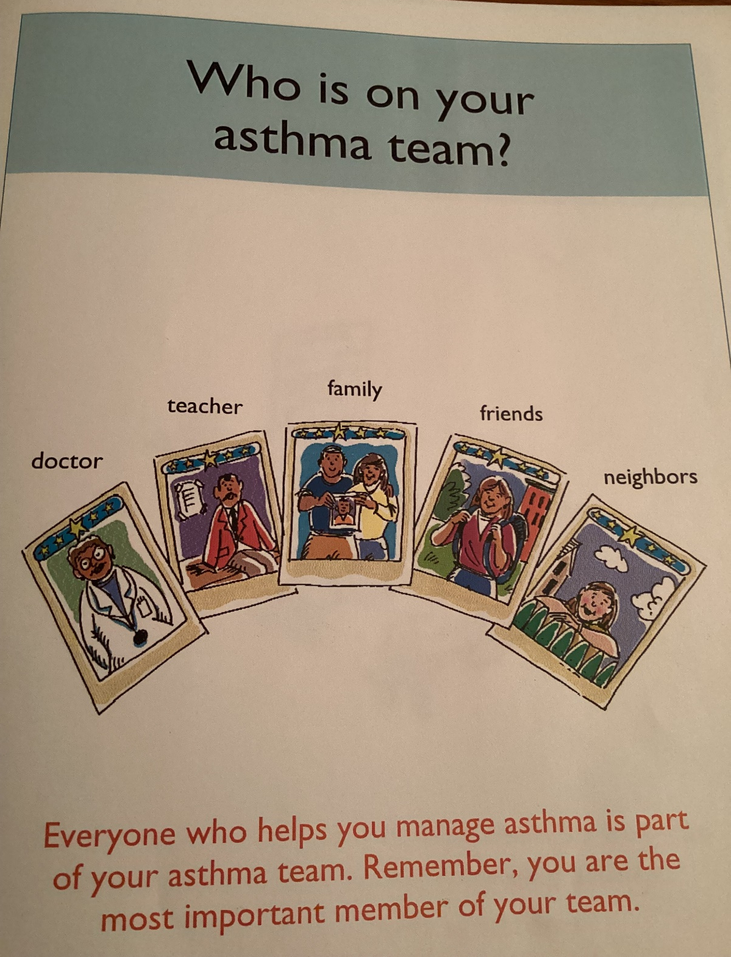
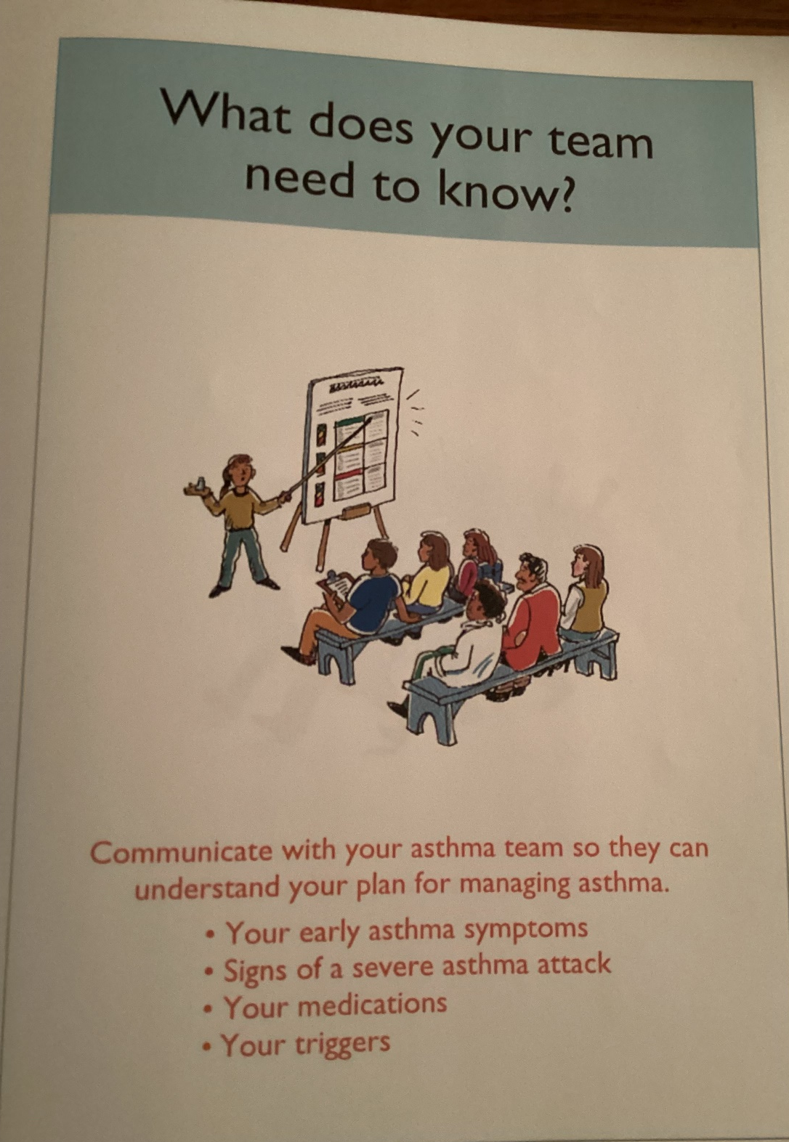

Slide 23
Questions?
What experiences can you share with the group that you feel would help us recognize and overcome barriers, be more sensitive and improve our communication and education with asthmatics and their team?

Slide 24
Allergy and Asthma Network assess to current educational information, videos, posters etc.: https://allergyasthmanetwork.org/
RI Department of Health: https://health.ri.gov/asthma/ American Lung Association: https://www.lung.org/lung-health-diseases/lung-disease-lookup/asthma/managing-asthma Holyoke Pediatrics: https://www.holyokepediatrics.com/resource-center
Resources & Contact Info
June Tourangeau junet16@comcast.net

Slide 25
Asthma Essentials ECHO® Case Presentation
PLEASE NOTE: Project ECHO case consultations do not create or otherwise establish a provider-patient relationship between any clinician and any patient whose case is being presented in a project ECHO setting
Care Transformation Collaborative of RI
Prepared by Care Transformation Collaborative of RI

Slide 26
Announcements & Reminders
Final Session Date: | March 8, 2023
Topic: | Managing Asthma Exacerbations
Presenter: | Andrew Foderaro, MD, Pulmonologist, East Providence Brown Physicians Patient Center
Case Presenter: | Thomas Warcup, MD, Block Island Medical Center
Asthma Quality Improvement Initiative – Applications due FEB 24th
https://www.ctc-ri.org/sites/default/files/Asthma%20Call%20for%20Applications.pdf

Slide 27
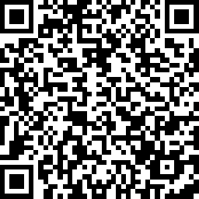
CME Credits (currently available for MDs, PAs, Rx, RNs and NPs)
CME Credits – Please request session credits when filling out the evaluation at the end of the meeting.
Evaluation/Credit Request Form: https://www.surveymonkey.com/r/M9VJ8LT
The AAFP has reviewed ‘ECHO Series Focused on Best Practices and QI,’ and deemed it acceptable for AAFP credit. Term of approval is from 09/16/2022 to 09/16/2023. Physicians should claim only the credit commensurate with the extent of their participation in the activity. NPs and RNs can also receive credit through AAFP’s partnership with the American Nurses Credentialing Center (ANCC) and the American Academy of Nurse Practitioners Certification Board (AANPCB).
Notes:
Linda

