Slide 1
NZ Import Profile Policies
Shared Library Services Platform Project
Maggie McGee

Slide 2
Purpose of NZ Import Profiles Policies
NZ import profiles policies have been created to ensure that all bibliographic records being imported into the NZ are consistent and adhere to MSP policies
Using consistent NZ import profile standards reduces:
Duplication
Importing MARC fields that do not adhere to MSP policies
Troubleshooting and clean-up projects in the NZ

Slide 3
When Should Network Zone Import Profile Standards be Applied?
NZ import profiles and standards only need to be used when you are importing physical title vendor order records using EOCR or API into the NZ. Example; GOBI order records through EOCR or API
This does not apply to exporting records from OCLC Connexions Client into the NZ to place an order
Use NZ import profile standards for all import profiles that import bibliographic records into the NZ
Only physical bib records will be imported and maintained in the NZ. Some examples of physical records that will be imported into the NZ:
Books
DVDs
Maps
Music
Print Journals
Visual materials

Slide 4
MSP- 54 Policy: Vendor Import Profiles
MSP- 54 Policy: All Vendor Import Profiles Must Follow Network Zone Standards when Importing Vendor bibliographic records into the Network Zone
Policy justification: This policy ensures that Network and Institutional import profiles have the same configurations to ensure consistency and accuracy when importing vendor bibliographic records into the Network Zone
All vendor import profiles that import bibliographic records into the NZ should use the same configurations as the NZ to ensure that the records are being imported into the NZ in the same way. Standardized import profile configurations ensure more accuracy with bibliographic records that are being imported into the NZ.
Recommendation: Institutional vendor import profiles should comply with the NZ import profile standards for all vendor and/or shelf-ready orders and bibliographic records that are being imported into the NZ.

Slide 5
MSP-43 Policy: Network Zone Policies Resolving Multi-Matches
MSP- 43 Policy: Resolving Multi-Matches from the Daily OCLC Loads in the Network Zone (NZ)
Policy justification: Multi-matches must be manually managed by the Network Zone Coordinator. The import profile makes it possible to merge records and combine inventory for multi-match.
­­­­­­­­­­­­­­­­­
There are two daily OCLC loads that import OCLC Worldcat master records into the SUNY Network Zone. The two OCLC import profiles are for new and updated OCLC Worldcat master records. New records that are imported into the Network Zone are records that are recently “held” by a SUNY library in OCLC. Updated records are imported when there are recent updates to the OCLC Worldcat master record based upon MARC fields that have been defined by SUNY.
Multi-matches can occur when new and updated OCLC Master records are imported into the SUNY Network Zone from the daily OCLC loads. Multi-matches occur when two or more NZ records have the same OCLC number or when OCLC merges and dedupes records in Worldcat and there are matching records in the NZ with invalid OCLC numbers.
Multi-matches must be manually managed by the Network Zone Coordinator and as a result an import profile is required to merge records and combine inventory for multi-match to manually handle these MARC records. The Network Zone Coordinator will install a Java script created by CalState to speed up the manual processing of merging multi-match records.

Slide 6
MSP-44 Policy: Merge Rule
MSP-44 Policy: Merge Rule in the Network Zone OCLC New and Updated Import Profiles
Policy justification: A merge rule is required for multi-match records to protect the 001 and replaces the 035 of bib records if they have an OCLC prefix.
The “SUNY Merge Rule for OCLC/MARC record update files” merge rule is being used in the OCLC import profiles in the Network Zone for new and updated OCLC Worldcat master records. The Network Zone Coordinator used Orbis Cascade’s primary merge rule, which protects the 001 field (MMSID) and it replaces the 035 if it contains an OCLC number, otherwise the 035 is retained if it does not have the (OCoLC) prefix.
Recommendation: all SUNY libraries will use the “SUNY Merge Rule for OCLC/MARC Records” merge rules in any import profiles that imports MARC records into the Network Zone. The merge rule is available for all SUNY libraries to use.

Slide 7
MSP-45 Policy: Normalization Rule
MSP-45 Policy: Normalization Rules in the Network and Institutional Zone
Policy justification: This policy standardizes which MARC fields are not imported into the Network Zone from OCLC.
The SUNY NZ Normalization rules is named “SUNY NZ OCLC Import Normalization Rule.” It removes the following MARC fields from bibliographic records being imported into the Network Zone: 015, 016, 017, 025, 029, 070, 071, 072, 080, 084, 092, 098, 242, 257, 263, 265, 340, 583, 653, 850, 851, 852, 856, 886, and 938.
Recommendation: All SUNY libraries should use the “SUNY NZ OCLC Import Normalization Rule” when importing bibliographic records into the NZ.
https://slcny.libanswers.com/faq/239032

Slide 8
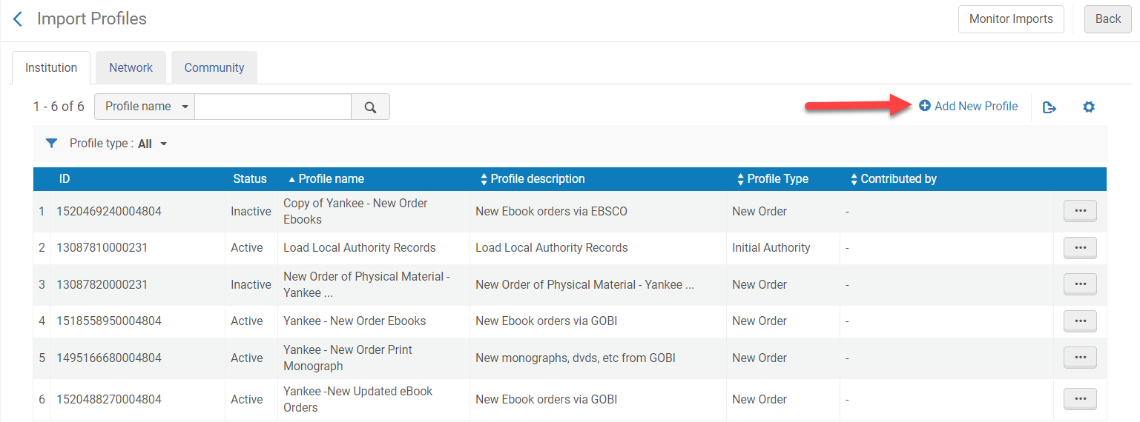
Applying NZ Standards to an Import Profile
Got to Resources>Import>Manage Import Profiles
Click Add New Profile

Slide 9
Applying NZ Standards to an Import Profile
Select New Order
Click Next

Slide 10
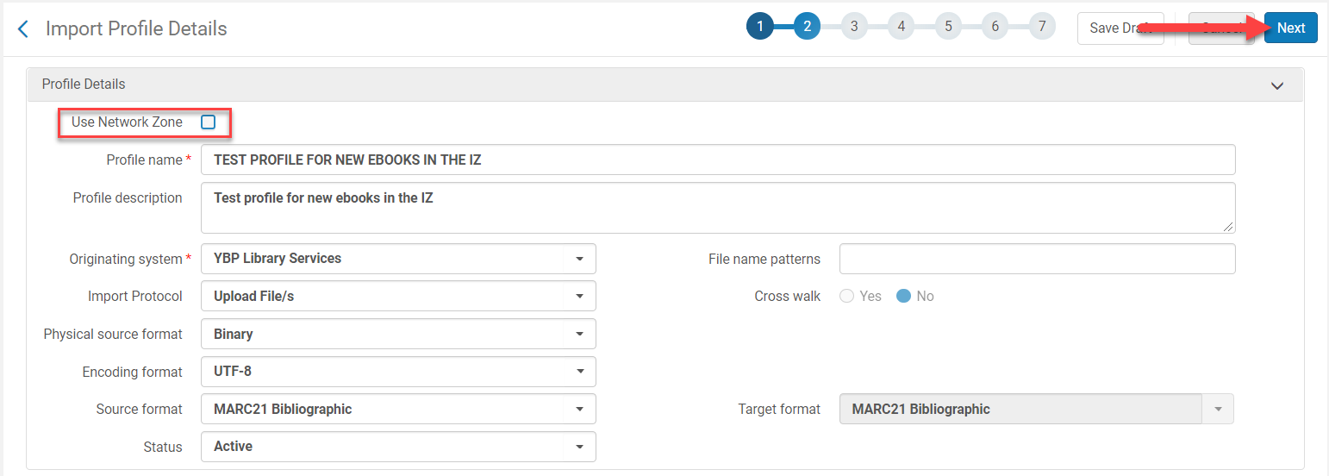
Applying NZ Standards to an Import Profile
5. Check the Use Network Zone for IZ import profiles box
It usually defaults to being checked
Fill out the rest of page 2 of the import profile wizard for the vendor providing records for the IZ
Click Next

Slide 11
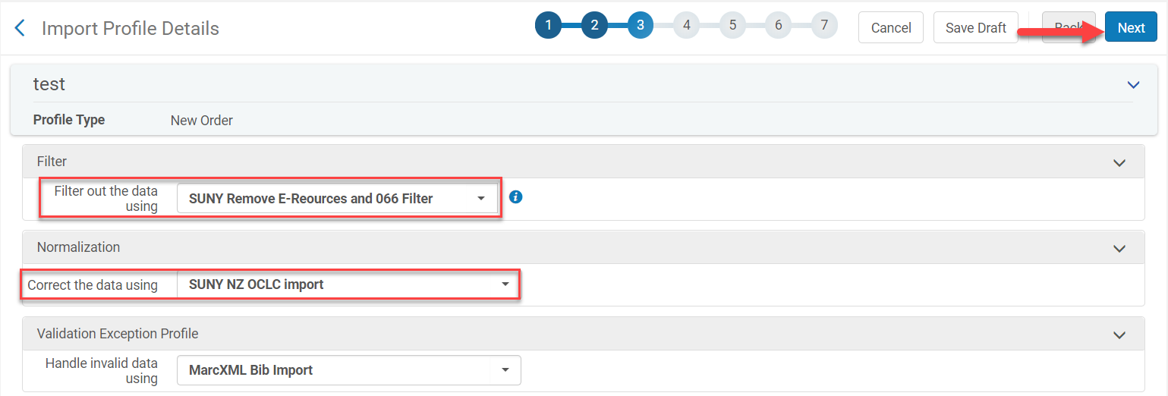
Applying NZ Standards to an Import Profile
Select the SUNY Remove E-resources and 066 Filter
This filters out bib records with Form o in the LDR
This also filters out strange diacritics that cause display issues
Select the SUNY OCLC Import Normalization Rule
Click Next

Slide 12
Applying NZ Standards to an Import Profile
Serial and Non Serial Match Method: Unique OCLC Identifier Match Method
Note: if the import file does not have (OCoLC) in the 035 choose 035 (other system identifier) match method
Upon Match: Merge
Merge Method: Overlay all but local fields or you can use the Copy of SUNY Merge
Rule for OCLC/Bib Records
Select Do not Override/merge a record with a lower brief version
Select Disregard matches for bibliographic CZ linked records
These options will vary based upon the Originating System that is chosen in the first page of the import profile wizard
Merge and Continue: Manually
Preferred record: Record with the highest brief level
Secondary record: Delete
Upon no match: Import
Click Next

Slide 13
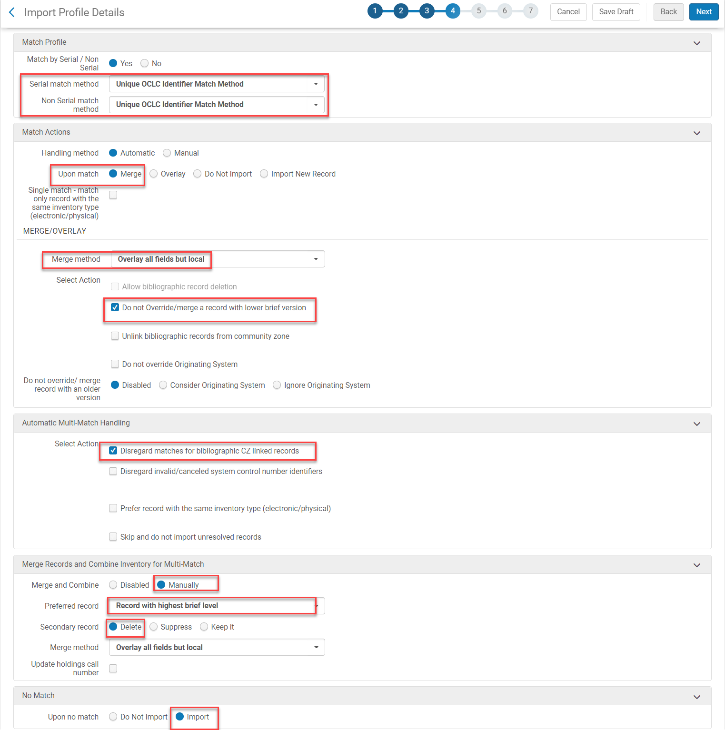
Applying NZ Standards to an Import Profile

Slide 14
Applying NZ Standards to an Import Profile
Synchronize with OCLC: Publish Bibliographic records
Condition: Unconditionally
Click Next

Slide 15
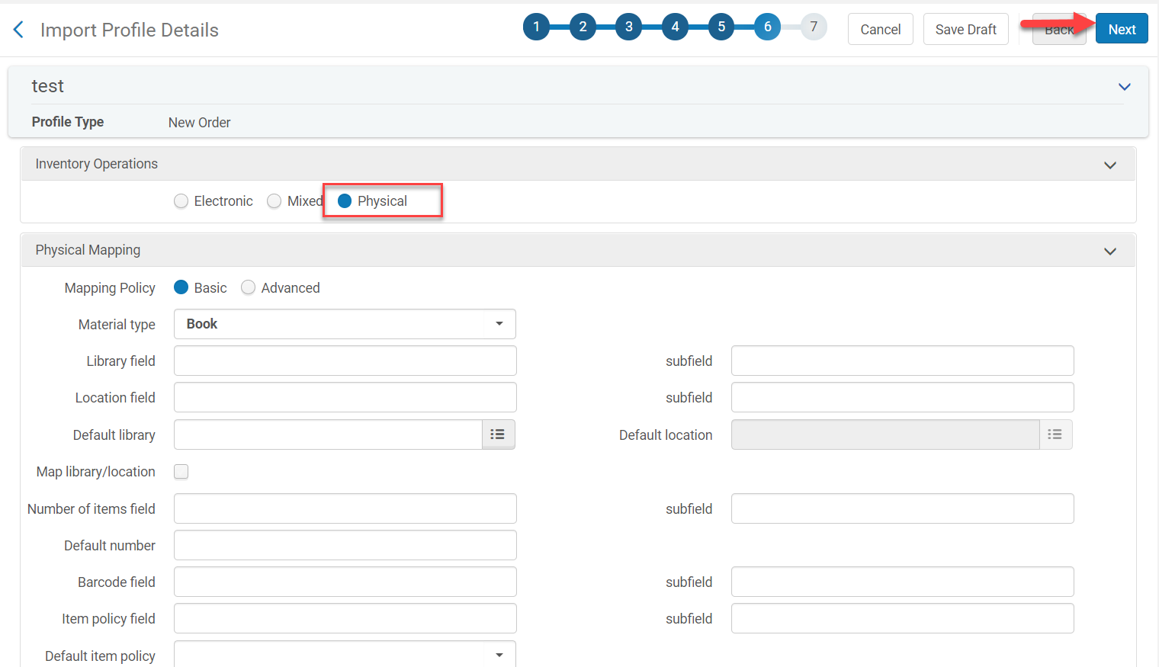
Applying NZ Standards to an Import Profile
Inventory Operations: Physical
Physical mapping: Fill in the appropriate MARC fields
Click Next

Slide 16
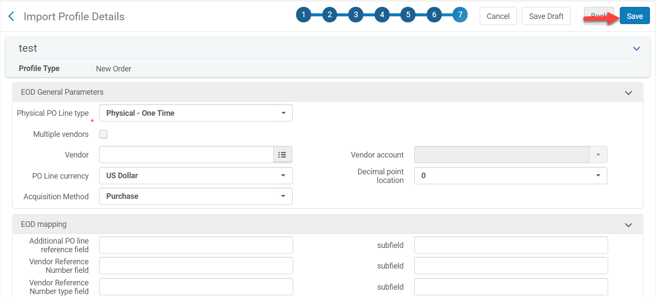
Applying NZ Standards to an Import Profile
Complete the EOD information
Click Save
Edit the import profile to add fund mapping if applicable

Slide 17
Importing Bibs Records Into the IZ Using NZ Rules
FAQ on how to use NZ rules in an import profile for IZ bib records: https://slcny.libanswers.com/faq/266382?m=p

Slide 18
MSP-42 Policy: Brief Level Rules
MSP-42 Policy: Brief Levels Rules are applied from the Network Zone to Institutional Zone Records that are Linked to the Network Zone
Policy justification: The brief level rules are applied at the Network Zone level. The NZ brief level rules establish the brief level for any IZ bibliographic records that are linked to the NZ.
The Network Zone uses brief level rules based upon OCLC LDR 17. All IZ records that are attached to the NZ will inherit the NZ brief level rules and apply them to the IZ bib record.
*If you would like to apply the same brief level rules to your IZ: https://slcny.libanswers.com/faq/266420?m=p

Slide 19
MSP Policy: Brief Level Rules
Alma Brief Level | Leader byte 17 | Description
10 | (blank) | Full level
09 | I / L | Full level input by OCLC participants (uppercase “i”) / Full level input added from a batch process (future: use ‘M’ instead)
08 | 1 | Full level, material not examined
07 | 4 | Core level
06 | K / M | Less-than-full added from a batch process
05 | 2 / 7 | Less-than-full level, material not examined / Minimal level (OCLC Bib Formats: OCLC participants cataloging online at Minimal level, use ‘K’)
04 | 8 | Pre-publication level
03 | 3 | Abbreviated level
02 | 5 | Partial (preliminary) level (and other codes, e.g., u & z, as encountered and appropriate)
01 | J | Deleted record

