Slide 1
Digital Delivery for Alma Resource Sharing Requests
Timothy Jackson
Resource Sharing & Fulfillment Program Manager
SUNY Library Services

Slide 2
Agenda
Background info on Alma RS digital delivery
Configuration work done by SLS
Filling lending RS requests digitally
Filling borrowing RS requests digitally
Live Demo

Slide 3
History of Digital Delivery for Alma RS Requests
No digital resource sharing was implemented at go live
ASRS working group decided that Alma article resource sharing did not work well enough
Nearly all SUNY libraries were still using ILLiad at the time, so we decided to keep using ILLiad for all digital resource sharing
Alma article resource sharing was implemented in spring 2020 once SUNY libraries began cancelling ILLiad subscriptions due to budget issues
19 libraries currently borrowing, 13 libraries currently lending
Initial article RS workflow required borrowers to manually delivery articles via email outside of Alma
August 2020 release allowed for automatic delivery of download links for article requests
January 2021 release expanded this functionality to loan requests

Slide 4
Digital Delivery Configuration
SLS has already taken care of all necessary configuration work (thanks, Gail!)
Digitization and Copyright Rules
Determine whether Alma delivers an attachment or a download link
Determine download limit if configured to send download link
How delivery works determined by lender’s Digitization and Copyright Rules
Emails with attachments come from lending library, so we opted for sending download links
Document Delivery Notification Letter
Made sure letter is enabled
Made sure addressFrom label was not still Your.Department@organization.com (used email address from other patron facing emails)
Added download limit to max_number_views label (value should be passed from lender, but that currently isn’t working properly)
Removed unnecessary download links from XSL template (default contains download links for SAML, CAS, and Alma authentication) and changed label for remaining download link

Slide 5
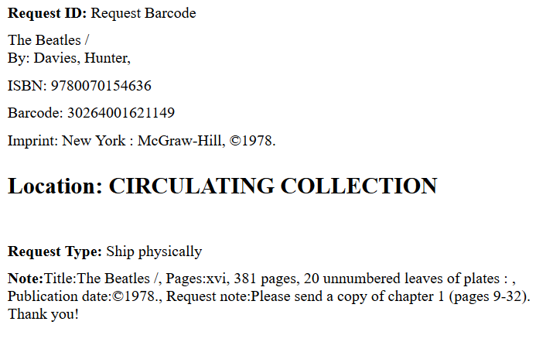
Filling Lending RS Requests Digitally
Current use scenarios:
Book chapter requests (chapter information will be in notes field)
Article requests that were mislabeled as physical requests
Items that have already been digitized or could be easily digitized (dissertations, government documents, microfiche, etc.)
Possible future use scenario:
E-books
Many issues still need to be worked out with vendors

Slide 6
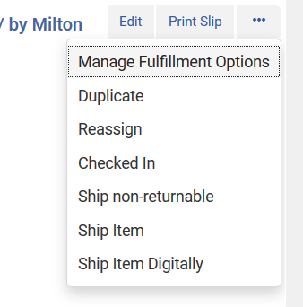
Filling Lending RS Requests Digitally
Save file to your PC
File name doesn’t matter
Click Ship Item Digitally link
Pop-up will appear
Document Delivery interface will open
Upload file and click Send
You can either browse for file or drag and drop
Possible to send any file type, including .zip
Cannot send multiple files
Borrowing user will receive download link via email (Document Delivery Notification Letter)
Download link cannot be shared
Request will be automatically completed and item will be removed from Pick From Shelf list

Slide 7
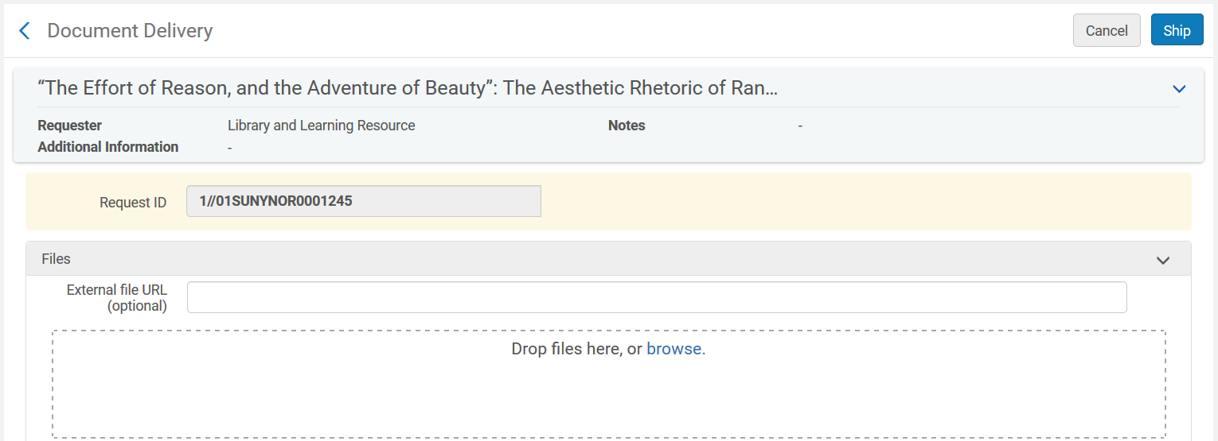
Filling Lending RS Requests Digitally

Slide 8
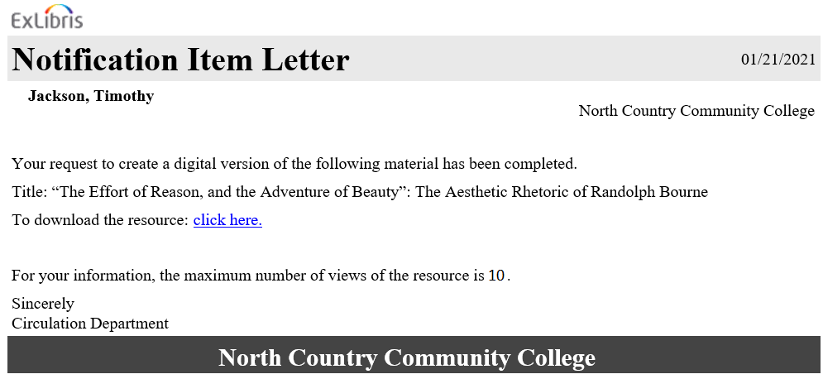
Filling Lending RS Requests Digitally

Slide 9
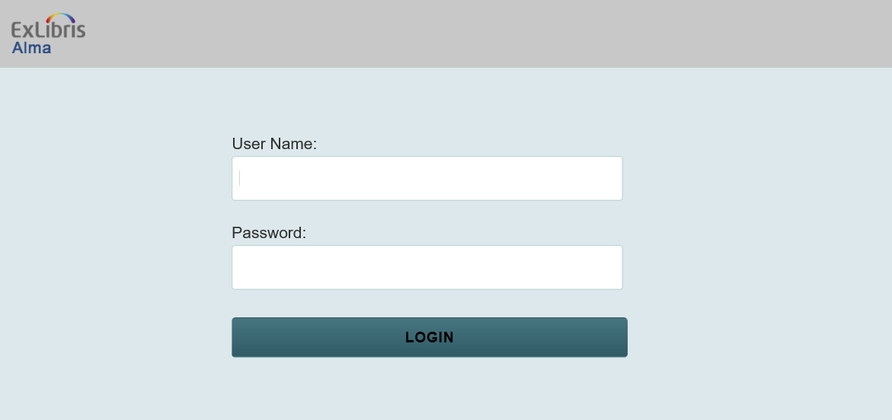
Filling Lending RS Requests Digitally

Slide 10
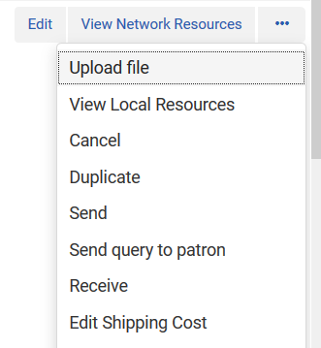
Filling Borrowing RS Requests Digitally
Current use scenario:
Requests being exported to ILLiad that could be filled digitally
Possible future use scenario:
RS with non-SUNY libraries
Click Upload File link
Document Delivery interface will open
Upload file and click Send
Borrowing user will receive download link via email (Document Delivery Notification Letter)
Request will be automatically completed

