Slide 1


Setting It Up Example: Google Scholar
In Alma, go to Resources > Publishing > Publishing Profiles
Select Edit from the ellipsis menu next to the “Publish electronic records to Google Scholar” profile
Under Registration Parameters, enter your LibKey Link URL in the OpenURL base field
Save
Google Scholar may take 10 to 14 days to populate
www.suny.edu

Slide 2
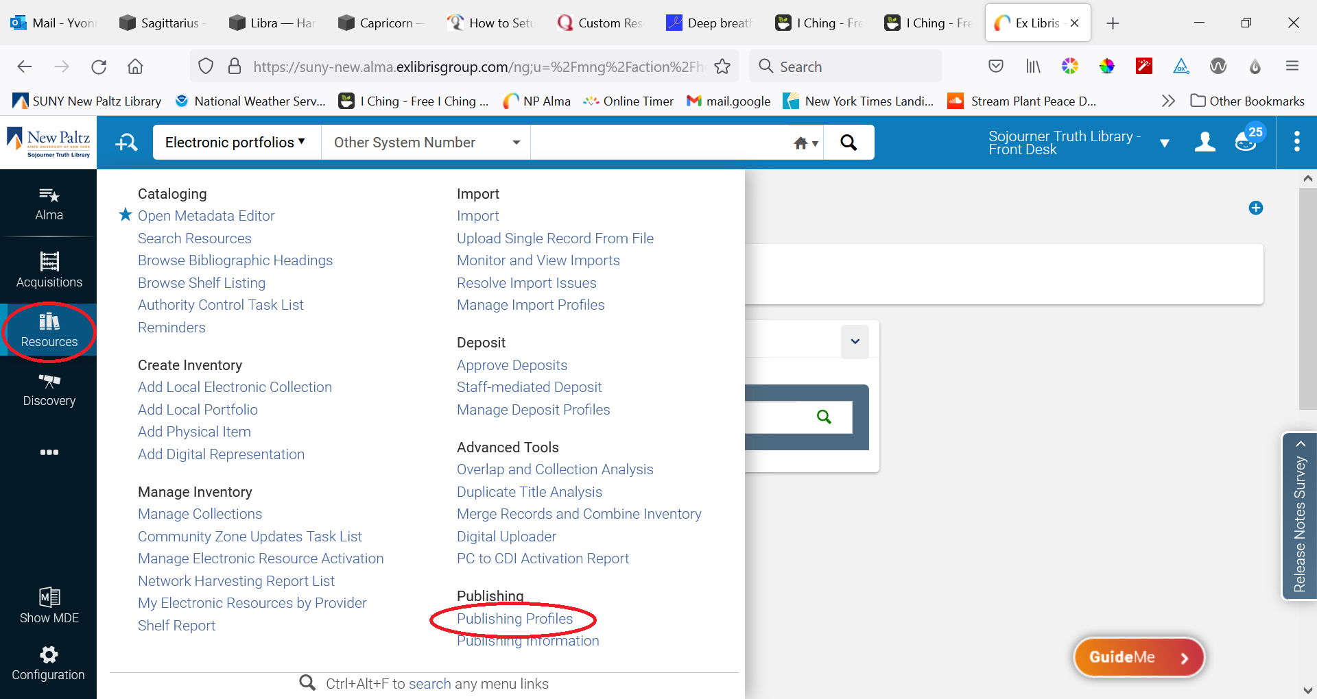
Setting It Up Example: Google Scholar
www.suny.edu

Slide 3
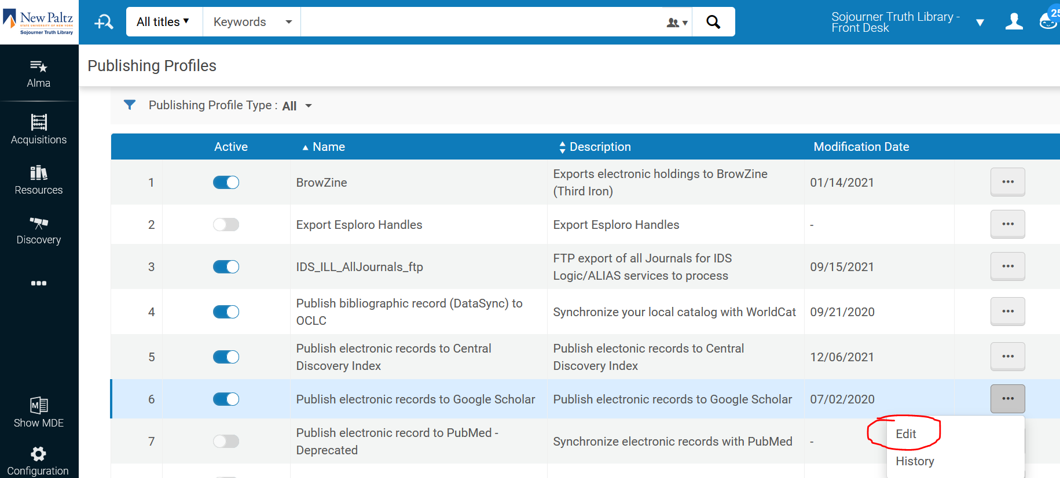
Setting It Up Example: Google Scholar
www.suny.edu

Slide 4
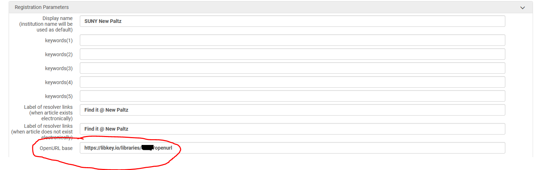
Setting It Up Example: Google Scholar
www.suny.edu

Slide 5
Setting It Up Example: ScienceDirect
You will need access to the Elsevier Admin Tool
On the Admin Tool home page, click on ScienceDirect
Under Linking, click Link resolvers
Under Available Link Resolvers, check to see if any are Enabled
If any Link Resolver other than OpenURL-OpenResolver-Standard is enabled, open it and disable it, Save.
Click on OpenURL-OpenResolver-Standard, enable it, and paste your LibKey Link URL in the Link Resolver base URL field
Save
It takes *15 days* for these changes to take effect
www.suny.edu
Notes:
(Elsevier mistakenly enabled the OpenURL-ArticleLinker-Standard for New Paltz, and we kept getting an error saying we weren’t a Serials Solutions client)

Slide 6
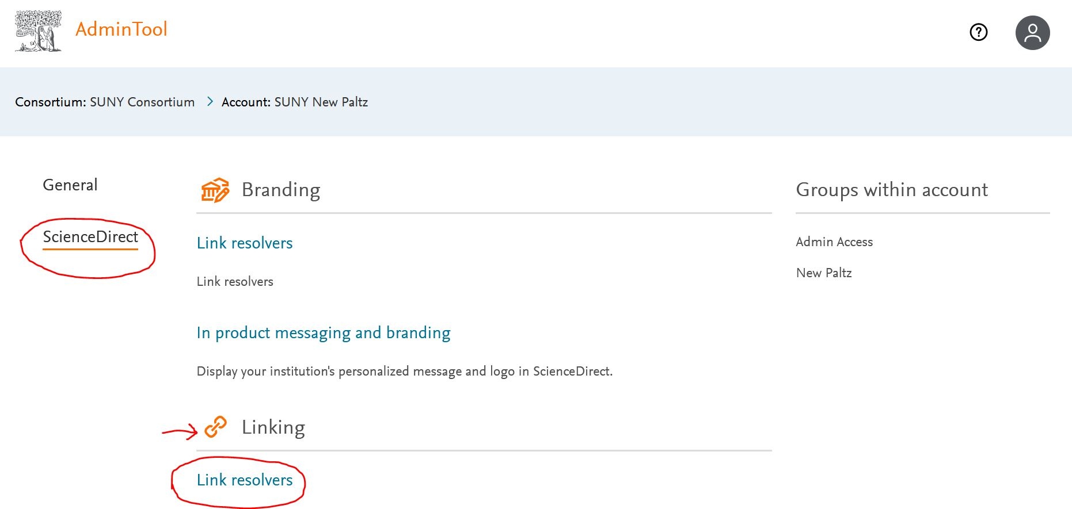
Setting It Up Example: ScienceDirect
www.suny.edu

Slide 7
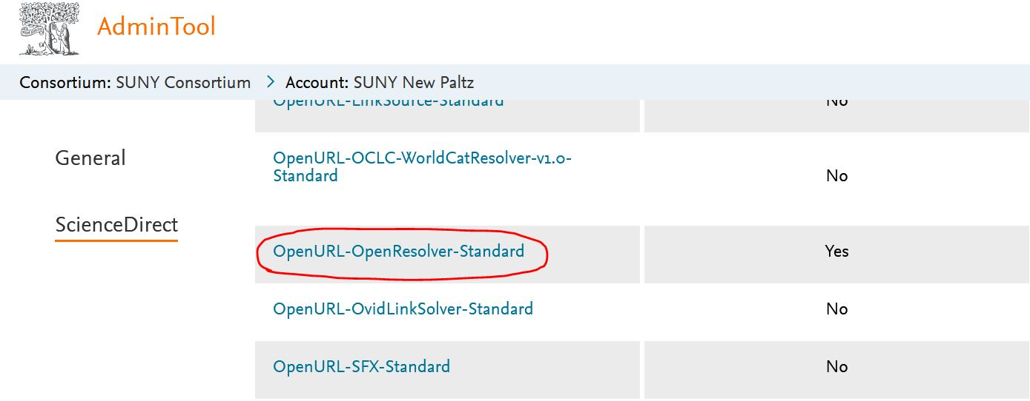
Setting It Up Example: ScienceDirect
www.suny.edu

Slide 8
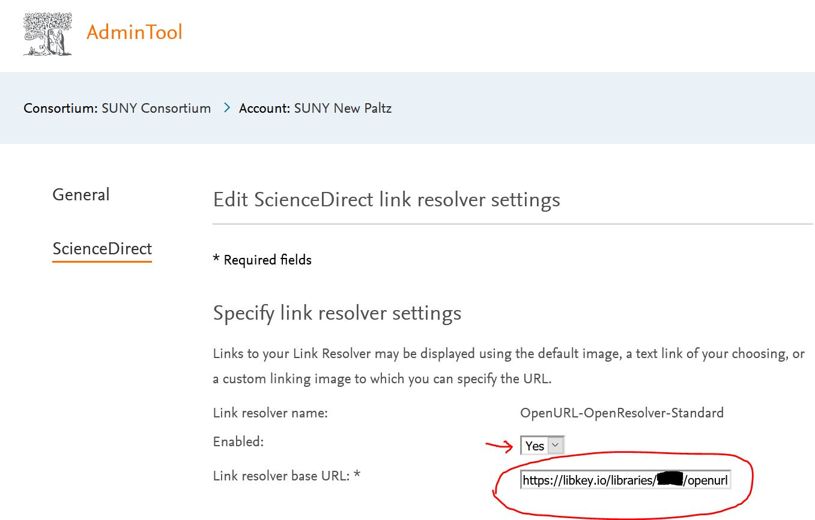
Setting It Up Example: ScienceDirect
www.suny.edu

Slide 9
Setting It Up Example: ProQuest
Log in to ProQuest Administrator Module at https://admin.proquest.com
Click on Linking In/Out on the left side of the page.
Click on Link Resolvers and Custom Resource Linking.
Under Create Your Own Custom Link, click “Add a new custom link”
Name the link “LibKey Link” or something you will recognize
Paste the template below into the URL box: make sure to add your library ID
  Note that the template ThirdIron provides is sufficient—you don’t need to select variables
Checkmark "Enable this custom link" near the top of the page.
Click to Save Changes
URL Template:
https://libkey.io/libraries/{Third Iron Library ID}/openurl?genre=<GENRE>&au=<AUTHOR>&aulast=<AULAST>&issn=<ISSN>&isbn=<ISBN>&title=<TITLE>&jtitle=<JTITLE>&pubname=<PUBNAME>&btitle=<BTITLE>&atitle=<ATITLE>&volume=<VOLUME>&issue=<ISSUE>&spage=<SPAGE>&date=<DATE>&doi=<DOI>&sid=ProQuest
www.suny.edu
Notes:
URL template comes from: https://support.thirdiron.com/knowledgebase/articles/1948078-how-to-add-libkey-link-to-several-popular-database

Slide 10
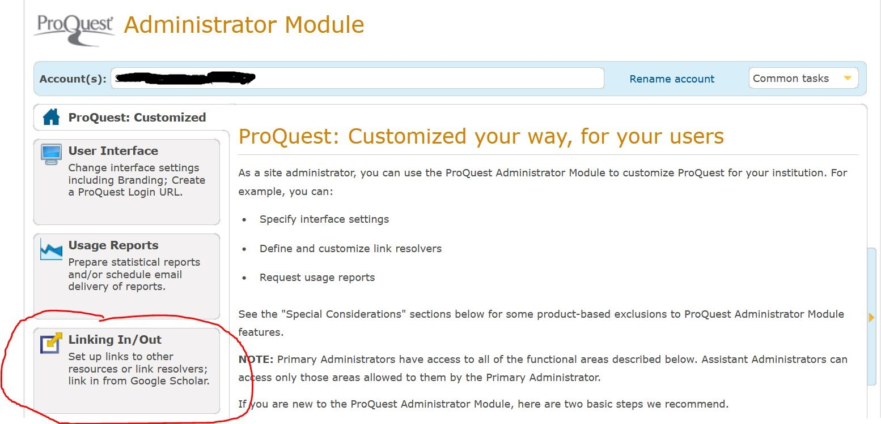
Setting It Up Example: ProQuest
www.suny.edu

Slide 11
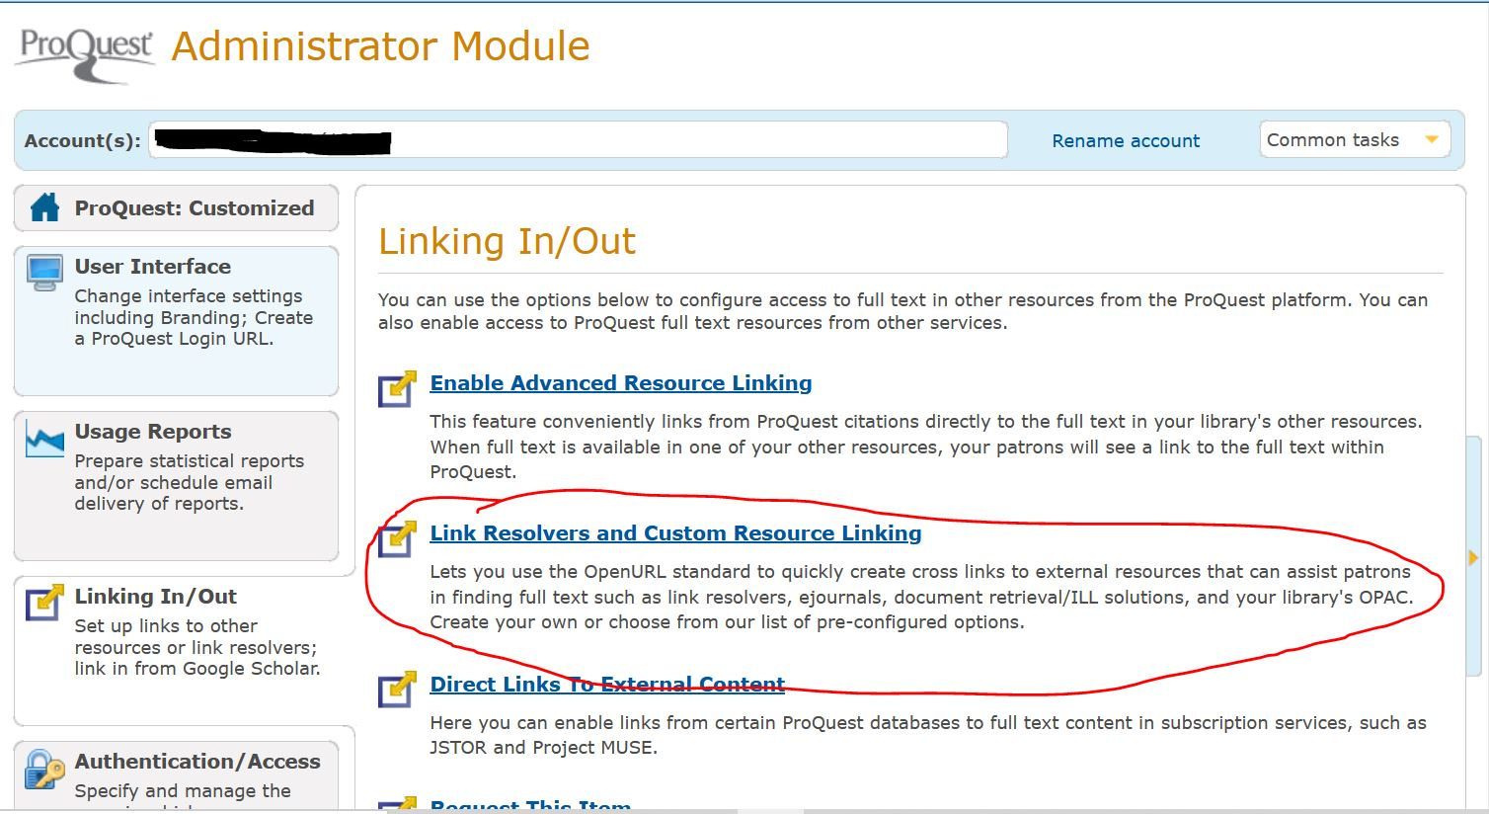
Setting It Up Example: ProQuest
www.suny.edu

Slide 12
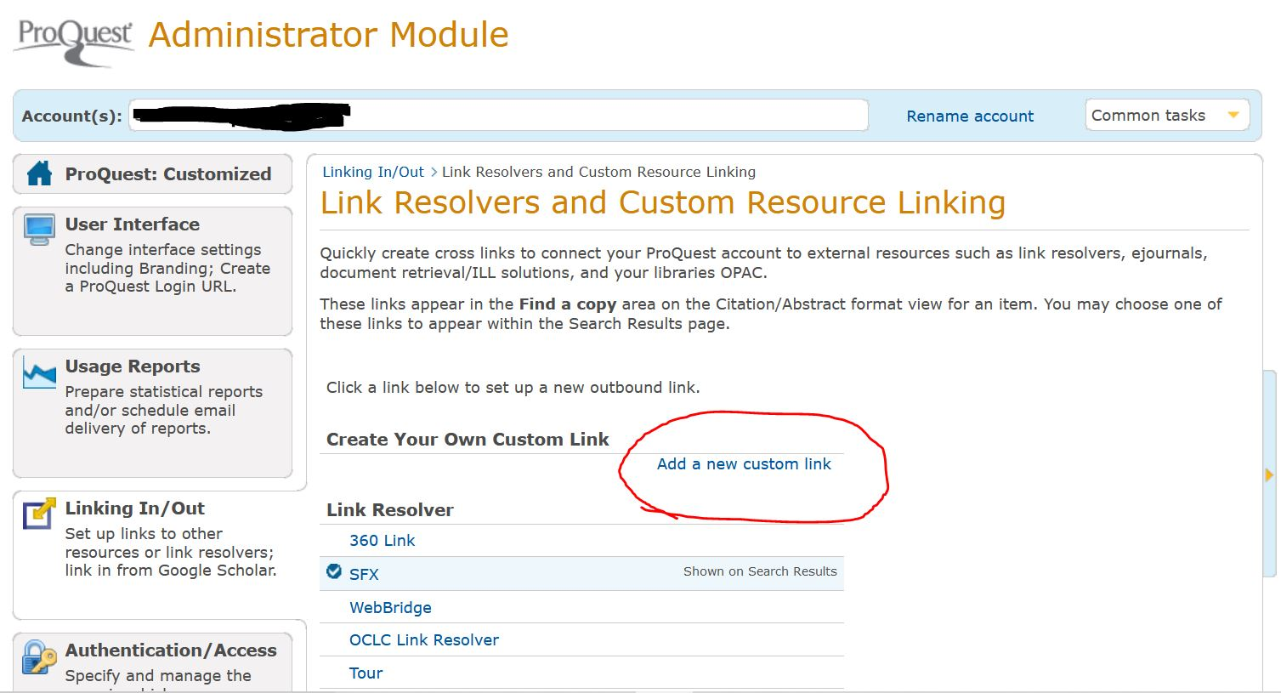
Setting It Up Example: ProQuest
www.suny.edu

Slide 13
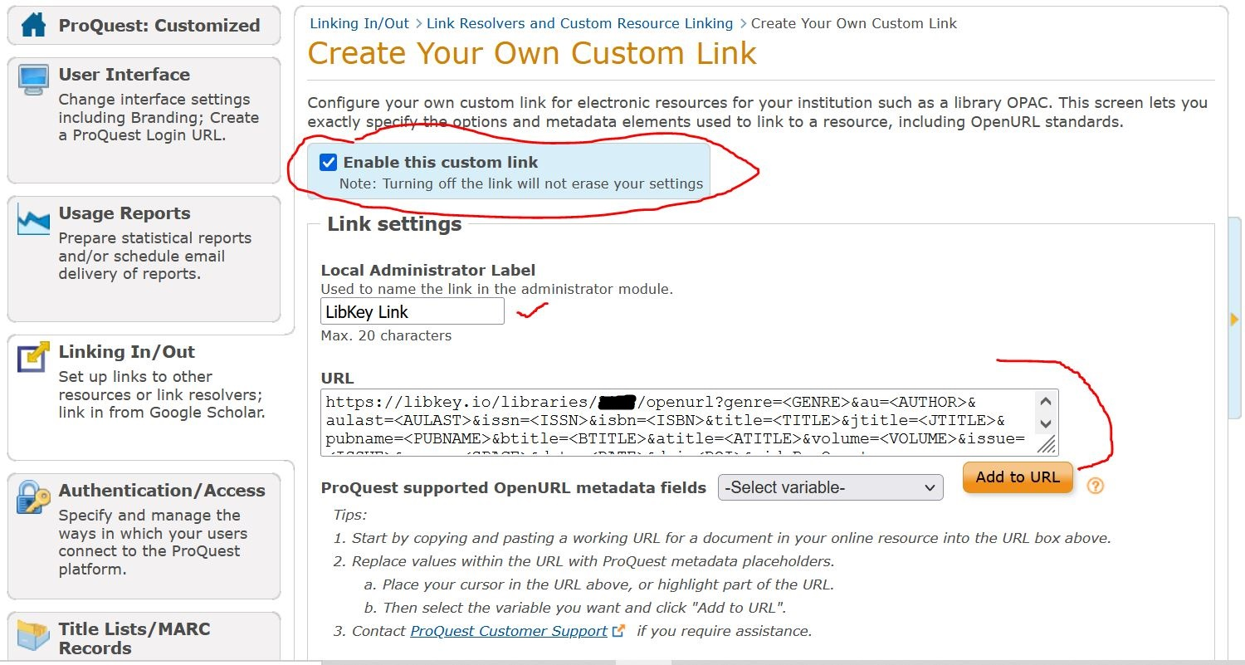
Setting It Up Example: ProQuest
www.suny.edu

Slide 14
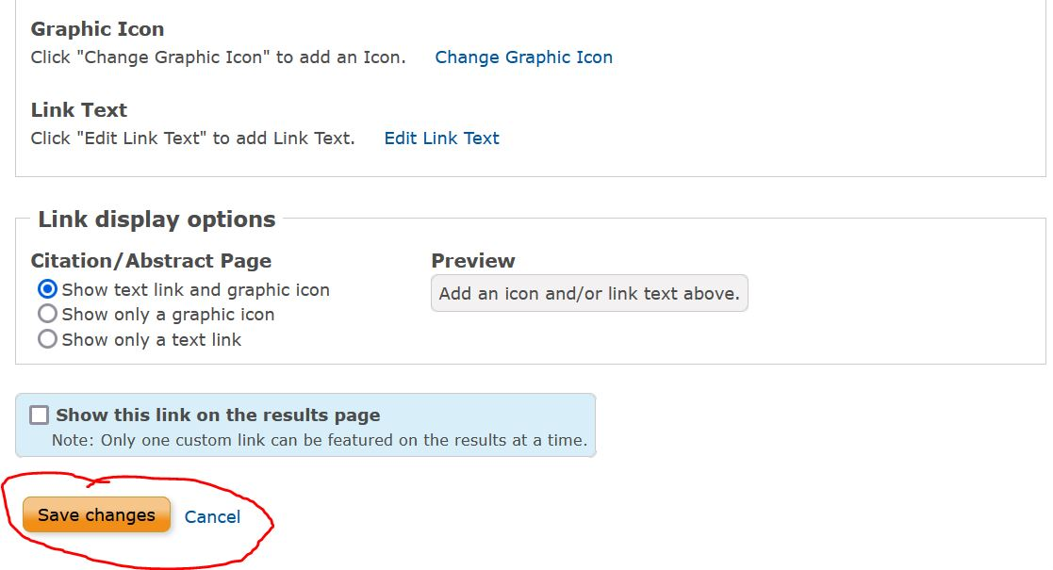
Setting It Up Example: ProQuest
www.suny.edu

Slide 15
Setting It Up Example: EBSCO
Log in to EBSCOAdmin
Go to Customized Services, choose your appropriate group (for most it will be a main user group)
Choose the EBSCOhost Web (ehost) profile
Switch to the Linking tab
Click on Custom Links: Modify
Click SetUp/Maintain CustomLinks
Click Add New CustomLink
Choose Copy from existing CustomLink and Continue
Choose Category Full Text and show my CustomLinks
Click on your Alma link resolver link (it should show Managed By “Self”—if it isn’t, please contact info@slcny.libanswers.com so we can help)
When the Copy CustomLink window opens, replace the Link Name with LibKey link resolver and the Base URL with your LibKey link base URL
Click Submit
www.suny.edu

Slide 16
Setting It Up Example: EBSCO
To add your newly created link to your list of CustomLinks:
Click Back to Customize Services
Click Add New Custom Links
Scroll to find your new link and click Submit
Be sure to remove your Alma link resolver CustomLink from the list
www.suny.edu

Slide 17
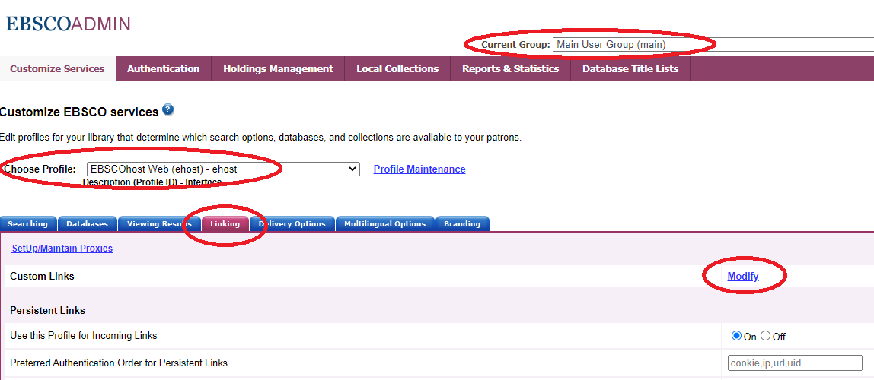
Setting It Up Example: EBSCO
www.suny.edu

Slide 18
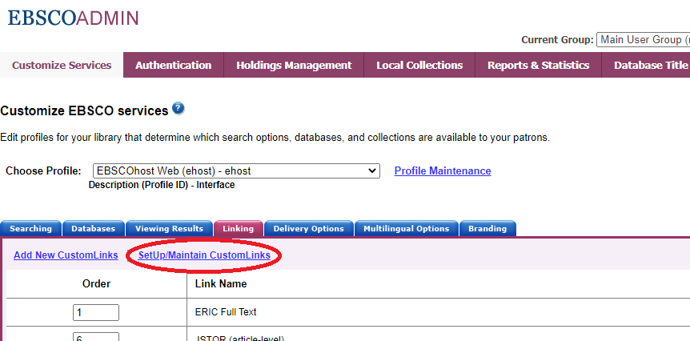
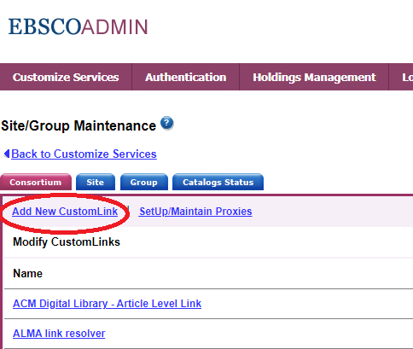
Setting It Up Example: EBSCO
www.suny.edu

Slide 19
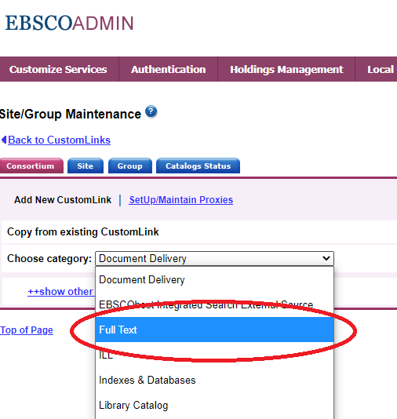
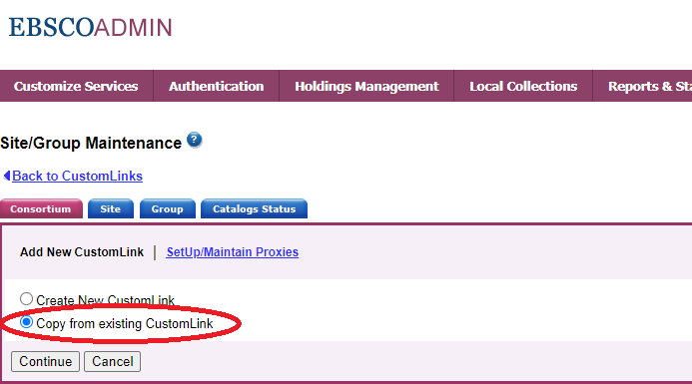
Setting It Up Example: EBSCO
www.suny.edu

Slide 20
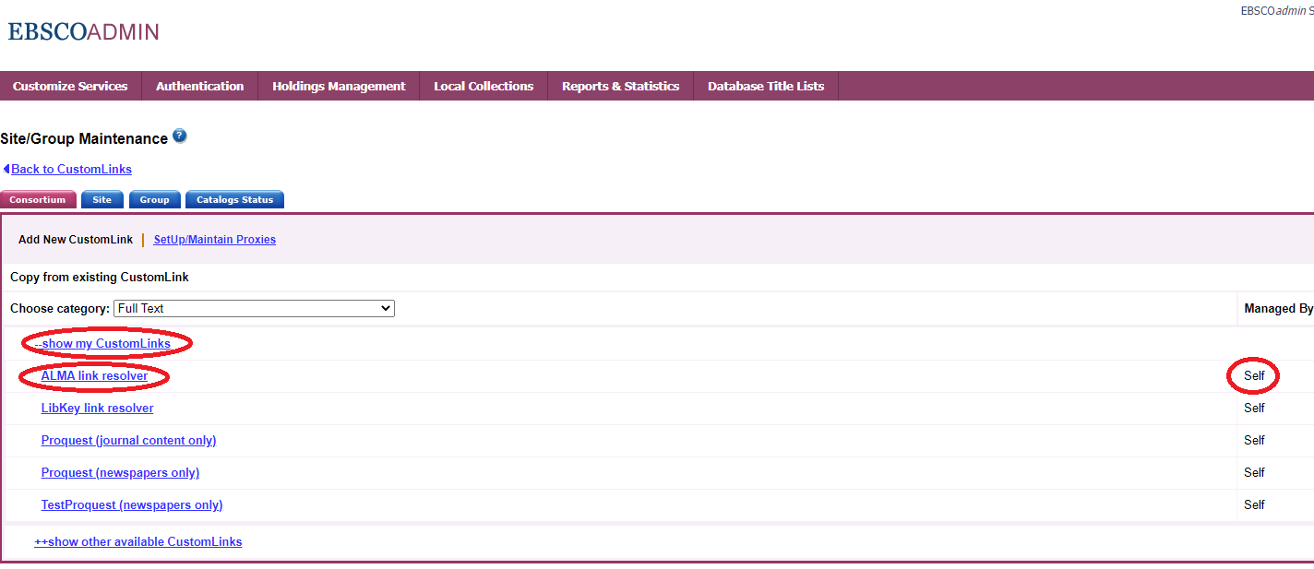
Setting It Up Example: EBSCO
www.suny.edu

Slide 21
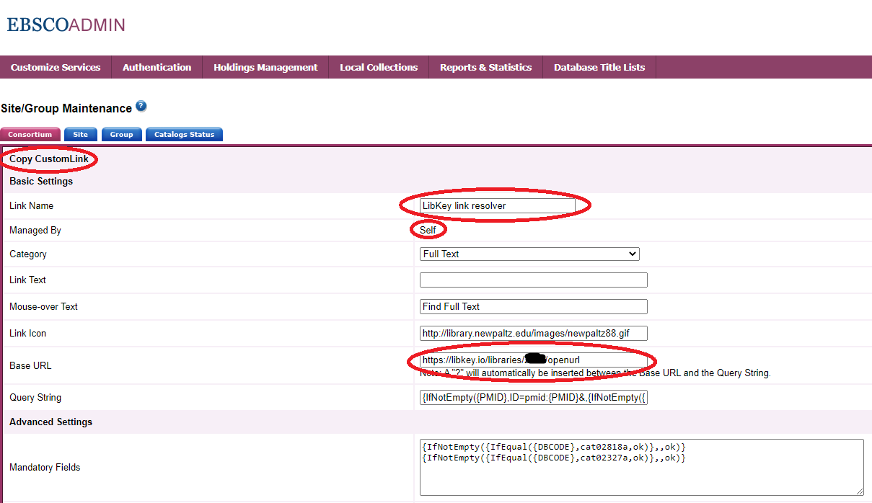
Setting It Up Example: EBSCO
www.suny.edu

Slide 22
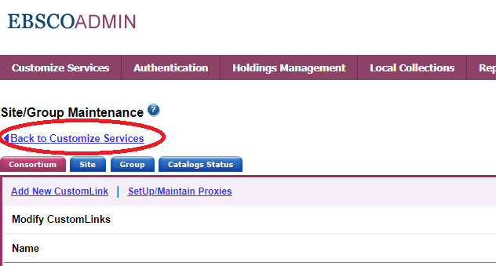
Setting It Up Example: EBSCO
www.suny.edu

Slide 23
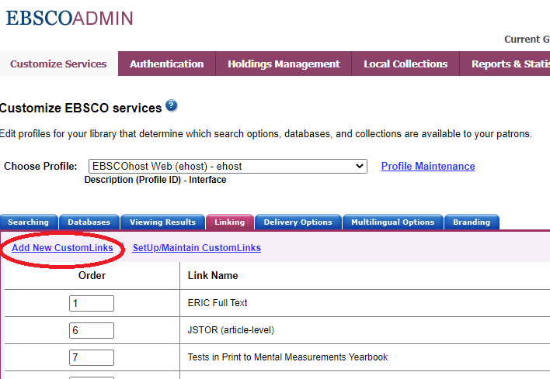
Setting It Up Example: EBSCO
www.suny.edu

Slide 24
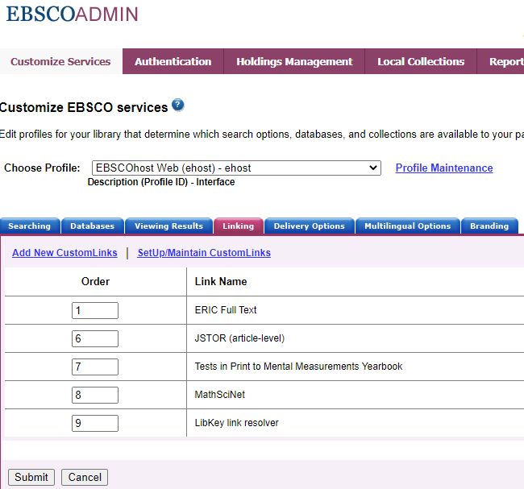
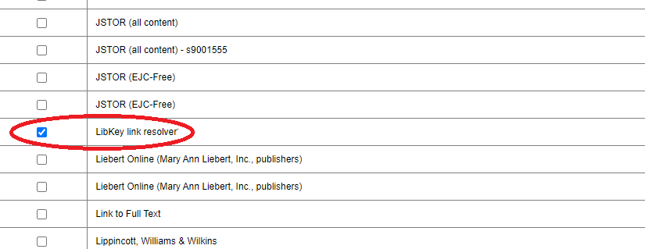
Setting It Up Example: EBSCO
www.suny.edu

Slide 25
Helpful Links
Sign up for LibKey Link and LibKey.io
LibKey Link 2.0 Technical FAQ
LibKey.io Technical FAQ
LibKey Link in Common Databases
Supported Publishers
www.suny.edu

Slide 26

The State University of New York
Questions? Comments?
Thank you!
www.suny.edu

