Slide 1
Pediatric Weight Management ECHO® Session Topic: Empowering Parents
Presenter(s): Sarah Hagin, PhD
Date: March 16th 2023
PLEASE NOTE: Project ECHO case consultations do not create or otherwise establish a provider-patient relationship between any clinician and any patient whose case is being presented in a project ECHO setting
Start the Recording

Slide 2
Welcome
This session will be recorded for educational and quality improvement purposes
Please do not provide any protected health information (PHI) during any ECHO session
Introduce Yourself
Microphones
Agenda
Please turn on your video
Please enter your name and organization in the chat box
Please mute your microphone when not speaking
Introduction
Lecture
Case
Close
Discussion

Slide 3
CME Credits (currently available for MDs, PAs, Rx, RNs, NPs, PsyD, PhD)
CME Credits – Please request session credits when filling out the evaluation at the end of the meeting.
Evaluation/Credit Request Form: https://www.surveymonkey.com/r/PediWtMgmtCMEEvaluation
The AAFP has reviewed ‘Advancing Community-Oriented Comprehensive Primary Care Through Improved Care Delivery Design and Community Health,’ and deemed it acceptable for AAFP credit. Term of approval is from 09/15/2022 to 09/15/2023. Physicians should claim only the credit commensurate with the extent of their participation in the activity.
NPs and RNs can also receive credit through AAFP’s partnership with the American Nurses Credentialing Center (ANCC) and the American Academy of Nurse Practitioners Certification Board (AANPCB).
Notes:
Linda

Slide 4
Agenda
Time | Topic | Presenter
7:30 – 7:35 AM | Welcome & Introductions | Linda & Liz
7:35 – 8:00 AM | Didactic: Empowering parents | Sarah Hagin, PhD
8:00 - 8:10 AM | Case Presentation | Dr Beth Lange, Waterman Pediatrics
8:10 - 8:25 AM | Discussion | All
8:25 – 8:30 AM | Wrap up; Evaluation; Announcements | Linda
Notes:
Liz Introduce Vania

Slide 5
Today’s Faculty
Sarah Hagin, PhD, is a pediatric psychologist in the Division of Child and Adolescent Psychiatry at Rhode Island and Hasbro Children’s Hospitals, specializing in pediatric gastrointestinal and feeding disorders, an Assistant Professor in the Department of Psychiatry and Human Behavior at The Warren Alpert Medical School of Brown University, and the program manager for the Pediatric Psychiatry Resource Network (PediPRN) at Bradley Hospital.

Slide 6
Disclosures
Session presenters have no financial relationships with a commercial entity producing healthcare-related products used on or by patients. If CME credits are offered, all relevant financial relationships of those on the session planning committee have been disclosed and, if necessary, mitigated.

Slide 7
Learning objectives
Understand different types of caregiver feeding styles and how these styles are associated with child growth
Understand the importance of caregiver involvement in weight management interventions for children
Utilize strategies and resources to support caregivers developing authoritative feeding styles throughout the child’s development

Slide 8
Common Caregiver responses to conversations about child weight management
Ask participants to generate their own

Slide 9
Parenting feeding styles
Journal of the American Heart Association. 2020;9:e014520
Notes:
the indulgent/permissive style is most consistently linked with poorer dietary patterns and elevated weight status in early childhood,⁶ suggesting that in early childhood, responsiveness in the absence of demandingness confers risk for unhealthy eating and weight outcomes. In a longitudinal study combining observational and self-report measures of general parenting style, children experiencing a permissive/indulgent parenting style at age 4.5 years were most likely to be at risk for subsequent elevated weight outcomes.⁵²

Slide 10
Authoritarian
DOI: 10.1159/000499145

Slide 11
Indulgent
DOI: 10.1159/000499145

Slide 12
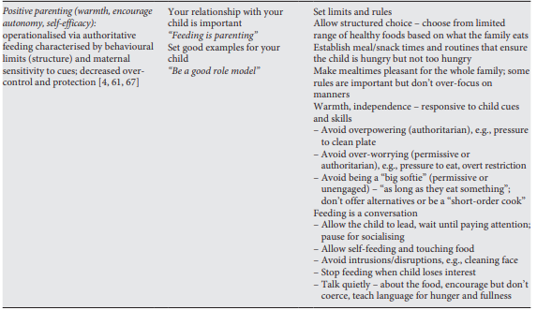
Authoritative
DOI: 10.1159/000499145

Slide 13
Caregiver accommodation/indulgent practices
2 main forms
Participation
Modification
Why caregivers accommodate
To reduce child’s distress
Esp in response to aggression
Worry/harm-reduction
Maintain/improve child/family functioning
Parents childhood experience
Protect child’s childhood experience
Support child listening to their body cues
Caregivers are often unaware of their accommodation responses
Responsivity to child needs/distress is innate

Slide 14
Consequences of accommodation
Reduces self-regulation
Poor insight into cues
Reliance on food for soothing/regulation
Restricts development of feeding competence and autonomy
Food choices
Portion sizes
Meal structure/routines

Slide 15
Factors that contribute to accommodation responses and parent feeding styles
Child characteristics
Children vary widely in eating self-regulation
Strong environmental influence
Child mental health
Food insecurity
Caregiver stress/work demands
Inconsistency across caregivers
Caregiver/family mental health
Cultural
Journal of the American Heart Association. 2020;9:e014520
Notes:
Early research (primarily observational) indicated eating self-regulation is present from birth. However it has also been observed that children vary widely in the extent to which they demonstrate eating self-regulation (49-75%). (BMI inversely associated with parent education) Bottomline: evidence of heritability suggests inherent individual differences in child eating self-regulation BUT does not negate the potential for caregivers to shape/moderate the expression of children’s eating tendencies.

Slide 16
Why family approach > individual approach
Authoritative feeding style benefits all family members
Supports development of self-regulation and autonomy
Provides routines, expectations, environments that promote healthy dietary patterns
Caregiver modeling has a significant impact on off-spring dietary behaviors
Evidence that caregiver dietary practices continue to influence youth eating behaviors into adolescence.
Evidence that family context has a significant impact on treatment engagement and outcomes
Evidence that individual focused treatment that directly encourages a child to lose weight may promote negative body self-esteem and disordered eating.
Caregivers are the mechanism of change (esp for younger children)
https://doi.org/10.1016/j.appet.2019.01.008
Journal of the American Heart Association. 2020;9:e014520
Notes:
https://doi.org/10.1016/j.appet.2019.01.008
Journal of the American Heart Association. 2020;9:e014520
Parents' diets and food parenting practices were consistent with their dietary behaviors. For their adolescents, parenting practices for FV consumption was positively related to adolescents' FV consumption, but parents/caregivers' rules/limits to avoid junk food/SSBs were positively related to adolescents’ junk foods and SSBs consumption.

Slide 17
Empowering caregivers - preventative
Review feeding styles and practices regularly
Support caregivers’ understanding of typical feeding behaviors as their child develops
Encourage authoritative feeding styles
Support problem-solving through socio-economic, cultural, familial factors that can be barriers to developing authoritative feeding styles
Ellyn Satter’s Division of Responsibility in Feeding

Slide 18
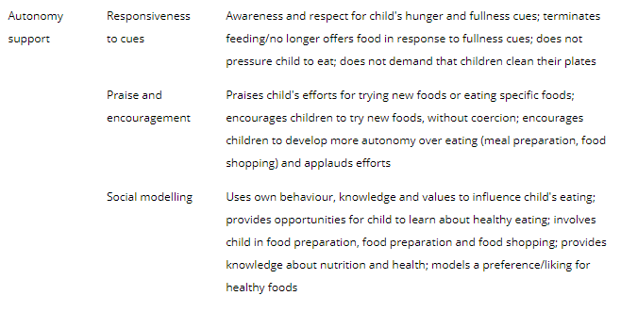
Positive caregiver feeding practices
https://doi.org/10.1111/ijpo.12722

Slide 19
Authoritative feeding
https://doi.org/10.1111/ijpo.12722
Notes:
Parental demandingness/structure and responsive/autonomy support are critical at every developmental stage (ie, there is a continuum of influence). Examples of developmentally appropriate positive food parenting practices reflecting overarching dimensions of demandingness/structure and responsiveness/autonomy support. Examples are illustrative and neither exhaustive nor limited to a particular stage. There may be cumulative impact of parenting, such that parenting at early developmental stages may continue to impact children at later developmental stages

Slide 20
Empowering caregivers - responsive
Validate and normalize accommodation responses
Provide education (with permission) on the patterns of accommodation and how it impacts their child’s health behaviors
Support development of non-food related coping/soothing strategies
Support making changes to accommodation responses
Pick on behavior to work on at a time
Communicate with the child about plan to change
Support problem-solving through socio-economic, cultural, familial factors that can be barriers to developing authoritative feeding styles
Use MI strategies and solution focused coaching to support communication with families

Slide 21
Contact information

Slide 22
Pediatric Weight Management ECHO® Case Presentation
Presenter(s): Elizabeth B. Lange, MD FAAP
Date: 3-16-23
Contact Info: elizlange@cox.net
PLEASE NOTE: Project ECHO case consultations do not create or otherwise establish a provider-patient relationship between any clinician and any patient whose case is being presented in a project ECHO setting
Prepared by Care Transformation Collaborative of RI

Slide 23
Reasons for Selecting this Case
Do Not Include PHI
Why did you choose this case? | This is a new patient to me.
What questions do you have for the group? | How do we build the relationship and gain the trust in just the first meeting to address obesity in a patient and a family?

Slide 24
Basic Patient Information
Do Not Include PHI
Age | 13
Gender Identity | male
Race/Ethnicity | Caucasian
Current Weight and Height 7/29/22 | Weight: 181.2 lbs Height: 65.25in
Current BMI and BMI%/Obesity class | 29.92 98th %ile
How long has the patient had concerning growth trends? | Age 5 BMI Crossed from 65th to 93rd %ile
How long has this individual been in your care? | First visit
Insurance type | Commercial

Slide 25
Patient presentation -
Do Not Include PHI
I first met this family in a sick visit.
Patient presented with all over abdominal pain and vomiting. No diarrhea. Appetite unchanged – eggs and toast for breakfast and stop at Dunkin en route to appointment for a second breakfast of wrap and large drink. Dad said they stopped because he was hungry.
Exam - diffusely tender abdomen with quiet bowel sounds – referred to ER
Labs reassuring – normal blood count (cbc), electrolytes (chem 7), inflammation slightly elevated (CRP 13.6).
Abdominal ultrasound – negative for appendicitis but noted liver had diffuse echogenicity in keeping with steatosis
Follow up – the abdominal pain continued for days, ultimately developing a fever. Repeat lab tests are elevated, suggesting significant infection (bands on cbc), and inflammation (CRP 99.6) and stool test (PCR) positive for infectious bacteria, causing this infection (enteropathogenic E. coli). He did lose 8 pounds with this illness.

Slide 26
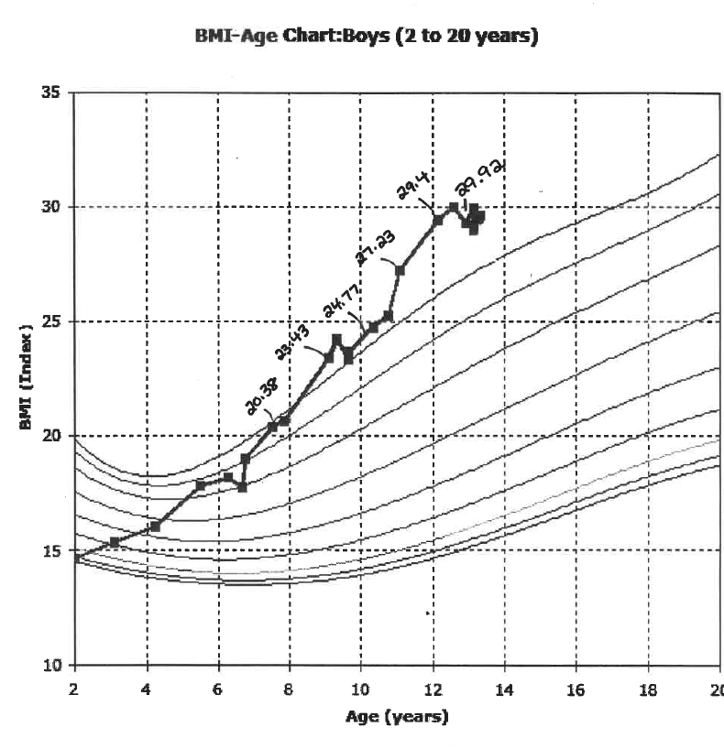
Growth Curve
Do Not Include PHI

Slide 27
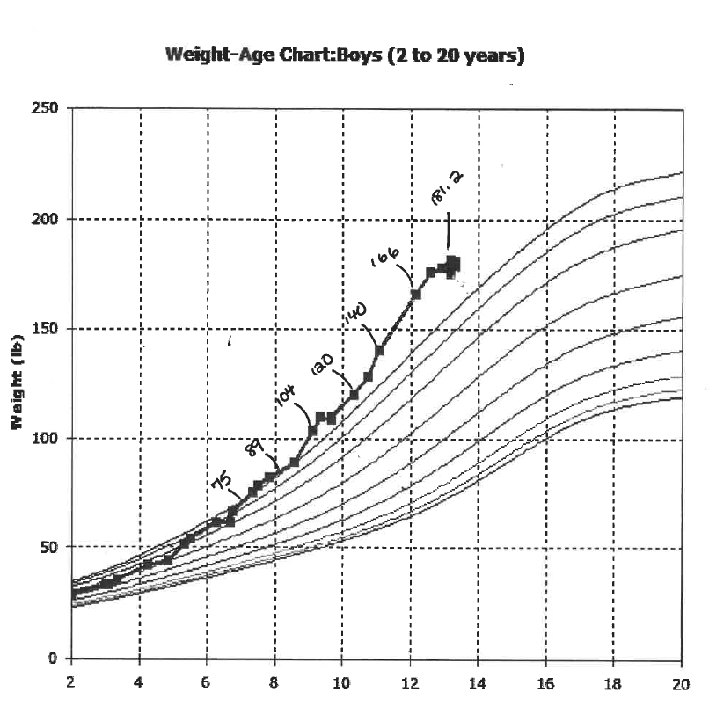
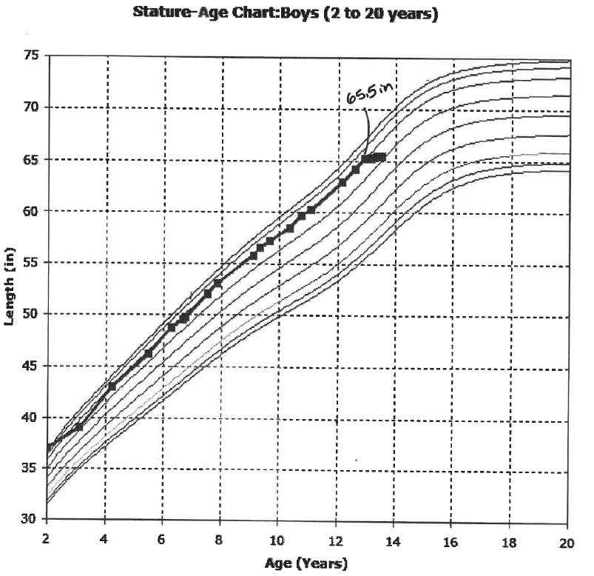
Growth Curve
Do Not Include PHI

Slide 28
Relevant Background
Do Not Include PHI
Relevant medical and/or behavioral comorbidities | ADHD
Relevant medications | Adderall
Relevant lab results | LFTs not done in this illness
Relevant BH Screening results | Counseling, not sure of clinical diagnosis, stopped the previous year
Relevant SDOH Screening results | none

Slide 29
Relevant Social History
Do Not Include PHI
Relevant obesity related family history? | All four members of this family are overweight/obese
Family/patient history of trauma? | Not known
School related concerns? | Not known
Other social history concerns? | Not known

Slide 30
Nutrition
Do Not Include PHI
What interventions have been tried? How responsive has the family been to nutrition interventions? | Follow up – at well child visit, 5 months after this illness visit, the family on their own made changes in their eating and exercise with the goal to healthier weights for everyone
What barriers have the family identified for improving nutrition? | Dedicated time and thought – the pandemic thru off everyone’s schedule
Does the patient have any of the following: Excessive hunger Night-time eating or binging Sneaking food Other | no
Other concerns with nutrition/eating (such as cultural considerations)? | Not known

Slide 31
Physical Activity
Do Not Include PHI
What interventions have been tried? How responsive has the family been to physical activity recommendations? | Since I just met the family, I am not aware of any work predating this sick visit
Does the patient engage in regular physical activity? (yes/no) Please describe | no
Is screen time a significant part of the patient’s social time? (yes/no) Please describe | no
Other concerns with physical activity/exercise (such as physical restrictions, access, environmental safety)?

Slide 32
Patient /Family Strengths?
Do Not Include PHI
Wonderful energy and “can-do” spirit
Warm, loving and respectful relationships within the family unit
Appreciation that healthy eating and exercise involves whole family
Commitment to being healthy
Comfortable with care staying in the medical home, even though I am a new pediatrician to the family

Slide 33
Summary & Clarifying Questions

Slide 34
Reasons for Selecting this Case
Do Not Include PHI
Why did you choose this case? | This is a new patient to me.
What questions do you have for the group? | How do we build the relationship and gain the trust in just the first meeting to address obesity in a patient and a family?

Slide 35
Recommendations from the group
• What to say when they come in with a huge Dunkin drink?
Sometimes asking permission to talk about weight/healthy weight can be an intro, especially for families you don’t know as well
Discuss alternatives, what else do they like?
Establish what they think is healthy or unhealthy
Re-visit how they’re implementing the preference/alternative foods and drinks
It's hard to talk about weight issues or other chronic problems during a sick visit, but asking permission can help
Using a personal example can be relatable to the family
Ex. My parenting style depends on my work schedule, a late night for parent at the office can mean pizza night
You're not going to be able to “do it right” every day, this can help family notice environmental factors, and keep them from feeling overwhelmed
Few parents have come in trying fad diets for their kids, this can move towards authoritarian style and unhealthy habits
Parents are modeling a more extreme option
Go over evidence for adults, there are few studies on effects for children, emphasize healthy eating and habits rather than restricting diets
Pediatrician’s own feeding and parenting styles can impact these conversations - important for pediatricians/providers to be informed of research/best practices
Notes:
IBH Clincian involved?

Slide 36
CME Credits (currently available for MDs, PAs, Rx, RNs and NPs)
Please provide us your feedback!
Evaluation/Credit Request Form: https://www.surveymonkey.com/r/PediWtMgmtCMEEvaluation
Please request CME credits when filling out the evaluation at the end of the meeting
The AAFP has reviewed ‘Advancing Community-Oriented Comprehensive Primary Care Through Improved Care Delivery Design and Community Health,’ and deemed it acceptable for AAFP credit. Term of approval is from 09/15/2022 to 09/15/2023. Physicians should claim only the credit commensurate with the extent of their participation in the activity.
NPs and RNs can also receive credit through AAFP’s partnership with the American Nurses Credentialing Center (ANCC) and the American Academy of Nurse Practitioners Certification Board (AANPCB).
Notes:
Linda

Slide 37
Announcements
Next Session: Thursday Apr 20th, 7:30-8:30am
Topic: Nutrition / Physical Activity Counseling - Doable Interventions in Primary Care
Presenter: Whitney Evans

