Slide 1
Is This Expected Behavior?
Decoding Primo VE
October 2, 2019
Michelle Eichelberger
Michelle.Eichelberger@suny.edu

Slide 2
Previous Discovery Systems
EBSCO Discovery System (EDS):
Local Bib records harvested once a week, harvest set up by OLIS, additions and deletions not synced immediately
Databases, eBooks, eJournals managed by library in EBSCOhost Admin
Searching defaulted to search both full-text and no full-text
Everything search was your OPAC content and local electronic holdings
Web Design: could make minimal changes to header, logo, display columns, footer, etc.
Record actions like send to, citations, printing, etc. managed by EBSCO
User accounts set up and managed by patron
Summon:
More flexible than EDS, more control, e-resources managed in 360 Link
Could do expanded or un-expanded default search

Slide 3
Primo VE
Local Bib records added and deleted: should see changes in 10-30 minutes BUT weekly availability cycle needs to run before you see changes in expand vs. Non-expanded view
Databases, eBooks, eJournals managed by you in Alma: you'll see brief bibs in 10-30 minutes but availability changes need weekly availability cycle [and weekend processing] and article/chapter level searching depends on PCI activation
Web Design: wide open. If you have code skills, you can change just about anything, and many changes don't require coding
Searching: defaults to search full-text only (un-expanded search)
Record actions like send to, citations, printing, etc. managed by YOU
User accounts set up and managed by YOU

Slide 4
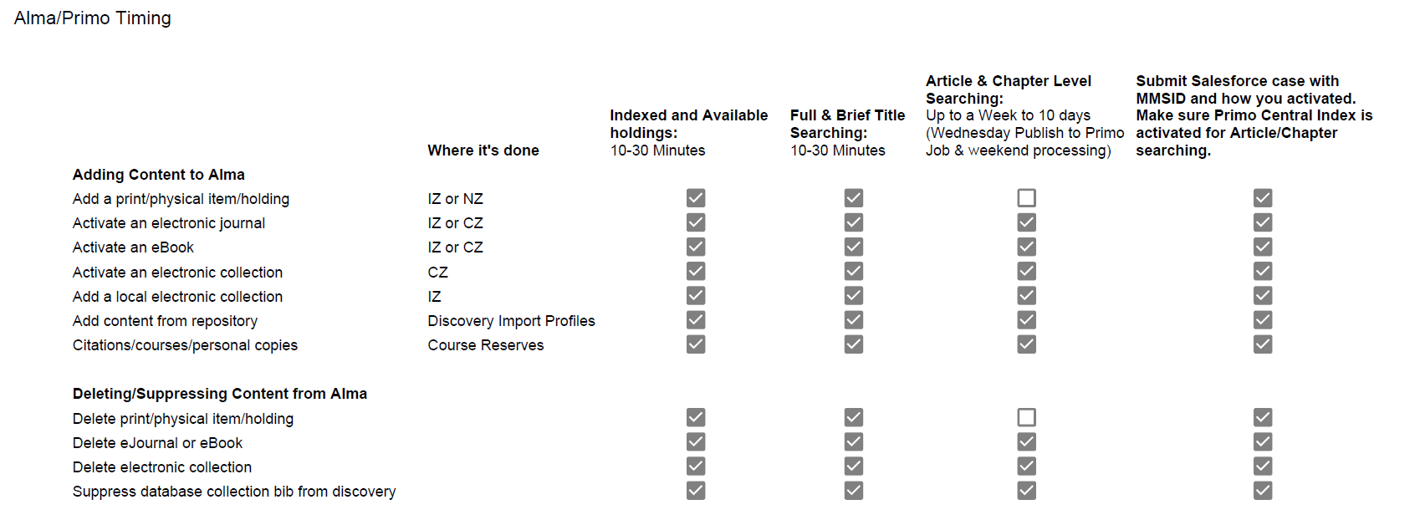
Expected Publishing Times

Slide 5
How Long Should Other Primo VE Actions Take?

Slide 6
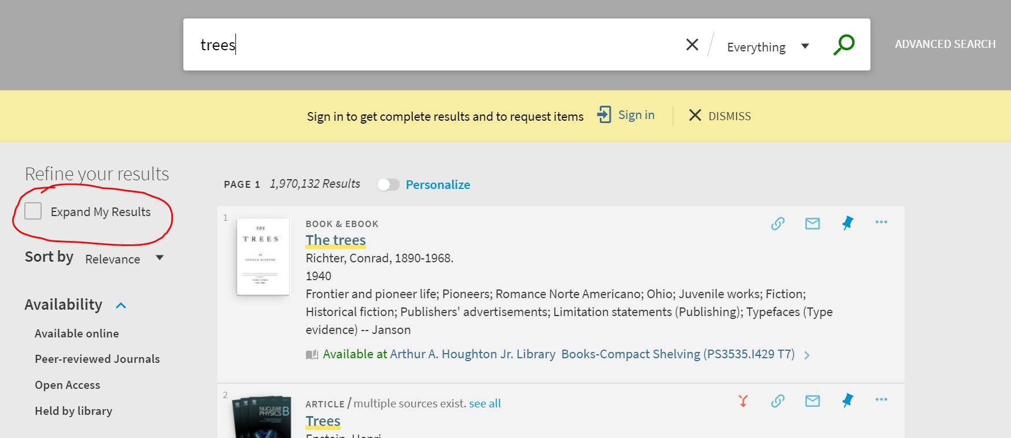
Searching Primo VE
The default search is unexpanded: it's searching only what Primo VE thinks that you own either physically or electronically. This is a major change from EDS.
Publish to Primo Central job runs on Wednesdays – you can see it in job history [and doesn’t get fully processed until after weekend] – time e-resource activation accordingly – Thursday is bad
Drawbacks:
Patrons may not notice expand search facet and may miss content
Decreased ILL activity
No "full-text" facet because it's defaulting to full-text
Note: Held by Library will limit to your holdings whether they're checked out or not

Slide 7
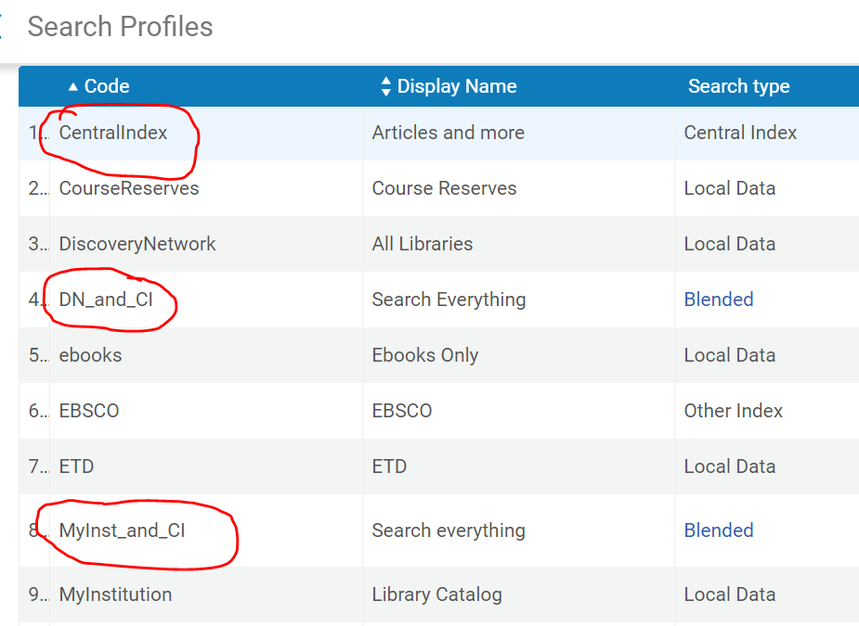
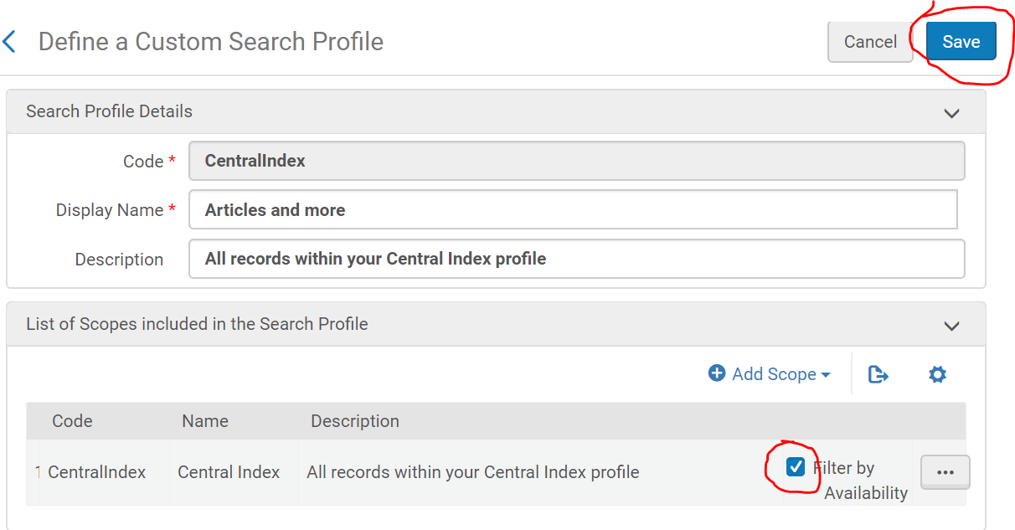
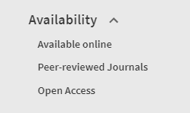
Changing Default to Expanded Search
Go to Config->Discovery->Search Configuration->Search Profiles
Look for any profile that includes the Central Index
Click on three dots to right of scope and edit, uncheck "Filter by Availability" box and save
Once you've set your search to default to all records, you'll still have the option to filter by Available Online (equivalent to full-text online)
FAQ: Change Default Search to Expanded

Slide 8
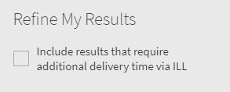
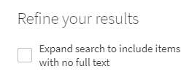
Changing Default to Expanded Search
Reasons you might not want to change your default search to Expanded Search:
Nancy Babb from UB: initially set to expanded and changed to unexpanded due to user feedback/complaints - if you have eBook or video collection activated in PCI, ALL records will show in expanded search and patrons can't get them via ILL.
Could increase work-load for local resource sharing staff
Hard to highlight your own content when SUNY content is added (Broome lost holdings facet, can't boost) – impact on instruction
Middle Path:
Amanda Hollister from Broome: Change "expand" facet wording to something more user-friendly

Slide 9
"Bad" Results
Some of the things you might find in Primo VE search results:
Excessive foreign language results
Dated results
Content that says available but when you go to get it, the link doesn't work
Records with limited or inaccurate metadata. Erin Rushton notes: "There are a few common culprits but Gale (Cengage Leaning) is particularly troublesome. For example, this week I reported problems (SF case 00731111) with book reviews from the "NYT Book Review" not opening correctly in Proquest. The records are from Gale."

Slide 10
"Bad" Results: Ways to Fix
The biggest thing that affects your search results is Open Access content in your Primo Central Index.
Ex Libris added by default
Could also have come into Alma via your link resolver
How do you find it and delete it? Slides 22-25 in this presentation
This FAQ lists the 9 Open Access collections approved of by MNPALS review team
Boosting:
As of the September 2019 Primo VE update, you now have the ability to boost by field, date, and resource type for local content
Caveat: it applies only to local records in Alma. Can't deboost indexed content from the PCI like book reviews, reference entries, etc.

Slide 11
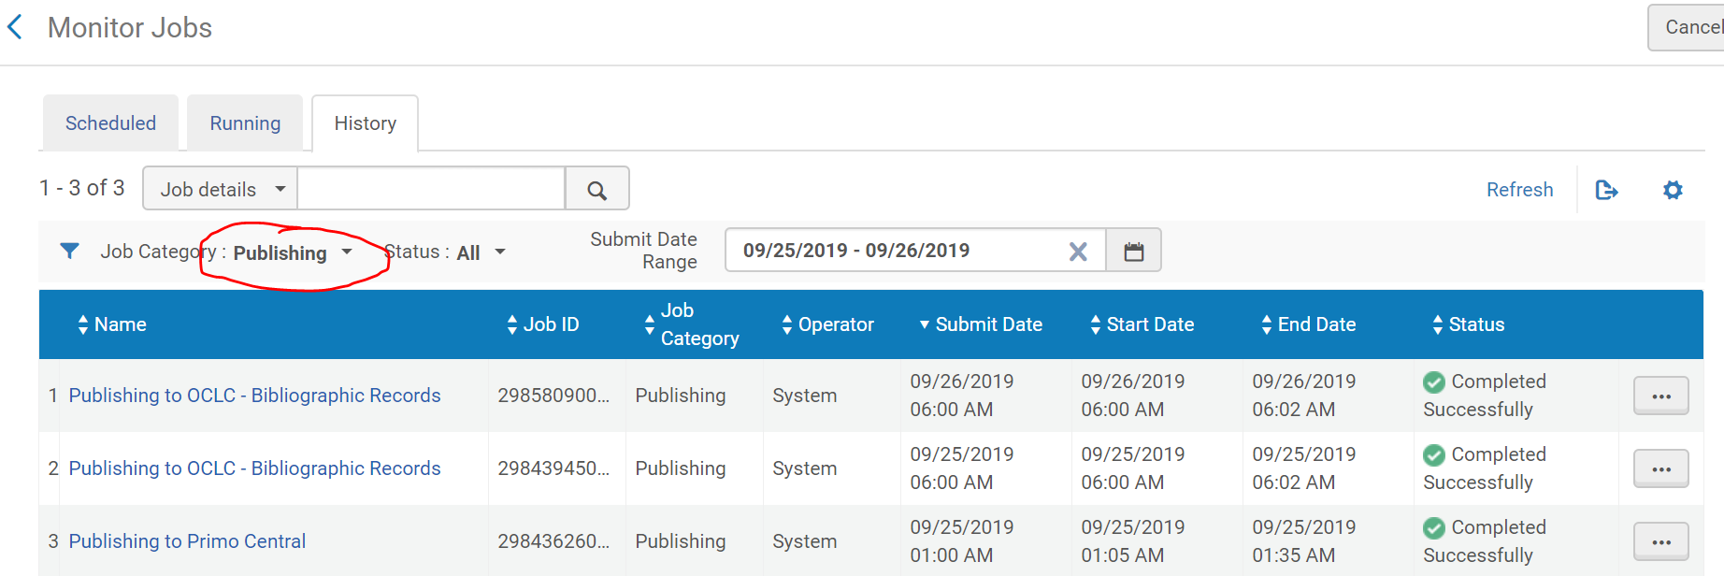
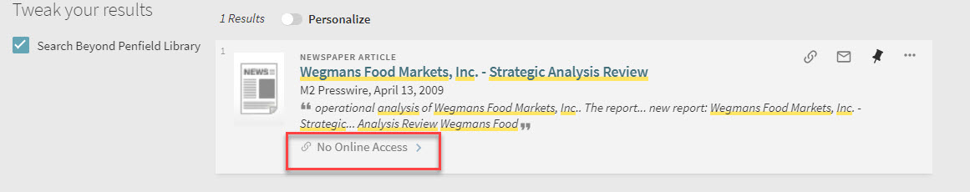
Searching: Other Tips
Availability:
When you activate an electronic resource Primo doesn't see that content as "available" until it's published to Primo Central once a week on Wednesday and then processed over the following weekend.
This can cause oddness in Primo because your patrons may see content that says "not available" in an expanded search, but when they open the record, they might get full-text links and No Online Access will switch to Online Access in results list
If content doesn't get published in a week to 10 days, submit a Salesforce ticket

Slide 12
Searching: Other Tips
Boolean Searching:
Cobleskill example: "Our instruction librarian would like to know why, in our "Other Libraries" scope (WorldCat + NZ Physical + unfiltered PCI) this search brings back "Cat in the Hat" as the 4th result: paraphimosis AND (feline OR cat)"
Search should work, but experimentation shows that it currently works better by breaking up sections in an Advanced Search
Facets & Truncation:
If you're seeing problems with your facets disappearing, try deactivating the Recently Added facet – it seems to help
Amanda Hollister from Broome: Primo VE: Vanderbuilt, Rutgers, Colorado School of Mines = search facets do not work with truncation but it works in Primo NUI - future enhancement?
Nancy Babb: Facet failure with truncation seems to be related to the number of characters stemmed c* = failed search (and that's known, not a problem) ca* and car* = failed facets cars* = everything's fine So 2-3 character stem fails the facets, but 4+ seems ok.

Slide 13
Searching: SUNY Catalog Sidebar
Everything search: what to include?
SUNY Catalog: Tim Jackson is seeing a large gap between Buffalo and everyone else in borrowing request volume. Their fill rate in Alma is about the same as everyone else’s but their borrowing volume is almost as high as the rest of SUNY combined. We think that this is because they include the SUNY Catalog in their Everything Search.
Each campus will need to find their own comfort zone in terms of making things discoverable for patrons but not too overwhelming
Pros are that content would be more easily discoverable, cons are that it muddies the water in terms of what you own, could increase ILL work-load and put lending strain on smaller campuses.
Related (sidebar sidebar):
Empire Shared Collection: can't easily add to Everything search because it's set up as a local scope – continuing to investigate the problem

Slide 14
Results List: Print Serials/Periodicals
One of the biggest questions about Availability is "Why does Primo VE show print serial/periodical results for articles that aren't included in your campus holdings date range?"
Answer: Primo VE can only tell what you own or don't own, it can't tell when you've gotten it or are getting it. It doesn't look at date coverage in your summary holdings or items.
In EDS you could fake out the system by loading a spreadsheet of your print titles and then setting them to link to your ILL article request form. This would cause your print journals to show up as a result in a link resolver Get Full Text pop-up.

Slide 15
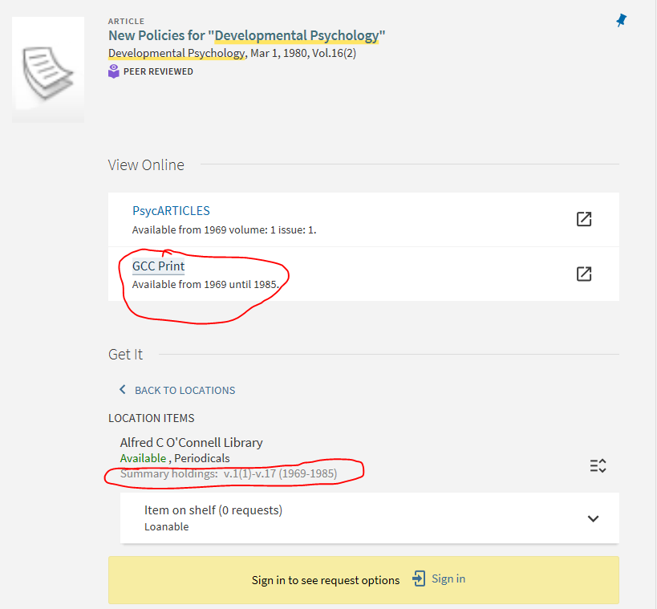
Print Serials/Periodicals Workaround
If you have mostly discrete coverage dates, eg. 1999-2008, for your print titles, you could create a similar "fake" print collection:
Retrieve a list of your print serial titles
Format it with the portfolio loader excel file format used during the in-person training for resource management
Follow the instructions used for loading the ScienceDirect file and create a collection called [Your Library] Print
Notes:
If you don't use specific dates for your coverage, this may not work for you. Things like "current 2 years" won't work, and it wouldn't match on Primo side
If you already have your summary holdings showing, this might not be useful for you
Linking is touchy: trying to get GCC Print link go to our ILLiad article request link but couldn't get it to work

Slide 16
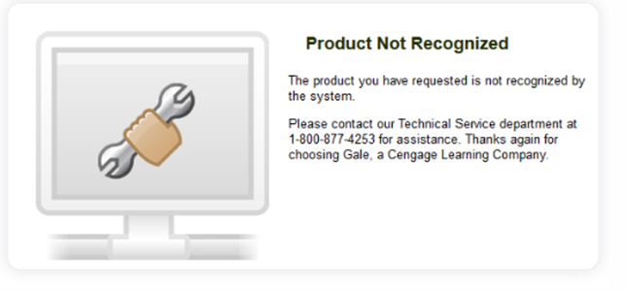
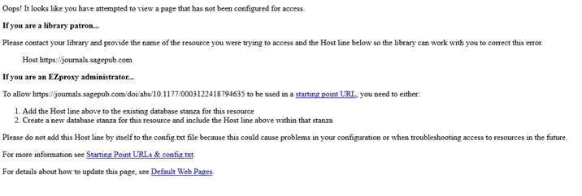
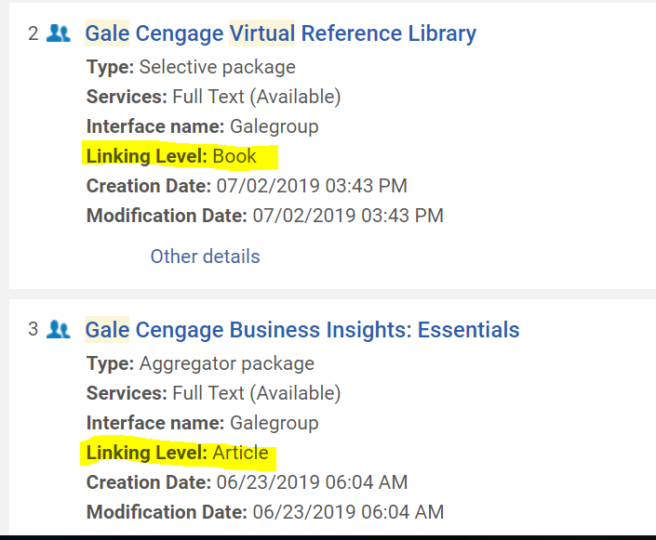
Linking
There are several ways that you can end up with bad links:
Your electronic collection in Alma is missing your identifying information (location_id, account number, etc. This happens most frequently with Gale, STAT!ref, and Proquest. Slide 20 in this presentation explains how to fix this problem.
Missing proxy information can also cause broken links. Slide 18 in this presentation has the fix.
OA content activated in the PCI can also give you false positive links. Give the bad link to your systems librarian and they can disable the collection in the PCI (take a week to apply).
Linking to eBook instead of chapter. This is expected behavior whenever the electronic collection is set to link at the book level rather than the chapter level. Activating the PCI collection will make the chapters searchable, but you won't be able to link directly to them.

Slide 17
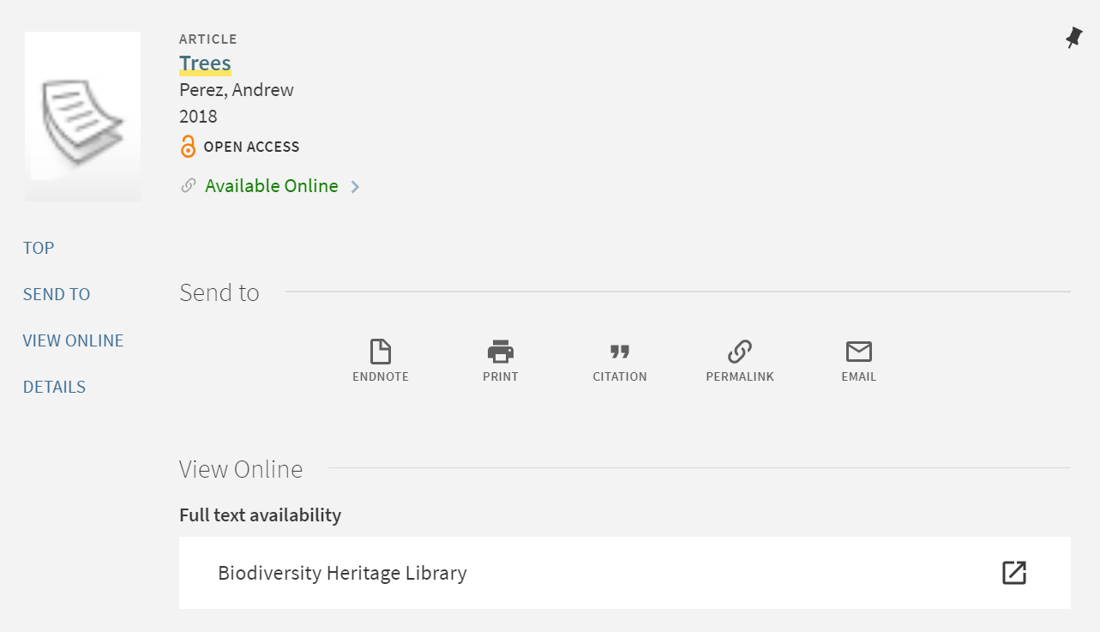
Record actions
You have control of Send To options
Can choose to hide, reorder, and select top three to show in brief results records
Note: Buffalo State has odd situation where sort order is backwards – don't be afraid to tinker with sort

Slide 18
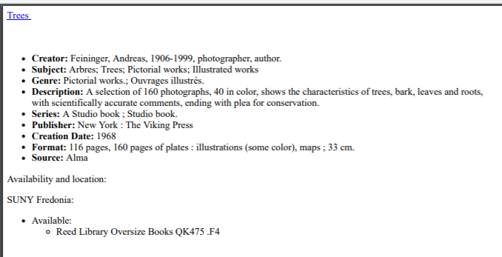
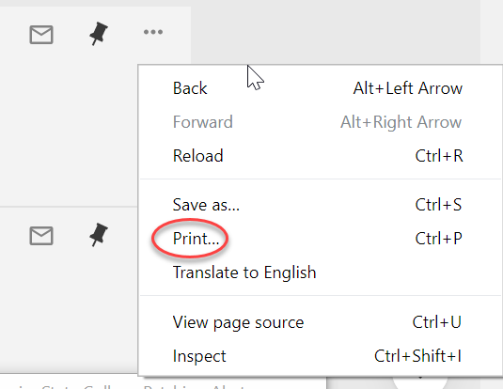
Record actions: Printing
Internal print button prints out full record with all details, which may not be what you want
Same thing happens if you pin a series of records and print all using Primo print button
You'll get better results if you just use browser print options
FAQ: What's the best way to print a list of results from Primo VE?

Slide 19
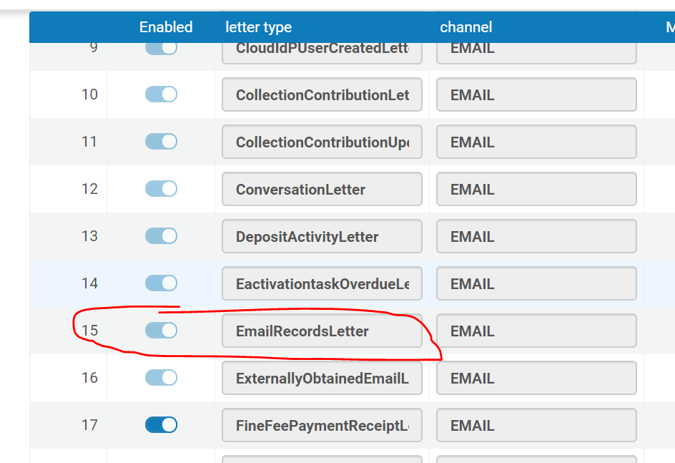
Record actions: Email
You can send records to an email address but in order to get this to work, you need to activate the Email Records letter in Alma Config
FAQ: How does the email function work in Primo VE and what do I do if it isn't working?
Related: there have been reports of Saved Searches being sent out to patrons with the same titles multiple weeks. It could be indexing related.

Slide 20
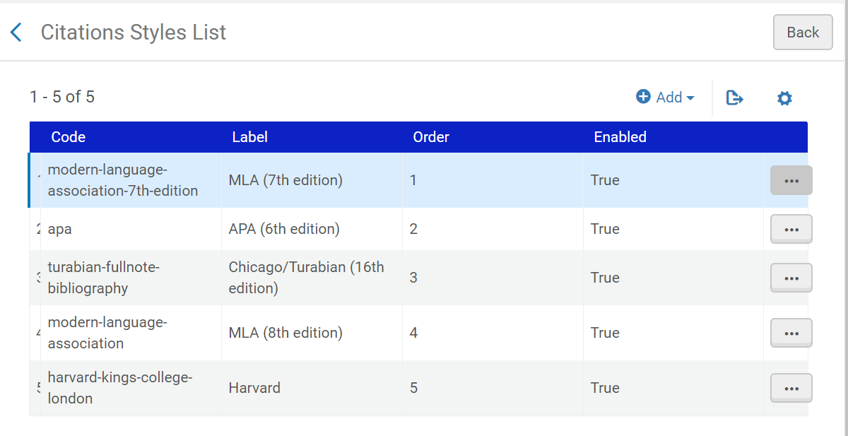
Record actions: Citations
You can change the order in which citation styles display in a record, whether or not they display at all, and the public name of the style.
You can also add styles to the list, which is handy if your patrons need styles outside of the default list.
FAQ: Can I modify the citation function in Primo VE?

Slide 21
Additional Links
SUNYLA 2019 Presentation: Usability and Customization Options for Primo VE Discovery Working Group
SUNY FAQ How long should things like activating e-collections, making changes to the Primo VE interface, indexing, etc. take to fully show up in the system so we can know when to test?
Acknowledgements:
Thanks to the Discovery Working Group for help putting this presentation together.

