Slide 1
Relinking Physical Bib Records
SUNY Shared Library Services
Maggie McGee

Slide 2
Physical Bib Records to be Relinked
Relink bib records with their associated order records, holdings, and item information when:
An order was placed on the incorrect bib record(s)
A Vendor sent the incorrect bib record(s)
An EOD arrives for a single volume within a multi-volume work which is more suitable to link to than the existing link
https://knowledge.exlibrisgroup.com/Alma/Product_Documentation/010Alma_Online_Help_(English)/020Acquisitions/020Purchasing/045Closing%2C_Reopening%2C_and_Relinking_PO_Lines#Relinking_PO_Lines

Slide 3
Relinking Physical Bib Records
DO NOT Overlay the OCLC number in a bib record to relink to the correct bib record
POLs/Orders that are attached to the incorrect bib record will need to be relinked to the correct bib record from the PO Line (POL)
Relinking from the POL will move the corresponding items and holdings to the correct bib record and retains the POL
POLS can be relinked for the following POL statuses:
In Review
Deferred
Autopackaging
Packaging
Ready
Unsent one-time closed PO lines
Closed one-time POL
Closed POLs that do not meet the above criteria will need to be re-opened and placed in review in order to be relinked to the correct bib record

Slide 4
Relinking Physical Bib Records
PO lines cannot be relinked if:
The PO line has items in a temporary location
The PO line has items on loan
The PO line is linked to a record from the Community Zone
The PO line contains items belonging to two different bibliographic records
The PO line for an electronic title lacks an MMS ID

Slide 5
When to Use Change Bib Reference Instead of Relink
Change Bib Reference only changes the bibliographic reference for the POL
The bib, item(s), and holdings record will be unaffected and remain linked to the incorrect bib record
Use Change Bib Reference when a brief bib record is created to order from in Alma
The POL is associated to the brief bib record description upon ordering
If the short bibliographic record gets updated with a full bibliographic record, the PO line will still have the now inaccurate old description of the title
DO NOT use change Bibliographic Reference to relink a bib record with the associated POL, holdings, and item records to another bib record

Slide 6
Relinking Physical Bib Records that have the Relink option
SUNY Shared Library Services
Maggie McGee

Slide 7
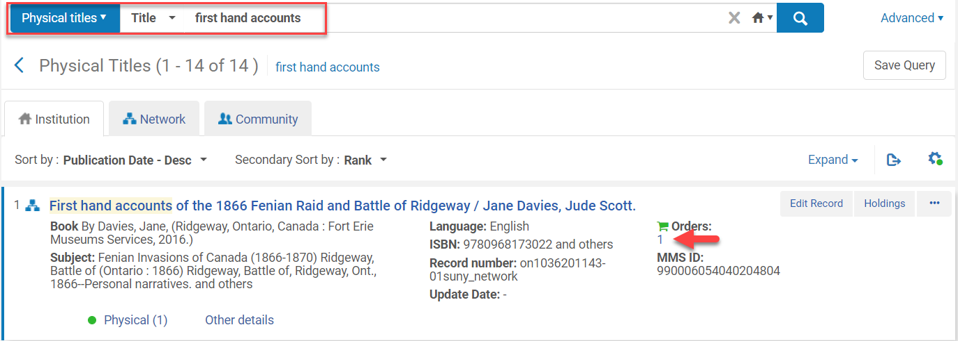
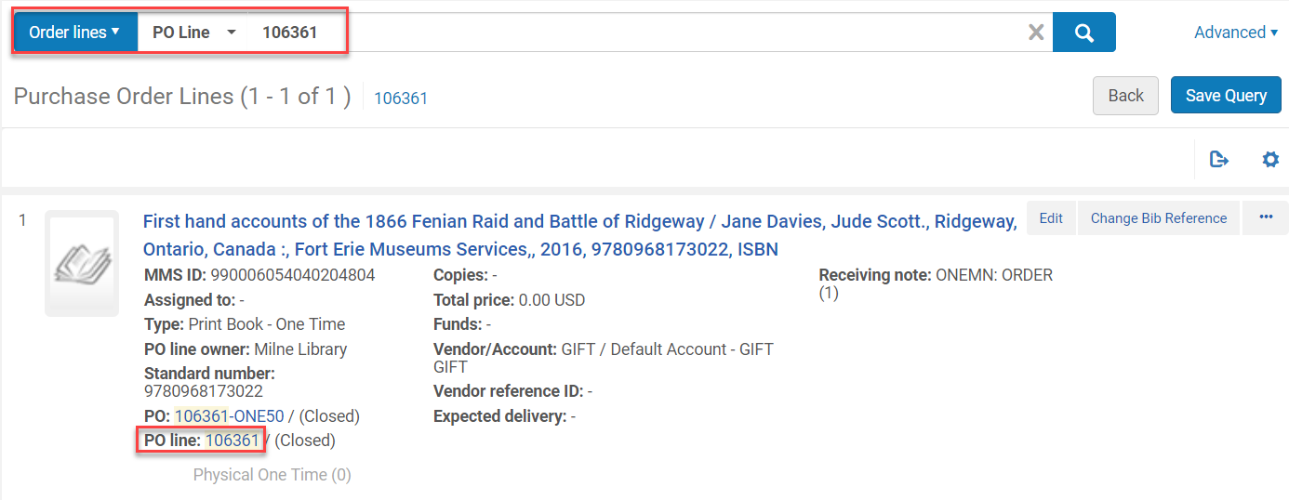
Relinking Physical Bib Records
Perform a repository search to for the title or POL number

Slide 8
Relinking Physical Bib Records
Click Edit or the POL Line number link
Click Relink

Slide 9
Relinking Physical Bib Records
FYI: Sometimes the Relink option will appear in the POL search screen

Slide 10
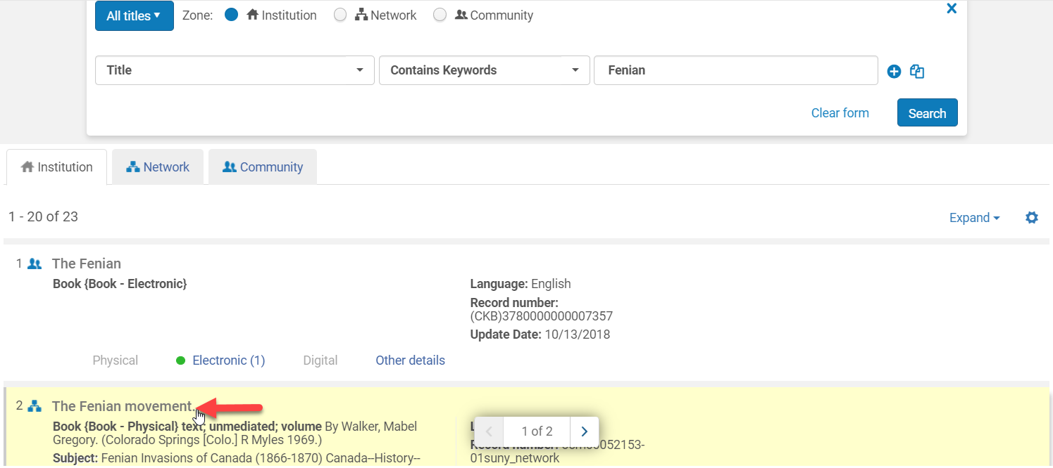
Relinking Physical Bib Records
Perform a repository search for the bib record to attach the POL to using:
Title, MSSID, ISBN, and/or Other System number to identify the correct bib record
Click on the title link for the appropriate title

Slide 11
Relinking Physical Bib Records
Click Confirm from the pop-up menu
The POL and associated inventory is now attached to the correct bib record

Slide 12
Relinking Physical Bib Records that Need to be Reopened and Placed in Review
SUNY Shared Library Services
Maggie McGee

Slide 13
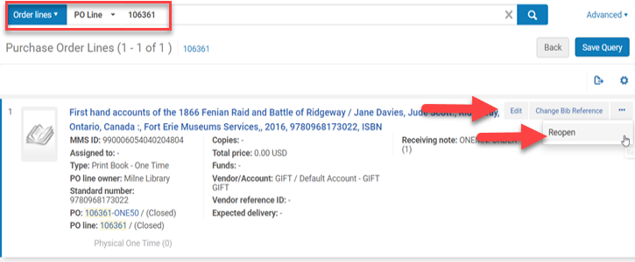
Reopening a POL and Relinking a Physical Bib Record
Use this option ONLY when the Relink option does not appear in the POL (Relink button or Relink from the Edit screen)
Perform a repository search for the title or POL number
Click Reopen from the ellipses
or Click Edit and then Reopen

Slide 14
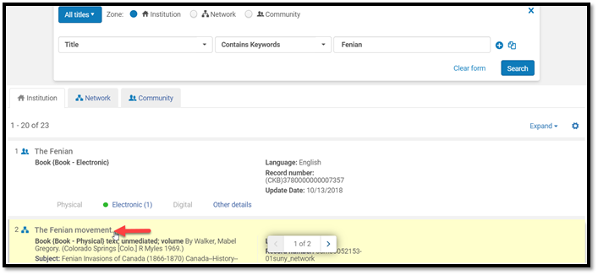
Reopening a POL and Relinking a Physical Bib Record
The POL goes into Review
Go to Acquisitions>Purchase Order Lines>Review
Click Edit
Click Relink
Search for the bib record the POL and associated holding/items will be linked to
Click on the link for the appropriate title

Slide 15
Reopening a POL and Relinking a Physical Bib Record
Click Confirm
The POL and all associated inventory has been relinked to the new bib record
Click "Order Now" to close the order and remove it from review

Slide 16
Linking Electronic portfolios to the Community Zone (CZ)
SUNY Shared Library Services
Maggie McGee

Slide 17
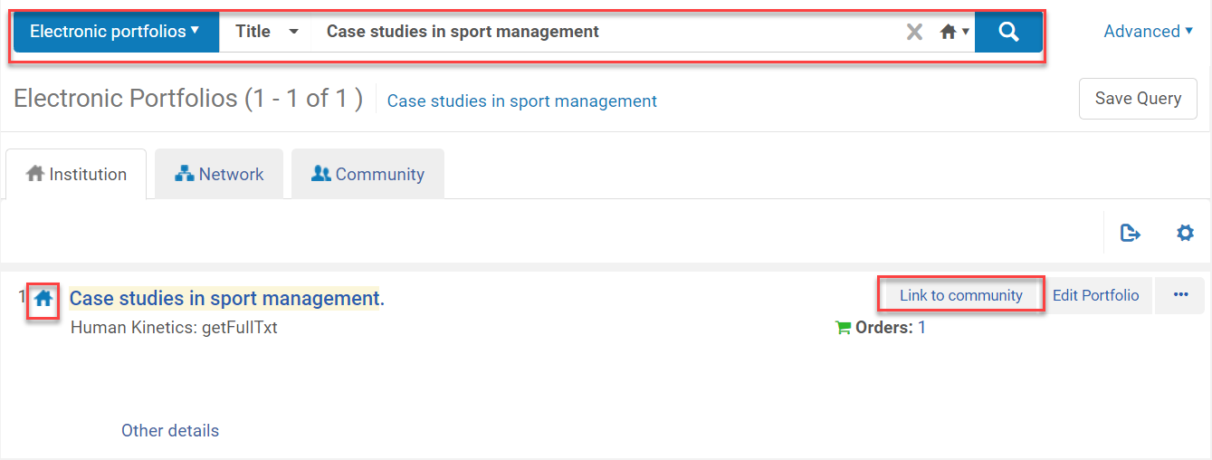
Linking Electronic Portfolios from the IZ to the CZ
“Link to Community” is useful to link the P2E portfolios that are in the IZ to the Community Zone
Perform a repository search for Electronic Portfolio:Title:[Portfolio Title]
Click Link to community for the electronic portfolio you want to link to the CZ

Slide 18
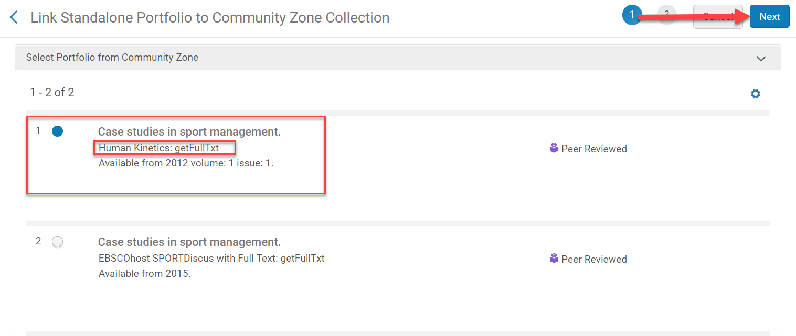
Linking Electronic Portfolios from the IZ to the CZ
Click on the radio button next to the CZ portfolio you want to link to based on the resources interface name (access provider)
Click Next

Slide 19
Linking Electronic Portfolios to the CZ
Select source of descriptive information:
Use descriptive metadata from the community
Select this option in order to associate the portfolio with the matched Community Zone bibliographic record. It bib record will be updated from the CZ.
Keep local descriptive metadata. Note….
When selecting this option, the bibliographic record associated with the portfolio in the Community Zone will be the matched Community Zone bibliographic record, but the bibliographic record associated with the portfolio in the contributor’s environment will remain local.
Click Next

Slide 20
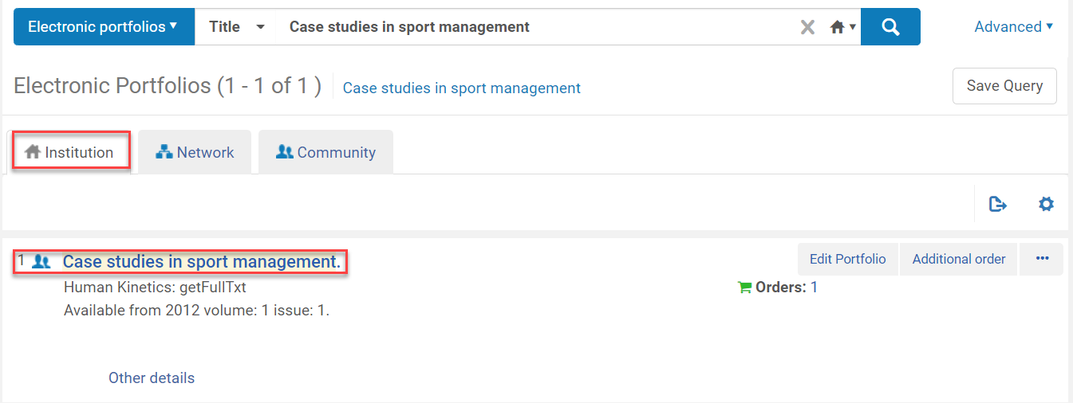
Linking Electronic Portfolios to the CZ
Review and confirm what/how you are linking to the CZ
Click Link to community

Slide 21
Editing the Electronic Portfolio
Then you will need to edit the electronic portfolio by either:
Clicking Edit Portfolio
Click Create E-activation task from the Ellipses
Michelle’s presentation on post-go live troubleshooting e-resources:
https://zoom.us/recording/share/V-yKo1ZwkhTtSMZiRNKVaoGhyfjUq_UB7uYNmA6poR6wIumekTziMw?startTime=1563888844000
Alana’s e-resources acquisitions training session on Ordering, Invoicing, and Activating Electronic Collections:
https://public.3.basecamp.com/p/EfDXis4pXKmgpMjCfdEuUhA6

Slide 22
Edit Portfolio Option
Click Edit Portfolio from the electronic portfolio
Click on the General tab
Portfolio availability: Available
Activation date: [today’s date or earlier]
Library: [correct library]
Access type: [correct access type]

Slide 23
Edit Portfolio Option
General tab

Slide 24
Edit Portfolio Option
Click on the Coverage tab
Which coverage statement will be applied?
Embargo?
Click Save

Slide 25
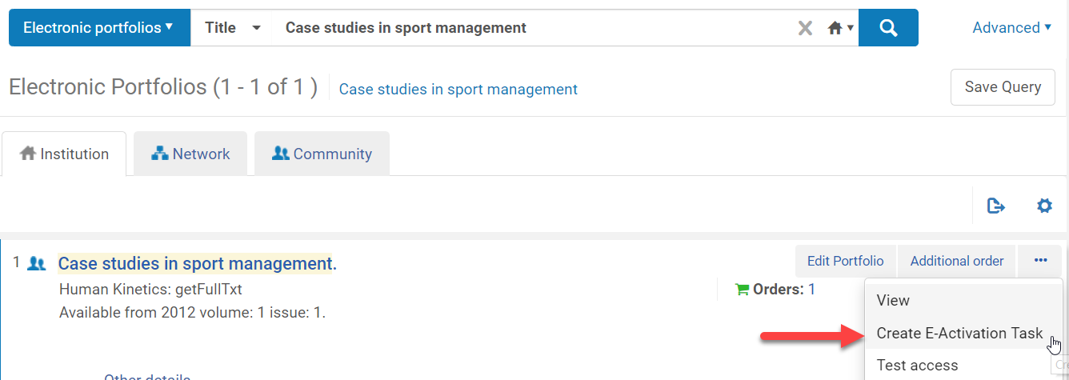
E-activation Option
Click on Create E-Activation Task from the ellipses for the portfolio that was just linked to the CZ

Slide 26
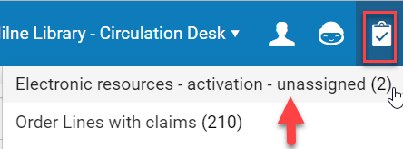
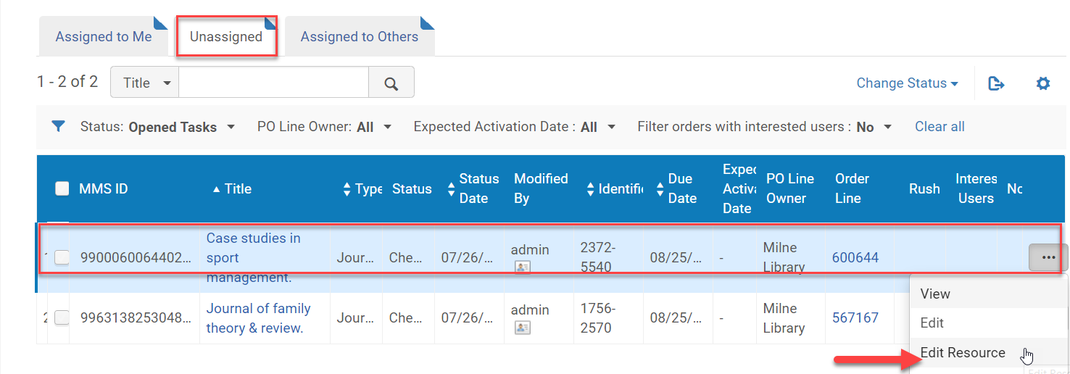
Activating the Newly Linked CZ Bib Record
Click on the Task List icon
Click on Electronic resources – activation - unassigned
Click Edit Resource from the Portfolio to be activated

Slide 27
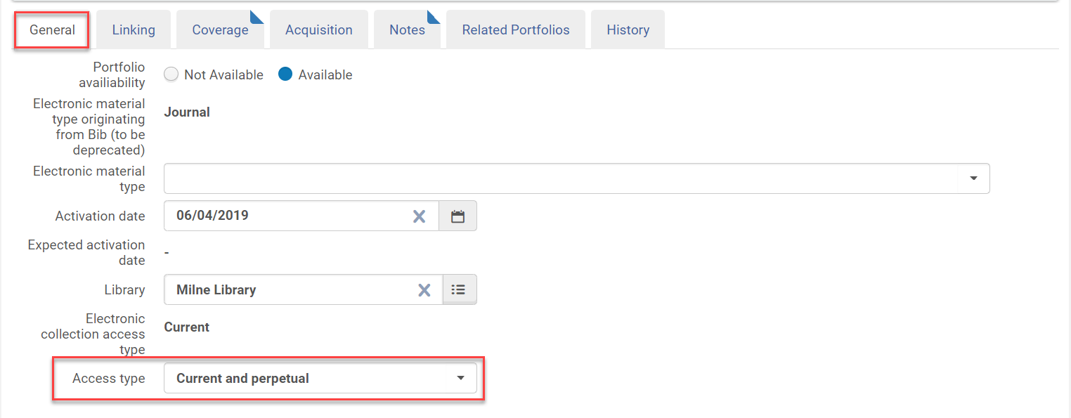
Activating the Newly Linked CZ Bib Record
Click on the General tab
Check to see it is Active
Check the other information is accurate
Add the Access type

Slide 28
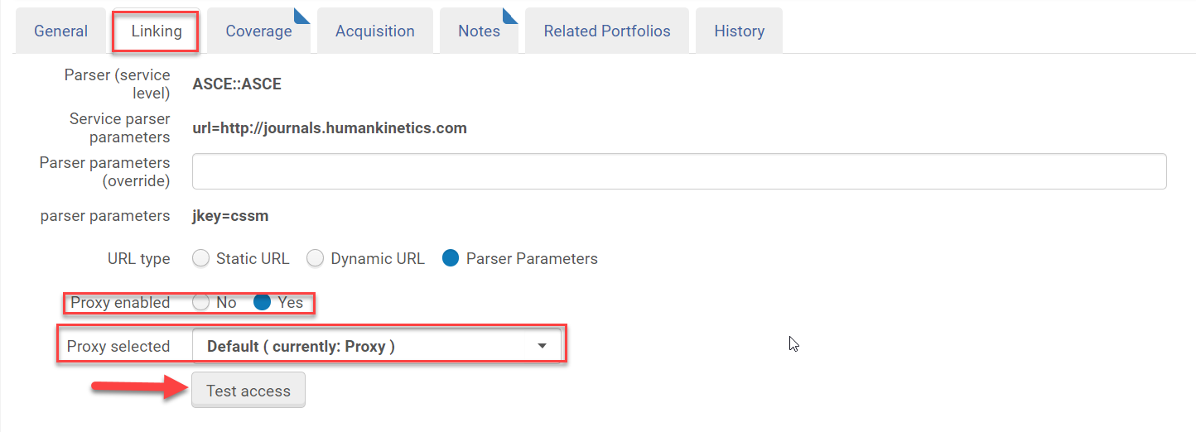
Activating the Newly Linked CZ Bib Record
Click on the Linking tab
Proxy enabled: Yes if it requires a proxy to access it
Proxy selected: Default proxy
Click Test access

Slide 29
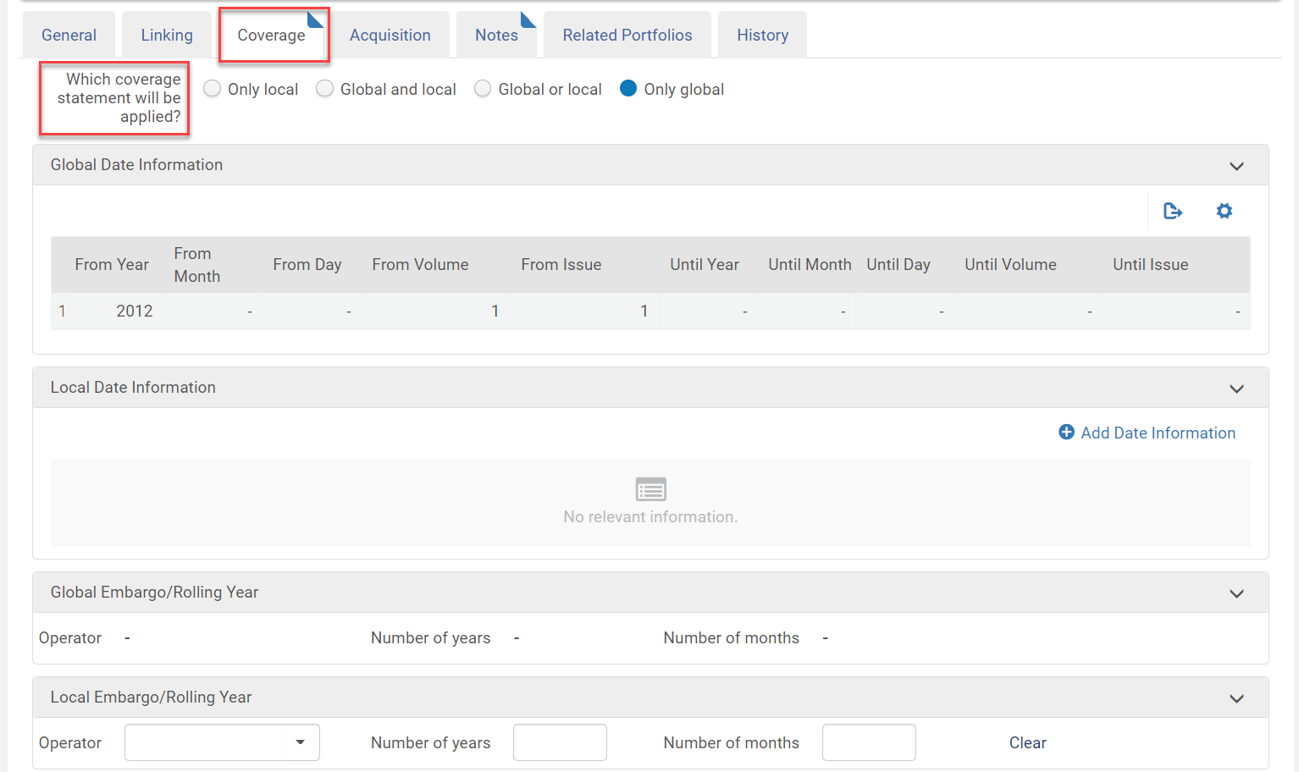
Activating the Newly Linked CZ Bib Record
Click on the Coverage tab
Select the Coverage Statement that will be applied
Add an Embargo if it applies

Slide 30
Activating the Newly Linked CZ Bib Record
Click Save after you have made all the changes you want to apply to the electronic portfolio
Click Done from the ellipses

Slide 31
Electronic Portfolio is already Activated in the CZ
SUNY Shared Library Services
Maggie McGee

Slide 32
Electronic Portfolio is Already Linked to the CZ
If you have an electronic portfolio activated for the Interface Name and the dates of coverage match:
Click the order number or Edit portfolio of the IZ electronic portfolio to get the POL #
Copy the POL #
Click Edit Portfolio on the electronic portfolio that you want to associate the POL #
Click on the Acquisition tab
Type or paste the POL # in the PO Line
Click Save

Slide 33
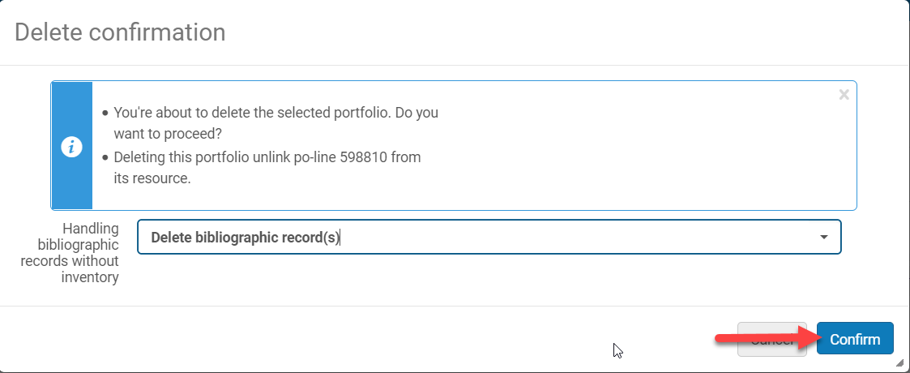
Electronic Portfolio is Already Linked to the CZ
Delete the IZ Electronic Portfolio
Click Delete from the ellipses of the IZ electronic portfolio
Select Delete bibliographic record(s)
Click Confirm

Slide 34
Creating a Local Electronic collection
SUNY Shared Library Services
Maggie McGee

Slide 35
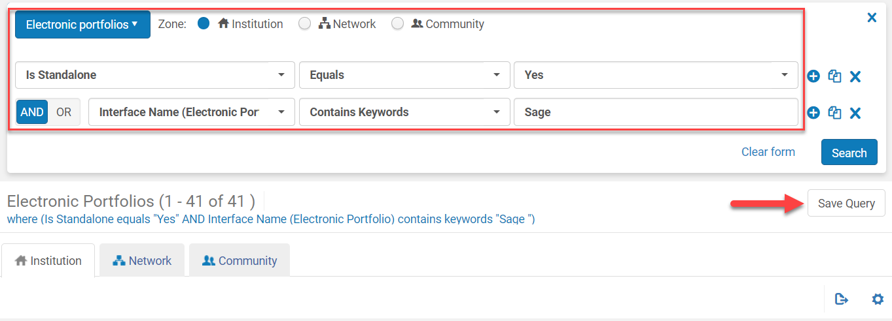
Creating a Local Electronic Collection
Create a local electronic collection for e-resources that cannot be linked to the CZ for various reasons:
Cannot find in the CZ
Cannot identify the correct Interface
Do not want to link to the CZ
Create a set for electronic portfolios by using an advanced repository search

Slide 36
Creating a Local Electronic Collection
Go to Resources>Create Inventory>Add Local Electronic Collection
On the Activation tab
Service activation status: Available
Active from date: [today’s date or date you want it active]
Click Save

Slide 37
Creating a Local Electronic Collection
Click on the Linking tab
Use parser parameters or Dynamic URL
https://knowledge.exlibrisgroup.com/Alma/Product_Documentation/010Alma_Online_Help_(English)/040Resource_Management/050Inventory/020Managing_Electronic_Resources
Linking level: [select the linking level]
Service is free: [select Not Free or Free]
Crossref enabled: [Enabled]
Proxy enabled: [Yes if required to access]
Proxy selected: [Default (currently: Proxy)]

Slide 38
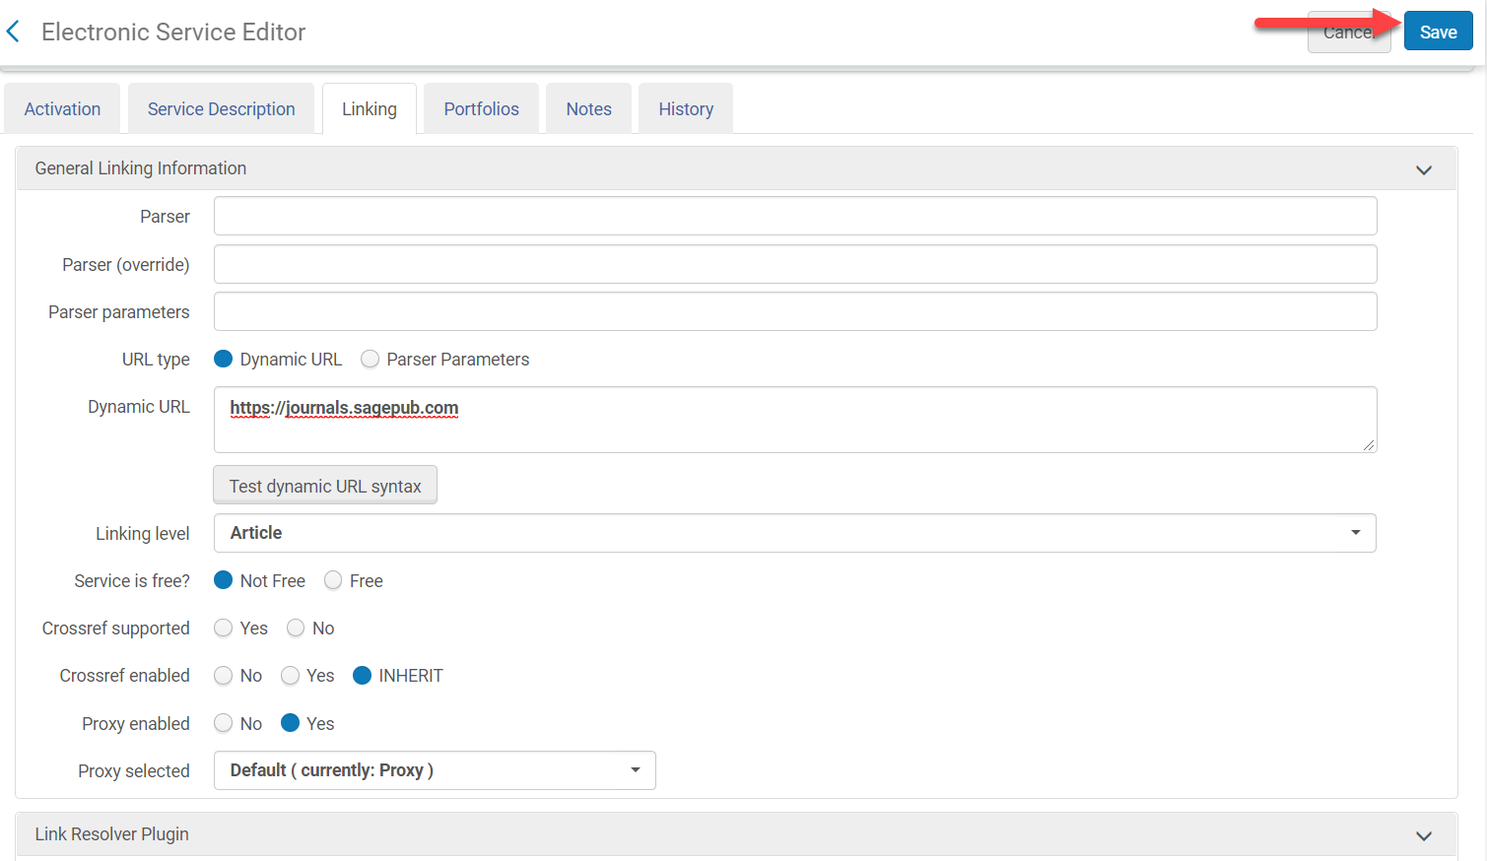
Creating a Local Electronic Collection

Slide 39
Creating a Local Electronic Collection
Click on the Portfolios tab
Click Add from Set
Select the set
Click Submit

Slide 40
Creating a Local Electronic Collection
Click Confirm
Click Save

Slide 41
Creating a Local Electronic Collection
Electronic Collection Editor opens
Level URL: [base URL for the collection access]
Is Free?: [select Not Free or Free]
Proxy enabled: [Yes if required for access]
Proxy Selected: [Default (currently: Proxy)]
Language: [English]
Click Save

Slide 42
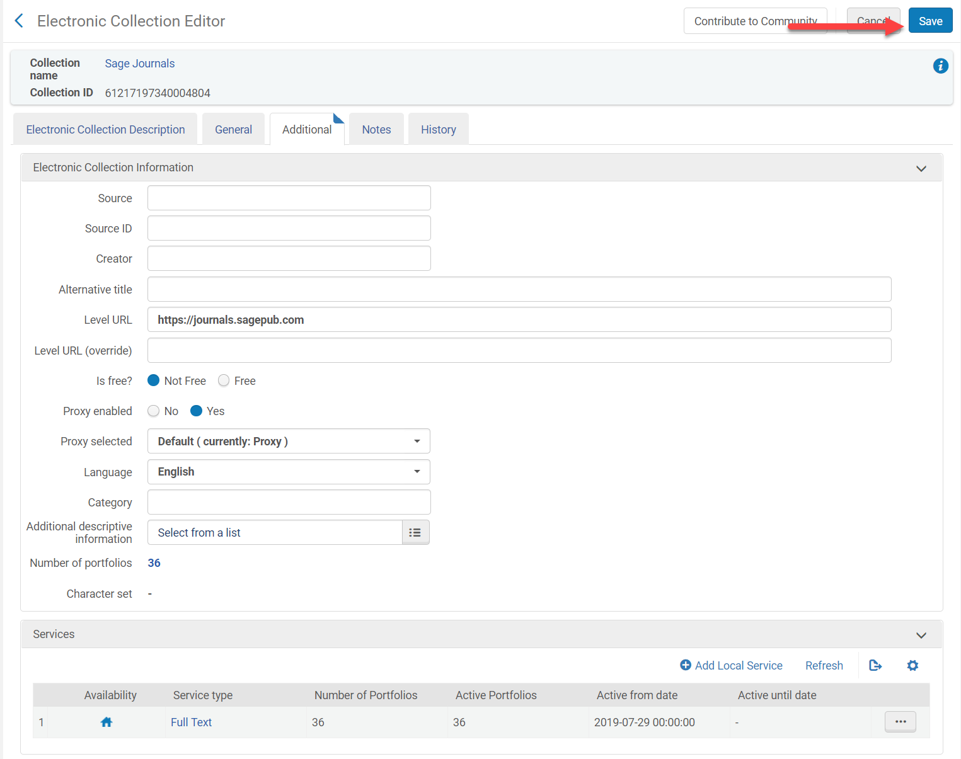
Creating a Local Electronic Collection

Slide 43
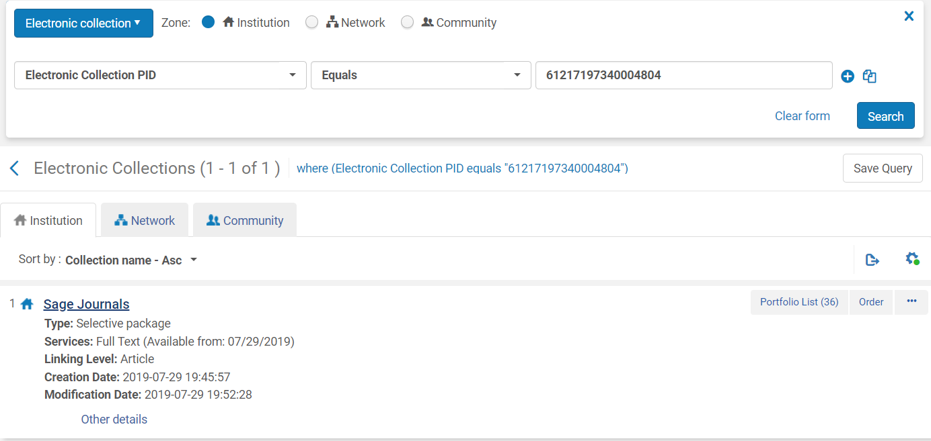
Creating a Local Electronic Collection
The set is now a local electronic collection and can be managed as a collection

Slide 44
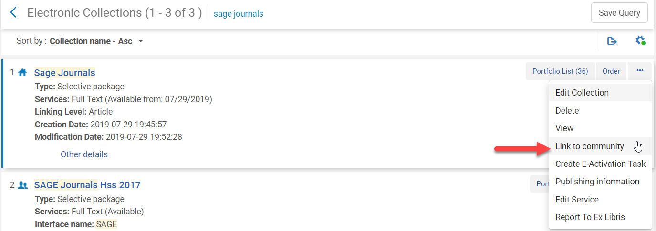
Creating a Local Electronic Collection
If you know the electronic collection you want to link the local collection to you can
Click Link to Community from the local electronic collection
Fill out the CZ electronic collection name that you want to link the local collection to
Click Link
Click Confirm

Slide 45
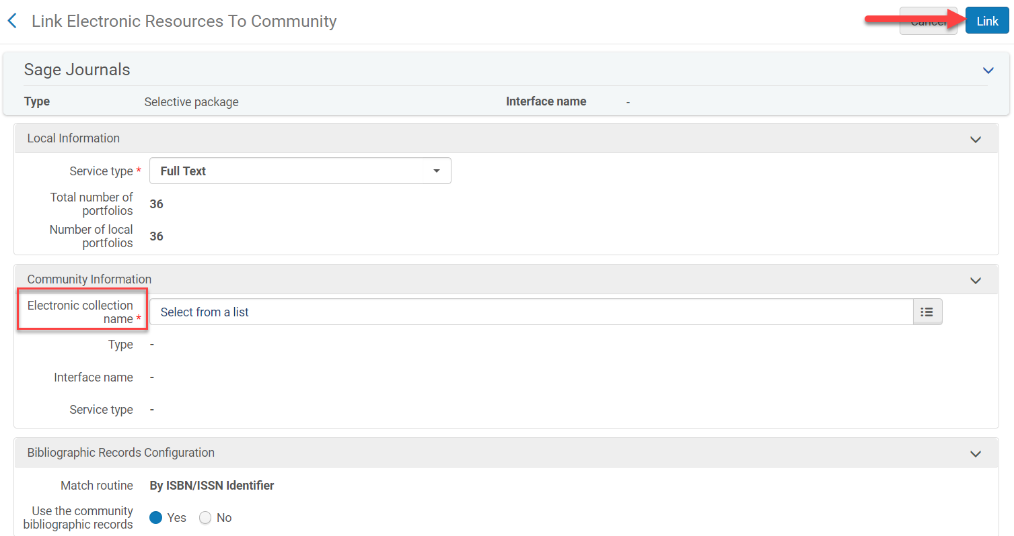
Creating a Local Electronic Collection

Slide 46
Electronic Collection is linked to the CZ
SUNY Shared Library Services
Maggie McGee

Slide 47
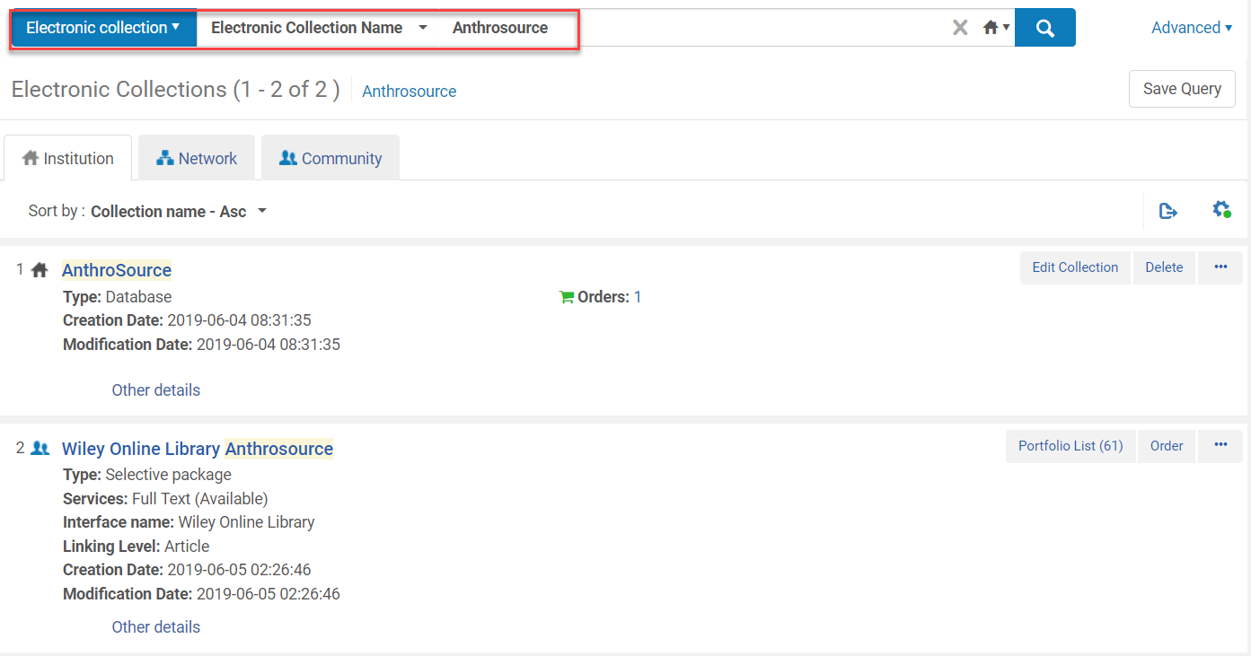
Electronic Collection is Linked to the CZ
Perform a repository search for: Electronic Collection:Electronic Collection Name: [Name]

Slide 48
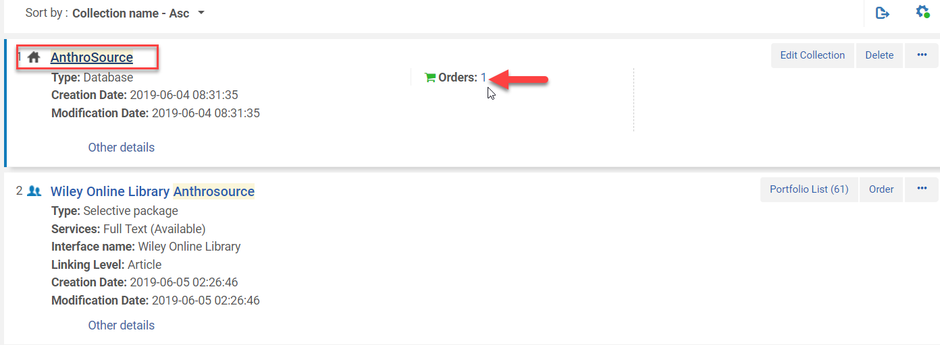
Electronic Collection is Linked to the CZ
Click on the Order number for the electronic collection in the IZ

Slide 49
Electronic Collection is Linked to the CZ
Copy the POL #
Verify the vendor is the same as the electronic collection that is linked to the CZ
Click Back or on the blue < to return to the previous screen

Slide 50
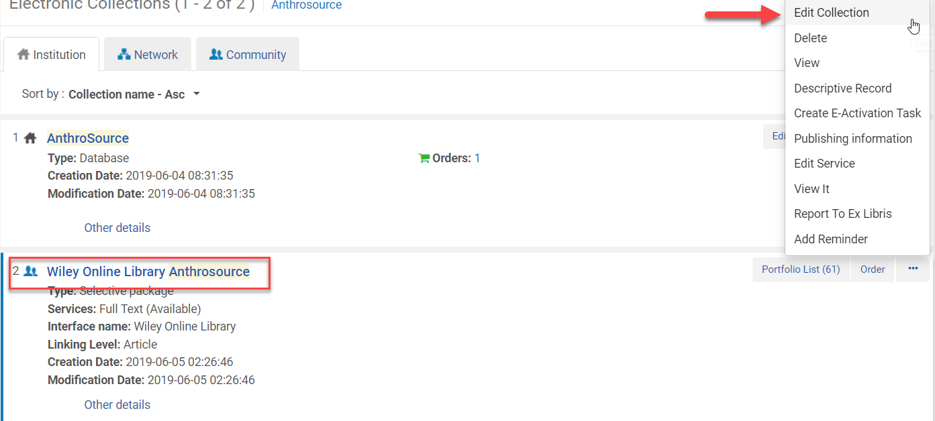
Electronic Collection is Linked to the CZ
Click Edit Collection from the Ellipses of the Electronic Collection in the CZ

Slide 51
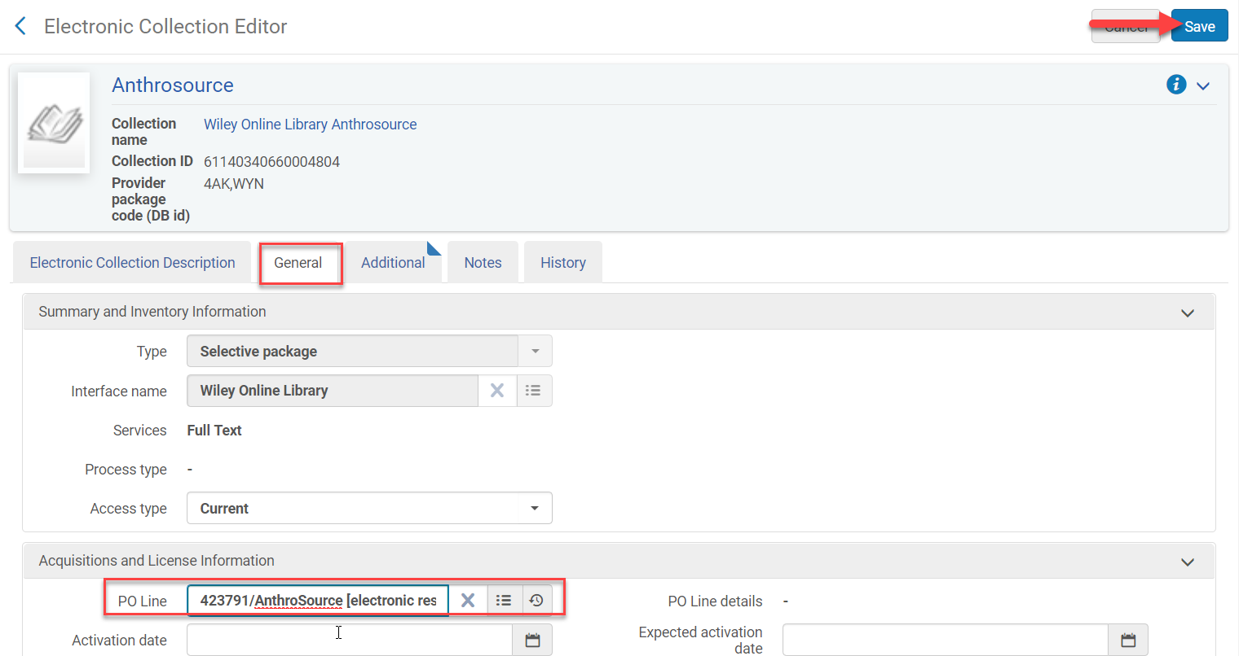
Electronic Collection is Linked to the CZ
Click on the General tab
Type/paste the POL number into the PO Line
Click Save

Slide 52
Electronic Collection is Linked to the CZ
Both records now have the POL number (order) attached
Click Delete from the IZ record

Slide 53
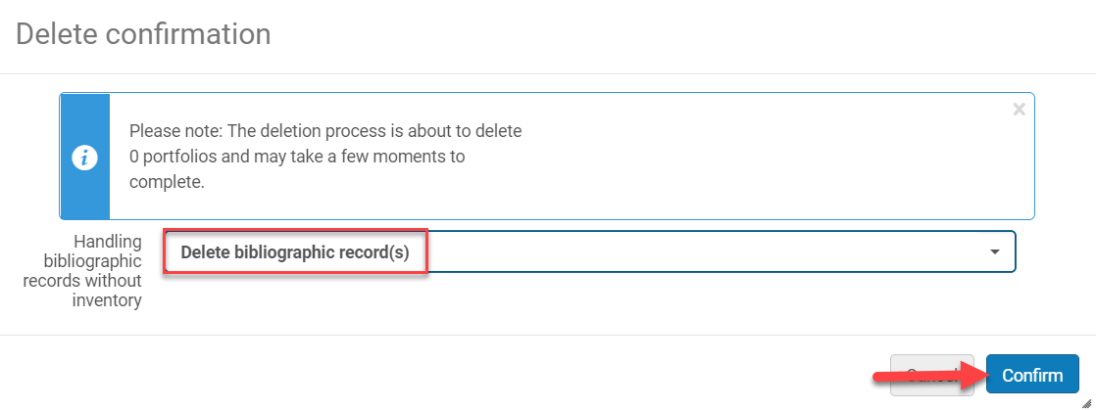
Electronic Collection is Linked to the CZ
Select “Delete Bibliographic Record(s)”
Click Confirm
Only the CZ electronic collection exists with the POL attached

Slide 54
Electronic Collection is not activated in the CZ
SUNY Shared Library Services
Maggie McGee

Slide 55
Electronic Collection is Not Activated in the CZ
Perform a repository search for Electronic Collection: Electronic Collection Name: [Name of Collection]
Click on the Community tab
Click Activate from the electronic collection that matches the IZ electronic collection
Activate the e-resource, but do not order it because a POL # already exists

Slide 56
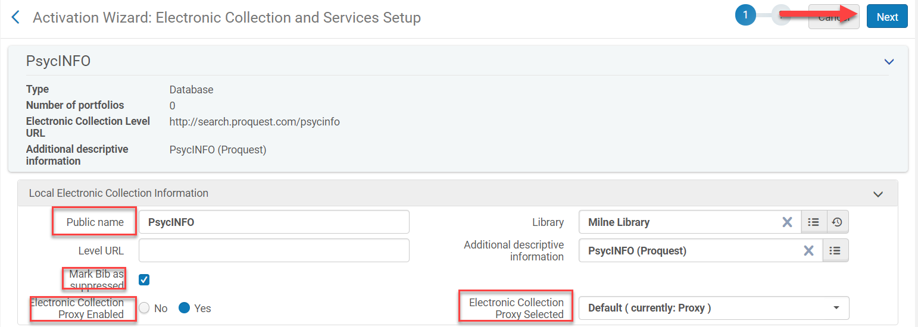
Electronic Collection is Not Activated in the CZ
The Activation Wizard Opens
Public Name: [optional name the public will see]
Mark bib as suppressed if you do not want the database record searchable in Primo VE
Electronic Collection Proxy Enabled: Yes
Electronic Collection Proxy Selected: Default (currently; Proxy)
Click Next

Slide 57
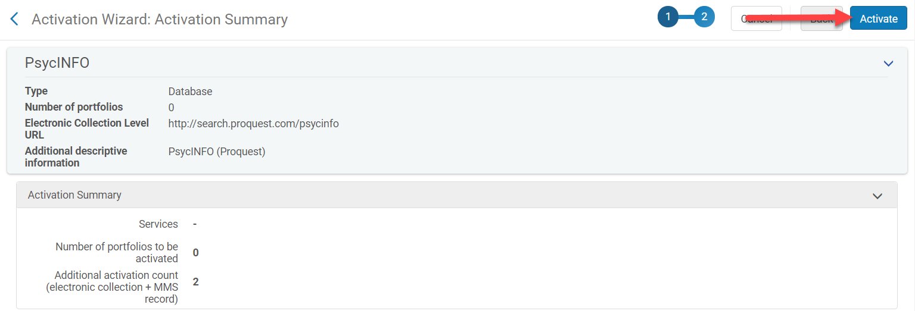
Electronic Collection is Not Activated in the CZ
Review the Collection
Click Activate

Slide 58
Electronic Collection is Not Activated in the CZ
Click on the Institution tab
Click on the Orders number for the IZ database record
Copy the PO Line number

Slide 59
Electronic Collection is Not Activated in the CZ
Click Edit Collection from the electronic collection that was just activated
Click on the General tab
Paste/type the PO Line number in the PO Line
Click Save

Slide 60
Electronic Collection is Not Activated in the CZ

Slide 61
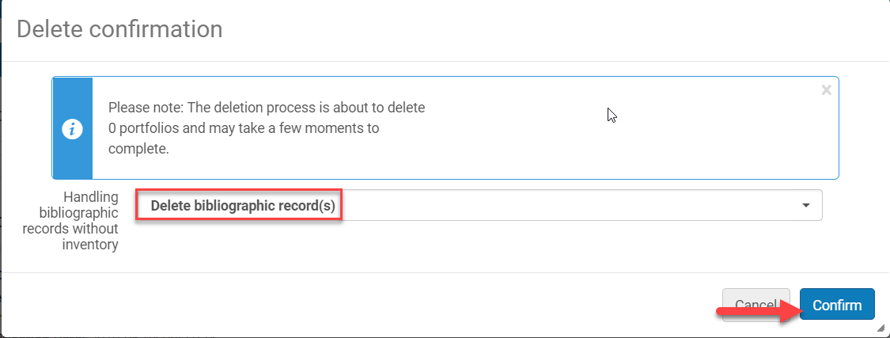
Electronic Collection is Not Activated in the CZ
Delete the IZ electronic collection
Click Delete from the IZ electronic collection
Select “Delete bibliographic record(s)”
Click Confirm

Slide 62
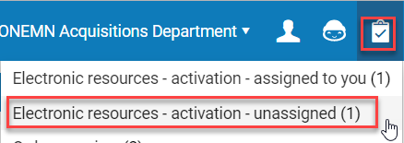
Electronic Collection is Not Activated in the CZ
Create an e-activation task list for the electronic collection to test access
Click on the Task List icon and select Electronic resources – activation – unassigned
Click Test Access from the ellipses
Click Done from the ellipses

