Slide 1

Washington, DC District (BSA)
2024 District Committee Structure
District Key 3
OA Chapter Advisor
(Appointed)
Nominations Chair
(Appointed)
Core Leadership Council
EVENTS FUNCTION
UNIT CONTINUITY FUNCTION
DISTRICT OPS FUNCTION
Activities & Civic Service
Pillar Lead
Unit
Membership
Pillar Lead
Marketing & Comm’ns
Pillar Lead
Deputy District
Chair
Camping & Outdoors
Pillar Lead
Activities & Civic Service
Pillar
Unit
Program
Pillar Lead
Camping & Outdoors
Pillar
Committee Vice-Chair(s)
Committee Vice-Chair(s)
Committee Vice-Chair(s)
Committee Vice-Chair(s)
Committee Vice-Chair(s)
Committee Vice-Chair(s)
Committee Vice-Chair(s)
Sub-Committees
Sub-Committees
Sub-Committees
Sub-Committees
Sub-Committees
Sub-Committees

Slide 2
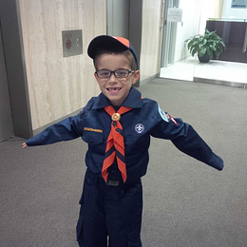
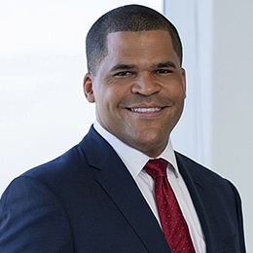
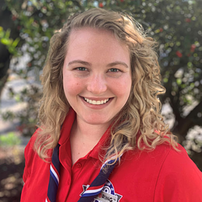


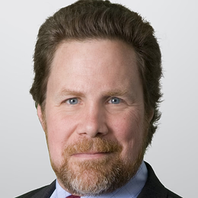



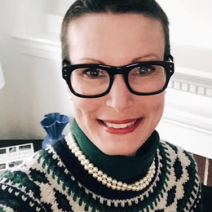
Washington, DC District (BSA)
District Committee Leadership
Updated December 1, 2024
Greg Fairbanks
District Commissioner
Tony Phillips
District Chair
Christa Waterweise
District Executive
John Keenan
Nominations
Chair
Jai Evans
Order of the Arrow Chapter Advisor
Sonja Kueppers
Camping and Outdoor Promotion
Chad Heflin
Activities and Civic Service
VACANT
Unit Program
Roberto Velez
Membership
VACANT
Marketing and Communications
VACANT
District
Deputy Chair
Tim Barber
Shooting Sports Chair
Zainab Smith
Scouting for Food
Co-chairs
Alex Alonso
Advancement and Recognition Chair
Aaron Marrs
Leads Manager
P-B
Historian
VACANT
At-Large Member Coordinator
VACANT
Quartermaster
Randy Jacobs
Pinewood Derby Chair
Doug Menorca
Unit Fundraising Chair
Vincent Baxter
DCPS Liaison
Marty Barnard
Alumni and Scouter Events Chair
VACANT
Grants and Development Chair
OA Chapter Advisor
Camporee Chair
Alex Pham
Merit Badge University Dean
Bill Mayo
Scouter Training Chair
VACANT
New Unit Strategy Chair
VACANT
Data and Promotions
Functions
Events
VACANT
International Scouting Chair
VACANT
COR Liaison
Chanteliese Watson
Cub Champion
District Key 3
Continuity
Appointments
Hank Brothers
High Adventure Chair
District Ops

