Slide 1

Overlap Analysis in Alma
Shannon Pritting
May 26, 2020
www.suny.edu

Slide 2

Get Your Alma Permissions Right
To work with overlap analysis, you must have one of the following roles:
Purchasing Operator
Purchasing Manager
Repository Manager
Electronic Inventory Operator
www.suny.edu
Notes:
To volunteer email Connie Perrin

Slide 3

Scenarios For Overlap Analyses in Alma
Comparing two collections.
Comparing one collection with multiple collections in your holdings (IZ) or in the Alma Repository (CZ).
Comparing a collection with your entire holdings.
Compare a collection you don’t subscribe to with all your holdings.
Compare a collection you don’t subscribe to with your holdings and what’s available in the Community Zone.
www.suny.edu
Notes:
To volunteer email Connie Perrin

Slide 4
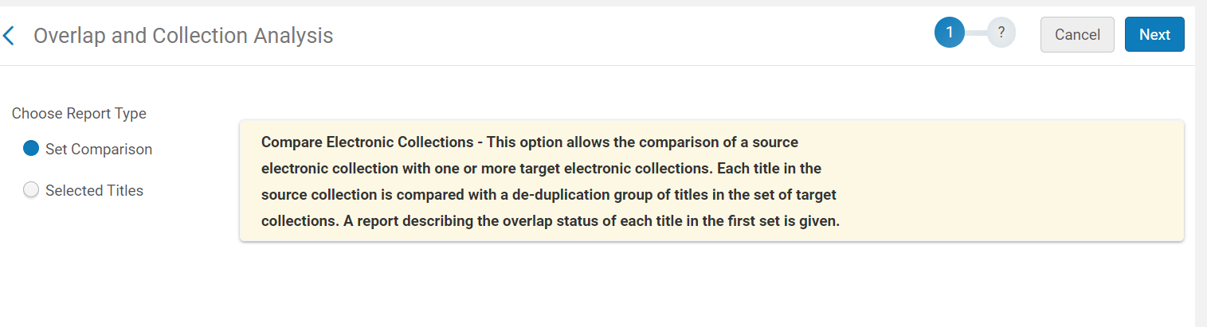
Two Types of Overlap Analyses
www.suny.edu

Slide 5
What’s the difference between the two types of analyses?
Selected Titles
Set Comparison
Can compare collections in your institution.
Only 1 source collection can be used.
Only compares active portfolios/collections.
Source collections must be in your IZ.
Target collections can be IZ/CZ.
Can compare holdings/coverage.
Must use an input file.
Input file only allows for identifiers (heading is name of identifier)
Does not compare holdings, although holdings are provided in report.
Can compare to CZ and IZ.
www.suny.edu

Slide 6
Set Comparison
Restricted to activated collections and portfolios in your IZ. Good for analyzing overlap of what you already subscribe to.
www.suny.edu

Slide 7
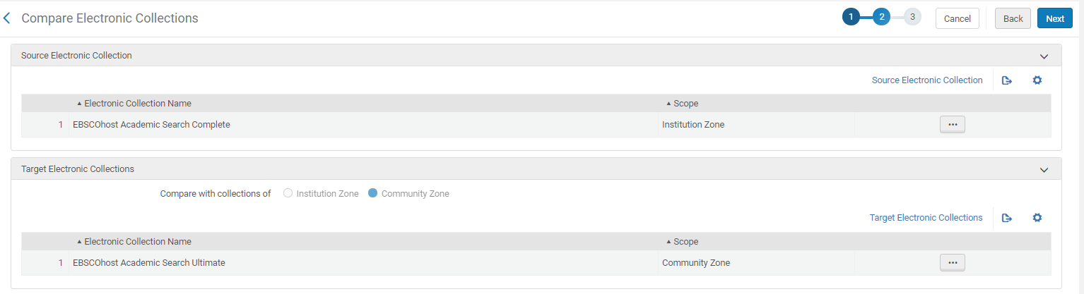
Comparing Two Collections
Single Source Collection vs. 1 or more Target Collection(s).
Collection Repository Search option available for adding collections.
www.suny.edu

Slide 8
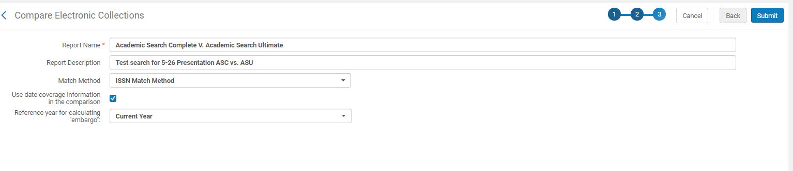
Comparing Two Collections
Try to be as descriptive as possible in report name as certain details aren’t retained on the job history.
  Description not viewable in any report view options.
www.suny.edu

Slide 9
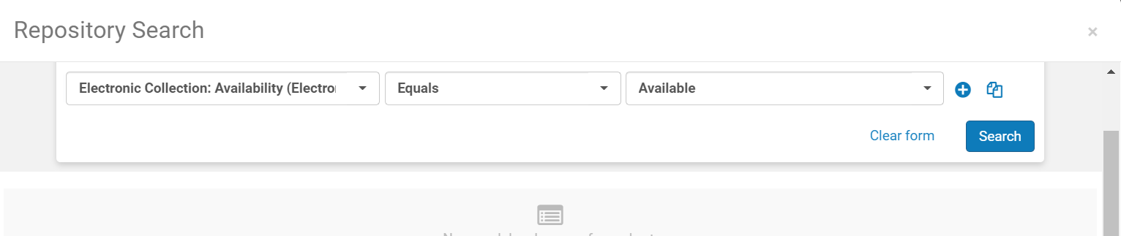
How to add all your E-Collections as Target Collections
Select Advanced Search—Use a parameter that would be common in all of the e collections in your IZ.
I typically use “Available”
Can limit to free/not free as well
www.suny.edu

Slide 10
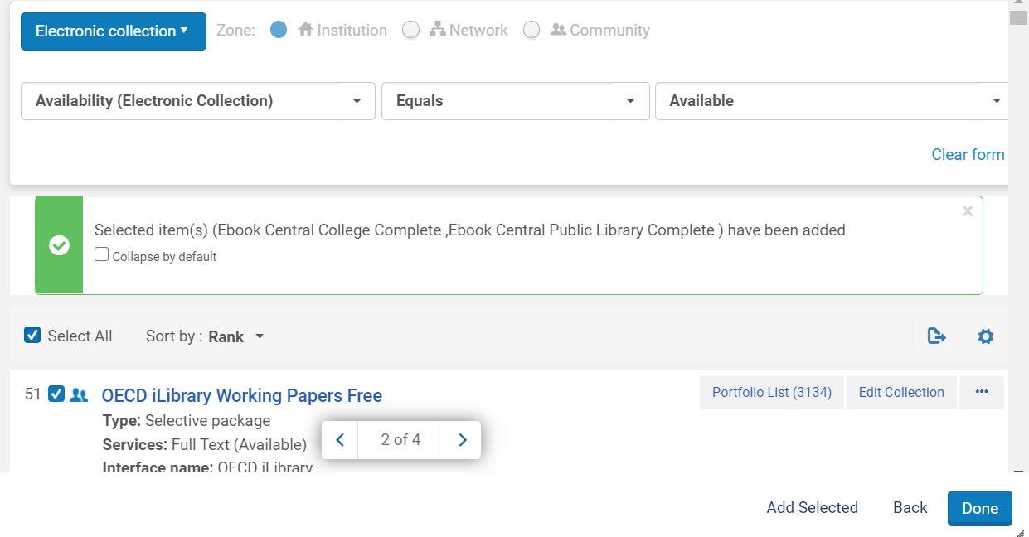
How to add all your E-Collections as Target Collections
Selections for collections only go page by page, but are in aggregate.
Easiest to select all, and then add selected.
Navigate to page of searches, and then select all again.
Remember not to hit Done until you’re ready.
www.suny.edu

Slide 11
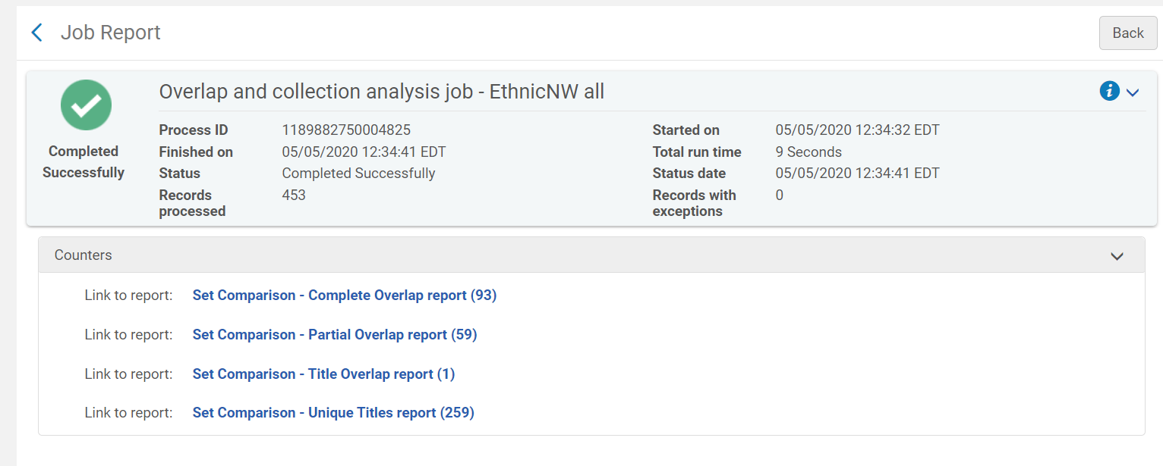
Reports Interface
www.suny.edu

Slide 12
Reports Explanation
The results will potentially give four reports:
Complete Overlap Report
  Contains matching titles with identical coverage dates.
Partial Overlap Report
  Contains matching titles with partially overlapping coverage dates.
Title Overlap Report
  Contains matching titles with mutually exclusive coverage dates.
Unique Titles Report
  Contains titles that are unique to the source set you created for the comparison.
www.suny.edu

Slide 13
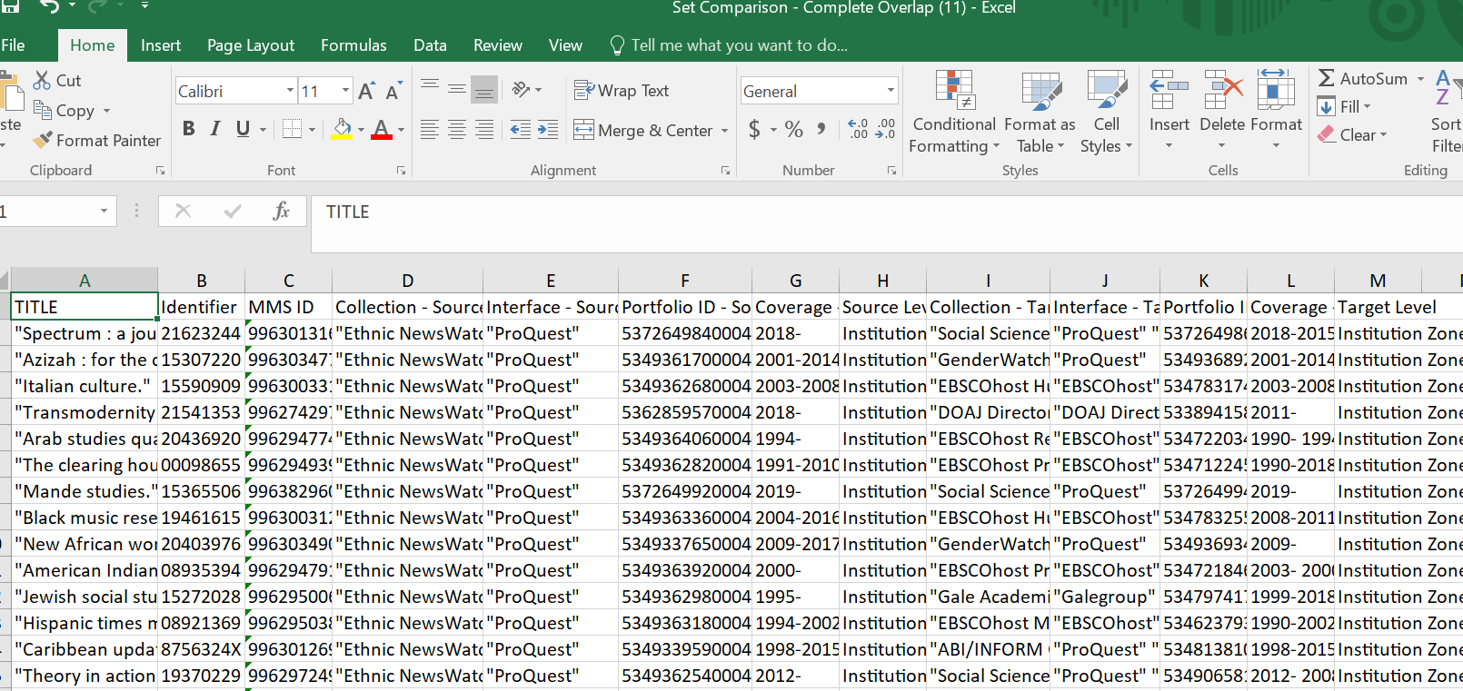
Reports are in linked Excel Docs
www.suny.edu

Slide 14

Demo of Set Comparison Overlap
www.suny.edu

Slide 15
Selected Titles
Good to analyze collections you don’t subscribe to yet, and to find matches for collections in the CZ.
www.suny.edu

Slide 16
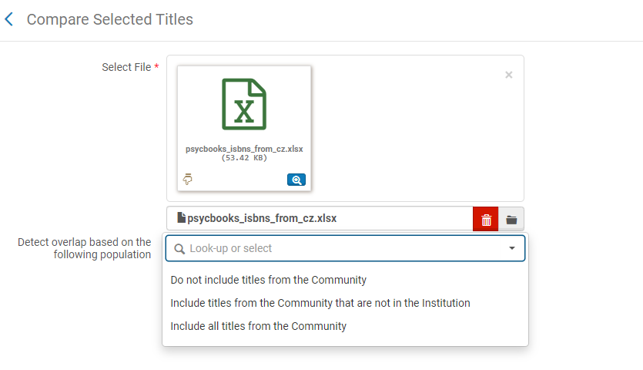
Selected Titles Reports
Must upload a file with a header of an acceptable identifier: ISBN, ISSN, LCCN, TITLE
Can include the CZ, or just focus on IZ
www.suny.edu
Notes:
https://knowledge.exlibrisgroup.com/Alma/Product_Documentation/010Alma_Online_Help_(English)/050Administration/070Managing_Jobs/050Viewing_Completed_Jobs#Viewing_the_Overlap_Analysis_Job_Report

Slide 17
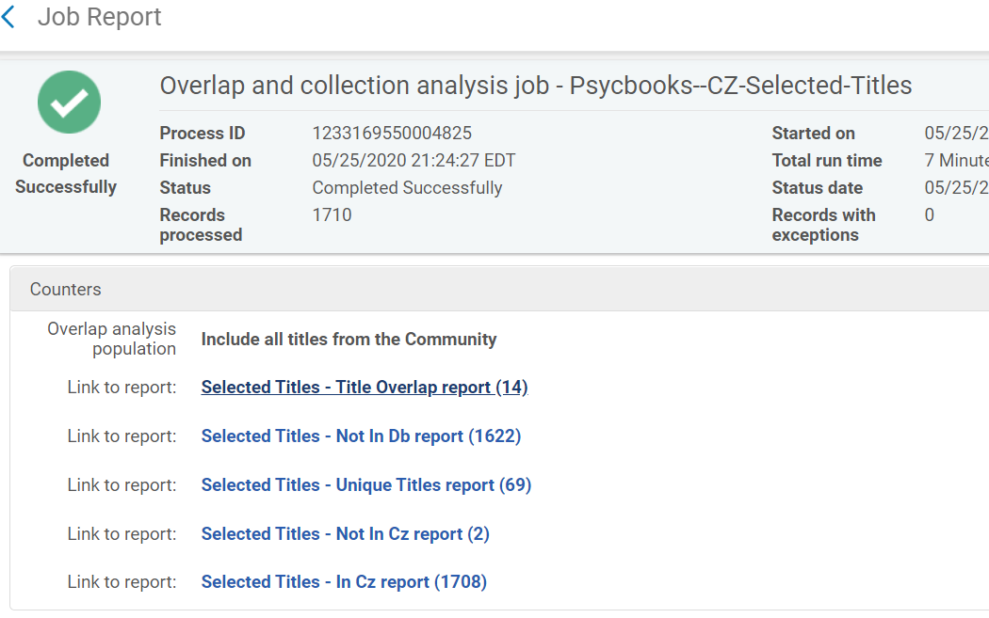
Selected Titles Report Interface
www.suny.edu

Slide 18
Selected Titles Reports
Refer to CZ Analysis:
In CZ/Not In CZ Report:
  Titles that Alma can/cannot find in the CZ.
Refer to IZ Analysis:
Not in DbReport:
  Titles not found in your Institution/IZ.
Unique Titles Report:
  From the file, those titles that exist in only one collection (so, still an overlap with your collection).
Title Overlap Report:
  From the file, those titles that exist in multiple collections (multiple overlaps in your collection).
www.suny.edu
Notes:
https://knowledge.exlibrisgroup.com/Alma/Product_Documentation/010Alma_Online_Help_(English)/050Administration/070Managing_Jobs/050Viewing_Completed_Jobs#Viewing_the_Overlap_Analysis_Job_Report

Slide 19
Demo of Selected Titles Overlap
www.suny.edu

Slide 20
What about Analytics?
There are some shared reports in the Community Section
Spent the better part of a few days trying to make these reports work, or rebuild them using similar parameters from “E-Inventory” part of Alma.
  Wasn’t successful in getting community reports to work or to rebuild reports that reliably worked.
  Limited in what you can analyze.
  Very tough to run analysis that factors in coverage.
  Could never get close to functionality of built in Overlap Jobs.
www.suny.edu

Slide 21
Alma Overlap Analysis Functionality Limitations
Collections that lack identifiers used for analysis such as streaming video.
  Title matching in selected titles is only as good as the data allows it to be.
NZ electronic collections are not able to be used in Overlap Analysis reports.
Prospective collections are unable to be compared with holdings level information.
Unactivated CZ collections cannot be compared to IZ collections.
Some CZ collections lack ISBN/ISSNs for all titles, so unless vendor provides title list with identifiers, the comparison is only partially useful.
www.suny.edu

Slide 22
Using Overlap Analyses in Collection Development
If making cuts, could factor in overlap percentage as a factor to decide what should be cut.
  Should also factor in the content that is part of overlap. Some of the overlap may be higher value than others.
  Easier to use usage and cost per use as a first cut factor, and then run overlap, as running overlap analyses is time consuming.
Consider the value of potential new proposals, especially for aggregators and large journal packages.
www.suny.edu

Slide 23
Overlap Analysis Lessons Learned
Not all journals are created equal. Review what journals are duplicated.
  Factor in cost of subscriptions to journals
  Journal quality and relevance are also important
Not all gaps are created equal.
  Frontfile content is often most important, especially in STEM fields.
  Length of gaps in coverage are also very important.
A second level of analysis is almost always helpful or needed to make reports useful.
You’ll get to know which vendors have more overlap in collections than others.
www.suny.edu

Slide 24

Overlap and Alma in General
If you don’t do this process often, it’s confusing.
The documentation on overlap analysis is dense, and sometimes omits information that would clarify how to interpret reports.
Unless it’s a simple compare 1 IZ collection to another, expect to spend some time getting familiar with the process.
Because of this, if you want an overlap analysis, you can request one from SLSS.
  Just be as specific as possible with what you’d like us to compare.
  Submit request to: info@slcny.libanswers.com
www.suny.edu

Slide 25

Question for Everyone
How do you use Overlap Analyses as part of your Collection Development Toolkit?
www.suny.edu

Slide 26


Questions?
Comments?
www.suny.edu

