Slide 1
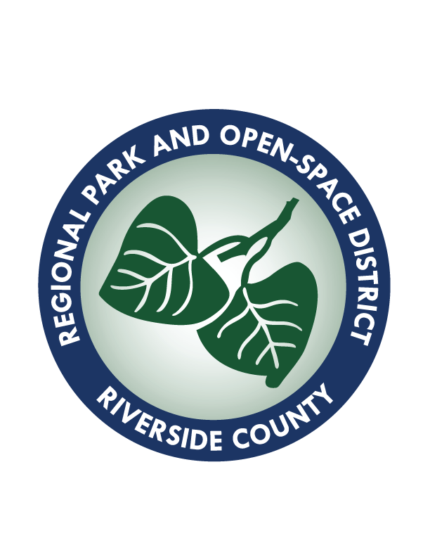
Santa Ana River Trail Riverside County
Riverside County Regional Park and Open-Space District
Camping Trails Nature Centers Ecological Reserves Historic Sites

Slide 2
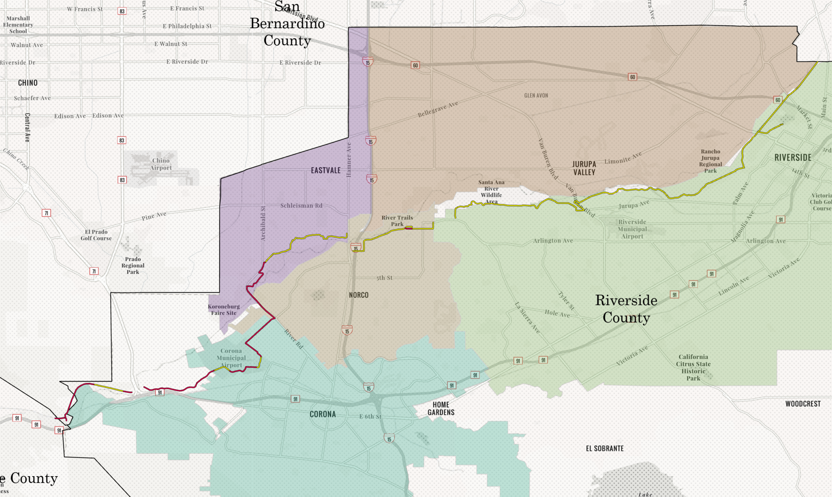
SART Alignment Overview

Slide 3
SART Overview
Status | Phase | Mileage
Planning Phase | Proposed Corona Segment Proposed Old Hamner Rd Segment (Norco) Proposed Eastvale Segment Proposed Prado Dam Bridge Phase 7 (Riverside) | 4.5 miles
Design Phase | Phase 2 (Corona) Phase 2A (Corona) Phase 3A (Unincorporated) Phase 3B (Unincorporated) Phase 6 (Corona/Unincorporated) | 5 miles
Construction Phase | Hamner Bridge | 0.3 miles
Completed | Phase 4 (Corona) Phase 5 (Unincorporated) Phase 8 (Norco) Corona STP Segment Hidden Valley Segment (Riverside) City of Riverside Segment Eastvale/JCSD Segment | 20 miles

Slide 4
SART Phase 2, 2A, 3A
Completed
Under Design

Slide 5
SART Phase 2, 2A, 3A Updates
Project Management by Riverside County Transportation Commission (RCTC)
Project construction documents at 95%
Circulation of environmental documents postponed pending changes requested by Federal Gov’t
Planning Phase funded 100%
Seeking construction funding

Slide 6
SART Phase 3B
Prado Dam

Slide 7
SART Phase 3B
Project Management by US Army Corps of Engineers
Project construction documents at 100%
Construction tied to Prado Dam Spillway Replacement Project
Tentatively scheduled for construction contract award April 2027
Prado Dam scheduled for completion 2033
Trail tentatively scheduled as one of the last items of completion

Slide 8
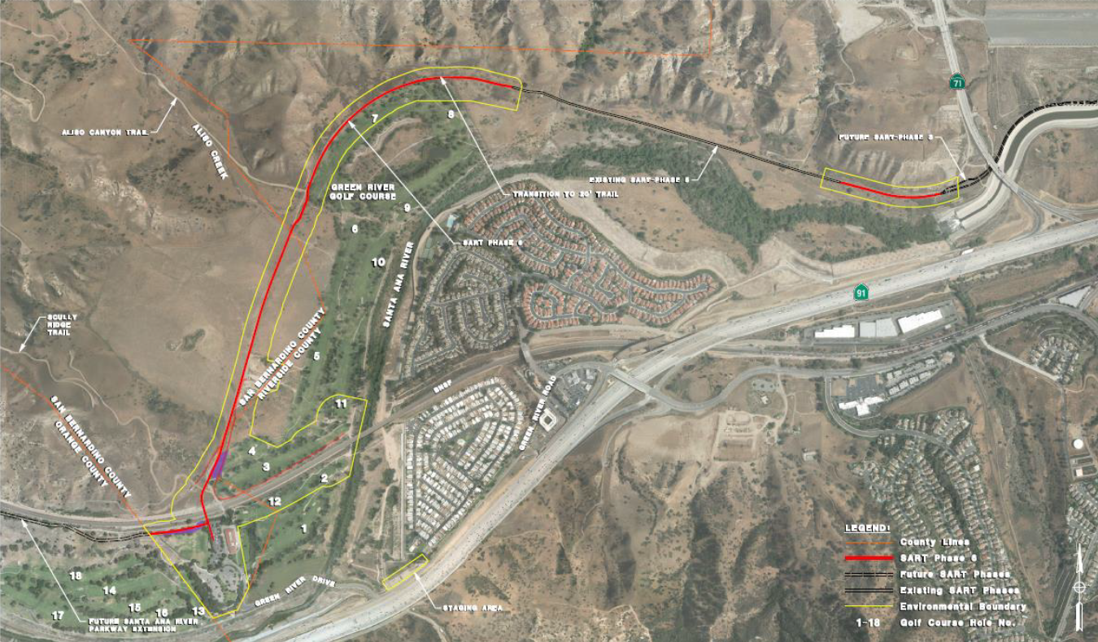
SART Phase 6

Slide 9
SART Phase 6 Updates
Also known as Green River Golf Course Segment or Pinch Point Segment
Project includes 1.65 miles of trail, two bridges, acquisition, reconstruction of impacted OCPW owned/privately run golf course
Construction documents at 95%
Environmental documents completed (IS-MND)
Easement/ROW acquisition phase underway
Federal Grant Applications submitted
RCE Grant $25.2 million – not approved
RAISE/BUILD Grant $25 million – submitted Jan 2025
$9.2 million from Coastal Conservancy approved Nov. 2024 for trail construction and ROW acquisition

Slide 10
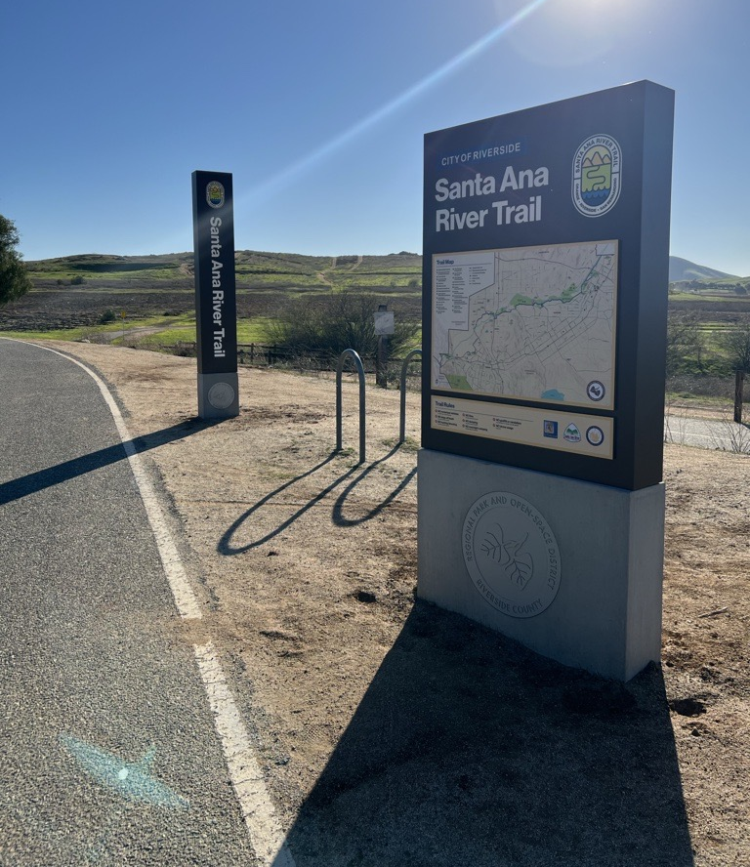
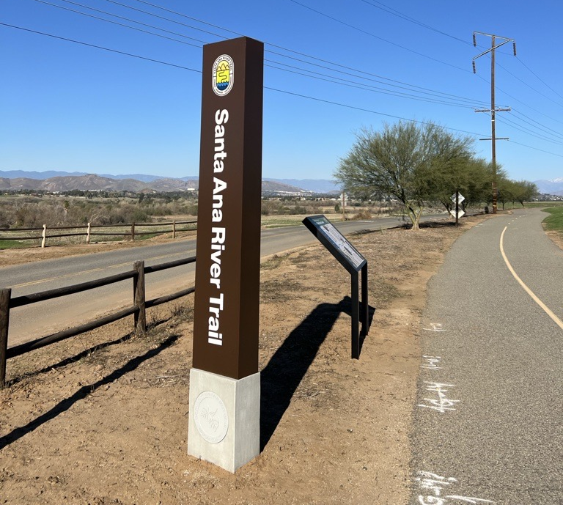
SART Wayfinding Project
$1 million project funded by ARPA
Partnership with:
City of Riverside
City of Norco
City of Eastvale
Jurupa Community Services District
National Park Service
Construction Update
40% complete
April 24 completion date
Friday, May 9 Ribbon Cutting Ceremony
CA State Parks Trails and Greenways Conference April 22-25 in Pomona, CA
April 22 Workshop - E-bike tour of SART
April 24 session on SART Wayfinding Project

Slide 11
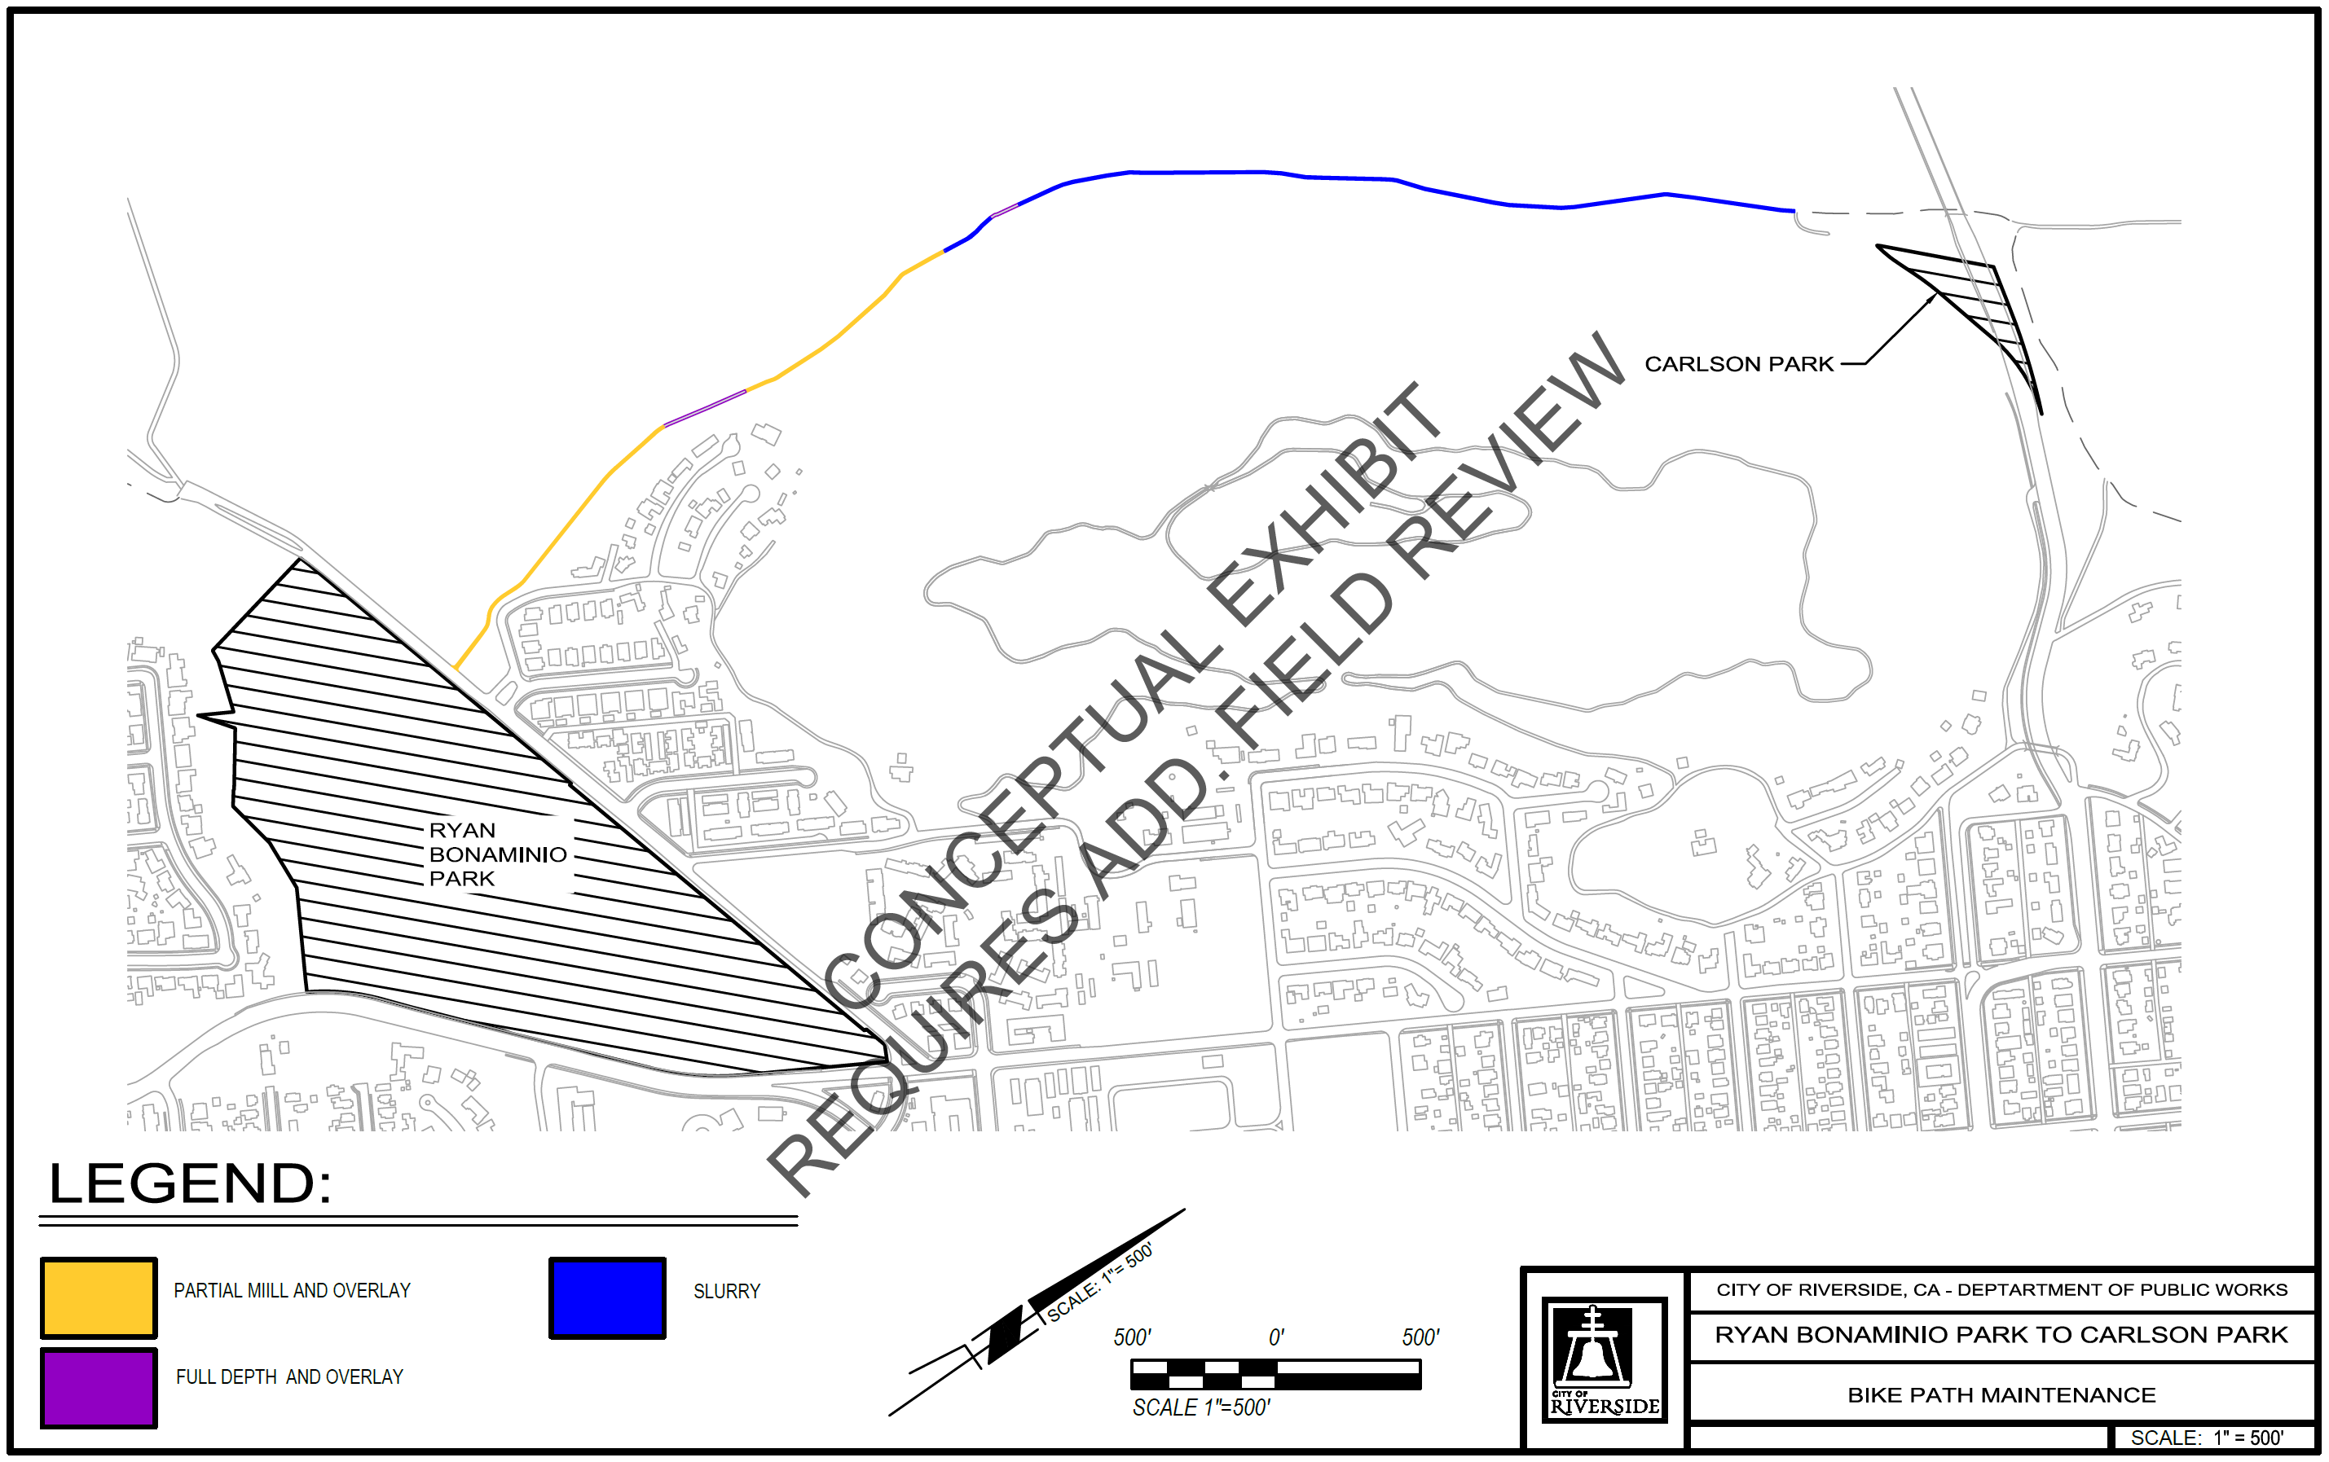
SART Repaving Project
Partnership with City of Riverside with 50:50 financial commitment
2-mile repavement of SART in City of Riverside

Slide 12
Financial Overview
Segment/Phase | Project Budget | Funding Procured | Budget Gap
Phase 2, 2A, 3A | $ 16,000,000 | $ 4,200,000 | $ 11,800,000
Phase 3B | $ 2,500,000 | $ 510,000 | $ 1,990,000
Phase 6 | $ 44,000,000 | $ 16,000,000 | $ 28,000,000
Phase 7 | $ 2,750,000 | $ - | $ 2,750,000
Proposed Corona Segment | $ 5,000,000 | $ - | $ 5,000,000
Proposed Old Hamner Rd Segment | $ 10,000,000 | $ - | $ 10,000,000
Proposed Prado Dam Bridge | $ 30,000,000 | $ - | $ 30,000,000
Proposed Eastvale Segment | $ 7,000,000 | $ - | $ 7,000,000
Total | $ 117,250,000.00 | $ 20,710,000.00 | $ 96,540,000.00

Slide 13
Comments/Questions?

