Slide 1
A continuum of LGBTIQA+ community engagement in libraries
From collections and cataloguing to book displays, bathrooms and beyond

Slide 2
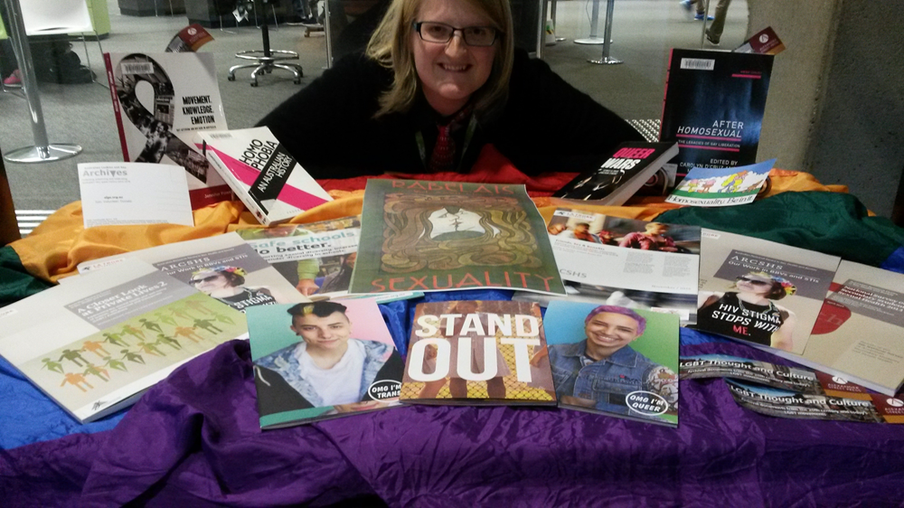
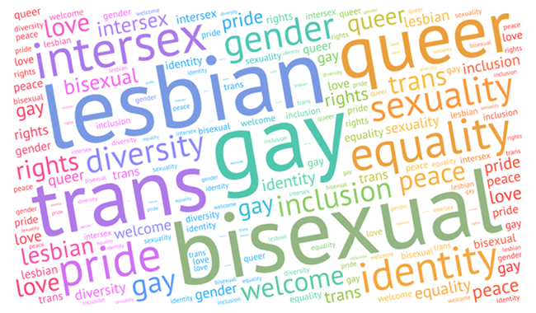
Creating safer spaces for LGBTIQA+ communities to connect with information each other on campus
Display to acknowledge the International Day against Homophobia, Biphobia, Intersexphobia and Transphobia (IDAHOBIT), recognise the extensive work academics have done in teaching, research and engagement to promote LGBTIQ equality, and to highlight some of our relevant resources.
Demonstrating that the library is a safe and welcoming place for the LGBTIQ community on campus.
A blog post by Lloyd (2010) illustrates the power of being visibly LGBTIQ-friendly in libraries and beyond.
Open to All: Serving the GLBT Community in Your Library: a toolkit prepared by American Library Association Gay, Lesbian, Bisexual, and Transgender Round Table.
Notes:
Setting the scene
Imagine you are a young LGBTIQA+ or questioning person and trying to concentrate on study in the midst of the coverage around Safe schools or the recent Australian marriage law postal survey. Or perhaps you are trying to build up the courage to come out to family and friends after learning that they voted No in the survey. Or you’re trans or non-binary and you don’t feel safe going to any toilet on campus because the last time you tried you got yelled at/threatened/kicked out. Or imagine you are a researcher in gender and sexuality studies and your research and community engagement work is being attacked and misrepresented by politicians and media. You’re probably going to find it hard to focus on your studies or research. Now imagine you walk into your university library in an attempt to escape from the negative media, politics and/or family life and focus on study or research and you discover a book display celebrating LGBTIQA+ people and the work that has been done for LGBTIQA+ communities by people at your university throughout its history.
My colleague and I collaborated widely within the library from collections and access to learning and engagement. However, we felt it was essential to collaborate beyond the library with the communities we seek to engage, so we worked with the LGBTIQA+ specialist counsellor in student wellbeing, the Australian Lesbian and Gay Archives (ALGA), the ALLY network, and the Australian Research Centre for Sex, Health and Society (ARCSHS) to prepare and promote the display. It is crucial to actively listen and adapt to feedback from community stakeholders. We adapted the display many times in response to feedback and our own critical reflections. Another great tip that will also make the process more collaborative is to find an ally or allies in your library. This will help you build courage and confidence to initiate and propose the idea, and reduce individual workload. It is definitely useful to start small and simple to test ideas, build support, trust, courage and confidence, and then reflect and adapt for the future. My initial ideas were larger than a book display and morning tea for library staff and my ally helped me adapt and propose it to our manager.
We received positive feedback from all stakeholders. It helped me foster partnerships with academics in gender, sexuality and diversity studies, history and health sciences, and with ALGA, which eventually led to one of the academics asking me to join them on ALGA’s committee. Thus it led to greater community and professional engagement.
Several people have told me that it has meant a lot to them to see me out and proud in the profession and I know how much it meant to me whenever I came across someone who was similarly out/open while I was in the closet, so I will continue to be visible and stand up for LGBTIQA+ rights and communities in libraries and beyond.
Lloyd (2010) vividly illustrates the power that even really small shows of visibility and LGBTIQA+ pride in libraries, such as badges and book displays, can have on community members. The American Library Association’s Open to All toolkit highlights different things that librarians across all sectors can do to support LGBTIQA+ communities.

Slide 3
Quick tips for queerying libraries
Question assumptions, biases, inequality, and existing ways of doing things
Be proactive
Start small
Read research on LGBTIQA+ inclusive practice in libraries as well as galleries, archives and museums
Attend LGBTIQA+ inclusive training and/or training on speaking up against LGBTIQA+ discrimination (and encourage others to attend)
Read books by LGBTIQA+ people
Talk and actively listen to LGBTIQA+ people
Find allies in your library and community
Be a visible ally
Speak up in response to library staff and visitors who express homophobic, biphobic or transphobic views or engage in any discriminatory behaviour
Notes:
Top tips
Question, Read, Listen, Learn and Act
Start small- test ideas, build support, trust and courage, reflect and adapt
Read books by LGBTIQA+ people
Talk and actively listen to LGBTIQA+ people
Attend LGBTIQA+ inclusive practice training
Importance of intersectionality and lived experiences
If you’re a gay man, you should learn from lesbian, bisexual, trans, non-binary, intersex, queer, and asexual people
If you’re a white LGBTIQA+ person, learn from People of Colour
If you’re not a First Nations person, learn from First Nations Peoples
Learn from LGBTIQA+ people of different faiths
Let people know you are an ally – display it in your email signature, on a lanyard and/or badge, at your desk or on your office door
Starting small is crucial, and responding to events, issues or initiatives on campus or in your local area or school and beyond it can be a useful gateway to action. However, it is important to do more and be proactively inclusive in order to facilitate a broader understanding of LGBTIQA+ communities in your workplace and community, and to change policies, infrastructure and culture.
Once you have started your journey with formal training and conversations/coffees, you will hopefully have gained confidence to start to do more visible and proactive actions and begin to influence curriculum development, collection development and cataloguing.

Slide 4
Recommended rainbow resources
Trans 101 videos and booklet (YGender and Minus 18)
https://www.trans101.org.au/
Pronouns (Minus 18)
https://minus18.org.au/index.php/resource-packs/pronouns
Library Bytegeist podcast: Classifying Books, Classifying People
https://medium.com/the-bytegeist-blog/classifying-books-classifying-people-302430282a3d
NC is a no-go: bathrooms, libraries, and the limits of welcoming by Chris Bourg https://chrisbourg.wordpress.com/2017/07/28/nc-is-a-no-go-bathrooms-libraries-and-the-limits-of-welcoming/
Call me by my name podcast
Notes:
Some resources to check out to help you start learning

Slide 5
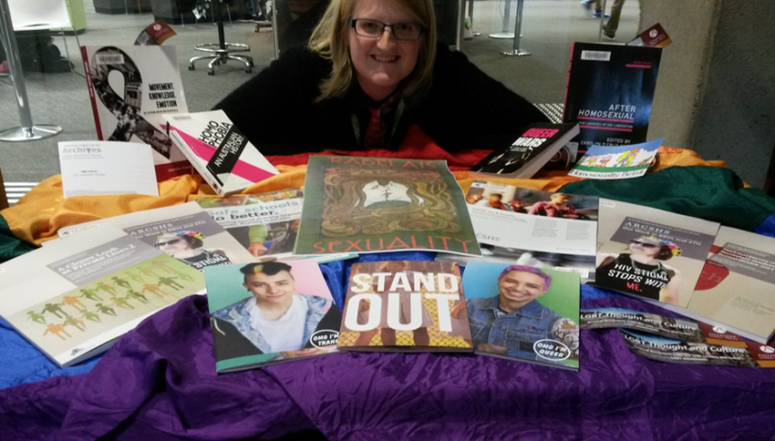
Displays
Badges
Pronouns
Flags
Book displays
Information about LGBTIQA+ campus/community services, events, and groups in library online and physical spaces
Safer spaces or zero-tolerance policy towards harassment of any guide
LibGuides
Anti-oppression Library Guide
https://simmons.libguides.com/anti-oppression
Pride Library
Gender, Sexuality and Diversity Studies Expert help guide
Social media
Notes:
Small individual displays of pride and allyship like badges, pins or lanyards can make a huge difference – you may not ever know how huge
Display your pronouns on your name badge and email signature, introduce yourself and your pronouns at meetings and encourage others to do the same
Display flags, relevant books and eresources, and community group information in the library during pride week or pride festivals or on days of significance for LGBTIQA+ communities
Help people find online resources related to LGBTIQA+ lives, health, culture and studies and even help people challenge oppression and discrimination with LibGuides

Slide 6
Collections
Books by diverse LGBTIQA+ people, including First Nations people, People of Colour, religious people, disabled people - not just those about them
Subscribe to and promote LGBTIQA+ studies resources across disciplines
Zine collections
Notes:
Kanopy, GALE, Alexander Street Press, Adam Matthew have useful film and/or archival collections related to LGBTIQA+ studies and/or gender
Zine collections are a great way to represent marginalised and underrepresented voices – they can be useful for students and researchers across a number of disciplines – gender, sexuality and diversity studies, history, health, social work, sociology, legal studies, English and creative arts, cultural studies

Slide 7
Curriculum
Use diverse research or keyword examples related to LGBTIQA+ communities in classes across disciplines – health, education, law, legal studies, history – not just for gender and sexuality studies
If you curate resources for lecturers, students or researchers, make sure you represent research and works from diverse voices within LGBTIQA+ communities
Use they/them pronouns as a default in class
Notes:
Don’t assume everyone is male or female, don’t assume anyone’s gender

Slide 8
Cataloguing and classification
Think critically about subject headings when cataloguing and/or copy cataloguing
Keep up with changes and proposed changes to cataloguing and classification systems
Help reform the systems by proposing and advocating for changes
Cataloguing lab
Use folksonomies/tagging systems to augment your catalogue and let your communities describe and find items in their own words
Notes:
– is the language and location appropriate? Outdated? Offensive?
The Cataloguing lab is a great project in the US – gender non-conconforming LCSH
Host metadata parties with tea, cake and cataloguing to bring people together and help them engage with the folksonomy/tagging system to improve the catalogue – and perhaps even invite them to write and share reviews or just lists of recommended books /databases to help others find them – it could help bring people together in a quiet, nerdy way and build a sense of community

Slide 9
Events
Rainbow cake
Human library
Zine making workshops
Rainbow storytime
Drag queen research hour
Bibliotherapy / shelf help
Metadata parties
Notes:
Small displays of visibility in collections, catalogues and curriculum will help you build trust with LGBTIQA+ communities on campus or in your area and find and recruit allies to help you organise events and make larger scale changes
offer space and/or other library facilities to host events during pride week on campus or pride month in your town
Attend events where appropriate to learn more about LGBTIQA+ communities on campus – e.g. keep an eye out for training sessions on challenging homophobia, biphobia and/or transphobia open to staff as well as students
ask to have a stall to showcase relevant resources staffed by librarians who can help people find and navigate them
Then, partner with groups to co-host an event – e.g. morning tea with rainbow cake, bibliotherapy or shelf help with student wellbeing or counselling could be a safe, fun, informal gaytway to counselling services, human libraries, rainbow storytime, drag queen research hour, zine making workshops
Several University libraries in Australia have partnered with their ALLY Networks to host human libraries for IDAHOBIT and related days
It makes sense to do this during pride week on campus and/or other days of significance such as IDAHOBIT, Bi Visibility Day, Transgender Day of Remembrance, International Non-Binary Day, International Trans Day of Visibility
Zine making workshops – help LGBTIQA+ people tell and share their stories, capture and connect with their histories, and perhaps even contribute to the library’s collection if you have a zine collection (or be the start of a zine collection if you don’t have one! – that would help you develop a more diverse and inclusive collection
Whenever you bring LGBTIQA+ people together for any of these events or meetings, start them by getting everyone to introduce themselves and their pronouns or have them add pronouns to their name tag

Slide 10
Language
Forms
Surveys
Loans/borrower notices
Notes:
Remove gendered language and titles from library forms, surveys and/or loans/borrower notices
If you decide you must include gender for some reason, then make sure you add more inclusive options than just binary male or female – and a free text option and option to leave it blank

Slide 11
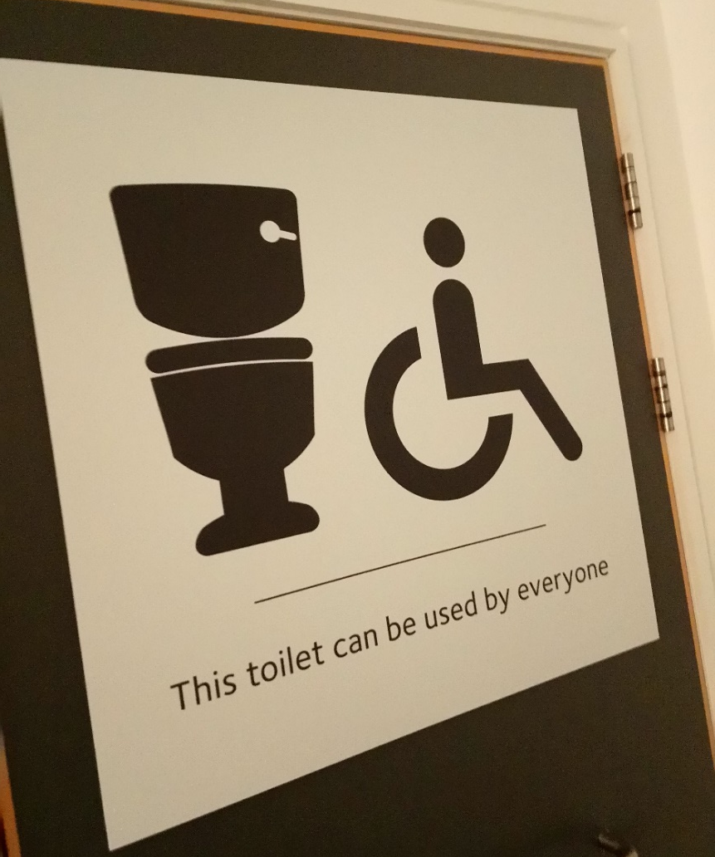
Bathrooms for all
Repurpose existing infrastructure
Ensure all major refurbishment projects include all gender toilet facilities
All single stall toilets should be for people of all genders
DIY inclusive signs
Notes:
Repurpose existing infrastructure/bathroom signs with new all gender signage – e.g. “all gender with sanitary bins”, “all gender with urinals” – you can start by having temporary DIY signs like those pictured for LGBTIQA+ events in the library
Make all single stall toilets, including but not limited to disabled toilets, all gender ones – there is no justification for any single stall toilet to be binary male/female at all
Add all gender toilet facilitates in any major building refurbishment
If you can’t change signage like this or add all gender toilets another way – create a poster or sign urging people to respect people and let the bathroom that feels right to them without question

Slide 12
Rainbow References
References:
American Library Association Gay, Lesbian, Bisexual, and Transgender Round Table (2016). Open to All: Serving the GLBT Community in Your Library. Retrieved from: http://www.ala.org/glbtrt/sites/ala.org.glbtrt/files/content/professionaltools/160309-glbtrt-open-to-all-toolkit-online.pdf.
Drabinski, E. (2013). Queering the Catalogue: Queer Theory and the Politics of Correction, The Library Quarterly 83(2),94-111. Retrieved from :
Farrell, S.L. and Mastel, K. (2016), Considering Outreach Assessment: Strategies, Sample Scenarios, and a Call to Action. In the Library with the Lead Pipe, Retrieved from: http://www.inthelibrarywiththeleadpipe.org/2016/considering-outreach-assessment-strategies-sample-scenarios-and-a-call-to-action.
Lloyd, E. (2010, October 2). Being Visibly Queer-Friendly: Please Consider It. Poesy Galore. Retrieved from: http://poesygalore.blogspot.com.au/2010/10/being-visibly-queer-friendly-please.html
Wood, L.M. (2012). Out of the Library and Into the Wild. In the Library with the Lead Pipe. Retrieved from: http://www.inthelibrarywiththeleadpipe.org/2012/out-of-the-library-and-into-the-wild/.
American Library Association Gay, Lesbian, Bisexual, and Transgender Round Table (2016). Open to All: Serving the GLBT Community in Your Library: http://www.ala.org/glbtrt/sites/ala.org.glbtrt/files/content/professionaltools/160309-glbtrt-open-to-all-toolkit-online.pdf.
ALA Office for Intellectual Freedom, Out in the Library: Materials, Displays and Services for the Gay, Lesbian, Bisexual, and Transgender Community
A brief history of homophobia in Dewey decimal classification By Doreen Sullivan
https://overland.org.au/2015/07/a-brief-history-of-homophobia-in-dewey-decimal-classification/
Cruising the Library: Perversities in the Organization of Knowledge by Melissa Adler
Naming the Love that Dare Not Speak Its Name: A Look at How Gays and Lesbians are Classified in the Dewey Decimal System

Slide 13
Rainbow Connections
Connect:
Join your university’s Pride or ALLY network (or related group) and get in touch with queer student union representatives
IFLA LGBTQ SIG
Academic librarians and social justice group: http://socialjusticelibrarians.pbworks.com/w/page/112578373/Academic%20Librarians%20and%20Social%20Justice%20LIST
#critlib
#Auslibchat: https://alianewgrads.wordpress.com/new-generation-advisory-committee/auslibchat/
On accessibility for a diverse community
On collaboration
On social justice
On LGBTIQA+ services
On critical librarianship
Explore resources from:
The Pride Library at Western University (Canada): http://www.uwo.ca/pridelib/
The Network (UK): http://www.seapn.org.uk/
Whole Person Librarianship

Slide 14
Further queeries
Contact me for further clareification:
Twitter @clareifications
Queeries and Clareification blog www.queerbrarian.wordpress.com
Notes:
Thank you

