Slide 1
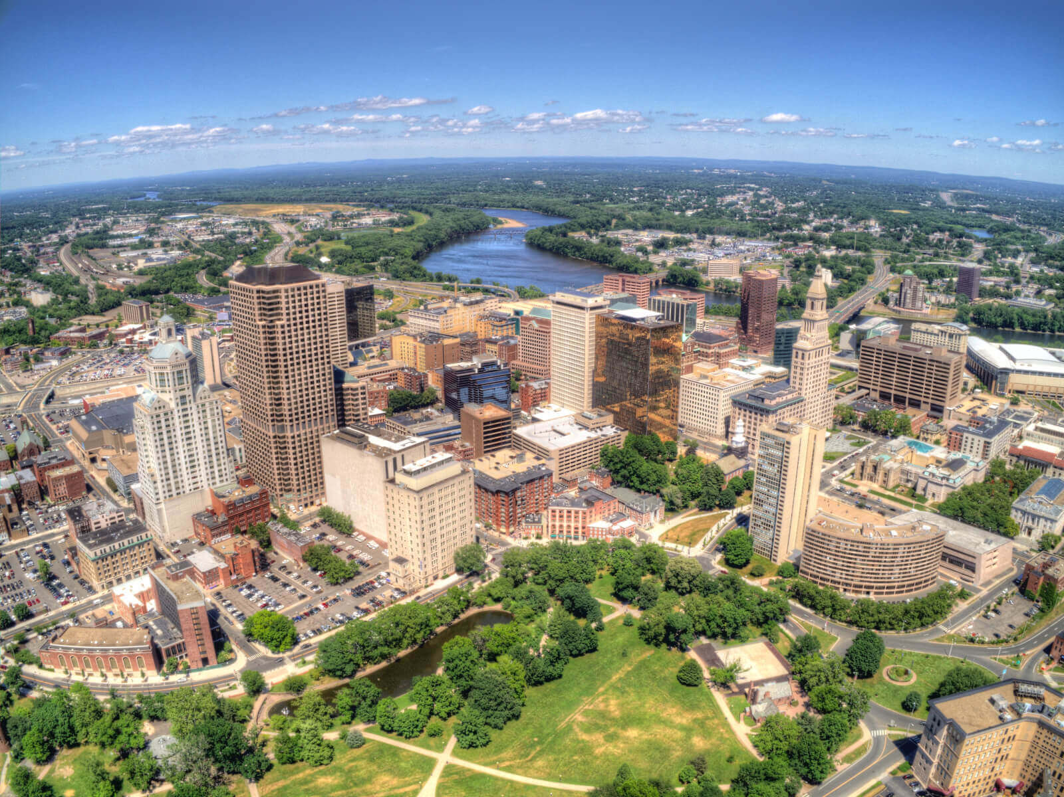
HARTFORD
Zoning in a Post-Industrial City
10/15/2020 Presentation to Live Green CT’s EV Readiness Program Module 5: Zoning

Slide 2
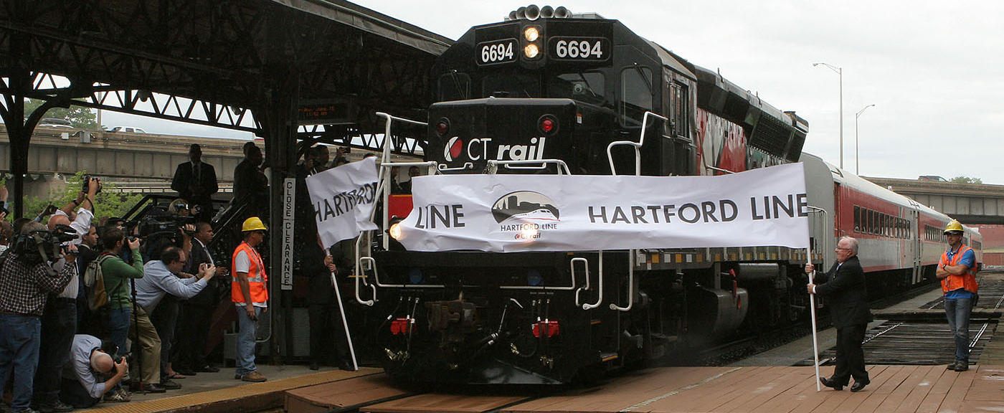
Initiatives
Broad environmental purposes served
Varied transportation initiatives created
10/15/2020 Presentation to Live Green CT’s EV Readiness Program Module 5: Zoning

Slide 3
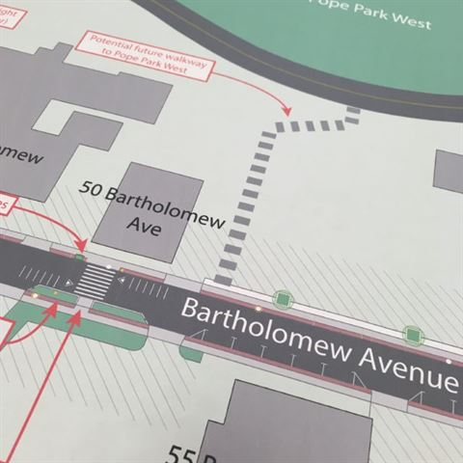
Approaches
Zoning Regulations
Plan of Conservation and Development
10/15/2020 Presentation to Live Green CT’s EV Readiness Program Module 5: Zoning

Slide 4
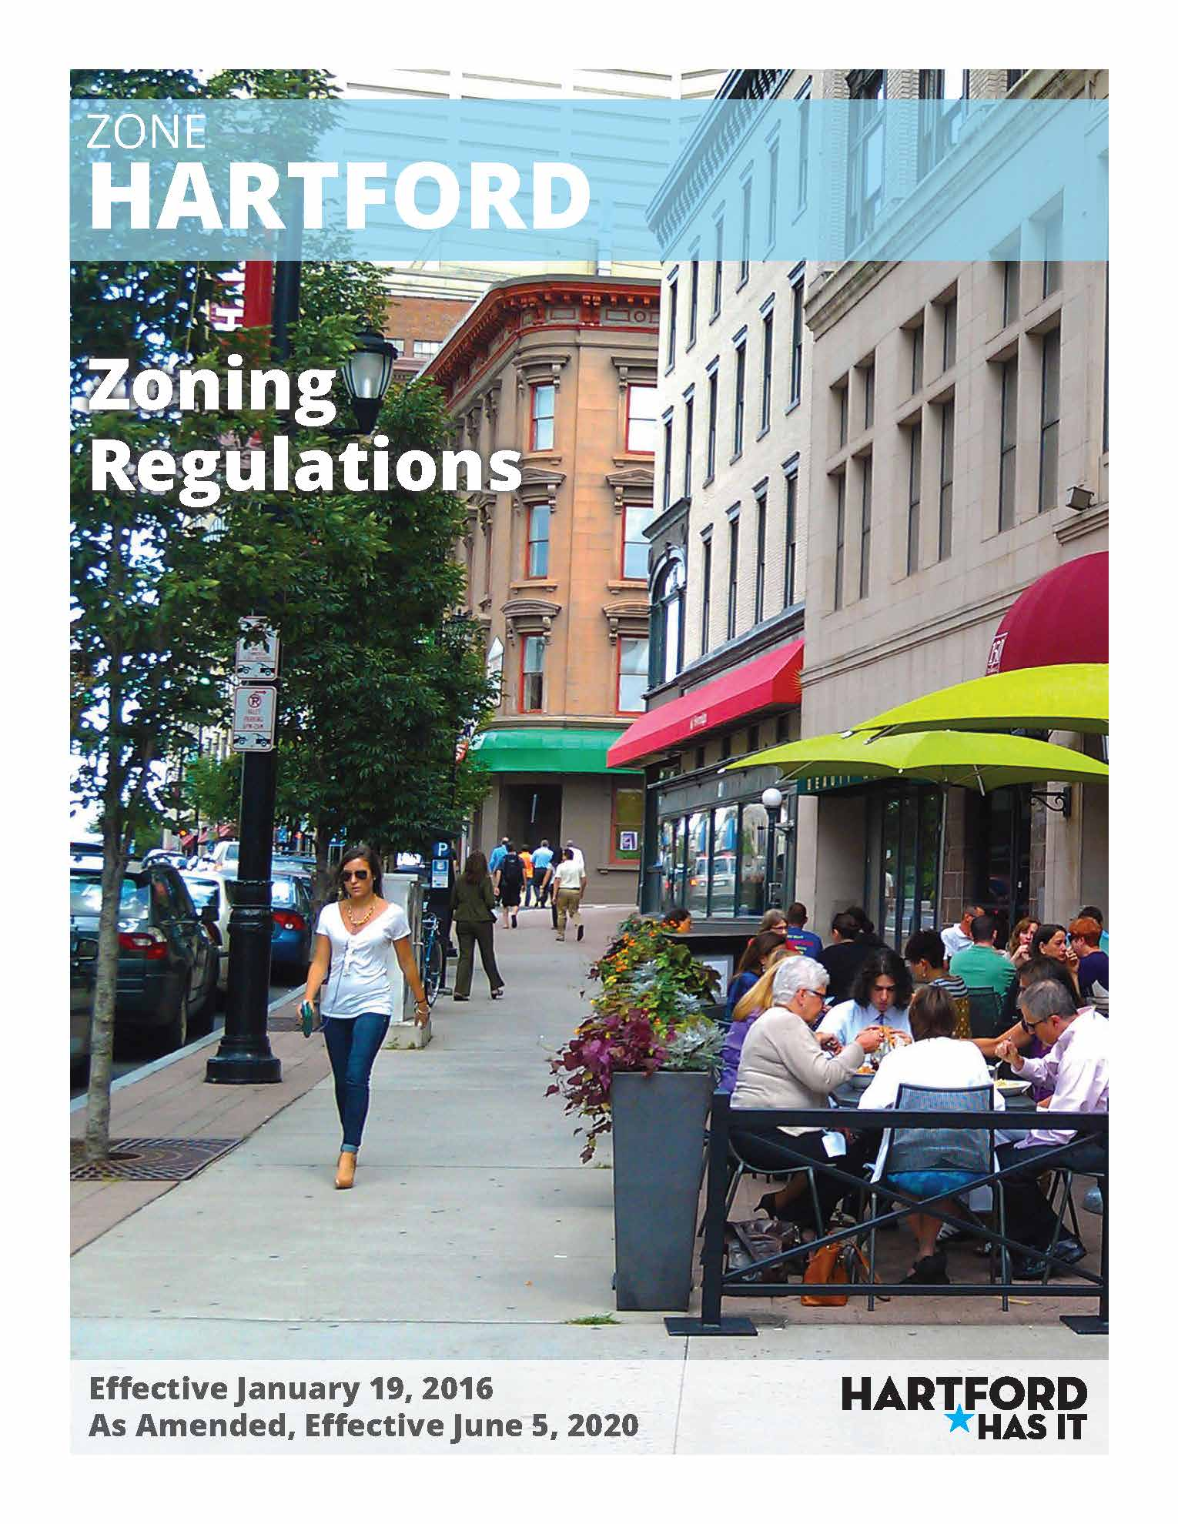
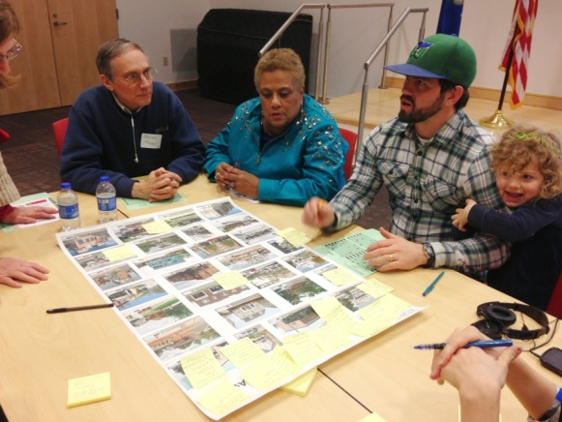
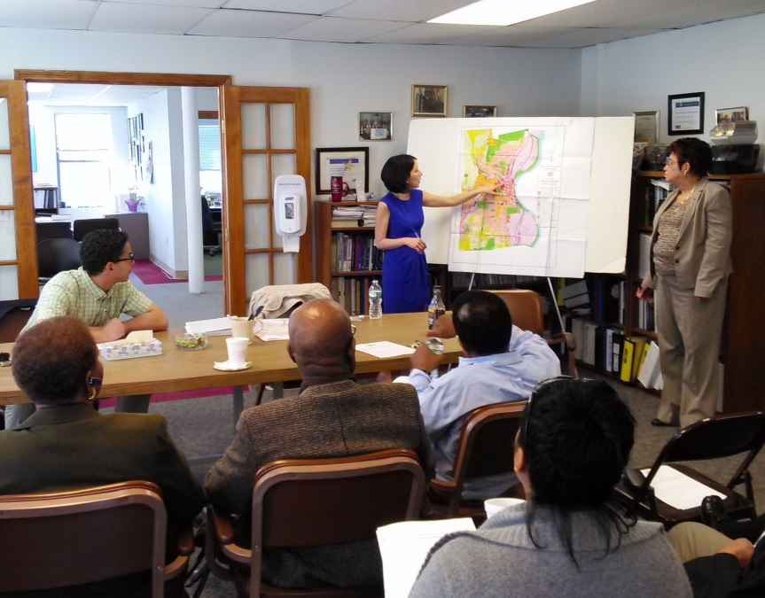
Zoning Regulations
10/15/2020 Presentation to Live Green CT’s EV Readiness Program Module 5: Zoning

Slide 5
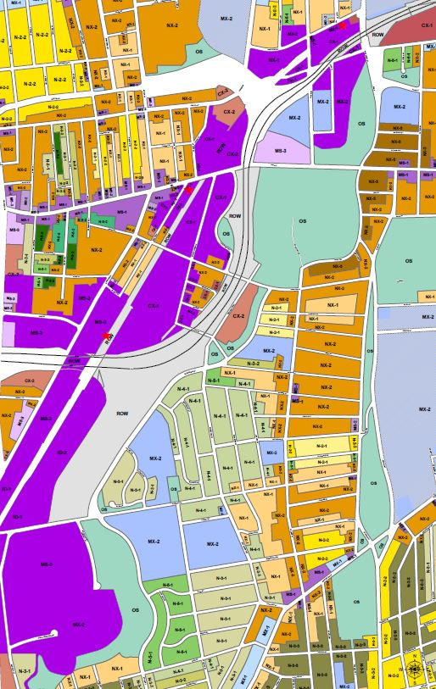
Transit Overlay Districts
Located along the CTfastrak bus rapid transit system
Existing structures: mostly 1-story & parking lots
New zoning:
Minimum 3.5 stories structures
Up to 8 stories + 6 stories in bonuses
Any uses allowed downtown
No parking required (here or anywhere)
10/15/2020 Presentation to Live Green CT’s EV Readiness Program Module 5: Zoning

Slide 6
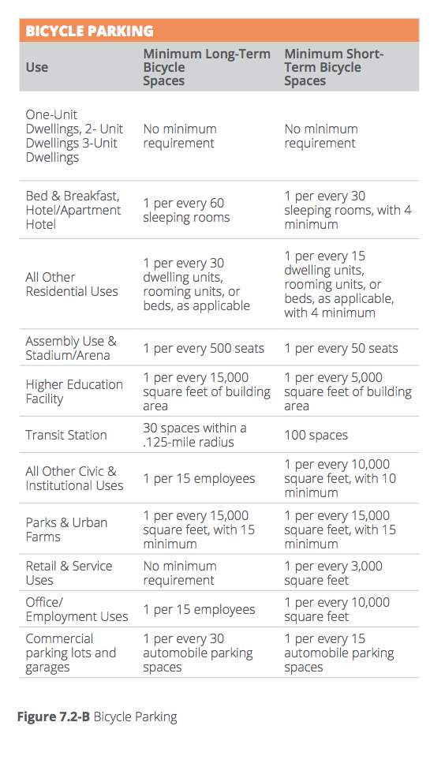
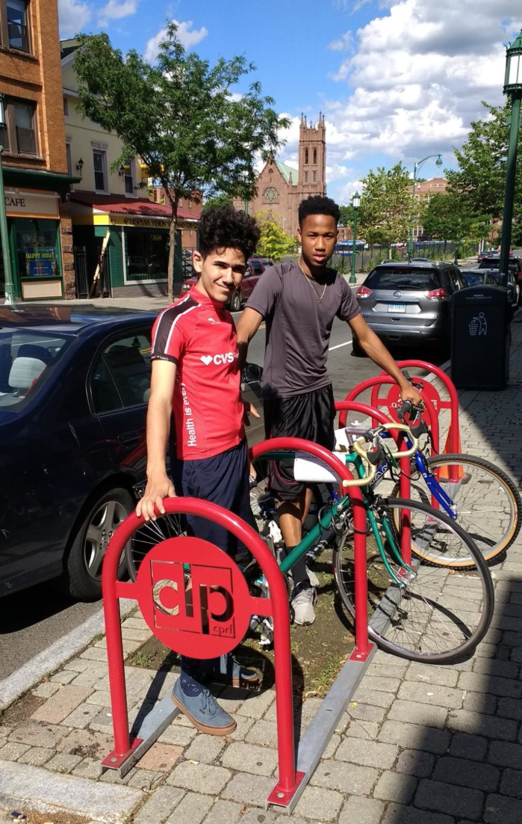
Bike Parking
10/15/2020 Presentation to Live Green CT’s EV Readiness Program Module 5: Zoning

Slide 7
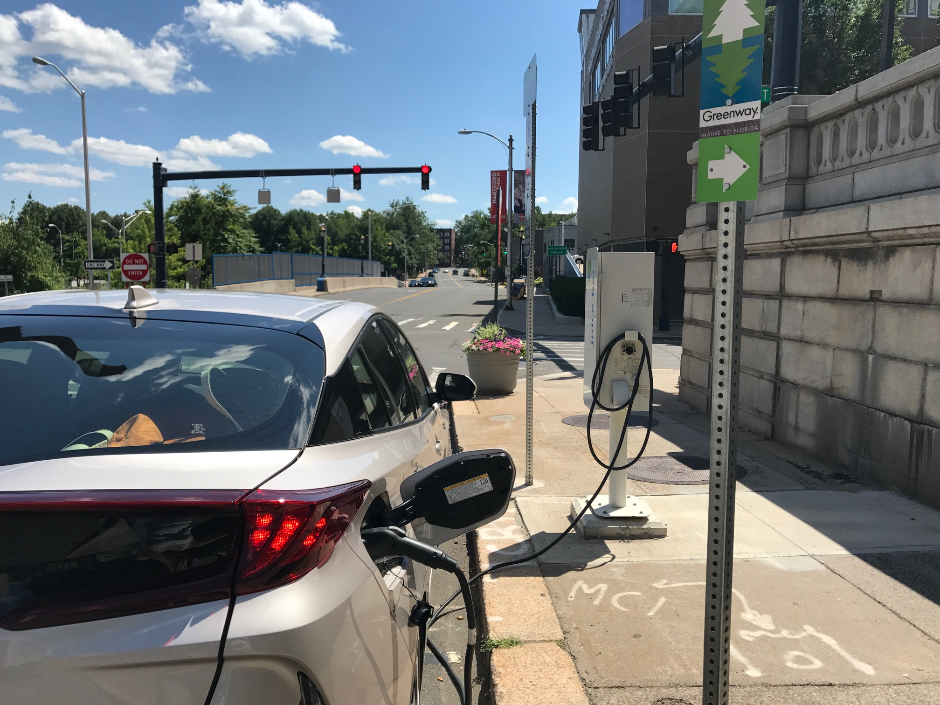
EV Charging Stations/Parking
10/15/2020 Presentation to Live Green CT’s EV Readiness Program Module 5: Zoning

Slide 8
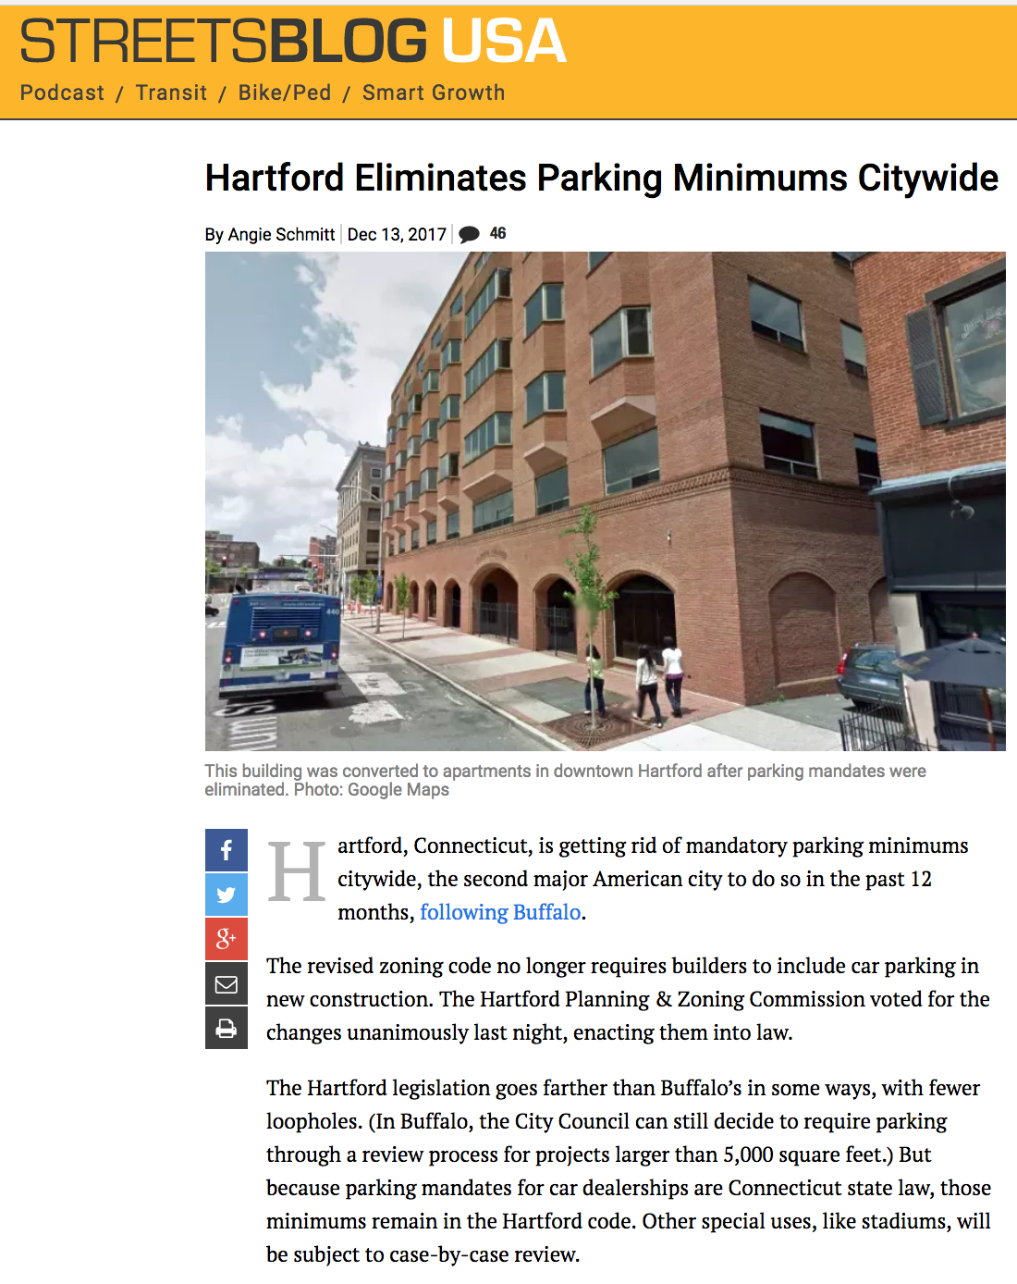
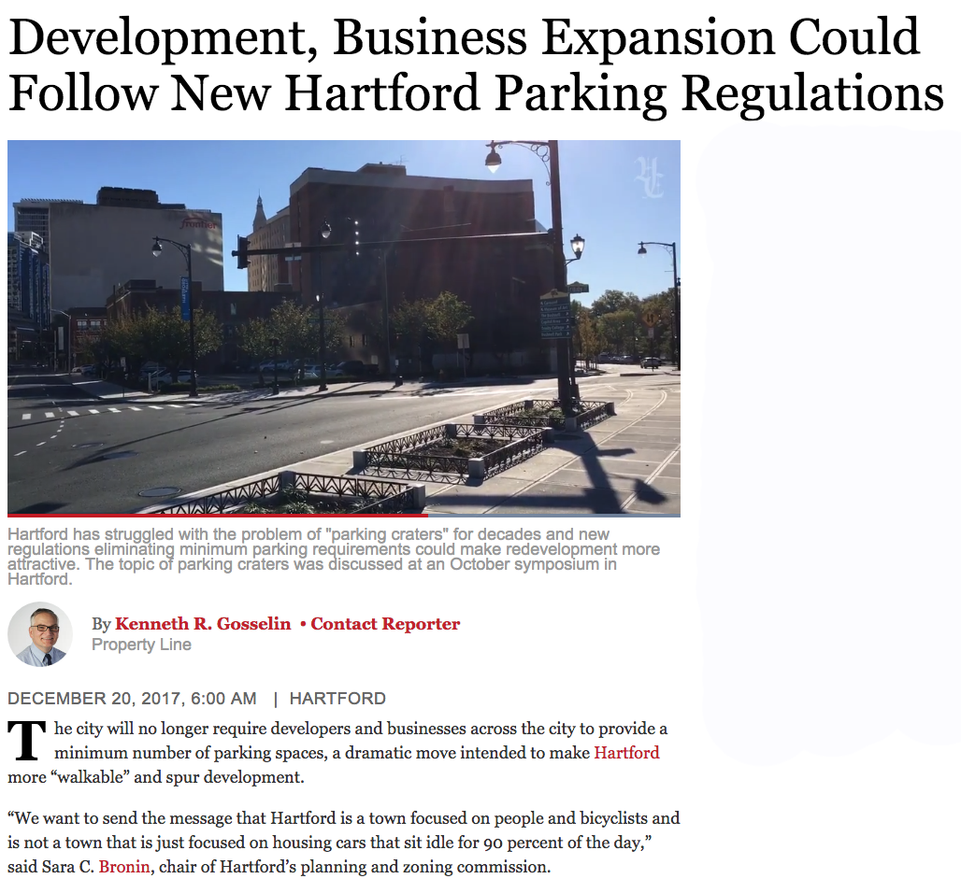
Parking Minimums
10/15/2020 Presentation to Live Green CT’s EV Readiness Program Module 5: Zoning

Slide 9
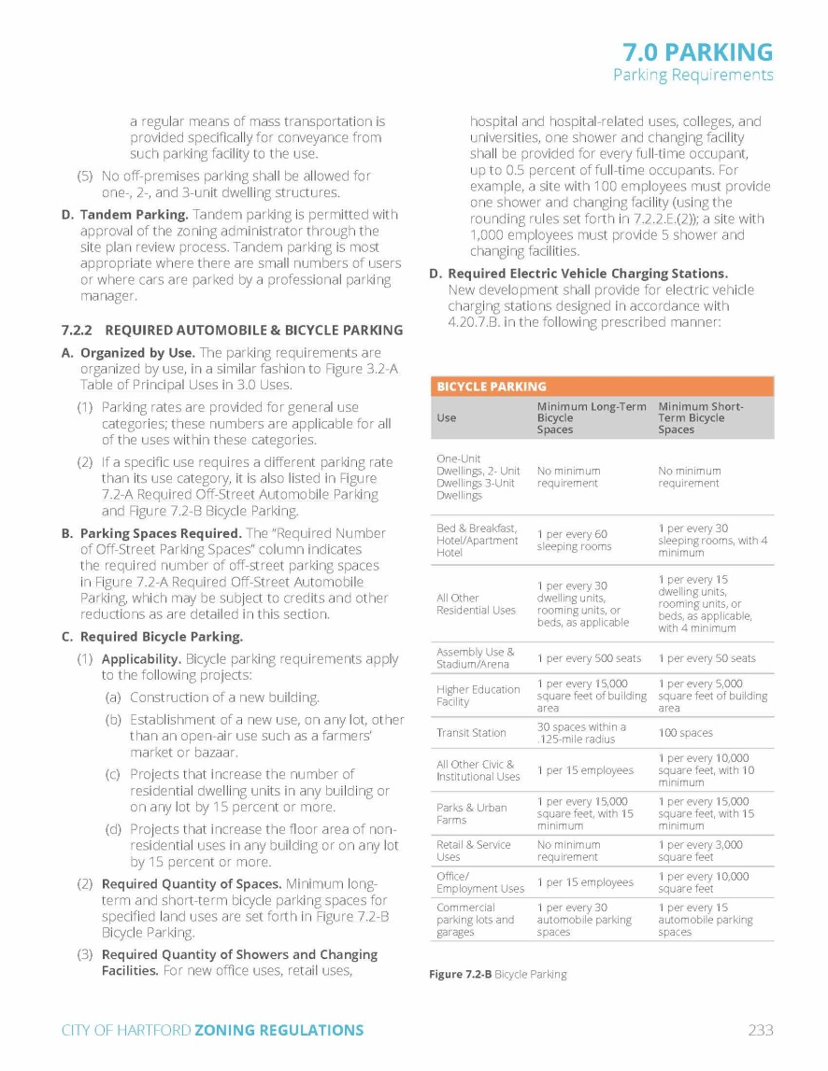
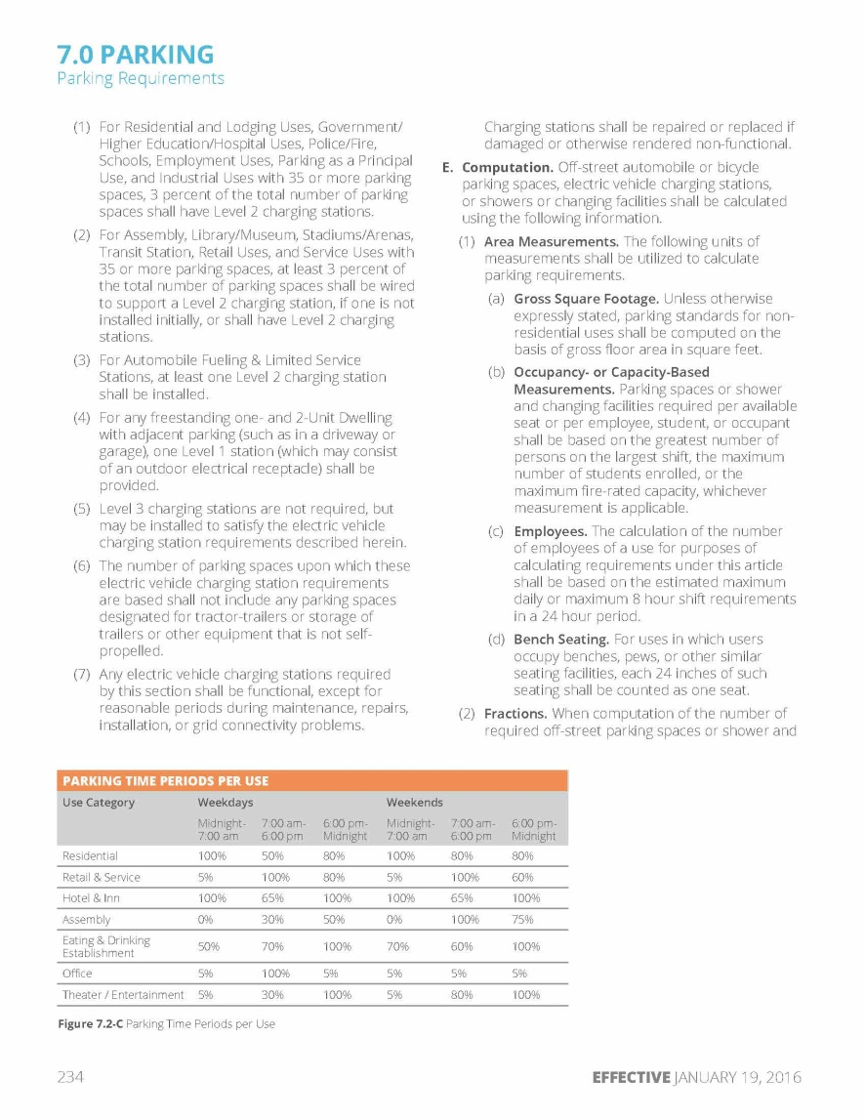
Zoning Regulations – Parking Provisions
10/15/2020 Presentation to Live Green CT’s EV Readiness Program Module 5: Zoning

Slide 10
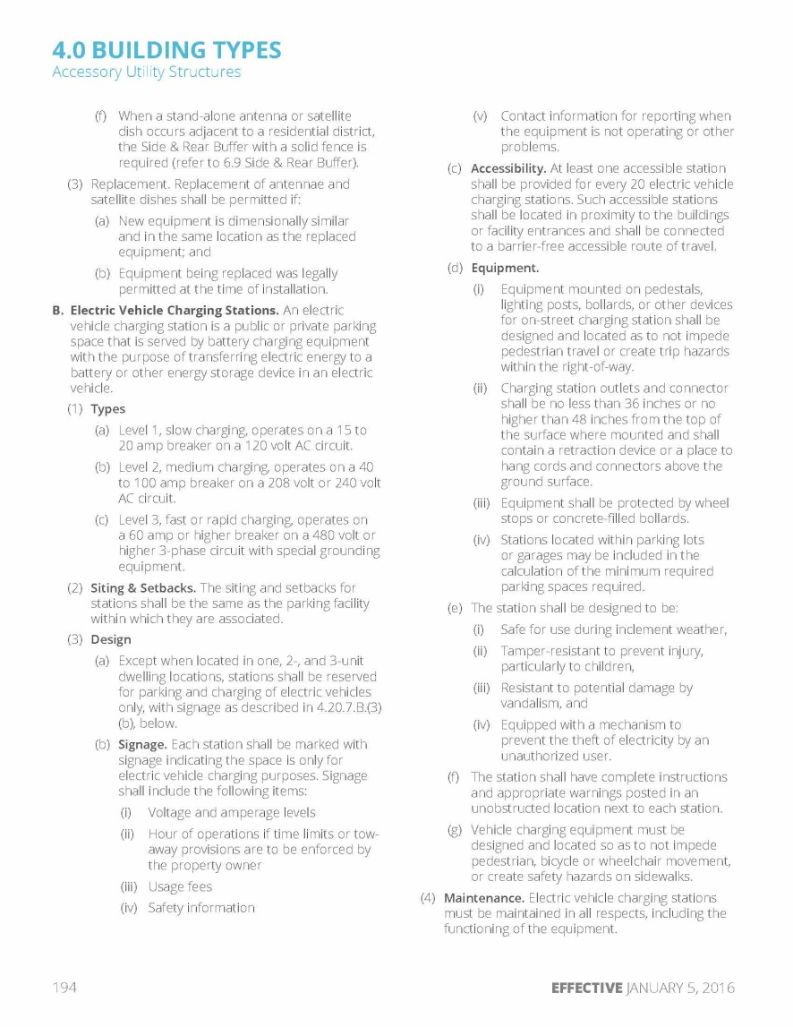
Zoning Regulations – Building Type
10/15/2020 Presentation to Live Green CT’s EV Readiness Program Module 5: Zoning

Slide 11
Plan of Conservation and Development
10/15/2020 Presentation to Live Green CT’s EV Readiness Program Module 5: Zoning

Slide 12
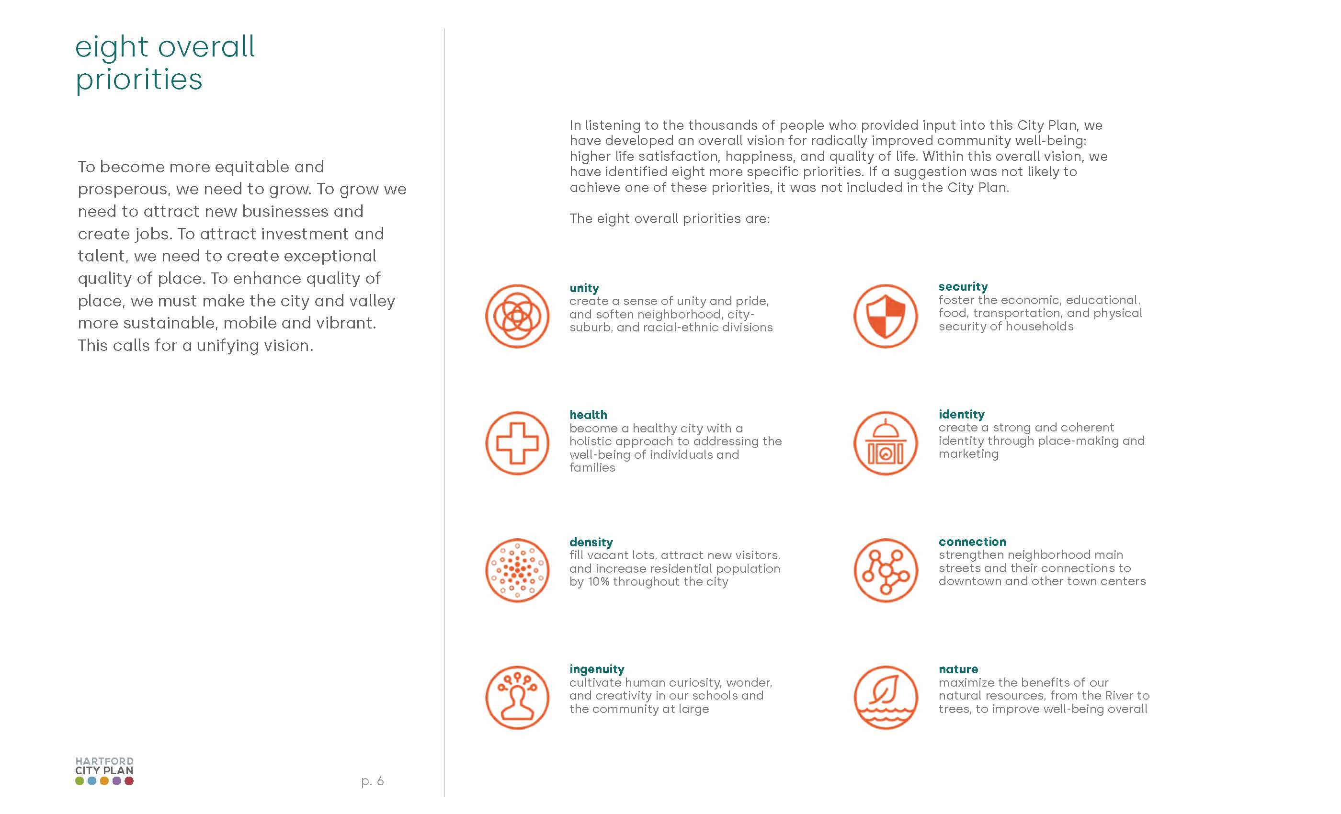
Plan of Conservation and Development
10/15/2020 Presentation to Live Green CT’s EV Readiness Program Module 5: Zoning

Slide 13
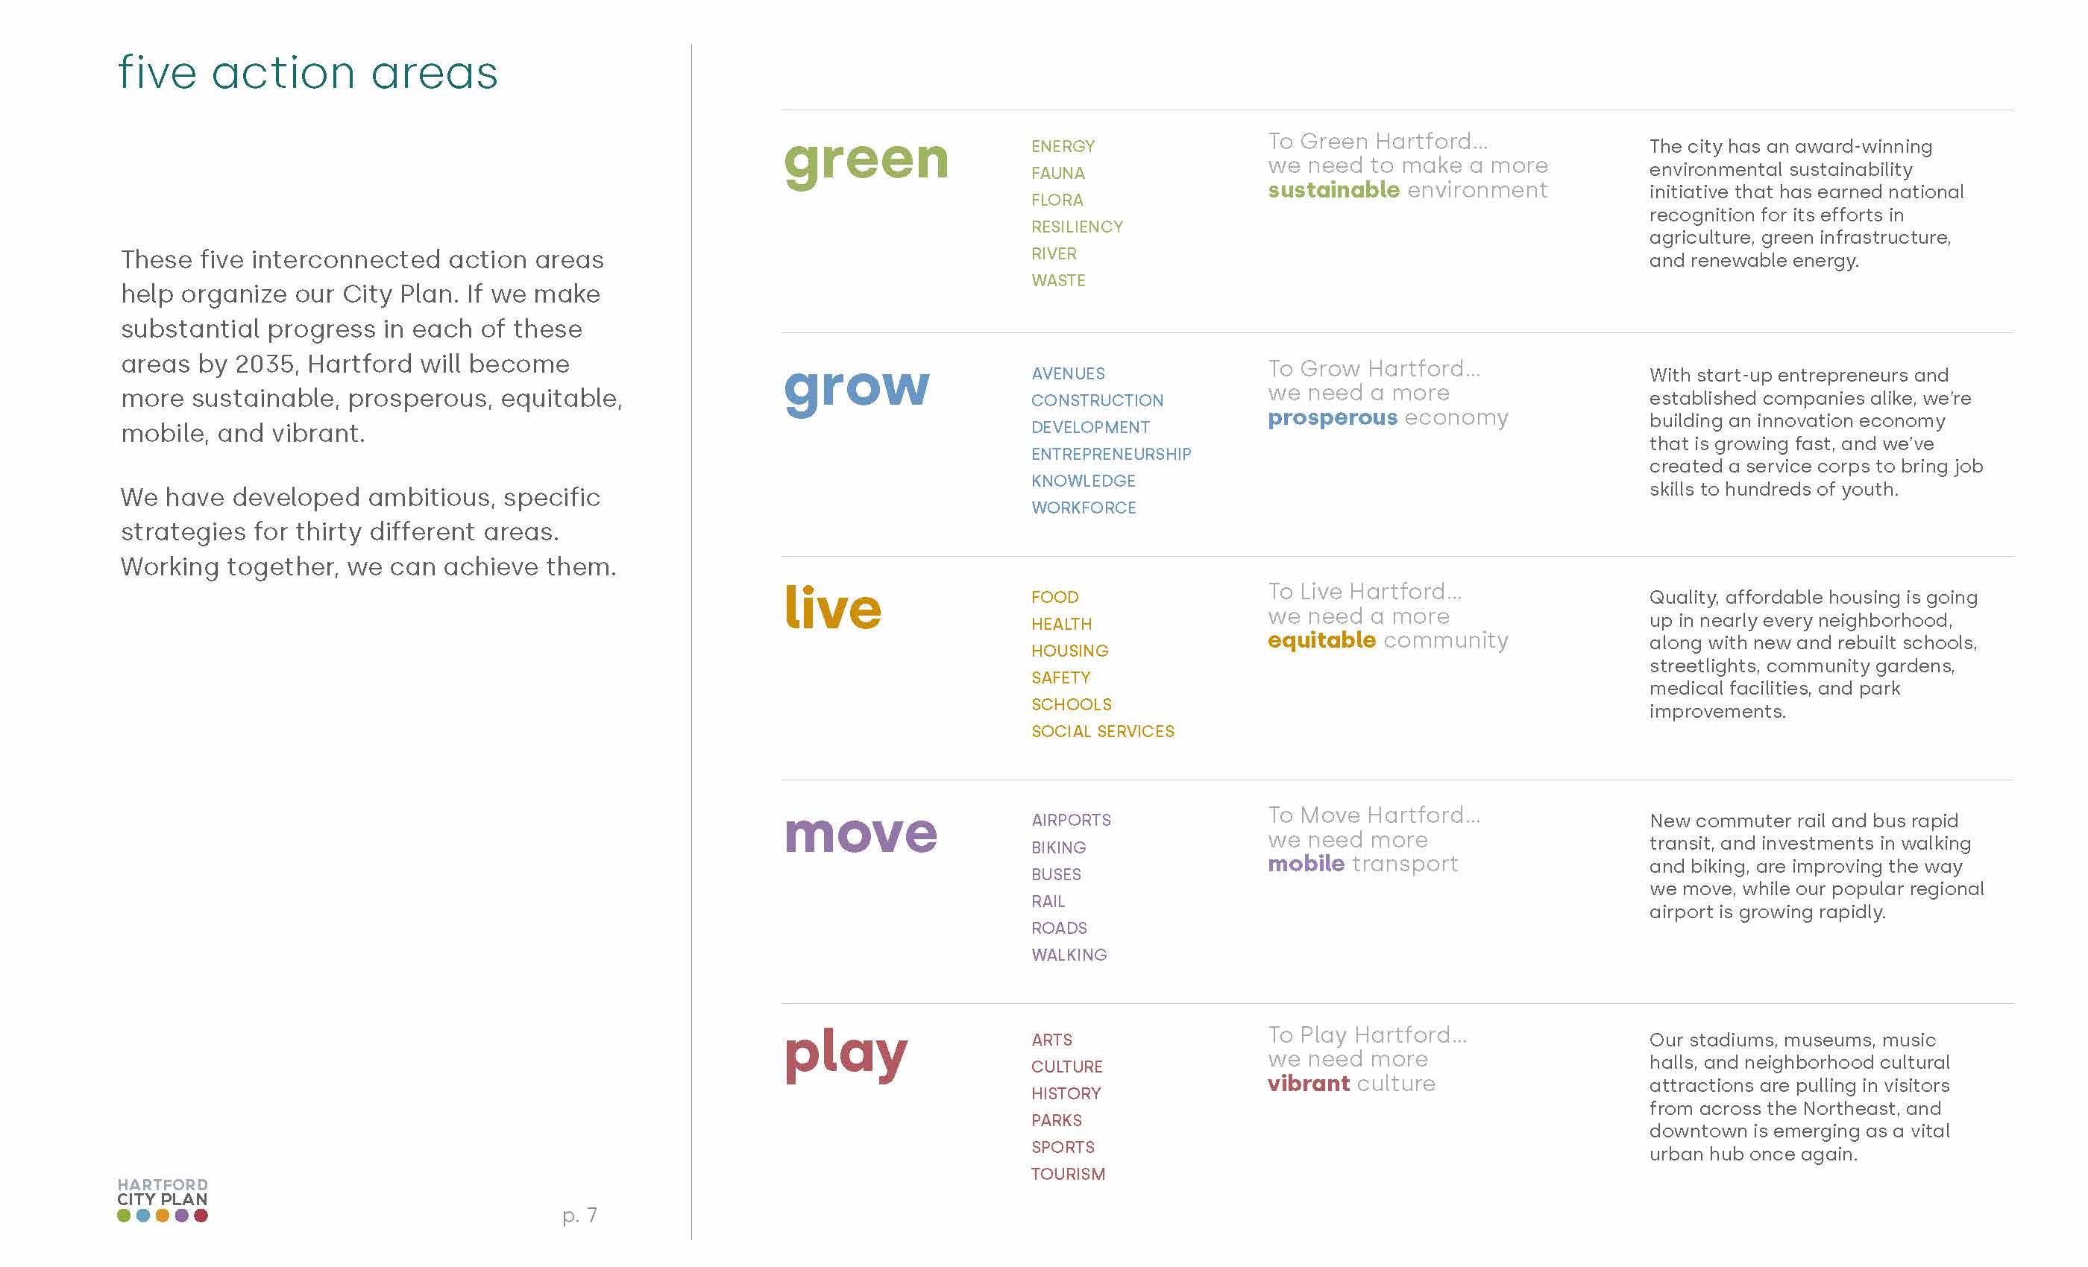
Plan of Conservation and Development
10/15/2020 Presentation to Live Green CT’s EV Readiness Program Module 5: Zoning

Slide 14
Plan of Conservation and Development
10/15/2020 Presentation to Live Green CT’s EV Readiness Program Module 5: Zoning

Slide 15
Plan of Conservation and Development
10/15/2020 Presentation to Live Green CT’s EV Readiness Program Module 5: Zoning

Slide 16
Plan of Conservation and Development
10/15/2020 Presentation to Live Green CT’s EV Readiness Program Module 5: Zoning

Slide 17
Plan of Conservation and Development
10/15/2020 Presentation to Live Green CT’s EV Readiness Program Module 5: Zoning

Slide 18
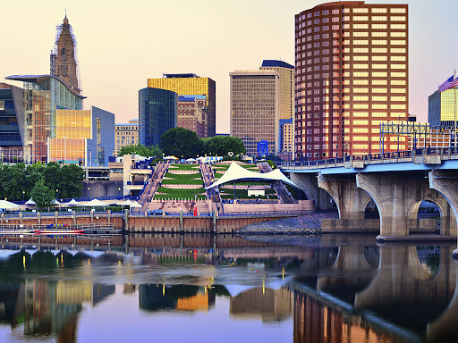
Resources
Zoning Regulations
https://www.hartfordct.gov/Government/Departments/DDS/DDS-Divisions/Planning-Zoning
Plan of Conservation and Development
(2020 City Action Plan)
https://hartford2035.org/
10/15/2020 Presentation to Live Green CT’s EV Readiness Program Module 5: Zoning

Slide 19
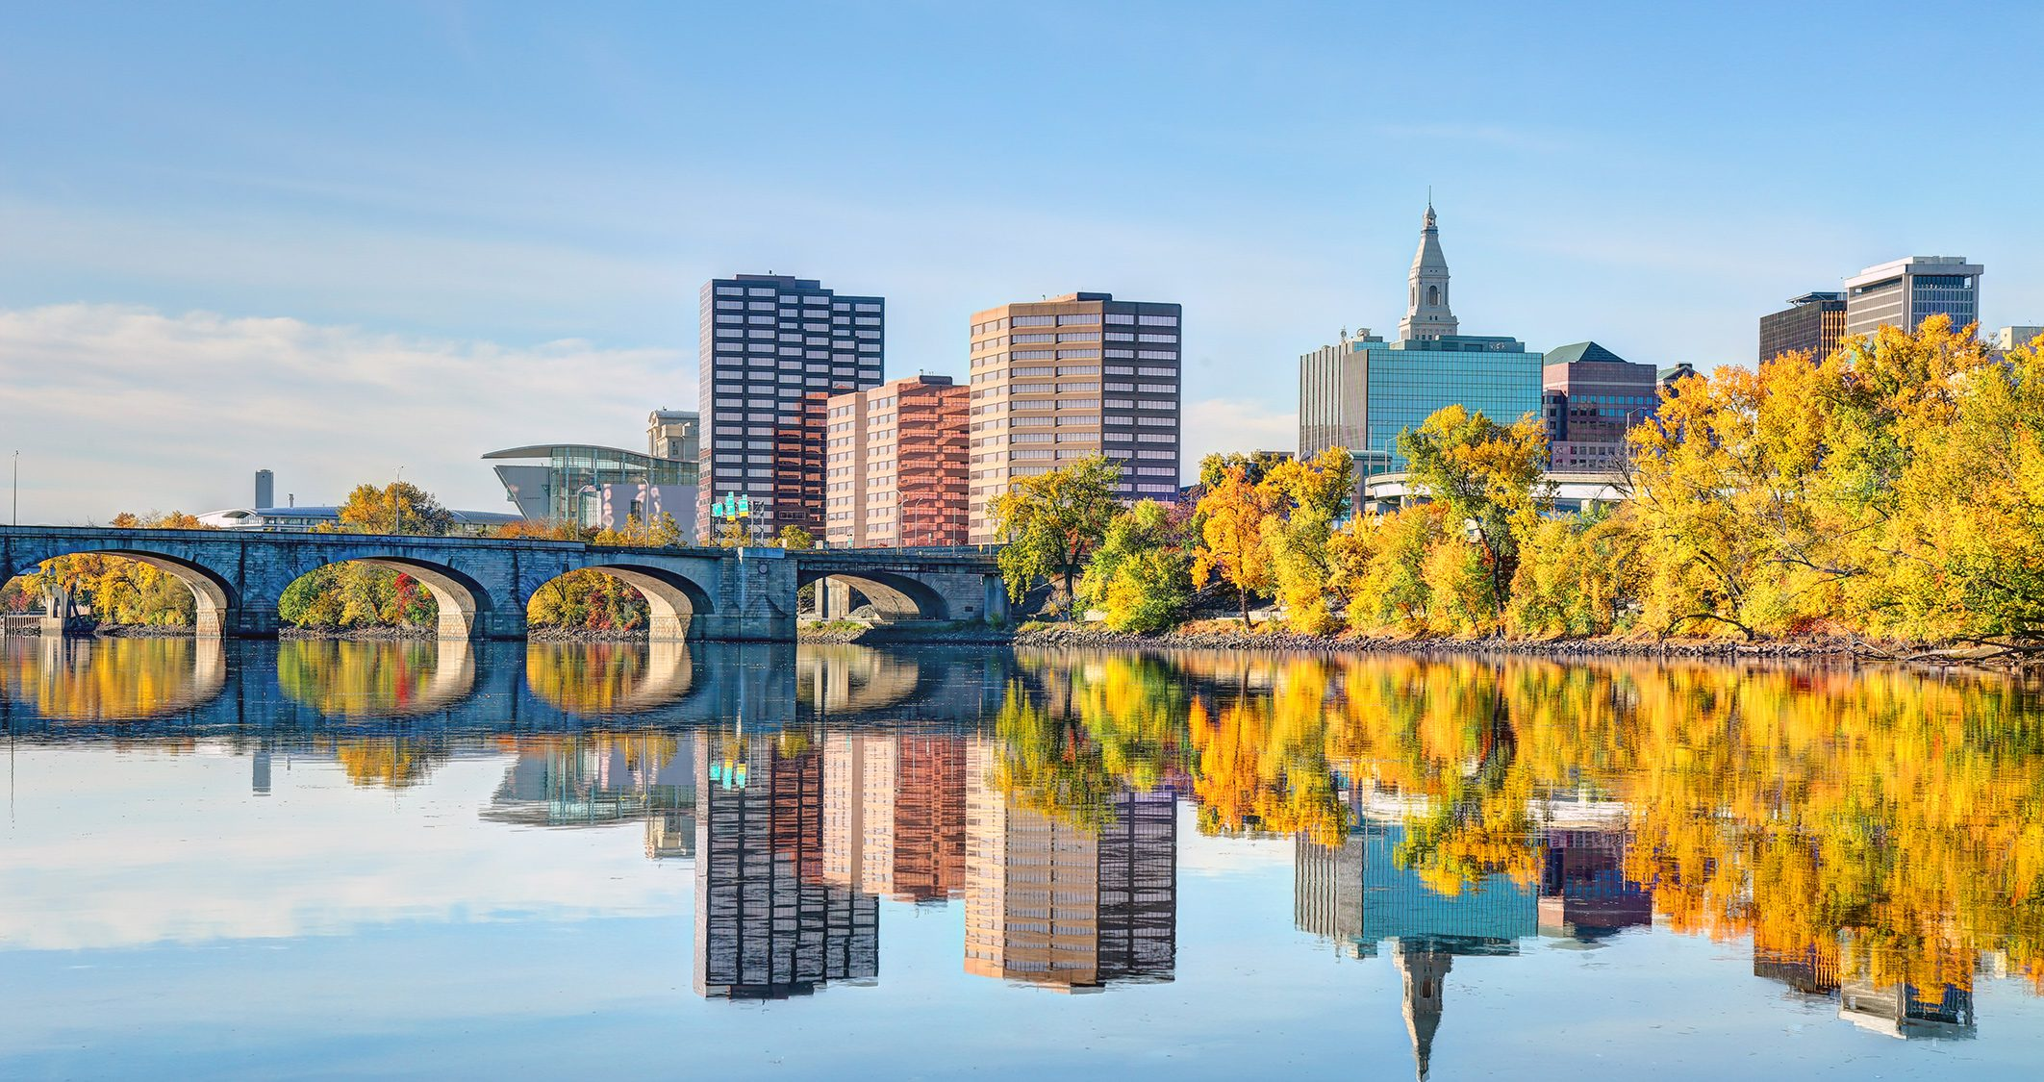
Thank you!
Josye Utick
Chair, Planning and Zoning Commission for the City of Hartford
Architect/Project Designer, JCJ Architecture
josye.utick@gmail.com
10/15/2020 Presentation to Live Green CT’s EV Readiness Program Module 5: Zoning

