Slide 1
Walk-in Borrowing Configuration
Heidi Webb and Timothy Jackson

Slide 2
Overview
What is Walk-in Borrowing?
Documentation
Demo

Slide 3
Who will configure? You or SUNY?
Deadline May 10th
Link to Request form in Institutional Leads Basecamp space

Slide 4
What is Walk-in Borrowing?
Walk-in borrowing is the ability for an employee or student from one campus to walk into another SUNY campus and their user record including blocks can be pulled from their home campus to the campus they are visiting.
These users will be in the user group "Open SUNY" and this configuration helps serve SUNY wide Open Access policies.

Slide 5
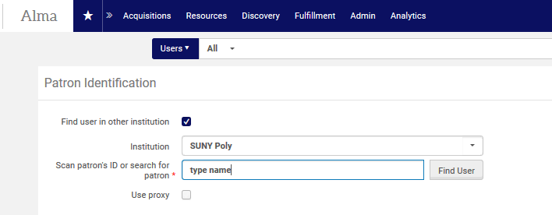
What does it look like?

Slide 6
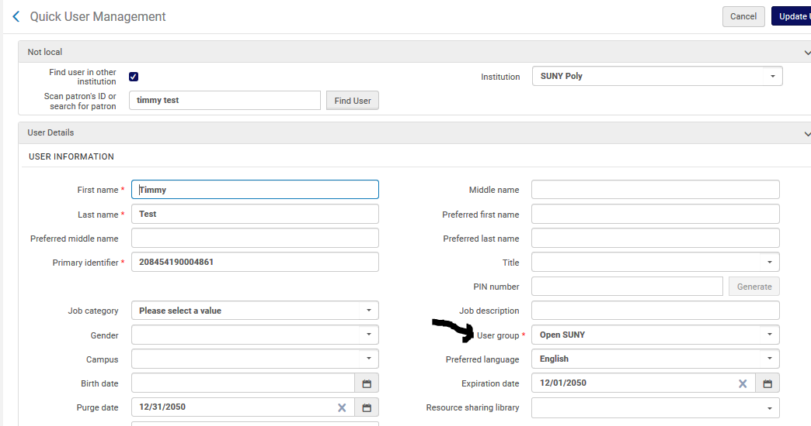
If there is a match, record is pulled in

Slide 7
How to Configure Walk-in Borrowing
https://slcny.libanswers.com/faq/263803

Slide 8
Configure Yourself
Configuration | User Management (Institution Level):
Create user group
Create user record type
Create linked account rule
Configure restricted user groups
Configure Searchable Identifiers

Slide 9
Configure Yourself
Configuration | Fulfillment (Institution Level):
Create Walk-in Borrowing Request TOU (non-requestable)
Create an Open SUNY request fulfillment rule for each circulating fulfillment unit and move rule to top of list
Add Open SUNY to each visitor/guest loan fulfillment rule
Hide GECs (ILLiad links) from Open SUNY

Slide 10
Demo

