Slide 1
Semester 1 - Data collection
Comparative analysis on Survey results and first GPs
Eleonora Turchetto
ANCI Toscana
atwork4neets@ancitoscana.it
14 November 2023 | Florence

Slide 2
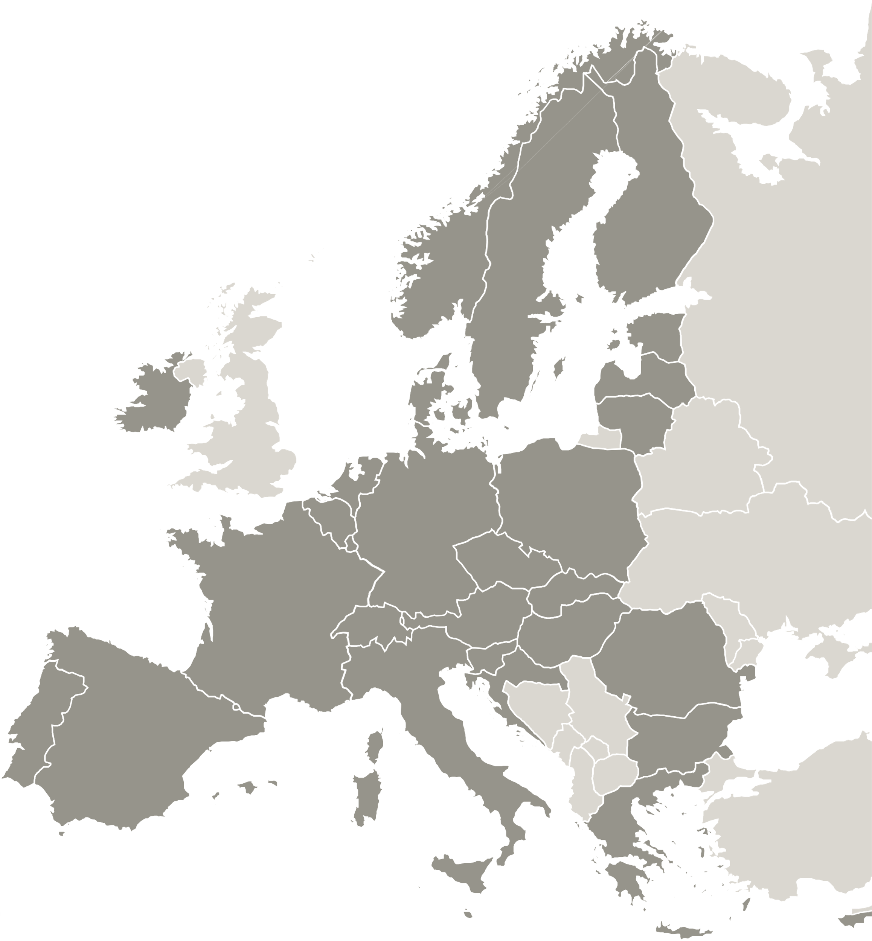
Summary
Topic
Definition of Good Practice
Survey
Overview of practices
General remarks
Conclusions for discussion

Slide 3
Topic
Topic: Data Collection and Analysis
This topic is intended as:
practices for retrieving qualitative and quantitative information (NEETs aged 15-29, disadvantaged groups or subgroups within this category),
2. practices for collecting information and data on the impact of specific interventions carried out on NEETs or on other categories of disadvantaged subjects (e.g. innovative practices for the follow-up of projects and their effects on the reference population and/or on the participants).

Slide 4
Definition of Good Practice
Good Practice refers to a set of effective and successful approaches, methodologies, or strategies that have been identified and recognized as beneficial in achieving the objectives of EU-funded or other projects.
These practices have proven to be efficient, impactful, and replicable, and they can be adopted or adapted by other project beneficiaries or stakeholders to enhance the quality and outcomes of their activities.

Slide 5
Survey
Survey Questions:
Could you name a good practice you know that was beneficial to:
- the process of Data Collection
- implementation of Qualitative surveys
- Analysis of Data
related to NEETs (or other disadvantaged groups), please?
2. Please describe the main activities related to the practice.
3. Could you give us the Programme, ALMP, implementing Institution names and/or a website please?
4. Respondent profile and contacts

Slide 6
Survey
Number of stakeholders contacted: This varied at the discretion of partners (what they found more appropriate at this initial stage). Total approx. 300 stakeholders contacted.
Types of stakeholders include:
NGOs, Relevant Ministries, Local Councils, Education/Qualification Agencies and Institutions, PES, Regional/National Agencies or Departments for Employment, Education, Stats, Demographics, Youth networks and services, Social/Health Services, Universities and Research centres, Decentralized relevant PA agencies, European Funds National Authorities/departments, private entities, …
Survey results -> Desk research and stakeholders interviews -> fist selection of practices (ongoing process): 22

Slide 7
Overview of Practices
For the purpose of this event, we selected and focused on a brief summary of Good Practices, including information on:
Brief description of GP: Practices collected were divided into 4 categories: Direct, Indirect, Studies and Impact Assessment.
Who collects Data: To understand at what level practices are collected
Who can access/use Data: To understand use of Data collected
Geographical scope: To understand the actual capacity of GP
Main features/Novelty: to briefly identify innovative aspects of GPs
Total number of practices collected so far by the 7 partners: 22

Slide 8
Overview of Practices
The 22 practices collected so far have been divided into 4 categories:
- Direct - When Data collection is the core activity of the Practice
- Indirect - When Data are collected while delivering other services
- Studies - Studies comparing Data on target
- Impact Assessment - Practices focusing on impact assessment of services

Slide 9
Overview of Practices
DIRECT - Cross sectoral Data - Core activity
When Data collection is the core activity of the Practice
Number of Good Practices proposed: | 5
 | National PA | Private/non PA
Who collects the Data | 3 | 2
 | National PA | Restricted
Data accessibility | 4 | 1
 | National | Local
Geographical scope | 4 | 1
Notes:
• 3/7 partners
• 4 different Data collectors
• In 2 cases, cooperation between 4 National Institutions

Slide 10
Overview of Practices
Indirect
When Data are collected while delivering other services
Notes:
• 5/7 partners
• 7 different Data collectors
• 1 cooperation between 2 institutions
• 2 cooperation between National PA and local stakeholders
• 1 "Public" access -> not clear if Data used by Policy Makers
• One of the "Local" scope practice includes a collection of 15 different local projects
Number of Good Practices proposed: | 9
 | National PA | Private/non PA
Who collects the Data | 5 | 4
 | National PA | Restricted
Data accessibility | 5 | 4
 | National | Local
Geographical scope | 7 | 2

Slide 11
Overview of Practices
Studies
Studies comparing Data on target
Number of Good Practices proposed | 4
 | National PA | Private/non PA
Who collects the Data | 4
 | National PA | Restricted
Data accessibility | 4
 | National | Local
Geographical scope | 4
Notes:
• 2/7 partners
• 2 different Data collectors

Slide 12
Overview of Practices
Impact Assessment
Practices focusing on impact assessment of services/measures
Number of Good Practices proposed | 4
 | National PA | Private/non PA
Who collects the Data | 4
 | National PA | Restricted
Data accessibility | 4
 | National | Local
Geographical scope | 4
Notes:
• 3/7 partners
• 1 cooperation between 3 National Institutions
• 1 practice has international scope

Slide 13
General remarks
All information collected through surveys and interviews is significant, although not always relevant to Topic 1, but useful for future semesters, in particular:
- Profiling (Semester 3): Sound interrelation between Qualitative analysis aspect of Semester 2 Topic and the Profiling Topic of Semester 3, as qualitative questionnaires/interviews are key to collect data;
Many reported practices propose questionnaires, evaluation forms, interviews, micro-data discourse analysis of secondary data, focus groups, world café sessions for NEETs
- Outreach (Semester 6): Sound interrelation with Outreach services, as data are generally collected when services are provided.

Slide 14
General remarks - novelties
Main novelties cited include (1):
- Special focus on NEETs or NEETs specific subgroups
- Intersectional Analysis/Multilevel approach/exchange of data
- Focus on students, especially ELET/involvement of Education Institutions
- Inclusion of indicators, such as Degree of urbanization, Skill gaps for matching opportunities

Slide 15
General remarks - novelties
Main novelties cited include (2):
- Individual approach/Personal/Customized plans due to specifics of target -> Qualitative data to develop new services
- Use of micro-data discourse analysis
- Single reference Information system connecting decentralized PES, citizens and companies to a National Database
- Comparison of data between persons in the Labor Market who participated in a measure with similar persons that did not to estimate effect of measure

Slide 16
General remarks - Actors
Many local projects were reported by stakeholders in all Countries at survey stage, confirming that the local dimension, thus a capillary approach, are crucial to reach, identify and collect data on our specific target group.
Education institutions are often involved.
Crucial role of PES and social workers.
Youth Guarantee measures, as well as European/International Projects are cited by different Countries.
In general, the stakeholders who responded are very motivated to address the NEET situation; the survey/interview exercise was important to identify different actors, actions and experiences at different levels.

Slide 17
General remarks
Importance of :
optimizing existing and varied assets (experiences, initiatives, knowledge, skills at different level)
to involve different actors, especially those acting at local level, to reach our specific target and analyze needs, obstacles to identify appropriate strategies
sharing information/networks
Accessibility of Data

Slide 18
Conclusions for discussion
What are the needs of Data Collection and Analysis practices for the purpose of the atwork4NEETs project?
What are the main strengths that a GP on our Topic should have?
Data Collection: (e.g. Local level, comparability of Data,…)
Data accessibility: (e.g. Data sharing, ...)
What shall we avoid? (e.g. missing relevant information, overlapping of efforts, Data incomparability, …)
How can practices be sustainable on a larger scale, on the long run?
When is a practices innovative?

Slide 19
Thank you!
www.interregeurope.eu/atwork4NEETs

Slide 20
The project @work4NEETs is implemented in the framework of the Interreg Europe programme and co-financed by the European Union.
www.interregeurope.eu

