Slide 1
Hub Activity Plan, Progress and Impact forms
An overview for LLME
Nicola Trubridge
Sam Radford

Slide 2
Hub Activity Plan, Progress and Impact forms
Hub Activity tab will be available via Axis
LLME leading Hub Activity will be able to create a HAPPI form and submit their Plan for the year
MHLM team link will be able to review/approve the plan
Ongoing access to update on Progress and amend plan
At the end of the year Impact reported
Notes:
Emphasise the three phases
The plan
The ongoing progress reflections to support LLME design/amend future components
The impact
It will be a live document and will be saved and shared with people that need to see it.
The HAPPI forms are being tested and will be launched soon along with videos to explain key features.
Work in progress for the MHLM team link for Hub Activity and report generation.
Note
Some sections will be populated with Maths Hub Activity information
New start and end date field
Greater focus on nationally-specified and locally-tailored outcomes
One form for Work Group / Programme / Community
Schedule ‘components’

Slide 3
Notes:
Hub Activities
There is a new tab coming in Axis where anyone will be able to view all Hub Activities that they are involved with.
All types of ‘Hub Activity’ are shown.
LLME can click on their Hub Activity and view additional information

Slide 4
Notes:
If LLME are leading Hub Activity, there will be an additional tab for the HAPPI form.

Slide 5
Notes:
If LLME are leading Hub Activity, there will be an additional tab for the HAPPI form.
Once in that tab LLME can create their form and then later go back and view / edit / submit their form.

Slide 6
Notes:
Core information
Sections of the core information will be populated already.
LLME to add planned start / end dates.

Slide 7
Notes:
Reach
The reach section is the same as on the current forms (next year we hope to be able to read this from within MHPod)
Note that the greyed-out boxes at the bottom cannot be edited at this point.
After the form has been submitted and approved these fields ‘open’

Slide 8
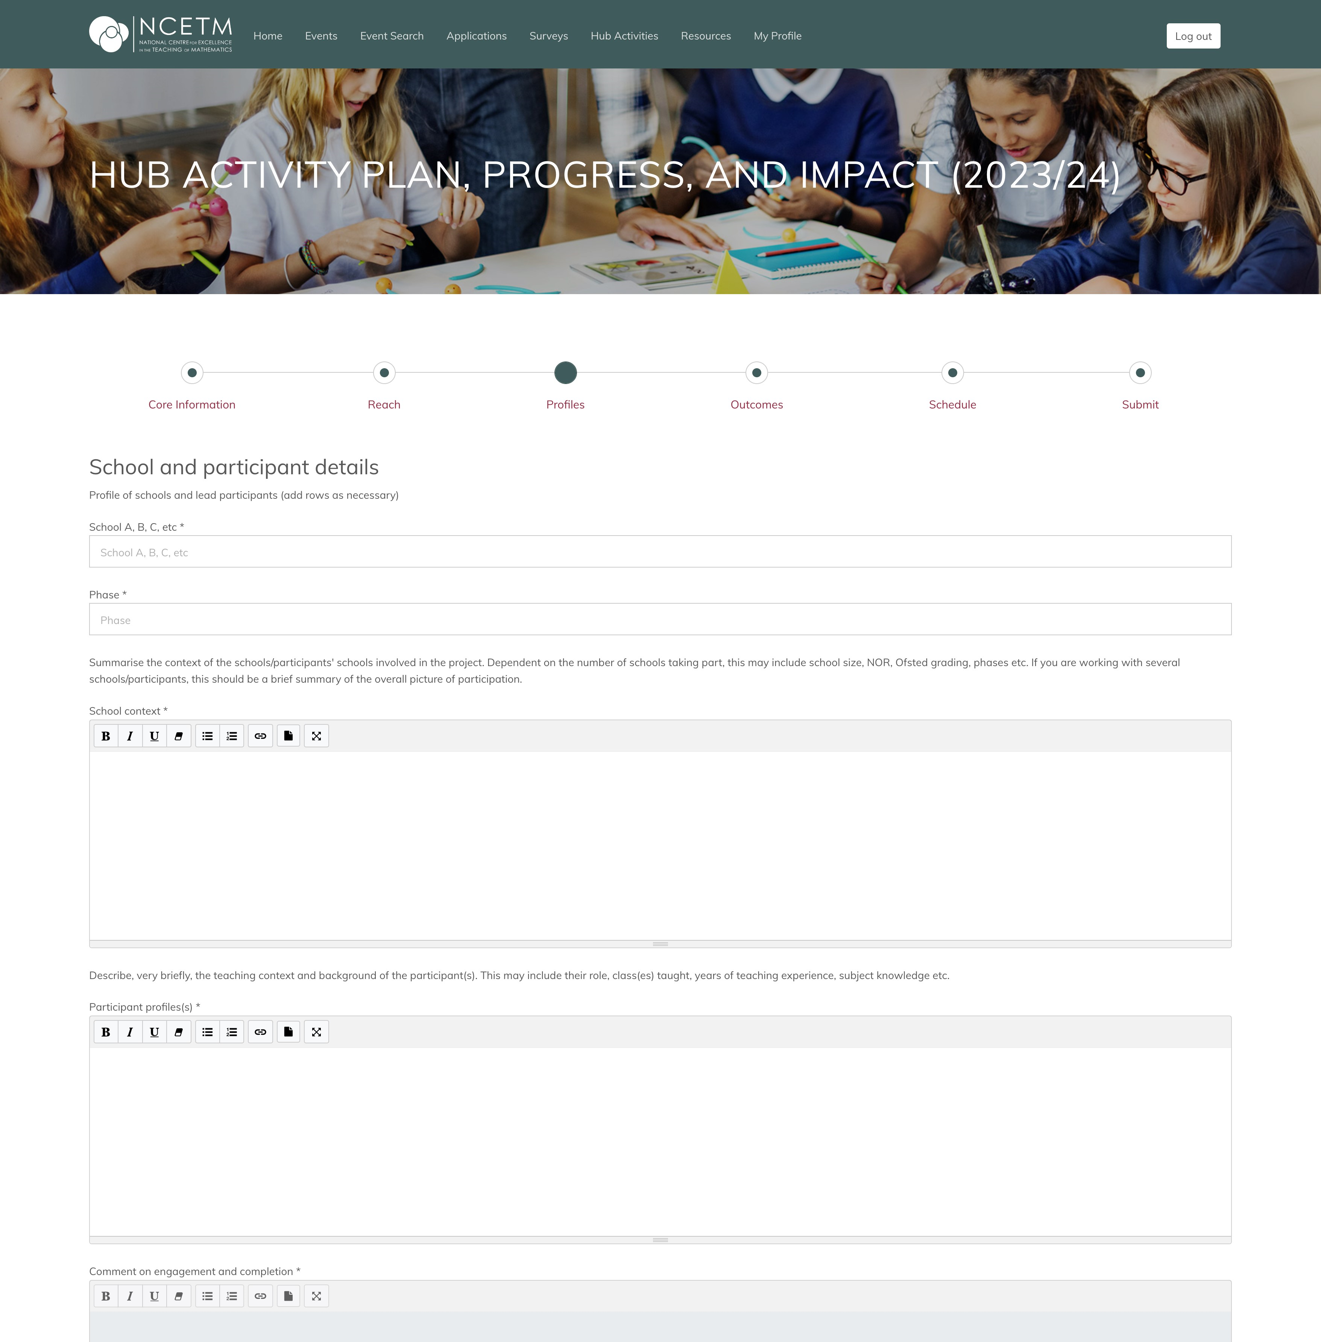
School context.
Summarise the context of the schools/participants’ schools involved in the project. Dependent on the number of schools taking part, this may include school size, NOR, Ofsted grading etc. If you are working with several schools/participants this should be a brief summary of the overall picture of participation.
Participant profiles(s).
Describe, very briefly, the teaching context and background of the participant(s). This may include their role, class(es) taught, years of teaching experience, subject knowledge etc.
Notes:
Profiles
Project Leads – please provide guidance on completing this section.
For WGs with a small number of schools/participants more detail will be needed than on an SKTM programme with 25 participants.
We don’t need to know the information from here as we already have access to this within MHPod.
This section is for LLME to reflect on the schools/participants they are working with.
Workshop suggestion
What information is useful for them to know? How will they gather it?

Slide 9
Notes:
Outcomes – table view
Once submitted they will be viewed in a table.

Slide 10
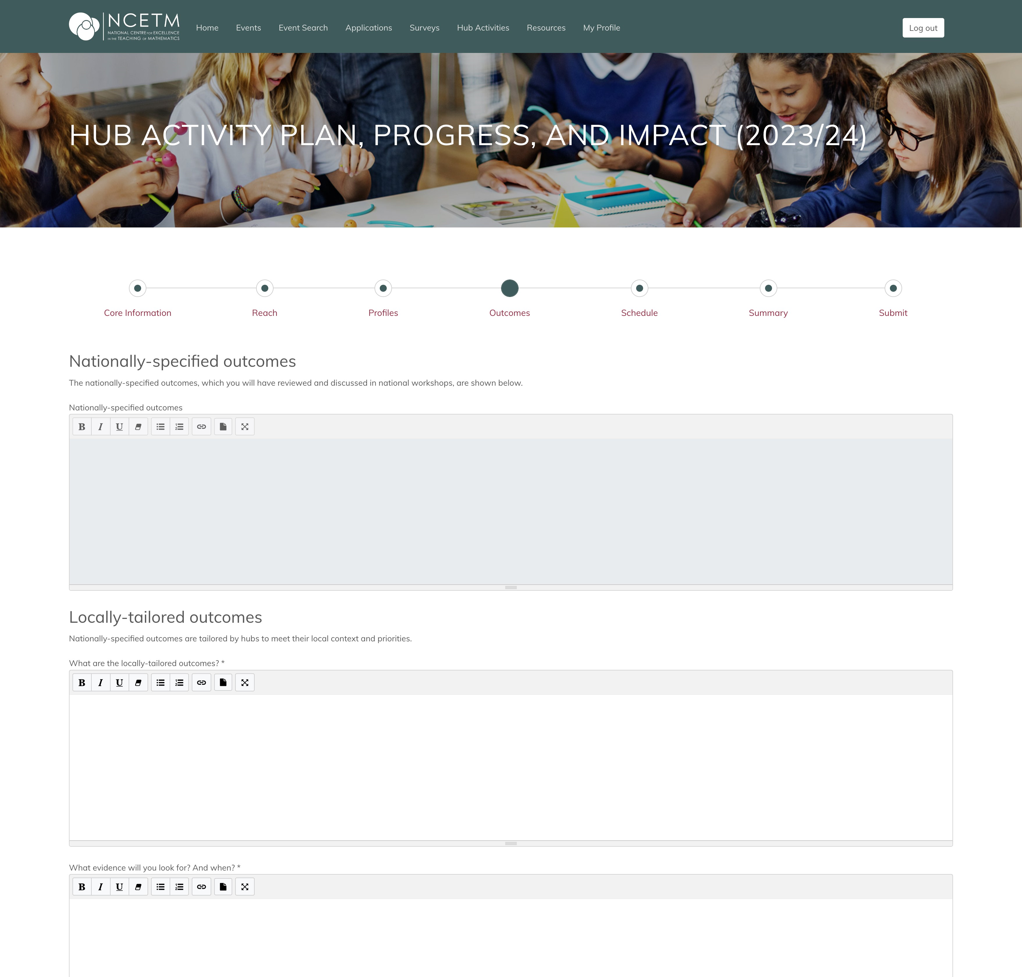
Nationally-specified outcomes.
The nationally-specified outcomes, which you will have reviewed and discussed in national workshops are shown below.
They will be populated for each NCP.
Locally-tailored outcomes.
Nationally-specified outcomes are tailored by hubs to meet their local context and priorities.
What are the locally-tailored outcomes?
What evidence will you look for? And when?
Notes:
Outcomes – form view
The top box will be populated with the nationally-specified outcomes (from the NCP booklet)
There is then the space to tailor them.
Workshop suggestion
Spend some time considering how the national outcomes will be tailored. Are there local priorities that can be added that align with the Maths Hub areas of work?
Will they work on a subset of the national outcomes i.e. only explore one of the Five Big Ideas?

Slide 11
Notes:
Schedule – table view
The schedule is the big picture of the year.
1) What components will there be?
2) What will participants be doing?
3) And why?
This screen shows the big picture of the year, when edit is clicked on a ‘form’ appears with more guidance text as shown on the next page.
LLME can add a row for each component of work.

Slide 12
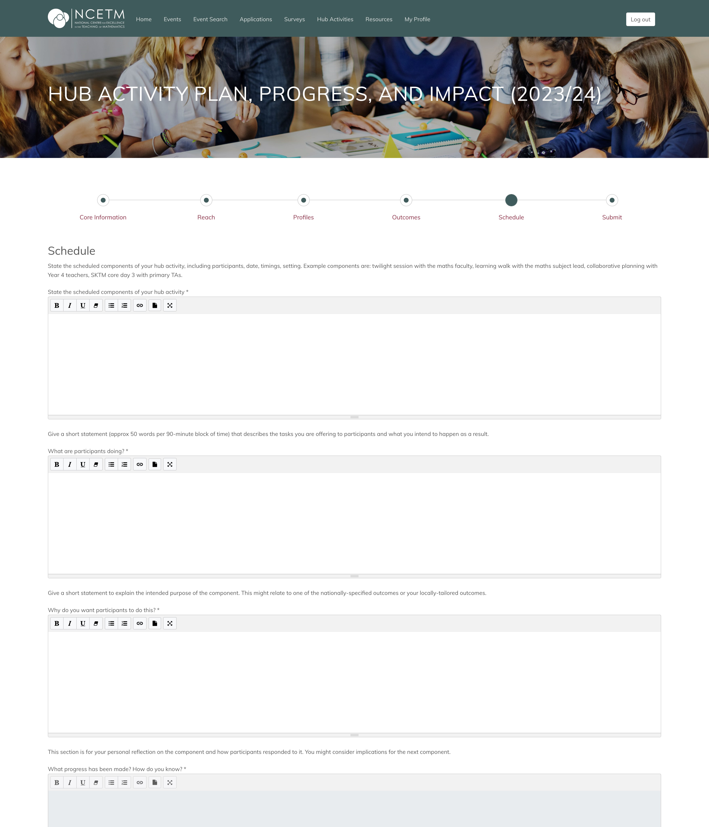
State the scheduled components of your hub activity.
Including participants, date, timings, setting. Example components are twilight session with the maths faculty, learning walk with the maths subject lead, collaborative planning with Year 4 teachers, SKTM core day 3 with primary TAs.
What are participants doing?
Give a short statement that describes the tasks you are offering to participants and what you intend to happen as a result
Why do you want participants to do this?
Give a short statement to explain the intended purpose of the component. This might relate to one of the nationally-specified or your locally-tailored outcomes.
Notes:
Schedule – form view
The schedule is the big picture of the year.
1) What components will there be?
2) What will participants be doing?
3) And why?
Workshop suggestion
Spend some time considering how types of components that you would expect to see for your projects, SKTM for example have core materials to be used, Development Work Groups might have early components meeting with maths subject leaders etc.

Slide 13
Summarise the impact of your hub activity. Write one or two sentences about each intended outcome.
Summarise how the design and delivery of the hub activity contributed to, or limited, the impact.
What recommendations would you make for the future? Give specific examples, using bullet points if necessary.
Notes:
Summary
At the end of the year this space will used for impact, further guidance to follow from the Evaluation and Impact strand.

Slide 14
FAQs
What happens if Hub Activity is led by Co-Leads?
When does the form save?
How often should you submit?
How/when does my MHLM team link person see the form?
Can I upload links to Jamboards or photos of work as part of the progress/impact part?
Should I name schools or anonymise them?

