Slide 1
MEDICAL LEADERSHIP IN ACTION - BREAKOUT
Prepared for CTC - RI
Notes:
The 3 Keys to Reducing Costs & Improving Value for Employers
Learning Objectives:
90% of Costs: Chronic Conditions & Mental Health - the Implications
Using Leading Indicators to Reduce Costs & Improve Value
Building Your "System in a Marketplace" for Employee Recruitment & Retention

Slide 2


Slide 3
A Primary Premise of The Art of Medical Leadership
A key link for peak performance as a team
is each person being a leader
from their role
Every person on the team can provide leadership.
It is not a function of whether people report to you or where you are on the organizational chart.

Slide 4
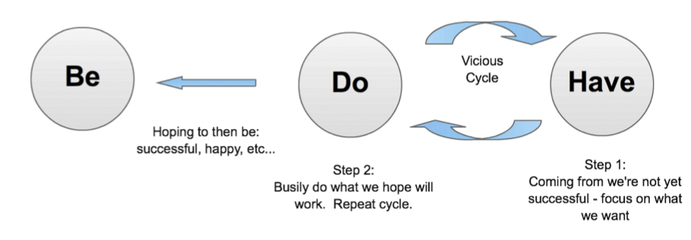
Be – Do – Have
Shifting the Paradigm: Automatic Human Tendency
Notes:
2:00 – 2:15
15 minutes: slide 24 – 29
Example: Ballerina “trying”

Slide 5
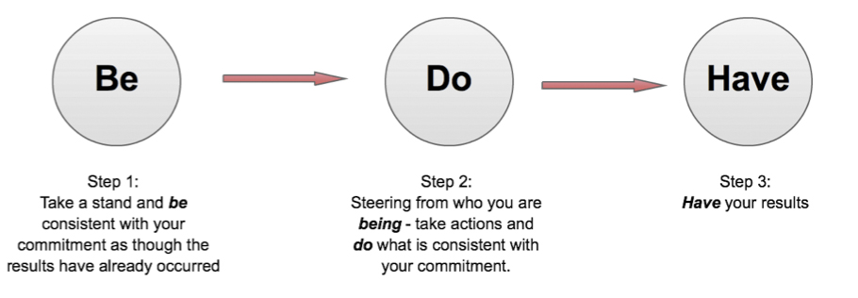
Be – Do – Have
A Paradigm Shift: Intentional Way of Being
Notes:
Example:
Ballerina “being”

Slide 6
Paradigm Shift
This is a shift from the
vicious cycle of our
automatic human
tendency to busily do
more in hopes that we’ll
have the results we want.
To an intentional way
of being whereby we
take a stand to be
consistent with our
commitment and
act accordingly.
➔
This provides access to authentic leadership!

Slide 7



This distinction is relatively new in business
The “Purpose Driven” Movement
Consider how elite athletes use this distinction to support their success!
Notes:
Example:
downhill skier

Slide 8
Please List - As a Leader In Your Practice….
Who do you want to be | What do you want to do | What do you want to have
Notes:
Pause for them to list
1 or 2 minutes

Slide 9
Now…
Envision yourself individually, as a practice and as a company 1 year from now at a whole new level of success
Please Share:
What do you see?
What do you experience in your body?
What actions are consistent with this new level of success?
Notes:
2:12 – 2:15 [final piece on Be-Do-Have]
One or two people share
2 or 3 minutes on this slide

Slide 10
MEDICAL LEADERSHIP IN ACTION
Prepared for CTC - RI
Notes:
The 3 Keys to Reducing Costs & Improving Value for Employers
Learning Objectives:
90% of Costs: Chronic Conditions & Mental Health - the Implications
Using Leading Indicators to Reduce Costs & Improve Value
Building Your "System in a Marketplace" for Employee Recruitment & Retention

