Slide 1
Introduction to DCS
7.20.2023
Notes:
GREET participants and WELCOME them to the training and DCS. START on time and share housekeeping details such as the location of the restrooms, break room, smoking areas, etc. REVIEW fire drill and safety locations. DISTRIBUTE sign-in sheets as well as a trainee information sheet. ASK participants to make a name tent and write their name on one side with one thing they would like to learn for the week on the other side of the card stock.
ALLOW time for laptop/tablet log-in and assist with any technical issues.

Slide 2
DCS Overview
Notes:
DCS Overview

Slide 3
DCS Mission
and Vision
Vision
Children first!
Mission
Act in the best interest of Tennessee’s children and youth.
Notes:
Introduction to DCS
Lesson Time: 90 minutes
Key Teaching Points / Instructions
SHARE we will now begin to learn more about the Department of Children’s Services and what drives practice in Child Welfare in the State of Tennessee.
INTRODUCE participants to the Department of Children’s Services Vision and Mission Statements.
ASK one of the participants to read the DCS Vision.
DCS Vision: Children First!
EXPLAIN this is the vision we strive for in Tennessee Child Welfare.
DISPLAY the Mission Statement and ASK a participant to read the Mission Statement.
DCS Mission: Act in the best interest of Tennessee’s children and youth.
DEBRIEF the Vision and Mission Statements by ASKING:
What makes these important to know?
How will you carry out the Vision and Mission?
SHARE the Department is focused on “high-quality prevention and supportive services.”

Slide 4
Values
• Integrity: Ethical Conduct
• Trauma Responsive: Realize, Recognize, Respond and Resist Re-Traumatization
• Do Good: When Children Succeed, We Succeed
• Partnership: Collaborating for Better Outcomes
Notes:
STATE we will now discuss an overview of DCS Values including Relationships, Integrity, Diversity, and Learning:
Integrity: Ethical Conduct
Trauma Responsive: Realize, Recognize, Respond and Resist Re-Traumatization
Do Good: When Children Succeed, We Succeed
Partnership: Collaborating for Better Outcomes
ASK participants to SHARE what stands out for them in the Mission, Vision, and Values. DEBRIEF. INFORM the group we will continue the discussion on values.

Slide 5
Personal Values
A person's principles or standards of behavior; one's judgment of what is important in life.
What personal values brought you to work in Child Welfare?
Notes:
ASK participants to share their definition of “Values.”
ENSURE this definition is included in the discussion:
Values: A person’s principles or standards of behavior; one’s judgment of what is important in life.
EXPLAIN the importance of having values. It is imperative every case manager understand our profession has at its core some deeply held values. These values, in turn, serve as the foundation for the ethical basis for practice, which in turn is the justification for the very existence of the profession and the interventions social workers undertake. If we did not have our fundamental ethical orientation, the profession of social work would look very different than it does today, if indeed it would even exist at all.
STATE before we talk about values in Child Welfare and DCS, let’s take a few minutes to explore our own personal values.
ASK participants to take a few moments and think about what personal values they have that brought them to work in Child Welfare and ASK for volunteers to share. THANK those participants for showing vulnerability in learning.

Slide 6
Child Welfare Values
We believe all children deserve a safe, stable and nurturing environment to grow and develop.
We approach people with acceptance, openness, and transparency to help them achieve change.
Every family has the right to be treated with dignity and respect.
We strive to differentiate between the person and the behavior.
We believe all children have a right to safety.
We strive to differentiate between the person and the behavior.
We believe families are the experts of their own lives.
We believe families are the experts of their own lives.
We always work towards family preservation.
We believe in Family-Centered Practice.
Notes:
INFORM the group everyone has their own value system which has been formed over the years by many different factors. In that same regard, Child Welfare has a standard set of values which must be considered.
EXPLAIN to do this work, we must accept the overarching values of child welfare.
We believe that all children deserve a safe, stable, and nurturing environment to grow and develop.
We approach people with acceptance, openness, and transparency to help them achieve change.
We believe all children have a right to safety.
We strive to differentiate between the person and the behavior.
We believe families are the experts of their own lives.
Every family has the right to be treated with dignity and respect.
We always want to work towards family preservation.
We believe in Family-Centered Practice.

Slide 7
DCS believes...
Children do best at home.
Families can be strengthened and successful.
Children deserve a forever family.
Well-Being matters.
Notes:
INFORM participants there are federal laws that must be followed and our DCS policies outline how DCS implements those laws. STATE we look at values in the same manner. SHARE DCS has our own standard of values that drives the work we do and the outcomes we strive to meet for children and families.
SHARE DCS believes:
Children do best at home: We believe children do better when they are at home with safe, nurturing parents and caregivers; we are strengthening families so children can be safe and loved at home.
Families can be strengthened and successful. When children must come into foster care, we are strengthening foster parents so that children remain stable and strengthening families so that children can return home quickly.
Children deserve a forever family.
Well-Being matter: Children and Family’s well-being and healthy development matters. It is important they receive the services and support they need from us to be successful. Staff well-being is important as well, and they need the training, services, and supports to be health to meet the needs of the children and families they support.

Slide 8
Values Review
How may your personal values impact your work with children and families?
Why is it important to follow DCS values even if they do not coincide with our own.
Notes:
PROCESS information shared on values by asking the following:
How may their personal values impact their work with children and families?
What makes it important to follow DCS values even if they do not coincide with our own?
TRANSITION by SHARING as Child Welfare Professionals, we must commit to striving for best practice.

Slide 9
DCS Themes
Strengths-Based
Family-Centered
Culturally Responsive
Notes:
INTRODUCE the DCS Themes by STATING evidence-based practice shows services are more likely to be effective if our practice follows principles. SHARE the key themes toward which we strive our practice to be are:
Strengths-Based Practice: Identifying the strengths and resources within the family system that can be used to assure the safety and well-being of the child.
Family-Centered Practice: The provision of individualized services that strengthen and enable families to find solutions to their own needs and issues and to provide safe care to their children in their own homes and communities, consistent with their cultures.
Cultural Responsiveness: Address the issues using cultural competency and cultural humility as the framework for engaging diverse families and communities. Cultural humility requires attitudes, beliefs, and actions that invite new information and new perspectives continuously.

Slide 10
Federal Laws
Mandate involvement and intervention with families.
Child Abuse Prevention and Treatment Act (CAPTA, 1974)
Indian Child Welfare Act
(ICWA, 1978)
Defined child abuse and neglect.
Established state reporting law.
Gives exclusive jurisdiction to tribes over any child custody proceeding involving an Indian child who lives in or is domiciled in the reservation of that tribe or is a ward of a tribal court.
Notes:
STATE there are several Federal Laws that set mandates around our involvement and intervention with families. BRIEFLY DISCUSS each.
SHARE Child Abuse Prevention and Treatment Act (CAPTA, 1974):
Defined child abuse and neglect
Established a state reporting law that provided immunity of the reporting person (EMPHASIZE a referent’s identity cannot be revealed even to a Judge.)
Requires states receiving grants to establish citizen review panels to evaluate the performance of state and local child protection agencies.
Provides financial assistance for a demonstration program for the prevention, identification, and treatment of child abuse and neglect.
SHARE Indian Child Welfare Act (ICWA, 1978):
Gives exclusive jurisdiction to tribes over any child custody proceeding involving an Indian child who lives in or is domiciled in the reservation of that tribe or is a ward of a tribal court.
Requires child welfare workers to ask directly whether or not the client has Indian heritage, and to not assume anything from physical appearance or accept the information in record as absolutely accurate.
Specifies a hierarchy of preferences for foster care or pre-adoptive placements if the child must be removed from the home.

Slide 11
Federal Laws
Adoption Assistance and Child Welfare Act (1980)
Adoption and Safe Families Act(ASFA, 1997)
Requires CPS to make reasonable efforts to avoid unnecessary removal of children from their homes and to reunify foster children with their families whenever possible. (Reasonable Efforts)
Requires timely permanency plan and emphasizes the child's safety is the paramount concerns.
Notes:
SHARE the Adoption Assistance and Child Welfare Act (1980) requires child protective services (CPS) agencies make reasonable efforts to avoid unnecessary removal of children from their homes and to reunify foster children with their families whenever possible. “Reasonable Efforts” means providing parents with useful resources that enable them to protect the child, provide a stable home environment, and promote the child’s well-being.
EXPLAIN the Adoption and Safe Families Act (ASFA, 1997) was created in response to concerns many children were remaining in foster care for long periods or experiencing multiple placements. This landmark legislation requires timely permanency planning for children and emphasizes the child’s safety is the paramount concern. ASFA drives DCS timeframes in ensuring permanency for children.

Slide 12
Federal Laws
Provide DCS with the ability to intevene with families, create accountability and uniformity in interactions with children and families and serve as guidelines for best practice.
Families First Prevention Services Act (FFPSA, 2018)
Why is it important to be aware of laws that impact child welfare?
Provides provisions to enhance support services for families to help children remain in their homes, reduce unnecessary use of congregate care, and build capacity of communities to support children and families.
Notes:
DISCUSS the Families First Prevention Services ACT (FFPSA, 2018). SHARE this act provides provisions to enhance support services for families to help children remain in their homes, reduce the unnecessary use of congregate care, and build the capacity of communities to support children and families.
ASK participants why it is important that you are aware of the laws that impact child welfare? HIGHLIGHT laws provide DCS with the ability to intervene with families, create accountability and uniformity in interactions with children and families, and serve as guidelines for best practice.
TRANSITION to Lesson 2.2 Safety, Permanency, and Well-Being.

Slide 13
Safety, Permanency, Well-Being
What does Safety mean to you?
What does Permanency mean to you?
What does Well-Being mean to you?
Notes:
Safety, Permanency, and Well-Being
Lesson Time: 30 minutes
Key Teaching Points / Instructions
INFORM participants the DCS Outcomes of Safety, Permanency, and Well-Being come from the Adoption and Safe Families Act (ASFA).
EMPHASIZE safety issues are often easier to identify and therefore address, yet permanency and well-being are just as important.
Activity: Outcome Walk-Around
SHARE with participants flip charts have been placed around the room with the following questions:
What does Safety mean to you?
What does Permanency mean to you?
What does Well-Being mean to you?
ASK participants to take a marker and visit each flip chart answering each of the questions. Give participants 8 minutes to complete the activity and then DEBRIEF by reviewing the factors of each outcome below.

Slide 14
Stability
Relationships
Attachments
Long-Term View
Permanent Connections
Substance Use
Child
Maltreatment
Domestic
Violence
Current functioning
Parenting Capabilities
Education
Employment
Physical Health
Mental Health
Permanency
Safety
Well-Being
Notes:
SHARE the following information about Safety, Permanency, and Well-Being:
Safety
Must consider substance use, child maltreatment, and domestic violence
Permanency
Stability, relationships, attachments, long-term view, permanent parenting relationship, permanent connections with family and kin, a sense of connectedness and attachment, family that can meet the child’s needs
Well-Being
Current functioning, family’s parenting capabilities, education, employment, physical health, mental health

Slide 15
Continuum of Maltreatment and Parenting Practices
Child
Enriched
Fatality
Risk
Safety
Safe
Enough
Child Maltreatment
Child's Basic Needs Met
Notes:
EXPLAIN family functioning is typically fluid, and no family is perfect or completely free of risk therefore it is vital for case managers to develop critical thinking and assessment skills to evaluate if children are “safe enough” in their family home environment or if DCS intervention is required. PROVIDE an overview of the Continuum of Maltreatment and Parenting Practices. SHARE the continuum is not a formal tool used in assessment but can be used to critically think through a situation.
REMIND participants when rating safety, considerations of what impact substance use, child maltreatment, and domestic violence in the home have on the parent’s functioning and the child are essential.

Slide 16
If not, what alternative exist to ensure safety?
Is the child safe at home?
Essential
Safety
Questions
If not, are there services that would ensure safety in the home?
Notes:
DISCUSS the three Essential Safety Questions when assessing safety.
Is the child safe at home?
If not, are there services that would ensure safety in the home?
If not, what alternative exist to ensure safety?
STATE a child and family typically come to the attention of DCS as the result of a breakdown in the family system that threatens the child’s well-being. In most cases, with caring and timely intervention, the family can be strengthened in ways that permit the child to remain safely with the family. In cases where this is not possible, and the child must enter out-of-home care, DCS professionals diligently manage placements in ways that minimize, as much as possible, the pain and trauma of separation and assure the child will be protected and well nurtured until permanency can be achieved.
STATE we will now explore the Practice Wheel which helps to move cases forward toward achieving positive outcomes of safety, permanency, and well-being. TRANSITION to Lesson 2.3 The Practice Model

Slide 17
The Practice Model
A set of guidelines that capture the organizational, values, structures, mechanisms, tools, and skills needed to successfully implement the mission of the Department.
It is driven by DCS's overarching mission, vision, values, and professional ethics.
It represents DCS's expectations for best practices in serving children and families, internal and external partners, and the general public in Tennessee.
Notes:
The Practice Model
Lesson Time: 60 minutes
Key Teaching Points / Instructions
STATE The Department of Children’s Services (DCS) promotes excellence in child welfare. The Practice Model is a set of guidelines that capture the organizational values, structures, mechanisms, tools, and skills needed to successfully implement the mission of the Department. It is driven by the Department of Children’s Services’ (DCS) overarching mission, vision, values, and professional ethics. The Practice Model represents DCS’s expectations for best practices in serving children and families, internal and external partners, and the general public in Tennessee.

Slide 18
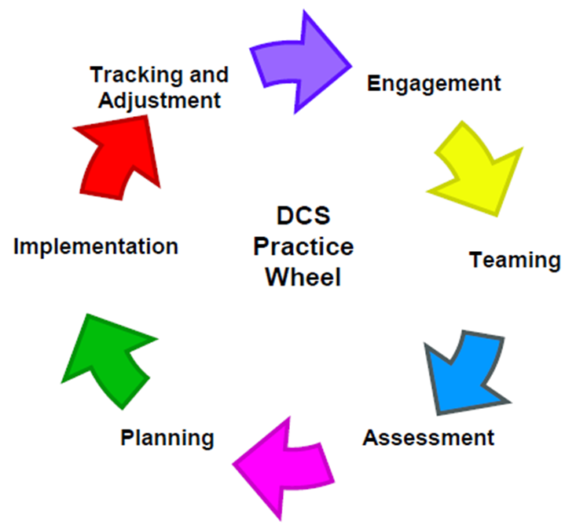
The Practice Wheel
A model for family-centered practice that has at its core 6 key functions.
Involves a strength's based, family-centered, and culturally competent approach to evidence-based best practice.
Notes:
SHARE in protecting the child while working to strengthen a family, the Child Welfare worker intervenes by use of a model for family-centered practice that has at its core 6 key functions:
Engagement
Child and Family Team Formation
Ongoing Assessment and Understanding
Planning
Implementation
Tracking and Adjusting (Adaptation)
REFER to the Practice Wheel graphic and EXPLAIN it is the framework for DCS practice. BRIEFLY REVIEW each spoke of the wheel and SHARE any mnemonic devices (E-TAP-IT or ETA-PITA) to assist participants in remembering the wheel.
INTRODUCE the 6 Core Functions of Practice:
Engagement: Engage families with genuineness, empathy, and respect.
Team Formation: Assemble a Child and Family Team with the family that includes the child, parents, family members, as well as other supports identified by the family as active and important partners.
Assessment and Understanding: Assess and understand the current situation, family strengths, and underlying factors.
Planning: Plan interventions, supports, and services with a long-term view for permanency and beyond.
Implementation: Implement a plan of interventions, strategies, and supports.
Tracking and Adaptation: Monitor progress, perform ongoing assessments, evaluate results, and adapt the plan and services to reflect changes in the child and family situation.
STATE each component of the Practice Wheel involves a strength’s based, family-centered, and culturally competent approach to evidence-based best practice. This is done through a trauma lens (focusing what has happened versus what is wrong with you) while employing empathy, genuineness, and respect.

Slide 19
Activity
Engagement
Teaming
Assessment
Planning
Take a marker
Walk around to each flip chart
List words that describe each oke of the Practice Wheel
Implementation
Tracking & Adjusting
Notes:
ACTIVITY: PRACTICE WHEEL
Trainer will prepare flips charts with the spokes of the Practice Wheel before class begins.
ASK participants to take a marker and walk around to each flip chart and include words that describe each part of the Practice Wheel.
ALLOW report out and DEBRIEF insight from the groups.

Slide 20
Key Points
What is it?
How do you use it?
Why is it important?
The framework for DCS casework methods.
Used as a collaborative approach that engages the family in a partnership to make change.
Successful interventions must reduce risk factors and promote protective factors (strengths) to ensure safety, permanency and well-being.
Notes:
EXPLAIN three key points of the Practice Wheel:
What is it? It is the framework for DCS casework methods used in assessing child abuse and neglect and to promote child and family well-being with a focus on strengths, resilience, and protective factors needed to implement successful interventions to reduce risks.
How do you use it? Using a collaborative approach that engages the family in a partnership to make change.
Why is it important? While there are many approaches to working with children and families. Research has found that successful interventions must both reduce risk factors and promote protective factors to ensure child and family safety, permanence, and well-being.
EMPHASIZE the importance of the following points regarding the Practice Wheel:
The wheel is not made up of different components that start and stop. It is an ongoing process that encompasses the spirit of partnering with the family throughout DCS involvement.
Case managers are constantly engaging, assessing, and tracking/adjusting during interactions with families, team members, and community partners who provide services/supports to the family and child.
Positive engagement leads to effective teaming. Positive engagement and thorough assessments, which then lead to individualized planning that we can track and adjust through the life of the case.
The goal is to build a trusting relationship even in the midst of crisis in order to develop lasting change strategies.
These strategies will enable the family to build on their current strengths, coping skills, and their supports/connections. They also help the case manager with identifying and employing interventions aided at the reduction of immediate and future risks.
It helps us view children and families through the trauma lens by asking, “What has happened to you” and stop asking “what is wrong with you.”
INFORM participants we will be talking through all of the above concepts in greater detail throughout the training weeks. TRANSITION to Lesson 2.4 Mandated Reporter.

Slide 21
Mandated
Reporting
What stood out?
What is one new thing you learned?
What is one thing you already knew?
Notes:
Mandated Reporter
Lesson Time: 60 minutes
Key Teaching Points / Instructions
STATE we will now look at mandated reporting of child abuse and how to recognize, respond, and report child abuse.
STATE the following video can be used for public education but has essential information. STATE after the video, we will discuss specific information when a DCS employee makes a referral. SHOW the Mandated Child Abuse Reporting Video (23:44) https://youtu.be/IgSnDAs3MM8
DEBRIEF the video by using the following questions:
What stood out?
What is one new thing you learned?
What is one thing you knew already?

Slide 22
T.C.A 37-1-403 (A) (1):
"Any person who has knowledge of or is called upon to render aid to any child who is suffering from or has sustained any wound, injury, disability, or physical or mental condition shall report such hard immediately if the harm is of such a nature as to reasonably indicate that it has been caused by brutality, abuse, or neglect or that, on the basis of available information, reasonably appears to have been caused by brutality, abuse or neglect."
Notes:
STRESS to participants T.C.A 37-1-403 (A) (1) states​ a Mandated Reporter is:
“Any person who has knowledge of or is called upon to render aid to any child who is suffering from or has sustained any wound, injury, disability, or physical or mental condition shall report such harm immediately if the harm is of such a nature as to reasonable indicate that it has been caused by brutality, abuse, or neglect or that, on the basis of available information, reasonably appears to have been cause by brutality, abuse, or neglect.”

Slide 23
PUBLIC Hotline:
1.877.237.0004
1.877.54ABUSE
Case Manager Hotline:
1.877.237.0034
Legal/Medical Hotline:
1.877.237.0026
K-12 School Staff:
1.855.209.4226
Non-emergency:
apps.tn.gov/carat
Child Abuse Hotline Information:
Notes:
SHARE the following Child Abuse Hotline information:
PUBLIC Hotline: 1-877-237-0004; 1-877-54ABUSE
(Case Managers) TN Child Abuse Hotline: 1-877-237-0034
Legal/Medical Hotline: 1-877-237-0026
K-12 School Staff: 1-855-209-4226
Non-emergency situations: apps.tn.gov/carat
Reports can be made 24 hours a day, 365 days a year
ENCOURAGE participants to save this information on their tablets and in their phones.

Slide 24
Sharing Information
Name
County/Region
Region/County
Your Specialized Team
Do you have an open case? If so, TFACTS Case ID is needed
Household Participants
View More
Notes:
SHARE local CPS case managers cannot begin to work a case in TFACTS until a call comes to them from the Child Abuse Hotline. STATE you may be on the phone for 20 minutes or more when making a referral.
DISCUSS the following information you will be asked when calling in a report:
Your Name
County/Region
Your Specialized Team
Do you have an open case? If so, TFACTS CASE ID
Household Participants (Names-Spellings, Ages, Relation, Contact Information, Visitation Schedule)
EMPHASIZE when making a referral it is important to clarify any buzzwords (i.e., dirty, filthy, beats, private parts) to provide more concrete information and details so a more correct determination can be made on assignment of the referral to investigate.
ASK if there are any questions and TRANSITION to Lesson 2.5 Balanced Protective Authority.

Slide 25
Protective
Authority
The application of helping skills and assertive strategies that results in a partnership between the child welfare professional and the family.
View More
Notes:
Balance of Protective Authority
Lesson Time: 60 minutes
Key Teaching Points / Instructions
EXPLAIN there is an inherent tension in the field of Child Welfare when engaging families. STATE we must intervene to protect children from harm while simultaneously building trust and rapport with families to engage them in the change process. Given most families do not seek assistance from protective services, achieving this balance is crucial, but often difficult to accomplish. SHARE Protective Authority is the application of helping skills and assertive strategies that result in a partnership between the child welfare profession and the family. Effect family engagement leads to the assurance of child safety, reduction of risk maltreatment, promotion of well-being, and timely permanence.

Slide 26
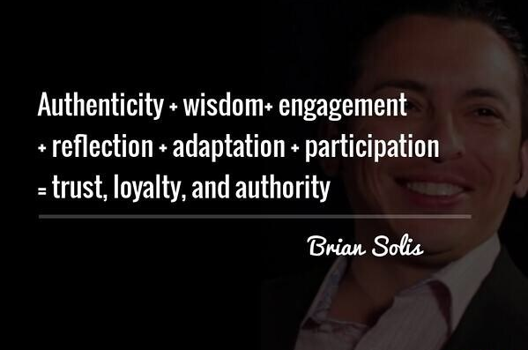
Collaboration
The goal is to collaborate with the family to resolve concerns and promote safety. The use of protective authority should be limited; an employed only when necessary to protect children from immediate harm.
Protection
Safety
Notes:
ADVISE the child welfare professional should always clearly explain the extent of their authority and under what circumstances it will be used. The goal is for the child welfare professional to collaborate with the client to resolve concerns and promote child safety. When the situation remains unsafe, the child welfare professional will have no choice but to use authority to protect the children. The use of protective authority should be limited; and employed only when necessary to protect children from immediate serious harm.
STATE some workers resort to using authority when other approaches would work better. Workers who are unsure of their role may feel anxious and threatened. Some are unable to control their anger about child maltreatment and may assume a position of authority. Workers who do not fully understand the importance and benefits of engagement, or who lack skills in engaging angry or resistant adults often use an authoritarian approach.
EXPLAIN in using the protective authority model, the caseworker acts primarily as a director and an enforcer. The strength of the protective authority model is that it allows workers to intervene immediately to protect children at risk of serious harm, when parents will not cooperate, or when less intrusive methods cannot assure children’s safety.
SHARE workers who feel uncomfortable with authority, who do not know how to use engagement strategies while still exercising necessary authority, or who are afraid of conflict or confrontation may fail to use authority when necessary to protect a child.

Slide 27
Engagement
Striving for collaboration, not cooperation. Collaboration implies the family is engaged in a partnership to make changes.
Notes:
EXPLAIN in an engagement model, we are striving for collaboration, not cooperation. While cooperation is fine, it implies the family is abiding by our wishes. Collaboration, on the other hand, implies the family is engaged in a partnership to make changes.
SHARE some families may simply refuse to cooperate with the Child Welfare worker. Engagement is likely to improve over time for most parents and the worker must be careful to not slip back into the protective authority mode simple because engagement strategies are slow to create trust and collaboration. Our goal is to build partnerships and collaboration.

Slide 28
Practice
Low, Moderate, and High Authority
What barriers might you run into trying to apply balanced protective authority
What potential solutions do you envision to deal with these bariers
What will you put into practice from what you learned?
Notes:
INTRODUCE the Balance of Protective Authority videos. EXPLAIN the purpose of viewing these videos is to analyze a caseworker’s ability to build rapport with a client, engage the client in an initial working relationship, and promote family-centered, collaborative work with the client.
INFORM the group they will be viewing videos showing how a case worker conducts themselves with families with low, intermediate, and high authority intervention. SHARE they will have the opportunity to assess the scenario and choose a response according to different levels of protective authority.
Low authority: https://youtu.be/HI_05PRinPU (2:12)
Intermediate authority: https://youtu.be/CZbbULsPHGE (2:37)
High authority: https://youtu.be/BlS7hsM4_j0 (2:53)
DEBRIEF after each video by asking the group how they feel about their responses to the scenarios. Other possible DEBRIEF questions include:
What barriers might you run into trying to apply balanced protective authority skills?
What potential solutions do you envision to deal with these barriers?
What do you know today that you didn’t know yesterday that will serve you tomorrow?
If you could go back and do it again, what would you do differently and why?
When would it be appropriate to take an intermediate level of approach? High level of approach?
What will you put into practice from what you learned?
What might you share with others?

Slide 29
Protective Authority Summary
Explained in non-threatening manner
Develop Collaboration
Joint problem identification, joint goal setting and desired outcomes, and discussion
The way a worker informs the family can contribute to whether it is considered a threat
Use should be LIMITED
Can be used to motivate
Indicated only when necessary to protect children from immediate serious harm
In these circumstances, worker's authority must be presented and explained in a calm, factual manner
Notes:
SUMMARIZE the ideal approach to family-centered child protective services is to develop a collaborative relationship with families to help them make positive changes in their families without compromising the appropriate use of authority when necessary. This includes joint problem identification, joint setting of goals and desired outcomes, and discussion with the family of the degree to which intervention may be helpful.
SHARE the worker should always clearly explain the extent of their authority and under what circumstances it will be used. We want the family to partner with the worker to resolve concerns and promote their children’s safety if partnership does not occur, the worker will have no choice but to use authority to protect the children. The worker should also explain the actions that can occur if the use of protective authority is necessary.
STATE the use of protective authority should be limited and is indicated only when necessary to protect children from immediate serious harm. This includes use of the juvenile court to legally protect children from harm.
EXPLAIN if parents refuse services and a child is at risk of serious harm, the worker should inform the parents in a non-threatening manner of the possible consequences. Using threats to enforce compliance is clearly a violation of parent’s Fourth Amendment rights to be free from unreasonable search and seizure. However, failure to inform parents of possible outcomes is fundamentally unfair to clients. There is a “fine line” between the two, and the way the worker informs the family can contribute to whether it is considered a threat. Families themselves can also misconstrue a worker’s effort to inform as a threat.
SHARE the exercise of authority can sometimes be used to motivate families to become involved in services, whether they become engaged in the casework relationship. However, in these circumstances, the worker’s authority must be presented and explained in a calm, factual manner. Intimidating clients is never appropriate.
STATE when children are at high risk of future serious harm, and strategies to involve family members voluntarily have failed, the worker is obligated to use protective authority. However, the worker should continue to help the family become involved in services, if not engaged in a collaborative relationship.
SHARE when clients ignore or resist the child welfare professional’s efforts to engage the family using helping skills and explanations of consequences, the child welfare professional must have the resolve and skills to follow through and enlist the assistance of the court system, and possibly law enforcement, to ensure the children are safe and will remain safe.
ADVISE the case worker will clearly define the next steps in the process to ensure safety of the children, the case worker will consult with supervision and legal, case worker will file a court order to comply, case worker will return to the home with the court order to comply, and, with police, only if necessary, to ensure child/worker safety.
EMPHASIZE the worker should clearly explain that there may be times when the caseworker’s actions could be perceived as unfair (i.e., when unannounced home visits or unannounced drug screen become necessary). This helps develop trust, and demonstrates respect for the client, and demonstrates the worker’s intent to be straightforward and honest.
SHARE the worker should explain removing children from the home is used only as a last resort when the child cannot be kept safe otherwise and the worker would prefer to work with the family to resolve problems.
REMEMBER the goal is always for the child welfare professional to collaborate with the client to resolve concerns and promote child safety.
ASK if there are any questions and TRANSITION to Unit 3: Case Introduction.

Slide 30
Working with Families
Notes:
Working with Families
Unit Time: 285 minutes
Resources:
Facilitator Guide
Course PowerPoint
Poverty Simulation Training Information
“An Introduction to Unconscious Bias” (3:30): https://www.youtube.com/watch?v=KCgIRGKAbfc
Video: I am Sam
Learning Objectives:
Receive and process information on bias in Child Welfare
Understand the guiding principles of Motivational Interviewing
Be introduced to the family case scenario
Experience poverty through simulation

Slide 31
Bias in Child Welfare
What are possible biases in child welfare?
Define Bias
How can bias influence your work with families?
Notes:
Common Biases in Child Welfare
Lesson Time: 60 minutes
Key Teaching Points / Instructions
EXPLAIN we will now discuss various barriers associated with Child Welfare practice, as well as various methods to overcome them. We will begin by exploring the concept of bias.
ASK participants to define “bias” as they understand it or to find a definition online using their phones or tablets.
Trainer Note: Oxford English Dictionary defines bias as: “Prejudice in favor of or against one thing, person, or group compared with another, usually in a way considered to be unfair.”
ASK participants:
“What are some possible biases in child welfare?” (Examples can include addiction, single mothers, absent fathers, etc.)
“How can bias influence your work with families?
STATE sometimes biases may lead to harsher judgement or ignoring red flags or concerns with parents, i.e., overlooking safety concerns for a single parent because you were raised by a single parent. This is referred to as the halo/pitchfork effect.

Slide 32
Where do our biases come from?
Unconscious Bias
How aware are we of our own biases?
Why is implicit bias dangerous in Child Welfare Practice?
Notes:
INTRODUCE the Bias video and INSTRUCT participants to listen for additional elements that can be added to the definition of bias.
SHOW video: “An Introduction to Unconscious Bias” (3:30): https://www.youtube.com/watch?v=KCgIRGKAbfc
DEBRIEF the video by having a discussion around bias and culture. COMPARE the information provided in the video with the definitions the group provided earlier. The following questions may be useful to guide the conversation:
Where do our biases come from?
How aware are we of our own biases?
Why is implicit bias especially dangerous in Child Welfare practice?
Trainer Note: An implicit bias is an unconscious association, belief, or attitude toward any social group. Due to implicit biases, people may often attribute certain qualities or characteristics to all members of a particular group, a phenomenon known as stereotyping.

Slide 33
Confirmation Bias
The tendency to interpret new evidence as confirmation of one's existing beliefs or theories.
Notes:
ASK the group to define “Confirmation Bias” based on their existing knowledge of the term or by looking it up online. Confirmation bias is defined as, “The tendency to interpret new evidence as confirmation of one’s existing beliefs or theories.” PROVIDE the group with a child welfare example.
BRIEFLY DISCUSS how Confirmation Bias can further affect the way we work with families based on our existing beliefs, values, and experiences.

Slide 34
Ladder of
Inference
A tool for helping individuals and teams to avoid reacting based on assumptions and inferences, rather than observable and tested data.
Notes:
INTRODUCE the Ladder of Inference. EXPLAIN it is a tool for helping individuals and teams to avoid reacting based on assumptions and inferences, rather than on observable and tested data. REFERENCE the “Ladder of Inference” resource in Google Classroom.

Slide 35
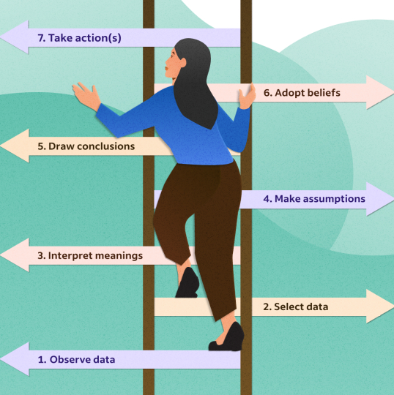
Moving up the ladder
Resources
Ladder of Inference
Bias in the Child Welfare System
Notes:
DISPLAY the Ladder of Inference and DISCUSS moving up the ladder takes only milliseconds. It happens all day long. It happens when we interact with people as they climb their own Ladders of Inference.
REFER participants to “Bias in the Child Welfare System” in Google Classroom and DISCUSS the examples of assumptions leading to poor judgments and poor outcomes for children, youth, and families.

Slide 36
Climbing Down the ladder
How do we climb down the
ladder?
Make thinking visible to others
Invite others to test assumptions
Use respectful inquiry to help others
Explore impasses
Take note of triggers to emotional reactions
Be critically reflective and set aside pre-conceived notions
Notes:
FACILITATE a discussion around how we can use the Ladder of Inference to challenge our biases and assumptions. Possible ways of climbing back down the Ladder:
Make your thinking process visible to others by explaining your assumptions, interpretations, and conclusions. This is easier to do in the office where there are other people around to help you think through things than it is while you are alone, driving down the road. Even when you are alone, you can take a moment to examine your journey up the ladder before deciding what action you will take.
Invite others to test your assumptions and conclusions. When you have the opportunity to work with others, have them help you think things through.
Use respectful inquiry to help other make their thought processes visible. Use open and nonjudgmental questions, rather than questions that exhibit a bias.
Explore impasses, and don’t agree to disagree too soon. This helps you avoid hidden or unspoken assumptions and conclusions that hide the journey up the Ladder of Inference.
Next time you find yourself having an emotional reaction to something, take the time to notice what triggered this feeling. Observe the events that have occurred. Examine the data you selected. Think about the filters you use to interpret information. Identify your assumptions and conclusions. Understand the root of your feelings. And then select the action you will take.
Avoiding the leap also involves being critically reflective and setting aside preconceived notions of another person and giving him/her another chance to demonstrate commitment, motivations, and dedication.

Slide 37
I am Sam
Who would remove? Why?
Who would leave Lucy with Sam? Why?
Who would need more information to make a decision? Why?
What are you feeling?
Notes:
STATE we will now watch a part of I am Sam to assess for any potential biases or assumptions from within the Child Welfare system and from outside the Child Welfare system.
SHOW the first 15 minutes of I am Sam (stop at end of balloon scene). After the clip have the group discuss the following:
ASK the group to write their initial FEELINGS on an index card or post-it note to hold up.
NEXT, POLL the class by asking the class based on their initial instincts and feelings:
Who would remove and why?
Who would leave Lucy with Sam and why?
Who would need more information to make a decision and why?
How could your initial instincts impact next steps?

Slide 38
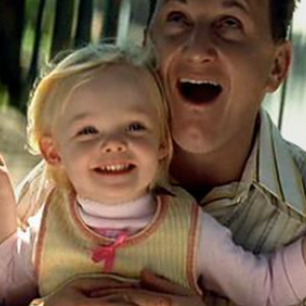
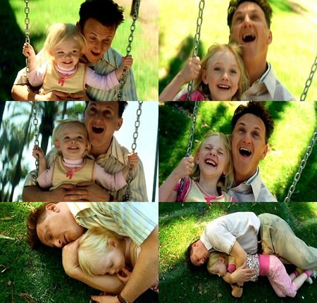
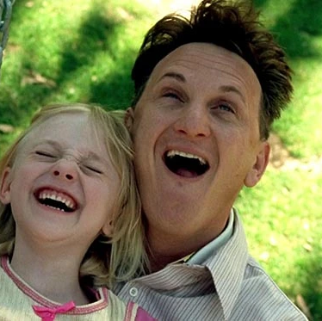
Sam and Lucy
What are potential biases/assumptions that could be made about Sam and Lucy?
Why do we want to AVOID making decisions based off of initial instincts or first impressions?
What are consequences of basing decisions based on feelings, emotions, instincts for Sam and Lucy?
Notes:
ASK what are some potential biases/assumptions that could be made about Sam and Lucy after viewing the video? Examples could include Sam can’t care for Lucy due to his disability, Sam is a single father, Sam can’t care for Lucy financially, Sam’s supports have mental health issues or developmental delays, Lucy’s babysitter has agoraphobia and should not care for her, Sam is not flexible (needs routine) which will impact Lucy receiving new experiences, Lucy is smarter than Sam, the mother shouldn’t be found since she left her child, Sam may be taken advantage of again, Sam isn’t Lucy’s biological father, etc.
STATE the consequences of not thinking critically while assessing children and families can be devastating. ASK why do we want to AVOID making those decisions on initial instincts or first impression?
ASK what may be the consequences of basing decisions on your feelings/emotions/instincts (first impressions) for Lucy and Sam?

Slide 39
Critical Thinking
The objective analysis and evaluation of an issue to form a judgement. Being able to assess our assumptions and biases.
Notes:
SHARE another tool we have to use in assessing our bias is to use critical thinking.
ASK “What is Critical Thinking?” FACILITATE a brief discussion around the group’s answers before providing the following definition: “Critical thinking is the objective analysis and evaluation of an issue to form a judgment. Being able to think critically means being able to assess our assumptions and biases.”

Slide 40
Deliberate
Curious
Desire for truth
Communicate clearly
Fair Minded
Demonstrate integrity
Critical Thinking
Characteristics
Allows us to look at our beliefs and challenge them through a cognitive process.
Helps minimize impact of personal values, beliefs, and biases reducing the likelihood of mistakes.
Importance in Child Welfare
Notes:
ASK what are characteristics of good Critical Thinkers? SHARE if not discussed:
Deliberate. They do not just react from the gut or go with their first instinct. They first think carefully.
Able to recognize complexities and work within them.
They are curious.
Have a desire to see the truth.
Communicate clearly and logically.
Fair minded and consider multiple points of view before drawing a conclusion.
Share intellectual empathy.
Demonstrate integrity and intellectual courage.
Able to develop conclusions using analysis, evaluation, inference, and deduction.
Don’t accept information at face value. They challenge assumptions and dig deeper to research the validity of conclusions or assertions.
FACILITATE a discussion around the importance of critical thinking in Child Welfare. EMPHASIZE the following points:
It allows us to look critically at our beliefs, to challenge those beliefs through a cognitive process, and to come to a conclusion that is supported by evidence.
It helps to minimize the impact of personal values, beliefs, and biases, and reduce the likelihood of mistakes.
ASK how would we climb back down the Ladder of Inference or use critically thinking to guide next steps with Sam and Lucy?
STATE we will now discuss one component of critically thinking: Self-Awareness. ENGAGE the group in an open discussion around Self-Awareness

Slide 41
Self-Awareness
Benefits
Better able to manage and regulate your emotions
Increased decision-making skills
Better Communication
Improved Relationships
Higher levels of happiness
More confidence
Better job satisfaction
Improved leadership skills
How do these benefits help child and families we serve?
"Too often we enjoy the comfort of opinion without the discomfort of thought." ~John F. Kennedy
Notes:
STATE we will now discuss one component of critically thinking: Self-Awareness. ENGAGE the group in an open discussion around Self-Awareness.
SHARE benefits of Self-Awareness include:
Being able to better manage and regulate your emotions
Having better communication
Increased decision-making skills
Improved relationships
Higher levels of happiness
More confidence
Better job satisfaction
Better leadership skills
ASK how these benefits ultimately help children and families we serve.
SUMMARIZE by sharing the following quote by John F. Kennedy and ASKING for thoughts:
“Too often we enjoy the comfort of opinion without the discomfort of thought.”
SHARE we will now be introduced to a case family. TRANSITION to Lesson 3.2 Motivational Interviewing: Guiding Principles.

Slide 42
Motivational Interviewing
What is Motivational Interviewing?
A collaborative goal-oriented style of communication for strengthening a person’s own motivation and commitment for change in an
atmosphere of compassion.
Notes:
Motivational Interviewing Guiding Principles
Lesson Time: 60 minutes
Key Teaching Points / Instructions
EXPLAIN Motivational Interviewing is a collaborative goal-oriented style of communication for strengthening a person’s own motivation and commitment for change in an atmosphere of compassion.

Slide 43
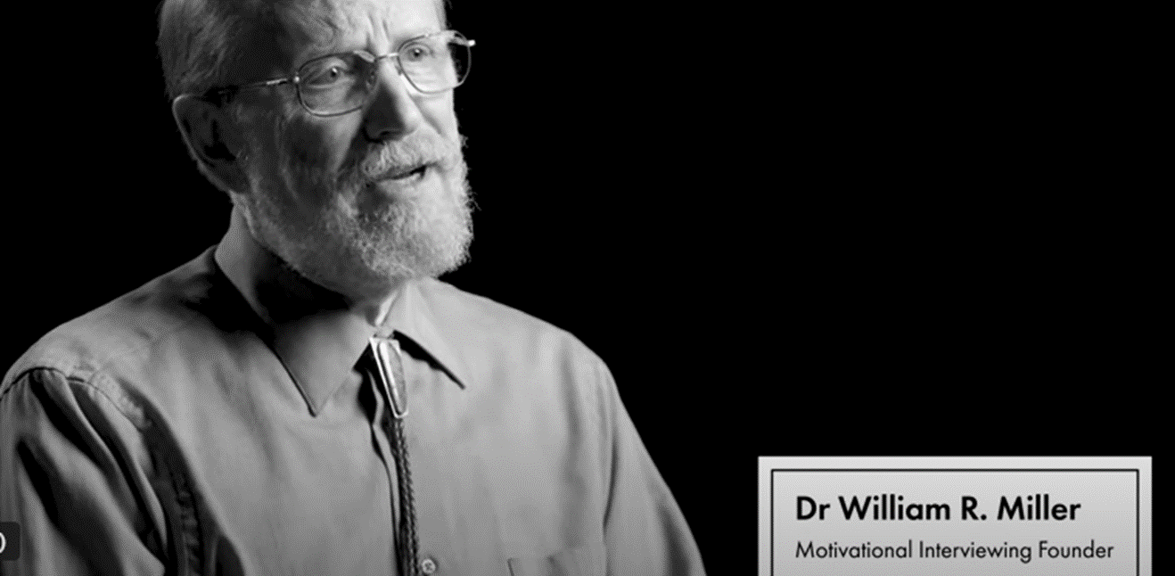
What is MI?
Notes:
SHOW video What is MI? Time: 0:59. Link: https://www.youtube.com/watch?v=reTb-x6UOmY. Founders and experts in Motivational Interviewing William Miller, Theresa Moyers and Stephen Rollnick explain how Motivational Interviewing allows you to engage with your clients in a practical way to help them find and build their own motivation for change. Video points include:
It's a way of having a conversation about change. It is about listening to and calling forth the person's own ideas about change.
It is not our job to convince people to change when they're convinced not to.
It is normal to be ambivalent about something where you are simultaneously wanting and not wanting something at the same time.
ASK participants what they think about change? STATE change is hard for everyone. ASK participants when was the last time they attempted to change something. ASK how long it took for them to be successful? ASK how many gave up after a period of time. STATE we must normalize and empathize that change is difficult.

Slide 44
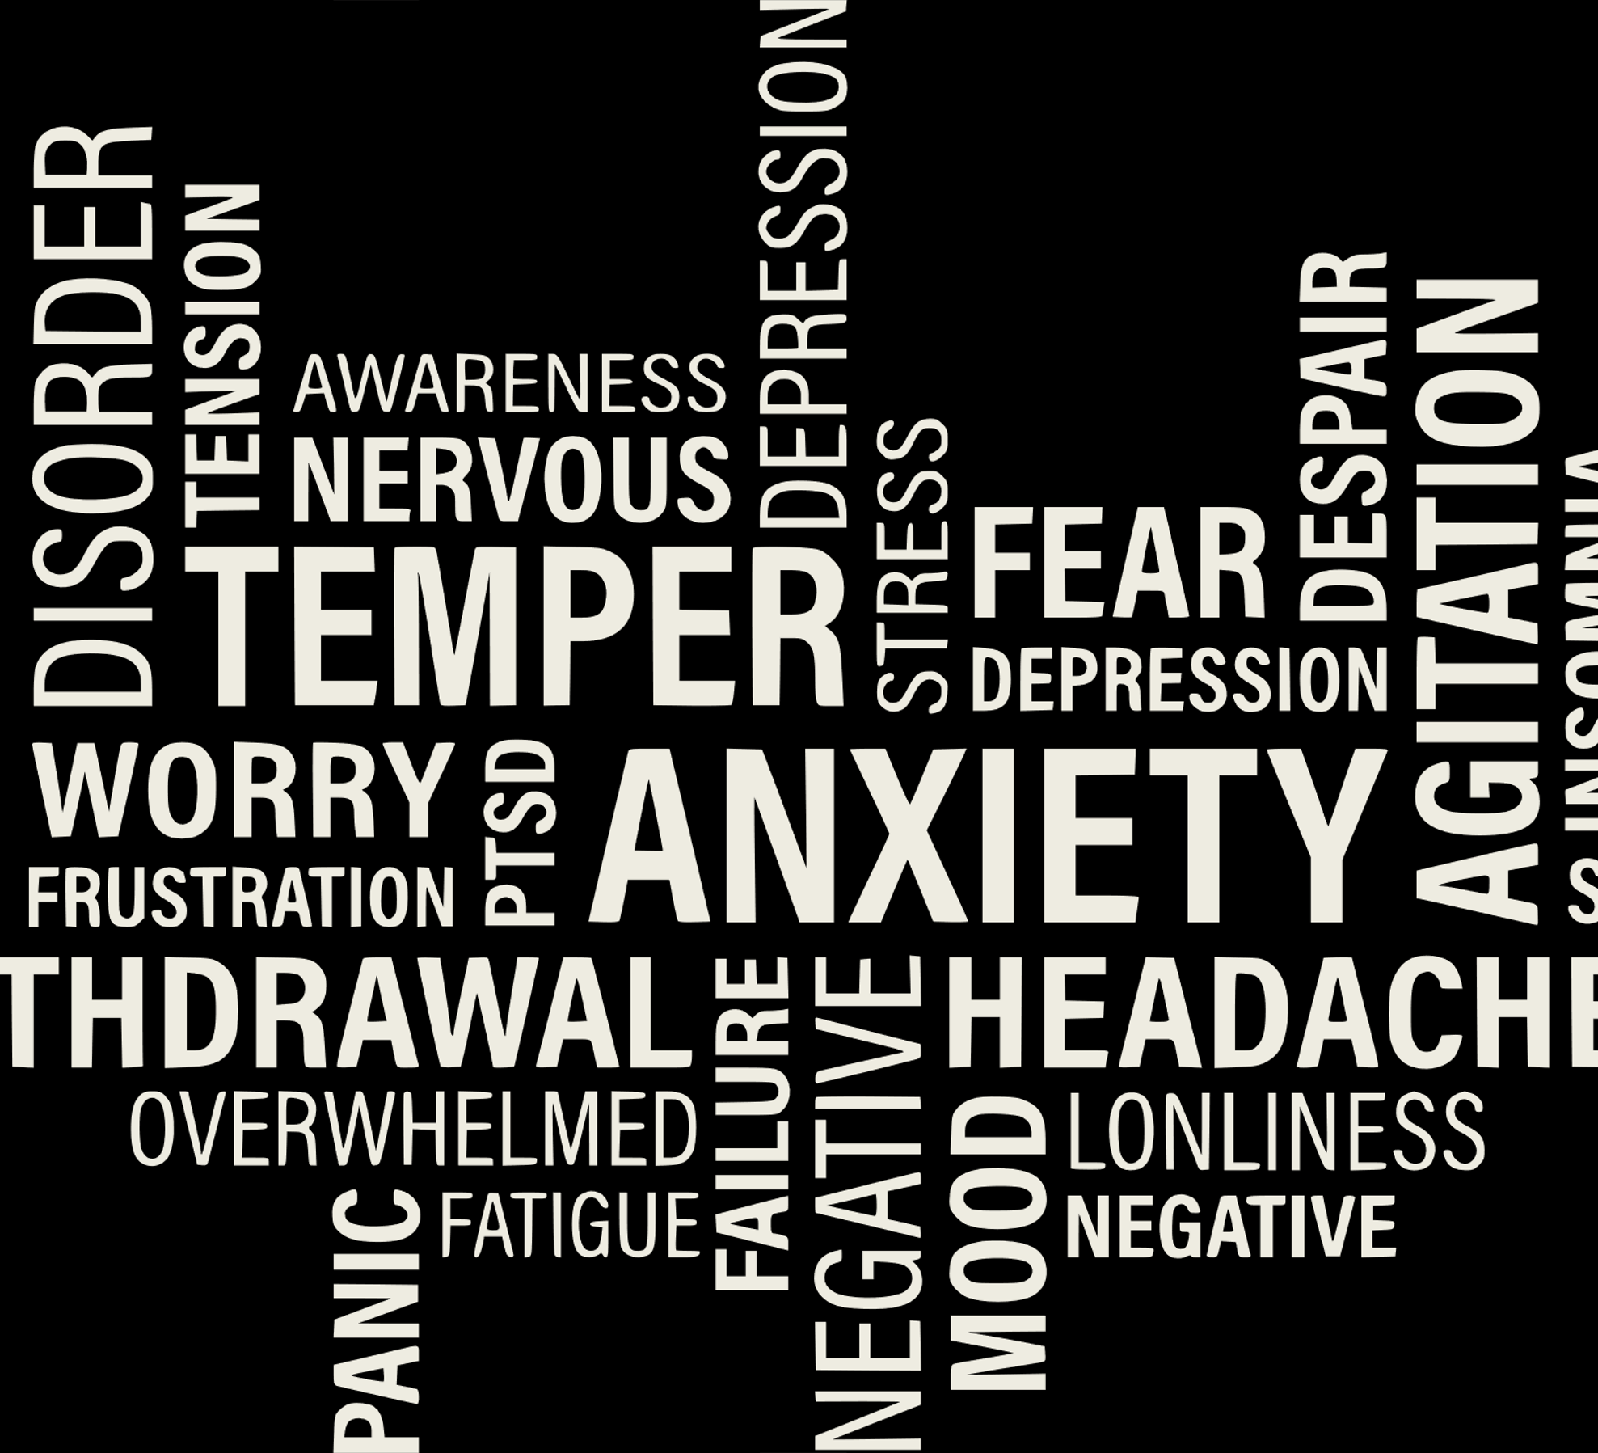
How can Motivational Interviewing be used in child protection?
Parents who come to the attention of CPS experience tremendous stressors and a range of emotions that may include fear, hopelessness, and a reluctance to engage with a system that is threatening to remove—or has removed—their children.
Notes:
ASK How can motivational interviewing be used in child protection? EXPLAIN Parents who come to the attention of child protection agencies experience tremendous stressors and a range of emotions that may include fear, hopelessness, and a reluctance to engage with a system that is threatening to remove – or has removed – their children.
SHARE As a result, child welfare agencies must be diligent about meaningful family engagement. EXPLAIN not only is it a best practice and something that families say they need and want, but successfully engaging caregivers in child welfare services has been shown to promote critical case outcomes such as fewer placements in out-of-home care and lower risk of repeat maltreatment.

Slide 45
We are responsible for assessing risk and safety concerns. Safety is always paramount.
Creating balance to ensure child safety while collaborating and engaging families.
DCS engages clients when we are uninvited.
All parties are held accountable.
Benefits
Feel more understood
Increase confidence
Desire for behavior change
Empowered to express their own idea
Gain ownership over the change process
Increase likelihood of success
Challenges
Notes:
INFORM there are many benefits of using MI with Parents and Caregivers including:
Feel more understood
Increase confidence
Desire for behavior change
Empowered to express their own ideas
Gain ownership over the change process
Increase likelihood of success
STATE however there are challenges to using MI in Child Welfare including:
As Child Welfare professionals, we are responsible for assessing risk and safety concerns. Safety is always paramount.
Child Welfare Professionals create a balance of ensuring child safety while collaborating and engaging families through creating motivation for change.
DCS engages clients when we are uninvited; therefore, assessing and understanding client’s readiness to change is important.
All parties are held accountable for the safety, well-being, and timely permanency of the child(ren).

Slide 46
Lifting the Burden in Motivational Interviewing
You are not the expert; you can’t make a person change.
The person across from you may have better ideas.
MI is not a directive approach. It is guiding and involves good listening.
Main Points
Notes:
SHOW the video Lifting the Burden in Motivational Interviewing. We will learn a key operational principle of Motivational Interviewing. Time: 2:06. Link: https://www.youtube.com/watch?v=SsNgZ47o2I4&t=65s. Video main points include:
You are not the expert; you can't make a person change.
You don't have to be the one to come up with all the good ideas - a person with really good ideas is sitting across from you and may have better ideas.
Motivational Interviewing is not a directive approach – it is more guiding. It involves good listening.

Slide 47
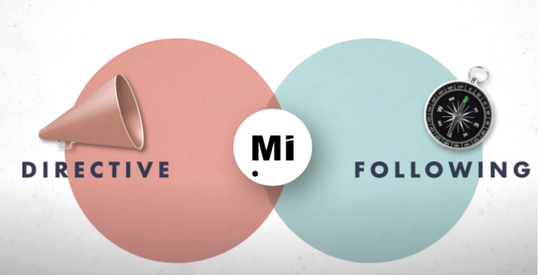
What is Guiding?
Getting family’s input
Actively listening
Offering suggestions/resources
Answering questions
Assessing interest and priorities
Assessing strengths and abilities
Guiding
Notes:
ASK participants to share what guiding looks like in their work in child welfare. Possible responses include:
Getting the family’s input
Actively listening
Offering suggestions/ resources
Answering questions
Assessing interest and priorities
Assessing strengths and abilities
TRANSITION by stating, we will now look at four principles essential to the spirit of motivational interviewing.

Slide 48
Spirit of Motivational Interviewing
Spirt of Motivational Interviewing
Collaboration
Acceptance
Evocation
Compassion
Notes:
SHARE there are four main concepts under the spirit of motivational interviewing are:
Collaboration
Acceptance
Evocation
Compassion
INFORM we are going to explore the meaning and application of each. While we explore these four concepts, we encourage you engage in self- assessment. Asking yourself how do you convey these concepts in your practice with children and families? We also challenge you to think of new or improved ways of conveying the principles in your daily practice.

Slide 49
Collaboration
Involves partnership that honors the client’s experience and views.
Emphasis is on creating an environment that is conducive to change.
Highlights the family is the expert in their lives, and we want to hear their stories.
Notes:
SHARE using a collaborative approach to working with clients involves a partnership that honors the client’s experience and views.
The emphasis is on creating an environment that is conducive to change, as opposed to convincing or coercing the clients to change. The family is fully engaged throughout the practice wheel process. Therefore, motivational interviewing is done “for” and “with” a person, not “to” or “on” a person.
Family-centered practice highlights the family is the expert in their lives and we want to hear their stories and develop an understanding of their perspectives while avoiding confrontation.
Trainer Note: Parallel this concept to the video about guiding, following and directing. This will lead the group into a discussion about what it might look like for the case manager to be in the directing/ expert role.

Slide 50
“Expert” Behaviors
Asking questions that confirm biases
Asking closed-ended questions
Using statements such as: “Don’t you think…/ You should…”
Use of confrontation versus inquiry
Behaviors we display in the “expert role”
Notes:
SHARE with participants the following behaviors we display when we in the “expert role.”
Asking close-ended questions
Questions that confirm biases
Don’t you think…/ You should…. Statements
Confrontation verses inquiry

Slide 51
Circumstances that cannot be changed
How do we collaborate with clients when there are circumstances that cannot be changed?
Offer choices around services
Give families a voice
Allow/Invite room for questions/discussion
Involve the family in planning
Listen to their story
Brainstorm barriers and solutions
Court Orders
Safety of the Child
Court Ordered Services
Restraining/No Contact Orders
Immediate Protection Agreements
Notes:
EXPLAIN In child welfare, there are certain things that must be done to protect children and ensure their safety, permanency, and well-being. Our protective authority allows us to communicate/ reinforce circumstances that cannot be changed; while collaboration with families is still possible and what we are trying to achieve.
ASK participants to share what are some examples of circumstances that cannot be changed? Possible responses include:
Court orders
Safety of the child
Court ordered services
Restraining/ no contact orders
IPAs
ASK participant how do we collaborate with clients when there are circumstances that cannot be changed? Possible responses include:
Offering choices around services/ how to achieve goals
Giving the family a voice around the circumstances they cannot change
Allowing room for questions/ discussion
Exploring the benefits
Involving the family in the planning process
Listening to their story
Brainstorming barriers and solutions

Slide 52
Acceptance
Absolute Worth
Accurate Empathy
Autonomy Support
Affirmation
Notes:
STATE the next MI principle is Acceptance. EXPLAIN we don’t accept the behaviors, but we do accept the person and that is where they are at this moment in time. Acceptance involves:
Absolute worth- accepting them as they are. Unconditional positive regard for the person. The opposite of this is judgement.
Accurate empathy- striving to understand the other person’s internal perspective/ see the experience through their eyes verses imposing your own perspective. An example of this is practice, is asking the family to share their family story.
Autonomy Support- honoring and respecting each person’s autonomy. Their irrevocable right and capacity to self-direction. Complete freedom to choose. The opposite is the attempt to make people do things, to coerce and control. (The person has the full ability to make their own decisions).
Affirmation to seek and acknowledge the persons strengths and efforts. The opposite is the search for what is wrong with people and having identified what is wrong and telling them how to fix it. This is called the “righting reflex.” We can affirm resources and strengths that the family has.

Slide 53
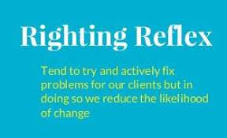
Righting Reflex
Stay curious
Ask open ended questions
Actively listen
Explore internal motivation
Assess the readiness
to change
How do you avoid telling clients how
to “fix” the situation?
Notes:
ASK participants, how do they avoid telling clients how to “fix” the situation (the Righting Reflex)? Possible responses:
Stay curious
Asking open-ended questions
Actively listen
Exploring your internal motivation (why do I want to “fix” this situation?)
Listening for change talk/ opportunities to help self-motivation
Assessing the client’s readiness to change.
STATE these strategies lead us to the next principle in the spirit of MI which is evocation.

Slide 54
Evocation
Our role is to learn about the family in order to maximize their protective capacity and build strengths to facilitate change.
Families have what they need to change
Elicit the goals and values of the family
The family has the potential motivation and resources from within
Incorporate expressions of change motivation in service planning
Notes:
EXPLAIN one of DCS’s values is the belief that families have the capacity to provide safety and stability for their children. Our role is to learn about the family in order to maximize their protective capacity and build on the strengths that can facilitate change.
STATE in the spirit of evocation, we are remaining curious in order to help families identify strengths that can be utilized in the change process including:
Families have what they need to change
Elicit the goals and values of the family
The family has the potential motivation and resources from within
Ambivalence brings opportunity: the family sees they need to make the change but are also familiar where they are currently.
Evoke and listen for change talk that expresses motivation for change
Incorporate expressions of change motivation in service planning

Slide 55
Seeking the well-being and interest of families through active engagement and teaming
Supporting the family through teaming and inclusive planning
MI is not a directive approach. It is guiding and involves good listening.
Intentions are centered around helping and empowering
Communicating concerns and risks in a collaborative way
Compassion
Notes:
NOW let’s look at the next principle of compassion. EXPLAIN what compassion looks like:
Seeking the well-being and interest of families through active engagement and teaming – acknowledging that we are not the experts of the families that we are working with the family in partnership, engaging them in the assessment of their concerns and risks.
To actively support the family’s welfare through teaming and inclusive planning-
Going in the interaction with children and families with your heart in the “right place.” – being sur that we go into our interactions with children and families with the intentions that are purely centered around helping to empower and support achievement of well-being.
Compassion does not dismiss that case managers have concerns- Concerns, risks, and circumstances that cannot change are communicated with respect in the context of a collaborative relationship.

Slide 56
Human Dignity
What is meant by human dignity?
Self-worth
Self-respect
Autonomy
What can you do to preserve human dignity?
Active Listening
Asking questions
Acknowledging strengths
Inviting dialogue
Acknowledge emotions
Notes:
STRESS Compassion is an essential element of this work. Compassion is engaging the family in assessment, planning and implementation in a way their human dignity is preserved (even during moments of crisis), and their well-being and interest is prioritized.
ASK participants, what do you think is meant by “human dignity?” Possible responses; self- worth, self- respect, autonomy.
ASK participants what are some things you do in interactions with children and families that promote preservation of human dignity? Possible response:
Active listening
Asking questions and showing genuine interest in responses
Acknowledging strengths observed
Inviting dialogue
Acknowledge emotional reactions to DCS involvement
Self-Awareness – being aware of biases that you hold toward children and families.
Global assessment – inviting data from different people, places, and methods
TRANSITION, now that we have explored the four principles of the spirit of Motivational Interview, let’s take a moment and reflect on how we convey these principles in interactions with children and families. We have learned the four main concepts of the spirit of motivation interviewing including:
Collaboration
Acceptance
Evocation
Compassion
ASK participants when thinking about the components of the Spirit of Motivational Interviewing, “what is one thing within their control that they would like to do moving forward?”
EXCLAIM the spirit of motivational interviewing starts with you. Being in a mind-set that aligns with these principles is essential as we work to help children and families in their journey toward change.

Slide 57
Guiding Principles
GUIDING
Expressing Empathy
Rolling with Resistance
Developing Discrepancy
Supporting Self-Efficacy
Notes:
STATE now that we have an understanding of the Spirit of MI, we will now discuss the Guiding Principles of MI. SHARE these are the fundamental principles used in motivational interviewing to help us think about how to best engage and collaborate with the children and families we work with. These principles represent conversational strategies that can help resolve internal conflict within clients, the client is able to talk themselves into change rather than us trying to convince them to change. There are Four Guiding Principles in Motivational Interviewing
Expressing Empathy
Rolling with Resistance
Developing Discrepancy
Supporting Self-Efficacy
SHARE with the group this is not just a concept it is a tool in terms of how to communicate, connect and collaborate with those we are in conversation with.

Slide 58
Expressing Empathy
Goals:
To see the world as others see it
To be non-judgmental
To understand the other person’s feelings.
Be able to communicate your understanding of the other person’s feelings.
Notes:
EXPLAIN when Expressing Empathy, the goals are for you to be able to:
To see the world as others see it.
To be non-judgmental.
To understand the other person’s feelings. We must be in touch with our own feelings in-order to understand someone else’s feelings
Be able to communicate your understanding of the other person’s feelings.
STATE Child Welfare work can be very exhausting because of the empathetic connection we have with our cases throughout the day. This can be draining for us as workers because we are engaging with children and families who might be in difficult places.
EXPLAIN Empathetic Connection is necessary though in terms of communication. It communicates to the individual we are working with that we understand their experience and that we can enter into some of their feelings and thought processes. We do this without judgement. This does not mean we endorse it; it just shows the individual our commitment to get at the level they are feeling and thinking, being able to understand their world, and the way they are feeling and seeing things.

Slide 59
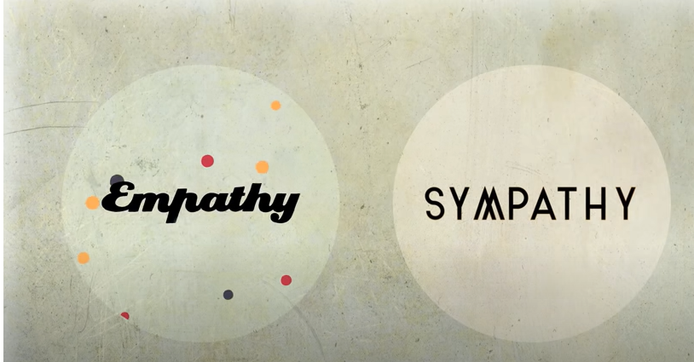
Empathy vs. Sympathy
Sympathy involves understanding from your own perspective.
Empathy involves putting yourself in the other person’s shoes and understanding why they may have these feelings.
Goal is to better understand
Notes:
STATE Empathy is different than sympathy. Sympathy involves understanding from your own perspective. Empathy involves putting yourself in the other person's shoes and understanding WHY they may have these particular feelings. In becoming aware of the root cause of why a person feels the way they do, we can better understand.
INTRODUCE Brené Brown who is an American professor, author, and podcast host. Brown is known for her work on shame, vulnerability, and leadership. SHARE we will watch a video on Empathy versus Sympathy. Time: 2:53 minutes. Link: https://www.youtube.com/watch?v=1Evwgu369Jw&t=10s
ASK participants their thoughts and DEBRIEF the video.

Slide 60
Rolling with Resistance
Avoid a direct head-on argument with the person
Show you have hear what they have said. Reflect and summarize.
Encourage the other person to come up with solutions or alternative behaviors versus explaining or forcing suggestions
A concept that gives us direction on how to engage the barriers the family has put up as they are confronting child welfare.
Walk with instead of resisting against
Lean into reflections
Apologize
Affirm
Shift focus
Notes:
SHARE the next guiding principle is Rolling with Resistance. Rolling with Resistance comes out of the concept of Ambivalence. Ambivalence is at the core of feeling stuck. Ambivalence gets acted out in our behaviors, and those behaviors are of the things that bring families to the attention of child welfare. DCS comes into families’ lives during a time of high stress, and also during a time when there are behaviors born out of this ambivalence.
EXPLAIN Rolling with Resistance is a concept that gives us direction on how to engage the barriers that the family has put up as they are confronting child welfare. Empathy is important in this regard; we want to walk with them rather than resist against them including:
Avoid a direct head-on argument with the person
Show that you have heard what the other person has said. Reflect and summarize. Get alongside them even if you don’t agree to defuse or prevent some of their instinctive defensiveness.
Encourage the other person to come up with possible solutions or alternative behaviors versus explaining or forcing suggestions on them. This can help them to feel empowered rather than attacked.
SHARE some specific tools you can use during Rolling with Resistance could include:
Lean into reflections
You can apologize for not seeing it the way they do.
Affirming
Shifting focus..."It seems like this one here might be more important to you."
STATE most people go into child welfare wanting to help other people. When we see kids and families pushing against “good choices” or “obvious good decisions” that would keep their family safe, most workers want to give advice or direction called “righting reflex.”
EXPLAIN this righting reflex is born out of concern where we as DCS workers can see the obvious choice or path is to safety and we want to provide that solution to the child or family. Many times, though if DCS is providing the solution it causes the individual to “push back.” This push back ends up feeding resistance rather than helping. It’s so important the child and family come up with their own solutions towards safety. It’s much harder to “push back” on your own idea. So, when you feel the “pushback” from the family and the “pull” within to come up with a solution. That is your indicator that you need to move back into curiosity and move back into walking beside them not in front of them.

Slide 61
It’s Not About the Nail
Notes:
SHOW It's Not About the Nail video. Time: 1:41 minutes. Link: https://www.youtube.com/watch?v=-4EDhdAHrOg
DEBRIEF and ASK participants their reaction to the video.

Slide 62
Developing Discrepancy
Asking us to look for statements or interactions where they are verbalizing they feel stuck.
Shift Focus to evoke difference between the status-quo and the way they wants things to be.
Look for mismatches between where they are and where they want to be.
Goal is for individuals to recognize their current behaviors place them in conflict with their values or interfere with accomplishment of goals.
Helps a person become more aware of those places of being stuck.
"Too often we enjoy the comfort of opinion without the discomfort of thought." ~John F. Kennedy
Notes:
MOVE to the next guiding principle of Developing Discrepancy. EXPLAIN Developing Discrepancy is asking us to really look for those statements, in our interactions with kids and families, where they are verbalizing, they feel stuck between two opposing thoughts or desires or behaviors.
STATE this is when we shift the focus of the conversation when there is little or no change talk, to evoke any difference between the status-quo and the way the client would like things to be.
SHARE Developing Discrepancy is looking for those mismatches between where they are and where they want to be and really developing those in our interactions through our questions and through our reflections with the person we are engaging in conversation with.
EXPLAIN when individuals recognize their current behaviors place them in conflict with their values or interfere with accomplishment of self-identified goals, they are more likely to experience increased motivation to make important life changes.
STATE in MI the goal is to help clients to become aware of how current behaviors may lead them away from, rather than toward, their own important values and goals.
SHARE there are going to be lots of interactions where we are hearing the individual say things like “on the one hand, I really want to change and make this change your asking me to do…” “On the other hand, I’m really not sure I can do it and here are the reasons why I don’t think I can be successful.”
EXPLAIN MI asks us to really listen for these types of statements and use them as a starting point towards change. Thinking about where the ambivalence and how is it coming out in the way a person is communicating to you about their feelings of being stuck.
EMPHASIZE we as workers are holding out these two sides and saying them out loud. The person can see them and decide which way they want to go. The place of being stuck (ambivalence) is not always something they see or recognize. It really takes conversations of curiosity and evocation for us at DCS to hear the pattern of stuck-ness.
SHARE we can use MI to develop discrepancy and bring it outside and say it out loud so a person can start deciding and untangling that knot (ambivalence) with now where do I want to go with this now that I see that’s where I am. Ultimately developing discrepancy helps a person become more aware of those places of being stuck.

Slide 63
Example
CM: “You’ve said you are working your plan to get the kids home and still taking Oxy on the weekends. How do those two things go together?
Family: “Well…I suppose they don’t.”
Notes:
TRANSITION and DISCUSS an example could be, CM: “You’ve said you are working your plan to get the kids home and still taking Oxy on the weekends. How do those two things go together?” Family: “Well, I suppose they don’t.” The family’s response shows they have heard the difference and recognizes their behavior isn’t resulting in what they want.

Slide 64
Self-Efficacy
Focus on previous successes and highlight skills and strengths they already possess.
They have an internal locus of control
Refers to where you believe the power to alter your life events resides within you (internal locus of control) or outside of you (external locus of control).
Notes:
LASTLY, Self-Efficacy is Guiding Principle #4. STATE we can support self-efficacy by focusing on previous successes and highlighting skills and strengths they already possess.
EXPLAIN to put self-efficacy in other terms, you might say that those with high self-efficacy have an internal locus of control. The locus of control refers to where you believe the power to alter your life events resides within you (internal locus of control) or outside of you (external locus of control).
EXCLAIM we have to believe families know what they need and have the ability to accomplish what is needed.
HIGHLIGHT these guiding principles are a starting point in having conversations with families to help them recognize change is necessary to move forward and to be successful.
STATE other modules of MI will be discussed in upcoming trainings. ENCOURGAGE participants to research MI and continue exploring how to incorporate these practices into their daily work with families.

