Slide 1
Safe Sleep for Infants
Office of Training and Professional Development
Notes:
Introduce yourself and your co-trainer and welcome participants.
Post the Tips for participating in WebEx and overview it.
Inform participants that they can utilize the chat box if they have questions during the training.

Slide 2
Objectives
Participants will understand the importance of Safe Sleep practices
Participants will recognize the ABC’s of Safe Sleep
Participants will differentiate between unsafe sleep positions and environments and Safe Sleep positions and environments
Participants will be familiar with the Protocol for Safe Sleep Education and Delivery of Safe Sleep Furniture
Participants will be able to assemble Pack ‘n’ Play Safe Sleep furniture
Notes:
Review Learning Objectives
Ask participants to use the chat box to discuss what they know about safe sleep for infants.

Slide 3
Reduce Risk
“Sleep-related causes of infant death” are those linked to how or where a baby sleeps or slept. These deaths are due to accidental causes, such as suffocation, entrapment, or strangulation.
Entrapment is when the baby gets trapped between two objects, such as a mattress and a wall, and can’t breathe.
Strangulation is when something presses on or wraps around the baby’s neck, blocking the baby’s airway.
These deaths are not SIDS.
Sleep related deaths are preventable.
Education is a key to reducing risk.

Slide 4
Infant Mortality Trends 2016-2020
Notes:
REVIEW the Infant Mortality Trends from 2016-2020 using the PowerPoint graphs from the Tennessee Department of Health.
EMPHASIZE these key points:
"Infant mortality" refers to the death of a baby before it reaches its first birthday. The "infant mortality rate" is the number of infant deaths per 1,000 live births. The infant mortality rate in Tennessee (shown in blue) is still higher than the national infant mortality rate (shown in red).
Information on the following slides can be found here: https://www.tn.gov/health/health-program-areas/fhw/vipp/safe-sleep/safe-sleep-statistics.html

Slide 5
Tennessee Sleep-Related Deaths 2016-2020
Notes:
REVIEW Tennessee Sleep Related Deaths 2016-2020
Even though the overall infant mortality rate and number of infant deaths has been declining over the past few years, sleep-related deaths consistent account for 1 in 4 infant fatalities. In 2020 there 115 infant sleep-related deaths. That means that 25% of all infant deaths were due to sleep-related causes!

Slide 6
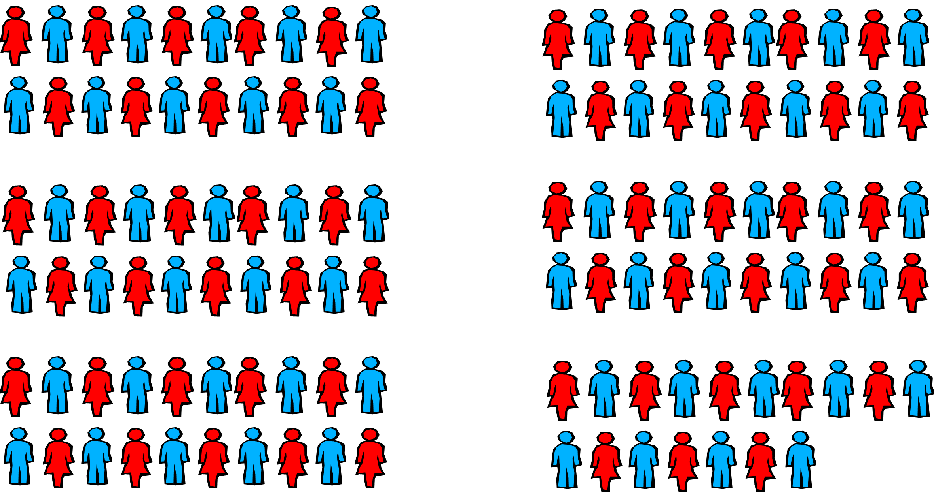
Impact of Eliminating Sleep-Related Deaths
115 children= nearly 6 Kindergarten classrooms
Notes:
REVIEW The Impact of Eliminating Sleep Related Deaths Slide and share the following information:
The majority of sleep related deaths are preventable. There are steps we can take to reduce the risk of a sleep related death.
In 2020 in Tennessee, 495 babies died before reaching their first birthday. That's the equivalent of nearly 25 kindergarten classrooms!
Of those deaths, 115 were sleep related, which is equivalent to nearly 6 Kindergarten Classrooms.

Slide 7
DCS Near Death/ Death Cases
January 2021- April 2022.
167 Total children reviewed
74 were age 0-1 year.
34 incidents involved unsafe sleep (46%)

Slide 8
Notes:
ASK participants “What are some factors that you believe contribute to sleep related infant deaths?”
ASK them to give responses in the chat box. Review the answers given on the screen and acknowledge participants for their contributions.
Some people may think that these sleep-related deaths only occur when parents are obese, or when parents are under the influence of alcohol or drugs.
Data from Tennessee's Child Fatality Review process shows otherwise. The main contributors to sleep-related deaths in Tennessee are: Unsafe bedding or toys in the sleeping area (86% of deaths), Infant not sleeping in a crib or bassinette (69% of deaths), infant sleeping with other people (58% of deaths), and infant not sleeping on back (56%). These data show why it is important to follow the ABC's of safe sleep—babies should sleep Alone, on their Back, and in a Crib.

Slide 9
Other Sleep Practices
Bed Sharing
Can be seen by parents as
Soothing for a fussy infant
Facilitates breastfeeding
Increases supervision
Minimizes environmental dangers
Room Sharing
Can be seen by parents as
Safer
Convenient
Space saving
Notes:
REVIEW Other Sleep Practices regarding why caregivers might promote room sharing and bed sharing.
Room share—keep baby's sleep area in the same room where you sleep for the first 6 months or, ideally, for the first year. Place your baby's crib, bassinet, portable crib, or play yard in your bedroom, close to your bed. The AAP recommends room sharing because it can decrease the risk of SIDS by as much as 50% and is much safer than bed sharing. In addition, room sharing will make it easier for you to feed, comfort, and watch your baby.

Slide 10
Barriers to Safe Sleep
Parental beliefs about infant sleep
Lack of plausibility between SIDS and sleep position
Perceived inconsistency in recommendations
Non-back sleeping positions based on infant preference, comfort, and fear of choking
Lack of Safe Sleep furniture
Notes:
ASK participants “What are some barriers you think could get in the way of a caregiver implementing safe sleep practices?” ASK them to give responses in the chat box. Review the answers given on the screen and acknowledge participants for their contributions.
REVIEW key points from the slide. Include a discussion about how culture and how the parents or caregivers were raised can impact their view of safe sleep practices.

Slide 11
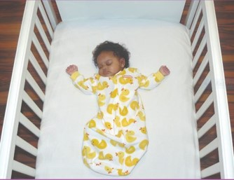
The ABC’s of Safe Sleep
A
B
C
Babies should sleep…
Alone
Not with an adult, another child, or pets
Not with pillows or stuffed toys
Not with crib bumpers
On their Back
Not on their side
Not on their stomach
In a Crib
Not in an adult bed
Not on a couch or sofa
Not in a chair
Notes:
REFER to the Power Point slide ABCs of Safe Sleep and STATE “Let’s look at the ABC’s of Safe Sleep”:
It is important to ensure that infants sleep ALONE. They can room share, but not bed-share
It is equally important to ensure that nothing is in the infants sleep area.
Cribs should be free of pillows, bumpers, stuffed toys, extra blankets or anything that could accidentally cover the infants face and suffocate them. Even younger babies, who can’t roll on purpose, can manage to roll closer to stuffed animals, etc. And while older babies have the muscle strength, they may be in a deep sleep and not awaken.
Keep loose objects, soft toys, and bedding out of the baby's sleep area. Do not use pillows and blankets in a baby's sleeping area.
Always place babies on their BACKS to sleep at night and at nap time. Until their first birthday, babies should sleep on their backs for all sleep times.
We know babies who sleep on their backs are much less likely to die of Sudden Infant Death Syndrome (SIDS) than babies who sleep on their stomachs or sides. The problem with the side position is that the baby can roll more easily onto the stomach.
Note: Some babies will roll onto their stomachs. You should always place your baby to sleep on their back, but if they're comfortable rolling both ways (back to tummy, tummy to back), then you don't need to keep turning your baby to their back again. Be sure that there are no blankets, pillows, stuffed toys or bumper pads in your baby's bed, though. Your baby could roll into any of these items, which could block their airflow.
Babies should always sleep in a CRIB. The safest place for a baby is in the same room as the parents but alone in a separate sleep area. Use a crib or bassinet for naps and at night. Do not place babies to sleep in or on adult beds, couches, chairs, car seats, swings, and infant carriers for naps or at night.
A baby should sleep in a crib with only a tight-fitting sheet.
It is fine to swaddle your baby. However, make sure that the baby is always on his or her back when swaddled. The swaddle should not be too tight or make it hard for the baby to breathe or move his or her hips. When your baby looks like he or she is trying to roll over, you should stop swaddling.

Slide 12
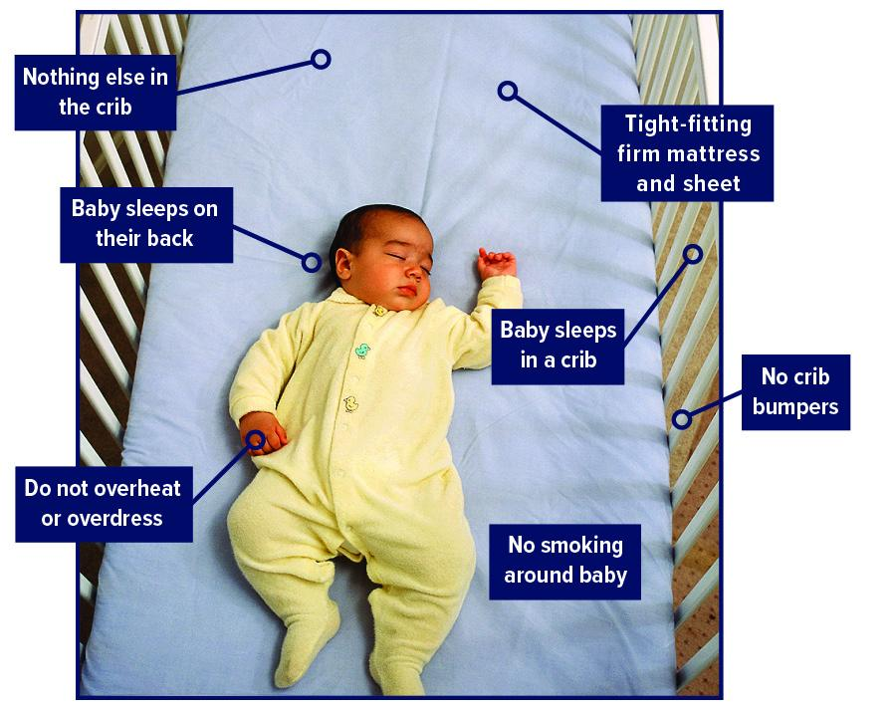
American Academy of Pediatrics Recommendations
Avoid overheating
No crib bumpers
Avoid smoking
Breastfeeding
Routine immunizations
Use a pacifier
Notes:
STATE: Other recommendations made by the AAP that can contribute to Safe Sleep for infants include:
Avoid letting your baby overheat during the night. A baby should be dressed lightly for sleep. Set the room temperature in a range that is comfortable for a lightly clothed adult.
Do not use crib bumpers. These do not reduce injuries and can cause suffocation.
Avoid smoking. Both maternal smoking during pregnancy and secondhand smoke after birth should be avoided. There are chemicals that can increase the risk of SIDS found in cigarette smoke. It is best not to smoke around the child at all and definitely not in the home or car where an infant lives or is transported. If a caregiver smokes outside the home, recommend they wear a shirt that is removed prior to coming back into the house. RECOMMEND they also wash their hands thoroughly before touching the infant.
Breastfeeding is recommended for at least the first six months of life. Breastfeeding is associated with a reduced risk of SIDS.
Room-sharing without bed-sharing
Routine immunizations
Consideration of a pacifier, as it prevents the baby from sleeping too deeply.

Slide 13
Safe Sleep for Babies Act of 2021
This bill makes it unlawful to manufacture, sell, or distribute crib bumpers or inclined sleepers for infants. Specifically, inclined sleepers for infants are those designed for an infant up to one year old and have an inclined sleep surface of greater than 10 degrees. Crib bumpers generally are padded materials inserted around the inside of a crib and intended to prevent the crib occupant from becoming trapped in any part of the crib's openings; they do not include unpadded, mesh crib liners.

Slide 14
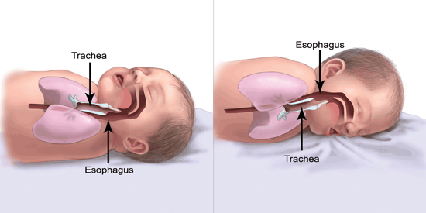
Safe Sleep Position
Which baby is in a Safe Sleep position?
Notes:
REFER participants to the Power Point slide Which position shows safe infant sleep?
ASK Based on the information we have discussed so far, which position is the correct position for safe infant sleep? Invite responses in the chat box and review participant’s answers.
STATE The answer is the baby on the left.

Slide 15
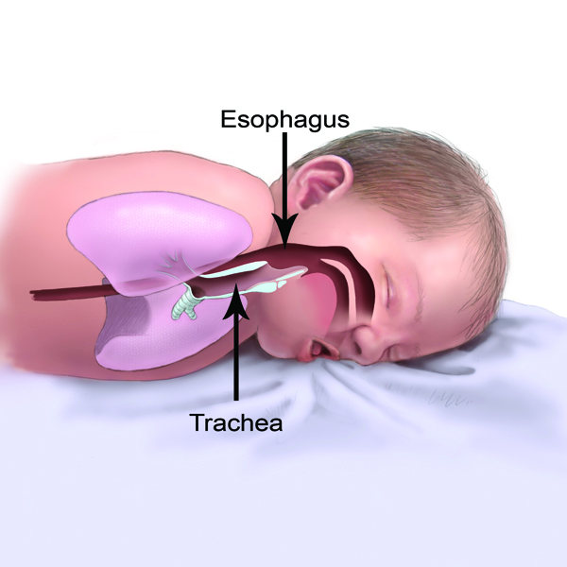
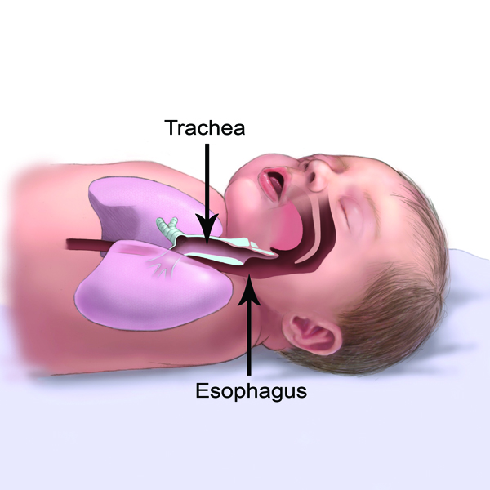
Safe Sleep Position
Baby on Back CORRECT
Baby on Stomach INCORRECT
Notes:
EMPHASIZE the baby on its back and the position of the Esophagus and Trachea. Point out that if the baby vomits or spits up while on its back, gravity might keep food from going into the windpipe (trachea), making it less likely for the baby to aspirate or choke.
STATE Once an infant can roll over on its own and move its head, they may sleep in the position that is most comfortable for them.

Slide 16
Safe Sleep Position
Notes:
SHOW Video: Safe Sleep Practices: Why babies don't choke on their backs
https://www.youtube.com/watch?v=ETouQosHO4I
REVIEW the ABC’s of Safe Sleep once again with participants: Babies should sleep Alone, on their Back, in a Crib!

Slide 17
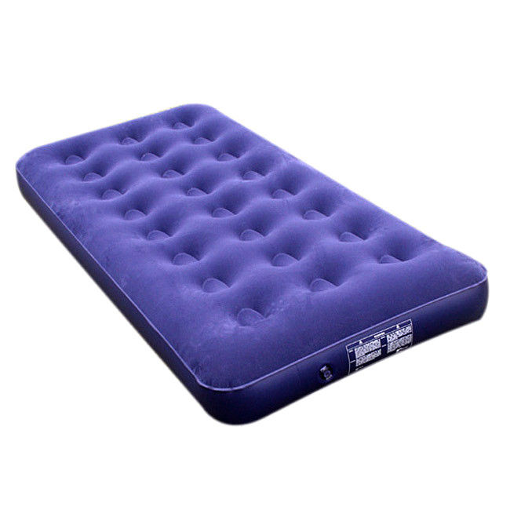
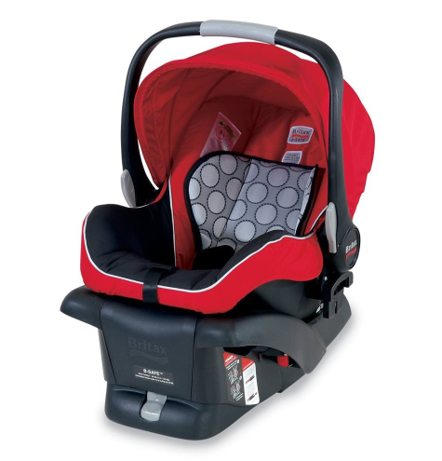
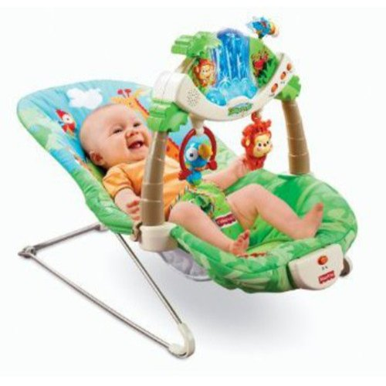
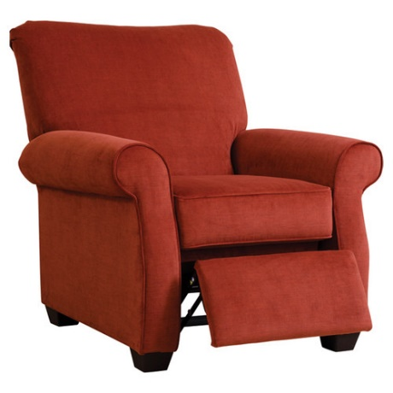
Safe Sleep Environment
Unsafe places for a baby to Sleep
Notes:
REVIEW Unsafe Places for Babies to Sleep Slide
STATE Couches, chairs, recliners, waterbeds, infant chairs, car seats are not safe environments for a baby to sleep in (AAP recommendations, 2011).
STATE This is one of the most shocking parts of educating caregivers because infants will often fall asleep in a car seat or baby swing. It is tempting to just let baby sleep in these locations; however infant deaths have occurred when infants were left alone on these surfaces and not moved to a safe sleep surface. Deaths from these devices were caused from strangulation from straps or suffocation from padding.
NOTE If a baby is in a device such as a car seat, swing or baby seat, never leave them unstrapped or partially strapped.

Slide 18
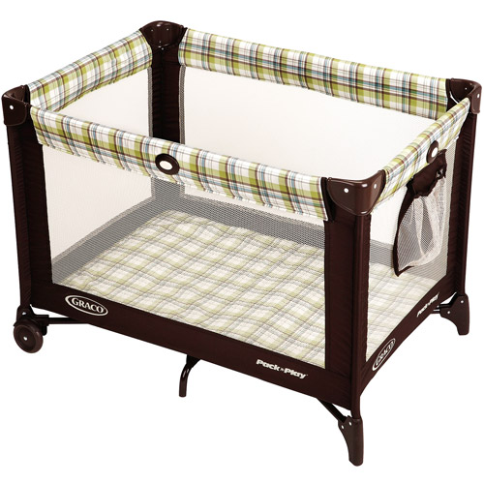
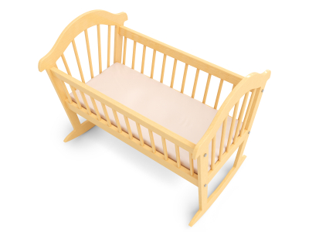
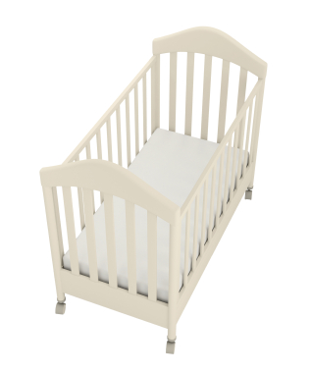
Safe Sleep Environment
Safe places for a baby to sleep
Notes:
REVIEW Safe Places for Baby to Sleep Power Point slide
Firm crib mattresses are the safest places for babies to sleep. Bassinets and pack n’ plays are also safe options for babies to sleep.
Make sure that the crib mattress is firm and fits snuggly with no space between the mattress and the side of the crib, where the baby could become trapped.
Keep loose objects, soft toys, and bedding out of the baby's sleep area. Do not use pillows and blankets in a baby's sleeping area. A baby should sleep in a crib with only a tight-fitting sheet.

Slide 19
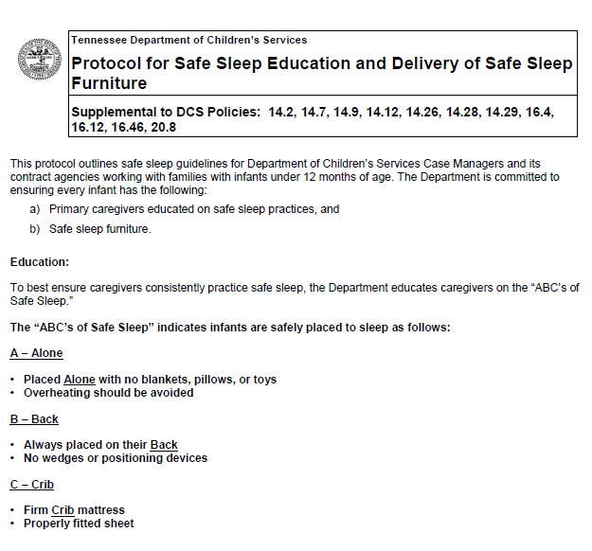
Protocol for Safe Sleep Education and Delivery of Safe Sleep Furniture
Notes:
REVIEW Protocol for Safe Sleep Education and Delivery of Safe Sleep Furniture on the DCS Policy page.
Located in Chapter 14
SHARE the protocol on the screen and review the key points including:
Safe Sleep furniture is available 24/7 to all families served by the Department
Safe sleep furniture is promptly provided to the family. This happens as soon as possible, but always within 8 hours of the need being identified.
the child’s name is written in large letters on the bottom of the pack-n-play.
any safe sleep furniture belonging to the child be taken with the child to the new placement.
CMs submit a Case Service Request (CSR) in TFACTS in the name of the infant for whom the safe sleep furniture was delivered. This CSR should be entered into TFACTS within two (2) business days to ensure an appropriate supply of safe sleep furniture is maintained in the region.
CM must visually verify the presence of fully set-up safe sleep environment.

Slide 20
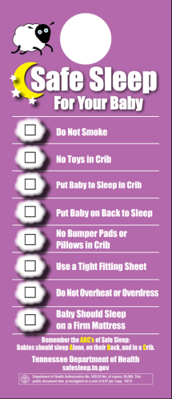
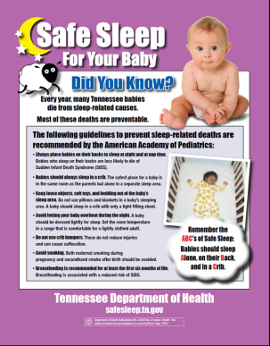
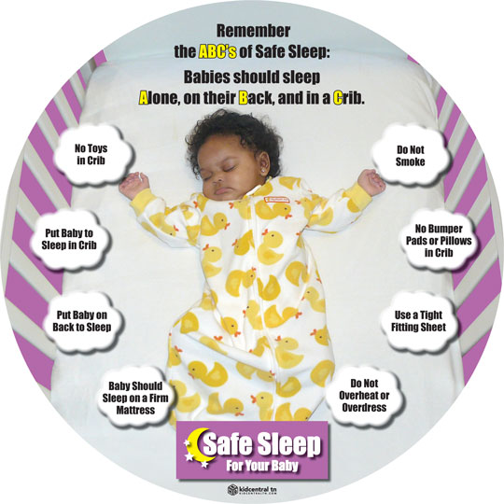
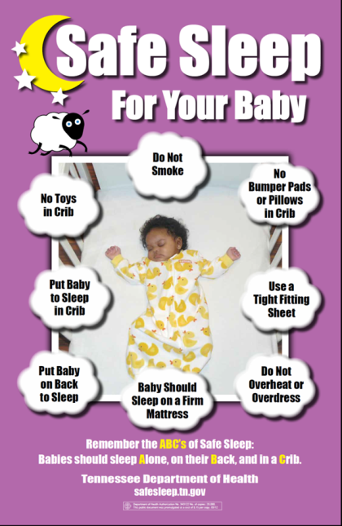
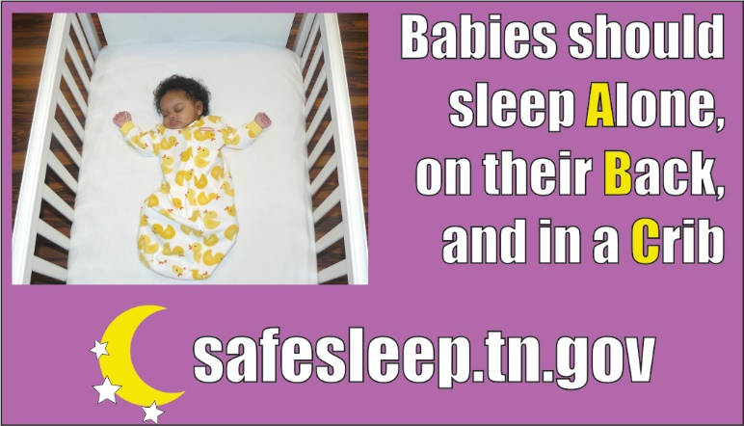
Safe Sleep Resources
Safe sleep packets will
be available in a central
location within each DCS
office.
Notes:
STATE Safe Sleep resource packets will be available at each DCS office for staff to provide to families with children one year old and younger.

Slide 21
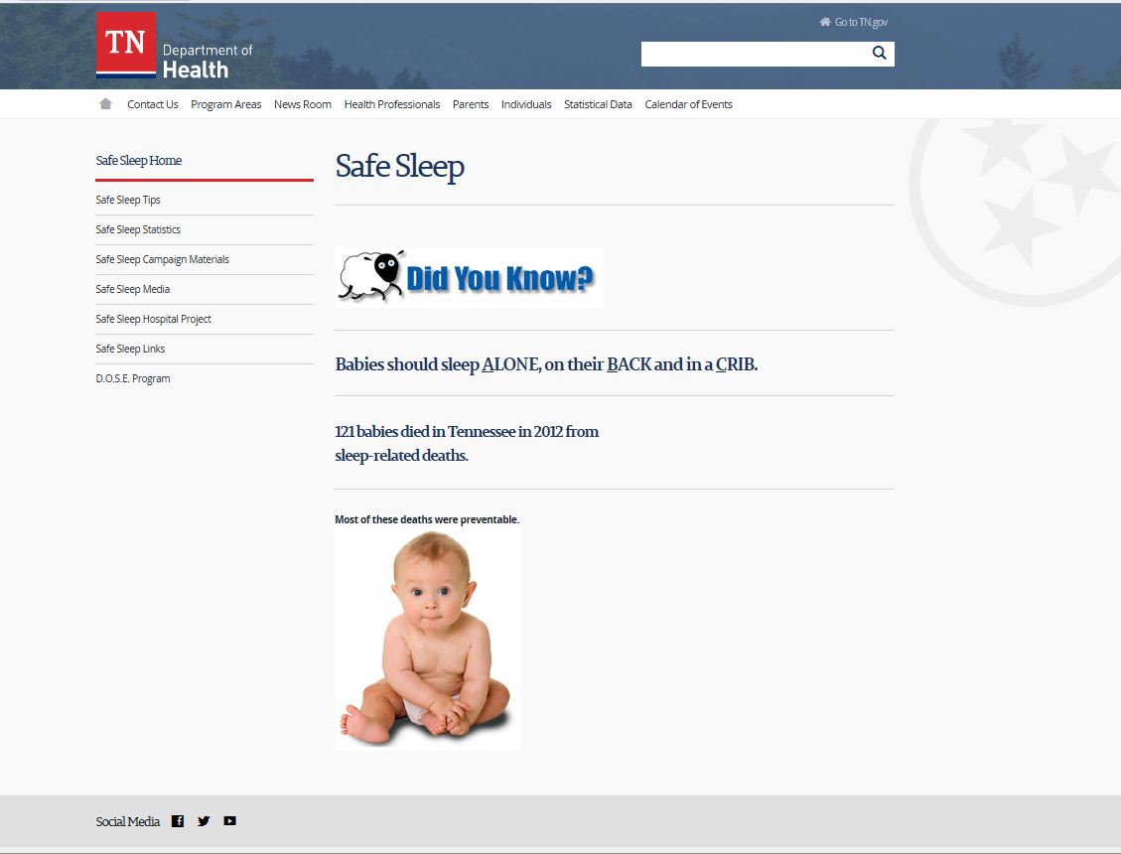
Safe Sleep Resources
Website: http://safesleep.tn.gov
Notes:
REFER participants to the Safe Sleep website http://safesleep.tn.gov for additional information and for resources to share with families.

Slide 22
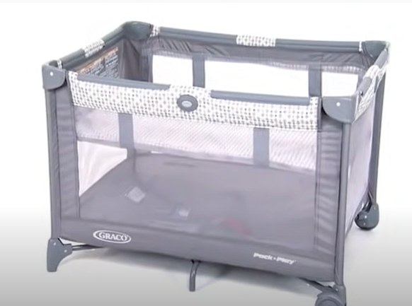
Pack ‘n’ Play Challenge
Notes:
Show the Pack ‘N Play video (1:35 minutes) https://www.youtube.com/watch?v=liBWGHIUKNw&t=1s
INFORM participants they will have an opportunity to practice assembling a Pack ‘n’ Play if they wish, when they compete the Child Passenger Safety Car Seat installation training.

Slide 23
Scaling!
Not Confident
Very Confident
Notes:
ASK participants to answer the following questions using the checkmark or pointer on the slide. REVIEW their answers and thank them for their contributions.
On a scale of 1 to 10; 1 being not confident at all and 10 being very confident how would you rate your confidence at putting together a Pack ‘N Play? Why would you rate yourself there? Is there anything that would help you rate yourself higher?
On a scale of 1 to 10; 1 being not confident at all and 10 being very confident how would you rate your confidence at teaching a birth parent and/or caregiver how to put a Pack ‘N Play together? Why would you rate yourself there? Is there anything that would help you rate yourself higher?
ASK if they have any additional questions or concerns.

Slide 24
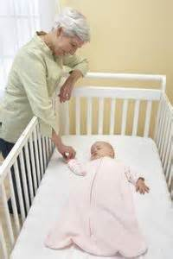
Every Sleep Counts
Have a safe sleep surface
for ALL sleeps
Don’t let “just this one time” turn into baby’s last time!
Your role is vital in educating families to help more babies live to see their first birthday.
Notes:
ASK if there are any questions regarding the Protocol for Safe Sleep Education and Delivery of Safe Sleep Furniture.
REMIND participants of the importance of having a safe sleep surface for all sleeps.
STATE “Don’t let just this one time turn into baby's last time.
REMIND participants that they play a vital role in providing safe sleep education

Slide 25
Thank you for your participation
Notes:
CONCLUDE the training by asking participants if they have any questions or concerns about using the information received in the training in their work with children and families.
THANK participants for their participation and explain how they can complete the training evaluation.

