Slide 1
Child Care Basics
Pre-Service
Ver. 20.3

Slide 2
Welcome
Notes:
Welcome participants to the class and explain that the class was created in order to help caseworkers gain some knowledge about how care for babies and children on their case loads if they do not have a lot of experience with young children since they are frequently asked to transport and sit with children. Explain that the class will not go into great depth about any of the topics but the class is meant to provide working knowledge of various guidelines when it comes to caring for young children.
Share that several paper resources will also be provided for participants to refer back too.

Slide 3
Objectives
Participants will be knowledgeable of childhood developmental milestones.
Participants will learn and demonstrate basic childcare practices.
Participants will be knowledgeable of basic medical needs and when to seek treatment.
Participants will understand the role caregivers play in strengthening child development.
Participants will review strategies and discuss building resiliency in children.
Notes:
REVIEW the Learning Objectives Slide: o Participants will be knowledgeable of childhood developmental milestones. o Participants will learn and demonstrate basic child care practices. o Participants will be knowledgeable of basic medical needs and when to seek treatment. o Participants will understand the role caregivers play in strengthening child development. Child Care Basics Facilitator Guide CHDE3055 TN Dept. of Childen's Services Ver. 20.3 6 o Participants will review strategies and discuss building resiliency in children.

Slide 4
Ice Breaker- How Comfortable Are YOU?
Listen to the questions and determine how comfortable you are with it on a scale of 1-10
(1 being least comfortable and 10 being most comfortable)
Move to the number corresponding to your comfort level
Notes:
For this activity, use tape or bungee cords to create the circles on the floor. If you have a large class you can be creative with how they will show their comfort levels, ex: standing up, sitting down, touching the wall.
Questions…
How comfortable are you changing a baby/child’s diaper?
How comfortable are you feeding a baby a bottle or baby food?
How comfortable are you knowing what nutritious food and snacks are ok to give a toddler?
How comfortable are you helping a child in the bathroom?
How comfortable are you giving recommendations to birth parents?
How comfortable are you assessing attachment?

Slide 5
Milestones…
“Milestones matter! How a child plays, learns, speaks, acts, and moves offers important clues about his or her development.”
Notes:
ASK What are developmental milestones? o Developmental milestones are things most children can do by a certain age. o Skills such as taking a first step, smiling for the first time, and waving “bye-bye” are called developmental milestones. Children reach milestones in how they play, learn, speak, act, and move. You see children reach milestones every day. Though all children develop at their own pace, most children reach developmental milestones at or about the same age. • EXPLAIN that milestones are not concrete, and many babies may hit certain milestones ahead of time while others reach milestones behind other children their age.

Slide 6
What we know about Child Development
1. Children grow in stages.
2. The capacity to accomplish a task is biologically based.
3. What is considered “normal” for each age varies widely.
Notes:
SHARE these are some things we know about child development: o Children grow in stages. During each stage of development, children display a particular set of physical, psychological, and emotional characteristics and develop a particular set of skills and abilities. Developmental tasks follow a predictable sequence. All children must accomplish the same tasks, and the tasks follow a relatively predictable sequence. Each set of developmental tasks is more complex than the previous one and is based on the learning of the previous state, so stages cannot be skipped, but the range of task achievement varies from minimal to mastery. o The capacity to accomplish a task is biologically based. Children cannot be pushed to move faster than their biological capabilities allow. For example, accomplishing the task of toilet training is dependent upon certain physiological capabilities that aren’t present until a certain age. o What is considered “normal” for each age varies widely. A child approaches each developmental task with her or his own unique personality, set of circumstances, and physical attributes. Therefore, what is considered “normal” behavior for each stage may vary widely. For example, some children walk at 8 months while others don’t walk until 15 months. A child who has not begun to walk by 3 years of age may have developmental delays.
EXPLAIN there are many milestone resource guides out there and the Milestone Checklists resource from the Centers for Disease Control and Prevention is included in your participant guide. Have participants take a few minutes to look over Milestone Checklists in their participant guide. Share that we will be referring to this guide throughout the training today.

Slide 7
Dumping and Sorting
Notes:
SHOW video about spotting milestones like dumping and sorting https://youtu.be/GgBvMnPhahQ

Slide 8
Milestone Activity
In your groups, using the milestone checklists handout:
Summarize the key developmental milestone for your assigned age group and
List parenting practices that support child development
Record this information on your flip chart
Notes:
ACTIVITY: Developmental Milestones o Divide participants into 5 groups. Assign each group an age category (2 months, 4 months, 6 months, 9 months and 1 year). o Prior to the training, create flipcharts with the age categories on them and a T-chart with “developmental milestones” on one side and “parent interactions” on the other. o Utilizing the Milestone Checklists resource in their Participant Guide have the small groups summarize the key developmental milestone for their age group and list parenting practices that support child development on the created flipchart.
For Small classes complete activity as a large group by utilizing the following slides.

Slide 9
2 Months
Developmental Milestones
Parent Interactions

Slide 10
2 Months
Begins to smile at people
Cuddle and talk with baby
Turns head towards sounds
Copy baby’s sounds
Pays attention to faces
Help baby get into a routine
Holds up head; pushes up while on tummy
Hold toys at eye level in front of them
Notes:
Discuss these highlights from the 2 month pages of the milestone handout.

Slide 11
4 Months
Developmental Milestones
Parent Interactions

Slide 12
4 Months
Smiles spontaneously
Play peek-a-boo
Babbles
Set sleeping and eating routines
Uses hands and eyes together
Encourage use of toys/rattles
Brings hands to mouth and can hold head unsupported
Encourage baby to reach for toys and explore surroundings
Notes:
Discuss these highlights from the 4 month pages of the milestone handout.

Slide 13
6 Months
Developmental Milestones
Parent Interactions

Slide 14
6 Months
Responds to other people’s emotions
Engage in reciprocal play
Begins stringing vowels together
Read books to baby
Brings things to mouth
When baby drops a toy on the floor,
pick it up and give it back
Begins sitting without support and may roll
Point and name things
Notes:
After the 6-month group reports out, play the following video and briefly discuss: https://youtu.be/PqkS9Fg5LC0

Slide 15
9 Months
Developmental Milestones
Parent Interactions

Slide 16
9 Months
May be clingy
Ask for behaviors you want from baby
Makes a lot of different sounds like “bababababa”
Continue with routines
Looks for things baby sees you hide
Talk about what baby wants when they
point at something
May crawl
As baby moves around more, stay close
Notes:
After the 9-month group reports out, play the following video and briefly discuss: https://youtu.be/kynBaPiiqo0

Slide 17
One Year
Developmental Milestones
Parent Interactions

Slide 18
1 Year
Has favorite things and people
Give child lots of affection and praise
Can use simple gestures like shaking head or waving “bye-bye”
Talk to your child about what he points to
Takes things out of containers and puts things
back
-Play with blocks or shape sorters
May stand alone or take a few steps
Ask child to label things they see
Notes:
After the 12-month group reports out, play the following video and briefly discuss: https://www.youtube.com/watch?v=- ymRgo_hKaM&feature=youtu.be https://youtu.be/ymRgo_hKaM

Slide 19
18 Months
Likes to hand things to others or may play pretend
Encourage pretend play.
Says several single words or short sentences
Use words that describe feelings.
Can point to body parts
Provide a safe, loving, consistent environment.
Walks alone and can help
undress himself/ herself
Encourage child to drink from a cup
and use a spoon.
Notes:
CONDUCT a facilitated discussion around children who are 18 months, 2 years, 3 years, 4 years, and 5 years by asking the group what developmental milestones should be observed for each age category and what parenting interactions are important to support development. ENCOURAGE participants to share case examples.
After discussing children who are 18 months, play following video and briefly discuss: https://youtu.be/Jc4umXQ4A_c

Slide 20
2 Years
Gets excited with other children
Do art projects with child and hang it up.
Repeats words
Encourage child to say the word instead of just
pointing.
Completes sentences and rhymes in familiar
books
Teach your child to identify and say common things.
Climbs onto furniture without help
Take child to the park to run and climb.
Notes:
Discuss these highlights from the 2 year pages of the milestone handout.
After discussing children who are 2 years, play the following video and briefly discuss: https://youtu.be/QVTaSjAkR6Q

Slide 21
3 Years
Takes turns in games
Encourage your child to play with other children.
Can name most familiar things
Work with child to solve problems when they are upset.
Can build towers with more than 6 blocks
Play matching and counting games.
Can run and climb easily
Set rules and limits for your child.
Notes:
After discussing children who are 3 years, play the following video and briefly discuss: https://youtu.be/ZawAkzTkGCQ

Slide 22
4 Years
Can be more creative with pretend play
Teach child how to play outdoor games
Can sing songs or poems from memory
Use good grammar when speaking to child
Can tell you what he thinks will happen next in a book
Take time to answer “why” questions.
Can catch bouncing balls
Give child simple 2-3 choices
Notes:
Discuss these highlights from the 4 year pages of the milestone handout.

Slide 23
5 Years
Wants to be like friends
Talk to child about safe and unsafe touches.
Can speak clearly
Teach child time concepts.
Can copy geometric shapes
Play with toys that encourage child
to put things together.
Can use utensils on their own
Explore child’s interests within the community,
Notes:
Discuss these highlights from the 5 year pages of the milestone handout.

Slide 24
Addressing Cultural Differences
Notes:
FACILITATE an open discussion around the role culture plays in parenting practices. Refer to talking points for additional information. • Parents and caregivers, typically, want what is best for their children. Parenting techniques or styles vary across cultures and we cannot allow this bias or difference to hinder permanency or reunification. If there are concerns that the parenting style poses a danger to the child, these should be addressed as a team in a CFTM. • General guidelines for taking care of infants and children have been provided throughout this training. It is important to remember that parenting or taking care of a young child is not concrete in many situations. According to Dr. Michael Damron of Summit Medical Group, pediatricians will, typically, try to listen to a parent’s questions, carefully, and then counsel or educate them on risks involved. As long as a child’s immediate safety is not at risk, then considering the parent’s cultural preferences is appropriate. As Caseworkers, we may need to suggest to birth parents talking with a pediatrician is best. • STATE we are going to first discuss some basics for feeding an infant and the recommendations around introducing solid foods.

Slide 25
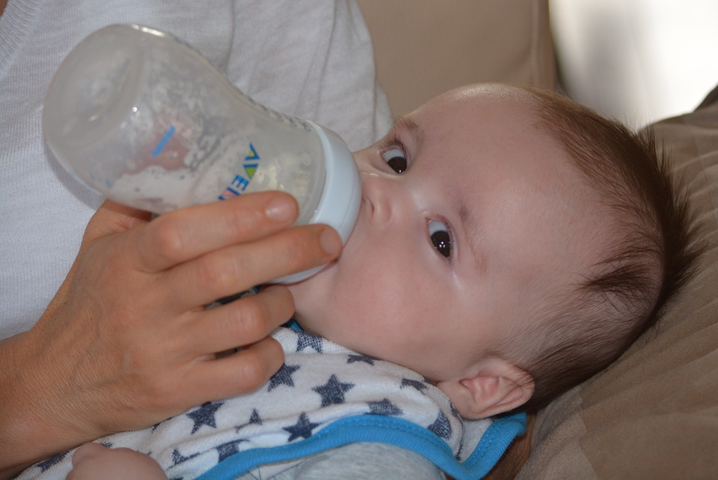
Appropriate Liquids for Infants
Formula or breastmilk
At about 6 months old, babies can have 2-3oz. of water
Information provided by Dr. Michael Damron of Summit Medical Group of Maryville, TN
Notes:
SHARE slide Appropriate Liquids and ASK participants to share what information they know about feeding an infant? • Ensure the following talking points are covered. o Babies, ages 0-1, only need formula or breastmilk to drink. These foods are complete and gives them all of the water they need daily. o When babies turn 6 months old, it is acceptable to give them 2-3oz. of water if you are outside and it is hot, or you do not have any formula or breastmilk available. o When feeding an infant, it is best to have them in a reclined, sitting position to help them digest their food better. o Propping a bottle for a baby in their carrier or crib is not recommended as it is linked to ear infections and choking. If their teeth have started coming in, it can lead to tooth decay. • If there are concerns about dehydration, babies can be given Pedialyte in some situations, but always consult a pediatrician if the baby has significant vomiting. • Babies do not need juice, soda, tea, Kool-Aid, or other drinks as sugary drinks can lead to dental decay and poor nutrition. • It is important to discuss any feeding concerns with the infant’s pediatrician since all babies are different and their stomachs can be sensitive. • We discussed culture earlier and feeding infants and children is an area where cultural bias can occur, so it is important to ask questions to gain an understanding of the family’s culture around feeding and assess the safety risk the actions may propose.

Slide 26
Feeding Infants
Newborns = 8-12 feedings of breastmilk or formula (about every 2-4 hours)
Signs they are hungry:
Hands in mouth
Sucking on fist/fingers
Smacking lips
Fussiness/crying
Notes:
SHARE Feeding Infants Slide and state newborns, typically, start out needing 8-12 feedings a day as they may eat every 2-4 hours. This will decrease as they get older but varies by child. o As babies get older, they take in more formula or breastmilk in less time at each feeding. o Cow’s milk should not be added to the diet of a baby under the age of 1 because it does not provide the right nutrients for babies. Caregivers should avoid giving honey of any and all kinds for children under the age of 1 as it can cause a type of botulism. Trainer’s note: Botulism is a serious illness caused by a botulinum toxin that causes paralysis. The paralysis starts in the face and moves to the limbs and if it reaches the breathing muscles it can cause respiratory failure. o Babies who are breastfed may differ in how often they eat from babies who are formula fed.

Slide 27
How to prepare a bottle (video)
Notes:
ASK how do you know when a baby is hungry? Once participants respond, share the following if not discussed: Babies may bring their hands to mouth, suck on their fists or fingers, or smack their lips to show they are hungry. Fussing or crying can follow. • PLAY the “How to prepare a bottle video” (54 seconds) • ASK participants if they have any questions about how to prepare a bottle with formula.
https://www.youtube.com/watch?v=EU3uWocz-TQ

Slide 28
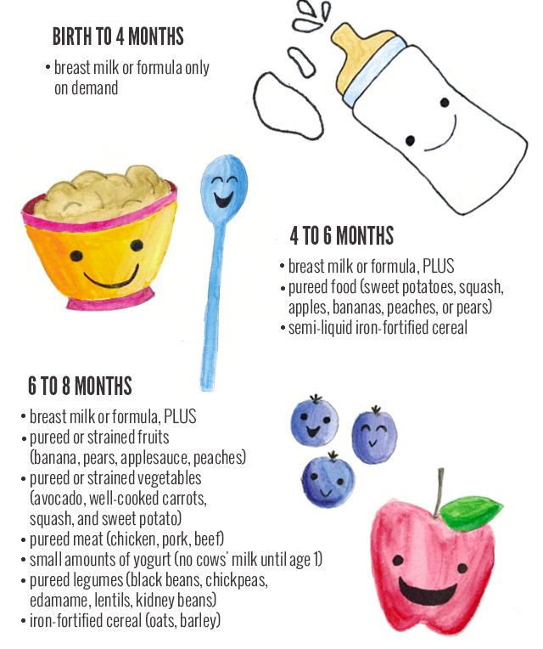
Introducing solids
Notes:
REVIEW the Introducing solids slide and provide an overview of the chart on the slide. Explain these are general guidelines. • REMIND participants to consult a doctor for individual feeding plans based on their child’s needs and developments. • It is important for toddlers and young children to have balanced and nutritious meals and snacks. o Toddlers will, typically, need 2-3 cups of milk daily, as well.

Slide 29
Feeding Toddlers or Young Children
Balanced and nutritious meals and snacks
need 2-3 cups of milk daily
Suggestions for healthy snacks or foods:
Fruits
Vegetable sticks
Salads
Sandwiches
Graham crackers and milk
Cheese cubes and pretzel sticks
Notes:
Share that encouraging young children to always clean their plates is not always a good method to follow as this can encourage children to eat the food in front of them just because it is there and not because they are hungry. This can lead to poor nutrition habits.
Share that if a child cannot speak yet, they will show they are full by pushing the bottle or spoon away or turning their heads away.

Slide 30
Diaper Changing
Notes:
ASK participants for some suggestions for healthy snacks or foods for toddlers and young children. Possible ideas include: o Fruits such as apples or peaches o Vegetable sticks o Creative salads o Sandwiches using a variety of bread types o Graham crackers and milk o Individual pizzas made with English muffins topped with tomato sauce and shredded cheese o Cheese cubes and pretzel sticks • ASK participants what foods to avoid or be cautious about due to potential choking hazards. Possible suggestions include: o Grapes o Hotdogs o Popcorn o Chips o Hard Candy Child Care Basics Facilitator Guide CHDE3055 TN Dept. of Childen's Services Ver. 20.3 15 • TRANSITION into a discussion around diapering. ASK participants who rated themselves as fairly comfortable with changing a diaper? ASK the participant to share what strategies they utilize when changing a diaper.
SHOW video about how to change a diaper and answer any questions participants may have from the video. Do not assume that everyone knows how to change a diaper appropriately. VIDEO -Parenting and Infant Care | How to Change a Baby's Diaper | Woman's Hospital | Baton Rouge, La. - YouTube (2 minutes, 20 seconds)

Slide 31
Steps to Changing a Diaper
Collect all needed items prior to laying the infant on the changing table
Lay the baby on his/her back. Remove any clothing that inhibits access to the diaper.
Removed the soiled diaper. For disposable diapers, pull up the sticky tabs.
Lift your baby up gently by both legs so you can scoot the diaper out from under his/her bottom.
Use wipes to clean the baby’s diaper region. Always wipe from front to back to avoid infection, especially for girls.
If the area is red or inflamed, sooth it with diaper rash ointment.
Wait for the baby’s skin to dry before putting on a fresh diaper.
Take a fresh diaper and place it under the baby. Bring the front part up on the baby’s stomach and fasten the tabs to secure the diaper on his/her waist.
Replace any clothing over the new diaper.
Notes:
Steps to change a diaper include:
Collect all needed items to change the diaper prior to laying the infant on the changing table or surface used to change the diaper.
Lay your baby on his/her back. Remove any clothing that inhibits access to the diaper.
Remove the soiled diaper. For disposable diapers, pull up the sticky tabs.
Lift your baby up gently by both legs so you can scoot the diaper out from under his/ her bottom.
Use wipes to clean your baby's diaper region. Always wipe from front to back to avoid infection, especially for girls.
If the area is red or inflamed, soothe it with diaper rash ointment.
Wait for your baby's skin to dry before putting on a fresh diaper.
Take a fresh diaper and place it under your baby. Bring the front part up on your baby's stomach and fasten the tabs to secure the diaper on his/ her waist.
Replace any clothing over the new diaper.
• SHARE that some diaper brands have a yellow line on the front of the diaper that will turn blue when the diaper is wet. This can help parents and caregivers know when to change the diaper.
• SHARE that changing boys can, sometimes, be a challenge and laying a wipe on top of their penis can be helpful.
• ACTIVITY - Diapering practice. Provide the participant with a doll, diaper, and wipes and have them practice changing the baby’s diaper. Provide additional instructions and feedback as needed.

Slide 32
How to Prevent Diaper Rash
Check your infant's diaper often (every two hours) and change it promptly.
Clean your infant's diaper region thoroughly during changes.
Do not use scented wipes or soaps on your infant's diaper region.
Pat, do not scrub, a baby's bottom when drying your infant after a bath.
Avoid plastic pants and look out for skin marks, which, indicates the diaper is too tight.
Notes:
SHARE there are things that caretakers can do to prevent an infant from developing a diaper rash. o Check your infant's diaper often (every two hours) and change it promptly. o Clean your infant's diaper region thoroughly during changes. o Do not use scented wipes or soaps on your infant's diaper region. o Pat, do not scrub, a baby's bottom when drying your infant after a bath. o Avoid plastic pants and look out for skin marks, which, indicates the diaper is too tight.

Slide 33
How to Prevent a Diaper Rash Continued…
Call your pediatrician for rashes that don’t seem to improve in a couple of days with OTC ointments and diaper changes.
Information provided by Dr. Michael Damron of Summit Medical Group of Maryville, TN
Notes:
Call your pediatrician for rashes that don’t seem to improve in a couple of days with over the counter ointments and diaper changes. Yeast diaper rashes are common in infants and tend to be bumpier and raised. These types of rashes tend to require antifungal medications. • SHARE that diaper rashes are very uncomfortable for little ones which is why appropriate diaper care is crucial. • Infants only need to be bathed three to four times per week, as long as caregivers are cleaning their diaper region during changes. More frequent baths may result in dry skin. • CONDUCT a brief discussion on the age children typically potty train and what assistance they might need when going to the bathroom. o Children are often ready to begin learning the concepts and skills of potty training around 18 months of age. Child Care Basics Facilitator Guide o Almost all children can be made ready for toilet training between 2-3 years of age. • Refer participants to the Child Abuse Prevention Standard of Practice located in their participant guide. If children need assistance when using the toilet DCS staff should ensure that the door remains open while they are assisting the child.

Slide 34
Tummy Time
Develops chest, arm, and neck muscles
Newborns = 2-3 times a day for 1-2 minutes at a time.
Add a minute or so each week up to 20 minutes an episode by the time they are 4-5 months old.
This is when they typically start rolling over.
Try not to do after a feeding, as there may be spitting up.
Information provided by Dr. Michael Damron of Summit Medical Group of Maryville, TN
Notes:
TRANSITION to the topic of tummy time by asking participants why tummy time for an infant is important. Tummy time is important for babies to develop the muscles in their upper chest, arms, and neck. o For newborns, you can do tummy time 2-3 times a day for 1-2 minutes at a time. o As babies get older and bigger, they typically can spend more time on their bellies. You may want to let them add a minute or so longer each week, up to about 20 minutes an episode by the time they are 4-5 months old. This is when they typically start rolling over. o Try not to do this after a feeding, as there may be more spitting up.

Slide 35
The ABC’s of Safe Sleep
A
B
C
Babies should sleep…
Alone
Not with an adult, another child, or pets
Not with pillows or stuffed toys
Not with crib bumpers
On their Back
Not on their side
Not on their stomach
In a Crib
Not in an adult bed
Not on a couch or sofa
Not in a chair
Notes:
TRANSITION by stating babies do not have regular sleep cycles until about 6 months of age. While newborns sleep about 16 to 17 hours per day, they may only sleep 1 or 2 hours at a time. As babies get older, they need less sleep. However, different babies have different sleep needs. It is normal for a 6- month-old to wake up during the night but go back to sleep after a few minutes.
REFER to the Power Point slide ABCs of Safe Sleep and STATE “Let’s look at the ABC’s of Safe Sleep”:
It is important to ensure that infants sleep ALONE. They can room share, but not bed-share
It is equally important to ensure that nothing is in the infants sleep area.
Cribs should be free of pillows, bumpers, stuffed toys, extra blankets or anything that could accidentally cover the infants face and suffocate them. Even younger babies, who can’t roll on purpose, can manage to roll closer to stuffed animals, etc. And while older babies have the muscle strength, they may be in a deep sleep and not awaken.
Keep loose objects, soft toys, and bedding out of the baby's sleep area. Do not use pillows and blankets in a baby's sleeping area.
Always place babies on their BACKS to sleep at night and at nap time. Until their first birthday, babies should sleep on their backs for all sleep times.
We know babies who sleep on their backs are much less likely to die of Sudden Infant Death Syndrome (SIDS) than babies who sleep on their stomachs or sides. The problem with the side position is that the baby can roll more easily onto the stomach.
Note: Some babies will roll onto their stomachs. You should always place your baby to sleep on their back, but if they're comfortable rolling both ways (back to tummy, tummy to back), then you don't need to keep turning your baby to their back again. Be sure that there are no blankets, pillows, stuffed toys or bumper pads in your baby's bed, though. Your baby could roll into any of these items, which could block their airflow.
Babies should always sleep in a CRIB. The safest place for a baby is in the same room as the parents but alone in a separate sleep area. Use a crib or bassinet for naps and at night. Do not place babies to sleep in or on adult beds, couches, chairs, car seats, swings, and infant carriers for naps or at night.
A baby should sleep in a crib with only a tight-fitting sheet.
It is fine to swaddle your baby. However, make sure that the baby is always on his or her back when swaddled. The swaddle should not be too tight or make it hard for the baby to breathe or move his or her hips. When your baby looks like he or she is trying to roll over, you should stop swaddling.

Slide 36
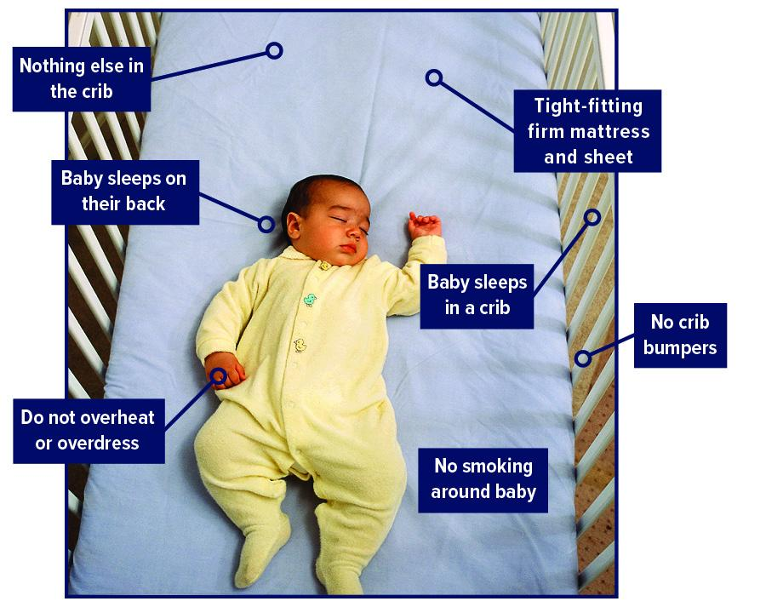
American Academy of Pediatrics Recommendations
Avoid overheating
No crib bumpers
Avoid smoking
Breastfeeding
Routine immunizations
Use a pacifier
Notes:
STATE: Other recommendations made by the AAP that can contribute to Safe Sleep for infants include:
Avoid letting your baby overheat during the night. A baby should be dressed lightly for sleep. Set the room temperature in a range that is comfortable for a lightly clothed adult.
Do not use crib bumpers. These do not reduce injuries and can cause suffocation.
Avoid smoking. Both maternal smoking during pregnancy and secondhand smoke after birth should be avoided. There are chemicals that can increase the risk of SIDS found in cigarette smoke. It is best not to smoke around the child at all and definitely not in the home or car where an infant lives or is transported. If a caregiver smokes outside the home, recommend they wear a shirt that is removed prior to coming back into the house. RECOMMEND they also wash their hands thoroughly before touching the infant.
Breastfeeding is recommended for at least the first six months of life. Breastfeeding is associated with a reduced risk of SIDS.
Room-sharing without bed-sharing
Routine immunizations
Consideration of a pacifier, as it prevents the baby from sleeping too deeply.

Slide 37
Notes:
ASK participants “What are some factors that you believe contribute to sleep related infant deaths?”
ASK them to give responses in the chat box. Review the answers given on the screen and acknowledge participants for their contributions.
Some people may think that these sleep-related deaths only occur when parents are obese, or when parents are under the influence of alcohol or drugs.
Data from Tennessee's Child Fatality Review process shows otherwise. The main contributors to sleep-related deaths in Tennessee are: Unsafe bedding or toys in the sleeping area (86% of deaths), Infant not sleeping in a crib or bassinette (69% of deaths), infant sleeping with other people (58% of deaths), and infant not sleeping on back (56%). These data show why it is important to follow the ABC's of safe sleep—babies should sleep Alone, on their Back, and in a Crib.

Slide 38
Safe Sleep for Babies Act of 2021
This bill makes it unlawful to manufacture, sell, or distribute crib bumpers or inclined sleepers for infants. Specifically, inclined sleepers for infants are those designed for an infant up to one year old and have an inclined sleep surface of greater than 10 degrees. Crib bumpers generally are padded materials inserted around the inside of a crib and intended to prevent the crib occupant from becoming trapped in any part of the crib's openings; they do not include unpadded, mesh crib liners.

Slide 39
Safe Sleep Position
Notes:
SHOW Video: Safe Sleep Practices: Why babies don't choke on their backs
https://www.youtube.com/watch?v=ETouQosHO4I
REVIEW the ABC’s of Safe Sleep once again with participants: Babies should sleep Alone, on their Back, in a Crib!

Slide 40
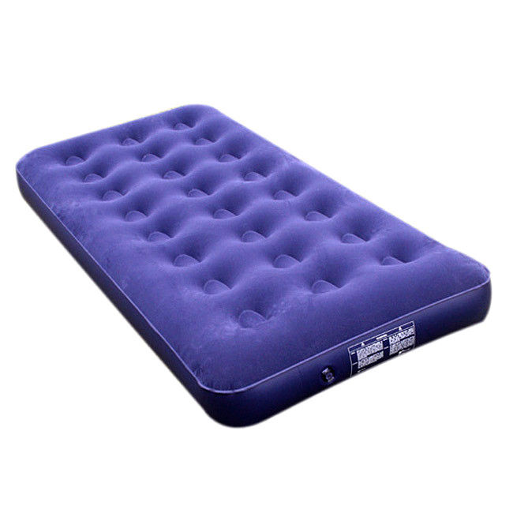
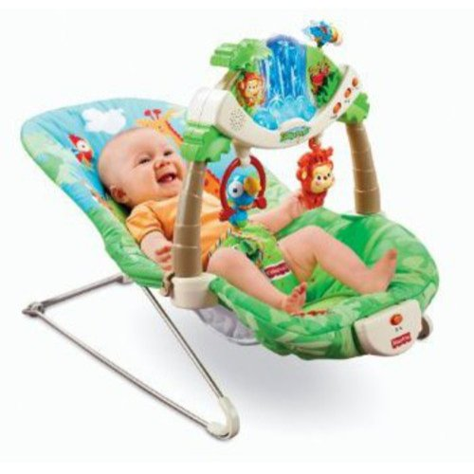
Safe Sleep Environment
Unsafe places for a baby to Sleep
Notes:
REVIEW Unsafe Places for Babies to Sleep Slide
STATE Couches, chairs, recliners, waterbeds, infant chairs, car seats are not safe environments for a baby to sleep in (AAP recommendations, 2011).
STATE This is one of the most shocking parts of educating caregivers because infants will often fall asleep in a car seat or baby swing. It is tempting to just let baby sleep in these locations; however infant deaths have occurred when infants were left alone on these surfaces and not moved to a safe sleep surface. Deaths from these devices were caused from strangulation from straps or suffocation from padding.
NOTE If a baby is in a device such as a car seat, swing or baby seat, never leave them unstrapped or partially strapped.

Slide 41
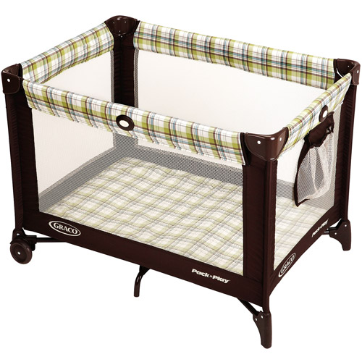
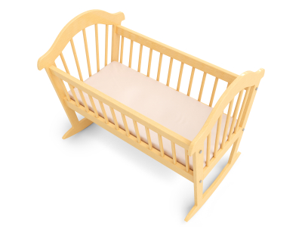
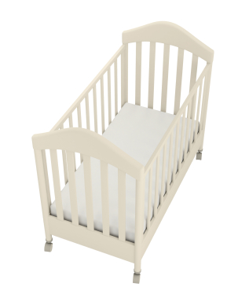
Safe Sleep Environment
Safe places for a baby to sleep
Notes:
REVIEW Safe Places for Baby to Sleep Power Point slide
Firm crib mattresses are the safest places for babies to sleep. Bassinets and pack n’ plays are also safe options for babies to sleep.
Make sure that the crib mattress is firm and fits snuggly with no space between the mattress and the side of the crib, where the baby could become trapped.
Keep loose objects, soft toys, and bedding out of the baby's sleep area. Do not use pillows and blankets in a baby's sleeping area. A baby should sleep in a crib with only a tight-fitting sheet.

Slide 42
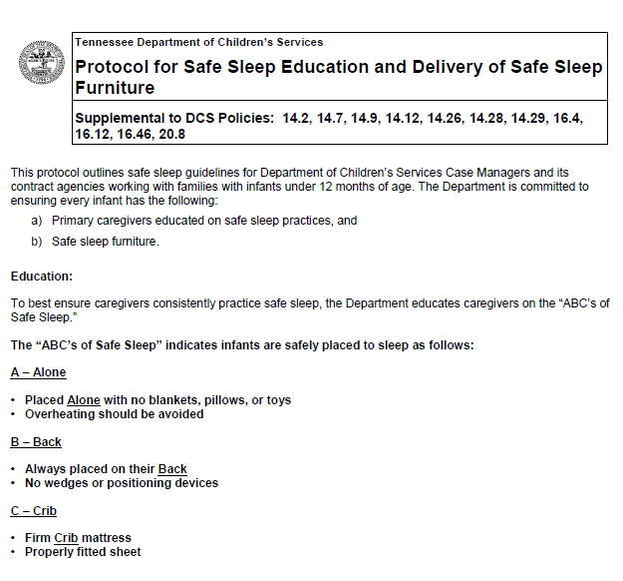
Protocol for Safe Sleep Education and Delivery of Safe Sleep Furniture
Notes:
REVIEW Protocol for Safe Sleep Education and Delivery of Safe Sleep Furniture on the DCS Policy page.
Located in Chapter 14
SHARE the protocol on the screen and review the key points including:
Safe Sleep furniture is available 24/7 to all families served by the Department
Safe sleep furniture is promptly provided to the family. This happens as soon as possible, but always within 8 hours of the need being identified.
the child’s name is written in large letters on the bottom of the pack-n-play.
any safe sleep furniture belonging to the child be taken with the child to the new placement.
CMs submit a Case Service Request (CSR) in TFACTS in the name of the infant for whom the safe sleep furniture was delivered. This CSR should be entered into TFACTS within two (2) business days to ensure an appropriate supply of safe sleep furniture is maintained in the region.
CM must visually verify the presence of fully set-up safe sleep environment.

Slide 43
Barriers to Safe Sleep
Parental beliefs about infant sleep
Lack of plausibility between SIDS and sleep position
Perceived inconsistency in recommendations
Non-back sleeping positions based on infant preference, comfort, and fear of choking
Lack of Safe Sleep furniture
Notes:
ASK participants “What are some barriers you think could get in the way of a caregiver implementing safe sleep practices?”
REVIEW key points from the slide. Include a discussion about how culture and how the parents or caregivers were raised can impact their view of safe sleep practices.

Slide 44
Safe Sleep Resources
Safe sleep packets will
be available in a central
location within each DCS
office.
Notes:
STATE Safe Sleep resource packets will be available at each DCS office for staff to provide to families with children one year old and younger.

Slide 45
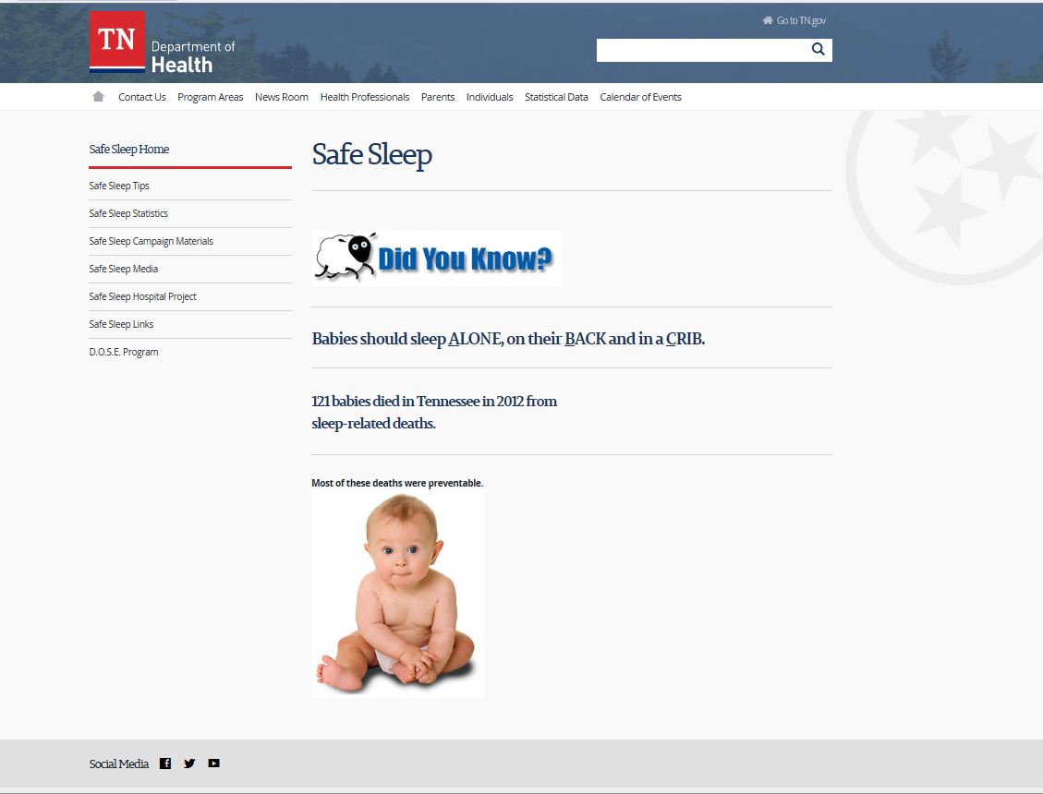
Safe Sleep Resources
Website: http://safesleep.tn.gov
Notes:
REFER participants to the Safe Sleep website http://safesleep.tn.gov for additional information and for resources to share with families.

Slide 46
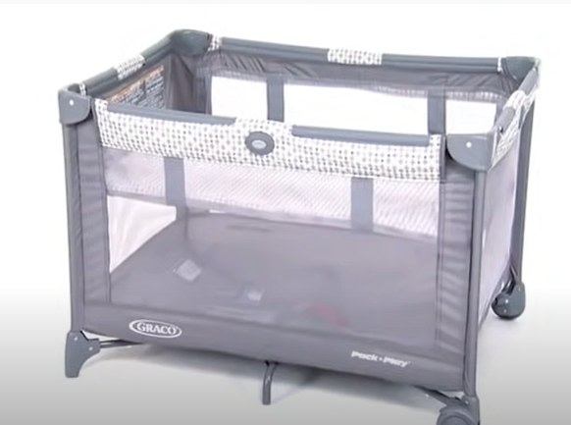
Pack ‘n’ Play Challenge
Notes:
Show the Pack ‘N Play video (1:35 minutes) https://www.youtube.com/watch?v=liBWGHIUKNw&t=1s
INFORM participants they will have an opportunity to practice assembling a Pack ‘n’ Play if they wish, when they compete the Child Passenger Safety Car Seat installation training.

Slide 47
EPSD&T Schedule
Children under 3 years of age will be seen on a more frequent basis:
At birth 4 months 15 months
2-4 days 6 months 18 months
1 month 9 months 24 months
2 months 12 months 30 months
Notes:
Policy 20.7 https://files.dcs.tn.gov/policies/chap20/20.7.pdf
SHARE DCS Policy 20.7 and the attached protocol outline the schedule in which children/youth in DCS custody must been seen at the Health Department for their early periodic screening diagnosis and treatment (EPSD & T). • SHOW participants where to access this policy and protocol and highlight Section C of the policy. • REVIEW slide that outlines the EPSD & T schedule for young children.

Slide 48
Benefits of Well-Child Visits
Prevention
Tracking growth and development
Raising concerns
Team approach
Notes:
DISCUSS the benefits of well-child visits and display slide. o Prevention. Your child gets scheduled immunizations to prevent illness. You also can ask your pediatrician about nutrition and safety in the home and at school. o Tracking growth and development. See how much your child has grown in the time since your last visit, and talk with your doctor about your child's development. You can discuss your child's milestones, social behaviors and learning. o Raising concerns. Make a list of topics you want to talk about with your child's pediatrician such as development, behavior, sleep, eating or getting along with other family members. Bring your top three to five questions or concerns with you to talk with your pediatrician at the start of the visit. o Team approach. Regular visits create strong, trustworthy relationships among pediatrician, parent and child. The AAP recommends well-child visits as a way for pediatricians and parents to serve the needs of children. This team approach helps develop optimal physical, mental and social health of a child. • You can call the doctor whenever you have a question about your child that you are unsure of the answer too. • Most pediatrician offices have answering services after hours that can assist you when you have questions. During office hours, you can also ask to speak to a nurse to ask questions. The DCS health nurse is also a resource for health information. • If you suspect a newborn may be sick, you can look for signs such as fever, poor feeding, vomiting, irritability, and difficulty breathing. • Reasons you may take an older child straight to the hospital would be difficulty breathing, persistent vomiting, signs of dehydration, severe abdominal pain, or a high fever

Slide 49
Dental Services
Teething between 4 and 7 months
First tooth between 6 and 12 months
Brush teeth twice a day
Massage gums or provide teething ring
Teething tablets and amber necklaces are not recommended
Notes:
Policy 20.12 https://files.dcs.tn.gov/policies/chap20/20.12.pdf
SHARE DCS Policy 20.12 outlines dental services for children in custody. According to the policy, children over the age of 12 months should be seen by a dentist every six months. o Teething usually starts between four to seven months and most babies will develop their first tooth between ages 6 months to 12 months. o Parents/caregivers can help ease teething pain by massaging their baby's gums with clean fingers, offering solid, not liquid-filled, teething rings, or a clean frozen or wet washcloth. If you offer a teething biscuit, make sure to watch your baby while he or she is eating it. o Stay away from teething tablets that contain the plant poison belladonna and gels with benzocaine. Both are marketed to numb your child's pain, but the FDA has issued warnings against both due to potential side effects. o In addition, amber teething necklaces are not recommended. Necklaces placed around an infant's neck can pose a strangulation risk or be a potential choking hazard. There is also no research to support the necklace’s effectiveness. o Caregivers should brush the child’s teeth with a smear of fluoride toothpaste, the size of a grain of rice, once their first tooth appears. o Teething is another area that cultural considerations should be taken into consideration. When in doubt, discuss your concerns with your supervisor

Slide 50
Discipline
Discipline should tell children they are worthy, even when their behavior is not appropriate.
Discipline should help children feel closer to parents, not be afraid of them.
Discipline should give consistent, fair, kind limits so children can feel secure.
DCS Discipline Policy for custodial children
(form CS-0553)
Notes:
Discipline Policy for Custodial Children (Form CS-0553) https://files.dcs.tn.gov/forms/0553.docx
SHARE the DCS Discipline Policy for custodial children (form CS-0553). This policy must be followed by all foster parents and by all individuals caring for a custodial child. While this policy is geared toward custodial children, the concepts discussed in the policy about discipline can be implemented by all caregivers and should be encouraged by DCS Staff. • EXPLAIN that discipline is a teaching process that is initiated by a trauma informed caregiver who is able to identify the underlying need of a child. It is through this process that a child develops the self-control, self-reliance, resiliency, and appropriate life skills necessary to assume responsibilities, make daily living decisions, and live according to accepted levels of social behavior. • Discipline should: o tell children they are worthy, even when their behavior is not appropriate o help children feel closer to parents, not be afraid of them o give consistent, fair, kind limits so children can feel secure • The following forms of punishment must not be used for ANY custodial child: o Corporal Punishment such as slapping, spanking, or hitting with any object, o Excessive exercising (particularly of a military nature), running laps, repetitive sit-ups, etc. o Cruel and unusual punishment, o Assignment of excessive or inappropriate work, o Denial of meals and daily needs, o Verbal abuse, ridicule or humiliation, o Permitting a child to punish another child, o Chemical or mechanical restraints ex; use of psychotropic medications as a restraint, o Denial of planned visits, telephone calls, or mail contact with birth family, attorney, siblings, Family Service Worker, pre-adoptive family, or attorney, o Seclusion as a punishment, o Threat of removal from the foster home, or o Any discipline that occurs more than 24 hours after the incident. • An appropriate form of discipline that is effective for children ages 2-12 is time out. Have the child sit down in a boring, safe place and set a timer for 1 minute for each year of the child’s life. Do not give your child attention during the time-out period.

Slide 51
Serve and Return Video
Notes:
Infants develop through the “Serve and Return” process. Here is a video that explains how the brain develops with these interactions. It also demonstrates how a child may have difficulty with attachment if they have missed these milestone interactions. • PLAY Serve and return video https://www.youtube.com/watch?v=m_5u8- QSh6A (1 minute, 42 seconds) • DEBRIEF the video by asking participants their thoughts on how the caregiver’s interactions can impact child development.

Slide 52
Debrief
What are your thoughts on how the caregiver’s interactions can impact child development?
What impact trauma (abuse or neglect) have on child development?
Thinking about serve and return, what impact would the caregiver using substances have on this process?
Notes:
ASK What impact trauma (abuse or neglect) have on child development? Thinking about serve and return, what impact would the caregiver using substances have on this process?

Slide 53
Support for growth and development comes from caregivers
Children need the support, protection, and involvement of caregivers to reach their developmental capacity
Regressions occur; they can be frustrating but are normal and temporary
Notes:
SHARE support for growth and development comes from caregivers. Although the capacity for development is biological, children need the support, protection, and involvement of the adults in their lives in order to reach that capacity. The most important source of support for growth comes from the child’s caregivers. Mastering a new developmental stage is not a complete, all at-once transformation, and there are frustrations and regressions to previous behaviors at every transition stage. o An example of this is “potty training.” A child may appeared to be “potty trained,” then get sick, go visit grandma, or go on a long trip and regress back to soiling and wetting. Once the family is back home in familiar surroundings and the child is back in his or her typical routine, the child is once again toileting herself or himself. Behaviors that occur when a child transitions from one stage to another are not very pleasant for the adult caregiver. It is important that the child’s caregiver and other adults in the child’s life understand these behaviors as normal and temporary and understand how to support the child in growth to the next stage.

Slide 54
Resiliency
The single most common factor for children who develop resilience is at least one stable and committed relationship with a supportive parent, caregiver, or other adult.
These relationships provide the child with the responsiveness and protection they need to recover from any disruptions in their development.
Notes:
We know that the children we work with in the child welfare system have experienced trauma. Despite the negative experiences they have had and the delays in their development that may occur, we know that the brain and other biological systems are most adaptable early in life. Recovery and resiliency are possible. • The single most common factor for children who develop resilience is at least one stable and committed relationship with a supportive parent, caregiver, or other adult. o These relationships provide the child with the responsiveness and protection they need to recover from any disruptions in their development. • Research indicates that supportive, responsive relationships with caring adults as early in life as possible can prevent or reverse the damaging effects of trauma. • Children aren’t born with the skills to be resilient and cope with adversity— they are born with the potential to develop them. If children do not get what they need from their relationships with adults and the conditions in their environments—or (worse) if those influences are sources of toxic stress—, their skill development can be seriously delayed or impaired. • The support that children need to build these skills is one of our most important responsibilities. Growth-promoting environments provide children with “scaffolding” that helps them practice necessary skills before they must perform them alone.

Slide 55
Our Role in Building Child Resiliency
Support adults to have healthy relationships with children
Make sure children have access to stable, supportive relationships with adults
NOT just one, but MULTIPLE healthy connections
Arrange consistent and frequent visitation
Discuss child development with caregivers
Share realistic developmental milestones with caregivers and how to respond/interact with children
Model parenting skills
Evaluate parent's ability to safely parent
Notes:
• Caregivers can facilitate the development of a child’s skills by establishing routines, modeling social behavior, and creating and maintaining supportive, reliable relationships. • When we support adults to have healthy relationships with children, we have the opportunity to change children’s trajectories by stacking the scale and creating resilience. • We can assist in this process by making sure vulnerable children have access to stable, supportive relationships with adults—as early and as consistently as possible. We can also make sure those caring for children are given the support and services to ensure their own development as parents. • Children are more resilient when they have multiple healthy connections or attachments, and that RESILIENCY is the key to surviving trauma. • Arranging consistent and frequent visitation between caregivers and children who are placed out of home, maintains and supports the parent-child relationship necessary for successful reunifications and also has life-long significance for the child. • When used effectively, visitation can minimize some of the effects of trauma that a child experiences, as a result of being removed from their family. • EXPLAIN that we as Caseworkers should regularly be discussing healthy development of children with caregivers. This is especially important when we are observing parent child interactions during visitation. • Sharing milestones with parents can also help them have realistic exceptions and better understand their child’s behavior. If parents do not know when a child should have a certain skill, they may worry unnecessarily or have higher expectations of the child. Children who have experienced trauma may be developmentally behind their chronological age and caregivers may have to alter their interaction to meet that child’s developmental need. o For example, a 1-year old child that was not talked to as an infant may need cooing and babbling from a caregiver similar to what a 6-month infant might need. The primary purpose of visits is to meet the child’s developmental need for maintaining and enhancing relationships with family members and to reduce their sense of loss due to removal. • The secondary purposes of visits are for Caseworkers to: o Teach parenting skills o Evaluate the parent’s ability to safely parent in order to determine the service and visiting plans and the final permanency plan

Slide 56
Milestone Checklist
Notes:
Included in your participant guide are some resources to assist you when you are observing visitation and observing children with their caretakers. o Have participants look at the Milestones Checklist created by the CDC. This resource summarizes some of the social/emotional, language, cognitive and physical development milestones that occur at each age and outlines some activities caretakers can do with their infants/children to assist in development. o This is information that Caseworkers can share with parents/caregivers in preparation for visitation so parents/caregivers can engage their children in developmentally appropriate activities during visitation. o This information can also assist Caseworkers during home visits when observing children to determine if they are developmentally on track or if they may be experiencing delays. o Have participants look at the Tips for Talking with Parents about Developmental Concerns resource created by the CDC. When observing parents/caregivers interact with children sometimes we notice that the parent might not be engaging the child in a developmentally appropriate way and could be jeopardizing the safety of the child. It’s important that we as Caseworkers address these concerns with the parent and help them understand their child’s developmental level. o The next training in this series, Meaningful Parent/ Child Visitation, goes into more detail about thoughtfully planning visitation between children and parents and giving feedback to parents about visitation.

Slide 57
“What do I do if…?”
In pairs or small groups discuss your assigned scenario and how you would respond to the parent/caretaker.
Notes:
Activity - Visitation Scenarios
EXPLAIN to participants that we will now be practicing how we can talk to parents/caregivers and intervene by providing feedback during visitation when we notice concerns. o DIVIDE participants into small groups of 2-3 people. Assign them one of the scenarios in the participant guide and have them answer the questions. Give them about 5 minutes to work on this. • DEBRIEF as a large group by asking each group to share how they would provide feedback and/or model/coach the parent/caregiver when observing visits between parents and their children. • Lastly, between now and when you participate in the next training in this series regarding thoughtful visitation and providing feedback, we ask that you utilize the Milestones Checklist when you are observing children and their interaction with caregivers. We also ask that you utilize the Interaction Observations by age range resource to assist you in assessing parental knowledge regarding child developmental and how to best provide feedback and modeling for the parent/caregiver. We will be utilizing this information during the next training.

Slide 58
Notes:
ASK participants to share one thing they are going to implement in the field as a result of this training.

