Slide 1
Safe Search and Transportation Procedures for Regional Employees
CHDE3127
Office of Training and Professional Development
Notes:
Welcome!

Slide 2

Virtual Offering
Skills Labs will occur at a later time/date.
Notes:
Welcome participants to training and conduct any necessary housekeeping activities regarding virtual training. Instruct to use the chat box for introductions.
Ask each person can introduce themselves, region, position and whether you are new to this training topic, or if you have some experience in this area. EXPLAIN that the training will be interactive, and we will be asking for input in the Chat Box. Participants will practice the skills learned in a classroom setting later.

Slide 3
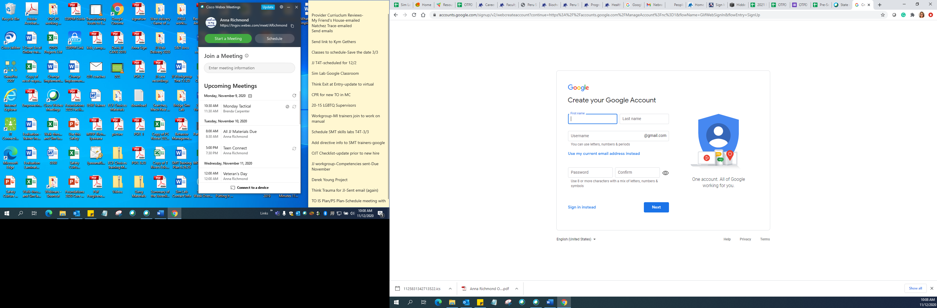
Google Account
Notes:
Part of this course is in Google Classroom. The checklists, training materials and post-test are in Google Classroom. You must pass the post-test to receive credit for this course.
Google accounts/Apps
Open current classroom and demonstrate the following sections:
SHOW THE “How to create a Google account” slide again.
Explain that having a Google account and using Google Chrome will ensure full access to all that Google classroom has to offer.
Go to google.com/accounts/NewAccount in your Web browser.
Type in your company’s email address in the “Your current email address:” field.
Type in a password for your Google account. This must be at least eight characters in length and should include a mixture of letters and numbers. Re-enter this password in the “Re-enter password:” field.
Select your location by clicking the drop-down menu next to “Location.”
Type in your birthday and the verification code under “Word Verification:.”
Click the “I accept. Create my account” button at the bottom of the page to create your Google account with a company email address.
Log in to your company email. Open the email from Google regarding your new account. Click the confirmation link in the email to activate your Google account and complete the process with your company’s email address
google.com/accounts/NewAccount
Talk about the firewall for Gmail. Use their work email!

Slide 4

Notes:
https://classroom.google.com/c/NTcxMzgzMDEzNjA1?cjc=yod4sbf

Slide 5

Working Agreement
Notes:
After participants have introduced themselves, develop a working agreement for the day. State that this is important because we will review a lot of material and participants must be able to demonstrate competency (at a later time). Turn on annotate feature and ask the participants to type on the PowerPoint slide.

Slide 6
Training Agenda
Searches
  Contraband
  Purpose for Searches
  Trauma Informed Searches
  Types of Searches
  Special Circumstances
  Documentation of Searches
Transportation
  Vehicle Inspection/Searches/Trip Requirements
  Secure Transports
  Emergency Situations During a Transport
  Monitoring Youth During a Transport
  Documentation of Transportation
Notes:
Review the agenda & objectives for the day.
STATE the overall goal of this training is for participants to prepare staff to perform their job duties proficiently related to searches, mechanical restraints and transportation. Furthermore, as professionals we can utilize practices that reduce trauma by conducting consistent, thorough and trauma-informed searches, restraints and transports to actively help to maintain safety and security.

Slide 7
Searches and Contraband

Slide 8

Notes:
STATE The purpose of conducting searches is safety; Safety of Staff, Youth and Community
Policy Statement from 31.4 states:
Department of Children’s Services staff and Contract Agency employees shall conduct/guide searches of children/youth and their personal property, including living quarters, when deemed necessary to ensure the safety of the child/youth and others. DCS Employees and contractors shall use the least invasive search techniques appropriate to the situation. All searches are conducted in a manner that preserves the dignity of the child/youth, visitor, volunteer or employee.
Ask the audience to name some health or safety risks that could be found during searches. Discussion should include:
Weapons
Drugs/drug paraphernalia
Pest infestations
Expired medicine/food products
ASK why we search. Discussion should include:
Safety
Prevent Escapes
Prevent Disturbances
Detection of and Prevention of Contraband
Ask participants to share in the chat box if they have been subject to search before and how that made them feel. Debrief with the group to remember that as we all feel differently so do our youth. Share story as appropriate on search.
Supporting Policy:
https://files.dcs.tn.gov/policies/chap31/31.4.pdf
https://files.dcs.tn.gov/policies/chap27/27.21.pdf
https://files.dcs.tn.gov/policies/chap20/20.20.pdf

Slide 9

What is Contraband
  Any item possessed by a youth that is:
    illegal by law
    prohibited by policy or procedure
    or unauthorized by administration and operation of the facility in which the youth may be placed.
Notes:
EXPLAIN what contraband is. Any item possessed by a youth that is:
illegal by law
prohibited by policy or procedure
or unauthorized by administration and operation of the facility in which the youth may be placed (a pen could be contraband for some youth depending on where they are placed).
REVIEW why it is important to search for contraband.
ASK the participants for any experiences or items found that they would like to share related to contraband.

Slide 10

Contraband
  Contraband is a serious safety concern. It is the primary reason why we conduct searches.
  On the next slides let’s determine if you can name this contraband:
Notes:
SET-UP the discussion on the primary reason we search. “Think safety first”.
REVIEW the following contraband slides and ask the participants what they think each slide represents:

Slide 11

Contraband
  Handcuff Key
Notes:
Handcuff Key

Slide 12

Contraband
Notes:
Vape pen

Slide 13
Contraband
Notes:
Suboxone hidden in magazine

Slide 14

Contraband
Notes:
Cell phone
Is a cell phone always contraband? What if the young person wants to run and is planning to ask to use the bathroom and have someone meet them there?

Slide 15
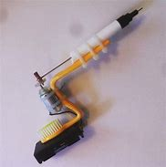
Contraband
Notes:
Tattoo Gun

Slide 16
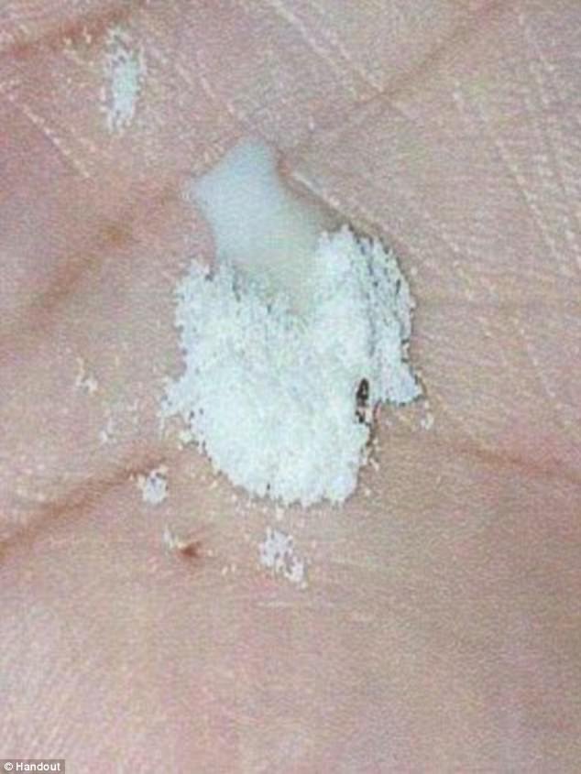
Contraband
Notes:
Baby formula with bugs

Slide 17

Think Trauma During Searches
Realizing the prevalence of trauma
Recognizing how trauma affects all individuals involved, including its own workforce
Responding by putting this knowledge into practice
Resisting re-traumatization
Notes:
Trauma-informed: A trauma-informed approach includes an understanding of trauma and an awareness of the impact it can have across settings, services, and populations. It involves recognizing that context plays a significant role in how individuals perceive and process traumatic events, whether acute or chronic.
Trauma-informed: It involves four key elements of a trauma-informed approach:
realizing the prevalence of trauma;
recognizing how trauma affects all individuals involved with the program, organization, or system, including its own workforce:
responding by putting this knowledge into practice:
resisting traumatization.
REVIEW with the participants what they know about trauma. ASK them to start thinking about trauma related to searches. How can a search be traumatic for youth? What triggers may occur?
STATE that it is important for staff to become trauma-informed during an experience such as searching that may trigger the youth we work with. ASK the participants why searches could trigger a youth. ANSWERS to pull out include physical touch, loss of control of their own bodies, etc.

Slide 18

Trauma Informed Approach
The search is conducted in a respectful, professional and trauma-informed manner in a location with respect to the privacy of the youth/child. The youth and family (if present) are given an explanation for the search.
How to reduce trauma:
  Respectful communication
  Consistency in technique
  Professionalism
  Awareness of safety
Notes:
The act of searching can be a trauma trigger for some. If youth are triggered, they may display the inability to cope, trust, manage cognitive processes or regulate behavior
Yet, if trauma-informed principles are introduced, staff can play a major role in minimizing triggers and de-escalating situations.
One way to reduce trauma triggers is by talking to the child professionally. Communicate clearly about what you are going to do, to help reduce their anxiety. Also, two staff are present to work together to provide a trauma informed environment and provide consistency in technique and professionalism. While you may never know which youth have experienced traumatic events, if you approach each youth in this way, you can make a big difference in maintaining safety.
If trauma-informed principles are introduced, staff can play a major role in minimizing triggers and de-escalating situations.
ASK participants for other ideas on how they can be trauma informed.

Slide 19
Types of Searches
Non-invasive searches include:
  Visual inspection of appearance
  Child/youth/person-driven searches
  Use of standard scanning equipment such as metal detectors, or wands designed to detect metal or dense objects
Notes:
There are several different types of searches. We will start by discussing non-invasive searches.
Non-invasive searches include:
a) Visual inspection of appearance;
b) Child/youth/person-driven searches-(turning out of pockets, self “pat-down”) in the presence of staff members or foster parents; and
c) Use of standard scanning equipment such as metal detectors, or wands designed to detect metal or dense objects. Trained employees may use a hand held scanner to search youth, visitors, or employees for weapons or other metallic objects, the employee will not touch the youth, visitor, volunteer or employee in this search process.

Slide 20
Types of Searches
Invasive searches include:
  Pat-down search
  Clothing Search
  Personal Property Search
  Unclothed Searches (YDC and Contract Detention Centers ONLY)
  Body Cavity Searches are PROHIBITED
Notes:
Invasive searches may follow initial placement of a child/youth in custody, admissions, after contact with the community such as a return from runaway or trial home visit, and after suspicious activity which would suggest hidden objects or weapons. Remember we shall use the least invasive search techniques appropriate to the situation.
In circumstances where an invasive search needs to be conducted in a foster home, the DCS employee or Contract Agency employee conducts the search with the foster parent observing.
Pat-down search
Involves DCS or Contract Agency employees and child/youth contact. Private areas are not to be touched (i.e., areas which are covered by undergarments). A staff member of the same gender performs the search.
In a Youth Development Center (YDC) and Contract Agency Detention Centers, pat-down searches may be required of youth, visitors, volunteers or employees.
Clothing Search
When a clothing search is necessary, children/youth are not viewed naked by staff. The child/youth is allowed to remove their clothing in a private area and hand the clothing to staff to search.
This type of search is only conducted when the child/youth engages in suspicious activity which would indicate possible concealed contraband or when there is a need to take certain precautions for safety, particularly if there is a risk of the child/youth harming themselves or others.
This is not a Strip Search.
Personal Property Search
Includes opening and inspecting the contents of any item being transported with the child/youth as well as a visual search of all outer clothing to include pants and jacket pockets that are turned out by the child/youth. We will practice this. There is also a CBT that covers this.
Unclothed searches- (YDC and Contract Agency Detention Centers only) An unclothed search is only a visual inspection (e.g., looking in the mouth, ears, having youth spread buttocks, etc.) of the youth’s unclothed body. An unclothed search is only permissible when:
A youth initially enters a Youth Development Center/Contract Agency Detention Center; or
A youth has been outside the facility and for any portion of the time outside the facility was not under the direct supervision of a staff member;
There is reasonable suspicion that a youth is concealing an item that may be used as a weapon or may have other contraband that could endanger his/her well-being or the well- being of others. The use of an unclothed search for reasonable suspicion is approved by the YDC Superintendent or Contract Agency Director of the facility and thoroughly documented in an Incident Report (IR).
Body Cavity Search - A body cavity search is PROHIBITED

Slide 21
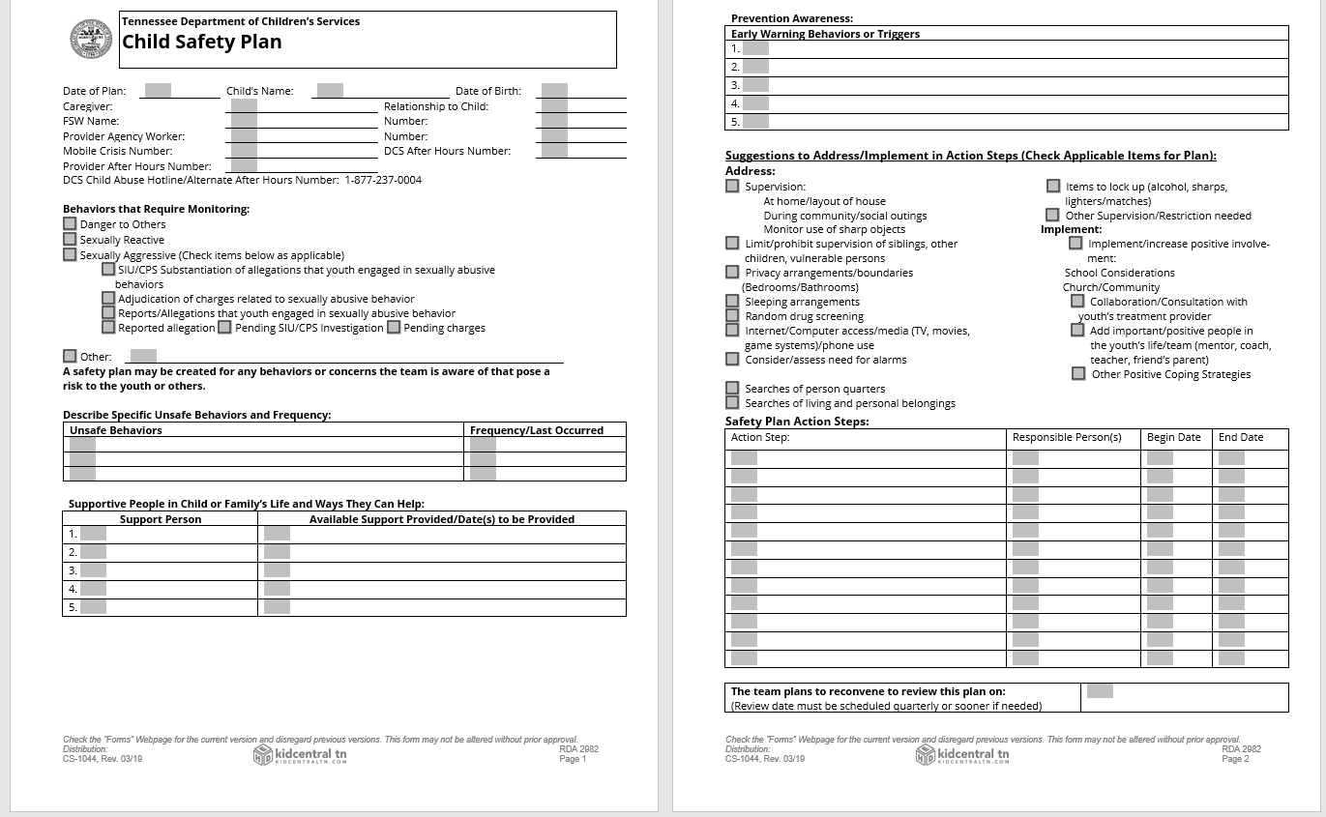
Foster Parent Involved Searches
Notes:
In circumstances where an invasive search needs to be conducted in a foster home, the DCS employee or Contract Agency employee conducts the search with the foster parent observing.
Prior to searching any child/youth, the staff person and foster parent need to consider the impact of the search based on several factors, including; ◻ Any past history of trauma that a child/youth has experienced; ◻ What can be achieved by engaging in ONLY visual inspection or appearance; and ◻ Child driven searches-(asking or requesting a child to “turn out” the pockets or self “pat down”) in the presence of staff members and foster parents.
2. When circumstances permit, two (2) staff members or one (1) staff member and one (1) foster parent, as an observer only, is present when a search is conducted on a child/youth, prior to entering or after a child is placed into a foster home. 3. It is preferred that Foster parents observe a search of a child/youth’s personal property/room/area/bags/suitcases/boxes or any other personal items when an FSW or Contract Agency worker is present. 4. If a foster child/youth has a history of concealing contraband/safety issues, or if there is a good and legal reason, the Child and Family Team may complete form CS-1044, Child Safety Plan, during a Child and Family Team Meeting to address alternative search procedures.

Slide 22
Personal Property Search Process
Explain Purpose of Search
Wear Gloves
Have two people present (trained staff member and witness)
Conduct the search in an area that is private
Visually inspect clothing being worn
Open and inspect all items/bags
Search every pocket of the bag/container
Search the pockets and seams of all clothing
Inspect the contents of every item (shampoo, hairbrush, etc.)
Notes:
Any personal belongings being transported with a child/youth entering custody, returning from a trial home visit, or returning from runaway are searched.
Make sure you follow this process for every bag, box, item.
Explain Purpose of Search
Wear Gloves
Have two people present. One of the people present must be the trained staff member. The witness is at the discretion of the staff member. For example: court liaison, a TL, LE, provider.
Conduct the search in an area that is private
Visually inspect clothing being worn Search pockets and seams of all OUTER clothing like jackets. Have the child turn their pockets out.
Open and inspect all items going WITH the child/youth to placement.
Search every pocket of the bag/container
Search the pockets and seams of all clothing
Inspect the contents of every item (shampoo, hairbrush, etc.)

Slide 23
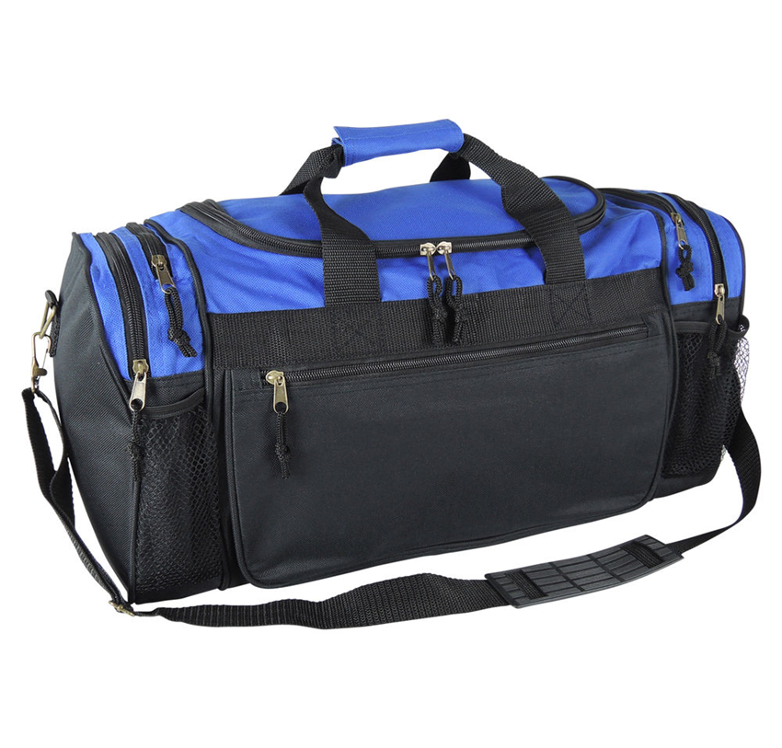
Personal Property Search
Notes:
To ensure the safety of all parties involved, any personal belongings being transported with a child/youth entering custody, returning from a trial home visit, or returning from runaway are searched. This also includes any suspicious activity which would suggest hidden objects or weapons.
Search of personal property of a child/youth includes, but is not limited to, opening and inspecting the contents of any item being transported with the child/youth as well as a visual search of all outer clothing to include pants and jacket pockets that are turned out by the child/youth.
ASK where would you start searching this bag? Outside and work inside (start with strap and outer pockets).
Let’s practice! In the classroom set-up a bag with “contraband” hidden that they will need to find.
CBT- Ensuring Safety through Searches CH-CB3172-200000-01

Slide 24
Pat Down Searches
Pat Down Searches should be conducted in accordance to Policy 31.4.
  Initial placement of a child/youth in custody/admissions,
  After contact with the community such as a return from runaway or trial home visit,
  After suspicious activity which would suggest hidden objects or weapons.
Notes:
These types of searches may follow initial placement of a child/youth in custody, admissions, after contact with the community such as a return from runaway or trial home visit, and after suspicious activity which would suggest hidden objects or weapons.

Slide 25
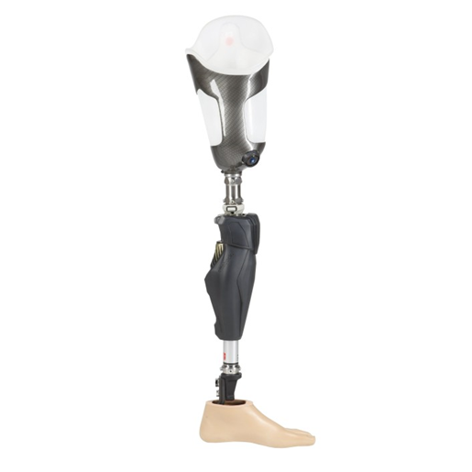
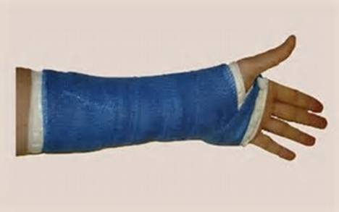
Special Circumstances
Obesity
Prosthesis
Casts and Bandages
Wheelchairs
Notes:
STATE that for Obesity
o If the youth is extremely obese and a search cannot be completed effectively by one person, use a partner.
o Each person should follow standard procedures, but one person should search the right half while the other searches the left.
o Make sure to overlap each other to ensure complete coverage.
o Keep in mind the sensitivity of the youth but be sure to conduct a thorough search.
• STATE that for a Prosthesis
o If while searching a youth, and you discover prosthesis, be sure to contact your supervisor before continuing the search.
• STATE that for Casts and Bandages
o Be sure to search these areas as thoroughly as possible.
o Under no conditions should you remove or tamper with medical devices.
• STATE that for Wheelchairs
o Searching a youth in a wheelchair can be a very delicate and potentially unpleasant situation.
o Youth in wheelchairs still need to be thoroughly searched as gently as possible.
o Follow regional/institutional procedures for searching youth in wheelchairs.
o Crutches and canes must also be thoroughly searched.
o Check padding and protective tips for contraband.
SHARE that there was an incident that occurred in one of our former YDCs where a wheelchair wasn’t searched properly, and a gun was later found. Searching these items is very important even though it may make us feel uncomfortable.

Slide 26
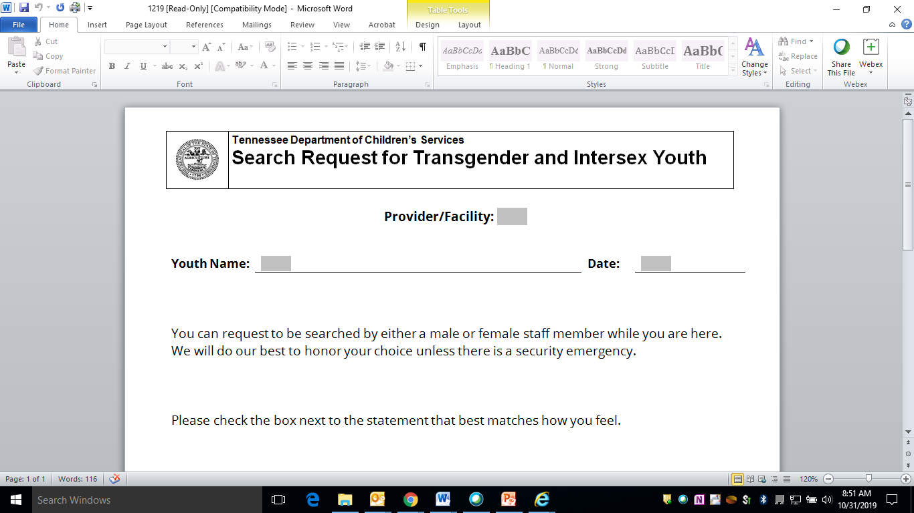
Respecting the Rights of Transgender Youth
Notes:
Let’s discuss some specific considerations around safety and security for transgender youth.
The PREA standards address several areas to guide facilities specific to transgender and intersex youth to include classification,
housing and placement, programing and training for staff. This includes our work today on pat searches.
Before we begin, I’d like to acknowledge that covering the special considerations for these populations can make some people
uncomfortable. Just like many other things in your personal life, you are entitled to your own perspectives when you are on your own time. But when you clock in for work, we know that we are expected to shift those concerns to focus on safety and security, and act in a professional manner at all times.
That means we all have to put aside our personal feelings or beliefs and focus on our mission at all times. We all know that it’s important to maintain our standard of professionalism in the language and actions we use with all youth.
Transgender or intersex youth will not be searched or physically examined for the sole purpose of determining genital status. No one should be searched in a manner that is humiliating or degrading.
Transgender youth may request accommodations regarding the gender of staff conducting the search. This request shall be documented on form CS-1219, Search Request for Transgender and Intersex Youth. DCS Policy 20.20, provides additional information on guidelines for working with transgender youth.
Transgender Search technique video option https://vimeo.com/183649668
Start video at 22:18
End video 28:08

Slide 27
Pat Down Searches
2 staff members are present when a search is conducted on a child/youth. At minimum 1 must be trained and the other can observe.
Should be conducted by employees that are the same gender as the child/youth (additional guidance will be provided for transgender youth)
Treat the youth with respect and “think trauma”
Explain to the child/youth the purpose of the search
Conduct the search in an area that is as private as possible.
Ask the youth if he/she is concealing any contraband
Notes:
Review Slide

Slide 28
Pat Down Search Process
Prior to conducting the search youth should:
  Remove outer layers such as jackets, coats and hats
  Remove shoes and socks
  Remove belts
  Remove watches and other pieces of jewelry
  Empty all pockets (including those of the coats or jackets) and turn them inside out
  Youth should not be able to access these items during the search
Notes:
Review Slide

Slide 29
Pat Down Search Process
If a youth refuses to submit to the search and you perceive there is a threat or danger, then contact your supervisor. Law enforcement may be contacted for assistance.
This is documented in an incident report.
If a visitor refuses a search, then they will be asked to leave.
Notes:
Review Slide

Slide 30
Pat Down Search Process
Notes:
Pat Down Searches Always Happen
Follow the Quadrant Method
Top to Bottom
Thoroughly
Systematically
We will now watch a video that will demonstrate this search technique. State that the video will use the term inmate however remember we are searching youth. This is also a cross gender search in the adult population which is NOT ALLOWED in DCS with juveniles.
For Virtual: REVIEW checklist and ASK participants to follow along with checklist
https://vimeo.com/183649668
Start at 6:39
End video at 14:15
Ask participants to consider while watching:
How to correctly implement the press and release method?
What are areas of special concern for safety and security?
How would you act differently in your own searches when you consider the youth’s trauma history?
Debrief the questions
For Classroom: State We will now model a pat down search. Ask the participants to follow along with the checklist during the model. Inform them that they can and should stop and ask questions at any point in the demonstration.

Slide 31
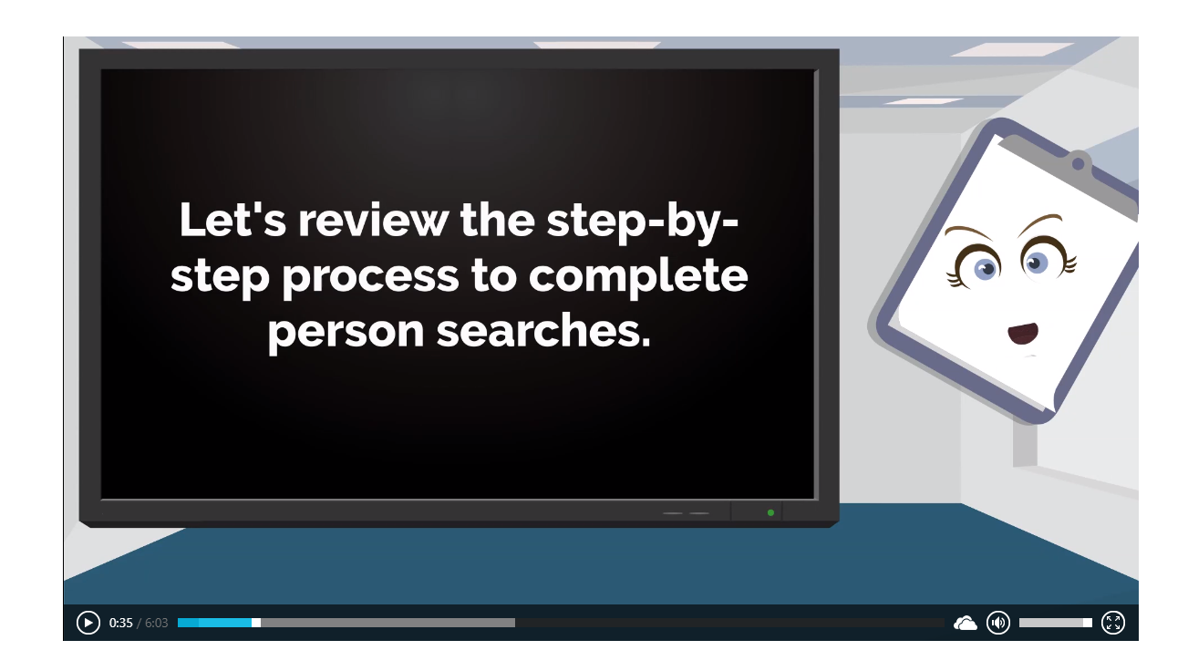
Person Searches Video
Notes:
Person Searches (office.com)
Person Searches (office.com)
Pat Down Searches Always Happen
Follow the Quadrant Method
Top to Bottom
Thoroughly
Systematically
We will now watch a video that will demonstrate this search technique. Show second video in Sway.

Slide 32
Documentation of Searches
For those employees who conduct a search prior to transporting a child/youth, utilize form CS-0350, Transportation Report.
All non-routine invasive child/youth searches are documented by completing form CS-1099, Search and Contraband Chain of Custody/Possession.
Any search (invasive or non-invasive; routine or non-routine) where contraband is found, or other noteworthy incidents occur, is documented by completing form CS-1099, Search and Contraband Chain of Custody/Possession.
After completion of form CS-1099, the FSW/residential case manager uploads the form into the documents section of the youth’s case file in TFACTS.
Notes:
Policy 31.4 Updated 10/20
All non-routine invasive child/youth searches are documented by completing form CS-1099, Search and Contraband Chain of Custody/Possession. After completion of form CS-1099, the FSW/residential case manager uploads the form into the documents section of the youth’s case file in TFACTS.
NOTE: Routine searches include, but are not limited to, hardware secure facility/congregate care room checks; personal property search upon entering/returning to custody; searches prior to transportation; and searches prior to placement change.
Any search (invasive or non-invasive; routine or non-routine) where contraband is found, or other noteworthy incidents occur, is documented by completing form CS-1099, Search and Contraband Chain of Custody/Possession. After completion of form CS-1099, the FSW/residential case manager uploads the form into the documents section of the youth’s case file in TFACTS.
If the child/youth refuses to submit to a search and there is a perceived threat or danger, law enforcement may be contacted for assistance. If law enforcement is contacted, an SIR is created.

Slide 33
Documentation Includes:
Employees and/or other persons involved
Reason for the search, including reasonable cause for the search and assessed risk of harm to the child/youth or others that triggered the need for a search
Location of the search (e.g. building, facility, parking lot, etc.)
Problems encountered
Items confiscated and means of disposition
Notes:
Review Slide

Slide 34
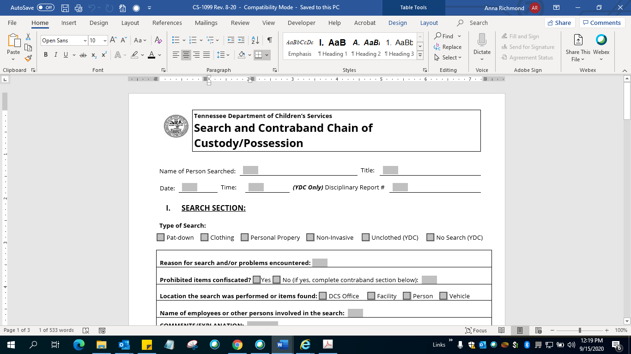
Contraband
Notes:
Individuals that conduct a search of a child/youth make a list of any items confiscated using form CS-1099, Search and Contraband Chain of Custody/Possession and have the child/youth verify the list. If the child/youth refuses to sign the list, the individuals conducting the search document the refusal and both sign and date the list. Items considered contraband are not returned to the child/youth. Any illegal items are surrendered to law enforcement.
For the YDC, all confiscated contraband must be handled in accordance with DCS policy 27.21, Contraband and Preservation of Physical Evidence.
Contract Agencies may document confiscated items according to their agency’s protocol.

Slide 35

Pat Down Searches Skills Lab
Notes:
REVIEW with participants their takeaways LISTEN FOR each item named below. As each item is mentioned, ask why that item is important.
o Gloves: protect from bodily fluids or unsanitary objects you may encounter
o Body position: Youth knows where you are. Promotes own safety.
o Ongoing professional communication: Youth knows what to expect
o Observation of non-verbal cues: to cue you for physical resistance
o Hand up: for spitting
o Hand on back: you can tell if they are about to make a move
o Keep eyes elevated: you can see if they are shifting their body/positioning
ACTION As each answer comes up, offer an affirmation and ask if the group agrees. If not all of these answers are elicited, try to remind people by asking them “What precaution would you take to be sure…[name the potential threat].
Share with the participants what the expectations are for the skills lab portion of this training:
We will use PPE (masks, sanitizer, etc.). The participants will pair up socially distanced from others. One pair at a time will demonstrate the skills on the checklist. The instructor will observe and check off on Google Document in Google Classroom. If the participants need more practice, ask them to observe the others then observe them at the end of the others demonstration. The checklists will be saved.

Slide 36

BREAK TIME!!

Slide 37
Transportation

Slide 38
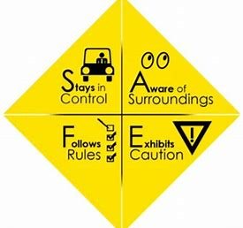
Stay SAFE
Stays in Control
Aware of Surroundings
Follows the Rules
Exhibits Caution
Notes:
Transition to section on Transportation by ASKING class who has conducted unsecure transports and who has conducted secure transports. Gauge class for familiarity with this practice.
Staff who transport are required to perform duties that place them in the public view. Good customer service skills are needed. Your job is more than transporting youth from place to place. You must maintain supervision and control of the youth when you are in the public.
We cannot account for all circumstances but you can be better prepared by using effective problem solving skills and building collaborative relationships with supervisors and experts where you can ask questions.
We also will focus on the importance of knowing the different types of emergencies that could occur while transporting youth. Knowing what could happen and preparing yourself in advance will limit the stress during the emergency. Pay attention as you travel, you will be on these roads again. Know where you are at all times.

Slide 39

Tools to Prevent Incidents While Waiting for Transport
Effective Communication
Proper Supervision
Crisis Response
Ankle Monitors (as approved by leadership)
Notes:
Prevention of incidents
https://files.dcs.tn.gov/policies/chap31/31.2.pdf
Talking Points:
Maintain effective communication by engaging the child(ren)/youth about their feelings, needs and problems that may influence their decision to run away or escalate their behaviors
Ensure proper supervision of youth by employees including awareness of abnormal behavior of youth;
When a youth is presenting a danger to self or others, staff shall notify Crisis Services for an assessment to determine psychiatric treatment needs.
Notify Supervisor and discuss next steps.
Continuing transport may not be in the youth’s best interest.
Discuss the fear the youth are experiencing and how communication can assist with those feelings showing up as behavior issues.
Maintain Constant Visual Contact-don’t leave the youth to go make copies or run to the bathroom.
Discuss Handle with Care concepts-how to be a solid object
Ankle Monitors

Slide 40
Prior to Transport
Review Policy 1.13 section D
  Staff trained
  Proper documentation and records for the trip
  Review travel route and available stops for restroom
  Maintain constant visual contact and supervision of youth at all times!!!
Notes:
Review Policy 1.13 section D to familiarize the participants with the requirements prior to transport.
Establish why this is important. What could potentially occur if the vehicle is not safe?

Slide 41
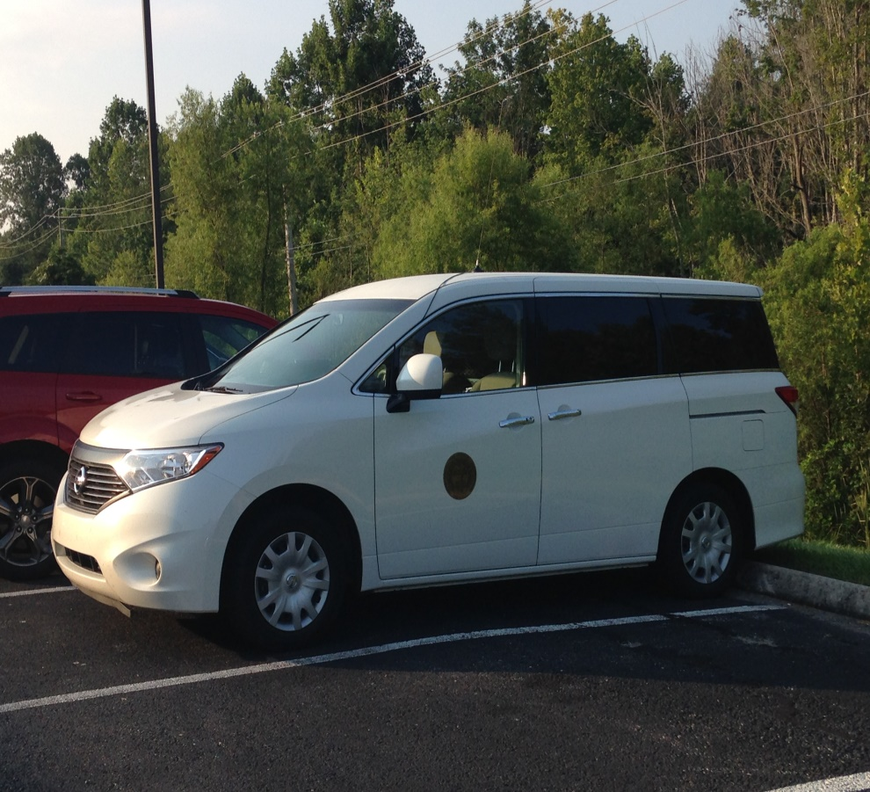
Prior to Transport
Vehicle will be functional and mechanically safe by inspecting:
  brakes
  headlights
  turn signals
  tires
  windshield wipers
  heat / air
  fuel level
  seatbelts
  safety equipment
Notes:
Review Slide

Slide 42
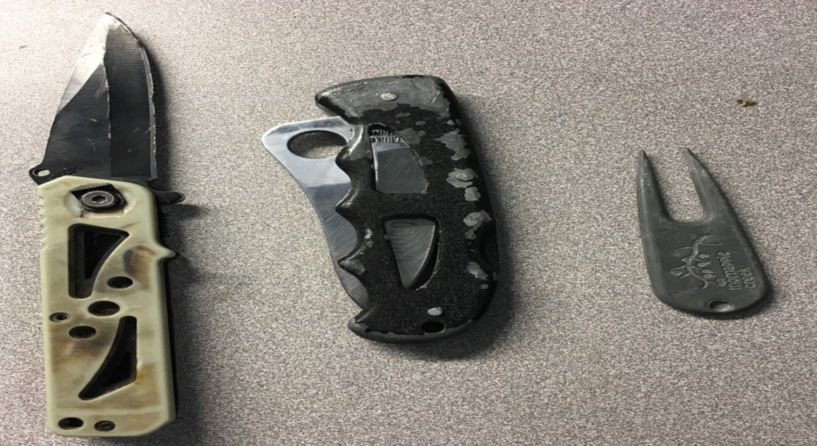
Prior to Transport
Vehicle will be searched by inspecting:
  where a youth will be riding
  cup holders and seat pockets
  underneath seats and floor mats
  seat belt areas
  Actual items found
  In DCS vans
Notes:
ASK about safety. Why is it important to search? SHARE that these items were found in both secure and non-secure transports. During the non-secure transport the youth had access to staff during the transport.
Transition to video on next slide.

Slide 43
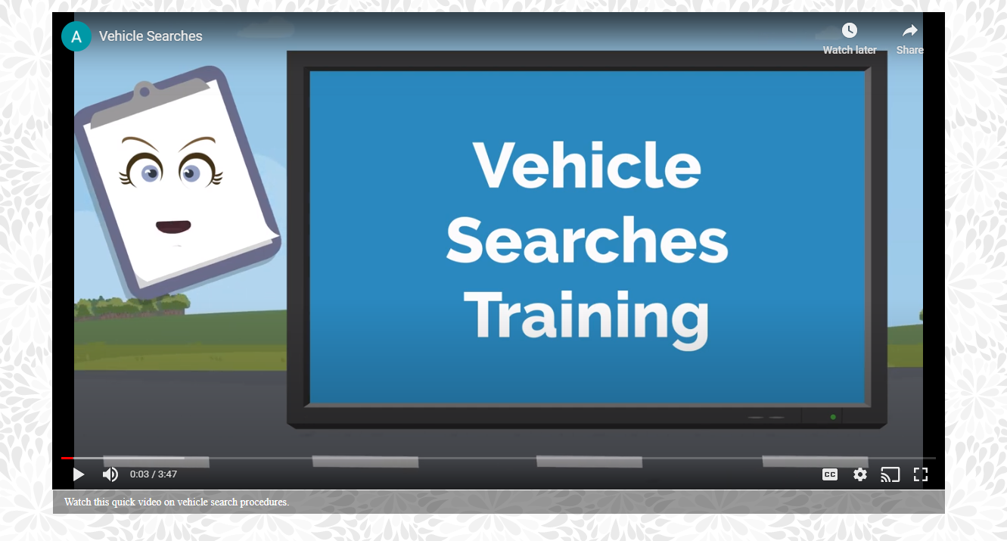
Vehicle Searches
Notes:
Show second video in Sway. Debrief.
Vehicle Searches (office.com)

Slide 44
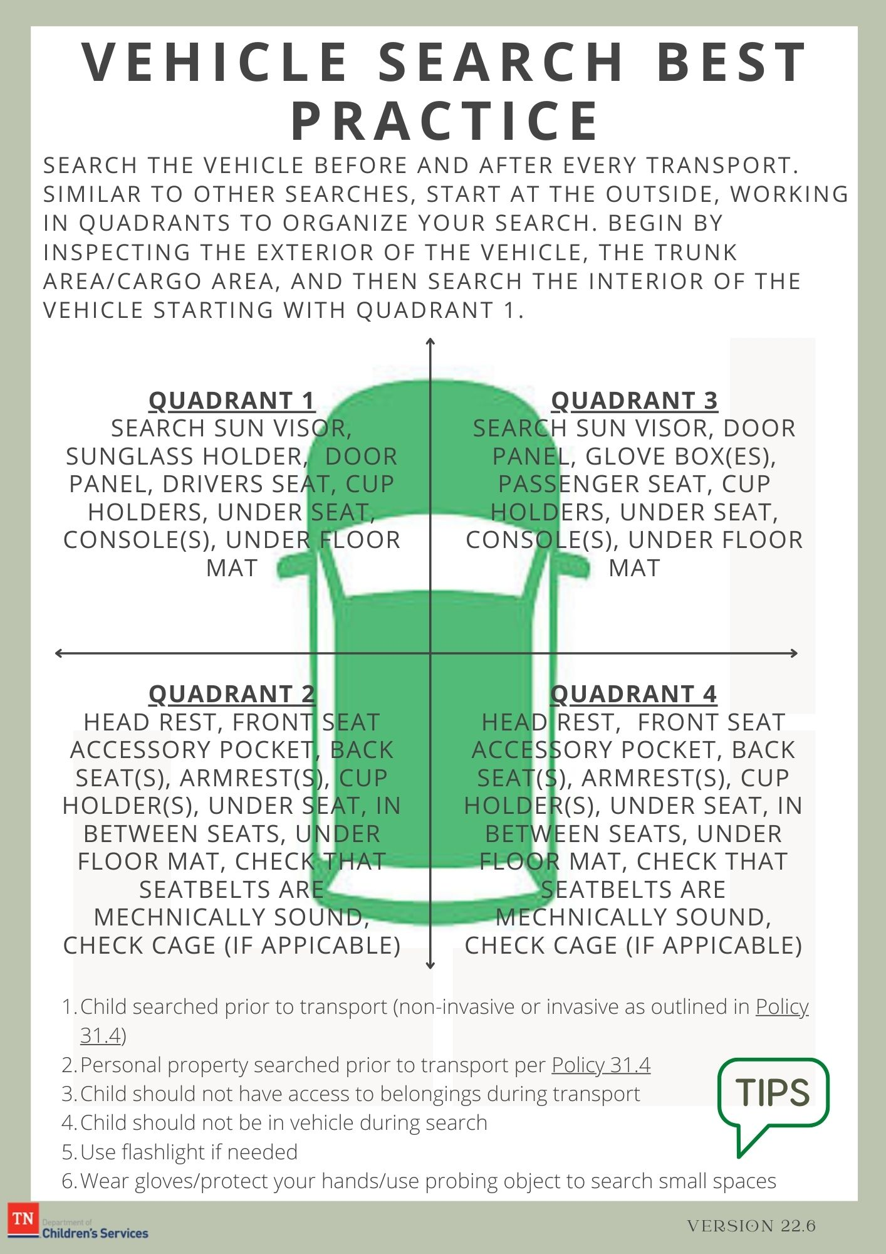
Vehicle Search Best Practice
Notes:
Review with participants.

Slide 45

Transportation
If an FSW is requesting a transportation officer transport a youth, then a request for transportation is submitting by using Form 0351
High Risk Protocol
Notes:
When an FSW requests a transport from a transportation officer they must submit a request via the approved form. Review the form with the participants.
https://files.dcs.tn.gov/intranet/forms/0351.doc
High Risk Protocol
1. CS-0351-Transportation Request, revised 8/20 is the current version that will be accepted. If this version is not used, transportation requests will not be scheduled and sent back.
2. Youth Identified as High Risk, as noted on the Transportation Request (CS-0351) with a detailed narrative will be transported by two transportation officers. High Risk defined as any youth who provide a high risk of absconding during a transport. Included are youth who have recent assaultive behaviors, have absconded during a prior transport or had a prior serious incident during previous transports, those in a mental health crisis or have had previous suicide attempts.
3. Public bathroom stops for youth during transport is prohibited. Bathroom stops are only permissible at local police departments, Tennessee Highway Patrol, Sheriff's offices or secure government facilities. Employees should familiarize themselves with these facilities.
4. If food is purchased during transport, only stops at fast food drive-thru windows are permissible.

Slide 46

Transitioning from the Office to the Vehicle
Escorting/Assisting
Placement of Vehicle
Notes:
When transitioning from sitting to standing and then from the office to the vehicle and then again into the vehicle assist by placing your hand on the youth’s arm to escort them safely. This is important so that they youth doesn’t trip or fall. If that does occur, you are right there to provide support. Physical touch is ok to assist youth (Policy 19.11 states The following is not considered physical restraint and is considered acceptable:
Physical touch associated with prompting, comforting or assisting that does not prevent freedom of movement.
May use one staff member on each side of the youth.
Where should the vehicle be parked/placed when transitioning from the office to the vehicle? Think near, far, obstructions, audience, etc.

Slide 47

Transportation Policy Review
Any employee trained in search techniques and the use of mechanical restraints is required to transport youth.
Review Section A Regional Policy
Review Transporting Delinquent Youth Policy
Review YDC Policy
This Photo by Unknown Author is licensed under CC BY-SA
Notes:
For the regions, let’s review policy 31.15 section A
• ENSURE a discussion takes place about prohibited practices.
Transporting Delinquent Youth policy 31.16
. Once a transport has begun, stops are only permitted:
◻ To refuel the vehicle;
◻ In case of an emergency;
◻ To adjust mechanical restraints in a safe and secure location (such as
any government operated location);
◻ Bathroom breaks (see note below), or
◻ To purchase meals (fast food only) using the drive through window.
Note: While transporting youth employees assess the youth’s need for
food, water and use of bathroom facilities. Public bathroom stops are
prohibited if a youth is being transported, bathroom breaks are only
permissible at local police departments, Tennessee Highway Patrol,
Sheriff’s offices or secure government facilities.

Slide 48
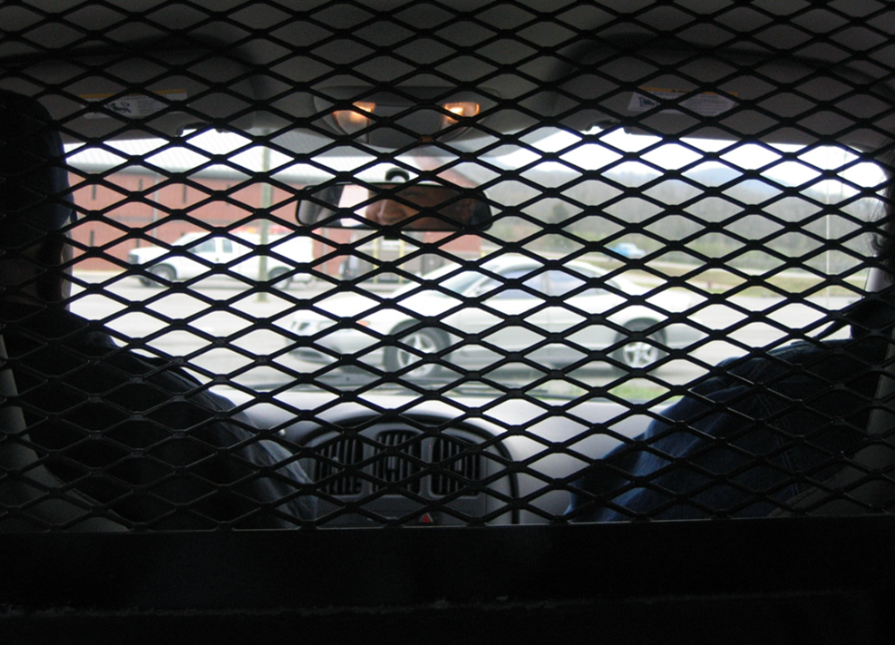
Secure Transportation
Review Policy 31.15 section B
Notes:
*RA can approve secure transport for non adjudicated delinquent youth*
Children/youth requiring transportation in a secure state vehicle meet at least one (1) of the following criteria: a) Adjudication of delinquency even if not committed as a delinquent child (i.e., a child/youth that has been adjudicated delinquent does not mean that he/she is COMMITTED as a delinquent child, etc.); b) Documented historical or recent assaultive behavior; c) Documented history of runaway; d) Documented history of incidents of self-harm; or e) The child/youth’s current behavior is deemed to present a threat to the safe operation of a non-secure vehicle or a threat to the safety of the employee.
It is preferred that delinquent youth are transported in a secure state vehicle. If a secure vehicle is not available, the second preference is an unsecured state vehicle.

Slide 49

Transporting with Medications
  Medications should always be transported with the youth (stored separately) along with the Medication Transfer form CS 0813 completed and signed.
  If the youth has medication scheduled to be taken during the transport, the transporting employee will consult with the regional well-being nurse prior to the trip.
  Review section I Policy 20.15
  Medication Transfer Form
Notes:
STATE that if the transporter has any questions about medications to contact the regional or YDC nurse.

Slide 50
Transportation Basics
A youth’s personal belongings will not be accessible to them during a secure transport.
All belongings should be placed in the rear cargo section of the vehicle or the trunk.
Medications should be kept in possession of the staff during transport.
You will assist the youth in and out of the vehicle. You may also need to assist him/her in securing his/her seatbelt.
Notes:
Review slide. ASK participants why it is not a good idea to let youth have access to their belongings during transport.

Slide 51

Placement in the Vehicle
Notes:
Ask the participants where they would place 1 passenger. What about 2 or 3? What about secure or nonsecure vehicle? What if they present behavioral problems?
The youth is seated in the rear passenger side seat with the second employee seated in the rear driver side. NEVER place a youth behind the driver!

Slide 52
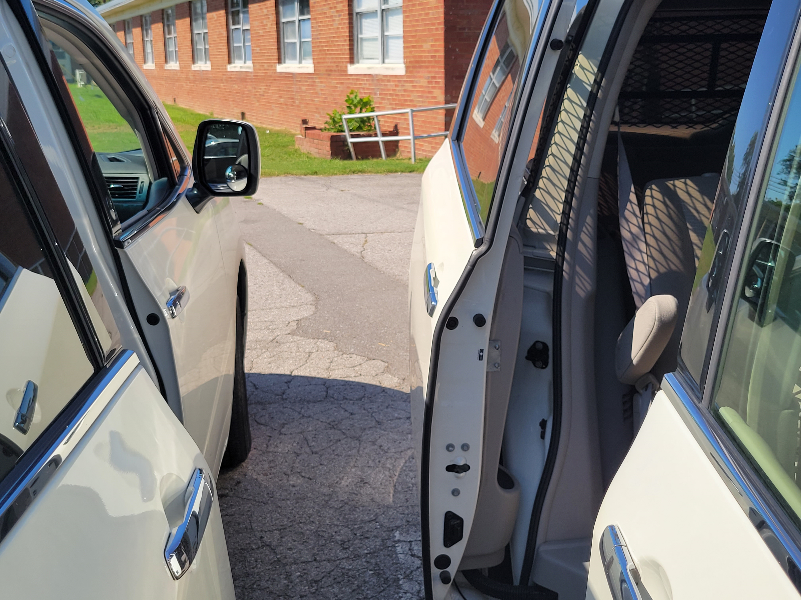
Transfers of Youth During Transportation
If a youth will be transferred to another vehicle during a lengthy transport you shall:
  Pre-plan
  Coordinate location
  Place vehicles to minimize the opportunity for escape
  Plan for any transfer of paperwork/files
  Plan for transfer of any belongings/medications
Notes:
There may be times when youth are transferred to another vehicle. To minimize the risk of an incident and/or escape remember to do the following on the slide. SOLICIT ideas for other ways to increase security and safety.

Slide 53

Emergencies and Special Circumstances
Review Policy 31.15 section E
  Medical/Mental Health emergencies
  Vehicle Malfunction
  Accident/Injury
  Inclement Weather
  Runaway/Escape Attempt
Notes:
MEDICAL EMERGENCY
A medical emergency is identified as any situation requiring medical assistance i.e., serious injury, prolonged seizures, heart attack symptoms, etc. Refer the participants to Policies 27.23 Section F and 31.15 Section E
Any medical emergency such as serious injury, heart attack symptoms, & prolonged seizures require immediate action.
Call 911, request assistance to the nearest medical facility.
Utilizing available first aid resources, provide first aid treatment, if it can be done safely.
If continuing transport threatens the life of the youth and or staff contact 911 and ask for assistance/guidance.
Notify Supervisor to request assistance.
Mental Health Emergency
Throughout the state, specialized Crisis Services staff assess and evaluate children and youth, and adults (18) who are experiencing a psychiatric emergency.
If someone you are transporting is experiencing a mental health crisis, please call 911 the statewide crisis line or the regional phone number in your area. Your call will be routed to a crisis specialist for help. 24/7 STATEWIDE CRISIS LINE: 855-274-7471 (855-CRISIS-1)
VEHICLE FIRE
Prior to accepting a vehicle intended for transporting youths, verify the vehicle is equipped with a fire extinguisher. In the event of a fire while transporting, the following actions will be taken:
Stop the vehicle and determine location of the fire.
If it poses an immediate threat to passengers, evacuate the vehicle.
Move the youth to a safe location away from the vehicle and out of the path of traffic. Maintain safety of the youth.
Administer first aid as needed.
Contact 911 (THP, Local Law Enforcement, Fire Department), and Supervisor.
TRAFFIC ACCIDENT
Refer participants to:
Policy 1.13 Section H
Policy 1.4 covers emergency medical treatment
https://www.tn.gov/content/dam/tn/hr/documents/Employee_Handbook_2015.pdf page 33 states “Workers’ Compensation/Accidents/Injury in the Line of Duty
Should you have an accident while on the job:
• Seek immediate first aid or emergency care. See that your supervisor or shift supervisor is notified of your accident/assault and your condition. All serious injuries that require outside medical services and/or result in lost time should be reported immediately to Corvell at 1-866-245-8588 for the name of a medical provider authorized to treat you.”
In the event that you are involved in a traffic accident while transporting youth, regardless of the extent of damage or injury, THP and your supervisor shall be notified immediately.
Regardless of the extent of the damage, notify THP *847, MVM and your supervisor.
Administer first aid if needed.
Youth needing further medical attention will be transported to the nearest hospital.
Youth not injured, may remain in the vehicle.
Supervisor will be notified and assistance requested to transport and supply additional security.
If you are injured, obtain medical treatment as needed. Inform supervisor for next steps.
DISABLED VEHICLE
In the event a vehicle transporting youth become disabled due to mechanical problems, the staff will:
Leave the youth in the vehicle, unless it becomes unsafe.
The staff are to remain with the vehicle & maintain security of the youth.
Notify Supervisor for assistance and to arrange transport.
Contact MVM
Weather
Check weather for starting, total trip and ending locations prior to transport. Youth are not transported during weather emergencies. If caught in a weather emergency during a transport
◻ Seek shelter in a safe area;
◻ Contact the supervisor to let them know where you are; and
◻ Follow the regional/facility emergency response preparedness plan.
Runaway
If, during transportation a child/youth attempts to runaway or escape, the safe operation of the vehicle takes precedence over preventing a runaway or escape.
Remember to follow policy 31.2 Responsibilities Regarding Runaways, Absconders and Escapees

Slide 54
After Transportation
Make sure gas is full.
Park in designated area.
Place mechanical restraints in a secure location when not in use.
Search vehicle-Any contraband confiscated and how it was disposed of should be documented.
Clean and sanitize vehicle after each transport.
Properly document each transport-Employees should complete form CS-0350 Transportation Report, the Monthly Vehicle Mileage Report/Travel Log during each trip.
Notes:
ASK participants why documentation is important. ILLICIT answers such as “if it wasn’t documented it didn’t happen”, etc.
Review other points of to-do’s after transportation.
ASK questions to gauge understanding
For classroom:
If time permits take participants to a van to search, review logbook, inspect equipment, practice placement in the vehicle, etc.

Slide 55

Final Remarks
Notes:
REVIEW with participants their takeaways from the entire class.
ACTION As each answer comes up, offer an affirmation and ask if the group agrees.
ANSWER any questions.

