Slide 1
R-X CSZ Earthquake and Tsunami Response Plan& State Integration Overview
OERS Council Meeting
February 24, 2022

Slide 2
Presentation Objectives
Review of R-X CSZ Earthquakes and Tsunami Response Plan
Discussion on points of State/Federal connectivity and operational integration
Identified State operational planning gaps/needs

Slide 3
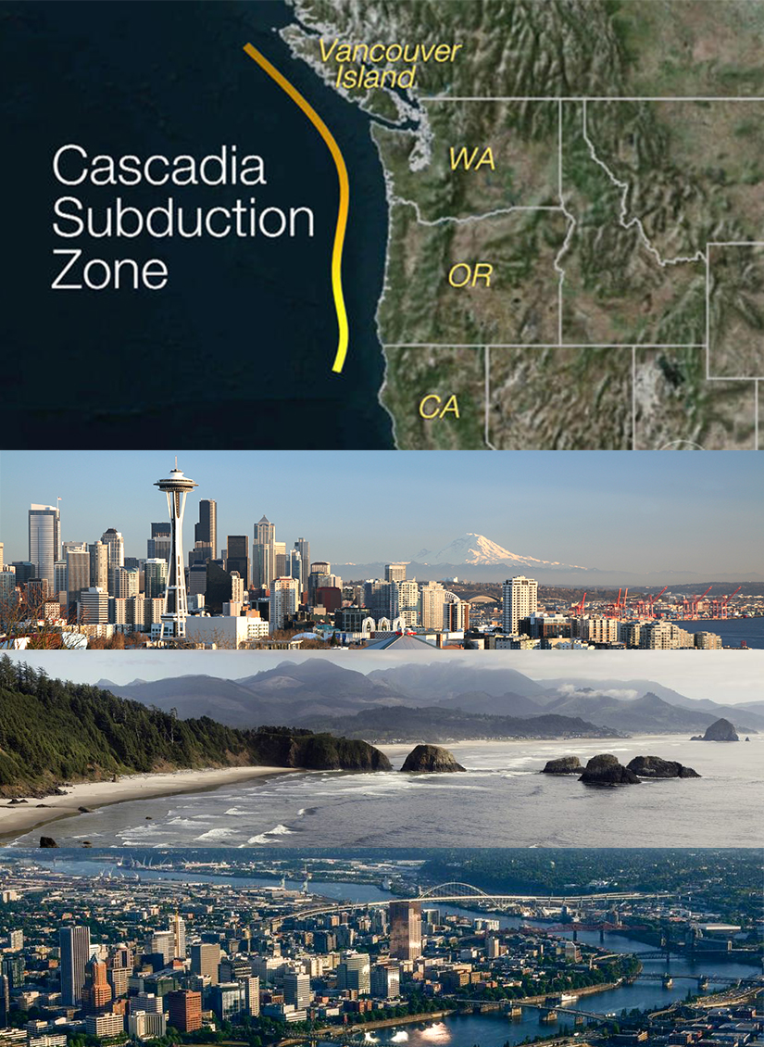
Region 10 Cascadia Subduction Zone (CSZ) Earthquake and Tsunami Catastrophic Response Plan (ver. 3.0)
FEMA Region 10 CSZ Plan Overview
Katelyn Grant, CSZ-Lead Federal Planner
February 2022

Slide 4
Agenda
Welcome
Scenario Overview
Key Facts/Assumptions/Shortfalls and Limiting Factors
Impacts by Geographic Reference Areas (GRAs)
Concept of Operations (CONOPs) Overview
Concept of Support Overview
Questions

Slide 5
Scenario Overview (Earthquake/Tsunami Impacts)

Slide 6
CSZ Plan Scenario
Magnitude (M) 9.0 earthquake strikes on the morning of Wednesday, February 6, at 9:41 a.m. (PST).
Ground shaking lasts up to 5 minutes and generates a tsunami wave of between 3 feet and 80 feet that will, depending on coastal location, reach the coast 10 to 30 minutes post-earthquake.
Event directly affects more than 140,000 square miles, covering three states, two FEMA regions, and British Columbia, Canada. The tsunami affects 27 counties.
The impacts from the earthquake in the states of Washington and Oregon are estimated to result in 5,800 fatalities and 87,535 injuries. Impacts from the tsunami are estimated to result in 8,000 fatalities and 20,000 injuries.
Notes:
Additional tsunamis resulting from the initial shake continue for a minimum of 12-24 hours, causing inundation and strong currents along the outer coast and coastline communities. The earthquake produces subsidence, collapsed structures, liquefaction, landslides, localized fires, hazardous materials spills and debris. Many fires occur as a result of the shaking. There is damage to structures resulting from the energy of shaking, amplified shaking and ground displacement due to liquefaction, and loss of soil-bearing capacity, particularly in areas of liquefaction. Widespread landslides will impact the transportation and utility corridors within the region. The earthquake and subsequent tsunami have resulted in significant damage to buildings, roads, bridges, and other structures. In addition, large segments of the coastal and I-5 corridors are without electricity and communications, and with thousands of ruptured water, gas, and sewer lines, many critical infrastructure services are unavailable.
Aftershocks are not considered in this initial response plan, but it must be acknowledged that aftershocks of magnitude 7.0 or more will continue for months and generates additional tsunami waves over the 453 miles of impacted coastline in Oregon and Washington. These aftershocks will cause additional liquefaction, subsidence, continue to impact facilities and infrastructure, while further hindering response and recovery.
Scenario is based on the maximum of maximums (MOM) and utilizes the most current ShakeMap.
TRIBAL CONSIDERATIONS:
Tribes are sovereign, independent, and culturally and governmentally unique. Tribes have the authority to request a federal declaration.
Response capabilities of tribes will become overwhelmed. Tribal populations will be disproportionately impacted.
PRIVATE SECTOR:
Private Sector Requests
Situational awareness between government and private sector
Transportation system access (ground, air, maritime) and waivers
Fuel (access and distribution)
Operational Coordination integration
Priorities: Lifesaving Efforts
Employee life safety
Facility access, inspection, and repair
Debris management
Situational awareness, including anticipated impacts on critical infrastructure
Priorities: Community Stabilization
Facility access for inspection/repair
Establishment of communications links: business-to-business; business-to-government; business-to-employees

Slide 7
Earthquake Impacts
Ground failures, rockslides, avalanches, seiches, and landslide-generated tsunamis occur within minutes of the earthquake and cause significant inundation in coastal communities.
Building damage – 618,599 buildings with moderate to complete damage
Schools – 2,026 schools with moderate to complete damage
Hospitals – 100 hospitals with moderate to complete damage
Critical facilities – 2,777 critical facilities with moderate to complete damage
Total economic losses – $134 billion
Utility system economic losses – $15.9 billion
Transportation system economic losses – $3 billion
Job/wage losses – $6.2 billion
Notes:
Add this information to the IAB Outline
72,000 ppl exposed to tsunami
“WA coast in 30-60 minutes” source: Nate Woods p.2
Introduce the ERUPT Layers to help define the scenario. We are going to dive into the layers behind the data, to give a better grasp of the impacts.

Slide 8
Tsunami Impacts
27 counties impacted, including areas along Pacific Coast, Puget Sound, and Columbia River
At least 17 tribal nations impacted
453 miles of impacted Pacific Ocean coastline (OR=296, WA=157)
1,810 miles of impacted Puget Sound coastline, including the San Juan Islands
10- to 30-minute warning for coastal areas
90- to 120-minute warning for Puget Sound areas
All seaports on Pacific coast at risk of sustaining complete damage; seaports along Puget Sound and Columbia River (west of the I-205 bridge) at risk for major damage
Multiple tsunamis 10-12 hours after initial earthquake; first wave may not be the largest
Wave heights that vary from 3’ to 80’
Aftershocks of M7.0 or greater that could generate additional tsunamis
Notes:
Washington Counties at risk for inundation:
San Juan
Island
Kitsap
Whatcom
Skagit
Snohomish
King
Pierce
Thurston
Mason
Clallam
Jefferson
Grays Harbor
Pacific
Wahkiakum
Cowlitz
Clark
Skamania
Oregon Counties at risk for inundation:
Clatsop
Columbia
Multnomah
Tillamook
Lincoln
Lane
Douglas
Coos
Curry
Add this information to the IAB Outline
72,000 ppl exposed to tsunami
“WA coast in 30-60 minutes” source: Nate Woods p.2
Introduce the ERUPT Layers to help define the scenario. We are going to dive into the layers behind the data, to give a better grasp of the impacts.

Slide 9
Key Facts Assumptions Shortfalls/Limiting Factors

Slide 10
Key Facts
Two UCGs/JFOs established (one in WA and one in OR).
NRCC will initiate response.
Critical infrastructure interdependencies among the communications, electricity, fuel, and transportation sectors will significantly impact the ability to deploy temporary emergency solutions within the impact area for initial life-safety response.
Achieving situational awareness and communicating this information to responders and the public is critical to lifesaving and life-sustaining efforts.
Coordination with the private sector on information gathering is necessary.
Transportation capabilities are essential to response efforts, including assessment, repair, and people/supply movement.
Notes:
2 UCGs/JFOs required for response operations (one in each state).
46 out of 102 EOCs in the impacted areas of OR and WA receive moderate to complete damage.
Cascading, secondary, and indirect impacts affect all of FEMA Region X and adjoining states.
Coastal communities are isolated.
Communications are limited within each state.
FEMA and all Region 10 states operate under the Incident Command System (ICS) with a consistent Command and General Staff organizational structure.
Fifty-one counties in OR and WA receive ground shaking of magnitude 4.0-9.0. These counties cover an area of over 100,000 square miles and are home to over 8 million people. They contain nearly 450 communities, more than 80 of which have populations of at least 10,000.
Forty percent of local EOCs in Washington and Oregon receive moderate to complete damage from the initial quake.
Forty-six out of 102 EOCs receive moderate to complete damage in the impacted areas of OR and WA. Most lose access and basic services: communications, power, water, sewer, etc.
Fourteen counties suffer tsunami inundation of coastal and shoreline areas
FRC maintains a fuel supply to support power for between 30 to 36 days.
MERS operational concepts are not integrated into all possible federal command and control structures.
Multiple redundant communications systems between the National Response Coordination Center (NRCC), Region X Regional Response Coordination Center (RRCC), and state Emergency Operations Centers (EOC) survive and provide initial communication and limited coordination capacity.
Number of counties in Coastal AO and I-5 Corridor AO; OR: Coastal: 7; I-5 Corridor: 14 (Douglas and Lane counties included in both Coastal and I-5 Corridor AOs); WA: Coastal - 4; I-5 Corridor – 15
Over 72,000 people live in the CSZ inundation areas
Power outages impact sustainability of back-up power systems.
Qualified state staff/leadership is affected by the event and may not be available to support command structure.
Reception, staging, onward movement, and integration of incoming national and regional Incident Management Assistance Teams (IMAT) require planning and coordination with state and federal partners.
Region 10’s No-Notice Earthquake Automatic Activation and Response Checklist is used in incident response.
Situational awareness is limited because of lack of communications and accessibility to impacted areas.
The Mobile Emergency Response System (MERS) operation center staff at the Federal Regional Center (FRC) performs initial coordination with impacted state operation centers.
The Region X Regional Administrator (RA), Deputy RA, Division Directors, Federal Coordinating Officers (FCO), four IMAT personnel and the Disaster Emergency Communications Unit Leader have satellite phones. These phones support initial communications until their charges run out.
There is a degraded ability to communicate and coordinate operational priorities and requirements.
There is a lack of situational awareness to make informed decisions.

Slide 11
Assumptions
Federal, state, local, and tribal resources are overwhelmed and require support from outside the impact area.
Communications infrastructure is significantly degraded immediately post-event and continues to deteriorate due to the nature of backup power systems at communications towers/wire centers and the inability to replenish fuel supplies.
Debris and road damage prevent access to critical infrastructure to assess damage, conduct repair operations, and sustain temporary power.
Instant loss of communications and power infrastructure limits the ability to provide local situational awareness information via traditional channels, such as email, telephone, and the internet.
There are competing demands for transportation resources and services; priority will be given to support lifesaving and life-sustaining activities.
Notes:
Key state and federal leaders have the ability to communicate via existing backup systems
Local, state, tribal, and federal agencies initiate existing Continuity of Operations Plans (COOP) procedures
Federal, state, local, and tribal governments, agencies, and resources are overwhelmed and require support from outside the impacted areas
Essential facilities have limited capacity to support coordination among local, state, tribal and federal agencies
Key leaders and staff are impacted by the event and may not be available during the initial stages of the response
Alternate facilities for the FRC (COOP locations) are in the impacted zone and will not be reachable by Regional Support Team (RST) and IMAT personnel.
Damage to roads, bridges, ports, rail systems, and airports will prevent staff from responding both regional and externally.
Response Times are going to be SLOW!!!!
An inability to communicate with regional leadership will trigger FEMA Headquarters to execute pre-determined response actions.
Damaged or blocked transportation routes within the impacted area will make it difficult for federal regional assets to support impacted states.
Destruction of local and county EOCs will adversely affect situational assessment and COP.
FEMA and federal regional support staff and families will be affected by a Cascadia incident and many not be available for duty or will not be able to get to the Federal Regional Center (FRC) or other assigned duty locations.
FEMA Headquarters will make pre-identified decisions immediately as soon as the incident occurs.
FRC will be relatively undamaged but unsustainable in the long term.
Ham radio operators will be a primary source of communication for surviving local EOCs.
Lack of communications systems and the destruction of local emergency operation centers will drive a requirement for national assets to be used in situational awareness and common operating picture.
Lack of communications will result in a fragmented command structure at the local, state, and federal levels.
Lack of communications will result in a fragmented command structure.
Lifesaving and life-sustaining activities will be the primary focus.
Local jurisdiction to state EOC communications may initially improve as the event matures but backup power will run out and communications will get worse before it gets better.
Local political entities will have limited functionality due to being overwhelmed and devastated.
Management of spontaneous volunteer forces will present management challenges at all levels of command.
Many coastal EOCs and resource caches might be destroyed, inaccessible or nonfunctional.
Many larger businesses have their own EOCs: the railroads, Microsoft, Boeing, Weyerhaeuser, etc.
Many local, state, and federal agencies will initiate existing COOP plans.
MERS staff will be on site 24/7 and can initiate the emergency notification system for response staff and the RA, but communications may not be available.
Qualified staff to assess primary and COOP facilities will be limited or will be unable to get to the site for inspection.
Senior state and federal leadership will have the ability to communicate via existing backup systems.
Severe winter weather including rain, snow, wind, and fog, will hamper air operations for reconnaissance, satellite imagery, impact determinations, and situational awareness.
Staffing and making strategic assumptions will happen immediately.
The end of the response phase will be dependent on the situation on the ground.
The recovery operation will be initiated within the response phase.
There will be a requirement to immediately develop temporary billeting for survivors and responders.
There will be limited ability of FEMA staff, teams, and federal partners to communicate and to support RRCC activation.
There will be limited capability to support incoming out-of-region resources and staff.
There will be multistate, multi-region demands for the same resources.
Winter weather and ground saturation will worsen physical earthquake impacts (landslides, liquefaction, avalanches) and further impact responders’ ability to travel within the impacted areas.

Slide 12
Shortfalls/Limiting Factors
Competing demands for resources will occur between impacted states, territories, tribal nations, border nations, and the private sector.
There is limited capability for coordinating and adjudicating resource requirements during the initial response.
Communications infrastructure failures and damage cause outages beyond the impact area.
There is a lack of situational awareness to make informed decisions.
Aerial assessment support is limited but will be critical to early response efforts.
Communities in the Coastal Geographic Reference Area (GRA) are limited to air and water access for much of the response.
Evacuation efforts are stalled due to lack of ingress and egress options.
Notes:
Fuel demand/prioritization (not enough in the system to support
Lack of available, trained, and qualified staff for all functions.
Limited ability to resupply county emergency management facilities .
Supply/Resupply Chain issues
Weather/Time of year
Competing demands for limited resources from impacted states, territories and border nations (Direct impacts to WA, OR, CA, British Columbia, FEMA Regions IX and 10; Indirect, secondary, or tsunami impacts to Hawaii and, the Pacific Islands, Alaska and adjoining states)
Limited ability to coordinate and adjudicate resource requirements during the initial stages of the response
Limited number of essential staff available for impacted state and local EOCs
Limited number of facilities with operational communications, power, and life support capabilities
Lack of situational awareness to make informed decisions
Limited ability to communicate/coordinate operational priorities and requirements
An established streamlined procedure for municipalities to rapidly request state aid (i.e., a county is unable to request aid for themselves).
Competition for limited number of ham radio operators by all functional areas.
Fuel, food, and water support will be necessary to continue local EOC operations.
Inability of communities to request help, requiring states to deploy resources to heavily impacted areas.
Lack of an identified list of facilities that meet criteria to serve as back-up EOCs.
Lack of available, trained, and qualified staff for all functions.
Lack of local and regional capability to support incoming staff in the initial 72 hours (e.g., food, water).
Lack of prioritized generator locations.
Lack of state familiarity with local government COOP plans and how to connect with them.
Limited local structural assessment capability.
Limited staffing to support operations.
Multistate demand on the same resources.
Poor accessibility into the impacted areas.
Shortage of EMAC, IMAT, and state overhead support.
Shortage of personnel to bolster command and control abilities in impacted counties.
Shortage of staffing relief will be needed after 24 hours of operation.
Unverified local and state policies, which may not provide the flexibility needed to respond effectively to a catastrophic incident.

Slide 13
Shortfalls/Limiting Factors: Transportation
Communities in the Coastal Geographic Reference Area (GRA) are limited to air and water access for much of the response; smaller airfields may only be able to handle rotary-wing assets; atypical solutions such as all-terrain vehicles, horseback riding, and foot travel are required for ground transportation.
Evacuation efforts are stalled due to lack of ingress and egress options.
Functionality of transportation systems is significantly degraded during the response, even after repairs have been made and temporary capabilities have been established. There is limited access throughout the impact area.
The need for transportation responders such as air traffic control and transportation security personnel, engineers, repair crews, debris removal crews, and traffic management personnel exceeds the capacity of available resources.
Notes:
General
Aftershocks continue to impact transportation systems throughout the response phase
Communities in the Coastal AO are limited to air and water access for much of the response; smaller airfields may only be able to handle rotary wing assets; atypical solutions such as all-terrain vehicles, horseback riding, and foot travel are required for ground transportation
Debris, landslides, avalanches, and sediment resulting from ground shaking and tsunami waves obstruct roads, rail lines, runways, and waterways
Due to the lack of services (power, water, communication, access, sustainment/shelter etc.), deployed transportation responders require extensive logistical support and will need to be self-sufficient
Evacuation efforts are stalled due to lack of ingress and egress options
Fires and hazardous-material releases constrain movement
Fuel distribution networks are inoperable during much of the response; bulk fuel deliveries are necessary to meet all fuel requirements until repairs to local infrastructure are completed
Functionality of transportation systems is significantly degraded during the response, even after repairs have been made and temporary capabilities have been established. There is limited access throughout the affected area.
The need for transportation responders such as air traffic control and transportation security personnel, engineers, repair crews, debris removal crews, and traffic management personnel exceed the capacity of available resources.
Port, Airport, and Rail operations do not have the equipment or personnel to run 24 hour a day operations needed to support the response.
Bulk fuel storage and distribution for assessment and repair teams.
Damage assessment resources/capabilities to support all modes of transportation.
Most ESF #1 engineers will not have required certification to respond to a Cascadia incident.
Restoration and repair resources/capabilities to support all modes of transportation.
There is overlap in the contactors that federal entities rely upon (FEMA, USTRANSCOM, etc.), which could result in resource shortfalls
Ground
Ground movement will be impossible in many areas.
Air
Although many communities will only be accessible by air, air transportation capacity will not be sufficient to meet the demand of impacted communities in wester portions of Washington and Oregon.
Air space management capabilities.
Rotary wing assets to support evacuation and supply to isolated coastal communities
There will be a national-level shortage of helicopters. ESF #7 (Logistics) will be responsible for requesting and coordinating movement of transportation resources, such as helicopters, in a disaster. ESF #1 does not track the number of helicopters available for federal emergency response.
Maritime
There are no functional ports in the affected areas until temporary port capabilities are established

Slide 14
Tribal Considerations
Tribes are sovereign, independent, and culturally and governmentally unique.
Tribes have the authority to request a federal declaration.
Response capabilities of tribes will become overwhelmed.
Tribal populations will be disproportionately impacted.
Participation in CSZ plan update:
Tribes were invited to participate in plan development as well as in various Community Lifeline work groups.
A tribal-specific questionnaire was distributed and the information provided has been incorporated into the CSZ plan update; participation will likely increase tribal interest in the Cascadia Rising exercise.

Slide 15
Community Lifeline Planning Factors
Transportation | Communications | Food, Water, Shelter | Health and Medical | Energy | Safety and Security | Hazardous Materials
15,858 miles of highway and 6,826 road bridges in CSZ impact areas of WA and OR. 5,828 miles of railroad track and 93 railroad bridges in CSZ impact areas of WA and OR. 98 airports are affected in CSZ impact areas of WA and OR. 72 ports affected in WA and OR. 716 maritime port facilities affected in WA and OR. 156 bus facilities affected within WA and OR. 99 bus facilities affected in OR, with potential losses of $29.7 million. 52 ferry facilities affected in WA and OR. | 682 of 1,032 communications infrastructure facilities receive moderate or greater damage. Lack of communications networks and impaired accessibility to impacted areas limits situational assessment. Responders and survivors in heavily impacted areas don’t have access to internet, cell phone, landline, television, or two-way radio services. Communication to coastal communities is limited to RF, satellite, and runners. Communications will be cut off completely in isolated areas and communities and will require direct contact. 3,912 financial institutions potentially affected. | Food supplies will be disrupted until transportation and power networks are restored. (Frozen and refrigerated food will be especially vulnerable.) 594,075 households will be without potable water service on Day 1. Sheltering options will be required for approximately 1,000,000 displaced survivors and 600,000 pets. Food and food processing facility inspection requirements will exceed local ESF #11 capabilities. | 13,800 fatalities expected. 107,535 injuries expected. 13,800 hospital beds are expected to be lost. Local pharmaceutical supplies will be insufficient to meet demand. Ability to re-establish supply chain will be severely impeded by damaged transportation infrastructure. Limited refrigeration capability will be available. | 3,947 natural gas line leaks/breaks occur. 88,288 households will be without power on Day 1. 9 out of 81 power facilities will sustain damage. Generator support will be insufficient to meet demand. Cascading effects of power outages will affect other lifeline stabilization efforts. | Police lack capability to perform services in heavily damaged areas; minimal capabilities available in lesser damaged locations due to lack of access and communications. Delay in response operations occurs due to compromised transportation infrastructure. Essential government facility inspection requirements overwhelm all resources. Evacuations difficult due to limited public safety personnel availability. | 86 chemical facilities in WA and OR experience moderate to complete damage. 2,295 facilities with reportable quantities of Extremely Hazardous Substances in impact areas in WA and OR. 107 petroleum facilities and 686 miles of petroleum pipeline experience moderate to complete damage in WA and OR. 2,810 miles of natural gas pipelines in the impact areas of OR and WA sustain more than 800 breaks.
Notes:
Update names of Lifelines to include symbols
Kate’s Briefing Notes:
Transportation: Not enough inspectors
Communications: Every team will need to bring own comms, Public Alert and warning nonexistent….Need to determine how to push out public messaging
F/W/S: Most shelters will experience moderate to complete damage. Not enough shelters in the inventory to house displaced populations. The feeding requirement exceeds federal capability, Looking to private sector for support. Potable water restoration will be long term. (bring people to water or bring water to people)
Health/Med: Local hospitals will not be able to support the medical surge, med evac planning
Energy: Access to power and fuel will be a limiting factor in sustained response,
Safety/Security: Responders will require their own security component….most essential government services (Police/Fire) will be impacted….slow response times), Prisoner evacuation planning will be required
Hazardous Materials: Protective/Mitigation measures will be comprised and suriviors will be at risk of exposure

Slide 16
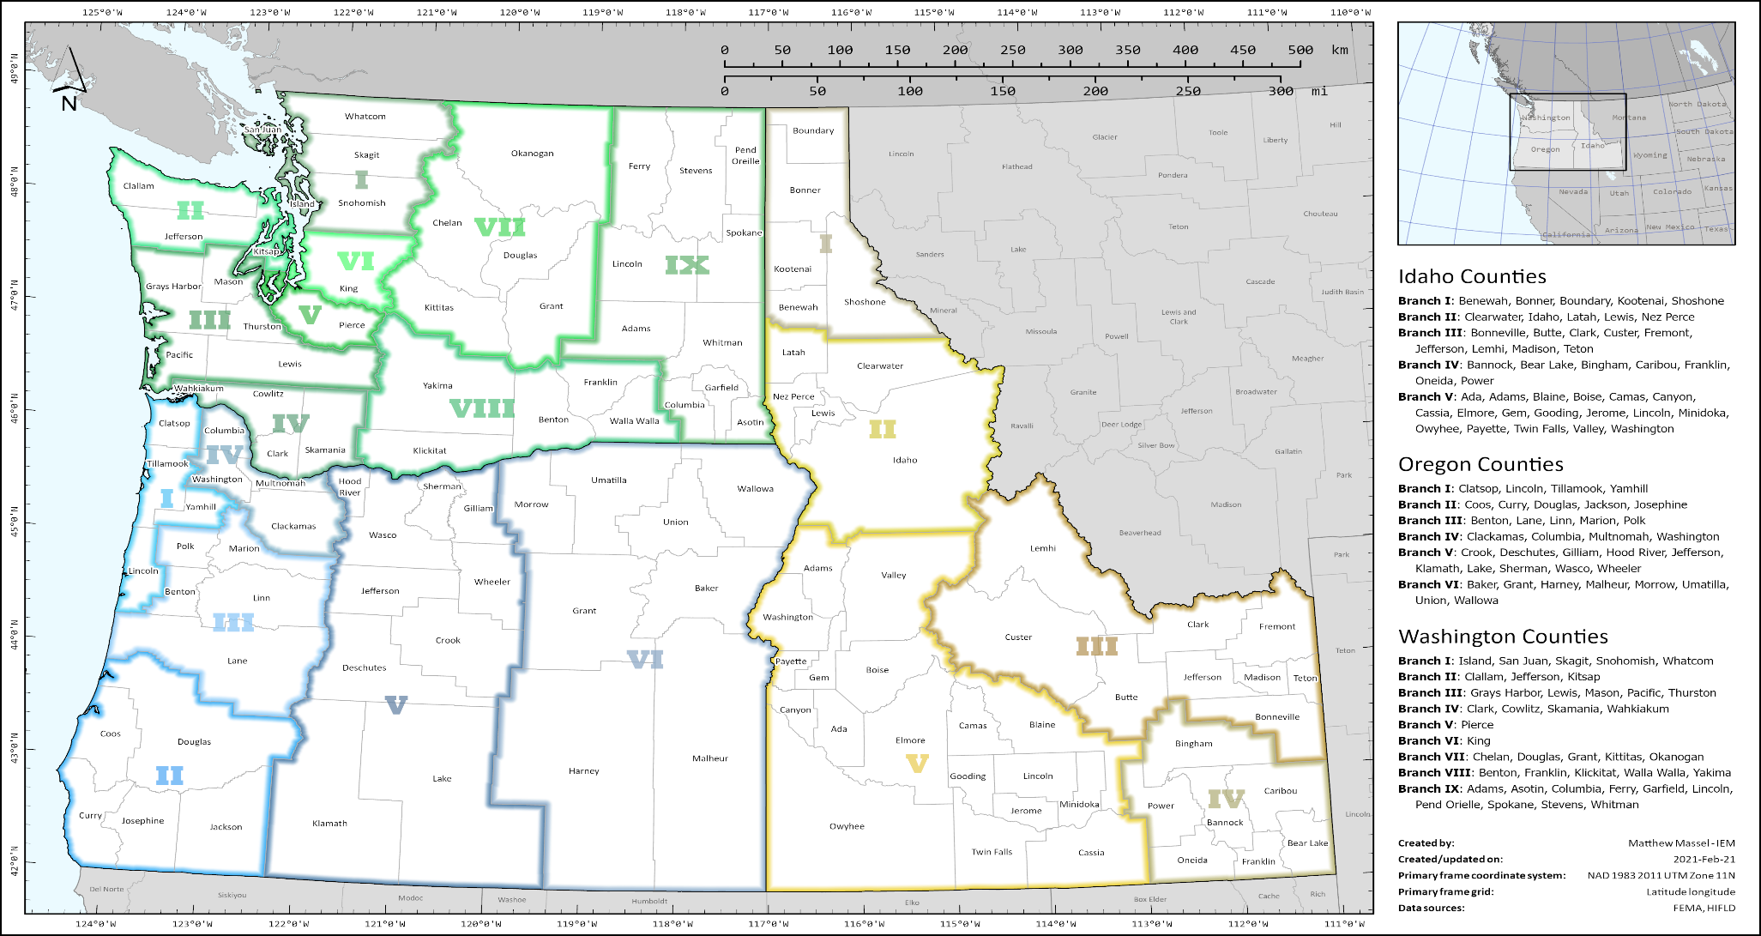
R10 Geographic Operations
Notes:
Earthquake Impacts
Ground failures, rockslides, avalanches, seiches, and landslide-generated tsunamis occur within minutes of the earthquake and cause significant inundation in coastal communities.
Building damage – 618,599 buildings with moderate to complete damage
Schools – 2,026 schools with moderate to complete damage
Hospitals – 100 hospitals with moderate to complete damage
Critical facilities – 2,777 critical facilities with moderate to complete damage
Total economic losses – $134 billion
Utility system economic losses – $15.9 billion
Transportation system economic losses – $3 billion
Job/wage losses – $6.2 billion
Tsunami Impacts
Washington Counties at risk for inundation:
San Juan
Island
Kitsap
Whatcom
Skagit
Snohomish
King
Pierce
Thurston
Mason
Clallam
Jefferson
Grays Harbor
Pacific
Wahkiakum
Cowlitz
Clark
Skamania
Oregon Counties at risk for inundation:
Clatsop
Columbia
Multnomah
Tillamook
Lincoln
Lane
Douglas
Coos
Curry
Add this information to the IAB Outline
72,000 ppl exposed to tsunami
“WA coast in 30-60 minutes” source: Nate Woods p.2
Introduce the ERUPT Layers to help define the scenario. We are going to dive into the layers behind the data, to give a better grasp of the impacts.
27 counties impacted, including areas along Pacific Coast, Puget Sound, and Columbia River
At least 17 tribal nations impacted
453 miles of impacted Pacific Ocean coastline (OR=296, WA=157)
1,810 miles of impacted Puget Sound coastline, including the San Juan Islands
10- to 30-minute warning for coastal areas
90- to 120-minute warning for Puget Sound areas
All seaports on Pacific coast at risk of sustaining complete damage; seaports along Puget Sound and Columbia River (west of the I-205 bridge) at risk for major damage
Multiple tsunamis 10-12 hours after initial earthquake; first wave may not be the largest
Wave heights that vary from 3’ to 80’
Aftershocks of M7.0 or greater that could generate additional tsunamis

Slide 17
OR Coordination Structure
Oregon Geographic Branches and Divisions
Consistent with Oregon’s Emergency Management Regions
Branch I Northwest
Branch II Southwest
Division A Clatsop Co.
Division B Tillamook Co.
Division C Yamhill Co.
Division E Douglas Co.
Division F Coos Co.
Division G Curry Co.
Division J Polk Co.
Division K Marion Co.
Branch IV Portland Metro
Division O Columbia Co.
Division P Washington Co.
Division Q Multnomah Co.
Division H Josephine Co.
Branch V Cascades
Branch VI Eastern
Division D Lincoln Co.
Division I
Jackson Co.
Division L Benton Co.
Division M Linn Co.
Division N Lane Co.
Division R Clackamas Co.
Division S Hood River Co.
Division T Wasco Co.
Division U Sherman Co.
Division V Gilliam Co.
Division W Jefferson Co.
Division X Wheeler Co.
Division Y Deschutes Co.
Division Z Crook Co.
Division AA Klamath Co.
Division AB Lake Co.
Morrow Co. Umatilla Union Wallowa Grant Baker Harney Malheur
Tribal Nations Confederated Tribes of the Siletz Indians
Tribal Nations Coquille Indian Tribe, Cow Creek Band of Umpqua Tribe of Indians
Tribal Nations Confederated Tribes of Coos, Lower Umpqua & Siuslaw Indians, Confederated Tribes of Grand Ronde
Tribal Nations Confederated Tribes of the Warm Springs Indian Reservation, Klamath Tribes
Tribal Nations Burns Paiute Tribe, Confederated Tribes of the Umatilla Indian Reservation
Branch III Willamette Valley
Tribal Nations Confederated Tribes of the Warm Springs Indian Reservation, Klamath Tribes
Notes:
Operational approaches….falls in line with the LOE construct though we may not call it that “out loud”
LL Outcomes
Identify the senior leadership

Slide 18
R10 Geographic Reference Areas (GRAs)

Slide 19
Coastal Impacts, by Lifeline
Transportation | Communications | Food, Water, Shelter | Health and Medical |  | Energy | Safety and Security | Hazardous Materials
Extremely limited routes in/out of the area; access could become cut off for long periods of time. Access via air (rotary only). No or limited water/port access. Roads, bridges, tunnels, and Aerial Points of Debarkation (APODs)/Federal Staging Areas (FSAs) will require inspection and temporary repairs. Debris will impact access in/out of affected areas. | Cell towers/landlines, broadcast, and internet capabilities will become inoperable. Land-mobile radio communications will be severely impacted. Public Information and Warning capabilities will be extremely limited. 911 services will be unavailable. | No access to shelter, water, or food. All life-sustainment resources require their own strategy. No ability to provide water from public utilities. Shelters will sustain severe to complete damage. No infrastructure or ability to provide wraparound services to sustain mass care operations. | Limited or no access to healthcare services or veterinary support. Limited medical supply chain to sustain medical or veterinary facilities or other healthcare providers. Insufficient fatality management capability. |  | Major power losses for cities and communities expected. Backup power generators insufficient. No access to fuel for sustaining operations. No access to fuel distribution capabilities. | Government services to the public will be extremely impacted. Emergency Operations Centers (EOCs) will have limited capabilities for coordinating operations. Potential threats to life safety are expected for responders and community members. | Extreme likelihood of spill or release of contaminants that could impact local populations and impede the response. Impacts to public will need to be mitigated.
Priority Lines of Effort (LOEs) Phase 2a: Damage Assessment (inspections) Airfield Opening Operational Communications Debris Management Resource Staging Responder Security Evacuation (survivor, medical) Search and Rescue (Rotary) |  |  |  | Priority LOEs Phase 2b: Fatality Management Private Sector Coordination Healthcare Systems Support Emergency Repairs or Augmentation to Infrastructure Commodities Distribution Medical Transportation Port Opening

Slide 20
Inland/I-5 Impacts, by Lifeline
Transportation | Communications | Food, Water, Shelter | Health and Medical |  | Energy | Safety and Security | Hazardous Materials
Multi-modal routes (air, rail, road, port) will experience major disruptions; Extremely limited routes in/out of the area; access could become cut off for long periods of time. Bridges, tunnels, and APODs/FSAs will require inspection and/or temporary repairs. Access/supply chain support will be via rotary- and fixed-wing aircraft and limited ground transportation. Debris and weather will impact access in/out of affected areas. | Cell towers/landlines, broadcast, and internet capabilities will become inoperable. Land-mobile radio communications will be severely impacted. Public Information and Warning capabilities will be extremely limited. 911 services will be unavailable. | Food and water distribution will need to be established. Potable water utilities will need to be inspected. Pre-identified shelters will need to be inspected for damage. | Medical facilities will lose access to the power, water, and fuel needed to sustain operations. There will be limited medical supply chain distribution operations to sustain medical and veterinary facilities or other healthcare providers. Insufficient fatality management capabilities available. |  | Major power losses for cities and communities expected. Backup power generators insufficient. No access to fuel for sustaining operations. No access to fuel distribution capabilities. | Government services to the public will be extremely impacted. EOCs will have limited capabilities for coordinating operations. Potential threats to life safety are expected for responders and community members. | Extreme likelihood of spill or release of contaminants that could impact local populations and impede the response.
Priority LOEs Phase 2a: Damage Assessment (inspections) Airfield Opening Operational Communications Debris Management Resource Staging Responder Security Search and Rescue (Urban Search and Rescue [USAR] teams) Medical Transportation |  |  | Priority LOEs Phase 2b: Fatality Management Emergency Repairs or Augmentation to Infrastructure Commodities Distribution Medical Transportation Search and Rescue Port Opening | Priority LOEs Phase 2b: Fatality Management Health Care Systems Support Mass Care Food and Water Sheltering Private Sector Coordination Emergency Repairs or Augmentation to Infrastructure Commodities Distribution Port Opening

Slide 21
East of Cascades Impacts, by Lifeline
Transportation | Communications | Food, Water, Shelter | Health and Medical |  | Energy | Safety and Security | Hazardous Materials
Multi-modal routes (air, rail, road, port) will have some disruption due to weather and landslide activity. APODs are mission-capable and can handle both rotary- and fixed-wing (heavy lift) aircraft. Bridges and/or tunnels may require inspections before use. | Cellular communications may be intermittent due to major system losses and/or high call volumes. Land-mobile radio communications may be impacted. | Supply chains to support the Food, Water, Shelter Community Lifeline will need to be re-established. | Supply chain to support health and medical operations will be strained but will remain capable. |  | No major power losses expected, but there is the potential for intermittent disruptions as teams work to re-establish the grid on the western side. | Government services to the public may be impacted. | Possible spill or release of contaminants that could impact local populations and impede the response.
Priority LOEs Phase 2a: Airfield Opening Operational Communications Resource Staging Responder Security Private Sector Coordination Temporary Power |  |  |  | Priority LOEs Phase 2b: Sheltering Operations (evacuees) Mass Care Food and Water (for evacuees) Health Care Systems Support Fatality Management

Slide 22
Isolated Community Impacts, by Lifeline
Transportation | Communications | Food, Water, Shelter | Health and Medical |  | Energy | Safety and Security | Hazardous Materials
No road access; air (rotor) and water only. No resupply routes or distribution areas established. Inspections will be required for APODs, roads, bridges, and tunnels. Debris will limit access in/out of affected areas. Mass transit, rail, and aviation services will be inoperable. Access may take weeks to months. | 911 services will be unavailable. No internet, broadcast, or cellular/landline services available to provide notifications or public information. Local communications infrastructure (radios, tv networks, etc.) will be down; responders will need to bring in own communications capabilities. | No access to shelter, water, or food; all life-sustainment resources require their own strategy. No ability to provide water from public utilities. Shelters will sustain severe to complete damage. No infrastructure or ability to provide wraparound services to sustain mass care operations. | No access to healthcare services or veterinary support. Medical facilities not functional nor capable of supporting local healthcare networks. No infrastructure or ability to provide wraparound services to sustain public health and medical operations. Insufficient fatality management capability. |  | Major power losses for cities and communities expected. Power restoration could take months-years depending on assets needed. Backup power generators insufficient. No access to fuel or fuel distribution capabilities. | Government services to the public will be non-operational. EOCs will have limited capability to coordinate operations. Potential threats to life safety are expected for responders and community members. Search and Rescue (SAR) assets will not be able to support survivors. | Potential for spill or release of contaminants that could impact local populations and impede the response. No capability for mitigating those public impacts.
Priority LOEs Phase 2a: Damage Assessment Operational Communications Debris Management (emergency route clearance) Responder Security Evacuation (survivor, medical) Search and Rescue Public Information and Warning |  |  |  | Priority LOEs Phase 2b: Fatality Management Medical Transportation Airfield Opening Resource Staging Commodities Distribution Private Sector Coordination
Notes:
Geographically Isolated
Seattle and Portland are surrounded by natural features that isolate them from other urban centers.
Pacific Northwest I-5 Corridor Impacts
Seattle and Portland are within the I-5 corridor, which will likely receive heavy damage during a CSZ incident.
Transportation Constraints
Damage to transportation infrastructure and debris clearance issues will hinder access to isolated communities and key infrastructure.
Reception, Staging, Onward Movement, and Integration (RSOI)
Extensive impacts/scarcity of resources will require responders to be self-sustaining in terms of supplies/lodging.
Private Sector Impacts
Private sector infrastructure (e.g., material handling, cold storage, temporary power, debris removal, financial infrastructure, and transportation systems) will be significantly impacted.
Limited Availability of Resources
Public and private sector resources activated through contracts/MOUs/EMAC will quickly diminish.

Slide 23
Mission Statement, Intent, and End State
Mission Statement: FEMA Region 10 will alert, deploy, and employ federal resources, staff the joint federal/state Unified Coordination Group(s) (UCG[s]), and direct the federal response in support of state and tribal priorities/requests in order to protect lives, property, and the environment and set the conditions for long-term recovery.
Senior Leaders’ Intent: Provide prioritized, rapid, and sustained support to the Region 10 states and tribes impacted by a CSZ earthquake and tsunami.
End State: Complete all lifesaving operations and stabilize Community Lifelines to facilitate restoration of essential infrastructure and a transition to long-term recovery.
Notes:
2013/17 Mission Statement:
Provide immediate federal support and resources to the impacted states in order to save and sustain life. Set the conditions for transition to long-term recovery from a Cascadia Subduction Zone (CSZ) earthquake and tsunami. (Inclusion of tribes and newer doctrine…aligned with AHP/ARP)
2013/17 Senior Leader’s Intent
Provide immediate disaster support to the Region X states impacted by a Cascadia Subduction Zone (CSZ) earthquake and tsunami. (Put and emphasis on Prioritized)
2013/17 End States
Provide prioritized, rapid, and sustained support to the Region 10 states impacted by a CSZ earthquake and tsunami. (Inclusion of community lifelines)

Slide 24
2021 CSZ CONOPs Overview

Slide 25
2021 CONOPs
Proposed 2021 COA: Maximizes the ability to push resources into the state by opening FSAs/ISBs, to establish, expand, and sustain the flow of resources to impacted communities within the GRAs.
Resources deployed to FSAs/ISBs in Washington and Oregon from outside the impact area. An additional ISB will be activated, in Boise, Idaho, to support the overflow of resources at FSAs/ISBs within Washington and Oregon. FSAs will establish channels for immediate lifesaving and enabling resources out to coastal GRA and isolated communities.
RSOI should be outside the impacted states. This will reduce the potential for congestion and use of resources to provide wraparound services at the logistical nodes within the impacted area.
Notes:
Reflective of hub and spoke, reduced point-to-point elements
Prioritizes ISBs and FSAs with some exceptions
Logistics nodes are pre-identified and prioritized for assessment and phased reopening
Establishes channels out of the I-5/Inland GRA to support immediate life safety and enabling capabilities for both coastal and I-5 corridor, including identification and support of isolated communities in the impacted area
Moves RSOI out of the impacted region

Slide 26
2021 CONOPs – Phase 2a
Immediately deploy capabilities and resources to inspect and establish logistics nodes within the impacted GRAs.
Initial deployments to the I-5/Inland GRA will include capabilities to establish and support lifesaving operations for the impacted area.
Initiate coordination of federal maritime assets capable of providing life sustaining support to the Coastal GRAs.
Establish pre-identified and prioritized logistics nodes and avenues of approach.
Notes:
2a emphasis:
Initial push balance of life saving and enabling resources to support establishment of logistics nodes
Lifesaving directly to FSAs supporting all impacted communities
Identification of isolated communities throughout the impacted area
Staging of life sustaining capabilities – not yet bringing in stabilization resources

Slide 27
2021 CONOPs – Phase 2b
Deploy and employ response capabilities to sustain lifesaving and life-sustaining capabilities in the impacted area.
Employ lifesaving and life-sustaining capabilities as they arrive in the impacted area.
Establish supply routes to facilitate operations and logistics requirements based on state priorities/objectives and situational assessments.
Notes:
2b emphasis:
Life-sustaining starts moving into the impacted area
Stabilization starts moving into the ISBs
Emphasis on phasing based on priorities

Slide 28
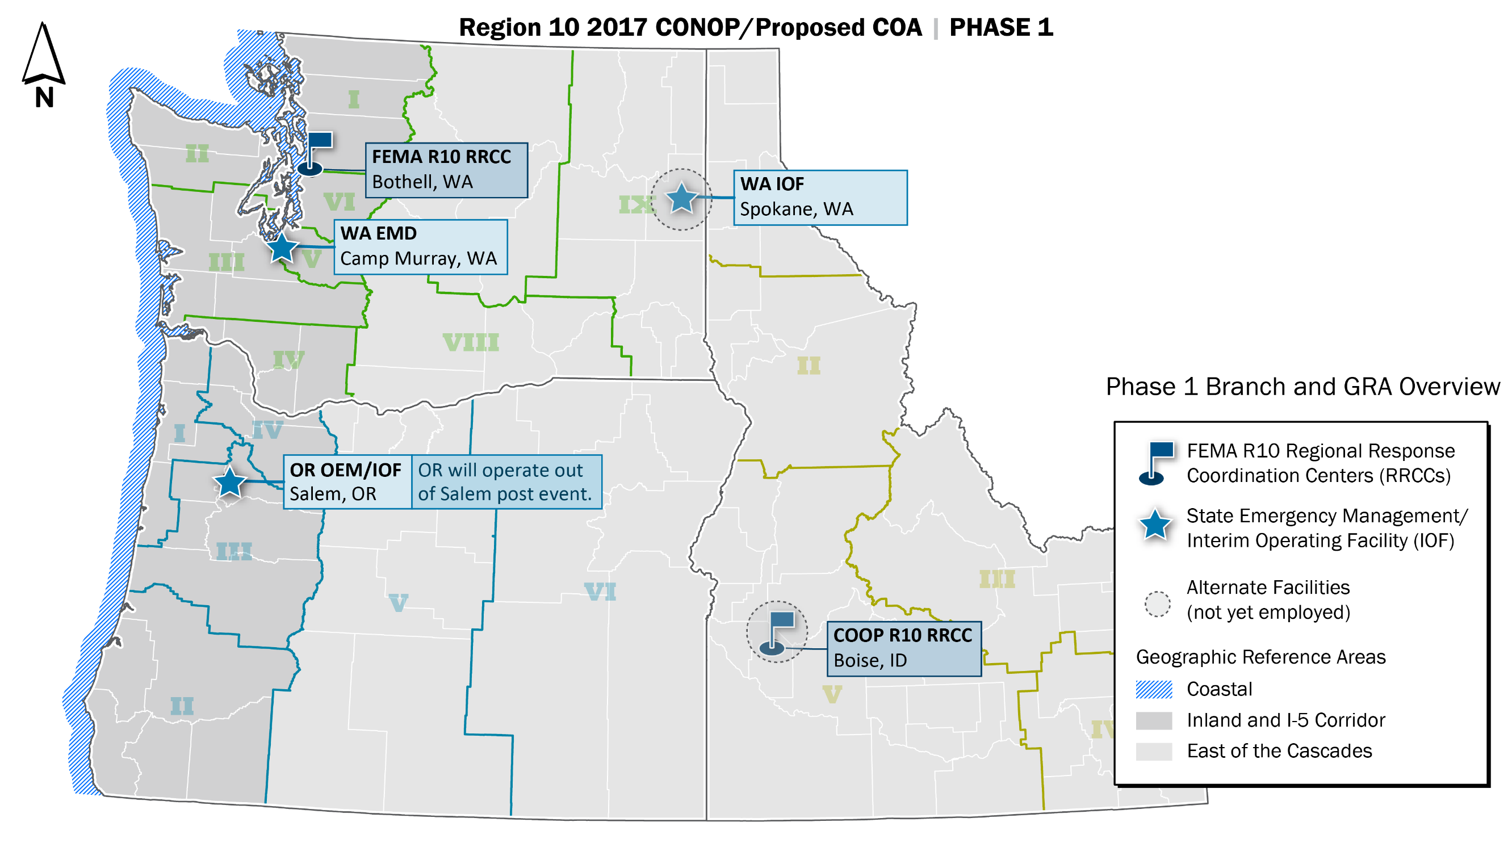
Concept of Operations – Phase 1Steady State
Notes:
Steady State and Planned COOP locations
OEM SECC is the planned IOF location
GRAs and Branches updated

Slide 29
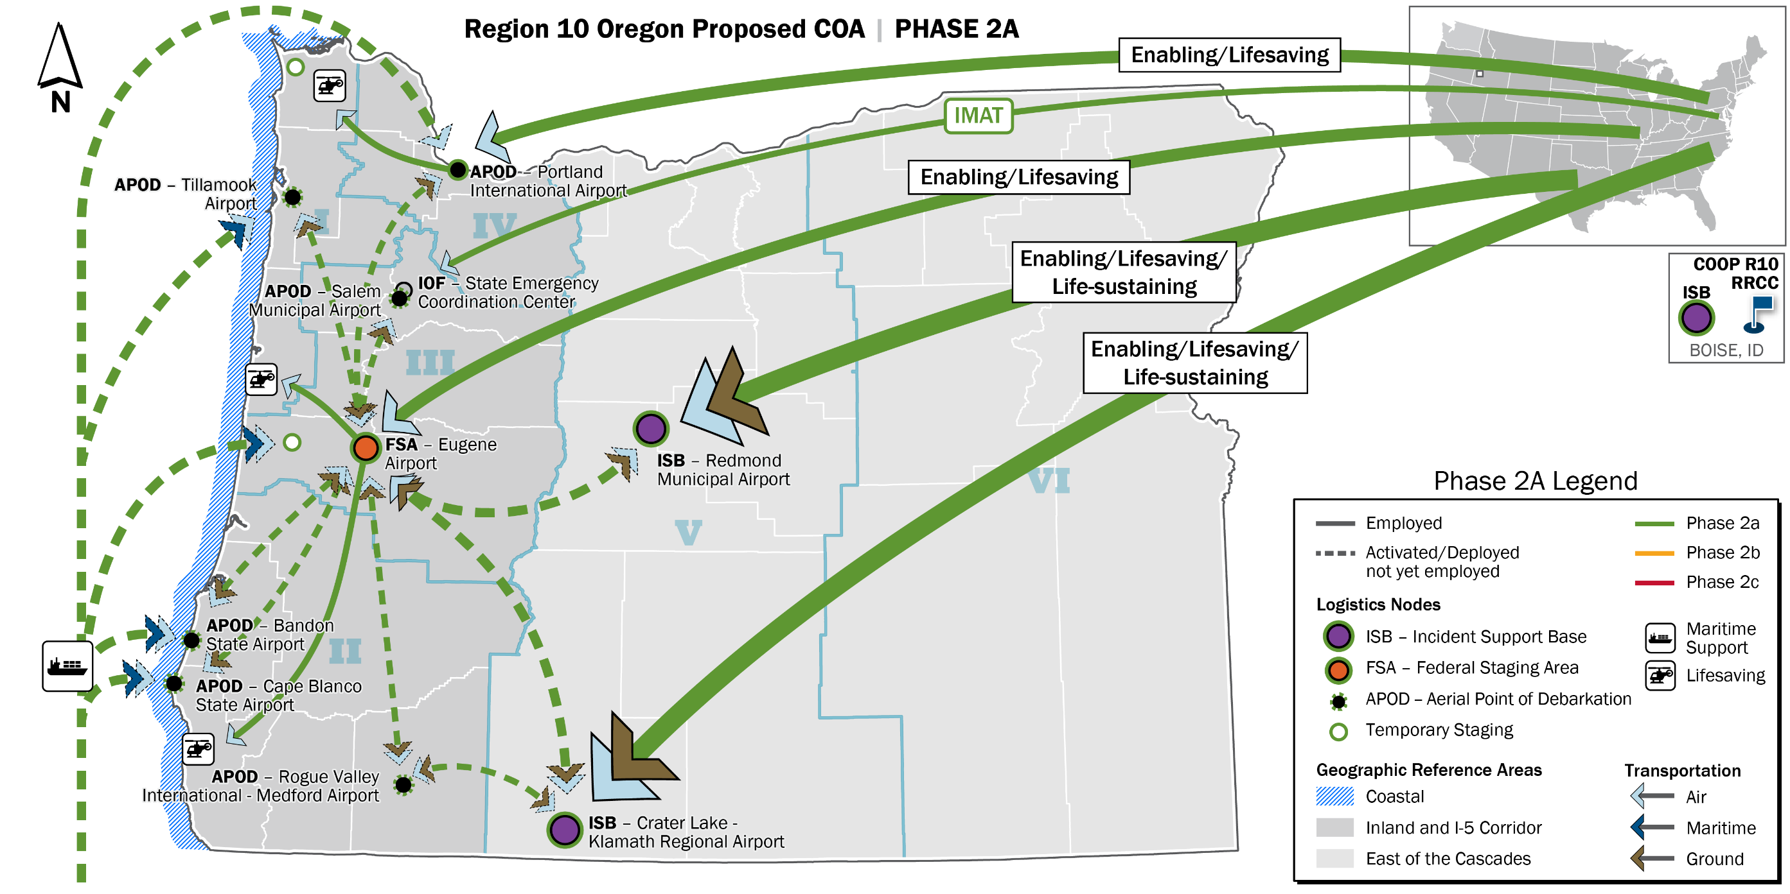
Concept of Operations – Phase 2a (OR)
Notes:
FSA in Eugene and APOD in PDX prioritized for assessment and repair to become operational (by 48-72hr mark) ISBs online almost immediately
PDX – not confident it can fully operate as an FSA due to anticipated impacts, but intend to utilize as such
ISBs – high priority, anticipate minimal damages – get up and running
Add ’l ISB in Boise, staging and force multiplier
If other APODs are able to be opened right away, will employ immediately (assumes assessed and can support staging ops)
Deploy lifesaving and enabling assets directly to the I-5/Inland GRA (FSA and PDX)
Provide lifesaving and initiate ability to stage the I-5/inland and coastal GRA
ID isolated communities, prepare to support or evacuate
Support medical and emergency evacuation to established safe areas – setting the stage for counterflow (planning is ongoing)
Employ remote sensing assets to verify anticipated damage and establish SA.
Deploy federal maritime platforms to support and expand operations
Enabling resources covered in concept of support
Phase 2a ends when the UCGs in Washington and Oregon are operational, when ISBs and FSAs for both states are established, and when the UACG (Unified Area Coordination Group) is activated

Slide 30
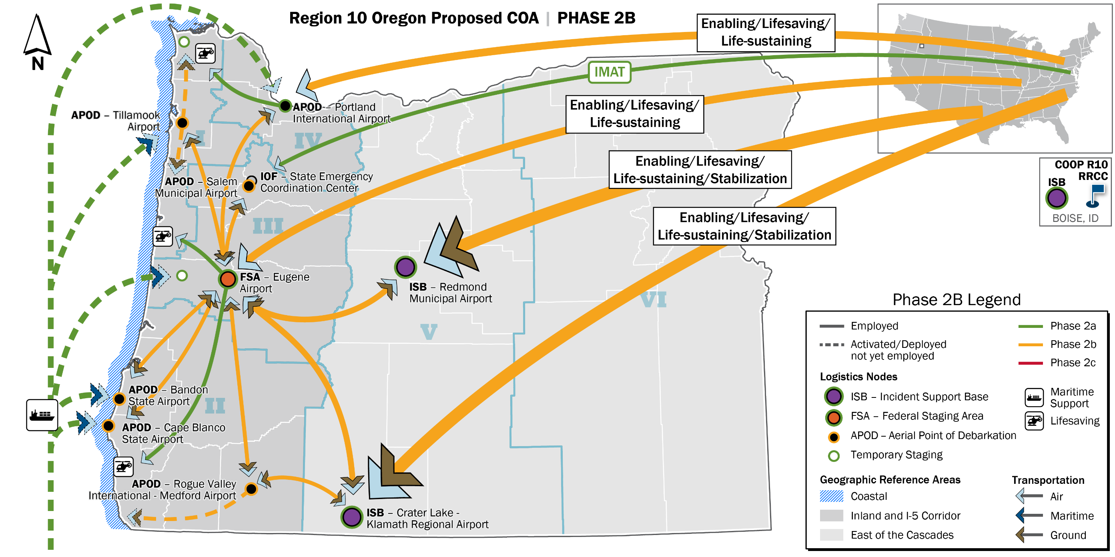
Concept of Operations – Phase 2b (OR)
Notes:
Phase 2b
APODs up - employ lifesaving/life-sustaining capabilities and resources to the Coastal GRA and Isolated Communities by air
Assess and stabilize critical logistics, transportation, communications nodes to expand response operations.
Support medical and emergency evacuation to established safe areas
Provide support to isolated communities when evacuation is not possible
ISBs can support both the FSA or APODs
Crater Lake may support Bandon, Cape Blanco, or even operations in CA
Establishing paths to support communities via temp staging
Phase 2b ends when lifesaving activities have been completed.

Slide 31
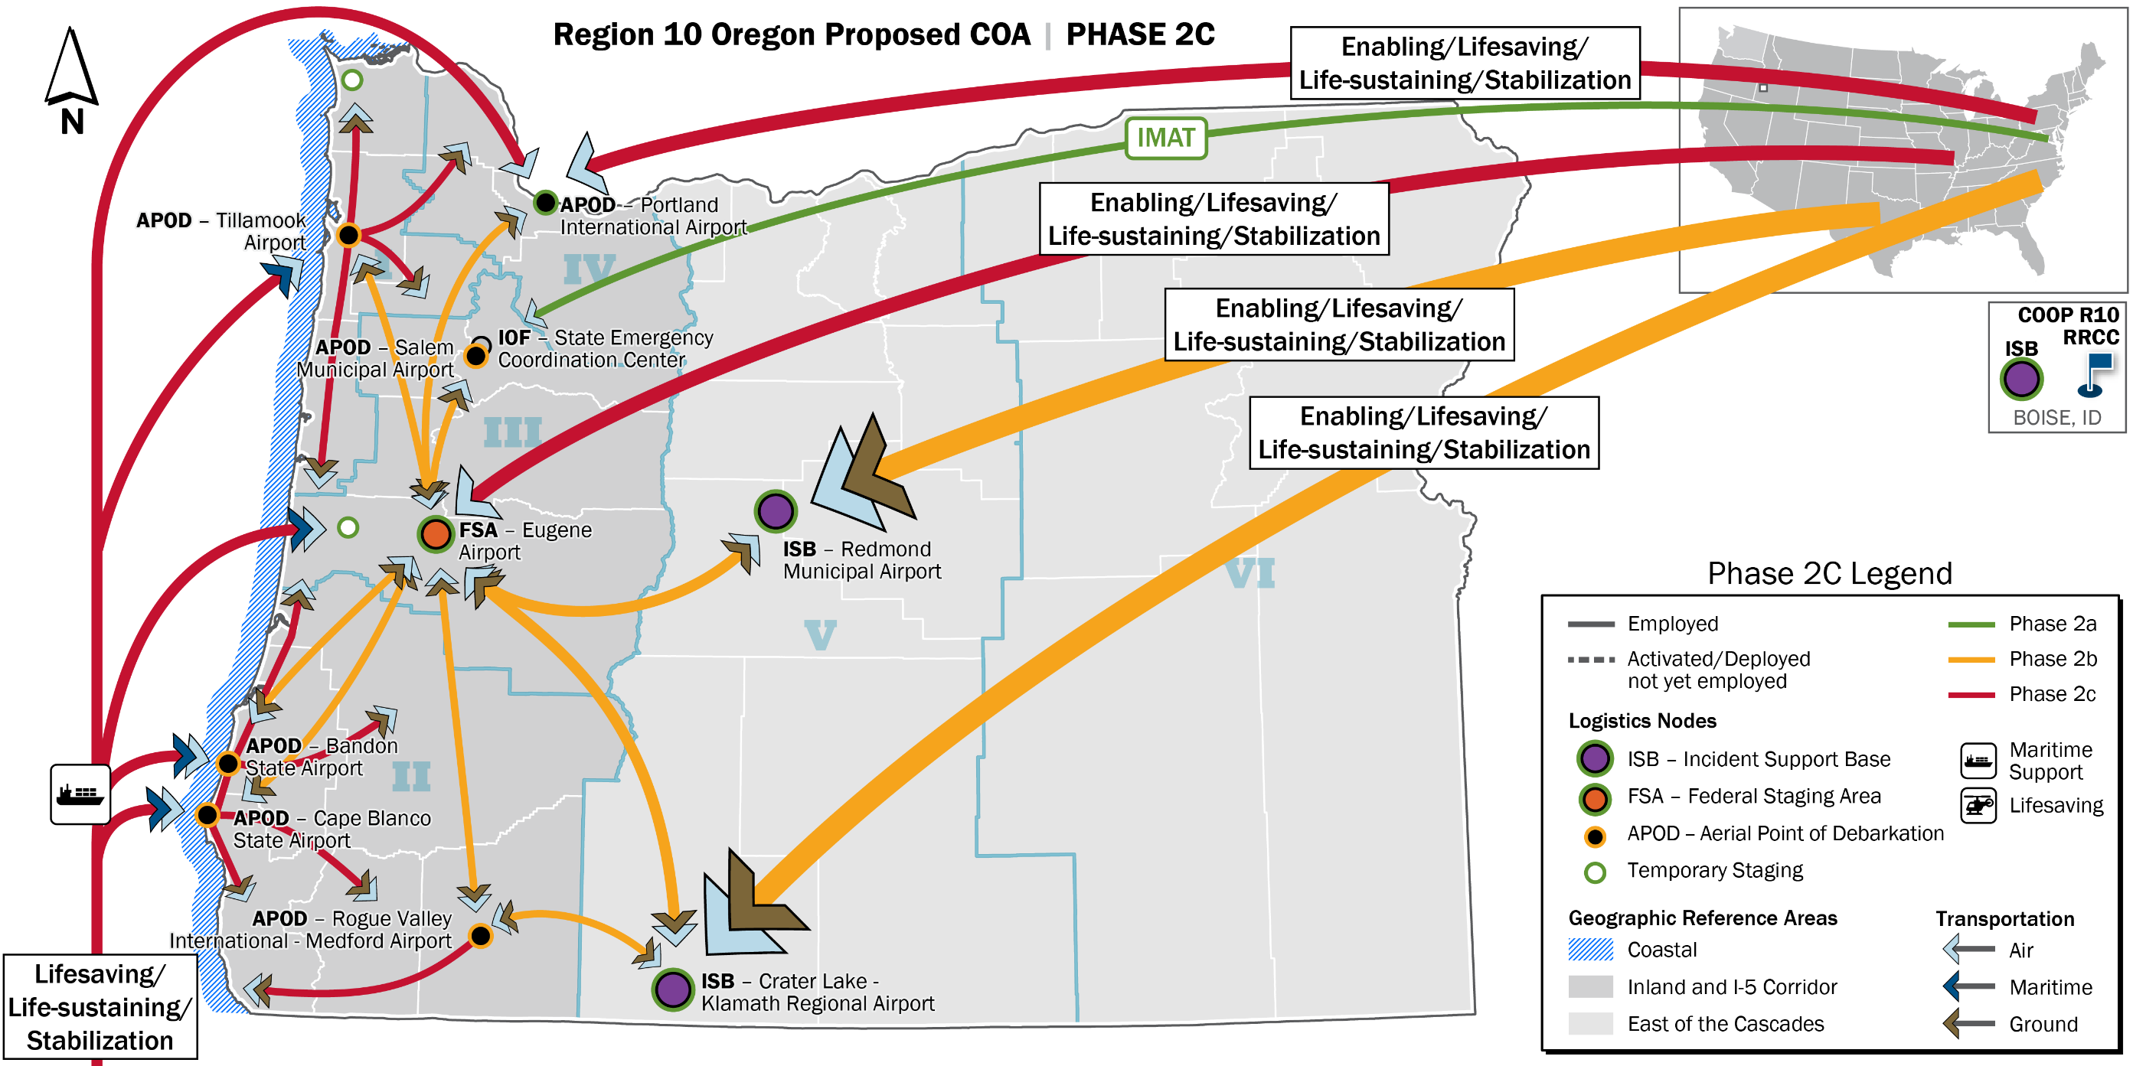
Concept of Operations – Phase 2c (OR)
Notes:
Phase 2c
General overview – red representing progression of resources coming in and/or routes established
Reaching stabilization
Now resembles hub and spoke with resources flowing from ISBs, FSA out to APODs
Maritime support fully employed
All ground routes open
Phase 2c ends when all response operations have been completed and the conditions are set for the transition to long-term recovery (stabilization sets up for recovery)

Slide 32
Concept of Support Phase 2a
Coastal
I-5/Inland
East of the Cascades
Lines of Effort
Enabling: Damage Assessment Airfield Opening Operational Communications Private Sector Coordination
Lifesaving: SAR (rotary) Evacuation (survivor/medical)
Lines of Effort
Enabling: Damage Assessment (inspection) Airfield Opening Operational Communications Emergency Route Clearance Resource Staging Responder Security Public Information and Warning Private Sector Coordination
Lifesaving: SAR (USAR teams) Medical Transportation
Lines of Effort
Enabling: Airfield Opening Operational Communications Emergency Route Clearance Temporary Power Resource Staging Responder Security Public Information and Warning Private Sector Coordination
Lifesaving: SAR Health Systems Support
Life-Sustaining: Commodity Distribution Mass Care
Temporary Staging
Temporary Evacuation POEs
FSA/APOD
Responder Lodging
Fuel Support
IOF-OR
IOF-WA
ISB/APOD
Responder Lodging
Fuel Support
Branch Operations
Branch Operations
Enabling/Lifesaving/Life-Sustaining
Enabling/Lifesaving
Enabling/Lifesaving
Notes:
Logistics Concept of Support:
FEMA employs a push-pull logistics-management strategy under the Initial Response Resources (IRR) concept, deploying lifesaving and life-sustaining resources as soon as possible after the incident. In the initial response, the priority is to connect lifesaving response teams and supplies with survivors in heavily impacted communities. IRR packages and lifesaving teams are moved to FSAs in the I-5 Corridor AO. IRR packages include meals, water, cots, blankets, infant and toddler kits, durable medical equipment (DME) kits, consumable medical supplies (CMS) kits, mobile communications office vehicles (MCOV), and generators. The Coastal AO requires deliveries of immediate life sustaining resources to identified locations until responders can reach them. , These resources include tents, tarps, water filtration, shelf-stable meals, and communications.
FEMA establishes field sites to support operations. Suitable real estate near state Emergency Operations Centers2 is identified and secured through the GSA for Initial Operating Facilities and Joint Field Offices. ISB and FSA sites are designated based on a review of sites recommended in Appendix D-1, and on initial situational awareness. Federally-owned sites are mission-assigned to serve as ISBs or FSAs. Memorandums of Agreement put in place prior to the incident are executed to establish ISBs or FSAs at non-federal sites. Accommodations for responders are established in the vicinity of ISBs and FSAs, either available hotel rooms or through the execution of the Responder Support Camp contract.
Additional field sites are established by FEMA response partners. Federal agencies establish staging areas and camps under their own authority. Field hospitals and patient evacuation and reception areas are established through the National Disaster Medical System (NDMS). State Staging Areas (SSAs), PODs, shelters, and survivor assembly points are established by the states, or with the support of FEMA and VOADS, if requested by the states.
FEMA utilizes its internal logistics capabilities (see Roles and Responsibilities) and collaborates with the Department of Defense (DOD) to meet CSZ response requirements. DOD tasks that are necessary to support CSZ logistics operations are identified in the Phases of the Operation section of this annex.
FEMA’s internal logistics capabilities include coordinating the ordering, procuring, delivering, and tracking of resources. Logistics also works with members from the whole community to acquire critical resources quickly and effectively. The goal is to support and sustain a responsive, scalable supply chain. FEMA uses a tiered-sourcing concept, identifying primary, secondary, tertiary, and quaternary suppliers for commodities commonly required to support response operations. Tier-one suppliers are FEMA organic capabilities, such as distribution centers. Tier-two suppliers are National Voluntary Organizations Active in Disaster (VOADs), such as the American Red Cross (ARC). Tier-three suppliers are other federal agencies, including the United States Army Corps of Engineers (USACE), DOD Defense Logistics Agency (DLA), and the General Services Administration (GSA). Tier-four suppliers are private sector partners. Contracts or MOAs exist with a number of tier-four suppliers (for example, ambulance and bus providers, FedEx) that can be executed immediately following a CSZ incident. All primary and secondary commodities are ordered through the LSC at the NRCC, or through private-sector entities.
Although some resources are deployed directly to the impact area, most are received by FEMA at ISBs, and then moved forward to FSAs and field sites as requested by the states. This concept of logistics support is demonstrated in Figure 28. A list of recommended ISB and FSA sites is provided in Appendix D-1. The ISB sites are all located slightly east of the Cascade Mountains. They have robust air transport capabilities, are located along major highways, and have ample space around them for Responder Support Camps (RSC) and staging areas. Following a CSZ incident, they may experience some disruptions in utility services.

Slide 33
Concept of Support Phase 2b
Coastal
I-5/Inland
East of the Cascades
Lines of Effort
Enabling: Emergency Route Clearance Resource Staging Responder Security Public Information and Warning
Lifesaving: Medical Transportation Healthcare Systems Support
Life-Sustaining: Commodities Distribution Mass Care (Food and Water) Sheltering Operations
Lines of Effort
Enabling: Debris Management Temporary Power
Lifesaving: Healthcare Systems Support
Life-Sustaining: Fatality Management Commodities Distribution Mass Care (Food and Water) Sheltering Operations Emergency Repairs or Augmentation to Infrastructure
Lines of Effort
Enabling: Debris Management
Lifesaving: Healthcare Systems Support
Life-Sustaining: Sheltering Operations Mass Care (Food and Water) Fatality Management Emergency Repairs or Augmentation to Infrastructure
Stabilization: Natural and Cultural Resources Restoration of Public Infrastructure Hazardous Waste
FSA/APOD
Responder Lodging
Branch Operations
FSA/APOD
Responder Lodging
Fuel Support
IOF-OR
IOF-WA
ISB/APOD
Responder Lodging
Fuel Support
Branch Operations
Branch Operations
Enabling/Lifesaving/Life-Sustaining/Stabilization
Enabling/Lifesaving/Life-Sustaining
Enabling/Lifesaving/Life-Sustaining

Slide 34
Concept of Support Phase 2c
Coastal
I-5/Inland
East of the Cascades
Lines of Effort
Enabling: Port Opening Debris Management Temporary Power
Life-Sustaining: Emergency Repairs or Augmentation to Infrastructure Fatality Management
Stabilization: Natural and Cultural Resources Restoration of Public Infrastructure Hazardous Waste Housing Solutions
Lines of Effort
Stabilization: Natural and Cultural Resources Restoration of Public Infrastructure Housing Solutions Hazardous Waste
Lines of Effort
Stabilization: Housing Solutions
FSA/APOD
Responder Lodging
Branch Operations
FSA/APOD
Responder Lodging
Fuel Support
IOF-OR
IOF-WA
ISB/APOD
Responder Lodging
Fuel Support
Maritime Operations
Fuel Support
Maritime Operations
Branch Operations
Branch Operations
Enabling/Lifesaving/Life-Sustaining/Stabilization
Enabling/Lifesaving/Life-Sustaining/Stabilization
Enabling/Lifesaving/Life-Sustaining/Stabilization
Notes:
Rob: Take now when briefing that Housing Solutions could mean (Temporary, transitional, alternative…etc.)….Not a fully fleshed out LOE yet but Temporary Housing didn’t quite cover all possibilities

Slide 36
Oregon Planning Needs/Gaps
Integration with FEMA Lifelines concept
Identification of State Staging Areas (SSA)
Evacuation planning criteria
ECC staffing levels
Alternate State ECC activation planning and readiness
Process for identifying operational priorities
Identification of primary/alternate State JIC
Incorporation of Transportation RRAP data
State COOP planning expansion

Slide 37
Questions

Slide 38
Further Information
Bill Martin
Catastrophic & Homeland Security Planner
Oregon Office of Emergency Management
Bill.martin@state.or.us
(971) 719-0841
Thank You!

