Slide 1
Pediatric Integrated Behavioral Health Models
CTC-RI Annual Conference| October 5, 2023

Slide 2
Agenda
Presenter/Topic | Time
Welcome Moderator: Cynthia Loncar, PhD, The Warren Alpert Medical School of Brown University | 5 minutes
Building Resilient Families by Incorporating a Family Strengths Assessment Visit into the Periodicity Schedule Allison W. Brindle, MD, FAAP, Associate Professor, Pediatrics, Clinician Educator, Hasbro Children’s Hospital | 20 minutes
TEAMUp for Children Anita Morris, MSN, FNP-BC, Project Director for TEAM UP for Children, Director of Research Strategy & Process Improvement for Boston Medical Center Health System. | 25 minutes
DULCE Swanette Salazar, CHW, Family Services of RI | 15 minutes

Slide 3

CTC-RI Conflict of Interest Statement
If CME credits are offered, all relevant financial relationships of those on the session planning committee have been disclosed and, if necessary, mitigated.
The AAFP has reviewed ‘Advancing Comprehensive Primary Care Through Improving Care Delivery Design and Community Health,’ and deemed it acceptable for AAFP credit. Term of approval is from 03/18/2022 to 03/18/2023. Physicians should claim only the credit commensurate with the extent of their participation in the activity. NPs and RNs can also receive credit through AAFP’s partnership with the American Nurses Credentialing Center (ANCC) and the American Academy of Nurse Practitioners Certification Board (AANPCB).

Slide 4
Objectives
Understanding Integrated Behavioral Health: Gain insight into the significance of Integrated Behavioral Health in pediatric care and its role in enhancing child and family well-being.
Family Strengths Assessment: Learn how to incorporate a Family Strengths Assessment Visit into the Periodicity Schedule to identify and harness family strengths for resilience building.
TeamUp Model for Children: Explore the TeamUp model's effectiveness in providing collaborative, multidisciplinary support for children with behavioral health concerns, fostering improved outcomes.
DULCE: To learn about an evidence-based model to embed family specialists into pediatric primary care to support families with infants newborn-6months
By the end of this presentation, participants will be equipped with the knowledge and tools to embrace integrated behavioral health models, assess family strengths effectively, and understand the TeamUp model's role in supporting children. This knowledge will contribute to the enhancement of pediatric care and the promotion of resilient, thriving families.

Slide 5
Cynthia Loncar, PhD
Associate Professor of Pediatrics & Psychiatry and Human Behavior
Brown Center for the Study of Children at Risk
Warren Alpert Medical School of Brown University

Slide 6




Why Early Matters

Slide 7

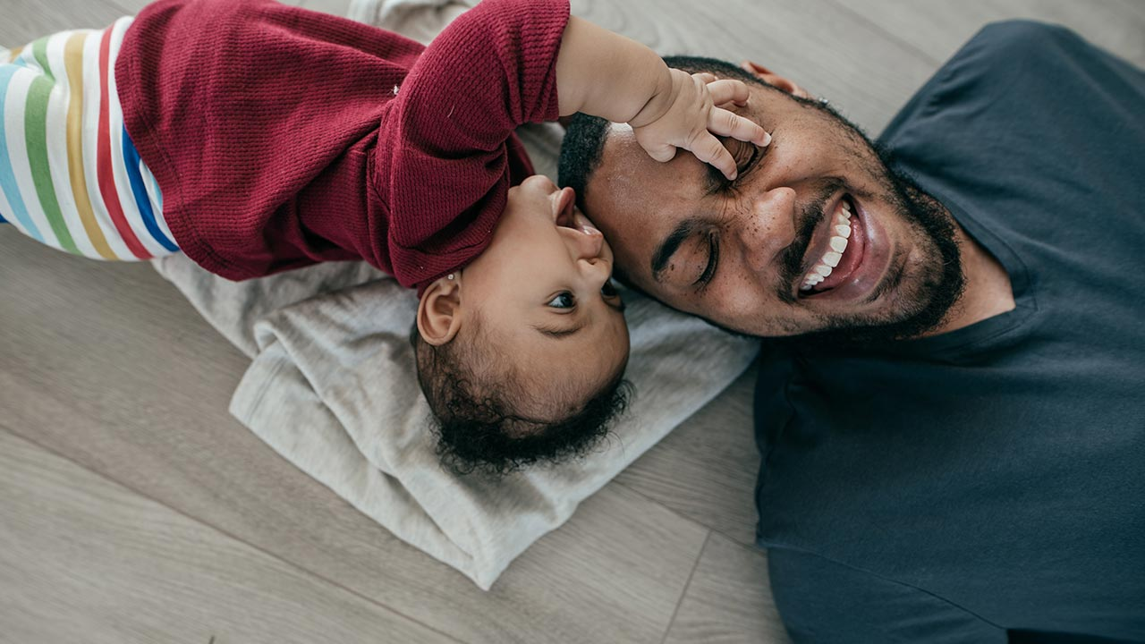







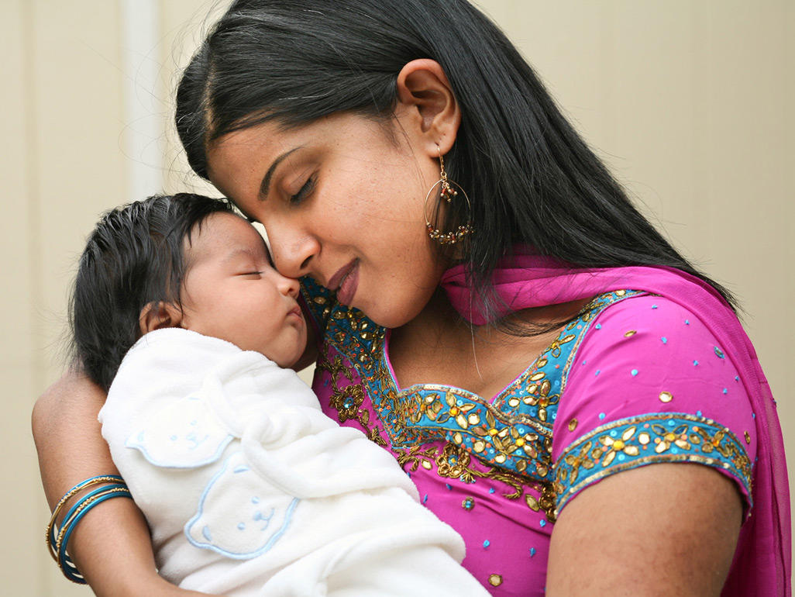
Infants develop in an environment of relationships

Slide 8
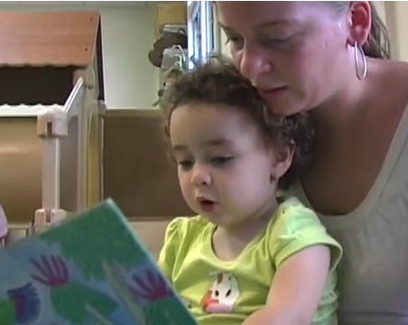
Early Relationships Matter
All children are wired to form
relationships—they can’t help it
Infants/toddlers depend on
supportive relationships with
primary caregivers for healthy
development in all domains
A baby remembers earliest relationship experiences

Slide 9
Early Relationships Matter
Relationship interactions shape the architecture of the developing brain (Neurons to Neighborhoods, 2000)
“Serve and Return” interactions promote child AND parent wellbeing:
  Child’s experience of being important in the relationship
  Child’s trust/anticipation of caregiver’s responses
  Parent’s experience of being effective in the relationship and improve self-esteem and efficacy
  Parent’s perceptions of the infant as predictable or knowable
The Science of Early Childhood Development (2007). National Scientific Council on the Developing Child. http://www.developingchild.net; “From Neurons to Neighborhoods” (2000)

Slide 10
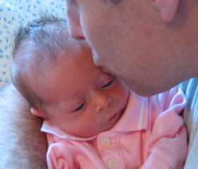
What is Infant/Early Childhood Mental Health?
Infant/early childhood mental health involves the developing capacity of the young child to experience, regulate, and express emotions; form close and secure interpersonal relationships; explore and act on the environment and learn, all in the context of cultural expectations
(Parlakian & Seibel, 2002)

Slide 11

Infant and Early Childhood Mental Health – Core Ideas
Promotion of health and prevention of problems
Keeping the Baby’s experience at the center
Focusing on families’ strengths & building parents’ confidence
Focusing on Diversity Informed Practice
Selma Fraiberg, (1975) ; Handbook of Infant Mental Health, (2019); Irving Harris Foundation (2018)

Slide 12
WHY Early Matters
Strength
Focused
Trust Building
Relational Health
Community Partners
Universal Health Promotion
Address Racial Inequities
Integrated Behavioral Health in Pediatric Care

Slide 13
Building Resilient Families by Incorporating a Family Strengths Assessment Visit into the Periodicity Schedule
Allison W. Brindle, MD, FAAP
Associate Professor, Pediatrics, Clinician Educator
Hasbro Children’s Hospital
October 5, 2023

Slide 14
Disclosures
This project is funded by the American Academy of Pediatrics Healthy People 2030 Grant
I have no personal financial disclosures

Slide 15
Teamwork Makes the Dream Work
Pat Flanagan, MD, FAAP
Jennifer Mann, MPH
Susanne Campbell, RN, MS
Members of the CTC-RI Team
Family and Physician Co-Designers

Slide 16
Objectives
Identify the unique strengths of families and their children early
Promote a positive, family centered relationship between the family and the patient centered medical home
Elevate the power of early relational health in building lifelong resilience

Slide 17
Background
Families/Caregivers and Pediatricians follow the Periodicity Schedule for routine Health Maintenance Visits
  Newborn
  2-week
  1-month
  2 month
  4 month
  6 month
  9 month
  12 month
  https://downloads.aap.org/AAP/PDF/periodicity_schedule.pdf. Downloaded 9/3/2023
  Bright Futures Guidelines (Hagan JF, Shaw JS, Duncan PM, eds. Bright Futures: Guidelines for Health Supervision of Infants, Children and Adolescents. 4th ed. American Academy of Pediatrics; 2017

Slide 18
Screenings Completed
Edinburgh Post-Natal Depression Scale
Social Determinants of Health
Food Insecurity
Housing Insecurity
Parental tobacco, alcohol and other substance use
All Important, but. . .

Slide 19
Screenings Completed
Deficit focus
Need trust building first

Slide 20
Toxic Stress
AAP Policy Statement 2012
  Early Childhood Adversity, Toxic Stress and the Role of the Pediatrician: Translating Developmental Science Into Lifelong Health (Pediatrics. 2012;129:e224-e231)
AAP Policy Statement 2021
  Preventing Childhood Toxic Stress: Partnering With Families and Communities to Promote Relational Health (Pediatrics. 2021;148(2):e2021052582)

Slide 21
Project Proposal
Offer a visit early in the periodicity schedule
Focus the visit on the family’s strengths, their community, their visit
Co-design the visit with families and providers
Pilot the visit with 50 families
  25: primarily commercial insurance
  25: primarily state insurance
Measure the satisfaction of the family and the provider

Slide 22
Visit Co-Design
Meeting with family partners
Family Visiting Council – 9/21/2022
Family Voices – English Language – 10/13/2022
DULCE Planning Committee – 10/28/2022
Family Voices – Spanish Language – 11/30/2022
Themes:
  Parents and families love their pediatrician
  Visits are too short
  Additional support is needed: schools, navigating systems
  Communication should be clear
  Build trust over time
  Avoid checklists
  Surveys should have a clear purpose
  Pros/Cons for different team members completing the visit.

Slide 23
Visit Co-Design
East Greenwich Pediatrics
  Karen Maule, MD, FAAP
  Peter Pogacar, MD, FAAP
Hasbro Children’s Hospital
  Jennifer Friedman, MD, PhD
  Kathleen Hughes, NP

Slide 24
Visit Activities
Explain the importance of early relationships in fostering lifelong resilience in children, and in buffering childhood adversity
  Ability to be present, nurturing, stable and dependable
  Engage in “serve and return” behavior with infant
  Gain joy from being with the baby
  Understand/have realistic expectations of child development
  Help baby with self-regulation, co-regulation, “hold” baby’s emotion
  As baby grows, help them name emotions, feelings
  As parents, learn to recognize, name, and manage feelings
Draw the Family ECO Map/ explain why you are interested in understanding the family
Review Modified Protective Factors Survey
Offer resources
Ask for questions
Review how to reach the practice
Provide brief anticipatory guidance
Thank them for sharing
Request feedback survey/give gift card

Slide 25
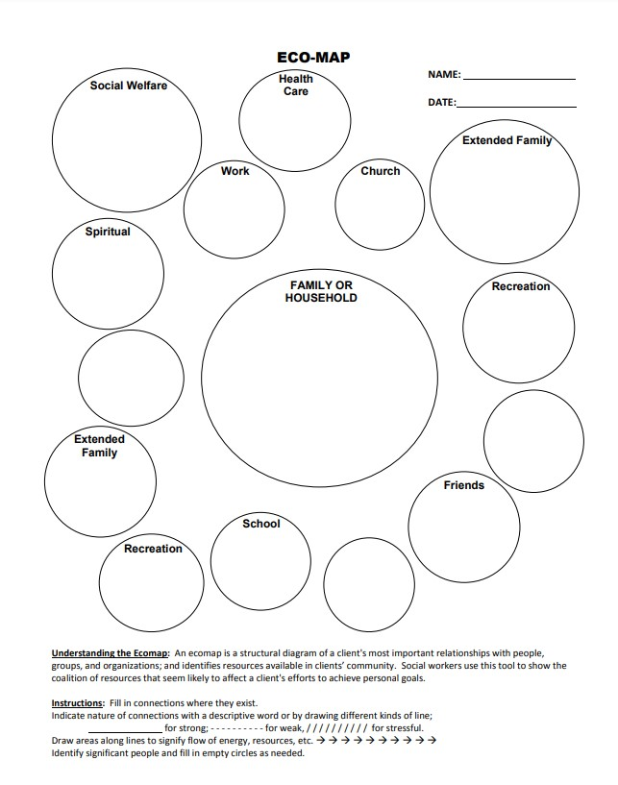
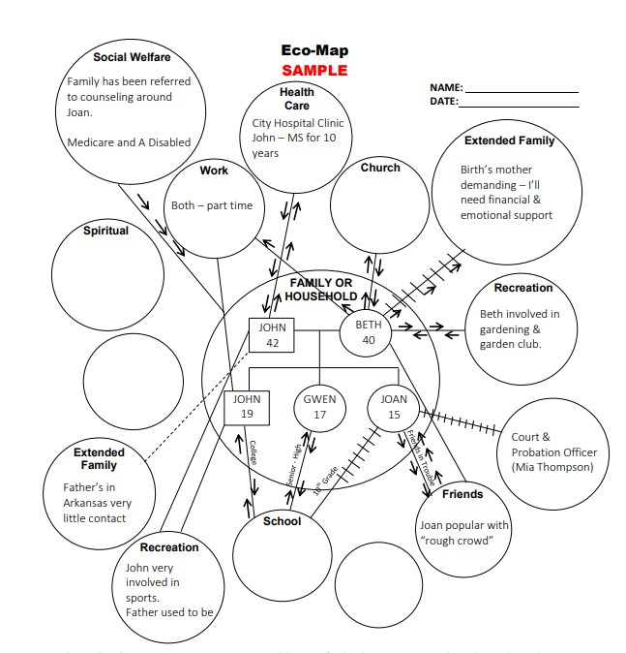
Eco Map

Slide 26
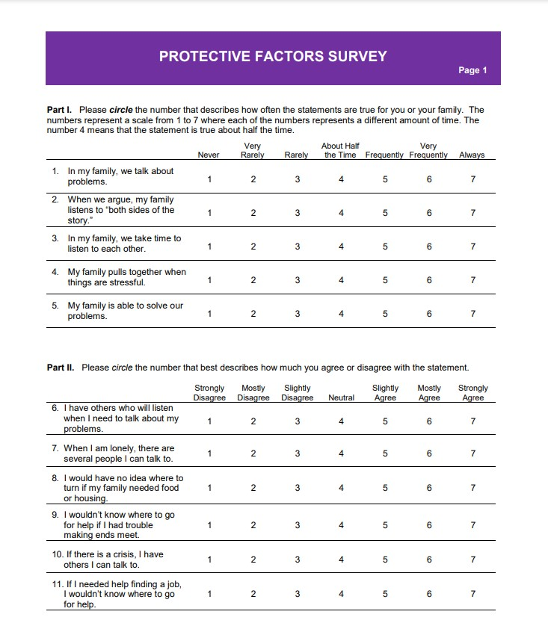
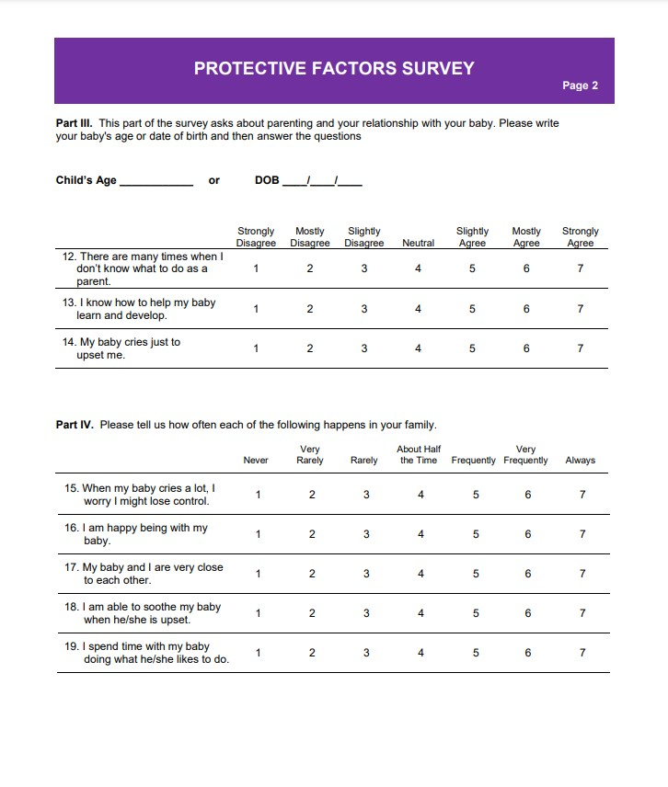
Modified Protective Factors Survey

Slide 27
To Date:
East Greenwich Pediatrics: Has started visits
Hasbro Primary Care: IRB Review/Revisions

Slide 28
Questions
I hear your laugh and look up smiling at you
  -Taylor Swift, The Best Day (Taylor’s Version), Fearless (Taylor’s Version)

Slide 29
October 2023

Slide 30









TEAM UP At a Glance
TEAM UP is an 8-year, $22M initiative to build the capacity of pediatric primary care to deliver high-quality, evidence-based integrated behavioral health care.
40,000
Children served annually
375+
Integrated workforce
trained
7+
Health centers & emerging partnerships
Our focus is Federally Qualified Health Centers.
TEAM UP is a sustainable, adaptable, and replicable model that strengthens pediatric primary care for all.
74% 37% 67%
At or below 100% of the federal poverty level
Racial and/or ethnic
minority patients
Best served in a language other than English

Slide 31

Emerging Partnerships
TPEC: Transforming Pediatrics for Early Childhood Partnership with Massachusetts Department of Public Health; HRSA-funded Initiative
Increasing Pediatric Integrated Behavioral Health Capacity Using
Community Health Workers

Slide 32
TEAM UP’s Aim and Mission Statement
TEAM UP for Children is grounded in the belief that access to services to promote behavioral health and family strengthening is a social justice issue.
The Initiative seeks to meet the needs of community members that have experienced multiple challenges in their home countries or local communities, from trauma and racism to poverty and violence.
It builds upon the strength of community health centers as anchoring, culturally competent institutions that share this mission, and that have come together to develop a sustainable, adaptable, and replicable model of integrated health care.
TEAM UP Mission Statement
To promote positive child health and wellbeing through innovation and consistent delivery of evidence-informed integrated behavioral health care
Our Aim

Slide 33
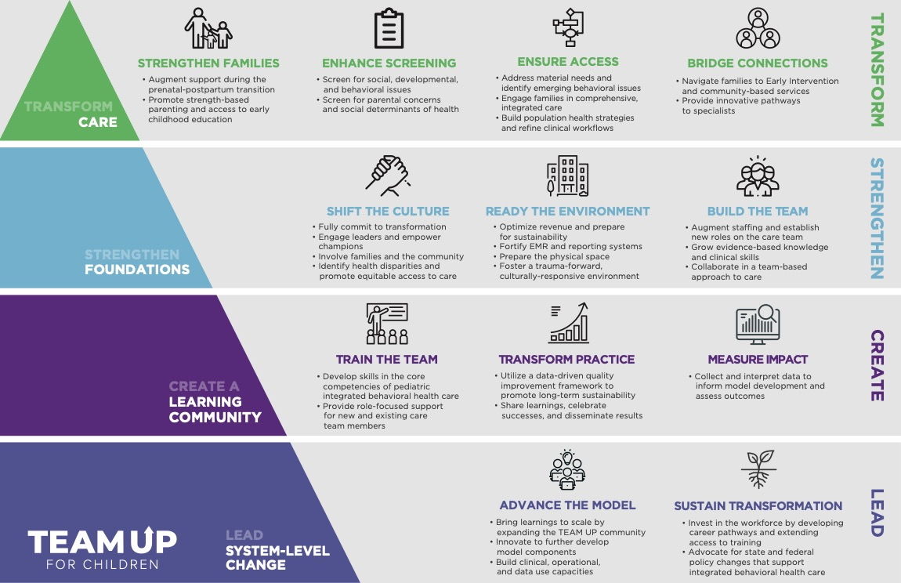
The TEAM UP model has been co-created with our partners and is ready for scale.
The model focuses on promotion, prevention, early identification of emerging BH issues, and swift access to BH care.
Services are delivered by a team of BH clinicians, community health workers, and primary care providers.
  TEAM UP is an exemplar in pediatric integrated care. Our goal is to be a leader in system-level change by:
  Advancing the model through scaling TEAM UP and creating new ways to access TEAM UP content, and
  Sustaining the transformation through investment in the BH workforce and policy changes that support integrated care.

Slide 34
IECMH within the Transformation Model
Families initiate care with the integrated team, often on the same day as their primary care appointment; EC-focused BHCs and CHW/FPs to support unique needs
Screening at all WCVs using the SWYC in early childhood
Universal newborn touch introduces the integrated team and provides healthy parenting support
CHW/FPs provide navigation support to close the loop on referrals with Early Intervention and other external resources
Support for infrastructure development, e.g., space for observation, implementation of new preventive BH services
Programming to engage and develop organizational champions and promote IECMH within primary care
Evidence-informed clinical pathways optimize a team-based approach to BH care; particular focus on EC skills
Foundational knowledge and skills for EC, advanced practice opportunities for EC-specialized staff
Technical assistance to support the development and implementation of IECMH-specific workflows
Advocate for policies that support IBH & IECMH

Slide 35
Core TEAM UP Workflows
Model Component | Clinical Workflow | Sequencing
Strengthen Families & Promote Healthy Development | Prenatal-Postpartum Transition Support
 | Universal Touch: Newborn & School-Entry
Enhance Screening for BH & Social Needs | Enhanced Universal Screening
Provide Access to Integrated Behavioral Health Care | Warm Hand-off to BHC
 | Warm Hand-off to CHW/FP
 | PCP BH Plan
 | BHC BH Plan
 | CHW/FP BH Plan
 | Clinical Pathways for Special Populations
Bridge Connections to Specialty Services | Early Intervention (EI) Tracking
 | Access to Specialty Care
1st | 2nd | Throughout
Notes:
Introduce workflows that are most applicable to adolescents and where there’s been a change via telehealth
Start with WHO workflows for all ages
Screening and symptom tracking protocols within BHC visit – challenges and technologies with telehealth
Need to focus on concerns arising for adolescents – depression, anxiety – through development of clinical pathways that include telehealth options
Specialty care – connection to psychiatry in particular and the ways telehealth has improved that connection

Slide 36
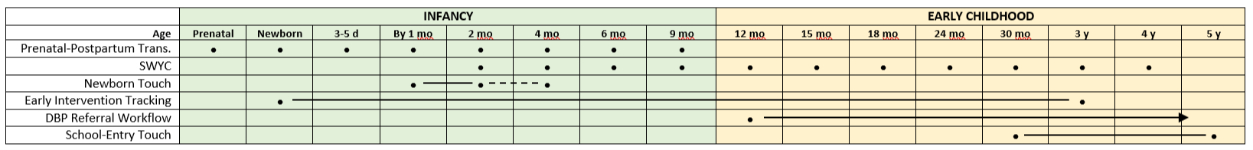
IECMH-Specific Workflows
Workflow development and implementation is supported through:
  Twice monthly health center-based practice transformation meetings
  Monthly Steering Committee meetings
  Quarterly Operations & Revenue Optimization Workgroup meetings
  Data-driven quality improvement sessions with each Pediatrics Dept.
  Facilitated mentorship and shared learning across a number of forums
Notes:
Goal to address the presenting challenges in adolescents, in response to national trends, TEAM UP data, anecdotal evidence from CHCs – supporting each member of the team to work at the top of their license, increasing knowledge and skills for how to address these needs in pediatrics, and supporting the workflow development

Slide 37
Learning Community Model
Identify need for adaptation
Document core principles & components
Monitor for additional need for adaptation
Adapt model, implement
The Learning Community is co-developed with TEAM UP health centers
All components evolve and are responsive to the needs, feedback, and ideas of our partners
Theoretical approaches are driven by the populations and contexts of each health center
Trauma-informed care & organizational structure
Cultural adaptation
Adaptations for primary care

Slide 38
Clinical Training Syllabus
Role-focused Training
E-Course Training
Mental Health Foundations
Team-based Approach through Case Based Learning
Organizational Training
CHW/FPs
Case Consultation
Trauma-informed Environment
Supervisor Consultation
Supplemental Training
Role-focused Skills and Core Competencies
Racial Equity in Health Care
Special Topics Forums
Self-care Sessions
Core Clinical Skills (MI, Problem Solving, Caregiver Engagement)
BHCs
Transdiagnostic Approaches
PCPs
Case-based Collaborative Office Rounds
Individual consults
Peer learning
Complementary Medicine Approaches
Early Childhood Alliance

Slide 39
Early Childhood Alliance
Goal: Build clinical capacity for IECMH care within each health center, beyond standard training approach
Who: EC-focused BHCs and CHW/FPs (aka EC Champions), supervisors, others as interested
What: Case-based learning, using a reflective, relational, trauma-informed, and culturally responsive lens
Additional Considerations: Support for IECMH Endorsement, sustainability of IECMH capacity within the health centers

Slide 40
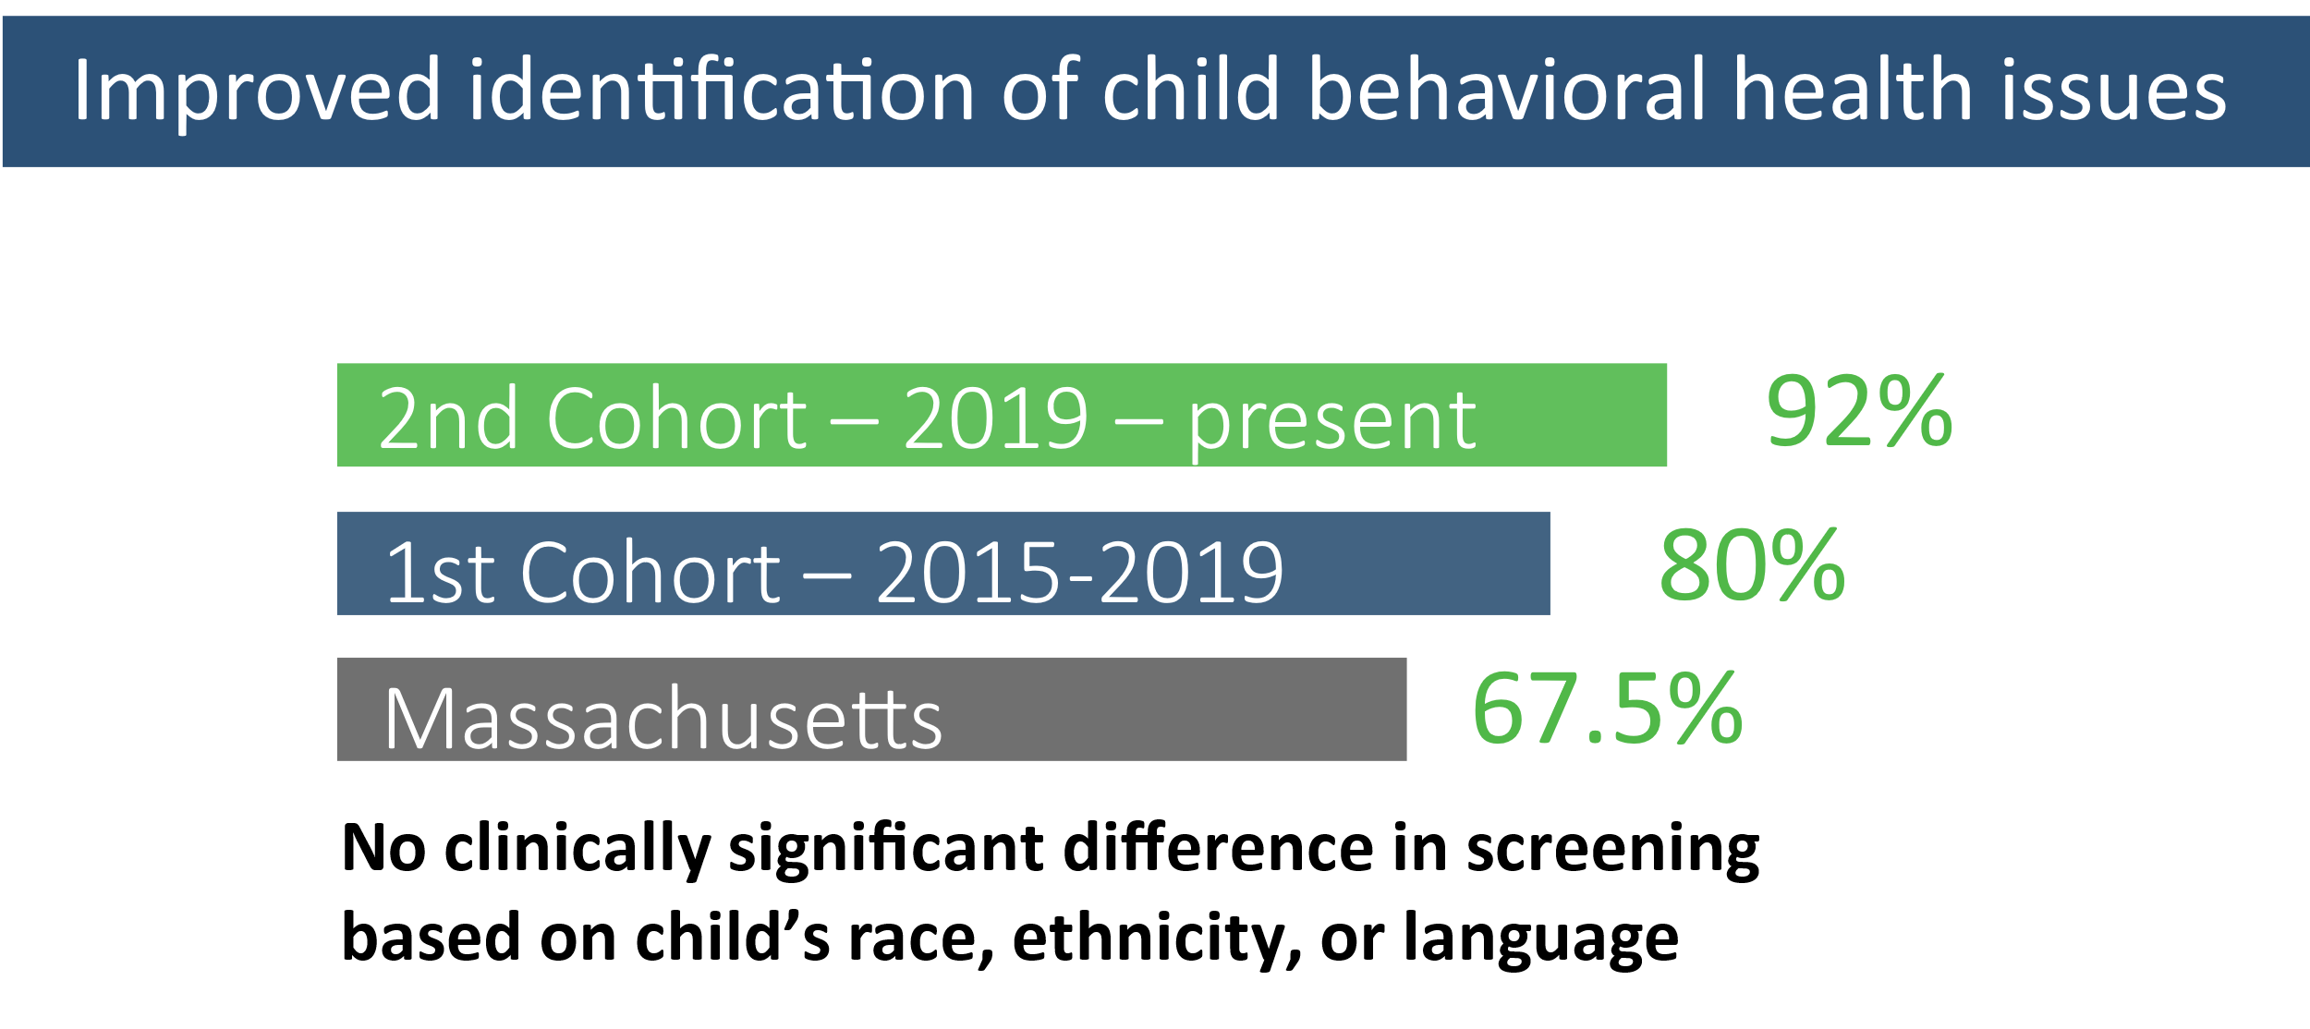
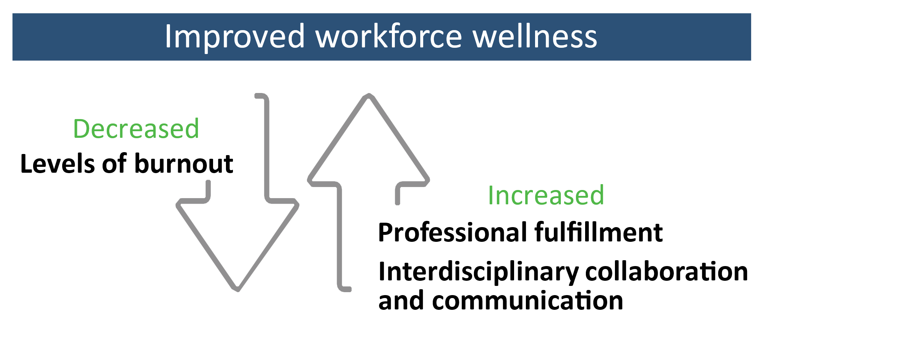
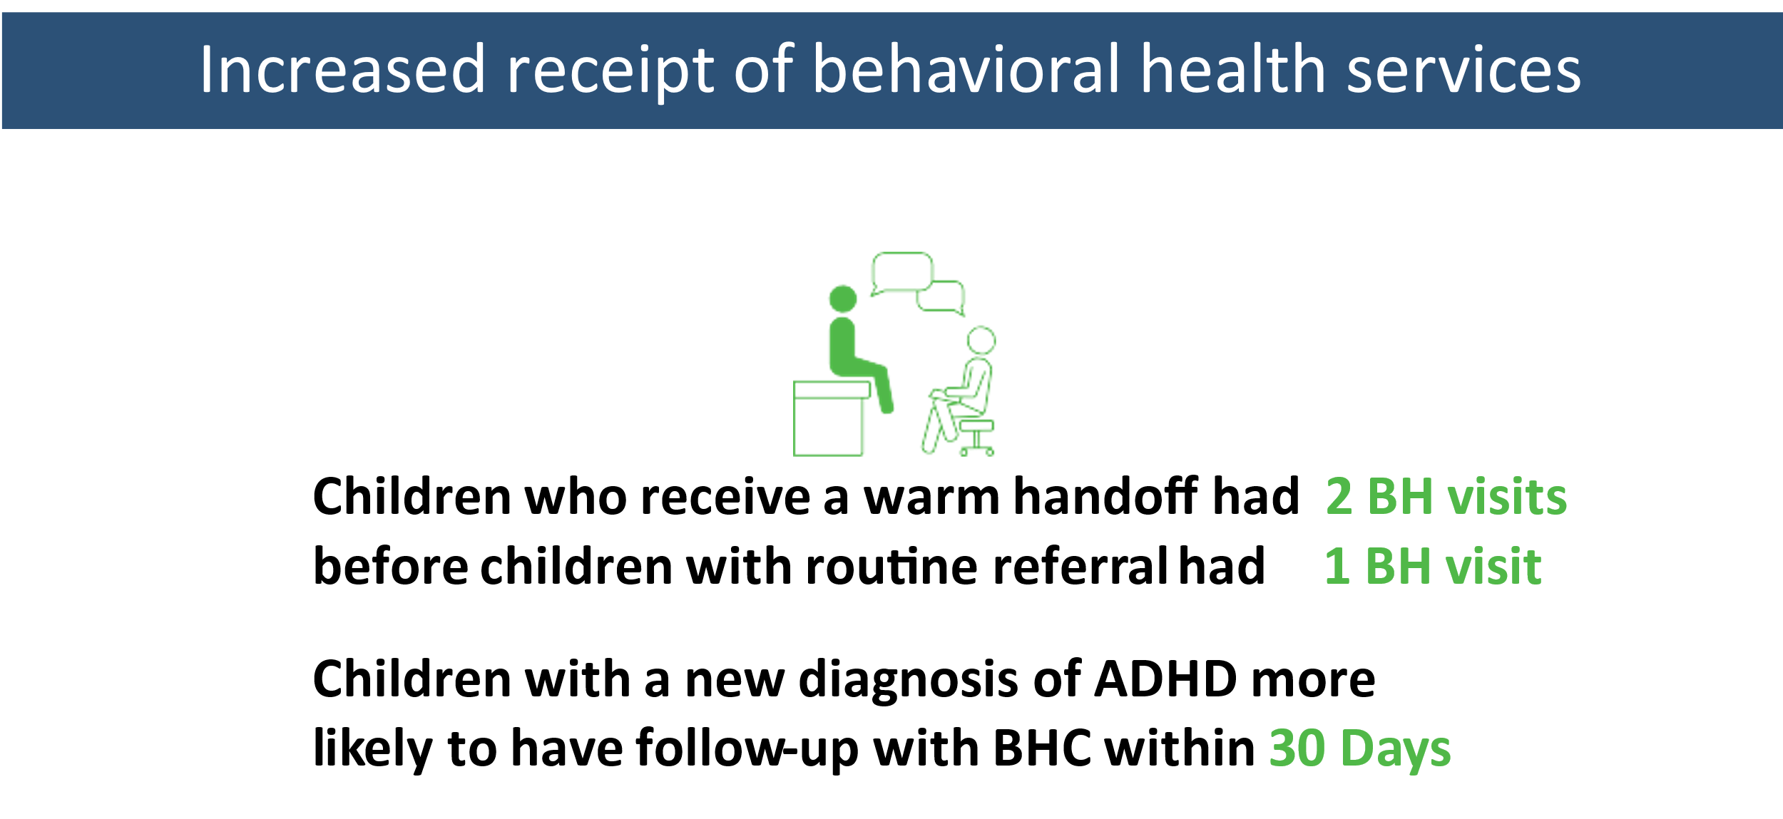
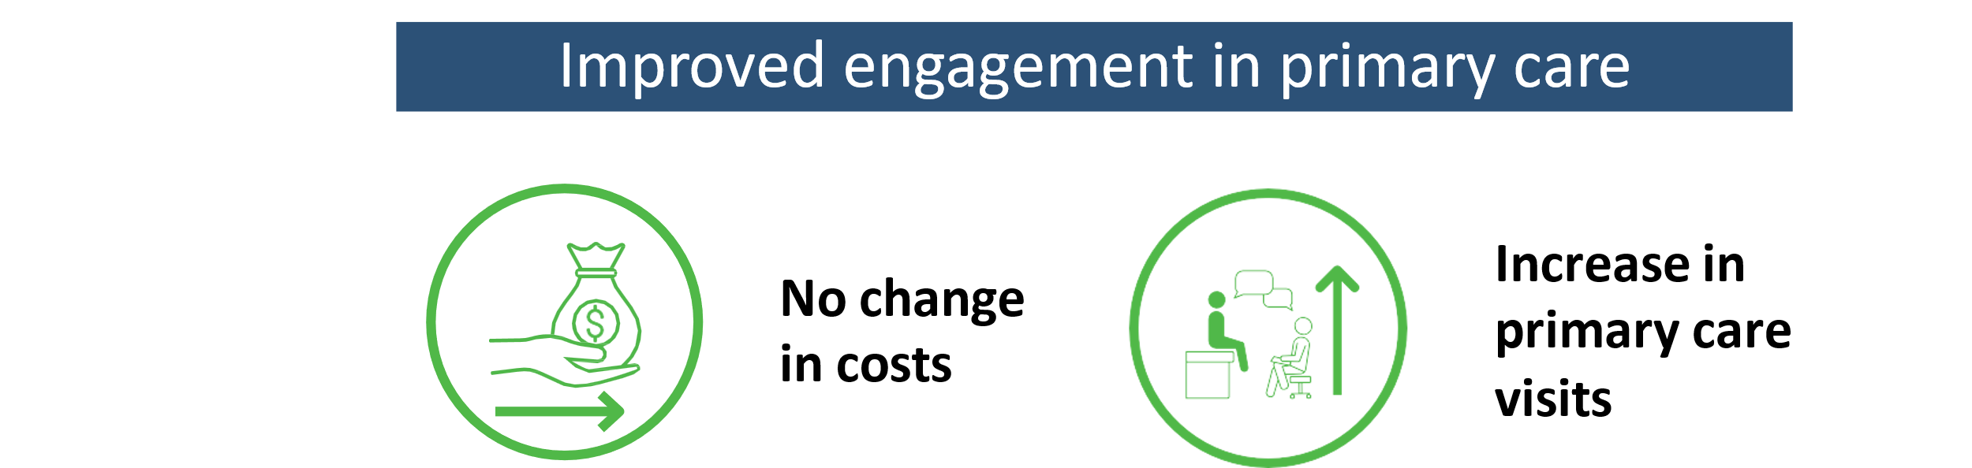
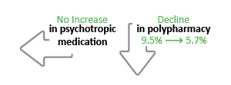
TEAM UP’s Impact: Better Outcomes for Children & Families, the Workforce, and
System-wide Utilization
Improved child outcomes

Slide 41








TEAM UP thanks our funding and health center partners.
All activities within the TEAM UP for Children initiative are made possible through the contributions of the TEAM UP partners. Funding for the TEAM UP for Children initiative is provided by the Richard and Susan Smith Family Foundation and The Klarman Family Foundation.
FUNDERS
IMPLEMENTATION AND EVALUATION PARTNER
HEALTH CENTERS

Slide 42



Slide 43
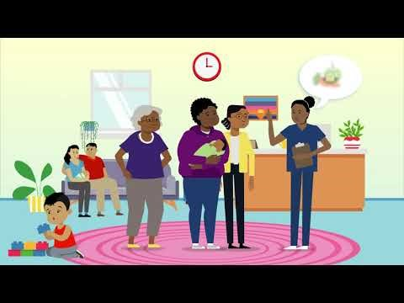
WHAT IS DULCE?
https://www.youtube.com/watch?v=FqL_wntsmSE

Slide 44
WHAT IS DULCE?
Developmental Understanding &
Legal Collaboration
For Everyone
Mission Statement
Through the collaborative efforts of early childhood, health, and legal systems, DULCE transforms the way families with infants experience the delivery of support and services. To do this, we employ a cross-sector, team-based model that proactively supports the health of families with infants in communities that are under-resources and have been marginalized by racist systems.

Slide 45


WORKING TOWARDS AN
ANTI-RACIST COMMUNITY
As a part of CSSP, DULCE is also on the journey with others in RI to work toward a just society in which all children and families will thrive, while also recognizing the social effects of racism.
Omitting a racial analysis from any work enables racist systems, laws, and policies to continue operating with the status quo.

Slide 46
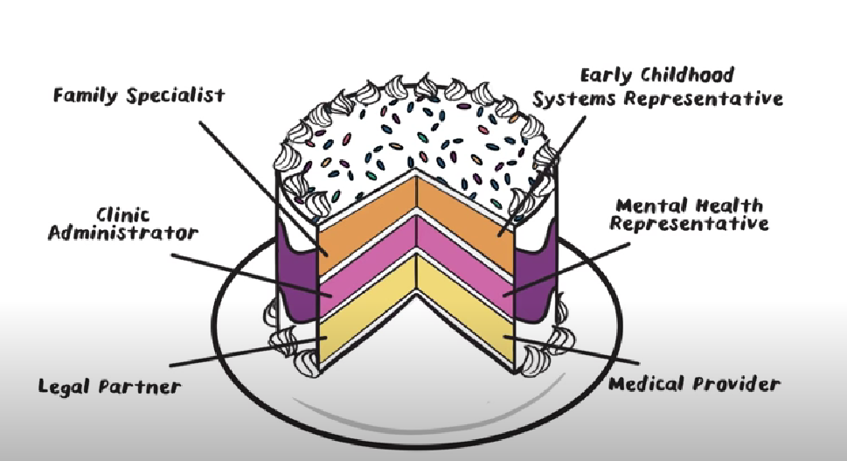
THE INGREDIENTS
Notes:
Each person have their own skills and expertise. Together, we are better. The team meets weekly to holistically problem solve a families complex needs. They not only help families on the individual level

Slide 47
HOW IT WORKS
First 4 well-child visits: screening for maternal depression and barriers to concrete supports, touchpoints-informed focus on the baby’s developing temperament, personality, anticipatory guidance and related parent coaching.
6-month visit: wrap-up to the intervention, transition plan implementation to assure ongoing support within the family-centered medical home.
Weekly interdisciplinary case review: assures all positive screens are addressed on ongoing basis.
Leveraging of legal partnerships throughout: to help families overcome barriers to concrete supports (including rapid response representation).
Continuous Quality Improvement: to monitor implementation and allow data-based adaptation to local environments.

Slide 48
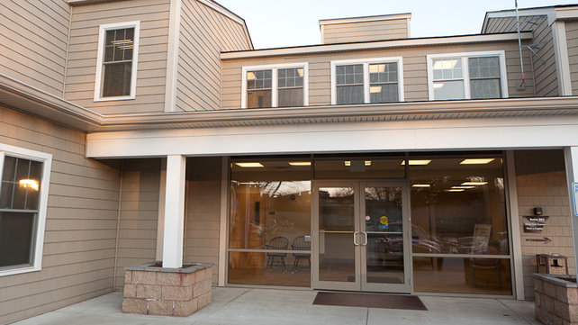

Local rock stars
Coastal Toll Gate Pediatrics
Care New England Family
Care Center
A postpartum mother commented:
“I never thought that a pediatrician's office could provide support for me and be so resourceful, I thought this office really only focused on my baby, my family and I are so thankful for the conversations I have had with you (family specialist)."
Over 150 families enrolled in DULCE in RI, including pregnant woman in their 3rd trimester
Ability to address immediate needs for families and provide resources to families before leaving the practice.
Staff received specialized training (including a collaboration with Brazelton Touchpoints Center)
Family specialist is being requested by families to support during and between medical visits
Ability to serve families with a different cultural backgrounds, education levels, and socioeconomic status – need is not only for those with low socioeconomic statues
Having the family specialist in the room helped improve engagement with the medical provider
Ability to meet with team to discuss a follow up plan proved to help cultivate a strong collaborative team

Slide 49

THANK YOU!
Swanette Salazar CCHW
salazarsw@familyserviceri.org

Slide 50
Questions?

