Slide 1

SUNY Library Services Update
August 25th, 2021
www.suny.edu

Slide 2
Memo Regarding Exemptions and Procurement
Recent SUNY policy that, if a central SUNY agreement exists, campuses must use it, or submit an exemption request (Form XV).
For some agreements we've established/we're establishing, there has been low participation.
  e.g. JStor
We've met continued delays with IFB contracts
  EBSCO Publishing CM 03786
  Proquest LLC CM 03787
  ITHAKA HARBORS DBA JSTOR CM 03788
  Chronicle of Higher Education CM 03790
  West Publishing Corporation CM 03791
  NY Times CM 03792
Campuses have wanted to renew/subscribe independently while we work on finalizing IFB contracts, but local procurement agents/offices have not wanted to do this.
  Memo was intended to address this issue to allow campuses to move forward with renewals related to IFB contracts.

Slide 3



Procurement Update
OCLC
  Waiting for OSC review, should be no more than a few more weeks.
  Please let your procurement offices know of this status, as I get daily messages. Often multiple from each campus on same day from different people reviewing different renewals.
Third Iron
  Contract is finalized. If you're not subscribing, and wish to, please contact us. PIA will be needed
CQ Researcher
  Contract is finalized: https://www.suny.edu/business/contractsearch/details.cfm?it_con_id=310
Springer-Nature
  First round of redlining on both ends done. Have begun to attempt to set more aggressive deadlines.
IFB
  6 Contracts: Ebsco, ProQuest, JSTOR, West, Chronicle of Higher Ed, NY Times
  Contracts finally executed by SUNY yesterday.
  Should be sent to AG (will be reviewed by AG and OSC) today.
OGS Serials, Databases, Books, Ebooks Contracts
  OLIS, SUNY Procurement, and University Center Reps engaging with OGS contract administrators
  Working with vendors already on OGS to expand offerings and adding many more products
  Engaging with OGS contract admins to review scope and address issues.
  Major benefit to everyone in SUNY if we can expand OGS offerings.

Slide 4
SUNY LARS: Let Us Know Process for You Going Forward
Reached out to campuses to get clarification on whether your campus will submit data next year, or whether you want SLS to gather for you.
  Sent to Directors Group in Workplace
No worries either way, but we just want to make sure we know how to proceed next year.
Have only received one response.
Will soon begin individual emails for those we need decisions from.
Submission process will be a hybrid next year; some campuses submitting themselves, us submitting for others.
No response will assume you're going to submit yourself.

Slide 5
Onboarding
Please let SLS know if you've hired a new staff and would like some assistance in onboarding them.
  Focus will be on Alma/Primo, but can also provide background on SUNY processes if the person works in acquisitions or library procurement.
  Are reviewing and refining processes, and will tailor to individual needs.
  Part of baseline services.
    If needs/demands of campus are beyond what we can offer, we'll suggest an extended support agreement for training.
  Email us at info@slcny.libanswers.com to arrange onboarding.

Slide 6
Whole Ebook ILL Update
Will begin testing workflows in Alma/Primo soon.
  Waiting on some customization code from ExLibris and CZ records.
Focus has shifted back to using Alma/Primo.
Understanding is that this will likely be a live product/service in 2022 from Ebook Central.
Will engage with our advisory groups:
  ASRS, LSP Advisory Board, and potentially SLC Board to determine if they would like SLS to pursue this as a live product/system
  Will need to consider SUNY tolerance for using systems still in development.

Slide 7
Diversity, Equity, and Inclusion Initiative
SUNY received funding from EBSCO for DEI initiatives.
DEI Task Force has met twice
  Subgroups formed in:
    Professional Development
    Collections
    Teaching/Outreach/Information Literacy
    Policies
    Buildings and Spaces
  Task Force chaired by Lauren Jackson-Beck
  Look for more details coming from this Task Force and Subgroups soon.

Slide 8

Deque University Access Returns
SUNY has contracted for system wide access to Deque University.
Deque University has a variety of courses and training materials related to accessibility.
Contact your EIT Accessibility Officer for access.
Accessibility Cohort will provide some suggested training for different library positions in the very near future.

Slide 9
Reminder on SIS Loading
Recent SORYALM application version is bringing in more data, and some of that data needs to be mapped.
SLS can't help with the mapping, but can help with fixing the data in the short term while your IT fixes or works with SICAS.
Just send us a ticket if you run into issues.

Slide 10

Discovery & E-Resources
Michelle Eichelberger
www.suny.edu

Slide 11
Discovery
September release will be maintenance only – no functionality changes
August Release:
  Accessibility: New pagination method, which allows users to display 10, 25, or 50 results per page on all results pages, is now the default and only pagination method supported. To help with load time, top results load first and bottom results render as you scroll.
  Unpaywall PDFs: if you have Unpaywall set up, you should see PDFs for available articles with DOIs in your results list, similar to Libkey/Browzine
  New roles: View Management (new), Discovery Operator - Limited (new)
  Add Copyright Statement to Request Forms instead of opening on new page
https://knowledge.exlibrisgroup.com/Primo/Release_Notes/002Primo_VE/2021/010Primo_VE_2021_Release_Notes

Slide 12
E-Resources
CZ Updates:
  JSTOR linking key problems should be fixed
  Springer problems should be fixed – deleted portfolios should be restored
  CZ team working to improve processes, submit a ticket if you have outstanding issues
August Release:
  Customize harvest time frame for COUNTER 5 SUSHI reports
  https://knowledge.exlibrisgroup.com/Alma/Release_Notes/2021/Alma_2021_Release_Notes

Slide 13
SUNY Shared Collections
Esta Tovstiadi
www.suny.edu

Slide 14
SUNYConnect Task Force
The SUNYConnect EBSCO databases are up for renewal June 30, 2022. A task force was formed to review strategies and recommend a course of action to the SUNY Shared Collections Committee and the SLC Board.
Currently surveying libraries for feedback on current package and strategy for renewal
  https://slcny.libwizard.com/f/sunyconnect . Please submit responses by August 31
Gathering usage data and other metrics
More information: https://slcny.libguides.com/sunyconnect_task_force

Slide 15
SUNY ScienceDirect Renewal
SUNY ScienceDirect journal package contract runs through December 31, 2022.
SLS beginning to reach out to stakeholders, including SSCC and campuses, to beginning initial discussions to help guide renewal strategy
More info forthcoming

Slide 16
Other updates
JSTOR invoices
  If you're expecting to pay for JSTOR via recharge but have received an invoice from Ithaka, let us know
Artstor 1 year contract extension in progress
  The vendor implemented new fee structure which reduces costs
  Discount pricing for most current subscribers ranging from 3% - 120%
New England Journal of Medicine renewal will start soon
  Pricing agreement between SUNY and NEJM; no central contract

Slide 17
Resource Management
Maggie McGee
www.suny.edu

Slide 18

Removing Foreign Language & Fast Subject Heading Initiative
MSP-59: Remove 6XX fields with $$2 containing foreign language and fast subject headings from Network Zone records to improve discoverability in Primo VE
Initiative began in May 2021
Initiative completed July 2021
Link to MSP-59: https://slcny.libguides.com/ld.php?content_id=61107866

Slide 19

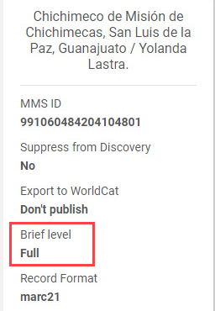
Brief Level Rules Initiative
OCLC is updating their encoding level (LDR 17) to adhere to MARC21 standards
  January 2021 OCLC began converting encoding level K to level 7
SLS will begin implementing this Initiative in Sept. 2021
  SUNY Brief Level Rules changes will be applied to the Network Zone and to Institution Zones
  Institutional and Cataloging leads will be contacted prior to SUNY Brief Level Rules being applied to their Institution Zone only records
  The SUNY Metadata Standards & Policies Working Group updated MSP-42 to reflect the changes to the brief levels and brief level display
Link to MSP-42: https://slcny.libguides.com/ld.php?content_id=50351537

Slide 20
Corrupted Diacritics
Recent increase in corrupted diacritics in Alma led to an investigation that discovered:
  Characters are coming in corrupted from the OCLC WorldShare Collection, which affect the OCLC daily imports for new, updates, and merged records
  [Brackets] appear to be the only character that are corrupted and displaying as &#x5d;)
  Records imported directly from OCLC Connexion Client are not impacted
OCLC is reviewing the corrupted files coming from the WorldShare Collection
Records are being re-imported from a batch file from OCLC Connexion to temporarily resolve corrupted characters

Slide 21

Exclusive Use of the New Metadata (MD) Editor
Exclusive use of the MD Editor will begin with the October 2021 release
Previous MD Editor will sunset and no longer be available
Begin using the new MD Editor prior to the October 2021 release
New MD Editor Exclusive Use Refresher Session on Tuesday, September 28 at 10:00 am
  Registration link: https://slcny.libcal.com/event/8107494

Slide 22

OCLC Connexion 3.0
OCLC Connexion 3.0 release date for the Windows bases OCLC Connexion Client has been delayed
SLS will test and communicate any significant changes with the new version once it is available
The current Connexion client will remain available until sometime in 2022
  OCLC will provide users with a 3-month advanced notice of when the older version will sunset

Slide 23

Survey for Catalogers with Foreign Language Skills
SMSP has created a survey to identify catalogers in SUNY with specific foreign language skills to help meet the needs of the larger SUNY cataloging community
The survey will be posted to Workplace and emailed to cataloging leads
Survey link:
https://slcny.libwizard.com/id/efbeef18423eb2d5b3e48ed39e4182c9

Slide 24
Resource Sharing
Timothy Jackson
www.suny.edu

Slide 25

Alma Resource Sharing Statistics - July & August
Book fill rate for all of SUNY: 69.3% (n = 2,084)
  University Centers: 71.2% (n = 1,166)
  Comprehensive Colleges: 66.8% (n = 785)
  Community Colleges: 70.1% (n = 133)
Book turnaround time: 8.2 days
Article fill rate: 87.2% (n = 86)
Article turnaround time: 1.1 days

Slide 26

Alma Borrowing With Nazareth College
Have gone live with Alma borrowing from Nazareth College
  Nazareth College is not borrowing from SUNY via Alma at this time
Following campuses have expressed interest in borrowing from Nazareth College:
  Adirondack, Albany, Alfred State, Alfred University, Binghamton, Brockport, Buffalo State, Buffalo, Cayuga, Clinton, Cobleskill, Columbia-Greene, Corning, Cortland, Delhi, Downstate, Dutchess, Erie, Farmingdale, Fashion, Fredonia, Fulton-Montgomery, Genesee, Geneseo, Herkimer, Hudson Valley, Jamestown, Jefferson, Maritime, Mohawk Valley, Monroe, Morrisville, New Paltz, Niagara, Old Westbury, Oneonta, Onondaga, Oswego, Poly, Potsdam, Purchase, Rockland, Schenectady, Stony Brook, Sullivan, Tompkins-Cortland, Ulster, Upstate Medical, Westchester
Half of those libraries have already been configured, and the other half will be configured by the end of August
  You will receive an email once Nazareth College has been added to your rotas

Slide 27

Alma Resource Sharing With Brandeis University
Went live in mid-June
SUNY Participants:
  Adirondack, Albany, Alfred University, Buffalo, Cayuga, Cobleskill, Corning, Dutchess, FIT, Fredonia, Fulton-Montgomery, Hudson Valley, Jefferson, Maritime, Mohawk Valley, New Paltz, Old Westbury, Oneonta, Onondaga, Poly, Potsdam, Purchase, Upstate Medical
Statistics to Date:
  Borrowing Volume: 30 items
  Lending Volume: 48 items
  Fill Rate Increase: 1.4%
  Average Turnaround Time: 8.2 days
Request volume discrepancy should decrease as more libraries go live with Rapido

Slide 28

Alma Resource Sharing With Cal State System
Went live in mid-July
SUNY Participants:
  Albany, Buffalo, Oswego, Purchase, Stony Brook
Cal State Participants:
  Chico, Fullerton, Humboldt, Northridge, Sacramento
Statistics to Date:
  Borrowing Volume: 21 items
  Lending Volume: 26 items
  Fill Rate Increase: 2.9%
  Average Turnaround Time: 9.7 days
Pilot project runs through end of Spring 2022 semester
  Will likely add more participants if pilot is successful

Slide 29


Turnaround Time Comparisons (June - Present)
Brandeis University via Alma: 8.2 days
Cal State Universities via Alma: 9.7 days
ELD libraries via ILLiad: 9.9 days*
Non-ELD libraries via ILLiad: 11.4 days*
* data taken from University at Buffalo

Slide 30
Alma Return Anywhere Functionality
SUNY using Automated Fulfillment Network (AFN) "Circulate For" feature to allow users to return items to any SUNY
Nearly all campuses using automated version of this functionality
Barcode scanning errors are sometimes putting items in transit and creating walk-in borrowing loans at other campuses
  Some seem to be the result of double-discharging ILLiad items in Alma
  Number of items being put in transit is low (2-3 per day) and accidental loans are rare (less than 10 since implementation)
Vast majority of problems caused by ILLiad transaction numbers that match item barcodes at one campus
Problems being cleaned up by SLS staff on a daily basis
Will reconsider how we're using this functionality if problems persist

Slide 31
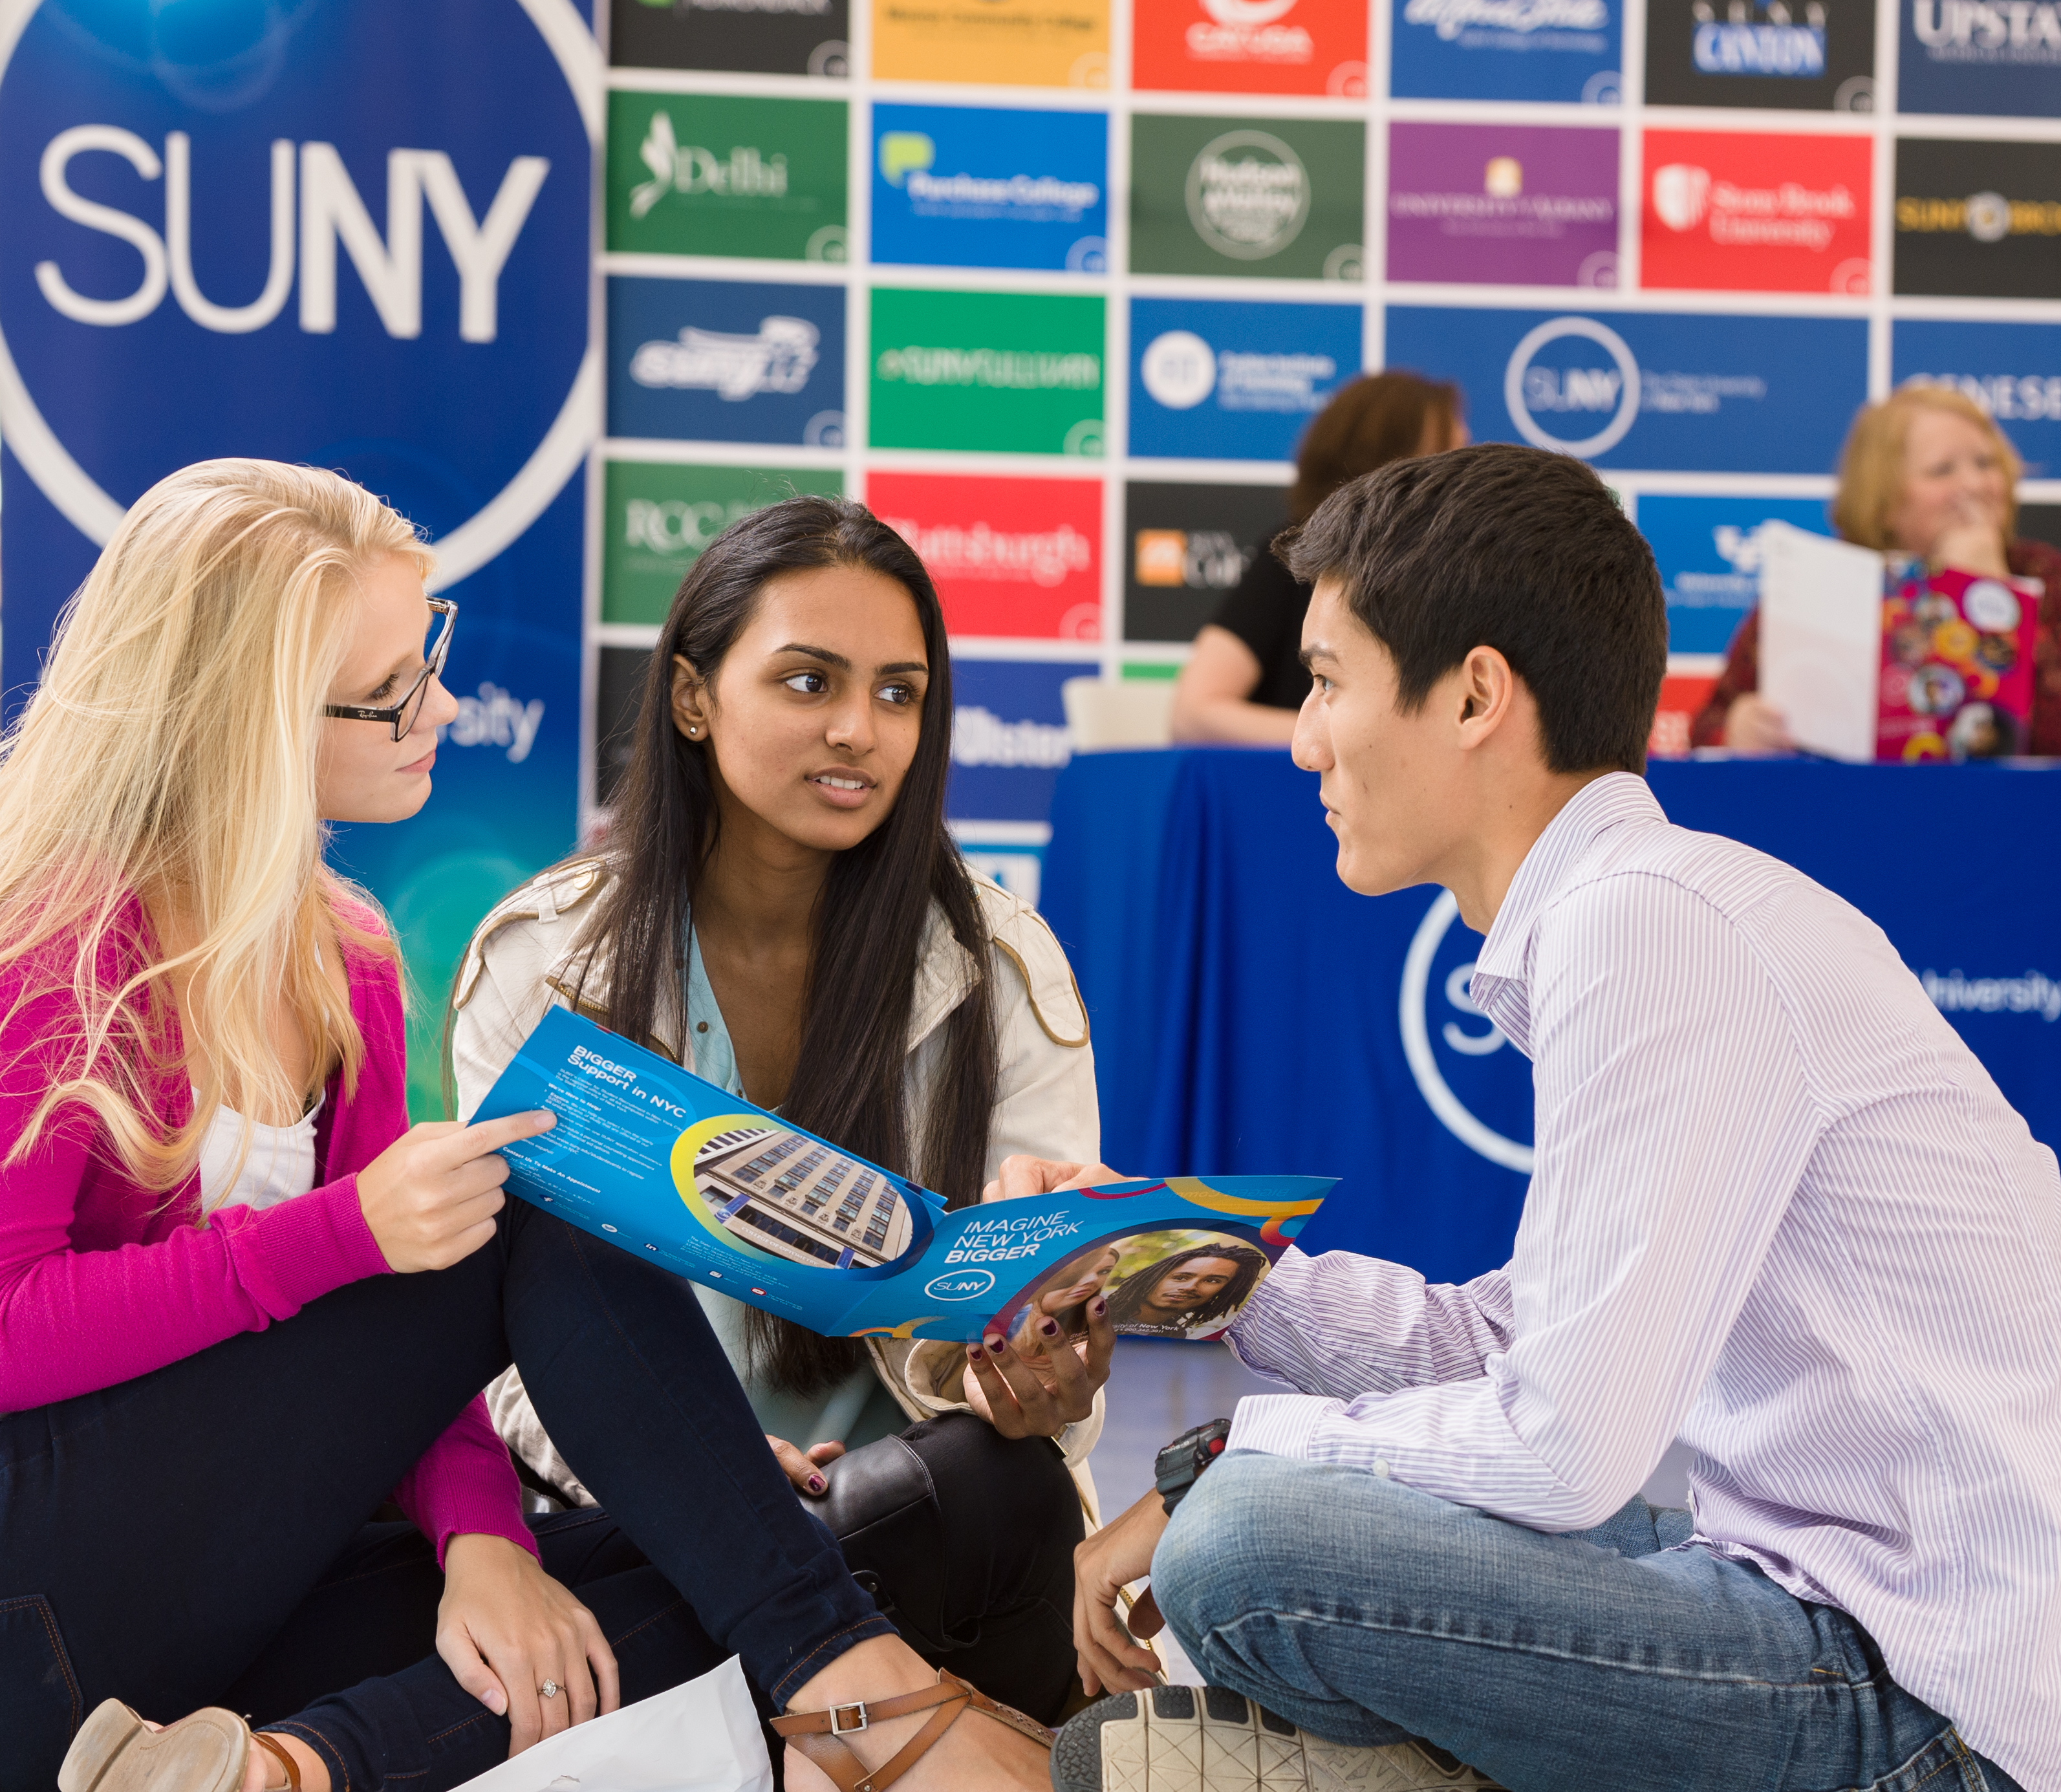

Questions or Discussion?
www.suny.edu

