Slide 1
Gamification > Games Greater Than
2018 NICE K12 Cybersecurity
Education Conference
San Antonio, Texas
Gordon W. Romney, PhD CEH, University of San Diego, San Diego, CA
Bradley Wolfenden, Circadence Corporation, San Diego , CA

Slide 2
Agenda
Gamification and “The Gap”
What Makes an Effective Environment
Role of Artificial Intelligence & Machine Learning
Closing the Cyber Workforce Gap

Slide 3
“Security is everyone’s problem!”
Security Hygiene
(a.k.a. Did you shower today?)
What makes up one’s security posture, anyway?
Take it Personally
80%+ of compromises are
SOCIAL IN NATURE
Cyber-attacks as Organized Crime

Slide 4
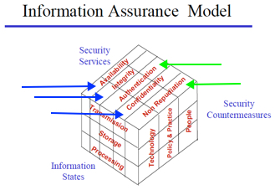
Cybersecurity is Complex
“Cybersecurity has become exceedingly complicated in recent years, and the complexity might now be our biggest vulnerability.” -Datamation`
Cybersecurity started with the IT “triad” – People, Technology & Process. Then came the McCumber INFOSEC 3x3 Cube Model (Blue I – A – C). Then the MSRW model that included Authentication and Non-repudiation (Green).

Slide 5
GenCyber: Six Cyber Principles
“A”
Think Like an Adversary
“I”
“C”
Keep it Simple
Defense in Depth
Confidentiality | Integrity | Availability
Think like an Adversary | Defense in Depth | Keep it Simple

Slide 6
The Current Landscape…
Traditional Learning Models
Textbooks, PowerPoint slides, and ‘clickfest’ training tends to lead to learning one, likely highly simplistic, approach/ solution.
Static Teaching Resources and Tools
The state of cybersecurity is ever-evolving to include new tools, threats, tactics, etc.
Disconnects between How to Extend the ‘Learning’ to other Approaches

Slide 7
A Different Approach
Focus on Problem Solving
Move BEYOND facts, theories and concepts, and towards critical thinking, persistence and diligence.
Education (vs. Training)
Gamification
Provides a “safe space” for trial and error.
Allows for variability of content, and better reflects the highly evolving nature that is cybersecurity.
Enables the incorporation of human factors into education and training.

Slide 8
Gamification & the “Gap”
In order to truly impact the worsening gap in demand vs. supply of well-qualified cyber professionals, we need to introduce a paradigm shift.
Importance of Technical/ Virtual Environments
Doctors have them, pilots have them, emergency professionals have them, professional athletes have them, etc.
‘Gamification’ introduces concepts of games into real-world education, training and assessment environments, to encourage repetition.
Provide positive incentives, not just negative ones, to make training “sticky”.
As skills improve, challenges should too!
Notes:
** Brain science makes it clear that repetition is essential to knowledge retention.
“Muscle Memory” is repeating tasks over and over enhances neural pathways. Multiple avenues means more neural pathways, and stronger retention.

Slide 9
What Makes an Effective Environment?

Slide 10
STEM Skills & Cyber Education Development
Problem Solver
Quickly and productively.
Creative Thinker
Includes the ability to propose multiple solutions.
Inquisitive Explorer
Requires hands-on, experiential learning.

Slide 11
Notes:
Example STEM Project- 3D Graphics First Rendering
Science. Physics – mechanics, lighting, color theory
Technology. Computer Science, programming, display
Engineering. Electrical Engineering, project management, integrating technologies, inventing rendering
Mathematics. Linear algebra and homogeneous coordinates
URL: www.firstrendering.com

Slide 12
Peer or Companion Needed Soft Skills
Communication ability, both verbally and written.
Critical Thinking ability turns failed attempts into positive experiences.
Problem Solving
Time Management
Teamwork. Cybersecurity is a Team Sport.
Creativity

Slide 13
Hands-on Step-by-Step Project
Example from an Oil Painting Project
The Final Objective…
is the next slide

Slide 15
First Master the Modules
Step by step…
A sky
Clouds
Volcano
Lake
Foliage/foreground

Slide 17
Then
Assemble the Project
Using the Modules

Slide 19
First Master the Tools…
Kali
Linux
Step-by-Step Tool Development Process for Gamification

Slide 20
Then Implement the Cyber Tools as Needed for K12 or Beyond
Learning by Hands-on …
Having Fun
in Gamification

Slide 21
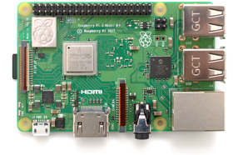
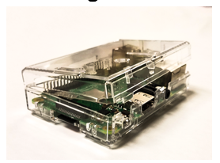
Raspberry Pi
A low cost, credit-card sized computer that plugs into a computer monitor or TV, and uses a standard keyboard and mouse.
Case Studies: → Cyber Saturdays at USD
→ NSA GenCyber Camps
Notes:
Does most things a desktop computer can do
Runs Linux: Ubuntu and Kali
Browses the Internet: Ethernet and WiFi
Plays high-definition video
Supports spreadsheets, word-processing, and PPTs
Cyber Saturdays → Used laptops, Raspberry PIs and virtualization ** Nov 2018 Ethical Hacking using virtualization
NSA GenCyber Camps → Used laptops, Raspberry PIs, Missions → 2019 proposed GenCyber Advanced Camp ** teaching “Capture the Flag” (CTF) employment of Cyber Tools ** employing CyberPatriot national first place students as TAs

Slide 22
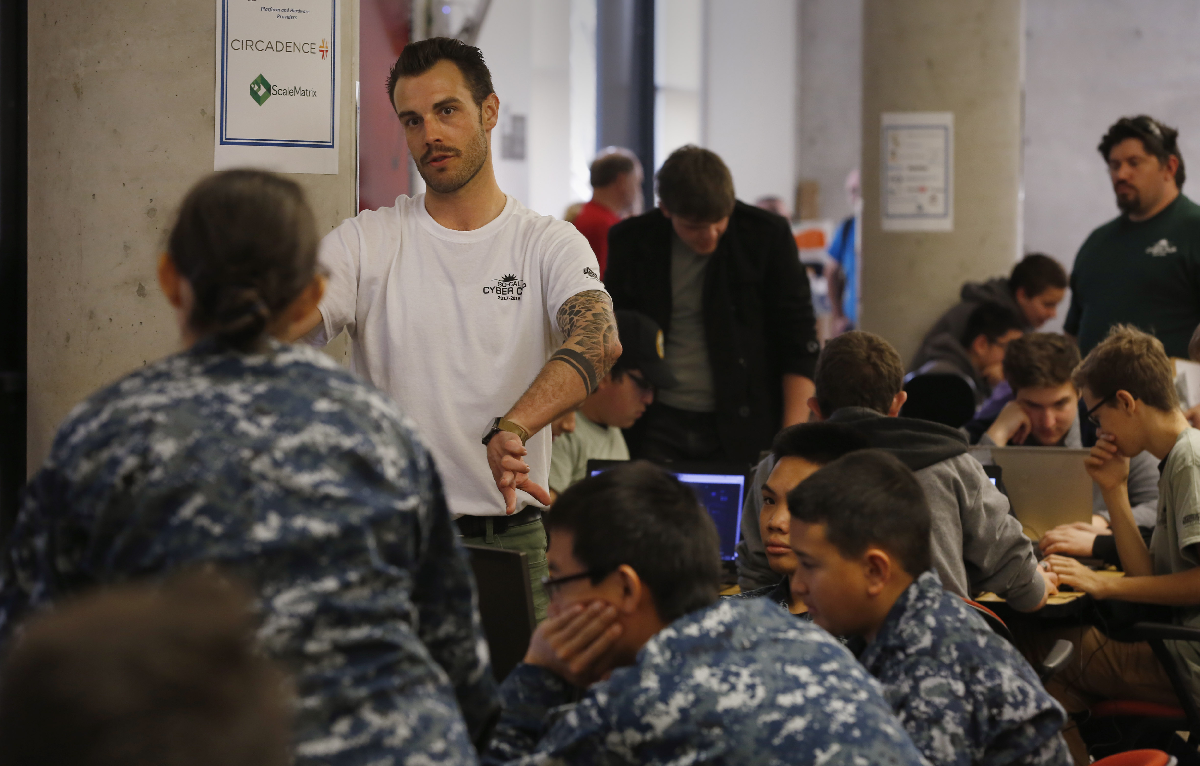
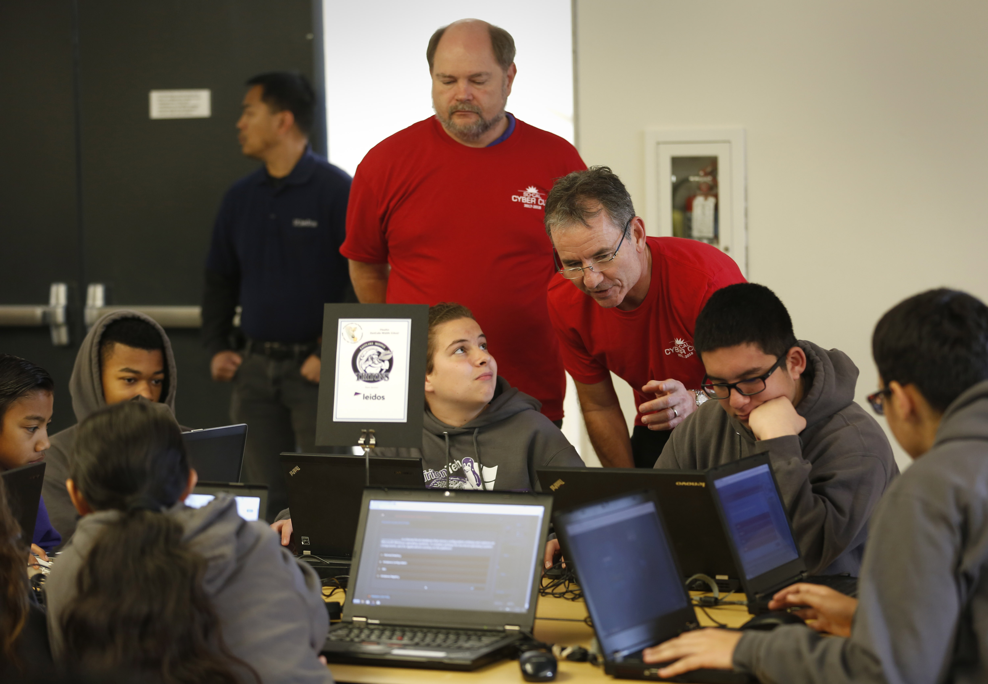
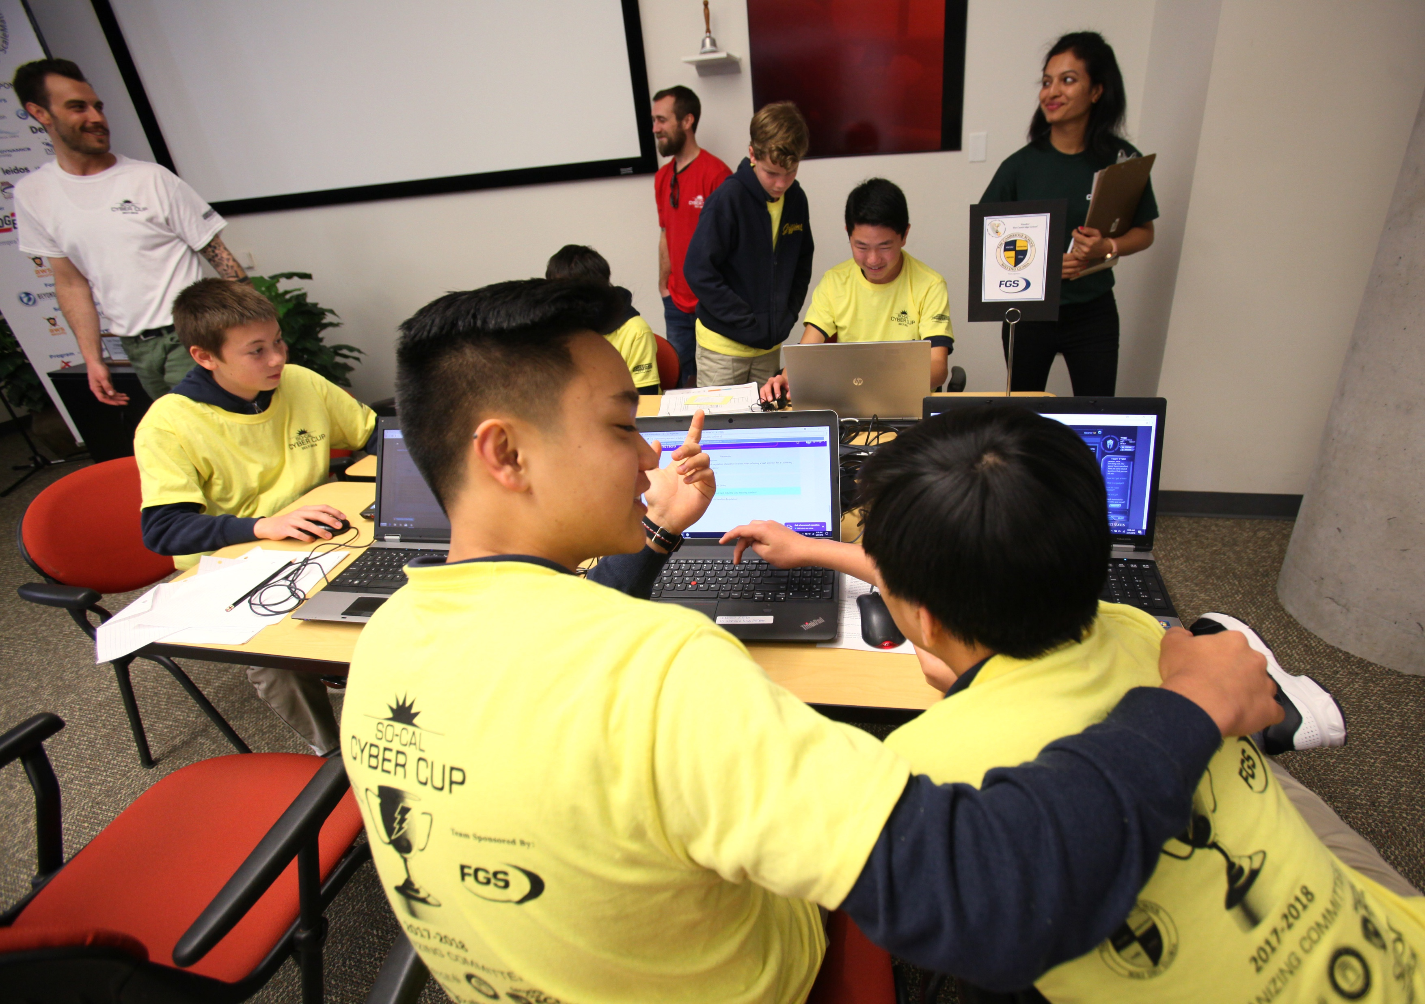
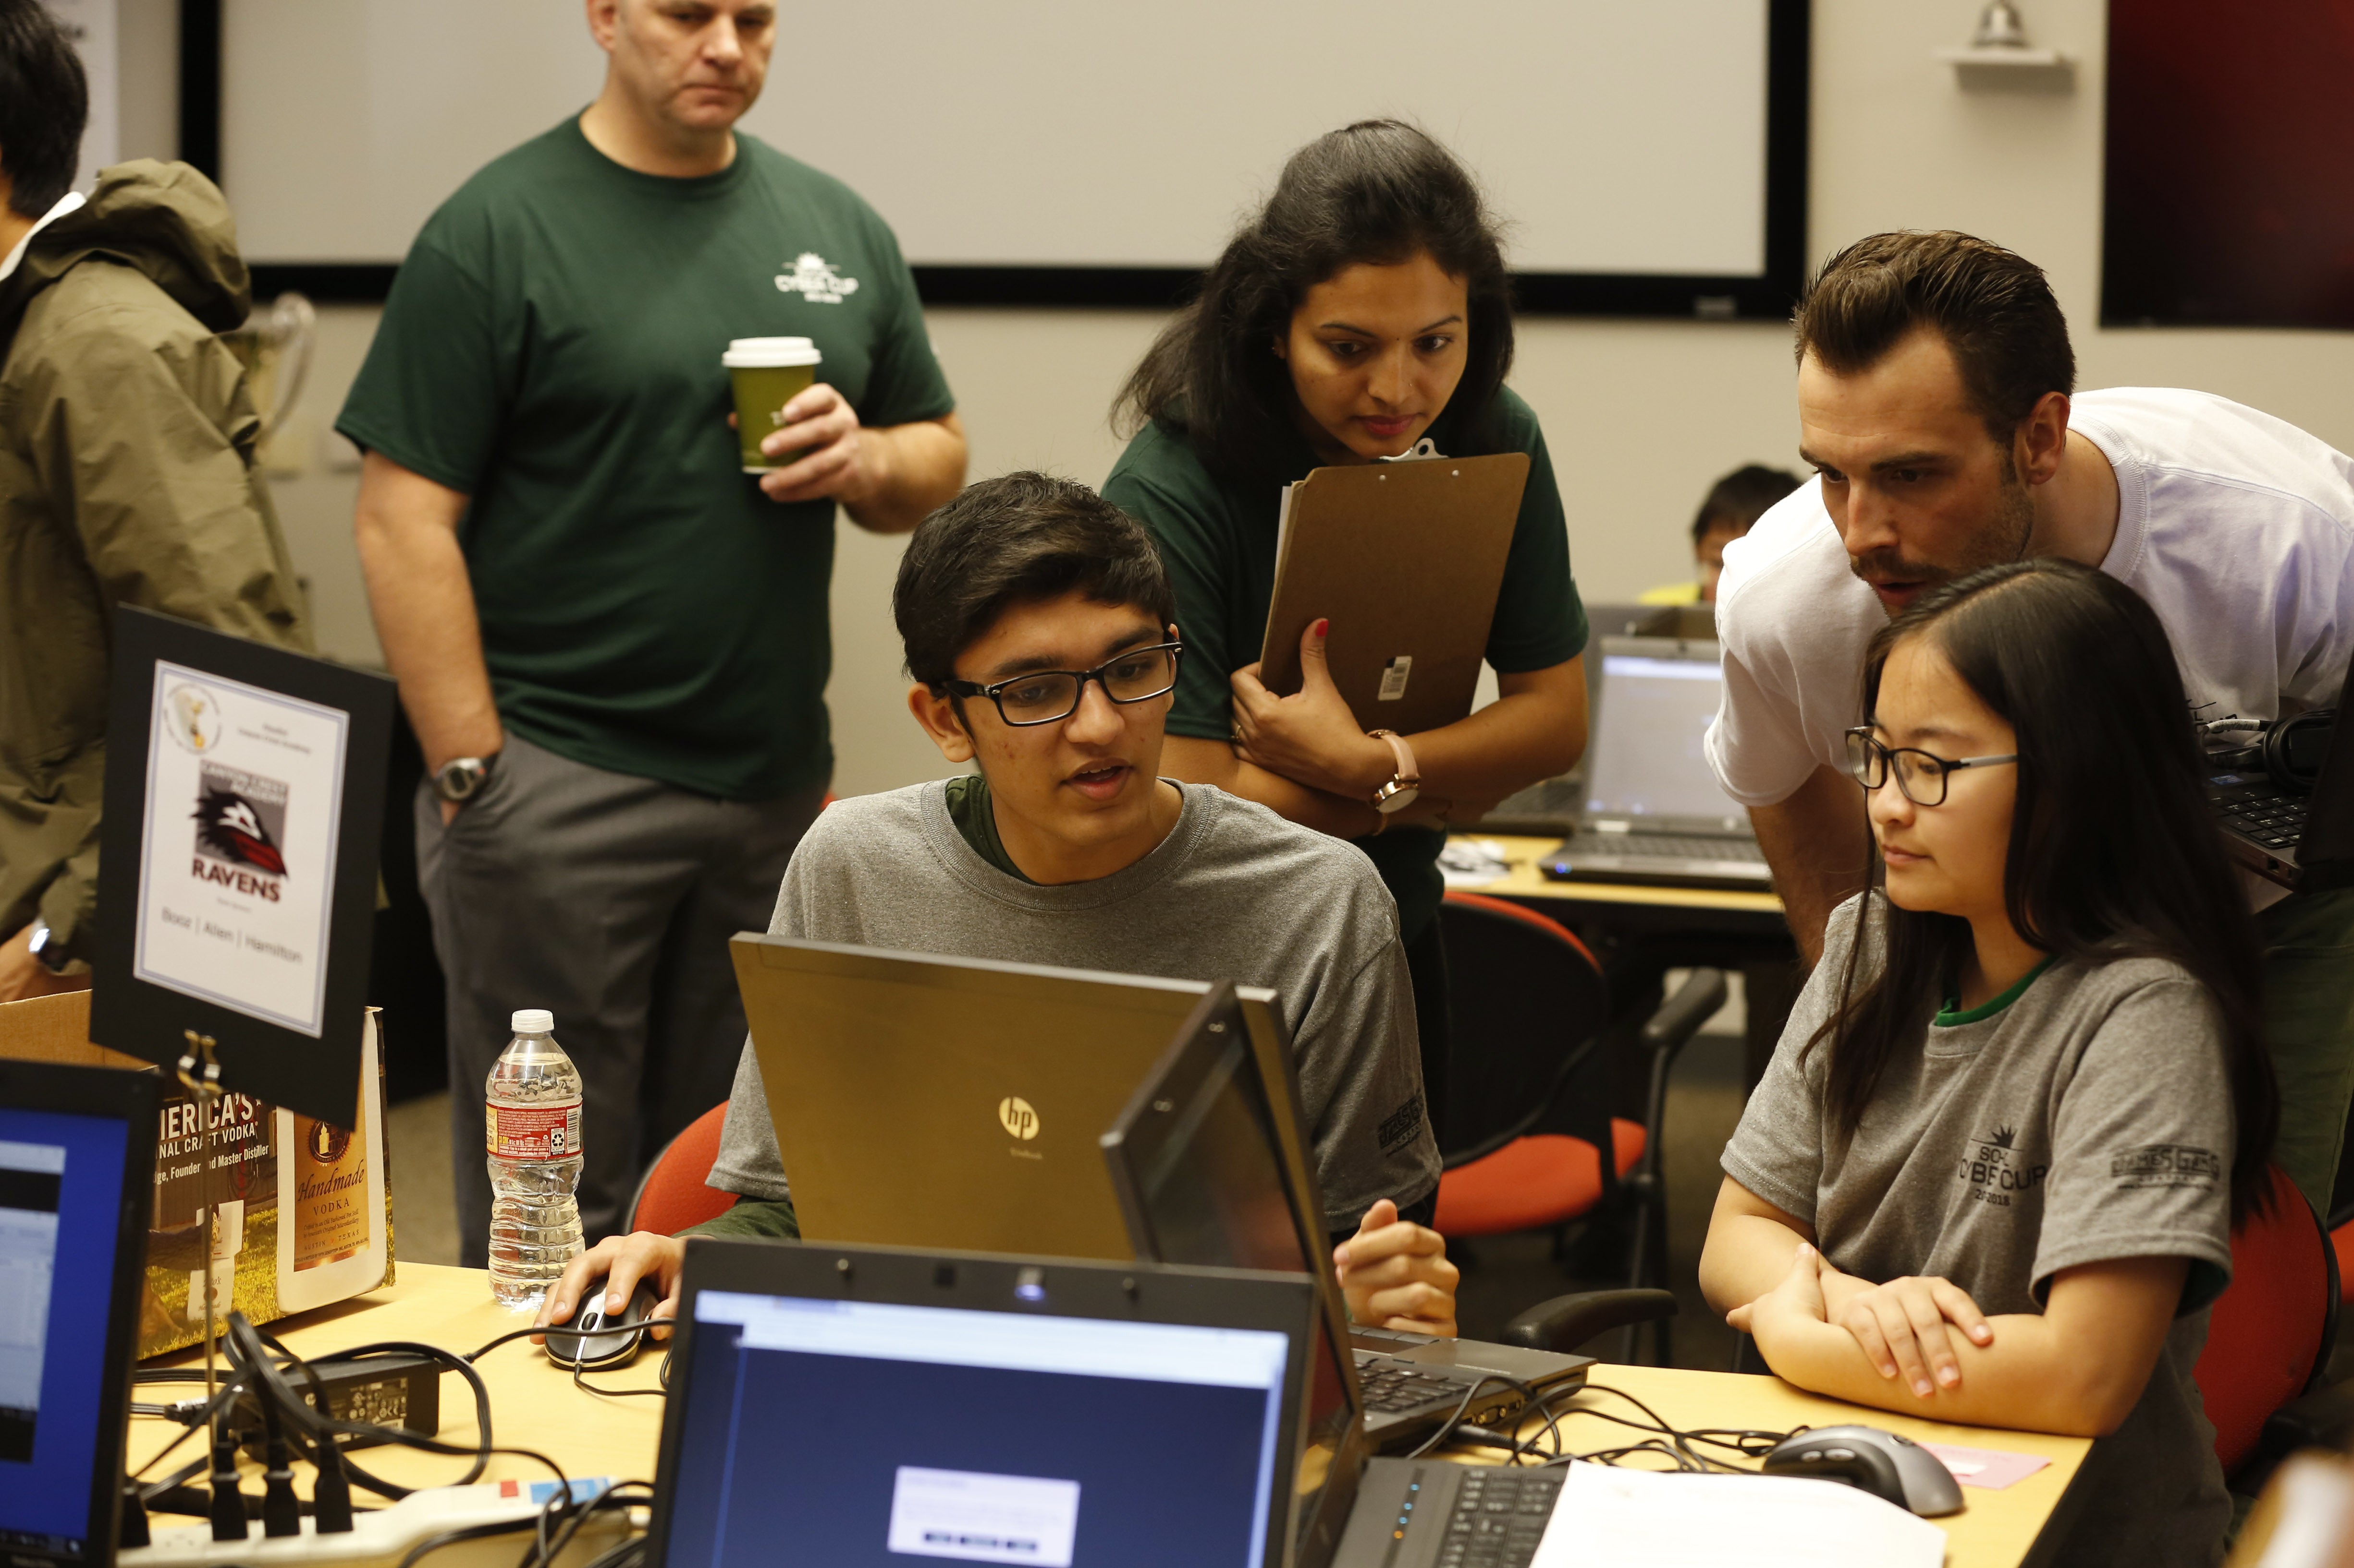
SoCal Cyber Cup Challenge
A cybersecurity incident response challenge for middle and high school students, designed to reimage cybersecurity education and provide students the opportunity to learn skills that can directly lead to an exciting career in cybersecurity.
Forensics Challenge (Hybrid)
Physical Investigation + Digital Forensics Battle Rooms
Mission Scenario (M12- Operation Bold Hermit)
Objectives: 1. Identify key terrain and scope, 2. Derive accurate network map, 3. Identify most vulnerable ingress/touch points, 4. Monitor and characterize network traffic, 5. Create and tune sensor alerting, 6. Analyze any abnormal traffic, 7. Conduct vulnerability assessment of specified hosts, 8. Conduct forensics to analyze any abnormal host assessment results

Slide 23
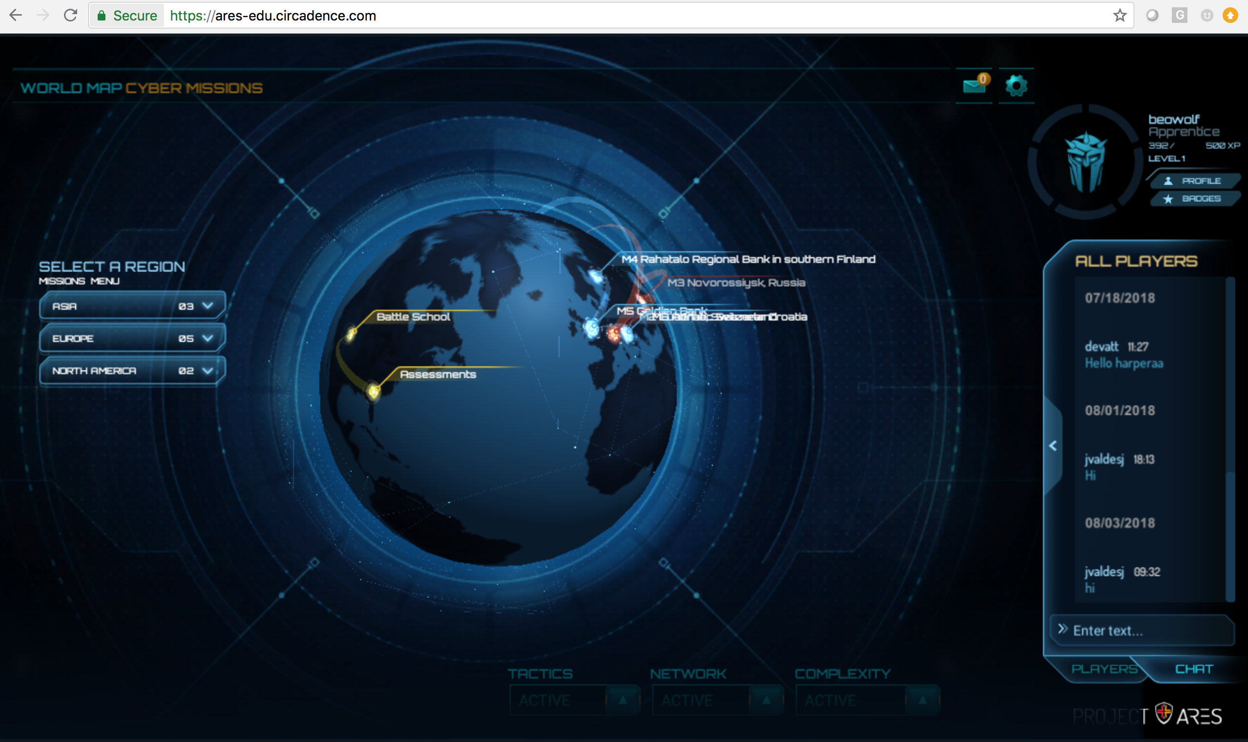
Project Ares: Persistent Cyber Training
Project Ares Video Trailer

Slide 24
Artificial Intelligence & Machine Learning
AI - Capability of a machine to imitate intelligent human behavior. It can be a decision tree with rules or a chat bot based on Natural Language Processing. (1950-1970’s)
ML - Uses algorithms that parse data, learn from that data, and then apply what they’ve learned to make informed decisions. (1980 – 2012+)
DL - Use a set of algorithms (Neural Nets) modeled loosely after the human brain, that are designed to recognize patterns. (Boon 2012- 2016+)
Artificial Intelligence
Machine Learning
Deep Learning

Slide 25
AI in Cyber / Information Security
In Operations
Identifying Vulnerabilities BEFORE they are Problems
Detection of Threats
(hopefully, before they have achieved their goals)
Response planning for Threats
In Awareness, Training, and Education
Intelligent “tutor” to supplement training / EDU staff
Discovery of what is being Learned and NOT Learned
Automated Assessment
Keeping Content and Training “Fresh”
It’s not the silver bullet, but it helps.

Slide 26
Formal Technical Education
Hands On / Technical vs. Theoretical
Practical, Scenario-based vs. Textbooks and Traditional Testing
Curriculum in 2yr. vs. 4yr. Schools

Slide 27
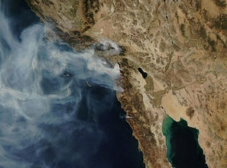
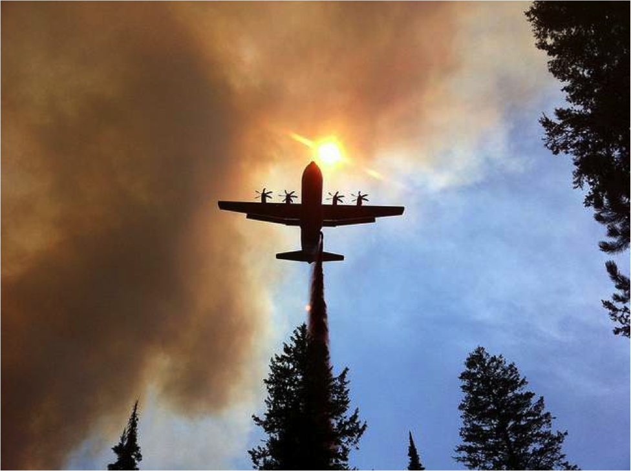
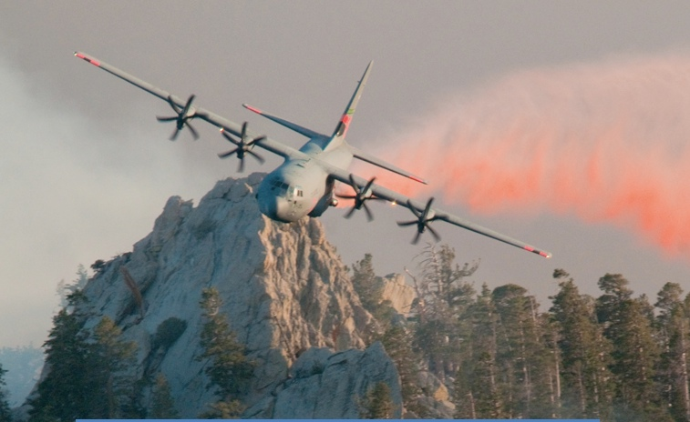
Security & Disaster Management Example
An example of a graduate level project that employed the step-by-step skill development process that served as a prototype for the USAF to begin authorizing iPad usage for the Modular Airborne Firefighting System (MAFFS).
October 2007 Southern California Wildfires
Notes:
Bryan Allen developed a prototype automation of the MAFFS Drop Log using Cloud technology.

Slide 28
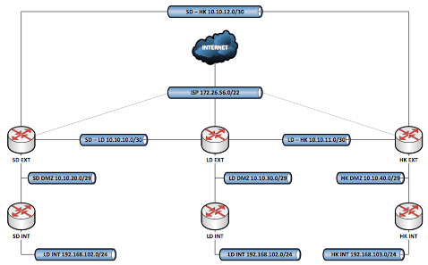
MS Capstone Project
San Diego – London – Hong Kong Capstone Team of 12 Project: 2,000 hrs. Merger of Three Companies: → 83 Virtual Devices → Complex Network Topology
Notes:
MS Capstone project that applied the Cyber tools
Three virtual companies were merged into one in second month
New company computer infrastructure was hardened and a penetration test was executed
Security Plan was created and complete documentation was produced
This project was produced by Professor Chuck Bane
It is an example of taking Network instruction from a flat 2D perspective to 3D

Slide 29
Questions & Answers
Dr. Gordon W. Romney, University of San Diego
gromney@sandiego.edu
Bradley Wolfenden, Circadence Corporation
bwolfenden@circadence.com | (858) 208-8003
Thank You!

Slide 30
References

