Slide 1
Breaking Barriers: Tackling Stigma to Enhance Behavioral Health in Primary Care
CTC-RI Annual Conference| October 5, 2023

Slide 2
Agenda
Presenter/Topic | Time
Welcome Moderator: Michelle Brophy, MA, Associate Director Interdepartmental Services/Vulnerable Populations, BHDDH | 5 minutes
Stigma & Equity Cathy Schultz, MPH, Director Governor’s Overdose Task Force, EOHHS | 20 minutes
Harm Reduction Strategies & Medical Respite Sarah Edwards, CPRS, CCHW, Drug Overdose Prevention Program, RIDOH Victoria Novotny, MPH, CHES, Project Manager, EOHHS State of Rhode Island | 25 minutes
Q&A / Discussion Michelle Brophy, MA, Associate Director Interdepartmental Services/Vulnerable Populations, BHDDH | 15 minutes

Slide 3
CTC-RI Conflict of Interest Statement
If CME credits are offered, all relevant financial relationships of those on the session planning committee have been disclosed and, if necessary, mitigated.
The AAFP has reviewed ‘Advancing Comprehensive Primary Care Through Improving Care Delivery Design and Community Health,’ and deemed it acceptable for AAFP credit. Term of approval is from 03/18/2022 to 03/18/2023. Physicians should claim only the credit commensurate with the extent of their participation in the activity. NPs and RNs can also receive credit through AAFP’s partnership with the American Nurses Credentialing Center (ANCC) and the American Academy of Nurse Practitioners Certification Board (AANPCB).

Slide 4
Objectives
Understand Stigma: Define stigma, explore its various manifestations, and recognize its profound impact on individuals, communities, and healthcare systems.
Humanizing Overdose Prevention: Examine the human side of overdose prevention and public health efforts, fostering empathy and a deeper understanding of the challenges faced by individuals affected by substance use disorders.
Language Matters: Explore the significance of choosing the "right" words in addressing behavioral health issues and learn how language can either reinforce or challenge stigma.
Strategies for Change: Identify practical strategies and best practices to address stigma, both within the primary care and in broader community settings, promoting a more inclusive and supportive environment for behavioral health care.
By the end of this session, participants will have a comprehensive understanding of stigma, a deeper appreciation for the human aspect of overdose prevention, enhanced awareness of the impact of language, and a toolkit of strategies to combat stigma and improve behavioral health outcomes in primary care settings.

Slide 5
The Stigma of Substance Use: Its Impact and What You Can Do
Cathy Schultz, Director Governor’s Overdose Task Force, EOHHS

Slide 6
Learning Objectives
Participants will increase knowledge about:
The definition, manifestations, and impact of stigma.
The human side of overdose prevention and public health.
Why choosing the “right” words matters.
Strategies to address stigma in and out of the work environment.
Notes:
Heather

Slide 7
What is Stigma?

Slide 8
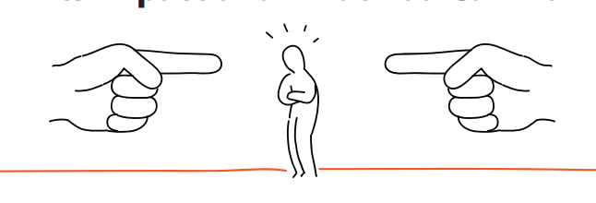
What Is Stigma?
humiliated
discrimination
devalued
rejected
shame
dishonor
prejudice
guilty
different
scorned
isolated
disgraced
Notes:
Heather

Slide 9
What Is Stigma?
alone
Notes:
Heather

Slide 10
What Is Stigma?
stigma noun
/ˈstiɡmə/
Definition of stigma
1. A mark of disgrace associated with a particular circumstance, quality, or person.
Synonyms for stigma
Shame, disgrace, dishonor, humiliation, and (bad) reputation.
Notes:
Heather

Slide 11
Why Does Stigma Still Exist?
2018 Survey:
20.3 million individuals 12+ experienced a substance use disorder in the past year.
Why does stigma still exist?
Humans can be judgmental/learned behavior
Compassion fatigue
Lack of education and excess of misinformation
Systemic stigma: racism, classism, etc.
Notes:
Heather

Slide 12
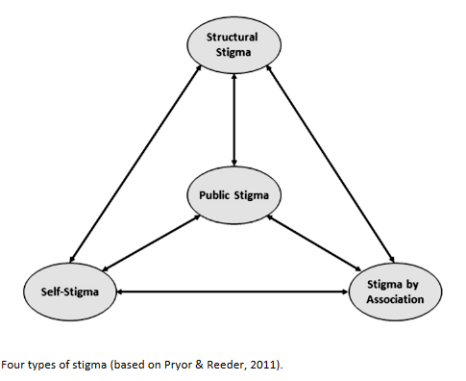
4 manifestations of stigma
Four Types of Stigma³
Public Stigma: People’s social and psychological reactions.
Self-Stigma: Social and psychological impact of being part of a stigmatized group, which perpetuates negative beliefs and feelings associated with the stigmatized condition.
Stigma by Association: Social and psychological reactions to people associated with a stigmatized person (e.g., family and friends).
Structural Stigma: “Legitimatization and perpetuation of a stigmatized status by society’s institutions and ideological systems.”
7
Notes:
Heather

Slide 13
Human Side of Overdose Prevention

Slide 14
Different Perspectives
In 2021, fatal overdoses for which any drug contributed to cause of death were 13% higher than in 2020.
Source: Office of the State Medical Examiners (OSME), Rhode Island Department of Health (RIDOH). Data updated as of June 14, 2022.
Note: Data reflect accidental drug overdose deaths and do not include suicides, homicides, or undetermined deaths.
Notes:
Cathy

Slide 15
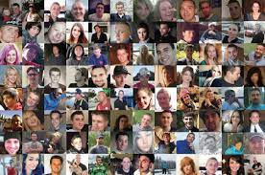
Different Perspectives
Each number has a name and a face.
A person’s spouse or partner, child, sibling, friend, neighbor, co-worker…
Notes:
Cathy - What we often discuss and what those impacted see

Slide 16
Charting Language: Before
Ms. J is a 44-year-old female with a long history of polysubstance abuse with poor compliance with outpatient treatment and little insight into her addiction who presents complaining of pain and swelling in her right lower extremity. She also has a history of drug-seeking behavior. I suspect this and homelessness are the primary reasons for her visit (i.e., secondary gain).
Notes:
Cathy
“Noncompliance”: this implies that the patient could resolve barriers to care through his/her own actions and does not acknowledge structural barriers
“Malingering”: represents that the patient is faking symptoms, rather than navigating a broken system as best they can
“Homeless person”: this implies that the patient’s identity is, first and foremost, wrapped up in their housing status

Slide 17
Charting Language: After
Ms. J is a 44-year-old female with a past medical history of substance use who presents with pain and swelling in her right lower extremity. She has previously been lost to follow-up in outpatient treatment possibly due to housing insecurity.
Notes:
Cathy

Slide 18
Words Matter

Slide 19
Stigma and Its Impact
Notes:
Cathy

Slide 20
Perception versus Reality
Words Matter
Language frames what the public thinks about substance use and recovery.
Language negatively and positively impacts the way society perceives substance use.
Language can depersonalize people. ⁴
Notes:
Cathy
Notes:
Language frames what public thinks about substance use and recovery, and affects how people think about themselves and their ability to change.
Inappropriate use of language can negatively impact the way society perceives substance use and those affected by it.
Language intentionally and unintentionally propagates stigma: depersonalizes people, depriving them of individual or personal qualities and personal identity.
Stigma is harmful, distressing, and marginalizing to those who bear it⁶

Slide 21
Moving Toward Recovery-Oriented Language
Stigmatizing
Recovery Oriented
Clean
Addict/Alcoholic
Relapse Prevention
Substance Abuse/Dependence
Dirty/Clean Screen/Urine
Illegal Drugs
Crazy
Diagnosis first
In recovery
Person in recovery
Recovery Maintenance
Substance Use
Positive/Negative Screen
Substances
Sick/ill
Person first
Notes:
Cathy

Slide 22
Strategies to Reduce Stigma

Slide 23
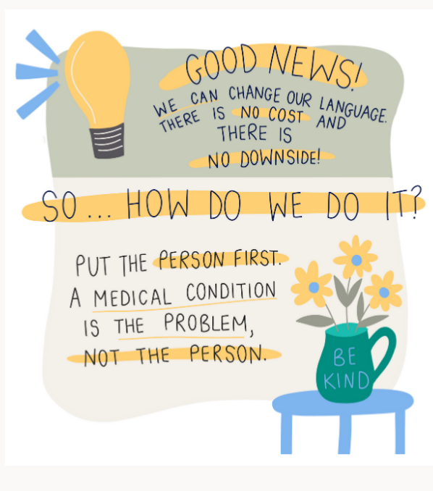
Notes:
Cathy

Slide 24
You Can Make A Difference to Reduce Stigma
Correct negative language that can cause stigma by sharing accurate information about addiction.
Speak out against negative behaviors and statements, including those on social media.
Make sure the images used in communications show diverse communities and do not reinforce stereotypes.
Notes:
Cathy

Slide 25
Thank You!
Cathy Schultz, Director Overdose Task Force, EOHHS
Sarah Edwards, Drug Overdose Prevention Program, RIDOH

Slide 26
For more information?
Resources, Research, Data, Governor’s Overdose Task Force: https://preventoverdoseri.org/
Free Community Narcan: https://preventoverdoseri.org/get-naloxone/?src=mnu
Xylazine Information: https://preventoverdoseri.org/xylazine/
Words Matter Guide: WordsMatterGuide-6.27.22 (ri.gov)
Resources in your communities: https://preventoverdoseri.org/covid-19/
Good Samaritan Law: http://webserver.rilin.state.ri.us/Statutes/TITLE21/21-28.9/21-28.9-4.htm

Slide 27
References
World Health Organization. (2019, May 28). Burn-out an "occupational phenomenon": International Classification of Diseases. https://www.who.int/news/item/28-05-2019-burn-out-an-occupational-phenomenon-international-classification-of-diseases
Mayo Clinic. (2021, June 05). Job burnout: How to spot it and take action. https://www.mayoclinic.org/healthy-lifestyle/adult-health/in-depth/burnout/art-20046642
Pryor and Reeder. (2011) Four types of stigma. HIV/AIDS in the Post-HAART Era: manifestations, treatment, and Epidemiology. https://www.researchgate.net/figure/Four-types-of-stigma-based-on-Pryor-Reeder-201159-Pryor-J-B_fig2_235349425
Pescoscolido, B. A., Medina, T. R., Martin, J. K., & Long, J. S. (2013). The backbone of stigma: Identifying the global core of public prejudice associated with mental illness. American Journal of Public Health 103, 853-860. https://doi.org/10.2105/AJPH.2012.301147

Slide 29
Harm Reduction In Rhode Island
October 5, 2023
CTC-RI 2023 Annual Conference

Slide 30
What is Harm Reduction?
“Harm reduction is a set of practical strategies and ideas aimed at reducing negative consequences associated with drug use. Harm Reduction is also a movement for social justice built on a belief in, and respect for, the rights of people who use (substances)”
National Harm Reduction Coalition

Slide 31
Harm Reduction Principles
Person-Centered
Helping to increase the quality of one’s life
Reducing adverse impacts associated with substance/alcohol use
Never judgmental
Empowering individuals by educating and not shaming
Allowing bodily autonomy
Advocacy
Anti-racist

Slide 32
Examples of Harm Reduction
Sterile syringe
Moderated/controlled use strategies
Safer sex
Narcan distribution
Substance testing before using
Overdose Prevention Centers

Slide 33
Implementing Harm Reduction Principles
Meet people exactly where they are at; physically and fundamentally
Honor autonomy and level of willingness to engage in services
Come from a place of non-judgement
Participate in anti-stigma and harm reduction trainings
Collaborate with local Harm Reduction experts
Help reduce stigma, be an advocate!

Slide 34
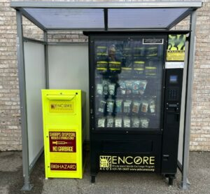
Harm Reduction in RI
Peer-led harm reduction community-based organizations providing services across the state of Rhode Island
Services Provided:
Basic needs supplies
Harm reduction supplies Rapid HIV/HCV testing
Safer Drug Use Education
Linkages to treatment and Recovery Supports
Services delivered through mobile outreach, drop-in centers, door-to-door canvassing, delivery services, harm reduction vending machines, etc.

Slide 35
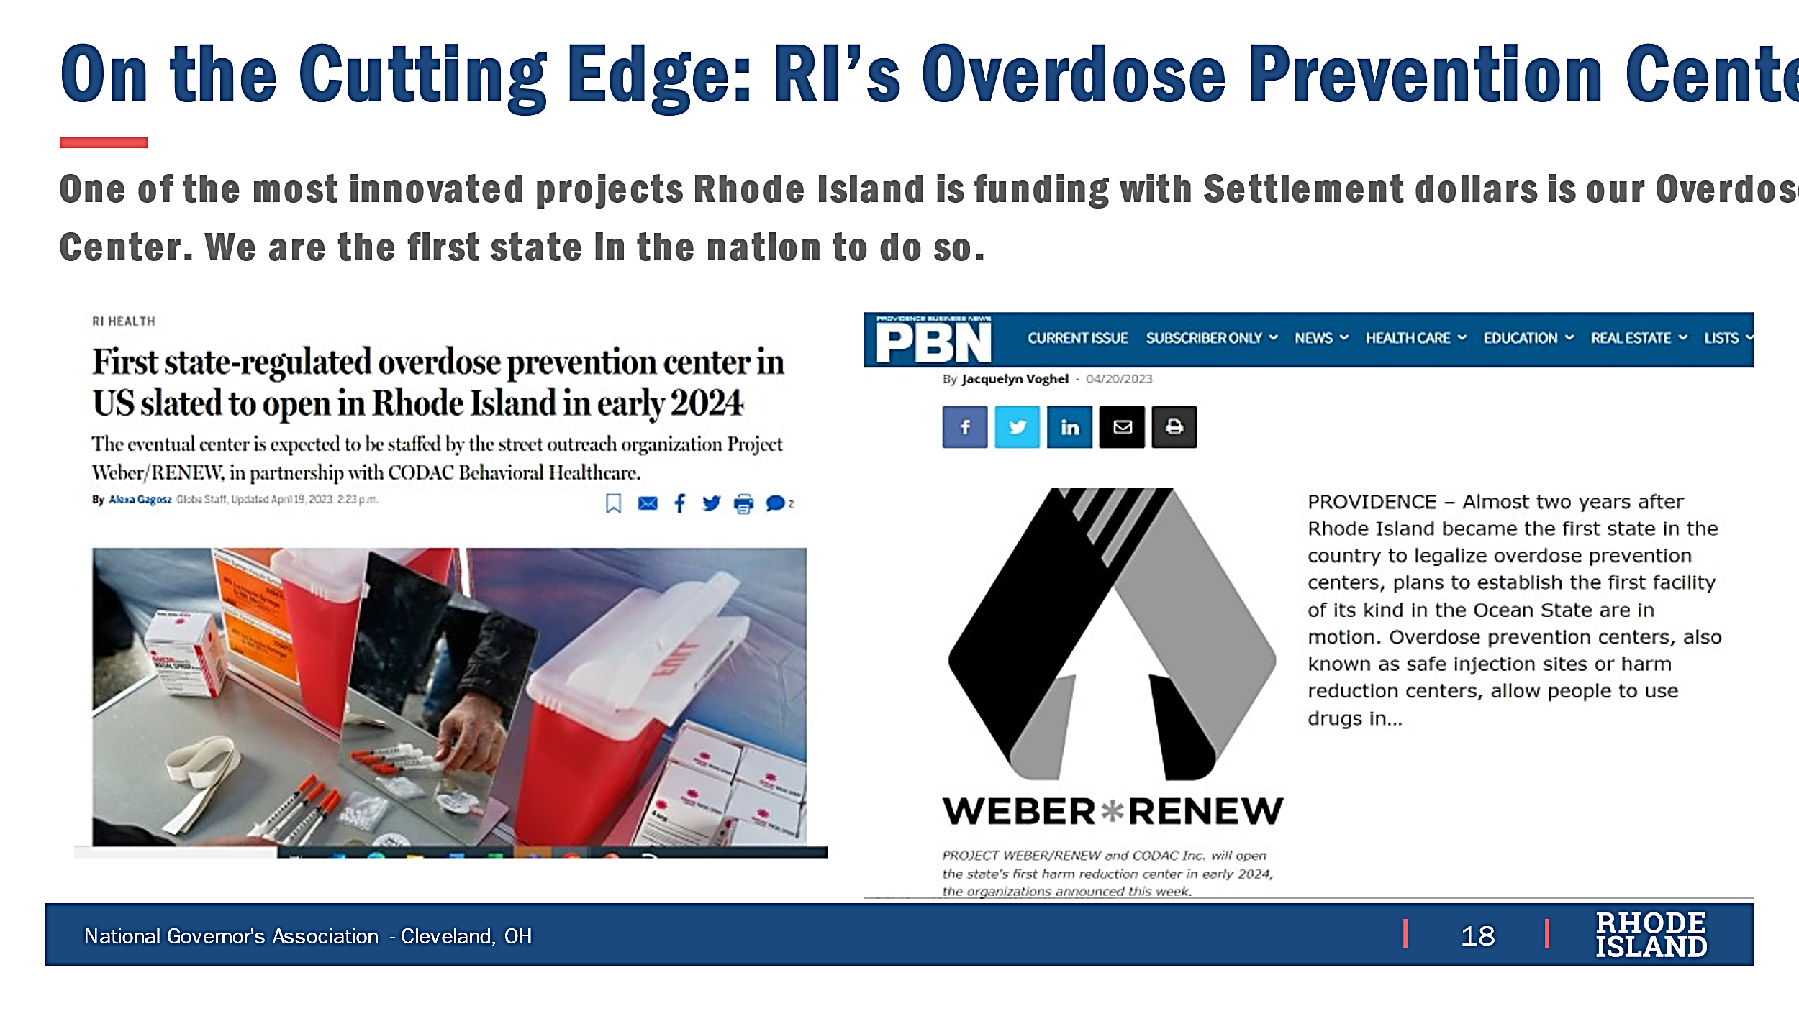
Rhode Island’s
Overdose Prevention Center
One of the most Innovative projects Rhode Island is funding with Opioid Settlement dollars is the Overdose Prevention Center.

Slide 36
Local Resources
Aids Care Ocean State (ACOS): AIDS Care Ocean State | Homepage - Main (aidscareos.org)
Project Weber Renew: Project Weber/RENEW (weberrenew.org)
Parent Support Network: Home : Parent Support Network of Rhode Island (psnri.org)
Community Care Alliance: Safe Haven (communitycareri.org)
Statewide Resources and Information on RI’s action plan to end the overdose crisis: Prevent Overdose RI – End the epidemic

Slide 37
Sarah Edwards
Drug Overdose Prevention Program
Rhode Island Department of Health
Sarah.Edwards.ctr@health.ri.gov

Slide 38
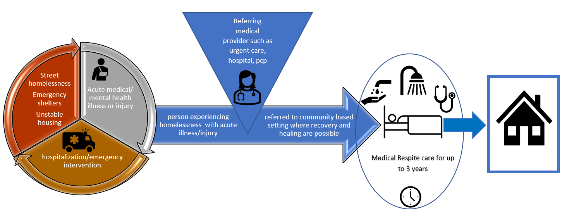
Medical Respite Care
What is Medical Respite? Non-permanent acute and post-acute care for persons experiencing homelessness who are too ill or frail to recover from illness or injury on the streets but are not ill enough to be in a hospital
Notes:
Harm reduction techniques:
Do not require sobriety for entry
Naloxone onsite
Anti-stigma trainer/ technical assistance provider assesses policies and procedures
Secure box with lock to lock belongings
Key aspect is a strong partnership between a housing and healthcare provider
Medical respite provides more than just a bed for individuals recover in, successful models typically provide complete wrap around services include medical care, behavioral health services, medication assisted treatment if needed, social workers who conduct social determinant of health screening, and housing specialists who ultimately aim to connect clients with permanent housing solutions
Medical respite programs have existed in the United States since the 1980s, today over 120 programs exist in 35 states, currently there are now 3 medical respite programs in RI (Lifespan/CRRI) (Westbay/EOHHS); BHDDH fellowship Health Resources BH respite
Currently over 120 medical respite programs in 35/50 states in the US (National Health Care for the Homeless Council 2021)- working group defined 8 standards in medical respite care

Slide 39
Questions

