Slide 1

COVID 19 Response in SUNY Libraries
April 24,2020
www.suny.edu

Slide 2

OLIS Update
Mark McBride, Library Sr. Strategist
www.suny.edu

Slide 3

Textbook Reserves Access Review
www.suny.edu
Notes:
Image from: https://www.nny360.com/news/suny-canton-library-doubles-textbook-loan-program/article_9f65da10-1c0f-5439-ab98-aa1b17140bf0.html

Slide 4
Textbook Access Review
No easy solution for maintaining digital access to course materials.
This is a moment in time to promote for more use of OER.
This also may make it easier for publishers to present inclusive access packages to your campus administration and bookstores.
Reserve materials are much more than textbooks. How do we approach videos, lab materials, etc?
Are there materials we currently have access to in our collections that can fill this gap?
Some of our libraries have a budget to purchase textbooks for reserve program.
www.suny.edu
Notes:
Image from: https://www.nny360.com/news/suny-canton-library-doubles-textbook-loan-program/article_9f65da10-1c0f-5439-ab98-aa1b17140bf0.html

Slide 5
Do we expect remote learning in the fall?
We should plan as if we will be remote.
Provost has joined a group of college presidents across NYS to discuss; SED is part of these conversations and planning.
Not all classes can be offered online.
Maybe expect some students.
Are libraries planning for this scenario?
Budgets will be tight.
www.suny.edu
Notes:
Image from: https://www.nny360.com/news/suny-canton-library-doubles-textbook-loan-program/article_9f65da10-1c0f-5439-ab98-aa1b17140bf0.html

Slide 6
SLSS Update
Shannon Pritting, Director of SUNY Library Shared Services
www.suny.edu

Slide 7
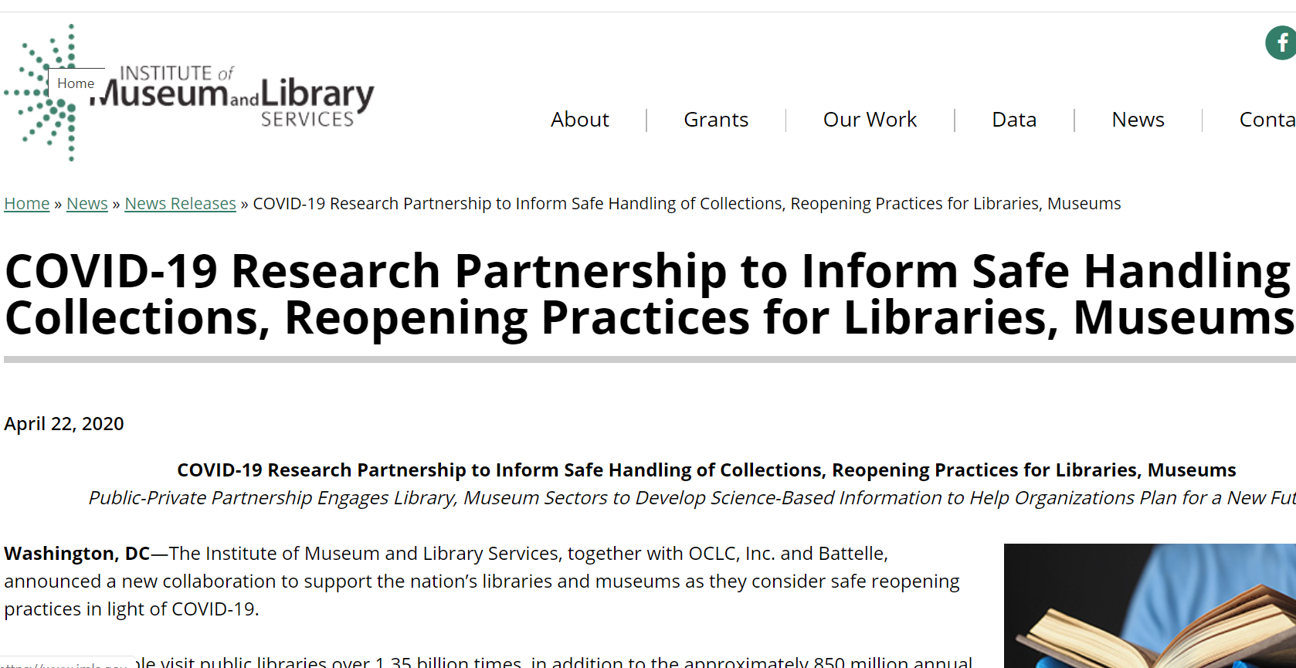
News Release about IMLS Research Study
IMLS coordinating a project to develop a “scientifically based look at library and museum protocols and practices for materials, staff, public and personal spaces, patrons, and the training and protocols needed for reopening.”
CUNY, NYU, NYPL, Columbia tentatively listed as participants.
SUNY has been invited, and we’ve expressed initial interest.
https://www.imls.gov/news/covid-19-research-partnership-inform-safe-handling-collections-reopening-practices-libraries
www.suny.edu

Slide 8
How Do You Handle Access to Library Content Via Guest Wireless?
There’s expanded access to Eduroam being reviewed in SUNY.
Could make access to guest wireless much easier for students.
What stance should SUNY libraries take in response to visitors from other SUNYs once facilities are open safely.
www.suny.edu

Slide 9
How is Everyone Feeling About Initiatives?
SLSS is reviewing what the capacity is at campuses for moving forward on new initiatives or functionality in Alma/Primo VE.
We want to be helpful and engage you if you’re interested, but understand that situations are different across institutions.
Let us know if there’s an initiative that we don’t have planned that would be good to address during this remote work time.
www.suny.edu

Slide 10
Virtual Visits
SLSS is spending time with campuses talking and listening to their experiences within the shared LSP, training, and collections.
We’re gathering trends, and developing responses to common issues brought up by campuses.
Thanks to the time that campuses have already spent providing us with valuable input.
www.suny.edu

Slide 11
Resource Sharing Update
Timothy Jackson, Resource Sharing and Fulfillment Program Manager
www.suny.edu

Slide 12

Alma Article Resource Sharing
Albany, Binghamton, Geneseo, and Stony Brook are now testing the article lending workflow
Buffalo and Upstate Medical will start testing next week
Workflow isn’t ideal, but it is manageable as long as lending volumes are kept low
We're finding most requests can be filled from electronic holdings
  Allows us to simplify the workflow
  Makes it possible to implement article resource sharing before libraries start reopening
www.suny.edu

Slide 13
Alma Article Resource Sharing
Hoping to roll out Alma article borrowing to a select number of libraries later this spring
We see this an option for non-ILLiad libraries and libraries that may want to stop using ILLiad/OCLC
Email me if you're interested in testing article borrowing and/or lending
SLSS staff will help fill requests using ESC's ejournal holdings, and we'll press Ex Libris to improve the workflow
www.suny.edu

Slide 14
Alma Physical Resource Sharing
Automatic renewals for borrowing resource sharing requests is not possible per Ex Libris
Lending renewal responses can be automated, but borrowers will be given a 12/31/1969 due date if they don’t enter a new due date when sending the renewal request to the lender
Please remember to process requests in the Mediated Patron Renewal Status, and be sure to enter a new due date!
  https://slcny.libguides.com/c.php?g=986100&p=7131255#Renewing
ASRS will consider implementing the automatic lending renewal response feature
www.suny.edu

Slide 15
SLC Update
Jennifer Smathers, SLC Consortial Engagement Coordinator
www.suny.edu

Slide 16

VOTE for SLC Board
Each institution can vote once and should select three candidates
Voting ends at 5 p.m. Friday May 8th
Results will be shared the following week
https://forms.gle/8VVHPfrHB8tSKhxSA
Brian Sullivan
Dean of Libraries, Alfred-Ceramics
David Schuster
Interim Associate University Librarian, Binghamton
Alana Nuth
Head of Collection Management, Geneseo
Pauline Lynch Shostack
Emerging Technologies &Makerspace Librarian/Professor, Onondaga
Jill Locascio
Associate Librarian - Digital and Technical Services , Optometry
Jillian Kehoe
Library Director, Maritime
Christine Faraday
Library Chairperson, Nassau Community College
Joshua Beatty
Instruction and Reference Librarian (Associate Librarian), Plattsburgh
www.suny.edu
Notes:
Katie Ghidiu sent email on 4/22
From WebForm:
Vote for SLC Board Members, 2020
Each institution should submit this form to select three candidates from the slate of nominations. Responses are due by Friday May 8, 2020 at 5PM. Results will be shared to the Membership shortly after voting closes.
The two candidates with the highest vote totals will fill the three year positions. The third highest vote getter will fill the two year position.

Slide 17
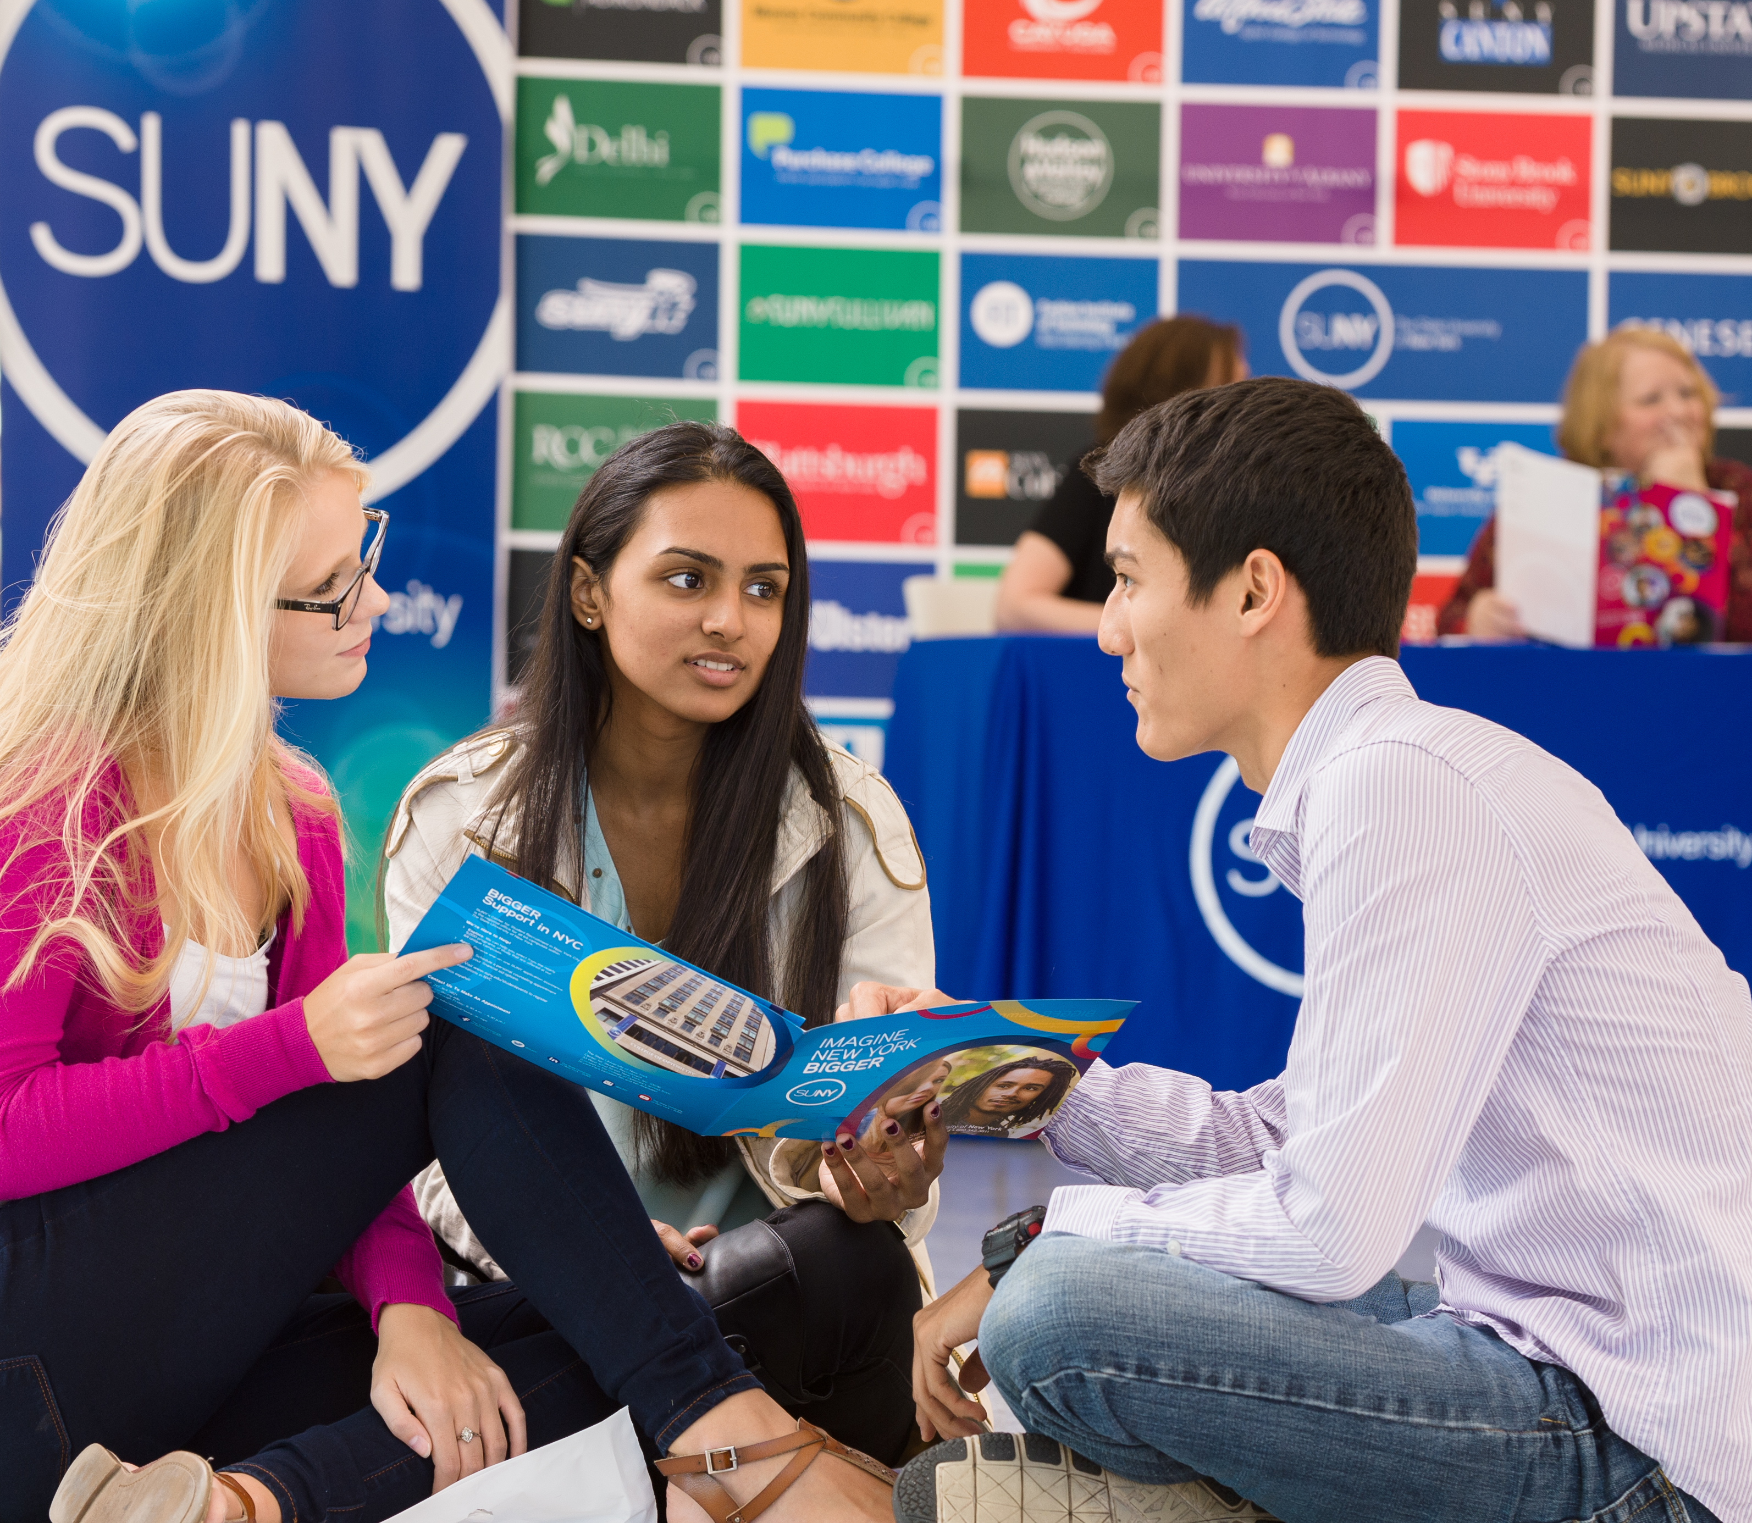

Questions?
How are Things Going at your Campus?
www.suny.edu

