Slide 1
Alma/Primo Link Resolver
Expected Behavior, Known Problems, Q&A
Michelle Eichelberger
Michelle.Eichelberger@suny.edu

Slide 2
What's a Link Resolver?
Most aggregator databases (eg. Gale, EBSCO, Proquest) don't have the rights to the full-text of all the articles that they index. Some will be full-text, some won't.
Publication vendors have different agreements with different database vendors: some sell their full-text to one vendor (EBSCO, Elsevier, etc.) but not to another: an article might be full-text in one database but not another.
The link resolver pulls all your holdings information together and identifies which, if any, of your databases provide full-text for your search result.

Slide 3
How did the old system work?
Most SUNY campuses used EBSCO's Full-text Finder (FTF) or 360 link for link resolving.
You maintained a list of database subscriptions, eBook purchases, etc. in EBSCOhost Admin Holdings or 360 link so that the link resolver would know what you had access to.
YOU control the accuracy of your results. The link resolver can be affected by human error.
FTF Example:
Patron searches in EBSCOhost Academic Search Complete and finds an article that doesn't have full-text.
Patron clicks on Get Full Text link:

Slide 4
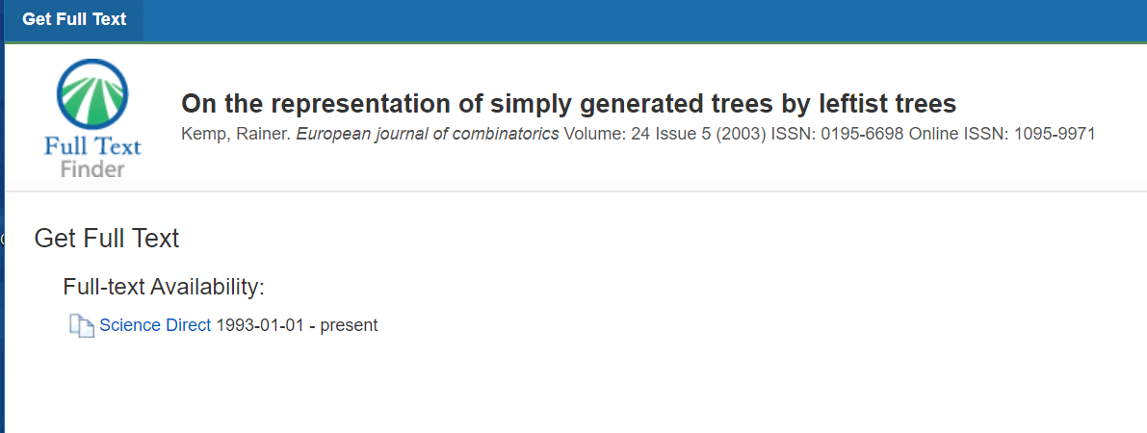
FTF Example, cont.
This window appears, often as a pop-up, and tells the patron where the article is available in full-text and provides the link to the article.
If there isn't full-text, it provides a resource sharing request link (usually ILLiad).

Slide 5
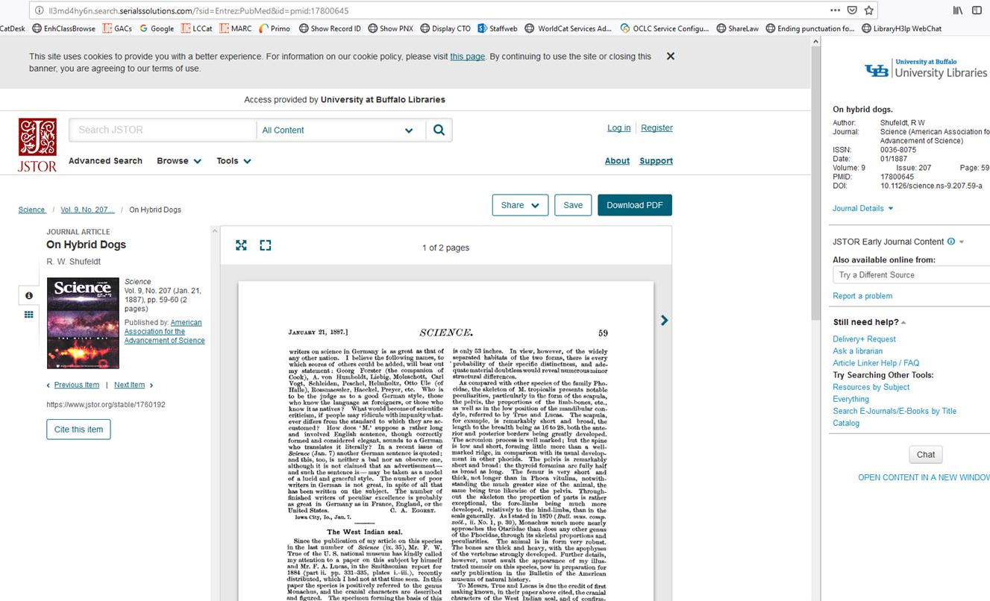
360 Link Example
Note the options panel on the right
Nancy Babb: "Even if full-text opened automatically, you still had the context identified, with the ability to try a different source, report a problem, etc."

Slide 6
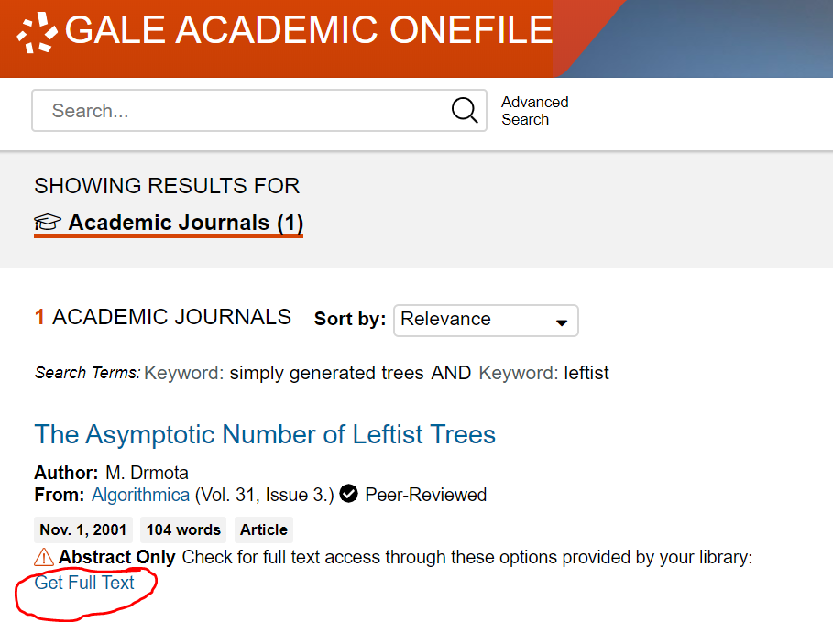
How does the new system work?
No longer separate place to maintain your electronic and print holdings. Everything is managed in Alma.
Same general workflow as old system:
Patron searches in stand-alone database.
Finds article that doesn't have full-text.
Clicks on Get Full Text link that's been updated by you to Alma/Primo link resolver.
EBSCOhost Full-text Finder contract expires 9/30/19.

Slide 7
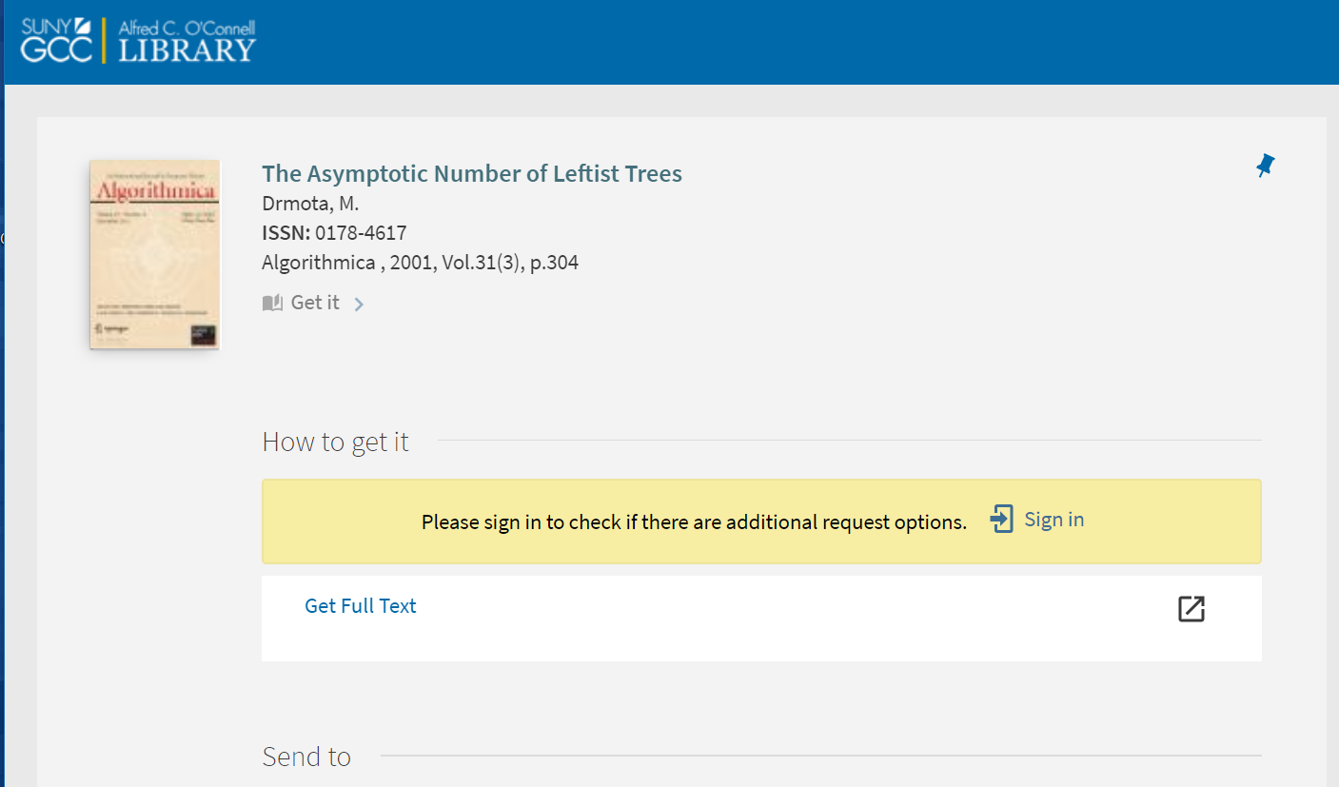
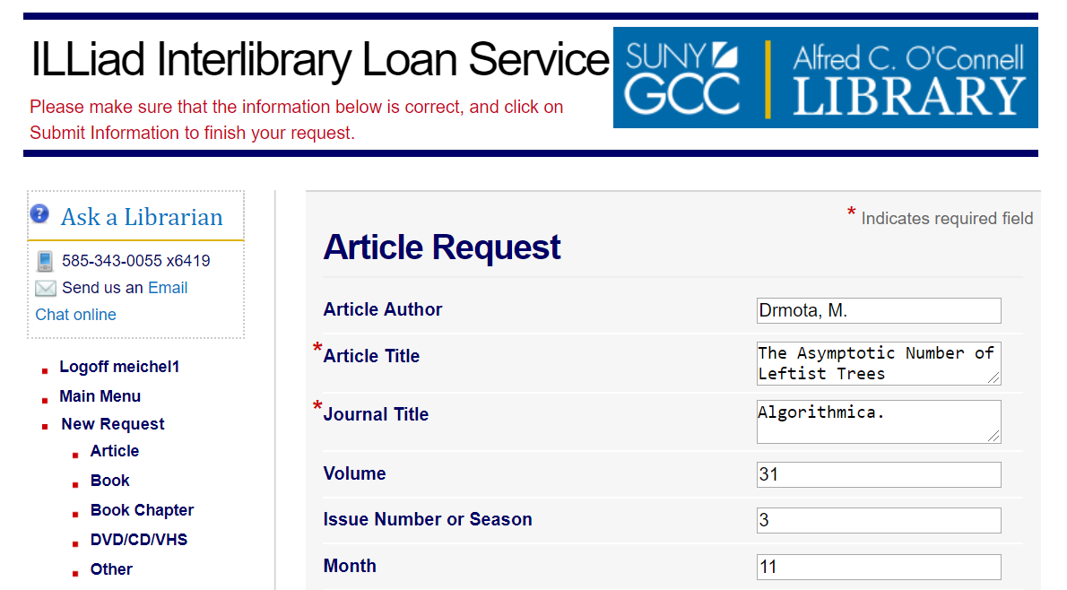
New system, cont.
Similar to FTF pop-up window, link resolver opens page, which then pulls up any full-text services that are available.
If there aren't any full-text services, the patron can log into Primo to see if they have option to request via resource sharing or ILLiad, or, if you chose to put your article request in front of your Primo login, they can click on the request link to order it:

Slide 8
Quick Review of Link Resolver format
https://<Primo_domain>/openurl/<Alma_institution_code>/<view_code>
eg.: https://suny-ups.primo.exlibrisgroup.com/openurl/01SUNY_UPS/01SUNY_UPS:01SUNY_UPS
Some campuses have found that they need to add a ? to the end of the string, eg. https://suny-ups.primo.exlibrisgroup.com/openurl/01SUNY_UPS/01SUNY_UPS:01SUNY_UPS?

Slide 9
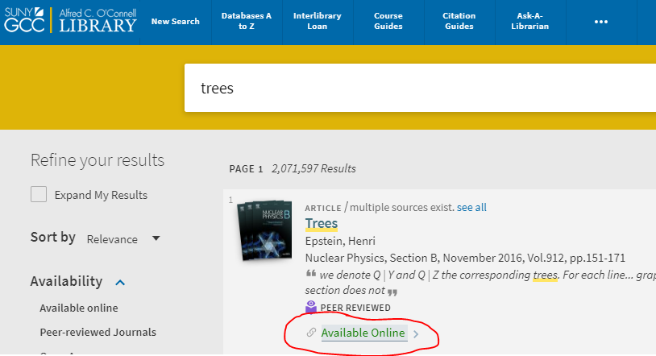
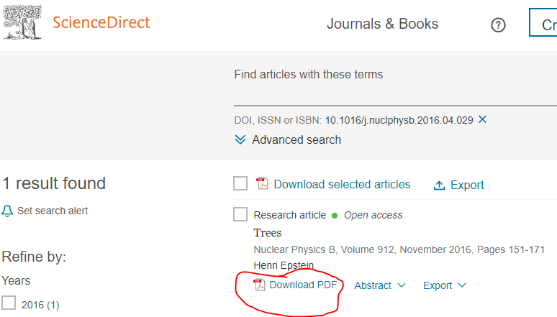
Direct Linking in Primo
What is direct linking? It's when a patron clicks on the "available online" in the brief record, and it takes them directly to the first full-text result in your list of results, bypassing the full record.
In a Primo search, patron can still see a list of all full-text services by clicking on the title of the brief result rather than "view online."

Slide 10
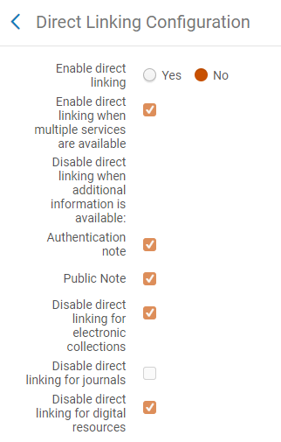
Direct Linking in Primo, cont.
Where do you activate it? Fulfillment->Discovery Interface Display Logic->Direct Linking
Can also configure Online Services order if you don't like the services that come first. Here's Juan Denzer's how-to video in Basecamp.
Setting it up for Primo results applies it to link resolver too.

Slide 11
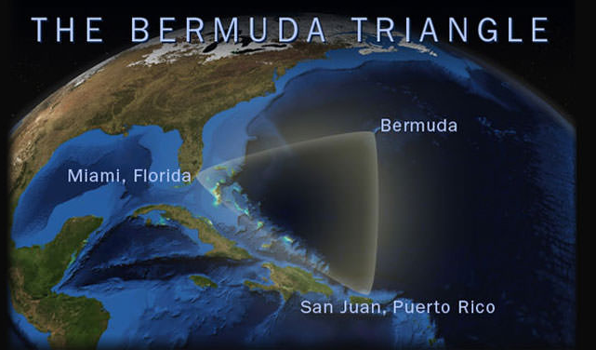
Direct Linking: Pros and Cons for Link Resolver
Pros
Convenient for patrons to go directly to article
Cons
There's no context for link – patron has no idea where they're being sent, why, or how.
Sometimes full-text service links are bad: they go to the journal homepage or a website rather than directly to the article, or they fail completely. The back button won't take patron back to list of full-text options.
Patron can't see full list of services so can't try different link if first one doesn't work
Can be proxy issues – e.g. Proquest problem where proxy is dropped in direct link (reported by ESC and ALF)
https://oceanservice.noaa.gov/facts/bermudatri.html

Slide 12
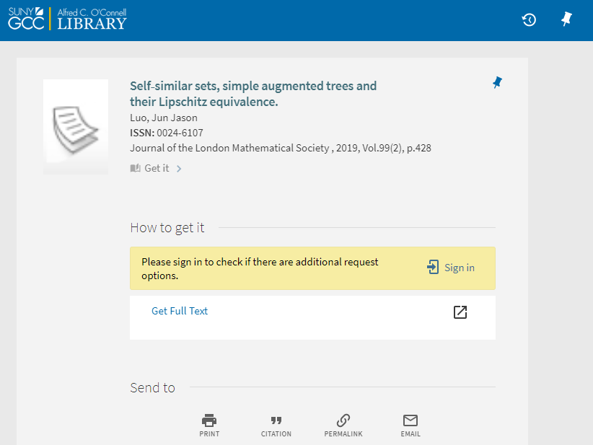
Known Issues: Display
It looks like you're in Primo, but there are no menu links at the top of the page – no way to redo search if link fails.
Can't edit this screen like you would FTF – if you make changes, it will change any full record display.
This isn’t linking to anything, record-wise. It’s just a generic pop-up like FTF, a “dummy record.”

Slide 13
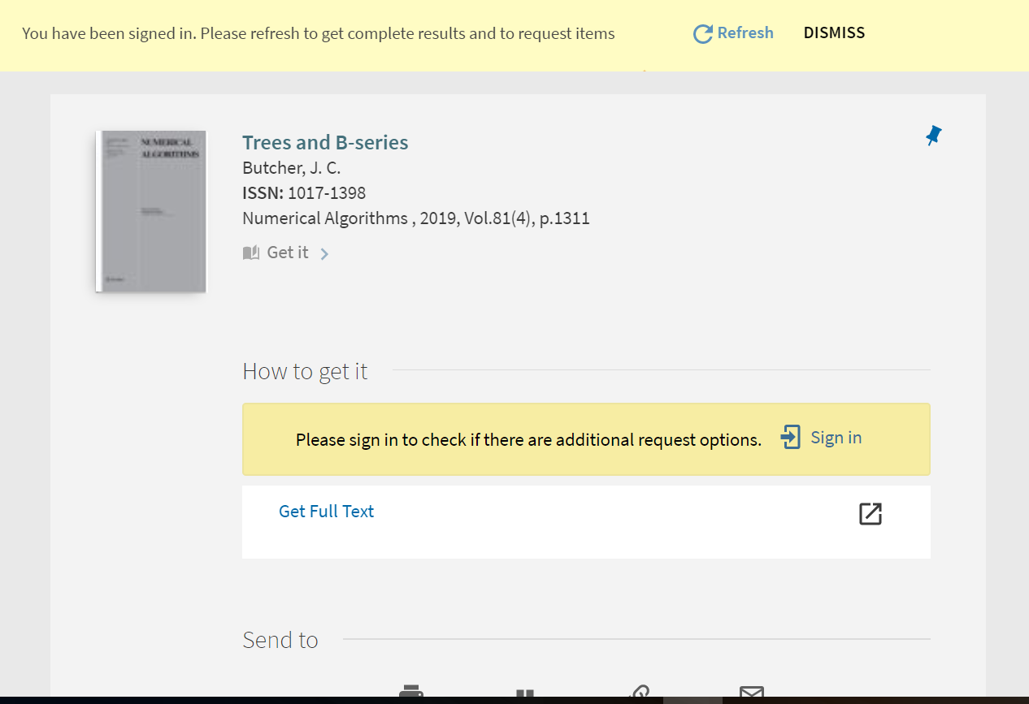
Known Issues: Authentication
Need to login to get your request options, even if you're already logged into Primo in a different window and have silent login activated. Are you in Primo, or not?
Proxy: you don't need to add proxy prefix to link resolver string - services and request forms will already be proxied through Alma/Primo settings
Ezproxy not working well with Shibboleth (UB) – login for request options spun and never logged patron in – had to add search.lib.buffalo.edu to "never proxy" in Ezproxy config file

Slide 14
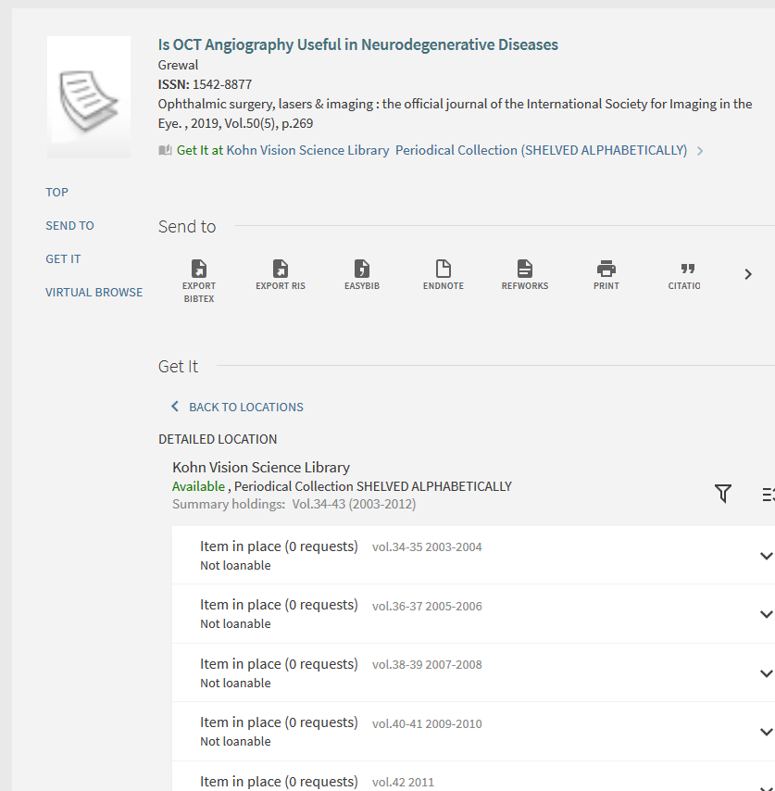
Known Issues: Linking to wrong Services/Holdings
Optometry reported a situation where the stand-alone database article had an outdated journal title but the correct ISSN, and the link resolver matched holdings by incorrect/old title rather than correct ISSN, so their old print holdings showed instead of current electronic content.
Keep an eye open for journal title holding matching instead of more specific ISSN or ISBN matching.

Slide 15
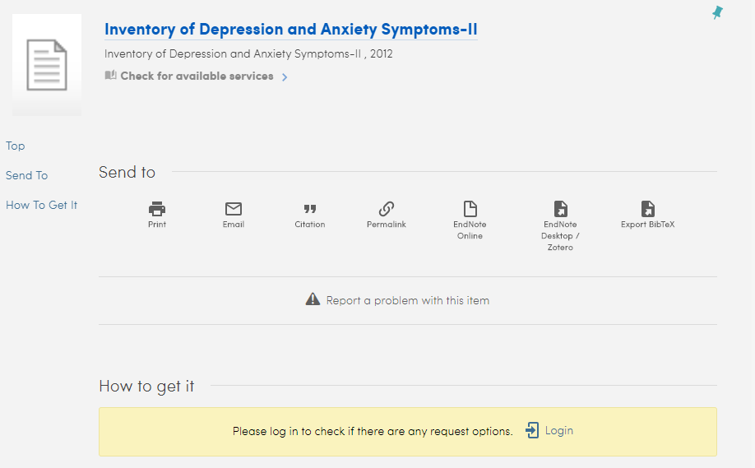
Known Issues: Incomplete Metadata
UB PsychTESTS example:
"Neither the resource sharing form nor either of of the ILLiad forms actually captures enough data to make a request really possible."
"Problem here is partly PsychTESTS and partly how we have the forms configured in Primo. We only identify 3 types of materials for our forms: books, book chapters, and articles. PsychTESTS has materials (like the inventories) that aren't being mapped to one of those types, so the system doesn't know which form to use, and also doesn't know how to best pass the data from the URL string."

Slide 16
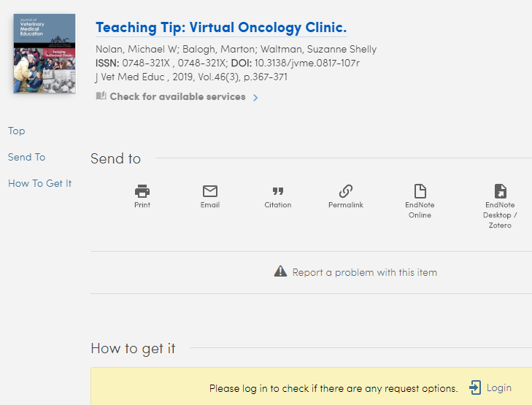
Known Issues: Incomplete/Odd Metadata
https://search.lib.buffalo.edu/discovery/openurl?institution=01SUNY_BUF&vid=01SUNY_BUF:everything&volume=46&date=2019&pages=367-371&aulast=Nolan&issn=0748-321X&issue=3&isbn=&spage=367&id=pmid:30721107&id=doi:10.3138%2Fjvme.0817-107r&title=Journal%20of%20Veterinary%20Medical%20Education&atitle=Teaching%20Tip:%20Virtual%20Oncology%20Clinic.&sid=OVID:medline

Slide 17
Known Issues: Incomplete/Odd Metadata and ILL/Resource Sharing
Watch out for mysterious resource sharing requests coming from link resolver records.
Abbreviated titles, missing page numbers, article titles, etc.
Resource Sharing and not ILLiad: are wrong request links showing because of bad metadata?
All have same MMSID – link resolver dummy record

Slide 18
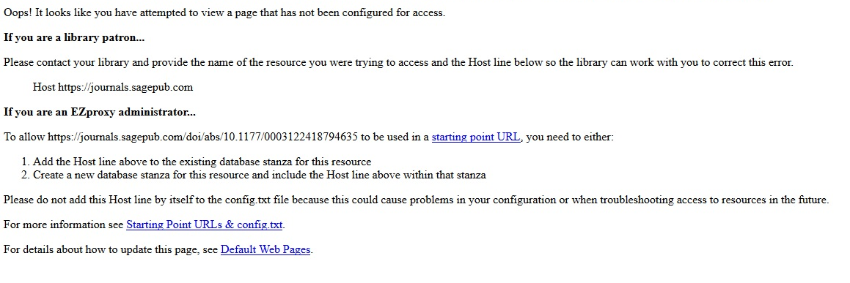
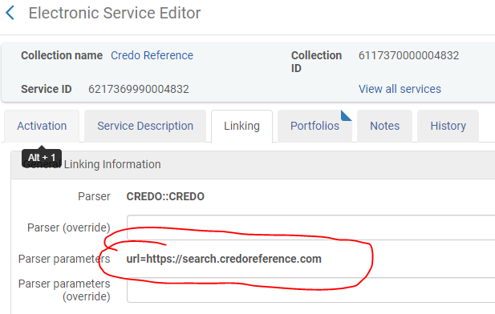
Known Issues: Linking Problems - Ezproxy
You'll get an error like this when the link that you're using to get out of Primo doesn't match a known link stored in your Ezproxy config file.
Could have happened through initial set-up or changes via CZ Update Task job.
How to fix:
Look up collection in IZ
Edit Service
Check link tab and make sure URL is included in your Ezproxy config file
And/or check OCLC for most current stanza

Slide 19
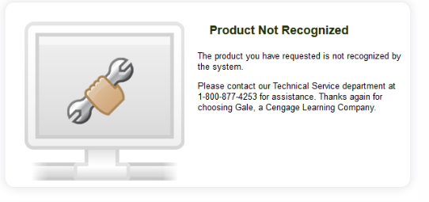
Known Issues: Linking Problems – No Access
You'll get an error like this when the link that you're using to get out of Primo doesn't recognize your credentials.

Slide 20
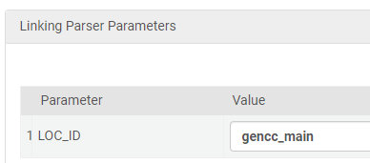
Known Issues: Linking Problems – No Access, cont.
How to fix:
Look up your electronic collection in the IZ:
Make sure that it's from the correct publisher – there are often many versions of the same collection.
Edit Service and check the linking tab:
Does URL link look close to your stand-alone database URL? Can vary a little.
If parser parameters have all caps field, you may need to add local code.
Scroll to bottom to check for loc_id or customer_id box

Slide 21
Known Issues: Our Friend EBSCO
Linking out to ILLiad: "Need separate rule for EBSCO and ProQuest is that they don’t send the journal title in the jtitle parameter. They use the title parameter"
Title and volume not included in OpenURL
EBSCO messing up volume numbers, drops the 1 from 185 and volume becomes 85
Use EBSCO link resolver plugin? Juan Denzer says yes
Recent Primo-L post from Drake University in Iowa: EBSCO OpenURL ending up with duplicate parameters in string: institution, url_ctx_val, url_ctx_fmt, isSerivcesPage. "If I remove the duplicates, the link resolves correctly. Otherwise we get a "Record cannot be displayed. The requested information is no longer available in this view" message."

Slide 22
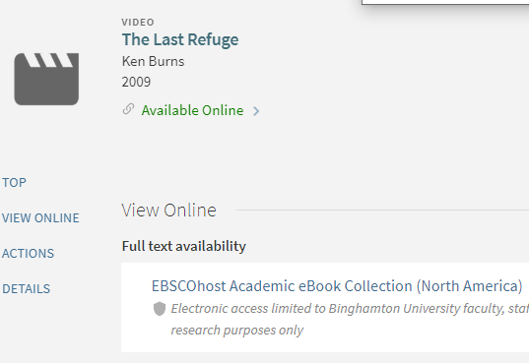
Possibly Related Known Issue: Linking on Records inside of Primo
Binghamton submitted Salesforce case about Streaming video records correct in Primo but service matching on titles and bringing up EBSCOhost eBook titles (doesn't happen if you don't own an ebook with the same title).
Heard from colleague at Royal Danish Library who noted that her colleague thinks that it's because "Primo VE uses the OpenURL linking instead of Direct link to resource for PCI records with the "Link in record" delivery setting - leading to the wrong resource due to the limited metadata available in e..g. video records."

Slide 23
Q&A Time
Acknowledgements:
Thanks to Nancy Babb at UB for her extensive help working through the content for this presentation and to Heidi Webb for slide review and input.
References:
SUNY FAQ: How will the openurl link resolver work in Primo VE?
List of all SUNY Shared Library Services Presentations

