Slide 1
Office of Library and Information Services
December 2022 – Meeting and Updates

Slide 2
AGENDA
10:00 – 10:30
OLIS and DIAS Structure / Overview of OLIS budgets
OLIS Strategic Plan / OLIS Advisory Board
Communities of Practice, Working Groups & Task Forces
10:30-11:00
SLS Extended Support Past, Current, and Future
-- short break until 11:00 --
11:00-11:30
OLIS Project Updates/Previews
11:30-12:30
Professional Development / RDM Updates
SUNY OER Services Updates / GE Framework
OLIS Communication and Time for Questions

Slide 3
OLIS and DIAS Structure and Overview of OLIS Budget

Slide 4
Digital Innovation and Academic Services
Interim Senior Associate Provost
Kim Scalzo
Executive Director SUNY Online Education
Director, SUNY Center for Professional Development
Interim Director, OLIS
Sr Strategist, Academic Innovation
Digital Learning Environment Project
Vacant
Lisa Raposo
Shannon Pritting
Lisa Stephens
Harry Cargile
Leadership for the digital transformation of the SUNY student experience
Align U-wide digital platforms in support of system-wide strategies for student success
Work with stakeholders across the System Office and with campuses to promote and facilitate change leadership in support of digital innovation
Establish/provide u-wide academic shared services to support digital platforms and digital innovation

Slide 5
Office of Library and Information Services (OLIS)
Interim Sr. Associate Provost of Digital Innovation and Academic Services (Kim Scalzo)
Interim Director of OLIS (Shannon Pritting)
Associate Director of SUNY Library Services (Maureen Clements )
Licensing and Business Operations Program Manager (Requested)
Director of Operations OER Services
(Tony DeFranco )
Director of Affordable Digital Learning Services
(Cori Wilhelm )
Associate Director of Assessment & Data Analytics
(Catherine Stollar Peters)
Resource Sharing Program Manager (Timothy Jackson)
Discovery & ERM Program Mgr. (Michelle Eichelberger)
SUNY Library Services Repository and Support Specialist
(Yvonne Kester)
SUNY Library Services Support Specialist
(Rebecca Nous)
Collections Support Analyst (Esta Tovstiadi )
SUNY Library Services
SUNY Library Services Support Specialist
(Susan Perry)
Metadata Coordinator (Searching)
Notes:
Shannon -

Slide 6
OLIS Budget Overview: Revenue
$235K PM Positions via LSP Agreement
$100K in Support Agreements
$4M OER NYS Funds
~$2M in State Funds

Slide 7
OLIS Budget Expenses
OER Technology and Program Support: $3.8M
$300K SUNYConnect Subsidy
$100K Repositories/SUNY Create Hosting
$200K Misc. Operations Support
Reviewing /Requesting Program Support Initiatives with Remaining $500K
$1.1M Staffing

Slide 8
Contract Passthroughs
~11.5M Annual Contracts
OLIS/SUNY Manages Contracts and Pays Vendor, Recovering Funds from Campuses via Direct Charge (in most cases)
No Net Effect to OLIS Budget. Recharge % goes to Business Operations. But, Benefit to Campuses in Efficiency/Savings.

Slide 9
High-Level Budget Considerations
Increasing costs of Repository will be a challenge we need to address, especially as research compliance requirements evolve.
Pass through contracts are helpful, but time consuming, and cost recovery hasn’t been something we’ve explored with campuses.
Challenge of shared service model that fits needs of all and is cost effective with limited ability to subsidize additional staffing.

Slide 10
Shared with stakeholder groups and broader community
Surveyed for feedback
OLIS Strategic Plan
2023-2026
OLIS Mission Statement:
The SUNY Office of Library and Information Services strives to support excellence and innovation in libraries and affordable learning programs by building collaborative learning networks, developing efficient shared services, growing and sharing campus staff expertise, and enhancing system-wide best practices.

Slide 11
Core OLIS Services
SUNY Library Services:
ALMA/Primo maintenance and support
Resource sharing and access strategies
Shared core collections
Core business management
SUNY OER Services
Open Access Repositories
Practice development, including training and professional development opportunities
Core strategic partners
SUNY Provost’s Office
Digital Innovation and Academic Services Departments: (SUNY Online, SUNY CPD, SUNY SAIL)
SUNY Press
ORIED
SUNYLA
ESLN
IDS Project
OLIS Strategic Plan
2023-2026
Notes:
Cori -

Slide 12
OLIS Advisory Board
OLIS will convene and facilitate an advisory board to provide guidance, feedback, and input on strategic direction.
Make recommendations to OLIS based on suggestions from working groups and task forces
Will include members from each campus sector, as well as from strategic partner groups such as SUNYLA and IDS
Communication between board members and sectors/stakeholder groups

Slide 13
OLIS Advisory Board
Membership:
Community College – Bonnie Gallagher (Dutchess)
Technology College – Jill Kehoe (Maritime)
Comprehensive – Jennifer Jensen (Oneonta)
Doctoral – Jamie Saragossi (Stony Brook)
SUNYLA President – Jennifer DeVito (rotating)
IDS Project – Mark Sullivan

Slide 14
Requires a Vote
Changes in SUNY Connect core services (unless PIAs are used)
Any non-SUNY Connect services involving financial commitment will require a campus PIA

Slide 15
OLIS will facilitate opportunities for networking and collaboration on shared projects
Goal: to provide a shared context for various SUNY libraries staff to communicate and share information/best practices and recommend policies.
Groups will be created, maintained, supported, and reviewed annually by OLIS.
Communities of Practice, Working Groups, and Task Forces
Notes:
Maureen -

Slide 16
Communities of Practice
A facilitated group of peers with common roles or duties who regularly come together to collectively learn, share, and network. Collaboration is ongoing, although membership may evolve.
CoPs will be invited to share out updates at virtual OLIS update meetings.
Current OLIS Communities of Practice:
New Library Directors and Chairs
New E-Resource Librarians
OER Campus Leads
Scholarly Communications
Discovery
Library Accessibility
Analytics
SUNY Library Directors (coming soon!)
Notes:
Maureen -

Slide 17
Working Groups
A facilitated community who convene and advise on specific topics related to their common roles/duties, including sharing of best practices and recommendations for process improvements
Present policy recommendations pertaining to their work to the OLIS Advisory Board for feedback
Membership is based on interest and demand, and open to all SUNY libraries staff
Invited to share out updates at virtual OLIS update meetings
Current OLIS Working Groups:
Metadata Standards and Policies
Access Services and Resource Sharing
SUNY Shared Collections Committee
Improvements and Enhancements

Slide 18
Task Forces
A facilitated ad hoc group convened with a clear and focused scope of work, which adjourns at the conclusion of the project or initiative.
Participation is based on interest and demand, or a call for nominations.
Current OLIS Task Forces (Fall 2022):
Library Courier TF
Expanding JSTOR Access
SUNY Connect eBook Program

Slide 19
SUNY Library Directors Community of Practice
Feedback from directors – desire to network, connect, and work together to solve problems
OLIS will facilitate regular meetings
Virtual and in-person
Meetings will include updates on major initiatives

Slide 20
SLS Extended Support Past, Current, and Future

Slide 21
History of Extended Support: The Migration
OLIS covered all ExLibris implementation and migration costs.
ExLibris costs and 3 FTE Project Staff, plus other extra service engagements.
Other OLIS Staff provided support.
Many campuses expressed concern that they did not have local staff to support Alma/Primo VE.
Majority of campuses requested additional assistance for the LSP migration.

Slide 22
The Guided Path.
Focus on cleanest and most streamlined completion of migration forms.
Minimal configuration designated in forms.
Provides best opportunity to learn new system configuration by doing configuration in system, not through forms.
Will look forward to strengths of Alma, not focus on migrating legacy system practices.

Slide 23
Beginning of SLS
Presented to SLC in December 2017.
SLC not able to come to consensus on how to move forward.
Mark began working to find a home to grow staff to meet needs short-term and long-term.
If positions housed at System, we would not be able to grow.
Fortunate move from EDS/Aleph/Summon/Hosted to Alma/Primo VE cost significantly less.

Slide 24
Extended Support and Baseline Support
Post-Migration, SLS needed to attempt to prioritize due to high volume of issues and needs.
SLS leaned in on training to get campuses more comfortable in their live system, reducing our ability to directly support, so limited to 5 baseline hours.
When pandemic hit, we shifted to provide more direct support to all, as well as offering extended support.
Shifted training to 1-1 and campus focused.

Slide 25
Early Extended Support Engagement Experiences
Many single-year agreements with high administrative overhead.
Hourly services, focused on blend of training, performing work for/with campuses, organizational consulting, and work within and beyond the LSP/Discovery environment.
Campuses saw these as transitionary, not long-term solutions.
Many requests for SLA’s to provide as part of labor-management and negotiations.
Had as many meetings about campuses avoiding extended support as we did campuses seeing this as valuable.

Slide 26
Adjustments to Extended Support
Met with campuses to understand their needs related to support.
Lowered costs significantly to focus on supplementing staff, but with understanding that this isn’t a transitionary engagement.
Low-Cost Small Campus Resource Management and Systems Agreement Developed
More campuses asking SUNY to provide long-range systems support.

Slide 27
Current Partnerships
17 Agreements in 22-23
3 Doctorals
2 University Centers
8 Community Colleges
4 Comps./Specialized

Slide 28
Focus on Services without Agreements
12 Onboarding Engagements
Extensive Auditing: Collections, E-Resources
Support of Integrations and New Modules (Rialto, Oasis, Gobi, etc)
In-depth reporting assistance
Project Advising and Transition Support for Campuses
Major project support in repository work
Consulting for campuses with major staffing/organizational changes

Slide 29
Areas Supporting Beyond Alma-Primo
Cataloging
Procurement
Accessibility
Interlibrary Loan—ILLiad, Worldshare, etc.
Processing Requests via ILL
Repository
Resource Management
Analytics
Scholarly Communications
Libguides
Organizational consulting
General Troubleshooting

Slide 30
Future of Support Services
Supplemental services
Retain and Build Local Staff
Targeted assistance in cooperation with campuses
Project Management for larger initiatives
Work with small campuses and small group of partners on more extensive support
Stabilize and make support more efficient via shared infrastructure
Target Limited Shared Service Opportunities such as cataloging.

Slide 31
Quick Break
reconvene at 11:00am

Slide 32
SLS Updates and Previews

Slide 33
SLS Collections /eBook Task Force
Goals – to secure buy-in for shared eBook collecting across SUNY.
Develop a cost model / plan for the first two years of eBook collecting program
All in, no opt-outs
Research acquisition models, products, consortia management models
Review vendor proposals and commit to Year 1 procurement
Recommend next steps for ongoing management of consortia eBooks (committee, working group etc.)
Continued communication through basecamp, sector meetings and presentations

Slide 34
eBook Task Force Timeline
Aiming for program to begin late summer or fall 2023
Fall 2022 – Early Winter 2023 – Task Force work
Early Spring/Winter 2023 – Vendor presentations
Spring 2023 – Task Force report and recommendations
Spring 2023 - Financial commitments from campuses

Slide 35
eBook Task Force members
Task force members:
Susan Davis (UB) (Chair)
Giovannine Matherson (Schenectady)
Jason Kaloudis (Old Westbury)
Jess Spooner (Canton)
Kimberly Kennedy (Stony Brook)
Lauren Bradley (Maritime)
Parker O’Mara (Plattsburgh)
Rick Squires (Monroe)
Sarah Maximiek (Binghamton)
Esta Tovstiadi (SUNY)
Maureen Clements (SUNY)
Shannon Pritting (SUNY)

Slide 36
JSTOR Task Force
Goal of the group: To evaluate Ithaka's offer to move to a single-fee model for access to all JSTOR journals.
Recommend whether to add JSTOR to SUNYConnect (all-SUNY contracts) or create an agreement for some campuses or a subset of campuses (e.g. sector)
Conduct analysis on ROI and overlap with current collections
Develop internal price structure
Review options for NZ management of JSTOR collections
Engage with library staff and administrators to solicit feedback and socialize the recommendations

Slide 37
JSTOR Task Force Timeline
If adding JSTOR, goal is for access to begin January 2024
Fall 2022 – Winter 2023 – Task Force work
Early Spring 2023 – Task Force report and recommendations
Early Spring 2023 – Contract work with Counsel and Business Office
Spring 2023 - Financial commitments from campuses

Slide 38
JSTOR Task Force Members
Andy Heinz (Orange CC)
Anna Wong (Canton)
Dana Laird (Brockport)
Jacquie Keleher (Schenectady)
Kimberly Detterbeck (Purchase)
Matt Gallagher (Binghamton)
Esta Tovstiadi (SUNY)
Maureen Clements (SUNY)
Shannon Pritting (SUNY)

Slide 39
SLS Collections Update
Recharge billing
Mid-December timeframe SUNYConnect and PIA charges
Renewals coming in March
Chronicle, Proquest
Artstor contract

Slide 40
Open Access
Cambridge University Press (CUP) Read and Publish Agreement​
Three-year deal
Provides read access for all journals
Free Open Access publishing for affiliates (Free Article Processing Charges (APCS))
Eight campuses participating
SUNY Press / Open Access deal
Opt-in program to fund Open Access monographs for SUNY Faculty

Slide 41
SLS Project Updates/Preview
Transition to Open Athens
Authentication software – more granular
Assist with implementation to Open Athens
Five –year project
Currently in the approval stages with SUNY Admin
SLS website changes
Archive SLC portions of the website
Changes over the break and into January

Slide 42
SLS Updates continued...
OCLC – data sync issue expected to be resolved this spring
OCLC Cataloging-Small Library Edition and Worldcat Visibility
Meetings with Extended Support campuses
Opening for a Metadata Coordinator / Support Specialist

Slide 43
Resource Sharing
Expansion of resource sharing partnerships via Alma across New York and beyond:
Existing - Brandeis, Canisius, Cal State, Gettysburg, Ithaca, Nazareth, Susquehanna, WRLC
Future partnerships - Univ of Central Florida, Russell Sage, and schools from the Connecticut State Colleges and Universities, and Connect NY consortia
ELD task force – ESLN currently receiving bids
Next steps – price sharing, re-survey schools about # of days for courier service, direct billing from ELD/ESLN in July. They will work with Sept FY schools.

Slide 44
E-Book ILL Pilot
Intended to run for 1-year as a proof of concept.
Original scope was to make this work in ILS/LSP and create eBook central functionality.
Engagement with small group of publishers.
Bloomsbury, NYU Press, Duke UP, Oxford UP, Taylor and Francis (no textbooks or newer than 2019), Brill
3,500 titles that SUNY owned or provided access to were eligible.
SUNY developed a form-based workaround and centrally processed ILL requests.

Slide 45
Pilot Data Highlights
3,587 titles available.
747 total requests on 457 separate titles.
12.7% of titles available received ILL requests.

Slide 46
Main Lenders

Slide 47
Borrowing by Campus
34 total campuses
Good distribution with 26 campuses with 5 or more requests.
Requests coming from a variety of campuses with different levels of e-book experience.

Slide 48
Interesting Data Observations
43% of requests never accessed.
Of the requests not accessed, 174 (54%) were on a title that had duplicate requests, and were likely requested multiple times and accessed once.
Minimal difference in access percentage between different types of institutions.
Mean of Time in book: 18 minutes (higher than Proquest Avg.)
Mean of # of Pages Viewed: 32
Mean of Chapter Downloads: 1.016
Majority of use in Ebook Central, not downloads

Slide 49
Pilot Future?
Met with ProQuest in late November. Entire team we worked with last year is no longer attached, and new individuals involved.
PQ proposed another year, implying that more publishers may be involved, and looking to add other libraries (specifically international)
No specifics provided.

Slide 50
SUNY’s Proposal to ProQuest
SUNY not interested in more discussions about RS software, would like to see this functionality work in eBook Central instead.
Would like more direct connection to publishers to work on models for eBook ILL.
Need list of publishers involved.
Question value of having another year of a complex workaround workflow, but would like to do analysis with publishers on usage of a title available via ILL vs. other access models.
Have follow up meeting with PQ, and will reach out to campuses about future plans, and to gather interest if we continue.

Slide 51
Library Leadership & Management Certificate
Spring 2023 courses available:
Introduction to Project Management for Libraries
Developing Library Partnerships
Change Management in Libraries
Library Strategic Planning
Library Assessment
Upcoming Virtual Offerings:
Spotlight on SUNY Libraries
Dec 7: Departmental Strategic Planning
Feb 9: Starting a Mentoring Program
Round-Table/Panel discussions
Learning Commons Model
Textbook Reserves and eBook Textbooks
Professional Development
Activities
Notes:
Cori -

Slide 52
Research Data Management Updates
Community of Practice around research data management support needs
Save the Date: Thursday, June 22, 2023 in Albany Area
ACRL Workshop – Building Your Research Data Management Toolkit: Integrating RDM into Your Liaison Work

Slide 53
Changes in Compliance Coming
Update to NIH data sharing policy: in effect January 2023.
White House Office of Science and Technology Policy (OSTP) changes to OA and Research Data Sharing: to be implemented by the end of 2025/2026.
Also called the “Nelson Memo,” which updates the 2013 “Holdren Memo”
General Trends in OA and Data Sharing and the Effect of NIH and Nelson Memo.

Slide 54
NIH Data Sharing Update
Data Sharing and Research Data Management Plans have been required by NIH since 2003.
But only for grants over $500,000
January 2023 policy requires data sharing and research data management plans for all NIH grants.

Slide 55
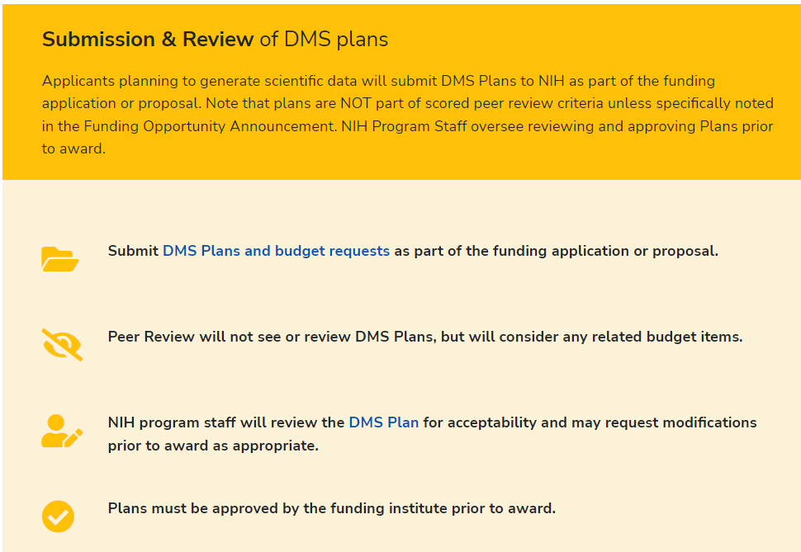
NIH Data Sharing Update
NIH has issued the Data Management and Sharing (DMS) policy (effective January 25, 2023) to promote the sharing of scientific data.
Sharing scientific data accelerates biomedical research discovery, in part, by enabling validation of research results, providing accessibility to high-value datasets, and promoting data reuse for future research studies.
Under the DMS policy, NIH expects that investigators and institutions:
Plan and budget for the managing and sharing of data
Submit a DMS plan for review when applying for funding
Comply with the approved DMS plan

Slide 56
NIH Data Requirements and SUNY
Current SUNY Awards Requiring Data Sharing and Plans: 3%

Slide 57
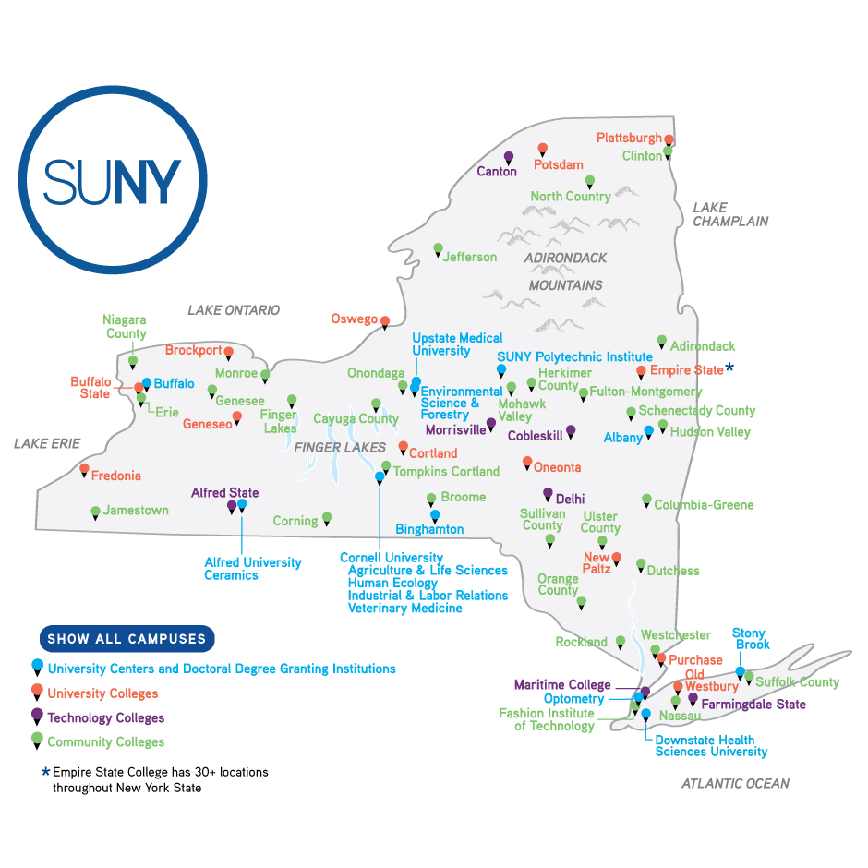
Future of Compliance Support
OSTP and NIH changes are part of shifts in funder compliance requirements.
Will require increased support involving multiple departments.
Some issues may be challenging long-term problems.
Transformative Agreements
Data Infrastructure

Slide 58
RDM, SUNY Repository, and Data Services
SUNY is currently reviewing Dryad as a Research Data Management solution to pilot for a year.
Will review RDM needs throughout year.
No plan to offer RDM as a shared service.
SOAR not intended for Research Data, and if campuses wish to host datasets, these will be treated as a specific service request that will likely involve charges to campus.

Slide 59
SUNY will cover the costs of all courseware from Ready-to-Adopt Catalog through Fall 2025
In planning stages to return to a model which includes direct funding to campuses
OER Advisory Board to provide feedback and recommendations regarding:
strategic planning,
outreach and professional development offerings,
potential partnerships,
sustainability and growth of OER and affordable learning resources across the system.
SUNY OER Services
Notes:
Cori -

Slide 60
OER Total Enrollment Trends

Slide 61
Courseware Enrollment: Courses

Slide 62
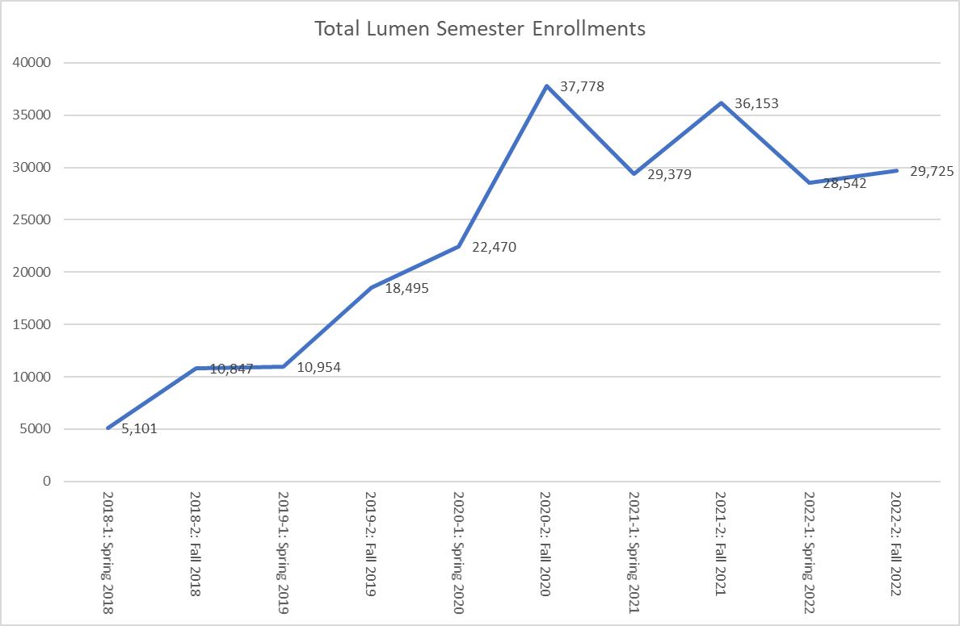
Courseware Enrollment: Students

Slide 63
Courseware Enrollment by Platform

Slide 64
OER Creation for Courses at Scale
Main focus will be on development of 5 courses over the next 30 months to add to Ready to Adopt Catalog via partnership with OLI.
Will gather input from campuses and advisory board on which courses to develop, with adoptions connected to them.
Focus will be on high-enrollment Gen-Ed.

Slide 65
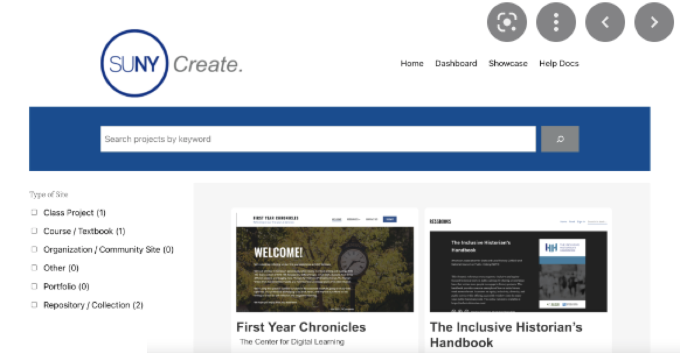
OER Creation for All
For faculty who want to create their own OER, SUNY Create is available.
SOS will be working with campuses relying on SUNY Create for large-scale institutional uses on cost-sharing model.

Slide 66
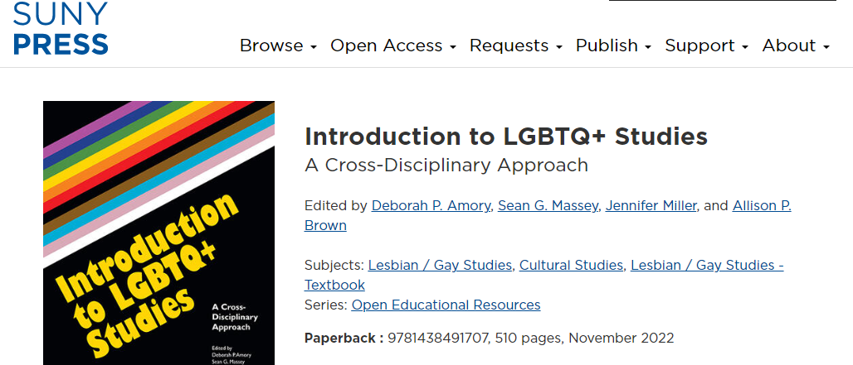
Creation Grants and Edited OER
No current plans for more OER textbooks via SUNY Press.
Reviewing approach for any potential creation grants in future years.
Some of previous textbooks have been multi-year projects.

Slide 67
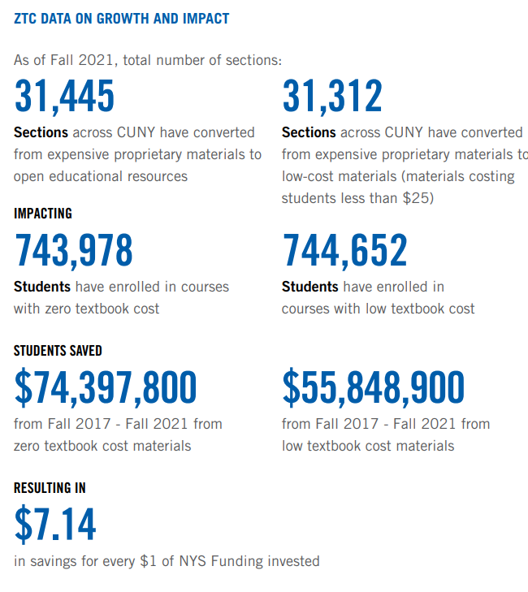
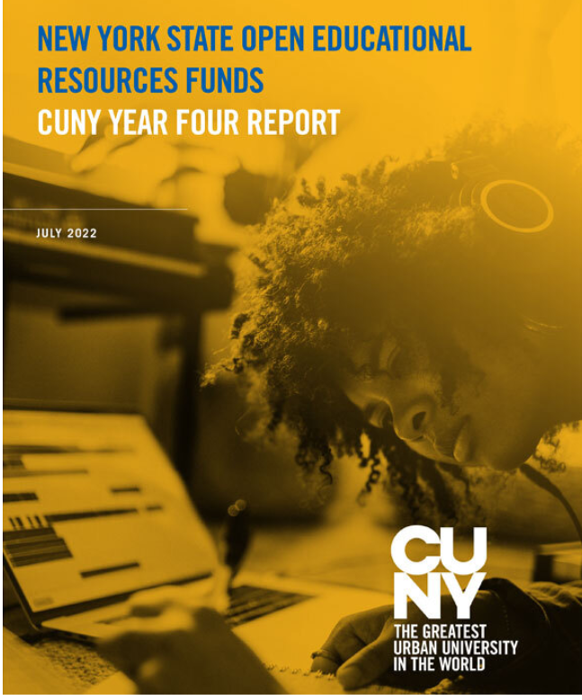
Affordable Learning: ZTC and LTC
CUNY began reporting LTC and ZTC in addition to OER savings.
SUNY reviewing how we can align with this strategy.
https://www.cuny.edu/libraries/open-educational-resources/

Slide 68
Spring 2022 Participants
180 enrolled
47 SUNY Institutions
Self Paced Exploration of Belonging (Pilot)
168* faculty enrolled
34 Institutions
*Self Paced Pilot available until July 31, 2022
Fall 2022 Applications status:
114 faculty expressed interest in Fall 2022
64 faculty committed, 50 awaiting circle date selection
Lumen Circles: Who is participating

Slide 69
Lumen Circles Trends
AY 21-22
AY 22-23

Slide 70
Circle Themes

Slide 71
Next Steps for OER Services
Proposals awaiting review to restart campus supports.
Will focus on picking up sustainability work again, adoption incentives, and targeted initiatives.

Slide 72
SUNY Gen Ed Framework
Changes to GE Framework coming in Fall 2023
Campuses will implement changes individually – guidance from System but no policies
How can OLIS best support campuses with new GE Framework?
Gen Ed Task Force
Mini-conference with workshops
Repository of best practices and documents
Notes:
Cori -

Slide 73
Updating website
Archiving older documents
New SLS pages
Email and Posts
New SUNY-wide Listserv
SCLD Listserv (directors)
SLS Blog
Basecamp
Meetings
OLIS Quarterly Updates
Library Directors Community of Practice
OLIS Communications

Slide 74
Questions?
Please raise hand or type in chat

