Slide 1
Creating Collections for Discovery Using ALMA
Marianne Hebert – SUNY Potsdam (hebertm@potsdam.edu)
Michelle Eichelberger - SUNY Library Services (michelle.eichelberger@suny.edu)

Slide 2
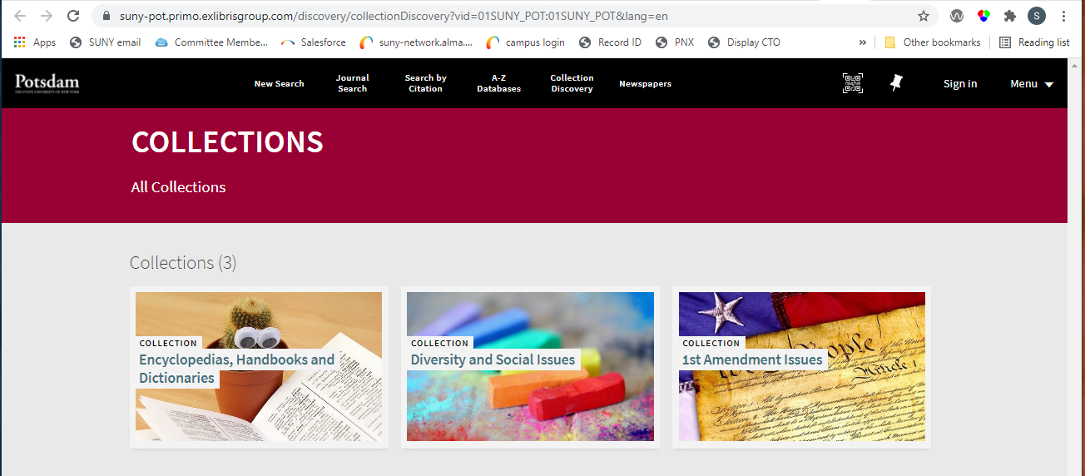
Discovery Collections not EResource Collections

Slide 3
Using Collections to support DEIA Initiatives
Diversity presence helps to promote an inclusive and welcoming atmosphere.
Diversity and Social Issues e-book collection
Curated during the Summer of 2020
Focus on voices of historically marginalized people
Encyclopedia and Dictionaries
Spring of 2021, while still working remotely
Disciplines that generate the most research (Art, History, Women Studies)
Support for DEI topics (Women’s Rights, Gender and Sexuality, Social Justice)

Slide 4
Benefits
Helpful tool for Reference Librarians
Browse print and electronic titles in one place
Titles suppressed & deleted in ALMA don’t display in Collections
Makes it easier to maintain
Similar content in LibGuide or website would have to be managed manually
Surprised at how much e-book content we had (Proquest & Gale)
Opportunity to identify gaps or outdated content
Promote findability and use of resources
Notes:
Also Oxford encyclopedias

Slide 5
Considerations
What is the scope of the collection?
What content do you have?
Print only? Electronic only? Or both?
Start by identifying topical areas
Where should interdisciplinary titles go?
Select some or all titles to be included in collections before you begin
Do you have too little or too much content for a collection?
How far down do you think users will scroll past “Load more items”?
You may want to create sub-collections

Slide 6
Finding items to add to collections
Subject Heading (LCSH) searches work fairly well
[Topic] and Encyclopedias, or Dictionaries, or Handbooks
Some e-book metadata can be very scanty
Try title and keyword searches
Verify linking to vendor website
Verify content on vendor website
Use Vendor website to search for additional titles

Slide 7
Use a spreadsheet to organize content

Slide 8
Sub-collections
Diversity Issues collection
It was impossible to pigeon-hole authors into topical categories such as race, ethnicity, gender, victims of discrimination, etc.
Opted for more generic Fiction, Non-Fiction, Memoirs, Self Help, etc.
“General and Interdisciplinary Resources” blooper
Not very descriptive or enticing (librarian-speak)
Added as a sub-collection to several collections (Art, History, WGS, etc.)
Makes it difficult to add items from ALMA title searches
Breaking up historical periods was a little tricky
Art: “Prehistoric to 18th century” and “19th, 20th, 21st centuries”
History: “Ancient Civilizations” and “Medieval and Renaissance”

Slide 9
Countries, Nations and Cultures
How to organize racial and ethnic groups?
Have plenty of African American encyclopedias, but not enough to create separate sub-collections for Asian Americans, Hispanic Americans or other groups
Too many country handbooks to include them all
We don't get many "country" questions
Wars often involve more than one country
Did not add encyclopedias of wars, to US History, but
Created more general Wars, Conflicts and Revolutionary Movements
Currently listed under History, but could be under Social Justice

Slide 10
Images are not required but…

Slide 11
Images Upload Thumbnail
jpg, png, or gif format ; maximum size of 100K
Images should be in public domain or free to use without attribution
Pixabay https://pixabay.com/
Free for commercial use
No attribution required
Wikimedia Commons for classic art and photographs

Slide 12
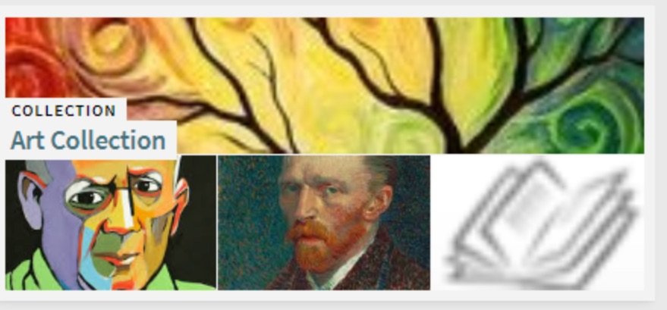
Collection Lobby Page
Allows the image from the Collection and up to 3 three sub-collections to display.
To prevent that, upload the images to both the General tab and the Discovery tab

Slide 13
Image considerations
For DEIA topics, honor the dignity of people especially historically marginalized groups
Avoid stereotyping
Don’t use potentially triggering imagery
Consider using generic images or patterns instead
Consider using classic art or photography images instead
Consider color scheme of your Primo pages
Consider how different images might look next to each other
Stay with themes for a cohesive look

Slide 14
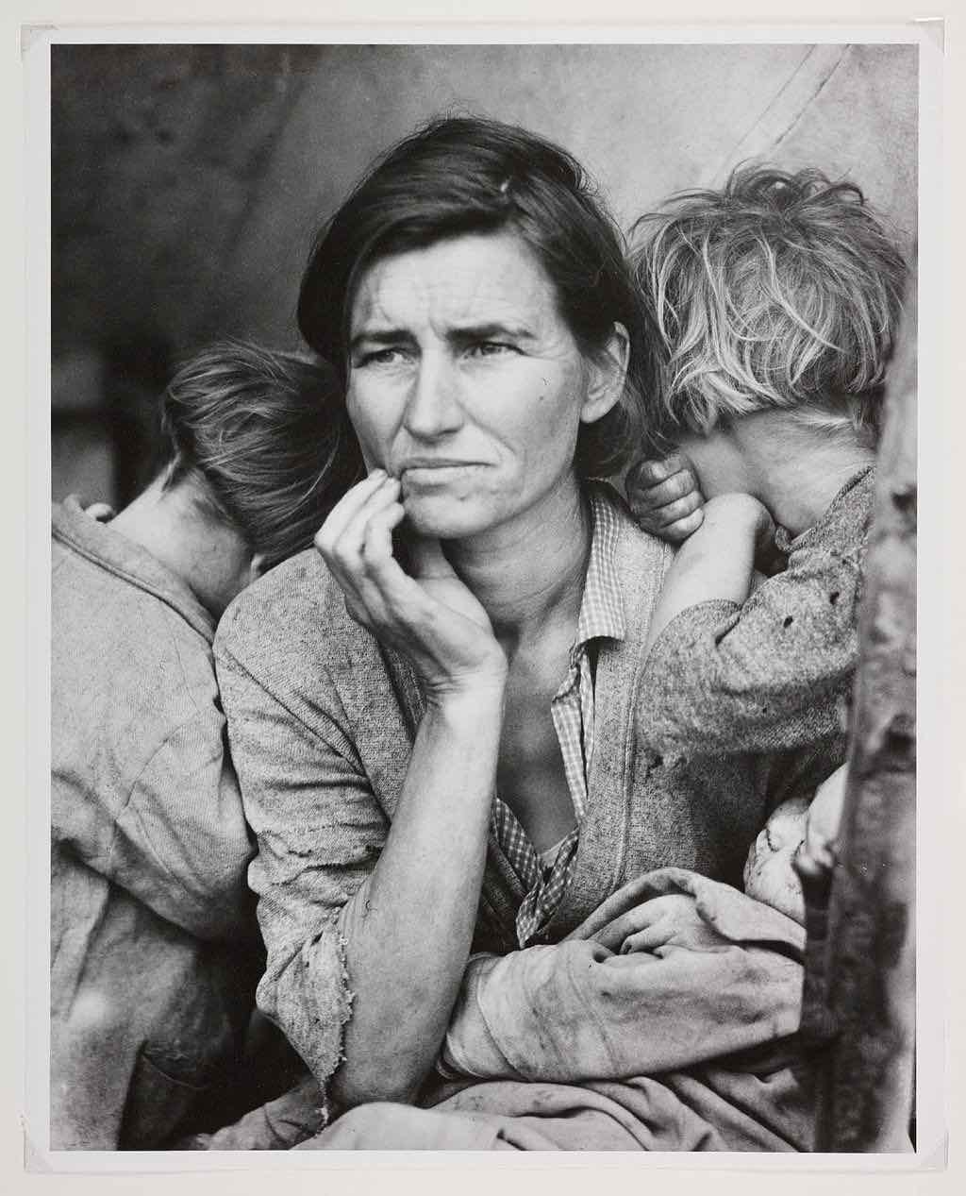
Dorothea Lange, “Migrant Mother” 1936 Portrait format is tall and narrow, and has a border

Slide 15
Image uploaded but not great

Slide 16
Collection image display on list of items page

Slide 17
Center and crop the image before upload

Slide 18
Banner on Collection title page improved?

Slide 19
Alma Workflow
Roles Needed to Work with Collections
Collection Inventory Operator – Create and edit sub-collections and move sub-collections between parent collections.
Collection Inventory Operator Extended together with Collection Inventory Operator – Create, edit, and delete top level collections and promote a sub-collection to be a top-level collection. Create, edit, and delete sub-collection and move sub-collections between parent collections.
Digital Inventory Operator – Add/remove titles to/from a collection and move a title between collections.

Slide 20
Create a Collection
Resources -> Manage Inventory -> Manage Collections
From Resources -> Manage Inventory -> Manage Collections, click Add Top-Level Collection
Fill out the required fields. The Title and Name of the collection should be the same, and the Name of the collection must be unique among all top-level collections.
Click Save to finish and come back later or Save and Continue to save your new collection and open the Collection Resource Editor page and add more information for the collection.
To Edit: Go to Resources -> Manage Inventory -> Manage Collections, Click the ellipsis next to the collection you want to work in and select Edit
The Collection will have a new Bib record that you can suppress in the Metadata Editor like other bibs

Slide 21
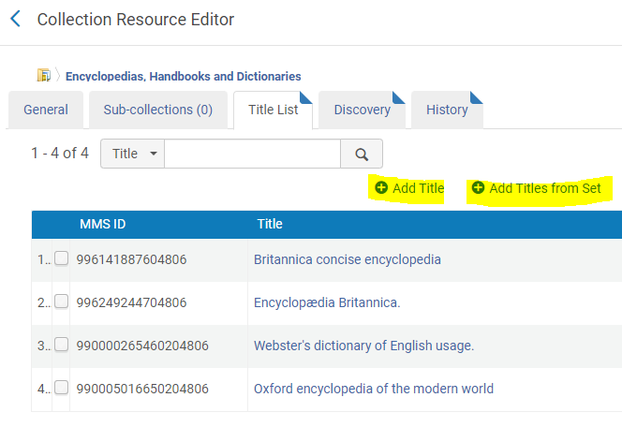
Adding Titles
From Title List tab, can add individual titles or from a set
To add titles from a set, click Add Titles from Set
How Do I Create a Logical Set?
How Do I Create an Itemized Set?
Manage Sets screen opens
Select the set you wish to add and click Add Set Titles
A job will run, adding the titles to the collection
If a title is already in the collection, it will not be added again
Click Save

Slide 22
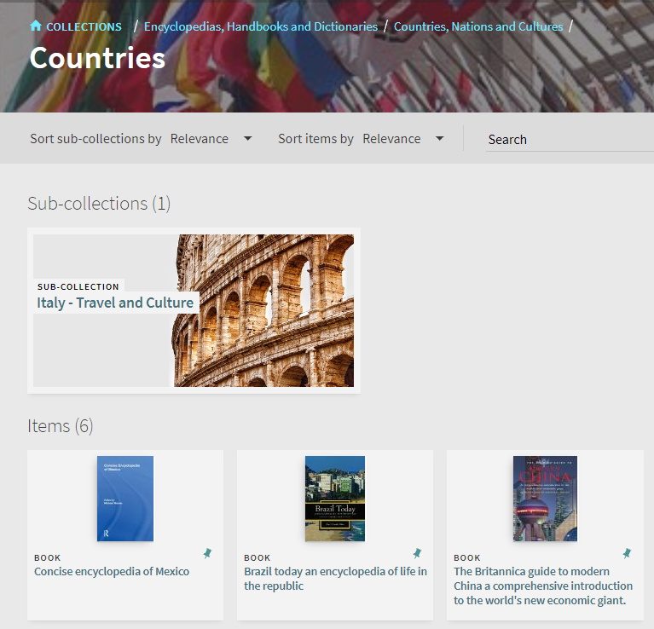
Adding Titles, cont.
Can have both titles and sub-collection under the top-level collection
Can add physical or electronic content active in Alma but can’t add articles because that data is coming from the CDI, not Alma
Could add database records, but those records would need to unsuppressed for discovery

Slide 23
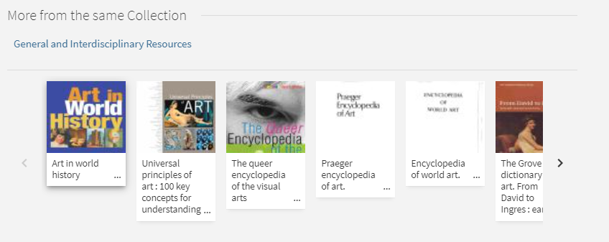
Adding Titles, cont.
Can use same title in more than one collection
Once a title is in a collection, you’ll get a link to that collection on the record, and the option to see other titles from the same collection

Slide 24
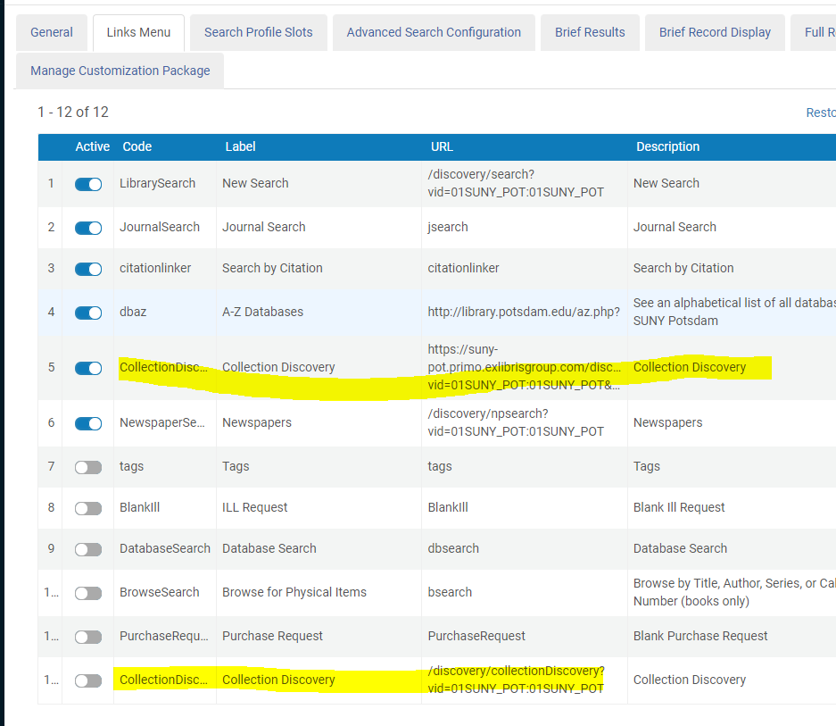
Adding to Primo VE
Config->Discovery->Display Configuration->Configure Views, edit view
On Links Menu, activate the Collection Discovery link. Should show up right away in Primo header.
Note that the default abbreviated URL path doesn't always work, so you may need to add a new link with the full path, such as https://suny-pot.primo.exlibrisgroup.com/discovery/collectionDiscovery?vid=01SUNY_POT:01SUNY_POT&lang=en

Slide 25
Modifying Primo VE Collection CSS
If you want the collection to use your default colors, you need to add this code to your CSS, which will cover the search bar, newspaper search and collection search colors:
*Search Bar Wrapper color */
prm-search-bar, prm-atoz-search-bar, prm-journals-search-bar, prm-browse-search-bar, prm-tags-search-bar, .prm-primary-bg, prm-collection-gallery-header .collection-header-inner, prm-newspapers-search-bar, prm-spinner.overlay-cover.light-on-dark:after { background-color: #d1cec4; }
Change the #d1cec4 to whatever color you want to use.

Slide 26
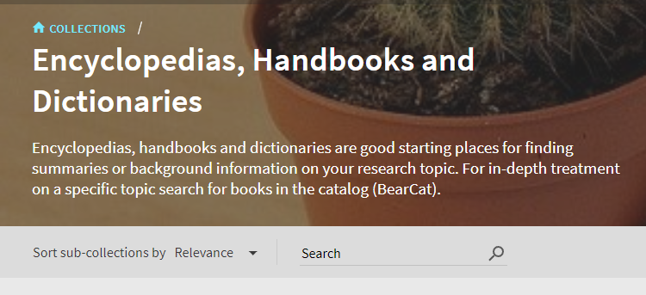
Primo Search
You can search in each collection and sub-collection in Primo.
November release will let you search across multiple collections.

Slide 27
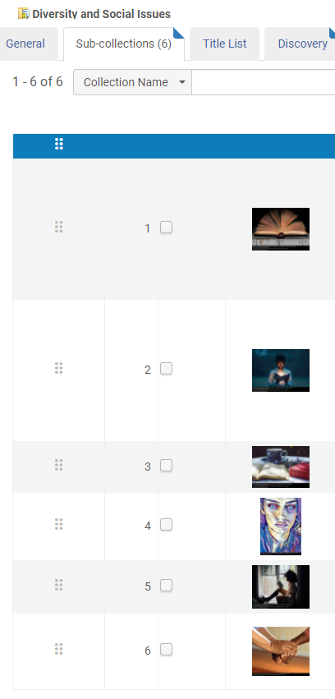
Editing Collection Display: Sort
Sort order of collections and subcollections can be changed manually.
Sort order of titles cannot be changed manually (only the default sort Author, Title, Date, Relevance). Note that author does not display out of the box. UB has a javascript solution.

Slide 28
Editing Collection Content: Deleting Content
If you’re using content that’s part of your Alma holdings, you can use the Remove Selected or Remove All options to manage your titles.
All titles need to be removed from the collection before you can delete it (click on ellipses and choose delete).
Titles imported via a digital import:
You can’t delete titles directly from a collection, even though it looks like you can.
To delete a title or all titles from a collection
Create an All Titles set by searching for the collection and selecting the titles you wish to delete
Run the Delete Bibliographic Records job on them

Slide 29
Editing Collection Content: Moving Content
To move titles:
Select the titles that you’d like to move from your title list, choose “Move Selected”
At the top of the page, search for the collection to which you want to move the titles
Select the collection and save
Can also move sub-collections to other collections, note that you get a pop-up collection search for that action
It can take a few minutes to see collection changes in Primo. Title displays can take longer.

Slide 30
Resources:
How do you manage collections [not e-resource collections] in Alma/Primo?
Ex Libris Documentation:
Managing Digital Resources
Managing Collections
Configuring Collections Discovery for Primo VE

Slide 31
Live Demo
Comments or Questions?

