Slide 1
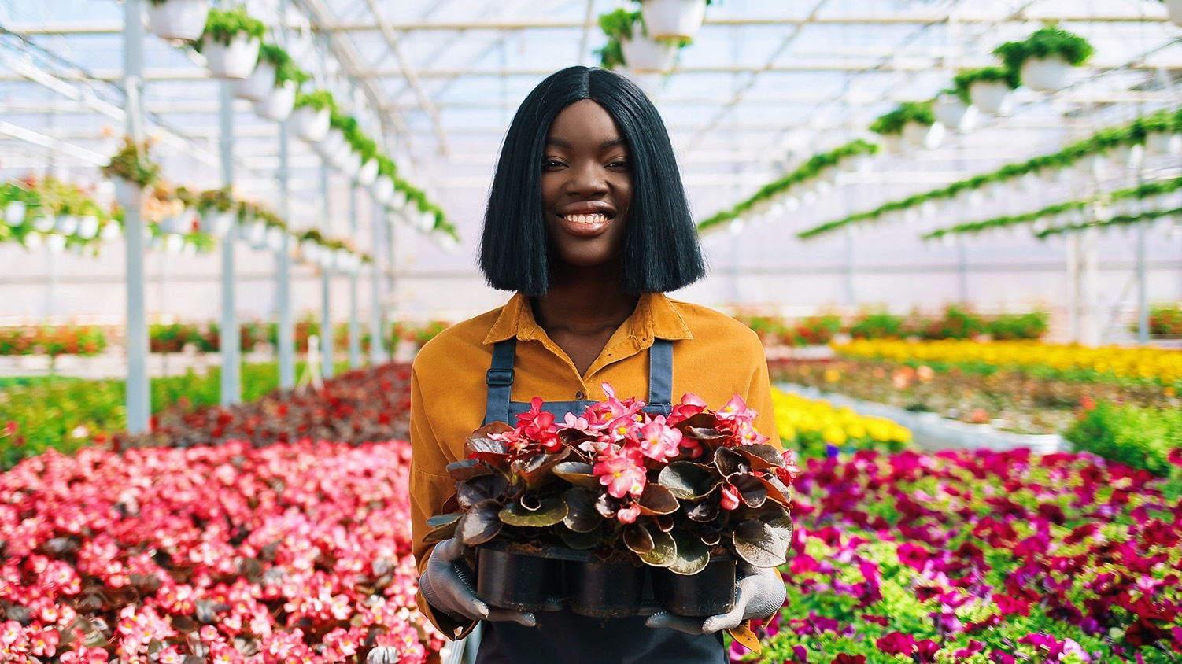
SMARTLY
R2 & R5 REVEALING THE POTENTIAL: GREEN AND DIGITAL PROFILING TOOLS
14/11/2023
Hrvatski zavod za zapošljavanje / Croatian employment service

Slide 2
RESULT 2 - Enhanced profiling questionnaire for neets
Primary objective: to develop, test and adjust a profiling tool
Developed for youths (aged 16-29) from different educational levels and fields
Objectives of the tool:
  to gather information on attitudes, competences, and skills relevant to the Green and Digital industries
  to provide a general recommendation for improvement

Slide 3
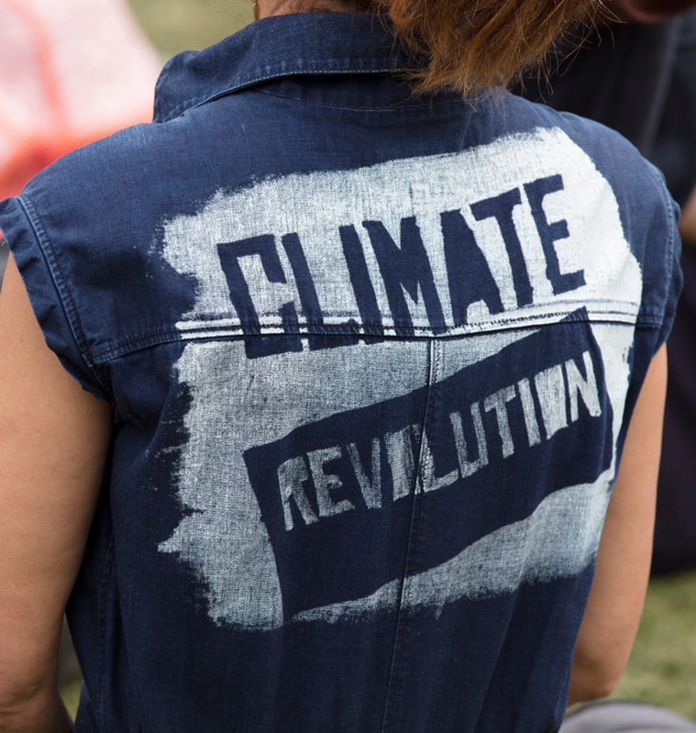
RESULT 2 - Enhanced profiling questionnaire for neets
Structure of the tool
Demographic information
  Gender
  Age
  Country
  Preferred job
  Educational level
  Educational area

Slide 4
RESULT 2 - Enhanced profiling questionnaire for neets
2. Digital tool
3 different forms of the tool (based on EQF level)
5 categories:
  Communication and collaboration
  Digital content creation
  Information and data literacy
  Problem solving
  Safety
3. Green tool
8 categories:
  Communication, collaboration, and creativity skills
  Information skills
  Assisting and caring skills
  Management skills
  Working with computer skills
  Handling and moving skills
  Constructing skills
  Working with machinery and specialized equipment

Slide 5
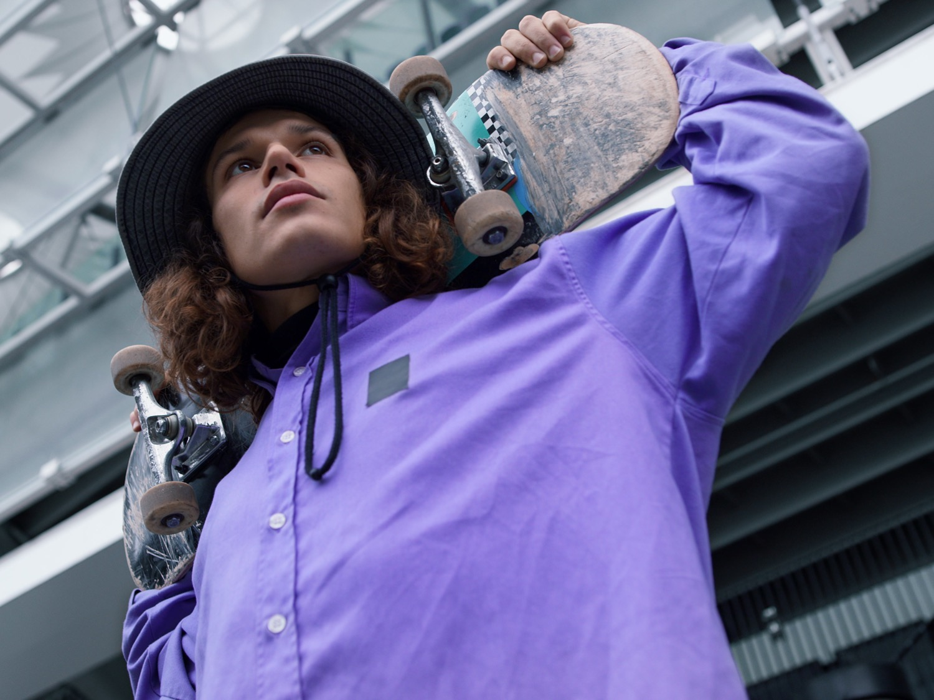
RESULT 2 - Enhanced profiling questionnaire for neets
4. Feedback form
Three sections:
  Ease of use
  feedback and recommendations
  Overall impressions

Slide 6
R5 - Testing of Profiling with target group
The tool developed within R2 was to be tested on 100 youths in NEET status
Carried out in three countries: Malta, Croatia and Cyprus (translated into Croatian and Greek)
Feedback gathered from PES staff and external providers

Slide 7
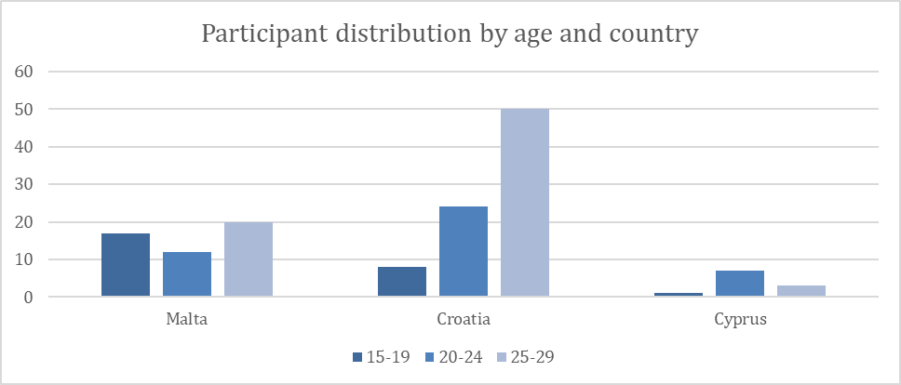
R5 - Results
DIGITAL TOOL
142 completed questionnaires
Country | Level 2 | Level 4 | Level 6 | TOTAL
Malta | 18 | 16 | 15 | 49
Croatia | 27 | 8 | 47 | 82
Cyprus | 4 | 1 | 6 | 11
TOTAL | 49 | 25 | 68 | 142

Slide 8
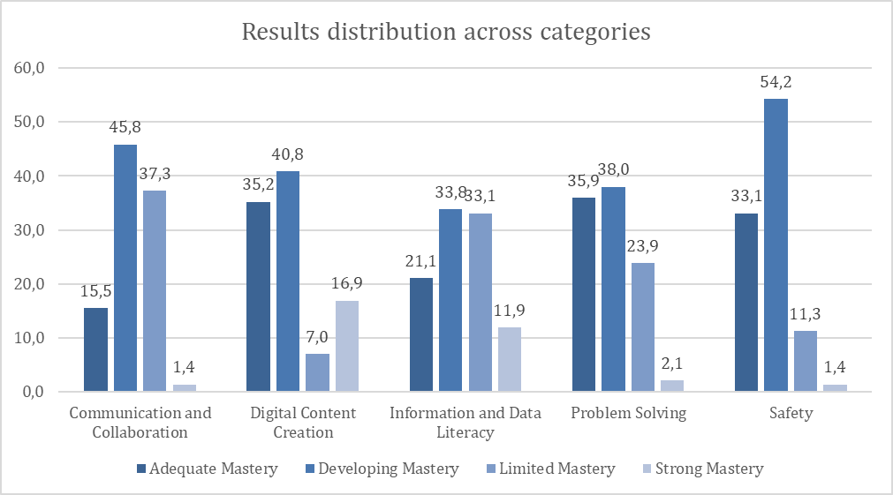
R5 - Results
DIGITAL TOOL
Participants could be placed in one of four categories:
  Strong mastery of basic knowledge
  Adequate mastery of basic knowledge
  Developing mastery of basic knowledge
  Limited mastery of basic knowledge

Slide 9
R5 - Results
DIGITAL TOOL

Slide 10

R5 - Results
DIGITAL TOOL
Results were further analised based on the percentage of correct answers by country and EQF level → bases for further recommendations
Criteria used:
  High level of knowledge: above 60% of correct answers
  Poor knowledge: 40% and less of correct answers

Slide 11
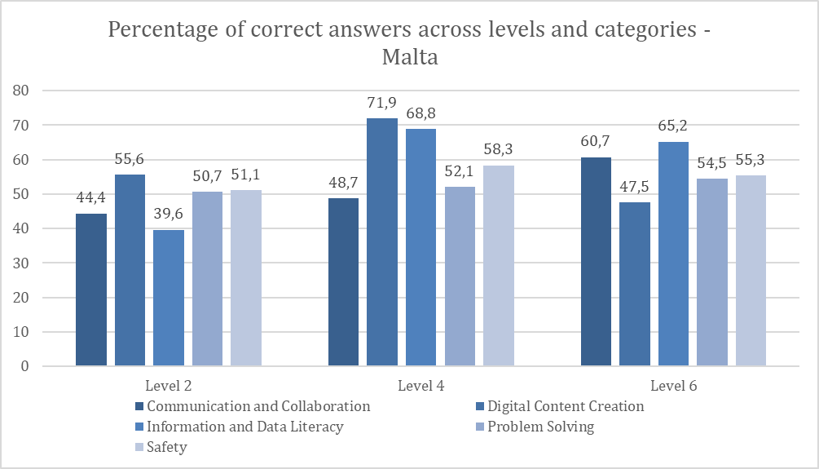
R5 - Results
DIGITAL TOOL

Slide 12
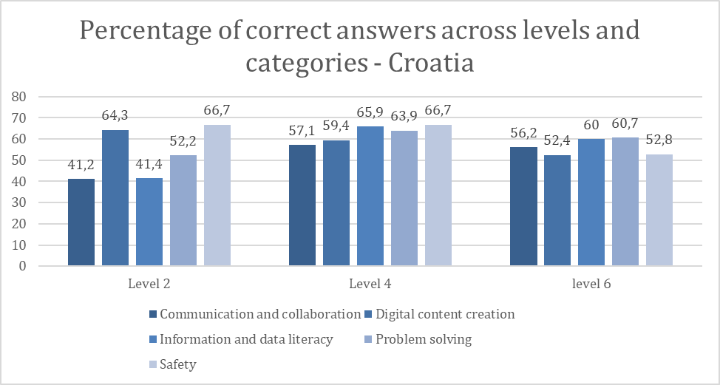
R5 - Results
DIGITAL TOOL

Slide 13
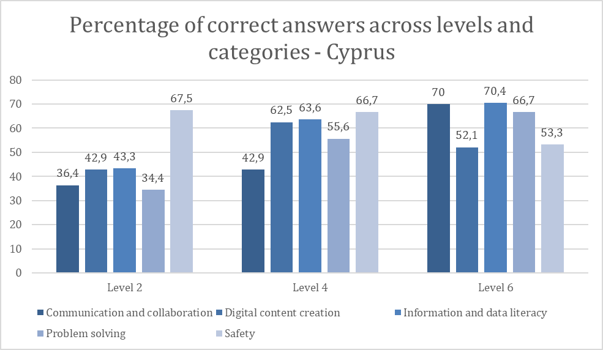
R5 - Results
DIGITAL TOOL

Slide 14
R5 - Results
GREEN TOOL
115 completed questionnaires

Slide 15
R5 - Results
GREEN TOOL
Participants could be placed in one of four categories:
  Exceptional skill proficiency
  Strong skill proficiency
  Developing skill proficiency
  Limited skill proficiency

Slide 16
R5 - Results
GREEN TOOL

Slide 17
R5 - Results
GREEN TOOL

Slide 18
R5 - Results
GREEN TOOL

Slide 19
R5 - Results
GREEN TOOL

Slide 20
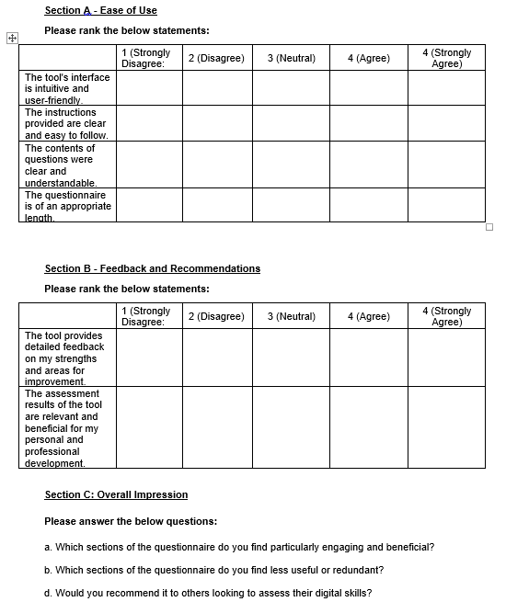
R5 – Results
FEEDBACK
Mostly positive from both participants and experts
Some recommendations for improvement

Slide 21
R5 – Results
FEEDBACK - RECOMMENDATIONS
DIGITAL TOOL
HIGH PRIORITY: questions need to be made more understandable and logically compatible with the answers
MEDIUM PRIORITY: to introduce a save the answers option; adjust feedback given to participants
LOW PRIORITY: the tool should be shortened; some of the more complicated questions could be omitted

Slide 22
R5 – Results
FEEDBACK - RECOMMENDATIONS
GREEN TOOL
MEDIUM PRIORITY: to introduce a save the answers option; adjust feedback given to participants
LOW PRIORITY: the tool should be shortened; some of the more complicated questions could be omitted
skills highlighted by the tool are broader and more general than solely those related to the green economy → more specific questions could be introduced

Slide 23

SMARTLY
Thank you.
Hrvatski zavod za zapošljavanje / Croatian Employment Service
hzz@hzz.hr www.hzz.hr

