Slide 1

COVID 19 Response in SUNY Libraries
April 17,2020
www.suny.edu

Slide 2

OLIS Update
Mark McBride, Library Sr. Strategist
www.suny.edu

Slide 3
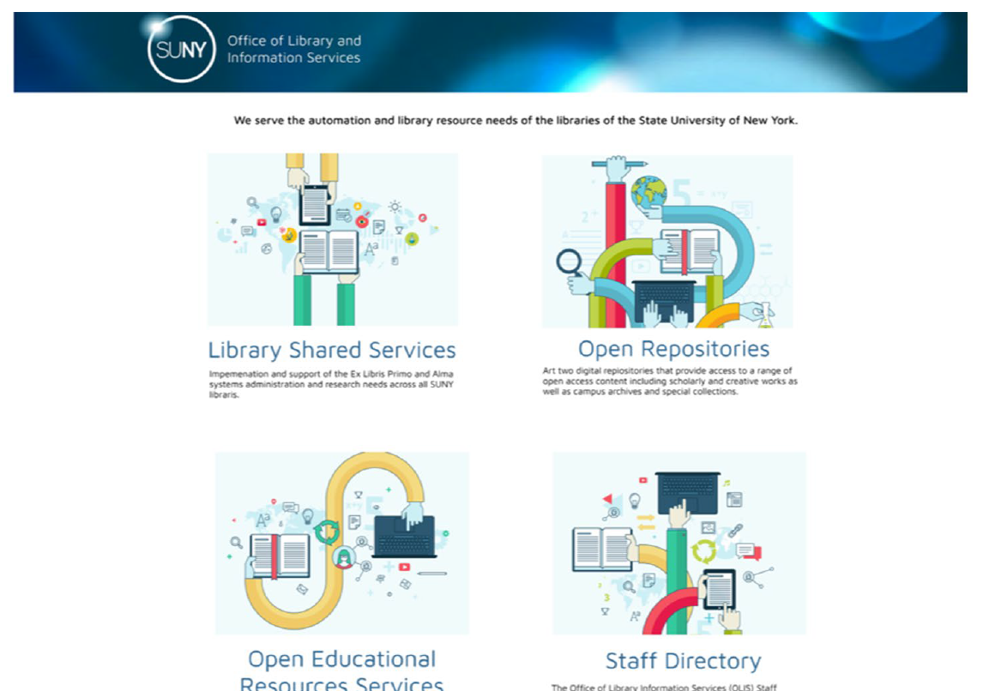
New OLIS/SLSS Web Site Coming
www.suny.edu

Slide 4
Planning for the Fall if Things aren't back to closer to normal
Are campus libraries considering what your services or preparation looks like in the Fall if hybrid/online learning is still the primary method of instruction.
Would convening a group to think through recommendations be of interest to you all?
Division of budget looking closely at accounts for any unused funds
There is a remaining fund balance in the SLC account
www.suny.edu

Slide 5
Library EIT Strategies
Nazely Kurkjian is working on developing some guidance on response to EIT requirements.
Nazely will send information to SUNYLA (and we’ll forward to SCLD)
Please contact Nazely if you are interested.
Nazely’s e-mail: Nazely.Kurkjian@suny.edu
www.suny.edu

Slide 6
SLSS Update
Shannon Pritting, Director of SUNY Library Shared Services
www.suny.edu

Slide 7
Collections Strategies Open Forum
April 23 from 10-11
Please register at: https://slcny.libcal.com/event/6648206
Esta will share some strategies we’re considering, and we’d like to hear from you as well.
www.suny.edu

Slide 8
Update on Repository Job Issues
It looks like ExLibris has fixed the issues we were having.
After Alma related troubleshooting, issue was with Primo VE.
Getting root cause analysis from ExLibris to engage further on this issue.
Will share more details as we have them.
Please let us know if you're seeing repository job problems (specifically e-resource activations).
ExLibris engaging with campuses who may need some complete due to problematic jobs.
www.suny.edu

Slide 9

Libkey
  Request for bids went out late last week.
  Should be working with vendor soon, and will be sending out request for committing to PIAs.
www.suny.edu

Slide 10
Potential SUNY Involvement in IMLS Program about reopening libraries
IMLS coordinating a project to develop a “scientifically based look at library and museum protocols and practices for materials, staff, public and personal spaces, patrons, and the training and protocols needed for reopening.”
CUNY, NYU, NYPL, Columbia tentatively listed as participants.
More information will be shared as soon as we have it.
SUNY has been invited, and we’ve expressed initial interest.
www.suny.edu

Slide 11
Resource Sharing Update
Timothy Jackson, Resource Sharing and Fulfillment Program Manager
www.suny.edu

Slide 12

RapidILL COVID-19 Pod
RapidILL is allowing libraries to borrow articles for free for 3 months
  No lending obligation, no need to provide holdings
  Requests can be sent to RapidILL from either ILLiad or Alma
  IDS Logic can automatically send requests from ILLiad to RapidILL
Send me an email if you're interested in participating or if you have any questions
Libraries who have already requested RapidILL accounts should have already received their account info from me
www.suny.edu

Slide 13
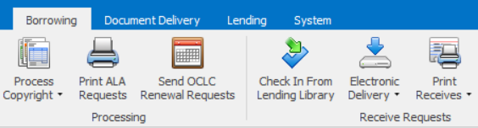
ILLiad Article Delivery Reminder
ILLiad's Trusted Sender feature can automatically deliver articles to users
Trusted Sender is not 100% effective
Doesn't work for some RapidILL lenders
Remember to check Electronic Delivery for undelivered files
www.suny.edu

Slide 14

Alma Article Resource Sharing
Currently testing article resource sharing in Alma
  Please don't process or cancel any article resource sharing requests you receive!
Fill rate has been pretty good so far (75-80%)
Working with Ex Libris on minimizing the number of false positives produced by the locate process and optimizing borrowing and lending workflows
Albany and Buffalo will begin testing soon (thank you!)
Goal is to implement Alma article RS at non-ILLiad libraries later this spring (electronic only?)
www.suny.edu

Slide 15

Alma Physical Resource Sharing
No timeline for turning resource sharing back on
Empire Library Delivery service suspended until further notice
  Will be able to restart service quickly once libraries start to reopen
Be sure to keep SLSS & ELD informed!
Still working with Ex Libris on automatic renewals
Manual renewals still being submitted, so please be sure to keep on top of those
www.suny.edu

Slide 16
Patron Expiration Guidance
Gail Pawlowski, Senior Alma Support Specialist
www.suny.edu

Slide 17
Patron Expiration Dates
Create Analytics report to identify the users to update
Who do you want to extend expiry dates for?
/Shared Folders/Community/Reports/Consortia/SUNY/Emergency Procedures
  Expiry Dates With Prompt
  Due Within X and Y Days with Expiry Date Prompt
Use the Users Subject Area
Be sure to include the Primary Identifier in the criteria
Download the results to Excel
www.suny.edu

Slide 18
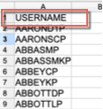
Patron Expiration Dates
From the Excel file grab just the Primary Identifier column
Make sure to change the "Primary Identifier" header for the column to: USERNAME
www.suny.edu

Slide 19
Create Set of Users
  Create the itemized set in Alma:
    -- Go to: Admin > Manage Sets
    -- Click: Add Set > Itemized
    -- Then fill in the required fields; Make sure to add "Set content type" of User.
  Use "Add Contents from File to Set" to load your Excel file.
www.suny.edu

Slide 20
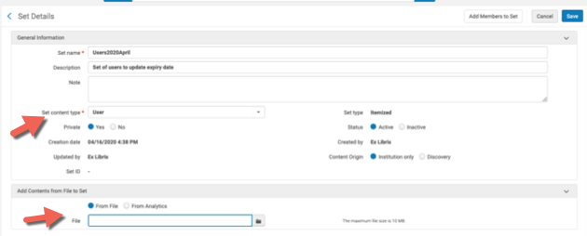
Create Set of Users
www.suny.edu

Slide 21
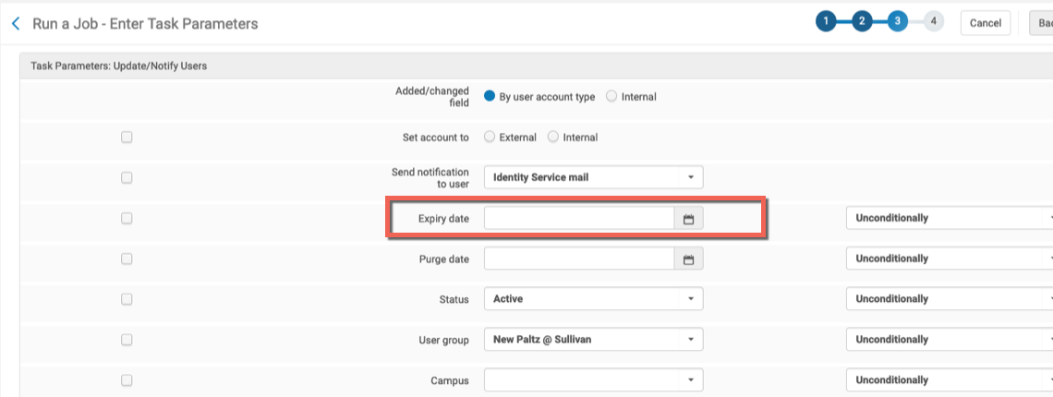
Go to Update/Notify Users job and fill in the new expiry date
www.suny.edu

Slide 22
SUNY OER Services Update
Mike Daly, Director of Operations, SUNY OER Services
www.suny.edu

Slide 23
EOP
SUNY OER Services has begun coordinating with SUNY EOP Directors as Summer 2020 programs move to online/distance/remote modalities
49 campuses
3,000 students
  Webinars and follow-up trainings stress that EOP Directors and programs should leverage internal campus-based resources to assist with this transition
    Contacting / working with librarians and libraries was encouraged
www.suny.edu

Slide 24
New Courses
New courses recently added to oer.suny.edu:
General Chemistry II
Principles of Computation with Java
Introduction to Genetics
Discrete Mathematics Primer
SUNY's OER content is designed for flexible use across modalities
www.suny.edu

Slide 25
SLC Update
Jennifer Smathers, SLC Consortial Engagement Coordinator
www.suny.edu

Slide 26
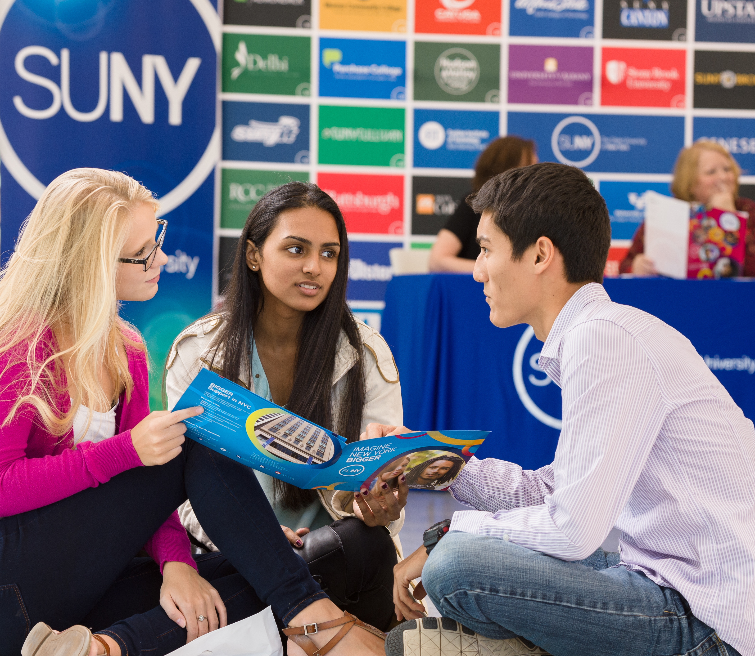

Questions?
How are Things Going at your Campus?
www.suny.edu

