Slide 1
INTERCEPT - Study Visit to Luxembourg
Jean Ries, Coordinator - Employment and Training Services

Slide 2
Agenda
Short overview of the Luxembourg employment market
ADEM – Luxembourg’s Public Employment Service
  PES services and internal functioning
  Impact of the COVID-19 health crisis
Important developments
  ADEM 2025 strategy
  Digitalisation et modernisation of our services, processes and communication
  eADEM – major modernisation programme for implementing a new and powerful IT infrastructure
  Future Skills programme

Slide 3
Overview of the Luxembourg employment market

Slide 4

Luxembourg: Some facts & figures
Second smallest country in the EU
Population: 645.000 inhabitants
> 170 nationalities
3 official languages : Luxembourgish, French, German
English and Portuguese widely spoken and necessary in certain business sectors
During the past 20 years, the population has increased by more than 45% due to immigration

Slide 5
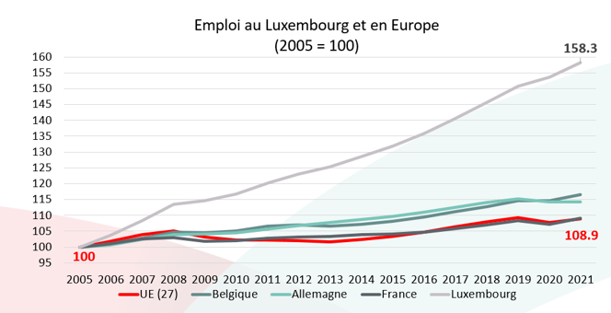
Continued growth in employment
Since 2005, employment has grown continuously, even in times of crisis, and has increased by almost 60%.

Slide 6

Workforce composition:
A special situation in Luxembourg!
220.000 daily cross-border commuters from
France: 120.000
Belgium: 50.000
Germany: 50.000
Total workforce: 460.000 employees
Almost every second employee is a cross-border commuter
Almost 75% of the Luxembourg workforce is composed of foreigners
Notes:
45% des travailleurs du Luxembourg résident dans un des trois pays limitrophes. La moitié en France (~ 85K personnes). L’autre moitié se répartit à parts égales entre la Belgique et l’Allemagne.
Un peu mois de 30% de travailleurs sont des ressortissants luxembourgeois qui résident au Grand-Duché.
L’emploi des frontaliers est très sensible à la conjoncture. Avant la crise, l’emploi des frontaliers a connu des taux de croissance très élevés, au-delà de 5% voire de 10% par an! Cette dynamique a été freinée par la crise et pendant un moment, l’emploi des frontaliers et celui des résidents (quasiment pas affecté par la crise) ont progressé au même rythme pendant un moment. Il y a quelque mois, grâce à la conjoncture plus favorable.
Les ressortissants des pays tiers constituent le plus petit groupe dans ce graphique (3% de l’emploi) mais ils affichent le taux de croissance le plus élevé (6%)

Slide 7
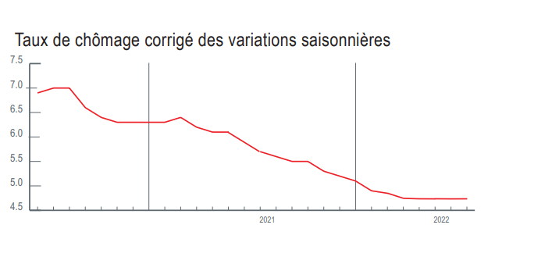
Unemployment rate at free fall
In August 2022, the unemployment rate stood at 4.6%.
The last time such a rate was seen was at the end of 2008.

Slide 8
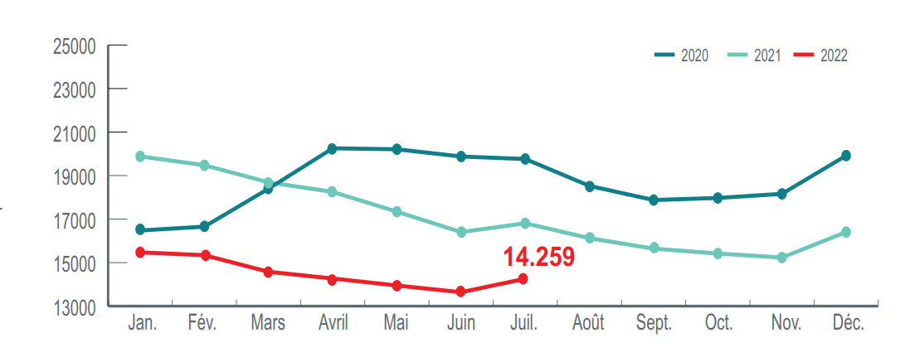
The number of registered jobseekers continues to decrease
The number of available resident jobseekers registered with ADEM on 31 July 2022 was 14,259. Compared to July 2021, this is a decrease of more than 2,500 people or 15%.

Slide 9
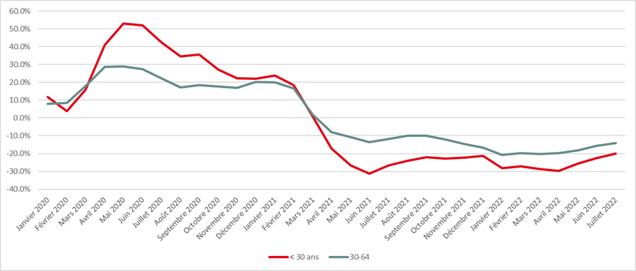
Development of the number of unemployed in age categories (in %)
While the number of young jobseekers rose dramatically at the beginning of the health crisis, it has also fallen significantly with the economic recovery and is now back to pre-crisis levels.

Slide 10
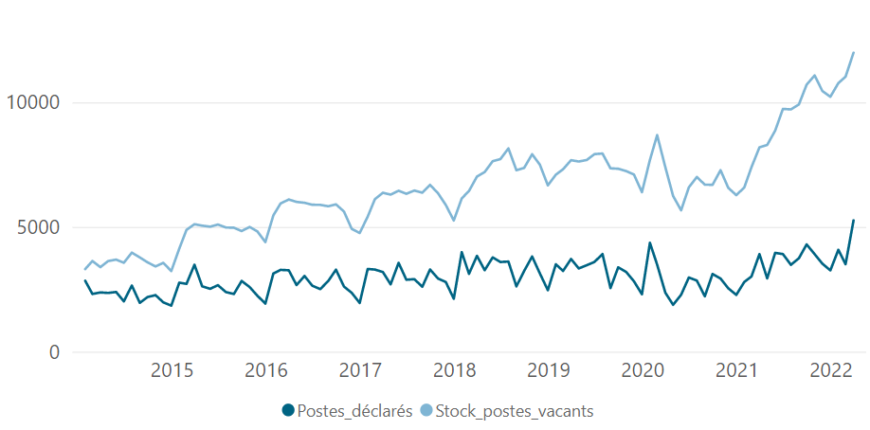
A new all-time high in available vacancies
In 2021, the number of vacancies reported to ADEM jumped significantly by almost 63%.
In July 2022, employers reported 4,000 vacancies to ADEM
The 13,000 mark of available jobs has even been passed since April 2022.

Slide 11
Main challenges
(situation in May 2022)
4,6 %
Unemployment rate
14.000
Jobseekers
13.000
Vacant positions
and
however
Some of our main challenges :
Transformation of the labour market with rapidly changing occupational requirements
Strong imbalance between supply and demand on the job market with a "skills gap" that is likely to increase
Rising number of people face barriers to enter the labour market
Increasingly diverse client population
New forms of employment and changing expectations regarding work-life balance
Increasing demand for digital services
Unpredictability of post-crisis economic developments

Slide 12
Agence pour le développement de l’emploi - ADEM

Slide 13

Luxembourg’s Public Employment Service (ADEM)
ADEM is a public administration directly placed under the supervision of the Luxembourg Ministry of Labour, Employment and the Social and Solidarity Economy.
The main role of ADEM is to:
match offers and demands on the national labour market both by helping jobseekers to get employed as quickly as possible, and by assisting employers in their recruitments
promote employment by improving the governance of employment policies in coordination with economic and social policies

Slide 14
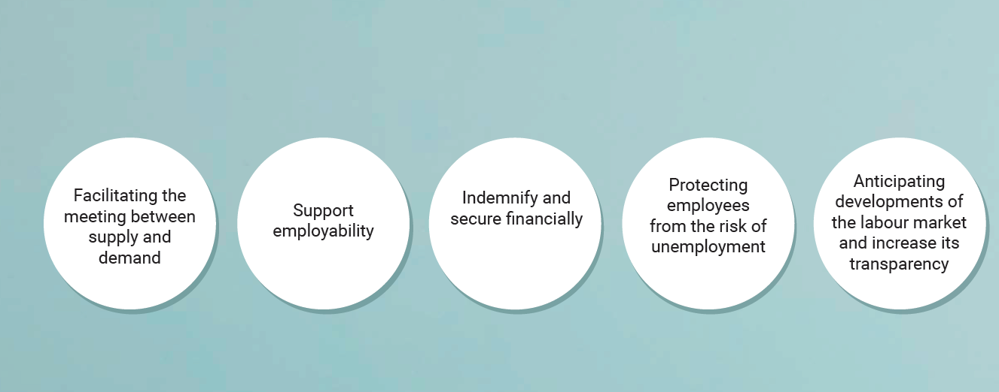
Missions

Slide 15
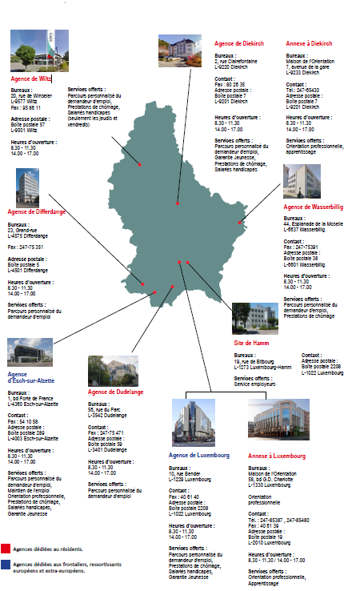
Head office, regional agencies and sites
Head office in Luxembourg-Hamm
Directorate, Employers’ service, Jobseekers’ service, Contact Center,
Internal services, Medical service, Service for people with disabilities
and reduced labour capacity, training department
7 regional agencies
  Diekirch
  Differdange
  Dudelange
  Esch-Belval
  Luxembourg-ville
  Wasserbillig
  Wiltz
2 offices at the National Guidance Centre
« Maison de l’orientation » (Luxembourg, Diekirch)

Slide 16


National Guidance Centre
Luxembourg has a National Guidance Centre (Maison de l’Orientation) with premises in Luxembourg-City and Diekirch.
The Maison de l’Orientation regroups all public actors that are offering educational and vocational guidance services thus facilitating a swift transition from school / university to the labour market
ADEM’s vocational guidance service is part of the Maison de l’Orientation in Luxembourg-City and Diekirch
ADEM’s professional guidance service is also present at the regional agency in Esch-Belval (adjacent building)
Services offered by ADEM’s vocational guidance service:
  Awareness raising, information and outreach activities for pupils and students
  Lifelong career counselling
  Apprenticeship placements
    Registrations of apprenticeship positions
    Registration of young and adult people who are interested in an apprenticeship
    Facilitate the matching between candidates and employers

Slide 17
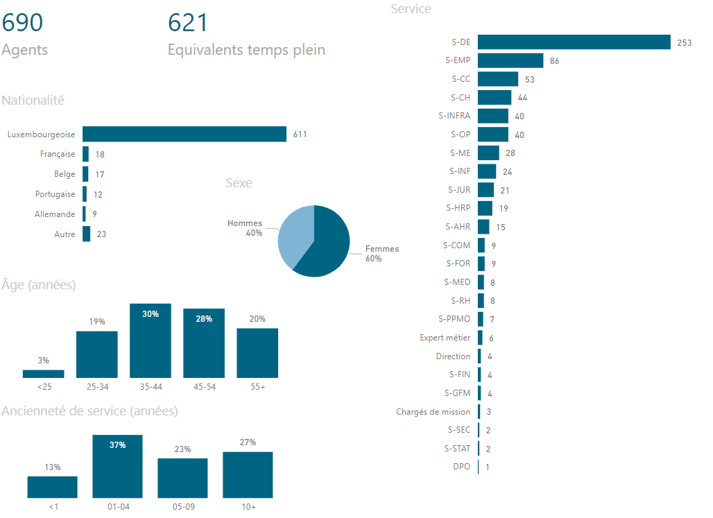
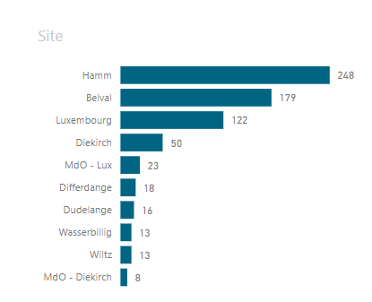
ADEM staff

Slide 18
Overview of COVID-19 impact

Slide 19
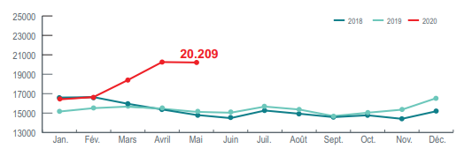
COVID-19 impact on the labour market
In spring 2020, the number of jobseekers exceeded the 20,000 mark and the unemployment rate stood at 7% (May 2020).
The increase in unemployment was mainly due to a drop in the number of jobseekers leaving the ADEM towards employment, rather than an increase in new registrations.
In April 2020, at the peak of the lockdown, the number of vacant positions employers reported to ADEM decreased by more than 40% compared to the previous year.

Slide 20
COVID-19 impact on the labour market
Protecting employment
Sudden and extremely heavy use of short-time work. Before the pandemic, an average of 15 applications for short-time work were submitted per month. In April 2020, ADEM registered more than 15.000 applications! Eventually, 160 000 workers have benefited from the scheme, around 40% of the eligible workforce
Rapid design and implementation of a new short-time working scheme in cases of force majeure linked to the COVID-19 crisis (i.e. advance payments, extended eligibility)
Immediate development of a new online-procedure for the application and payment of short time allowances by ADEM in cooperation with relevant stakeholders
New criteria for the leave for family reasons in the context of the COVID-19 pandemic
Cushioning the effects of unemployment
The period of entitlement to unemployment benefit, which is normally granted for a maximum of 12 months (maximum 24 months in the case of an extension), was extended by a period corresponding to the duration of state of crisis
Adaptations to jobseekers’ accessibility to ALMPs (new eligibility criteria for some ALMPs)

Slide 21
COVID-19 impact on PES services and internal functioning (some examples)
HR strategy
  Immediate shift to teleworking schemes
  new staff,
  staff reorganised (temporary allocation to other departments), adjustment of office occupancy
New organisational processes
  Shift from face-to-face meetings to counselling by phone or online
  Registration by phone or online procedure (via the Luxembourg administrative portal)
  Digitalisation of financial aids (application and payments)
  Increased collaboration and data sharing with other public administrations
  Increased use of online information channels: FAQ on website, Social media,..
New services to activate jobseekers during the COVID-19 crisis
  Massive investment in online-training platforms for autonomous learning
  Design of new online-training courses
  Organisation of online-jobfairs
Looking back, the pandemic was a catalyst and driver for change and innovation

Slide 22
Important developments

Slide 23
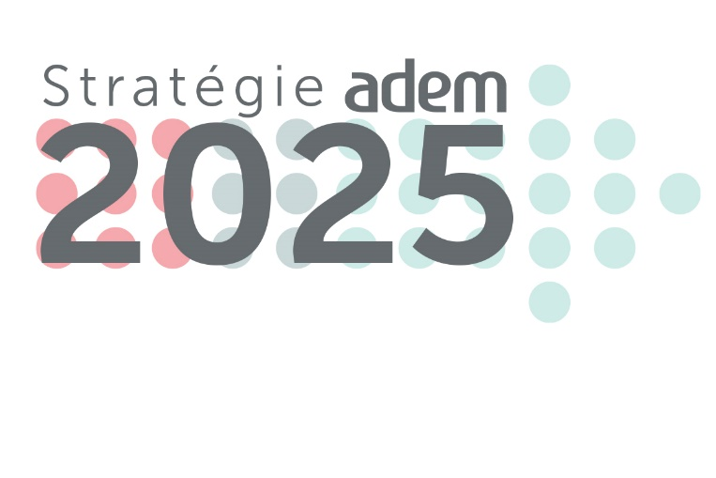

Strategy “ADEM 2025”
In 2020, ADEM adopted a strategy, shared and accessible by all ADEM staff
Bottom-up approach: Involving different departments in the design of the strategy
Change management: Presentation and explanation of the strategy to all ADEM staff
Introduction of new performance and activity indicators
The ADEM 2025 strategy is the "red thread" of all the projects and actions that have been carried out in 2021 and will be deployed in the coming years.

Slide 24
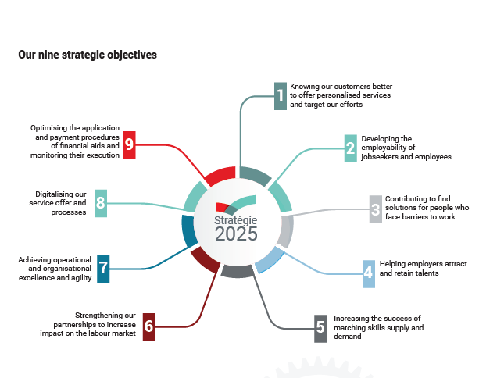
Two priority pillars and nine strategic objectives
The strategy is built on two priority pillars:
Vis-à-vis our clients
  Increasing or maintaining employability
  Develop tailor-made training and employment measures
  Continue to support companies to find profiles adapted to their needs
Vis-à-vis ADEM itself
  Achieve a high level of excellence and operational agility in our internal functioning
  Rely on an efficient IT-infrastructures and have digital tools at our disposal
  Offer more digital services to increase the autonomy of our clients
  Have a clear action plan shared by our employees

Slide 25

Digitalisation and modernisation of our services, processes and communication (some examples)
Online registration for jobseekers
  Jobseekers can now register with ADEM on the MyGuichet platform, by directly submitting
  the required documents. Currently, 14% of registrations are made via the MyGuichet
Online-Feedback on candidates proposed by ADEM
  Employers now have the opportunity to provide digital feedback on the candidates they meet
  in the course of an assignment around. 30% of assignment returns are made electronically
Increased transparency of ADEM’s JobBoard
  People who are not registered with ADEM can consult job offers that companies have decided to make public (7 days after their publication on the JobBoard with restricted access to registered jobseekers). 54% of offers declared to ADEM are disseminated publically
Fully digital telephone platform for ADEM's Contact Centre
  ADEM's Contat Center handles about 1’200 calls per day and has a first level resolution rate of about 85%.
Increased presence on social networks and confirmed success ADEM’s website
  More than 15,000 followers on LinkedIn, tripling the number in two years
  More than 380,000 unique visitors and 2.5 million page views in 2021

Slide 26
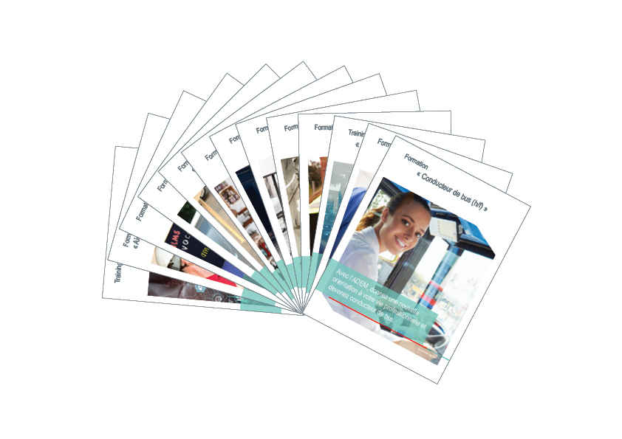
Significant increase in training activities
Focus on digital skills and autonomous e-learning
The "Soft Skills eAcademy" offered free access to the ilearn.lu platform to more than 1,000 job seekers.
The "Youth eAcademy" enabled nearly 450 young jobseekers to strengthen the skills they need to make their career plans a reality (via free access to the Belearn e-learning platform)
Partnership with the Competence Centre of Luxembourg University and Google Career
Tailor-made trainings designed in partnership with
Professional chambers
Public training instituts (i.e. National Vocational Training Centre, National Language Institute, Competence Centre of the Luxembourg University
Private companies and/or business federations, for example:
Sales Lentz et Emile Weber → for bus drivers’ positions
  La Provençale et Grosbusch → for delivery drivers’ positions
  Cocottes → for sales and production positions

Slide 27

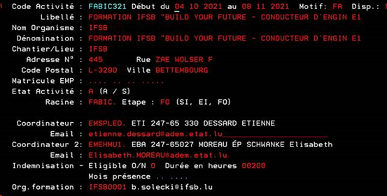
Modernisation of ADEM’s IT-infrastructure
Initial situation
Obsolete IT systems for managing customer data (e.g. EMAC⇨Cobol)
Various isolated applications, e.g. JobBoard, Datawarehouse,...
No interaction with clients
No integration with the GovCloud hosting of the Luxembourg State

Slide 28
Guiding principles
Once Only
Digital by default
Transparency
Inclusion and easy access
Reliability and security
Interoperability
In the transition to a participatory, efficient, user-friendly and intelligent administration, ADEM is following six guiding principles.

Slide 29
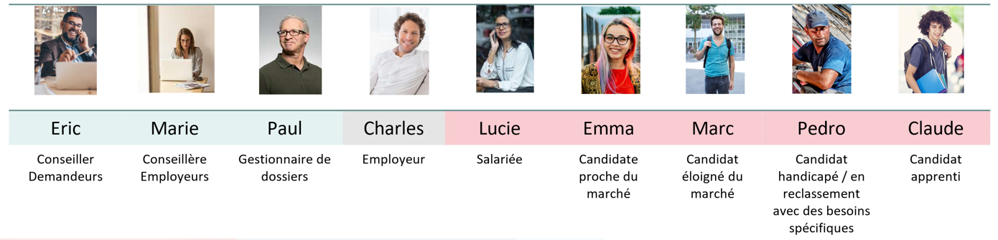
User-centric design
Creation of Personae
In the UX phase, nine personae were identified: five job seekers, three employees and one employer client. These personae anecdotally represent their experience of the services offered by ADEM. The aim is to optimise the use of the future eADEM solution by putting the users at the centre of the considerations.

Slide 30




: Launching an European tender for a new performant IT-infrastructure
Lot 2: Selection of technical solution(s) and service provider(s)
Creation of an implementation concept
Design and gradual introduction of the new IT solutions
Training of internal users and awareness raising of customers
Detailed examination of the offers received
Prioritisation of the offers and selection
Lot 1: Preparation of
technical specifications
Understanding the vision: UX based approach
Analysis of processes and interfaces
Needs analysis
Accompanying change management
Lot 3: Implementation and coordination

Slide 31
Future Skills Initiative
From May 2018 to November 2019, a pilot project (“Luxembourg Digital Skills Bridge”) was carried out with the aim of anticipating the impacts of technological advances on jobs and to test (as a "proof of concept") the usefulness of supporting companies and their employees in the transformation of their work, jobs and skills.
In October 2020, ADEM launched the “Future Skills Initiative” which aims at reducing the ever increasing “skills gap” on the Luxembourg labour market
Upskilling and reskilling of jobseekers
Analysis & studies of evolution in sectors, jobs and skills
Supporting companies in upskilling and reskilling of employees
via:
ADEM also participates in the elaboration of the National Skills Strategy, currently conducted by the OECD, with the aim of supporting the anticipation and development of future skills

Slide 32
Upskilling of jobseekers
FutureSkills programme launched in October 2020
300-500 jobseekers will participate in the whole program until end of 2021
(training modules will be opened to a wider public)
Who?
3 months (online) training in
Future Skills
(soft skills + digital skills)
Max. 6 months traineeship in a public administration
What?
Stay active during this difficult period of unemployment
Free access to a real upskilling in transversal future skills
Improve employment prospects (short- and long-term)
Why?
Participants remain available for the job market for the whole duration of the program, and continue to pursue actively their job search

Slide 33
Publication of foresight studies in 7 business sectors
Analysis of ADEM job vacancy data to study evolution of the demand of different occupations p. sector
Analysis of matching data and demand/supply data to study talent gaps (and surpluses)
Evidence-based reskilling and upskilling trajectories
Dedicated training programs
Text mining of vacancies to structure skills requirements p. job (and study their evolution)
Survey with companies on emerging occupations
Data-based advising of jobseekers and employers
Feeding into national skills strategy
Collaboration with research institutes and employer/sector associations

Slide 34
Upskilling and reskilling of employees
(« Skills Plang »)
Workforce planning & upskilling programme, to be launched Q2 2022
Companies whose activities, workforce and skills needs are significantly impacted by recent trends (digitalisation/automation, regulations, environment, client needs, pandemic…) → their employees in need of upskilling or reskilling
Who?
Methodological support by external experts (certified by ADEM) on workforce planning Output: workforce & training plan
Financial support of consulting/coaching fees and of training fees
What?
Strengthen employment prospects of employees impacted
Preventive (internal) upskilling and reskilling
Improve resilience of participating companies
Why?

Slide 35
Thank you for your attention!

