Slide 1
Upstate Library's Accessibility Workflow for Course Content
Stephanie Helsher, MSLIS
helshers@upstate.edu
Resource Sharing Librarian
Upstate Medical University Health Sciences Library

Slide 2
Some Caveats
The strength of the workflow has not been tested much yet
Not a workflow focused on making accessible documents, but making accessible choices
Decisions and workflows for libraries interested in addressing the same issues will probably look very different

Slide 3
Upstate HSL’s Accessibility Advances
Library EIT Committee/Campus EIT Committee
Scanner and Workflows for documented needs
Collection of Accessible Technology
Accessibility LibGuide

Slide 4
Requests without a Home
Requests for learning management system classroom content
In response to discussions on the Standards, faculty were making inquiries
This Photo by Unknown Author is licensed under CC BY

Slide 5
Questions to Answer
Providing content for multiple people, not just individuals
Potentially remediating content for an audience that may or may not contain a person with a documented need.
This Photo by Unknown Author is licensed under CC BY

Slide 6
Request that Crossed the Line
This Photo by Unknown Author is licensed under CC BY-SA-NC
Received a request for an accessible version of multiple chapters of a book—not owned by Upstate– that was only available in print.
Precipitated multiple conversations, which turned into policies and plans
This Photo by Unknown Author is licensed under CC BY

Slide 7
Pulling Together a Group
Subsection of the EIT committee with representation from Resource Sharing, Acquisitions, Liaison Services, and Reserves
Decided first on a set of rules for considering the request:
Pass a fair use assessment by HSL Librarians
Be owned or considered for purchase by the library
Be from a published work

Slide 8
3 Phases
Phase 1
Draft legal rationale for the remediation service. Send to Instructional Support for review
Phase 2
Receive clearance of the use of remediation from legal
Set up a request portal, workflow, and copyright statement
Phase 3
(in Process)
Communicate service to faculty
Monitor request volume for sustainability and need
Draft workflow and decision processes between Resource Sharing, Acquisitions, and Liaison Services
Communicate to staff about the process, where to send requests, and responsibilities in the workflow
Discuss plan with SUNY EIT committee
Make budgetary decisions
Solidify request guidelines and communicate them to Instructional Support

Slide 9
Drafting a Workflow
Goal of born-digital sources
Building a market-failure argument by incorporating alternative, accessible options. The argument was abandoned, but the alternative option still serves a purpose.

Slide 10
Seeking Input from Outside Parties
Instructional Support
Legal Council

Slide 11
Remediation Budget
Discussed many options with the library team, including chargebacks to departments and requesting a new funding line from financial leadership
Decided on a small line item out of our existing budget

Slide 12
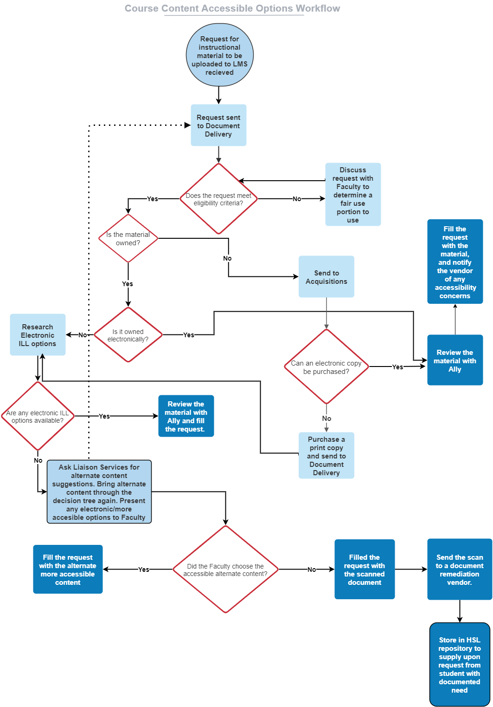
Workflow
PDF of Workflow: https://tinyurl.com/yjwyr4vn

Slide 13
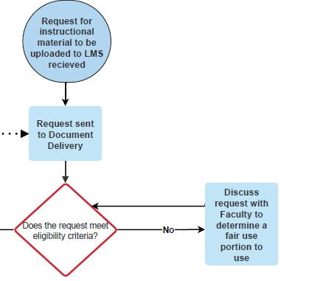
Meeting the Criteria

Slide 14
Meeting the Criteria– Workflow Pathway
Pathway:
Request received
Request sent to Document Delivery
Does the request meet eligibility criteria?
Must pass a Librarian’s Fair Use assessment
Must be from a published work

Slide 15
Pathway #1: Owned Electronically

Slide 16
Workflow Pathway: Owned Electronically
Pathway:
Is the material owned? (yes)
Is it owned electronically? (yes)
Review the material with Ally
Fill the request
Best option
Any accessibility concerns are communicated to the publisher/vendor

Slide 17
Pathway #2: Purchased Electronically

Slide 18
Workflow Pathway: Purchased Electronically
Pathway:
Is the material owned? (no)
Send to Acquisitions
Can an electronic version be purchased? (yes)
Review the material with Ally
Fill the request, communicating any accessibility concerns to vendor/publisher

Slide 19
Pathway #3: Owned in Print, ILL Electronic Version

Slide 20
Workflow Pathway: Owned in Print, ILL Electronic Version
Pathway:
Is the material owned? (yes)
Is it owned electronically? (no)
Research Electronic ILL options
Are there any electronic ILL options available? (yes)
Review the material with Ally and fill the request

Slide 21
Pathway #4: Purchase Print, ILL Electronic Version

Slide 22
Workflow Pathway: Purchase Print, ILL Electronic Version
Pathway:
Is the material owned? (no)
Send to Acquisitions
Can an electronic copy be purchased? (no)
Purchase print copy and send to Document Delivery
Research Electronic ILL options
Are any electronic ILL options available? (yes)
Review with Ally and fill the request

Slide 23
Pathway #5: Alternate Content Suggestion

Slide 24
Workflow Pathway: Alternate Content Suggestion
Pathway:
Electronic version is not owned or purchasable
Are any electronic version available via ILL (no)
Alternate content suggestions are solicited from Liaison Services; suggestions are vetted in the workflow
Did the Faculty select the alternate content (yes)
Fill the request with the alternate content

Slide 25
Rationale for Alternate Content Suggestion
Original intent (establish a case for market failure)
Still a useful step and a step towards more long term, sustainable model

Slide 26
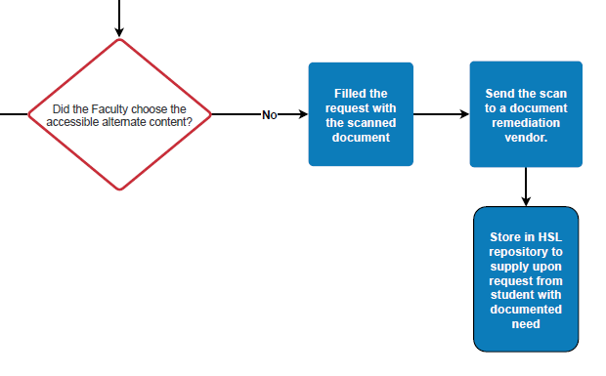
Pathway #6: Remediation

Slide 27
Workflow Pathway: Remediation
Pathway:
All electronic options are exhausted in the workflow and an alternate content suggestion was procured by Liaison Services
Did Faculty select the alternate content (no)
Filled the request with a scanned document
Send the scan to a document remediation vendor
Store remediated document in HSL repository to immediately provide on request from student with documented need

Slide 28
Changes to the Workflow
Altered plan based on discussion with Legal Council
Changes possible as we find repositories with accessible content
Ideas for scaling the service if demand is higher than assumed

Slide 29
Thank you!
Please feel free to reach out with any questions or thoughts
Stephanie Helsher
helshers@upstate.edu

