Slide 1
Create an Isolated and Legal Environment for Teaching Ethical Hacking and Security Principles
Dana Fellows & Travis Wilde

Slide 4
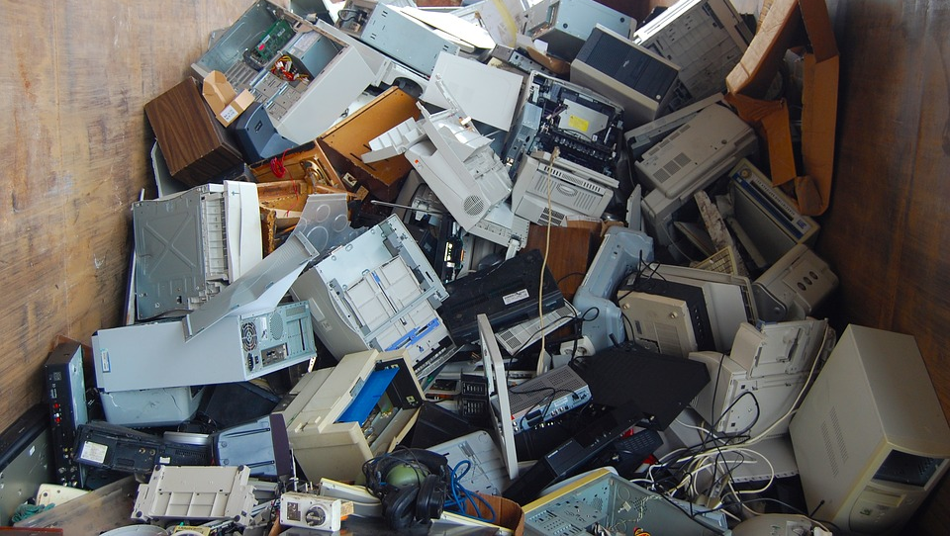

Slide 14
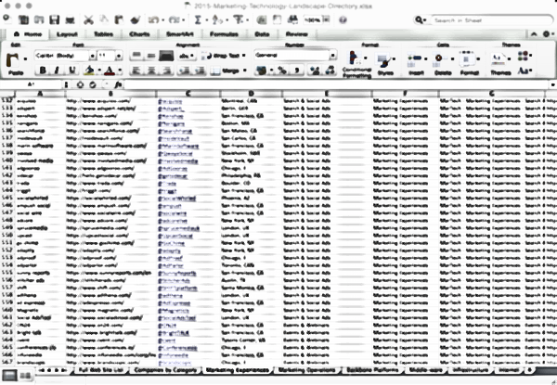

Slide 17
Student At Home School Proxy Internet

Slide 18
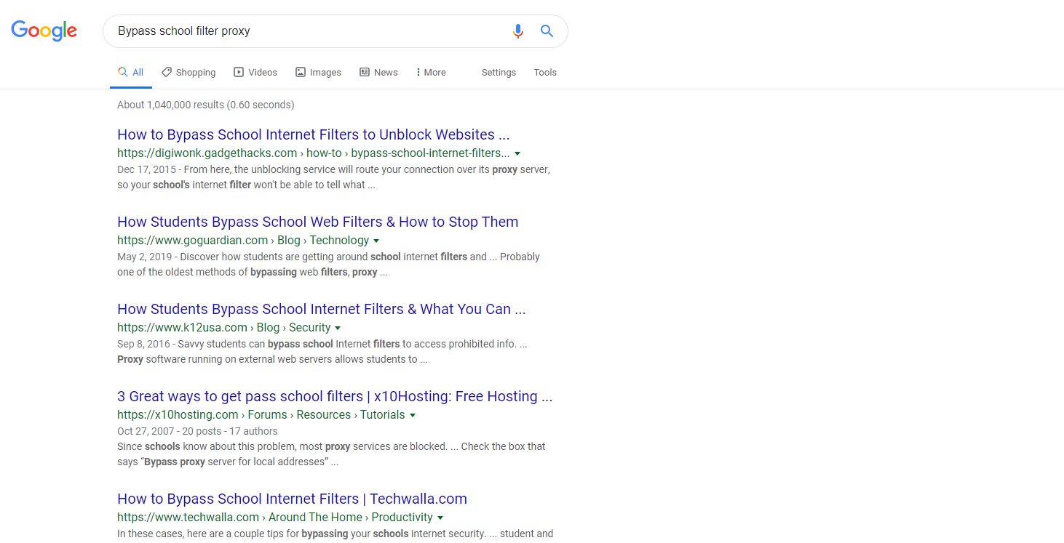

Slide 22
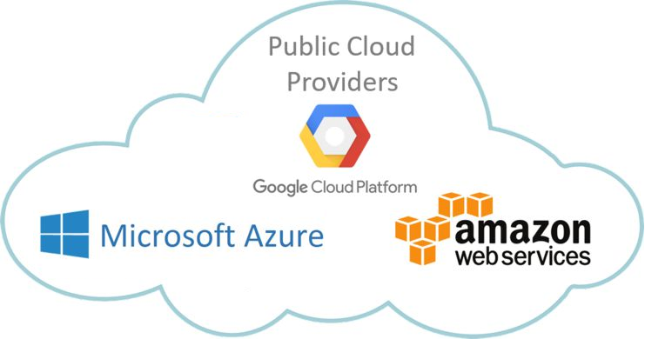

Slide 23
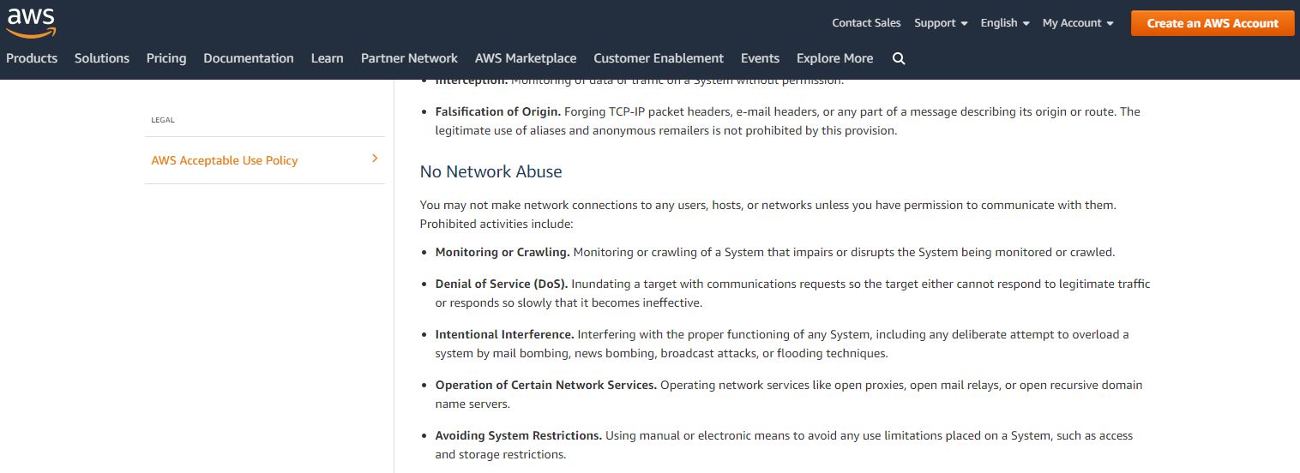

Slide 25
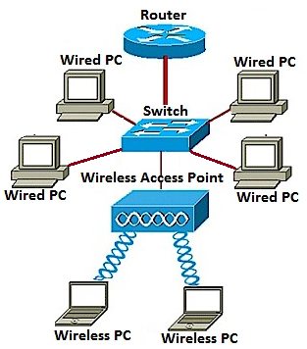
Students
Remote Labs

Slide 26
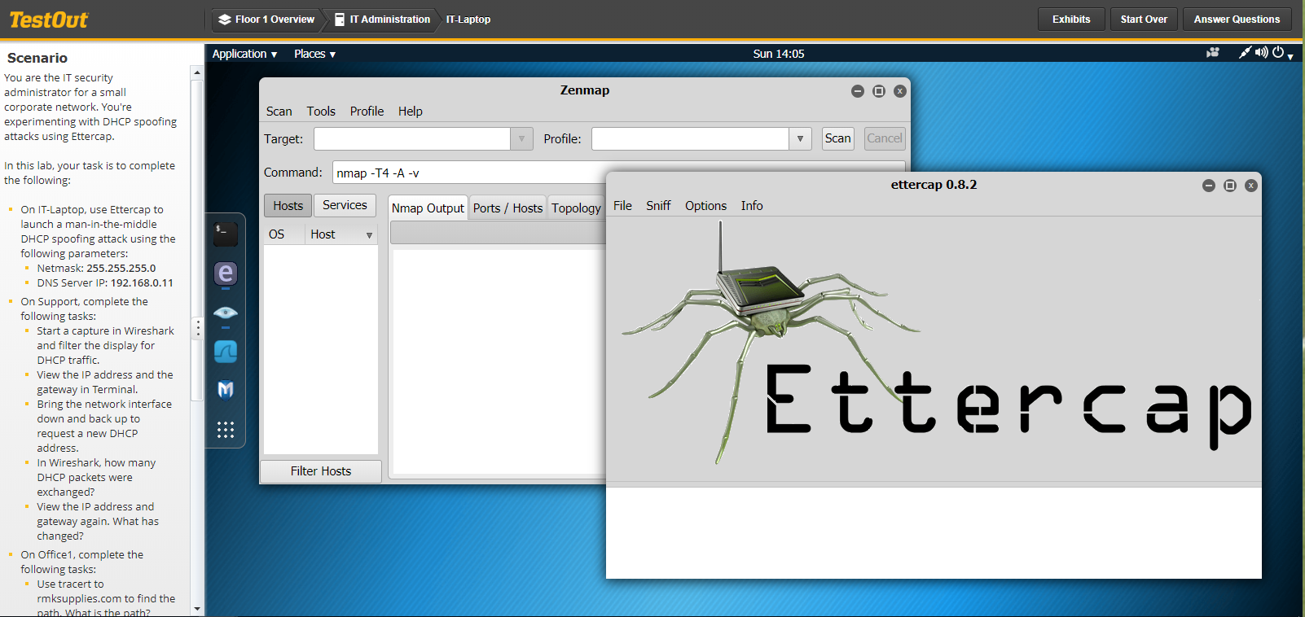

Slide 27
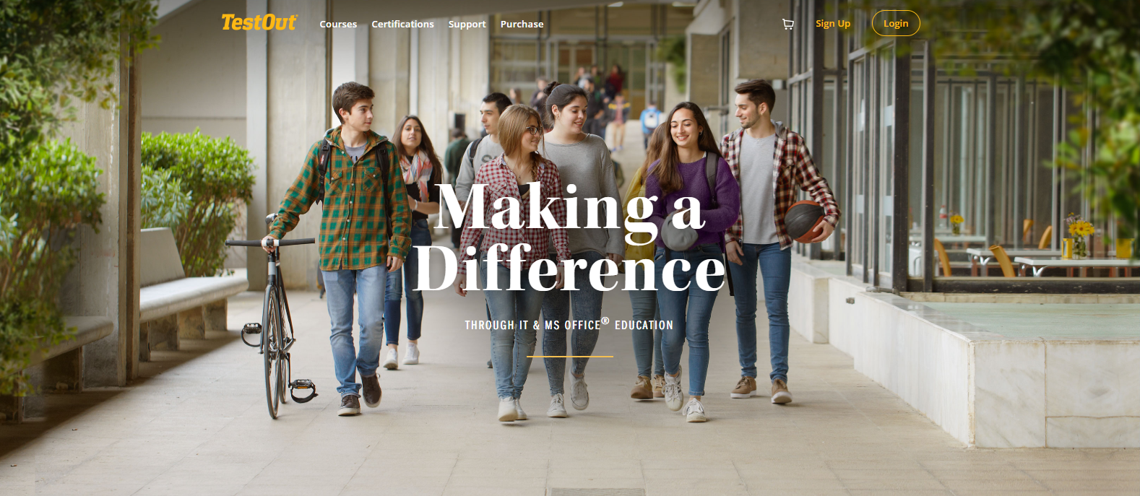

Slide 28
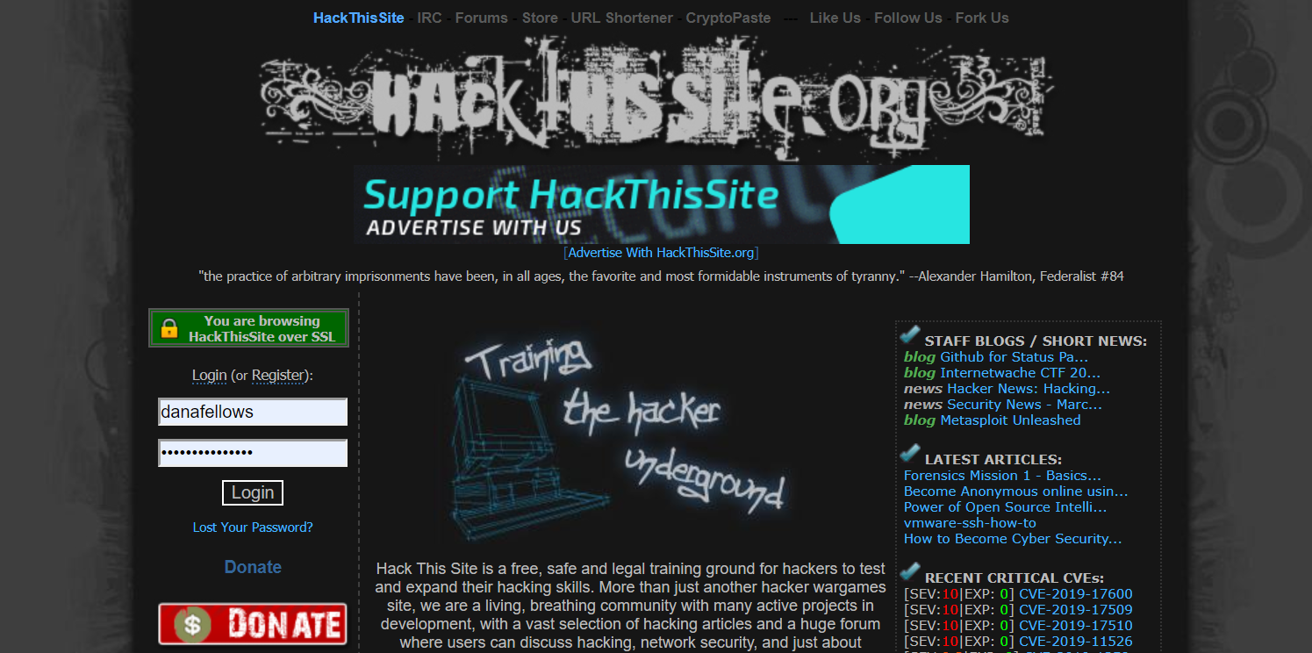

Slide 29
The End

