Slide 1
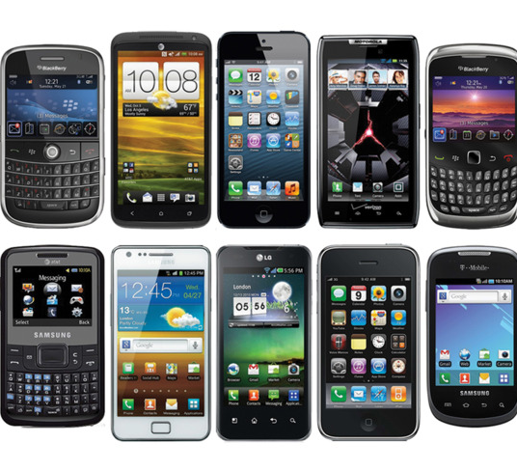
Threats to Education: The Weaponized Cellphone
Khester Kendrick
Dwight Farris, PhD

Slide 2
Power Comparison
S10 > 1,000,000 times greater than all processing power in the world in1969.
The iPhone 6 alone is 32,000 times more processing power than all the Apollo missions

Slide 3
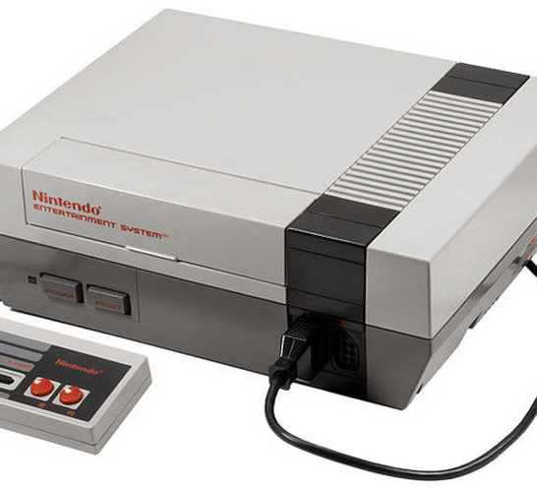
12 Nintendo to 1 Apple i6

Slide 4
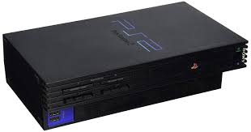
Playstation 2
5 playstations to 1 Galaxy S6

Slide 5
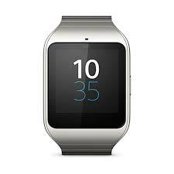
Smart Watch
1 Nintendo Wii to 1 Smart Watch

Slide 6
nethunter

Slide 7
Kali on a chromebook

Slide 8
Threat Landscape
Cybersecurity professionals rank mobile devices as the #1 hardest enterprise asset to defend - Cisco
93 percent of security professionals agree they need to take mobile security more seriously – Verizon
Mobile web traffic now represents 52.2 percent of all Internet usage worldwide – Statistica
More than 180 billion apps have been downloaded from Apple’s App Store® alone – Statistica
In 2017, 61 percent of all emails were first opened on a mobile device – Adestra
82 percent of cybersecurity professionals predict unsecured Internet of Things (IoT) devices (Alexa, Smart Watches, TV) will cause a data breach at their organization –Raytheon

Slide 9
Social engineering
71.4% of targeted attacks involved the use of spear-phishing emails – Symantec
66% of malware is installed via malicious email attachments – Verizon
93% of social attacks were phishing related – Verizon
63% of confirmed data breaches involved weak, default or stolen passwords. – Norton

Slide 10
Students
1/3rd of a child's life will be spent online – safesearchkids.org
50% of students face cyber bullying – bullystatistics.com
46% of kids provide file sharing – safesearchkids.org
15% of kids send sexts – CBS 25% receive them – Times
Smishing has risen by 300% in 2018 – Kaspersky

Slide 11
Mobile security should be at the top of everyone’s worry list — and for good reason:
Nearly every individual access data from smartphones, and that means keeping sensitive info out of the wrong hands is an increasingly intricate puzzle.
The stakes are higher than ever: The average cost of a data breach can be as high as a whopping $3.86 million, according to a 2018 report by the Ponemon Institute. That's 6.4 percent more than the estimated cost in 2017.

Slide 12
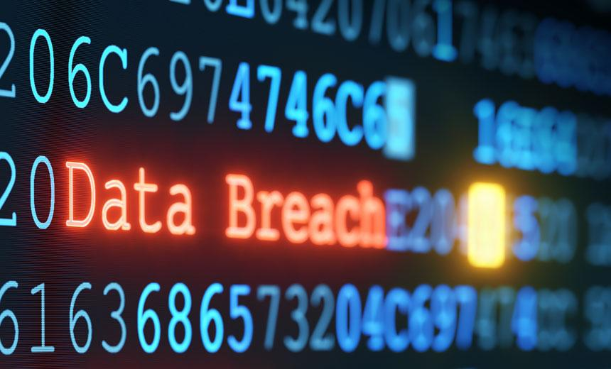
We must begin mobile cybersecurity learning process as early as possible.
While it is easy to focus on the sensational subject of malware, the truth is that mobile malware infections are incredibly uncommon in the real world — with the odds of being infected significantly less than the odds of being struck by lightning, according to one estimate.
Malware currently ranks as the least common initial action in data breach incidents, in fact, coming in behind even physical attacks in Verizon's 2019 Data Breach Investigations Report.

Slide 13
The more realistic mobile security hazards lie in some easily overlooked areas, all of which are only expected to become more pressing as we come to the end of 2019 and begin a new decade of cyber.
What are the seven (7) top concerns of mobile security for 2020 and beyond?
Data leakage
It may sound like a diagnosis from the robot urologist, but data leakage was widely seen as being one of the most worrisome threats to individuals during 2019.

Slide 14
Data leakage
Remember those almost nonexistent odds of being infected with malware? Well, when it comes to a data breach, these have happened nearly 28% in the last two years, based on Ponemon's latest research — odds of more than one in four, in other words.
Notes:
What makes the issue especially vexing is that it often isn't nefarious by nature; rather, it's a matter of users inadvertently making ill-advised decisions about which apps are able to see and transfer their information.
"The main challenge is how to implement an app vetting process that does not overwhelm the administrator and does not frustrate the users," says Dionisio Zumerle, research director for mobile security at Gartner. He suggests turning to mobile threat defense (MTD) solutions — products like Symantec's Endpoint Protection Mobile, CheckPoint's SandBlast Mobile, and Zimperium's zIPS Protection. Such utilities scan apps for "leaky behavior," Zumerle says, and can automate the blocking of problematic processes.
Of course, even that won't always cover leakage that happens as a result of overt user error — something as simple as transferring company files onto a public cloud storage service, pasting confidential info in the wrong place, or forwarding an email to an unintended recipient. That's a challenge the healthcare industry is currently struggling to overcome: According to specialist insurance provider Beazley, "accidental disclosure" was the top cause of data breaches reported by healthcare organizations in the third quarter of 2018. That category combined with insider leaks accounted for nearly half of all reported breaches during that time span.

Slide 15
Social engineering
The tried-and-true tactic of trickery is just as troubling on the mobile front as it is on desktops. Despite the ease with which one would think social engineering cons could be avoided, they remain astonishingly effective.
A staggering 91% of cybercrime starts with email, according to a 2019 report by security firm FireEye. The firm refers to such incidents as "malware-less attacks," since they rely on tactics like impersonation to trick people into clicking dangerous links or providing sensitive info.
Notes:
What makes the issue especially vexing is that it often isn't nefarious by nature; rather, it's a matter of users inadvertently making ill-advised decisions about which apps are able to see and transfer their information.
"The main challenge is how to implement an app vetting process that does not overwhelm the administrator and does not frustrate the users," says Dionisio Zumerle, research director for mobile security at Gartner. He suggests turning to mobile threat defense (MTD) solutions — products like Symantec's Endpoint Protection Mobile, CheckPoint's SandBlast Mobile, and Zimperium's zIPS Protection. Such utilities scan apps for "leaky behavior," Zumerle says, and can automate the blocking of problematic processes.
Of course, even that won't always cover leakage that happens as a result of overt user error — something as simple as transferring company files onto a public cloud storage service, pasting confidential info in the wrong place, or forwarding an email to an unintended recipient. That's a challenge the healthcare industry is currently struggling to overcome: According to specialist insurance provider Beazley, "accidental disclosure" was the top cause of data breaches reported by healthcare organizations in the third quarter of 2018. That category combined with insider leaks accounted for nearly half of all reported breaches during that time span.

Slide 16
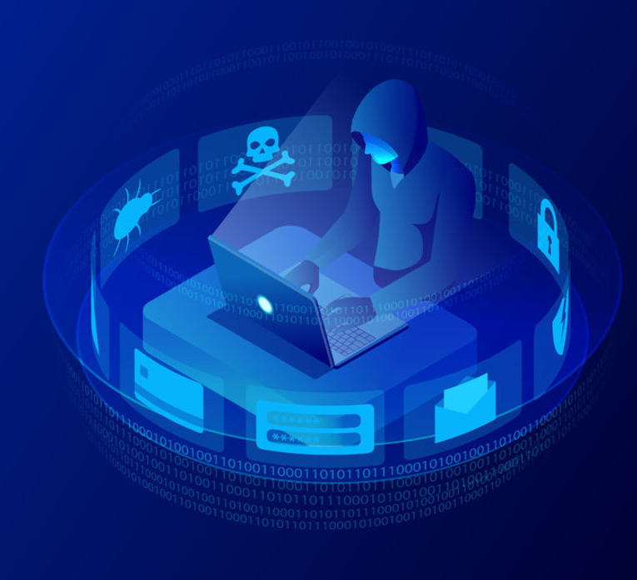
Social engineering
It is not just email anymore, either: about 83% of phishing attacks over the past year took place outside the inbox — in text messages or in apps like Facebook Messenger and WhatsApp along with a variety of games and social media services.
Notes:
The company notes that the more times someone has clicked on a phishing campaign link, the more likely they are to do it again in the future. Verizon has previously reported that 15% of users who are successfully phished will be phished at least one more time within the same year.
"We do see a general rise in mobile susceptibility driven by increases in mobile computing overall [and] the continued growth of BYOD work environments," says John "Lex" Robinson, information security and anti-phishing strategist at PhishMe — a firm that uses real-world simulations to train workers on recognizing and responding to phishing attempts.
Robinson notes that the line between work and personal computing is also continuing to blur. More and more workers are viewing multiple inboxes — connected to a combination of work and personal accounts — together on a smartphone, he notes, and almost everyone conducts some sort of personal business online during the workday. Consequently, the notion of receiving what appears to be a personal email alongside work-related messages doesn't seem at all unusual on the surface, even if it may in fact be a ruse.

Slide 17
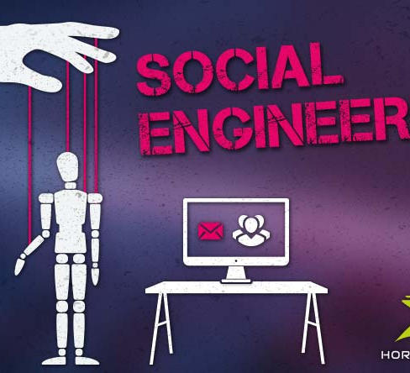
Social engineering
The stakes only keep climbing higher. Cybercrooks are apparently now even using phishing to try to trick folks into giving up two-factor authentication codes designed to protect accounts from unauthorized access.
Notes:
According to a study conducted by Google, New York University, and UC San Diego, even just on-device authentication can prevent 99% of bulk phishing attacks and 90% of targeted attacks, compared to a 96% and 76% effectiveness rate for those same types of attacks with the more phishing-susceptible 2FA codes.

Slide 18
Wi-Fi interference
A mobile device is only as secure as the network through which it transmits data. In an era where we are all constantly connecting to public Wi-Fi networks, that means our data are not as secure as we might assume.
Just how significant of a concern is this? According to research by Wandera, corporate, mobile devices use Wi-Fi almost three times as much as they use cellular data.
Notes:
Nearly a quarter of devices have connected to open and potentially insecure Wi-Fi networks, and 4% of devices have encountered a man-in-the-middle attack — in which someone maliciously intercepts communication between two parties — within the most recent month. McAfee, meanwhile, says network spoofing has increased "dramatically" as of late, and yet less than half of people bother to secure their connection while traveling and relying on public networks.
"These days, it's not difficult to encrypt traffic," says Kevin Du, a computer science professor at Syracuse University who specializes in smartphone security. "If you don't have a VPN, you're leaving a lot of doors on your perimeters open."

Slide 19
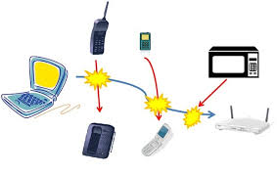
Wi-Fi interference
Nearly a quarter of devices have connected to open and potentially insecure Wi-Fi networks, and 4% of devices have encountered a man-in-the-middle attack — in which someone maliciously intercepts communication between two parties — within the most recent month and has begun to grow exponentially during the holiday season.
Notes:
"These days, it's not difficult to encrypt traffic," says Kevin Du, a computer science professor at Syracuse University who specializes in smartphone security. "If you don't have a VPN, you're leaving a lot of doors on your perimeters open."
Selecting the right enterprise-class VPN, however, isn't so easy. As with most security-related considerations, a tradeoff is almost always required. "The delivery of VPNs needs to be smarter with mobile devices, as minimizing the consumption of resources — mainly battery — is paramount," Gartner's Zumerle points out. An effective VPN should know to activate only when absolutely necessary, he says, and not when a user is accessing something like a news site or working within an app that's known to be secure.

Slide 20
Out-of-date devices
Smartphones, tablets and smaller connected devices — commonly known as the Internet of Things (IoT) — pose a new risk to enterprise security in that unlike traditional mobile devices, they generally do not come with guarantees of timely and ongoing software updates.
This is true particularly on the Android front, where the vast majority of manufacturers are embarrassingly ineffective at keeping their products up to date — both with operating system (OS) updates and with the smaller monthly security patches between them — as well as with IoT devices, many of which aren't even designed to get updates in the first place.
Notes:
"Many of them don't even have a patching mechanism built in, and that's becoming more and more of a threat these days," Du says.
Increased likelihood of attack aside, an extensive use of mobile platforms elevates the overall cost of a data breach, according to Ponemon, and an abundance of work-connected IoT products only causes that figure to climb further. The Internet of Things is "an open door," according to cybersecurity firm Raytheon, which sponsored research showing that 82% of IT professionals predicted that unsecured IoT devices would cause a data breach — likely "catastrophic" — within their organization.
Again, a strong policy goes a long way. There are Android devices that do receive timely and reliable ongoing updates. Until the IoT landscape becomes less of a wild west, it falls upon a company to create its own security net around them.

Slide 21
Crypto-jacking attacks
A relatively new addition to the list of relevant mobile threats, crypto-jacking is a type of attack where someone uses a device to mine for cryptocurrency without the owner's knowledge.
If all that sounds like a lot of technical mumbo-jumbo, just know this: The crypto-mining process uses a smartphone for someone else's gain.
It leans heavily on the technology to do it — which means affected phones will probably experience poor battery life and could even suffer from damage due to overheating components.

Slide 22
Crypto-jacking attacks
While cryptojacking originated on the desktop, it saw a surge on mobile from late 2017 through the early part of 2018.
Unwanted cryptocurrency mining made up a third of all attacks in the first half of 2018, according to a Skybox Security analysis, with a 70% increase in prominence during that time compared to the previous half-year period.
And mobile-specific cryptojacking attacks absolutely exploded between October and November of 2017, when the number of mobile devices affected saw a 287% surge, according to a Wandera report.
Notes:
Since then, things have cooled off somewhat, especially in the mobile domain — a move aided largely by the banning of cryptocurrency mining apps from both Apple's iOS App Store and the Android-associated Google Play Store in June and July, respectively. Still, security firms note that attacks continue to see some level of success via mobile websites (or even just rogue ads on mobile websites) and through apps downloaded from unofficial third-party markets.
Analysts have also noted the possibility of cryptojacking via internet-connected set-top boxes, which some businesses may use for streaming and video casting. According to security firm Rapid7, hackers have found a way to take advantage of an apparent loophole that makes the Android Debug Bridge — a command-line tool intended only for developer use — accessible and ripe for abuse on such products.

Slide 23
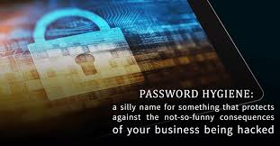
Poor password hygiene
It was once believed that cyber citizens have learned all they need to know about password effectiveness; but somehow, users are still not securing their accounts properly.
A recent survey by Google and Harris Poll found just over half of Americans, based on the survey's sample, reuse passwords across multiple accounts. Equally concerning, nearly a third are not using 2FA (or do not know if they're using it — which might be a little worse).

Slide 24
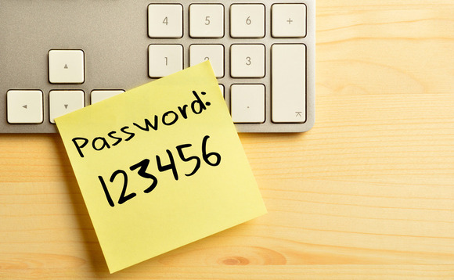
Poor password hygiene
Lest you think this is all much ado about nothing, in 2017, Verizon found that weak or stolen passwords were to blame for more than 80 percent of hacking-related breaches in businesses.
Notes:
Now combine that risk with the aforementioned risk of Wi-Fi interference, multiple it by the total number of employees in your workplace, and think about the layers of likely exposure points that are rapidly adding up.
Perhaps most vexing of all, most people seem completely oblivious to their oversights in this area. In the Google and Harris Poll survey, 69 percent of respondents gave themselves an "A" or "B" at effectively protecting their online accounts, despite subsequent answers that indicated otherwise. Clearly, you can't trust a user's own assessment of the matter.

Slide 25
Poor password hygiene
Lest you think this is all much ado about nothing, in 2017, Verizon found that weak or stolen passwords were to blame for more than 80 percent of hacking-related breaches in businesses.
Notes:
Now combine that risk with the aforementioned risk of Wi-Fi interference, multiple it by the total number of employees in your workplace, and think about the layers of likely exposure points that are rapidly adding up.
Perhaps most vexing of all, most people seem completely oblivious to their oversights in this area. In the Google and Harris Poll survey, 69 percent of respondents gave themselves an "A" or "B" at effectively protecting their online accounts, despite subsequent answers that indicated otherwise. Clearly, you can't trust a user's own assessment of the matter.

Slide 26
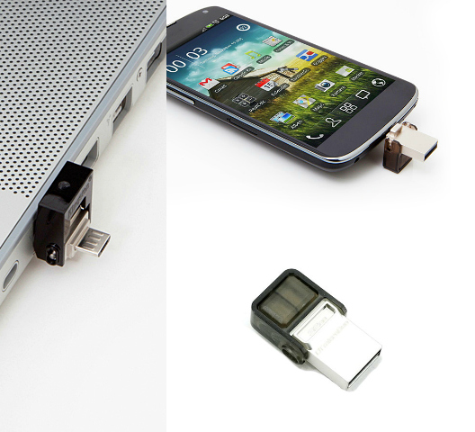
Physical device breaches
Last but not least is something that seems especially silly but remains a disturbingly realistic threat: A lost or unattended device can be a major security risk, especially if it does not have a strong PIN or password and full data encryption.
Notes:
Things don't seem to be getting any better. In its 2019 mobile threat landscape analysis, Wandera found that 43% of companies had at least one smartphone in their roster without any lock screen security. And among users who did set up passwords or PINs on their devices, the firm reports, many opted to use the bare-minimum four-character code when given the opportunity.

Slide 27
Physical device breaches
Consider the following: In a 2016 Ponemon study, 35% of individuals indicated their mobile devices had no mandated measures physical security.
Worse yet, nearly half of those surveyed said they had no password, PIN, or biometric security guarding their devices — and about two-thirds said they did not use encryption. 68%of respondents indicated they sometimes shared passwords…
Notes:
Now combine that risk with the aforementioned risk of Wi-Fi interference, multiple it by the total number of employees in your workplace, and think about the layers of likely exposure points that are rapidly adding up.
Perhaps most vexing of all, most people seem completely oblivious to their oversights in this area. In the Google and Harris Poll survey, 69 percent of respondents gave themselves an "A" or "B" at effectively protecting their online accounts, despite subsequent answers that indicated otherwise. Clearly, you can't trust a user's own assessment of the matter.

Slide 28
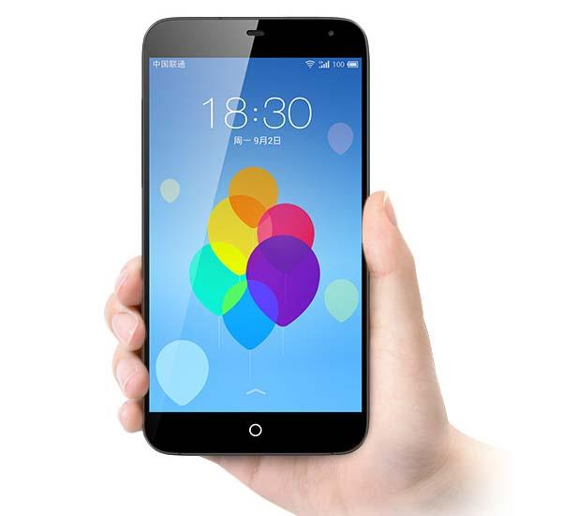
Mobile phones contain a great deal of personal information about users. Many apps on the phone provide access to bank accounts or other accounts that contain sensitive information.
These apps may also store credit card information that can allow criminals to buy whatever they want and ship it wherever they want.
Also, a mobile phone probably contains direct access to e-mail, text messages, and social media accounts that can be used to steal identity and to trick friends into providing their sensitive information as well.

Slide 29
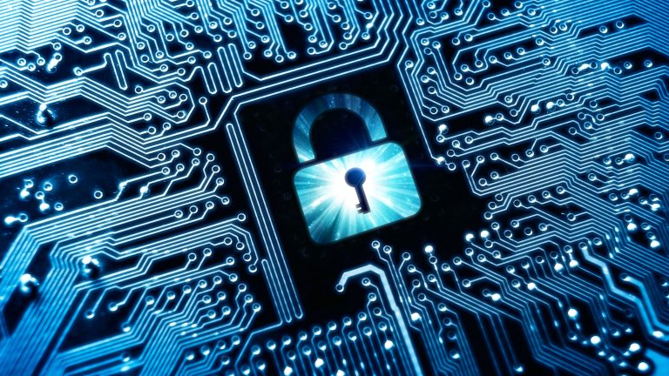
In the future, there will likely be more sophisticated mobile attacks in the enterprise. Although there could be new government regulations to combat the threats, it is not a good idea to wait for the law to catch up with technology.
Current methods of security, such as encryption, might not be sufficient enough to handle future waves of malware that can immediately steal data.
To combat this growing threat, educators must continually investigate new methods to help themselves and students learn about the cyber threats to smartphones.

Slide 30
The ability to understand the methods needed to combat mobile cyberattacks is the next important challenge. One of the major fundamentals of cybersecurity education is accepting this challenge to assist the current generation of young cyber citizens.
The more we know, the more secure the devices will become… let us begin an educational charge now!

Slide 31
References
Chahal, S., & Tatourian, I. (2019). U.S. Patent No. 10,178,132. Washington, DC: U.S. Patent
and Trademark Office.
Meng, X., Qian, K., Lo, D., Shahriar, H., Talukder, M. A. I., & Bhattacharya, P. (2018, July).
Secure Mobile IPC Software Development with Vulnerability Detectors in Android Studio. In 2018 IEEE 42nd Annual Computer Software and Applications Conference (COMPSAC) (Vol. 1, pp. 829-830). IEEE.
Roman, R., Lopez, J., & Mambo, M. (2018). Mobile edge computing, fog et al.: A survey
and analysis of security threats and challenges. Future Generation Computer Systems, 78, 680-698.

