Slide 1

Automated Fulfillment Network (AFN) Meeting #4
Timothy Jackson
Resource Sharing & Fulfillment Program Manager
SUNY Library Services

Slide 2
Agenda
Revised Project Scope
Return Anywhere
Hold Request Pickup at Other SUNYs
Resource Sharing Request Pickup at Other SUNYs

Slide 3
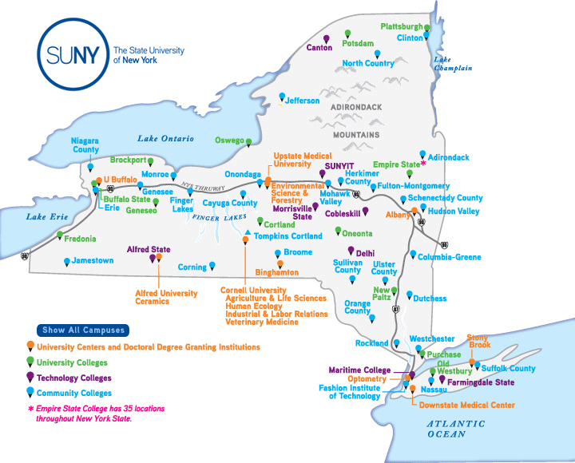
AFN Project Revised Scope
Scope of AFN project has been revised based on responses to AFN interest survey
Return anywhere functionality will be implemented for all SUNY libraries
  Will not override local COVID safety policies
Hold request pickup at other SUNYs will be implemented for interested libraries
Resource sharing request pickup at other SUNYs will not be implemented

Slide 4
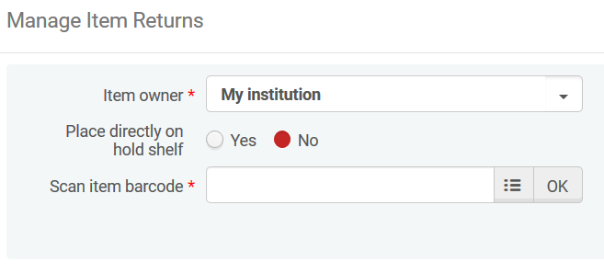
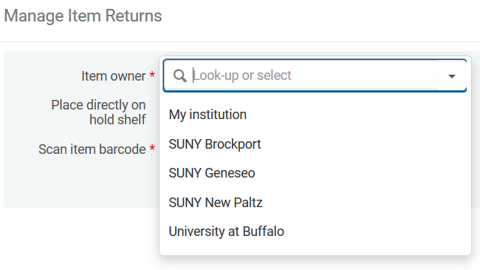
Return Anywhere Functionality
Vast majority of campuses are interested in return anywhere functionality
Long standing SUNY policy allows users to return items to any SUNY library
  Procedures for Open Access to State University Libraries (1974)
Definite need for this functionality
  More than 400 returns from other SUNY users have been reported to SLS
Implementing this functionality will not require a significant amount of training or increase staff workloads
  Workflow simpler and less labor intensive than current procedures

Slide 5
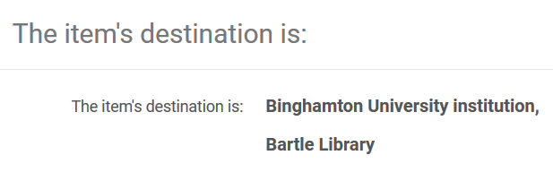
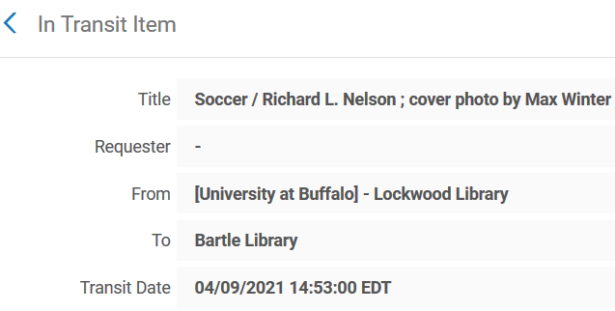
Return Anywhere Functionality
When an item is returned to another SUNY:
  Staff will need to select owning library from dropdown (dropdown defaults to your library)
  Item will be immediately removed from the user’s account at their home library
  Checked in item will be put in transit from library where item was returned
Will help provide better service to users who return items to other SUNYs
Better tracking for items returned to other SUNYs

Slide 6
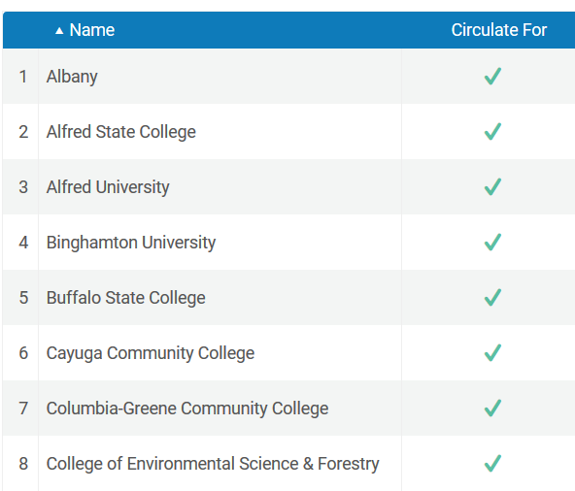
Return Anywhere Functionality
SLS will start working on configuration this week
  Will configure Institutions Relations table for each library
  Goal is to be finished by early May
  This will not have any impact on how Alma currently functions
  SLS will notify each library’s institutional lead once their Institution Relations table has been configured
  Thank you Susan & Yvonne!
Plan to implement return anywhere functionality in Summer 2021
  Need to wait until after the Ex Libris data migration scheduled for May 29 takes place

Slide 7

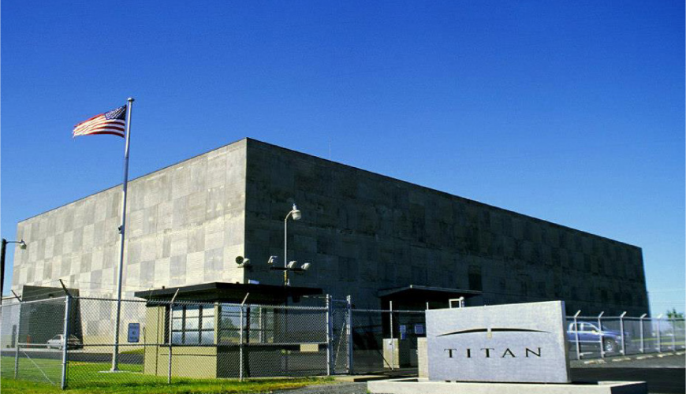
Moses Lake Data Migration
Ex Libris sent email to some SUNY libraries in March about a potential data migration at their data center in Moses Lake, WA
Migration is taking place on Saturday, May 29, 2021
Will result in a 24 hour service interruption
SLS does not want to make any significant configuration changes until we’re certain the data migration didn’t cause any problems
SLS & Ex Libris will provide more info soon

Slide 8
Return Anywhere Functionality
Currently plan to implement return anywhere functionality in mid-June
SLS will conduct training session shortly before implementation
Will discontinue use of webform and “Returned at Other SUNY” temporary location
Will continue to maintain FAQ on SUNY libraries accepting returns from other SUNYs
  https://slcny.libanswers.com/faq/302298
Implementing return anywhere functionality will not override local COVID safety policies
  SUNYs that limit campus access to their own students and faculty will not have to accept returns from other SUNYs

Slide 9
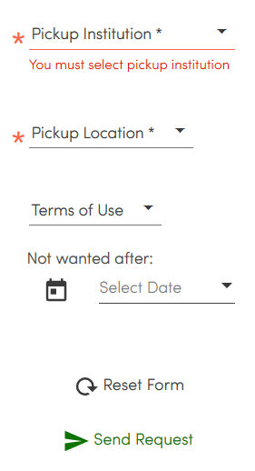
Hold Request Pickup at Other SUNYs
There was enough interest in this functionality to justify implementing it for those interested libraries
Implementing this functionality for only some libraries would not require us to break up our Network Group
  There will be no impact on libraries who choose not to implement this functionality
Configuration options offer far more flexibility than AFN resource sharing
  Possible to start with only a few libraries and slowly expand to other SUNYs
  Possible to configure multiple smaller networks within SUNY
Requires far less staff training than AFN resource sharing

Slide 10
Hold Request Pickup at Other SUNYs
SLS will reach out to interested libraries later this week to start conversation about beta testing
  Libraries that said either “Yes” or “Maybe” to both allowing their users to pick up items at other SUNYs and allowing users from other SUNYs to pick up items at their library
  Libraries that said either “Yes” or “Maybe” to being a beta tester
  Email info@slcny.libanswers.com if you’re interested in beta testing this functionality but don’t meet above criteria
Questions we’ll be asking:
  Are you still interested in implementing this functionality only for hold requests?
  Are you still interested in implementing this functionality even though not all SUNYs plan to participate?
  Are there any SUNYs you’re particularly interested in working with?
  When do you think your library will be ready to implement this functionality?
Implementation timeline will depend on responses
  Could implement this functionality as early as July 2021

Slide 11
Resource Sharing Request Pickup at Other SUNYs
There was not sufficient interest in implementing this functionality
  AFN resource sharing fill rates would have been too low
  Evenly distributing lending requests would have been too difficult
Would have provided confusing user experience
  Preferred pickup institution reverts to home institution if request cannot be filled within AFN
  Users not notified of this change
Would have required us to maintain parallel resource sharing configurations in Alma, which would have been confusing for staff
Would have forced us to break up our Network Group into two smaller groups
  System-wide walk-in borrowing would no longer be possible
  Would not be possible to implement return anywhere for all SUNY libraries
Provided feedback to Ex Libris, and we may revisit this functionality if improvements are made

