Slide 1
Patrick Schultz Wayne Boggs National BPA, MICE Co-Founder Hillsdale Area Career Center pschultz@micek12.com wayne.boggs@hillsdale-isd.org
MICE
Michigan Initiative for Cybersecurity Education

Slide 2
What is MICE?
Michigan Initiative for Cyber Education
Cooperative of IT Teachers
Train the Trainer Professional Development
Central Repository of Cyber Education Curriculum (LMS)

Slide 3
History
Many Years Ago
Initial Discussion of Cyber Security in Michigan
October 2016
NICE K-12 Cyber Education Conference (Virginia)
Draft Standards Creation
2017
Approval of 11.1003 - Computer and Information Systems Security/Information Assurance as a new CTE program. – Aligned to NICE / NIST Framework
Multiple Cybersecurity Teacher Trainings
Governor’s Education & Talent Summit, State Board of Education
2018
Launch of the MICE Learning Management System
Strategic Partnership Development

Slide 4
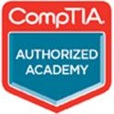
MICE Initiatives (LMS)
Repository of Cyber Education Curriculum

Slide 5
MICE Initiatives (LMS Continued)
Learning Management System
Courses Offered (examples)
Ethical Hacking, Law, and Regulations
Penetration Testing
Digital Forensics
Network Forensics
Certification Preparation
(Network+, Security+, Linux+, A+, MTA, CEH, CISSP, CCNA)
EC-Council Certification Preparation (EHA, CFA)
Computer Science – Java, C#, Python
Website Design – Prototyping to Launch Ready

Slide 6
MICE Initiatives (LMS)
Developing Learning Management System 2.0
Canvas LMS
Authored/Developed new EC-Council Ethical Hacking Associate (EHA), Cyber Forensics Associate (CFA), NOCTI Cybersecurity Assessment

Slide 7
MICE Initiatives (LMS Continued)
General Resources
Step by Step Example of How To Capture the Flag
Competitions
Cyber League, Capture the Flag, etc…
Virtual Sandbox Environment Competitions
CTSO National Connections
Business Professionals of America
SkillsUSA

Slide 8
Strategic Partnership (Cisco)

Slide 9
Strategic Partnership (TestOut)

Slide 10
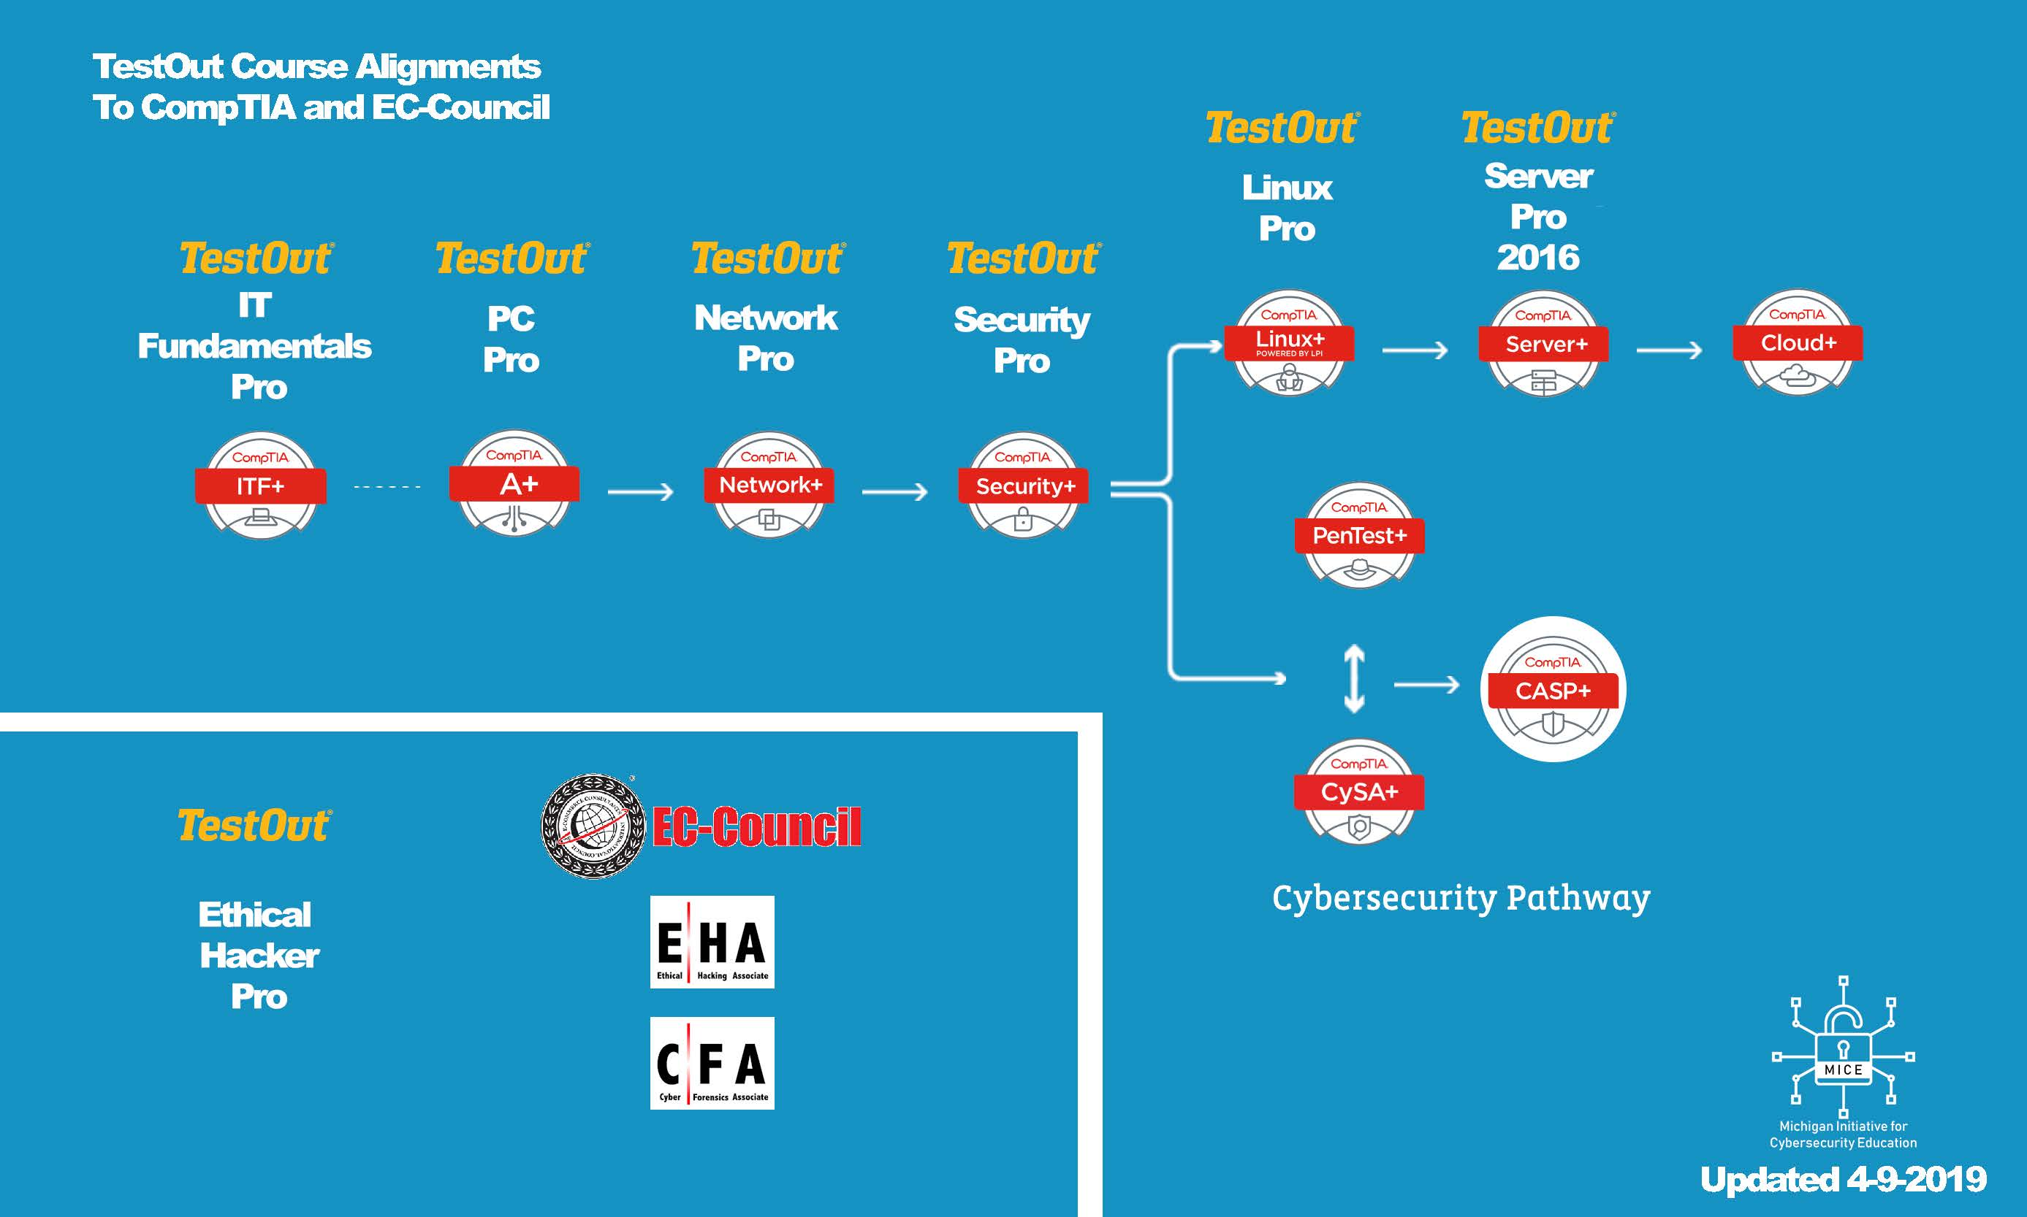
Curriculum/Certification Alignment

Slide 11
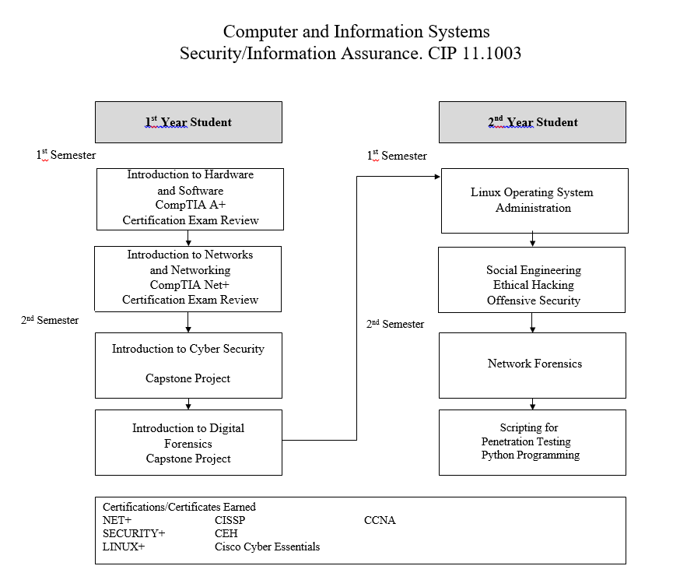
Sample Two-Year Curriculum
1st Year - 12 Segments
2nd Year - Section Q
Delivery Models Could Differ

Slide 12
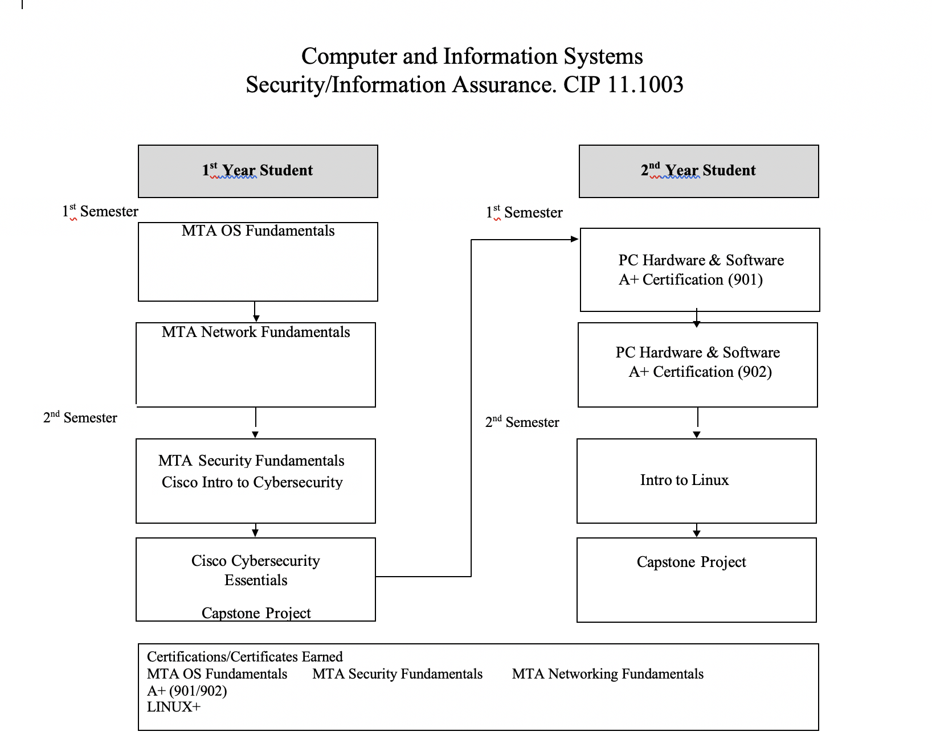

Slide 13
Computer Science Java – Course Content
AP Computer Science Preparation
In this course, you will get:
On-line lectures (with .pdf slides)
Online Assessments (in multiple choice format) with solution
Sample AP format exam with solution
Full Source Code For Instructors (Sample Programs in Java)
Chapter Student Lab projects
Online textbook access
Additional Links to Resources

Slide 14
Computer Science Java Essentials – Course Content
AP Computer Science Preparation
In this course, students will learn:
Java Development Environments (IDEs)
Java Keywords and Syntax
Procedural vs Object Oriented Programming
Decision Structures (Conditional Logic)
Loops
Methods
Single and Multi Dimensional Arrays, ArrayLists
Objects and Classes

Slide 15
Computer Science Java Advanced – Course Content
AP Computer Science Preparation
In this course, students will learn:
Java Development Environments (IDEs)
Objects and Classes
Object Oriented Thinking
Inheritance and Polymorphism
Exception Handling and File I/O
Abstract Classes and Interfaces
Recursion
Searching, Sorting, and Program Efficiency Analysis
Lists, Stacks, Queues, Sets, Maps, and HashMaps

Slide 16
Outcomes
MICE LMS
60 Schools using LMS
Over 2,200 students
75+ New Cisco Net Academies
Over 100+ teachers trained
465 of TestOut, MOS, and MTA Certifications earned in first semester
K-12 Pipeline connecting Business & Industry and Post-Secondary
Community Outreach Programs
Teacher Training, Student Scholarships

Slide 17
What else is upcoming with MICE?
Cyber/STEM Exploration Camp Model
Three-day camp for 7th-12th Graders
Explore Careers, Cisco NetAcad, Drones, Programming, Industry Tours
Teacher Trainings
Statewide Virtual Promotion of Cisco NetAcademy

Slide 18
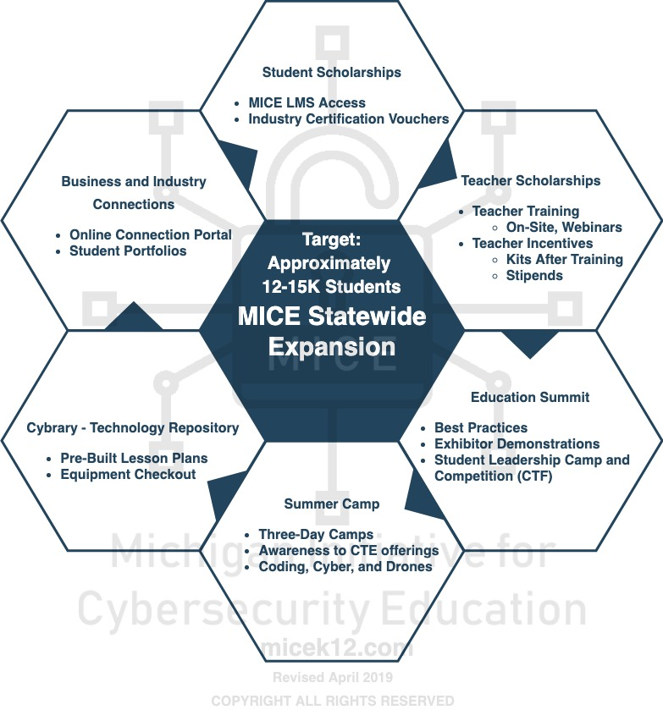
Steps for Growth

Slide 19
Any Questions?
Patrick Schultz
989-714-7572 pschultz@micek12.com
Wayne Boggs
517-812-6498 wayne.boggs@hillsdale-isd.org

