Slide 1
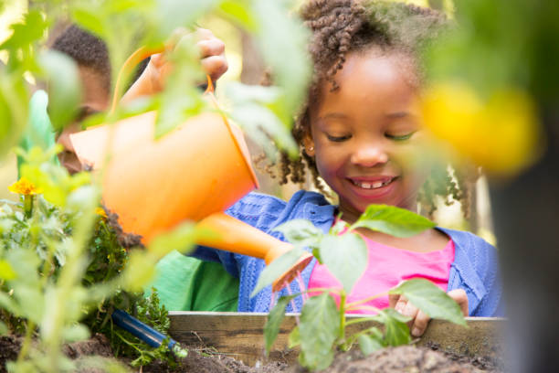
Learning Session 6:
Celebrating Success and Sustaining Your Garden
Enter Coach Name(s)
© 2024 The Nemours Foundation
Notes:
Welcome to Learning Session 6: Celebrating Success and Sustaining Your Garden.
Coaches, depending on the number of ECE programs that are participating in your learning collaborative, you may need to extend the time of this Learning Session or schedule another Learning Session so everyone will have ample time to share their Storyboards.

Slide 2
Agenda
Welcome & Introductions
Review Group Norms
Icebreaker
Storyboards
Sustaining Your Garden
Next Steps – Final Action Period
Notes:
Here is a quick snapshot of how we will spend our time together today.
Read aloud the agenda items.
Please remind participants that they can follow along with the slides during the Session.

Slide 3
Group Norms
Notes:
Share the Group Norms in the chat box and add them to this slide. These are the Group Norms you created in the Orientation Session with this group. Ask anyone if they have any questions or additions.
In our Orientation Meeting we created Group Norms to help guide our discussions. I will review them briefly now. If you have any additions or questions, please share those with the group.
A few suggestions are listed below. Having around 5 group norms is a good goal.
Be on time.
Respect other members of the learning collaborative at all times.
Speak 1 at a time without interrupting.
If something is unclear, ask.
Imagine the other person’s point of view.
Assume good intentions. Listen with respect.
Everyone has something to share. Be sure to share while also making space for others to share.
Share stories and tips with one another. Stories and experiences shared here are confidential.
Accept that each individual participating in the Session will be managing different circumstances in their environment.
Assume technological glitches will happen.
Adhere to agreements on using cameras and muting when possible.
We are going to start with an Icebreaker.

Slide 4
Icebreaker
Let’s create some gardening dance moves!
Notes:
Icebreaker idea: Let’s do one final physical activity icebreaker together! Let’s create some gardening dance moves using gross motor skills we know children work on in the garden and try them out. Let’s take turns thinking of different skills.
Here are a few ideas to get you started:
Push the wheelbarrow
Dig with the shovel
Pick the vegetable
Pulling up the weeds
Pouring water from the watering can
Shuck the corn
Snap the beans
Coaches: you can stop sharing your screen to help facilitate the conversation. Add the activity prompt to the chat box and provide everyone a chance to respond. If you have a larger group, you can utilize breakout rooms, and when you come back together, ask participants to share any thoughts with the group.

Slide 5
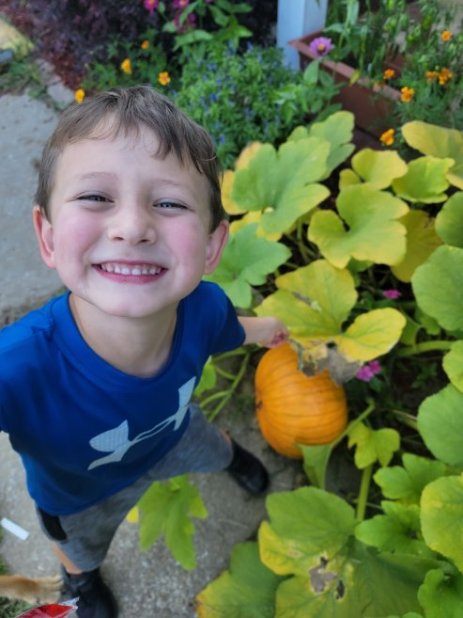
Learning Objectives
Participants share Storyboards, including successes and lessons learned.
Explore ways to sustain ECE program gardens.
Discuss next steps to finish up the Gardening Learning Collaborative.

Slide 6
Gardening Learning Collaborative
Session 1: Introduction to Gardening
Session 2: Benefits of Gardening with Young Children
Session 5: Maintaining Your ECE Program’s Garden
Session 6: Celebrating Success
& Sustaining Your Garden
OR
Action Period
LS 3&4
Action Period
LS 5&6
Action Period
Session 3: Gardening in ECE Programs
Session 4: Getting Started with Gardening
Notes:
We are now at Learning Session 6, our final session! Once this Learning Session ends, we will spend the next few weeks working to implement our action plans, and we will finish up a few final tasks, such as taking the Farm to ECE self-assessment again.

Slide 7
Storyboards
Notes:
Most of our time today will be spent hearing from you all about the progress you have made to create or expand your program’s garden! We are excited to hear about all you have learned, including your successes and lessons learned!

Slide 8
Learning Session 6 Storyboards
Notes:
It is helpful to share the order of ECE program’s that will be sharing during today’s Learning Session. We suggest having the participating programs to share their Storyboard slides with the Coach in advance. Adding all of the Storyboard slides to this PowerPoint will create a more seamless session with fewer technology issues.

Slide 9
Sustaining Your Garden
Notes:
Before we end today’s session, we’re going to walk through an activity to help you reflect on your experience of gardening with the children in your program.

Slide 10
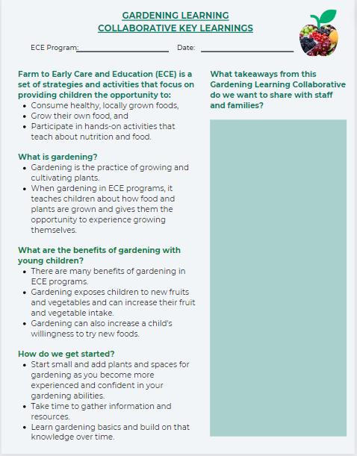
What are your key takeaways?
Notes:
What are your key takeaways from this Learning Collaborative and gardening so far this year? You can use this Key Learnings document to think about what information would be most helpful to share with staff and families. You can find this document in the Gardening Resource Guide.

Slide 11
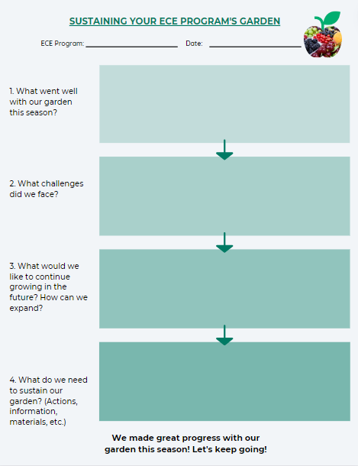
How can you sustain your program’s garden?
Notes:
It will be helpful for you to work together with your Leadership Team to talk through the questions on this handout. Let’s go through the questions together.

Slide 12
What went well with your program’s garden this season?
Notes:
Discussion Prompt: What went well with your program’s garden this season? We just heard from everyone about all of the successes that you had with your gardens so far this season. It will be great to write some of those down. Document them and build on your success in the upcoming seasons.

Slide 13
What challenges did your program face?
Notes:
Discussion Prompt: What challenges did your program face? Which challenges have you been able to overcome? Are there some challenges that you gave up on trying to find a solution?

Slide 14
What would you like to continue growing in the future?
How do you think you can expand?
Notes:
Discussion Prompt: What would you like to continue growing in the future? How do you think you can expand? With every year that you plant your program’s garden, you will learn more about gardening and develop your knowledge and skills. What’s your dream for your garden for next year?

Slide 15
What does your program need to sustain and/or expand your garden?
Consider:
Actions you need to take
Information you may need
Materials that you need
Support from community partners
Notes:
Discussion Prompt: What does your program need in order to sustain and/or expand your garden?
Consider:
Actions you need to take
Information you may need
Materials that you need
Support from community partners- What community partners can you reach out to? Your state’s Extension program is a great one to contact!

Slide 16
Reflection
Notes:
Discussion Prompt: How will you use this handout to share your key learnings and to develop a plan to sustain and expand your ECE program’s garden?

Slide 17
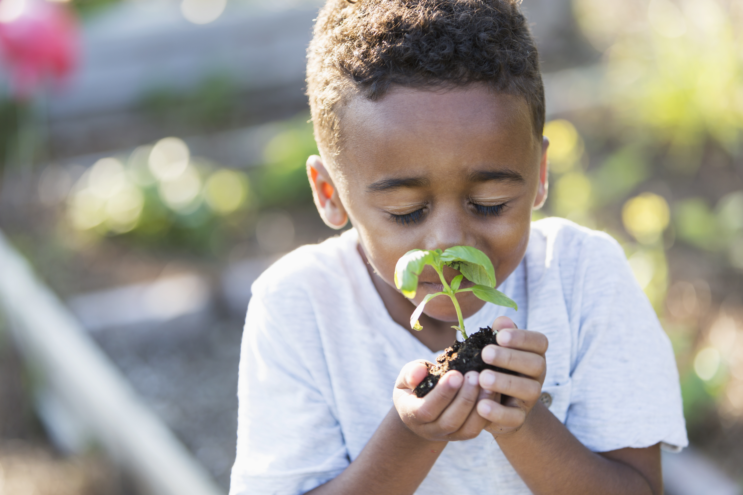
Resources

Slide 18
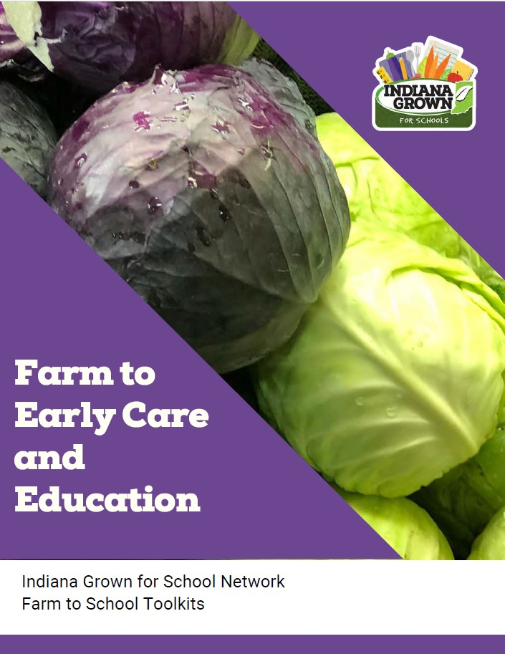
Indiana Specific Resources
Indiana Farm to Early Care and Education Toolkit
Indiana Grown: School Gardens
Purdue University Cooperative Extension
Notes:
https://www.ingrown4schools.com/farm-to-ece

Slide 19
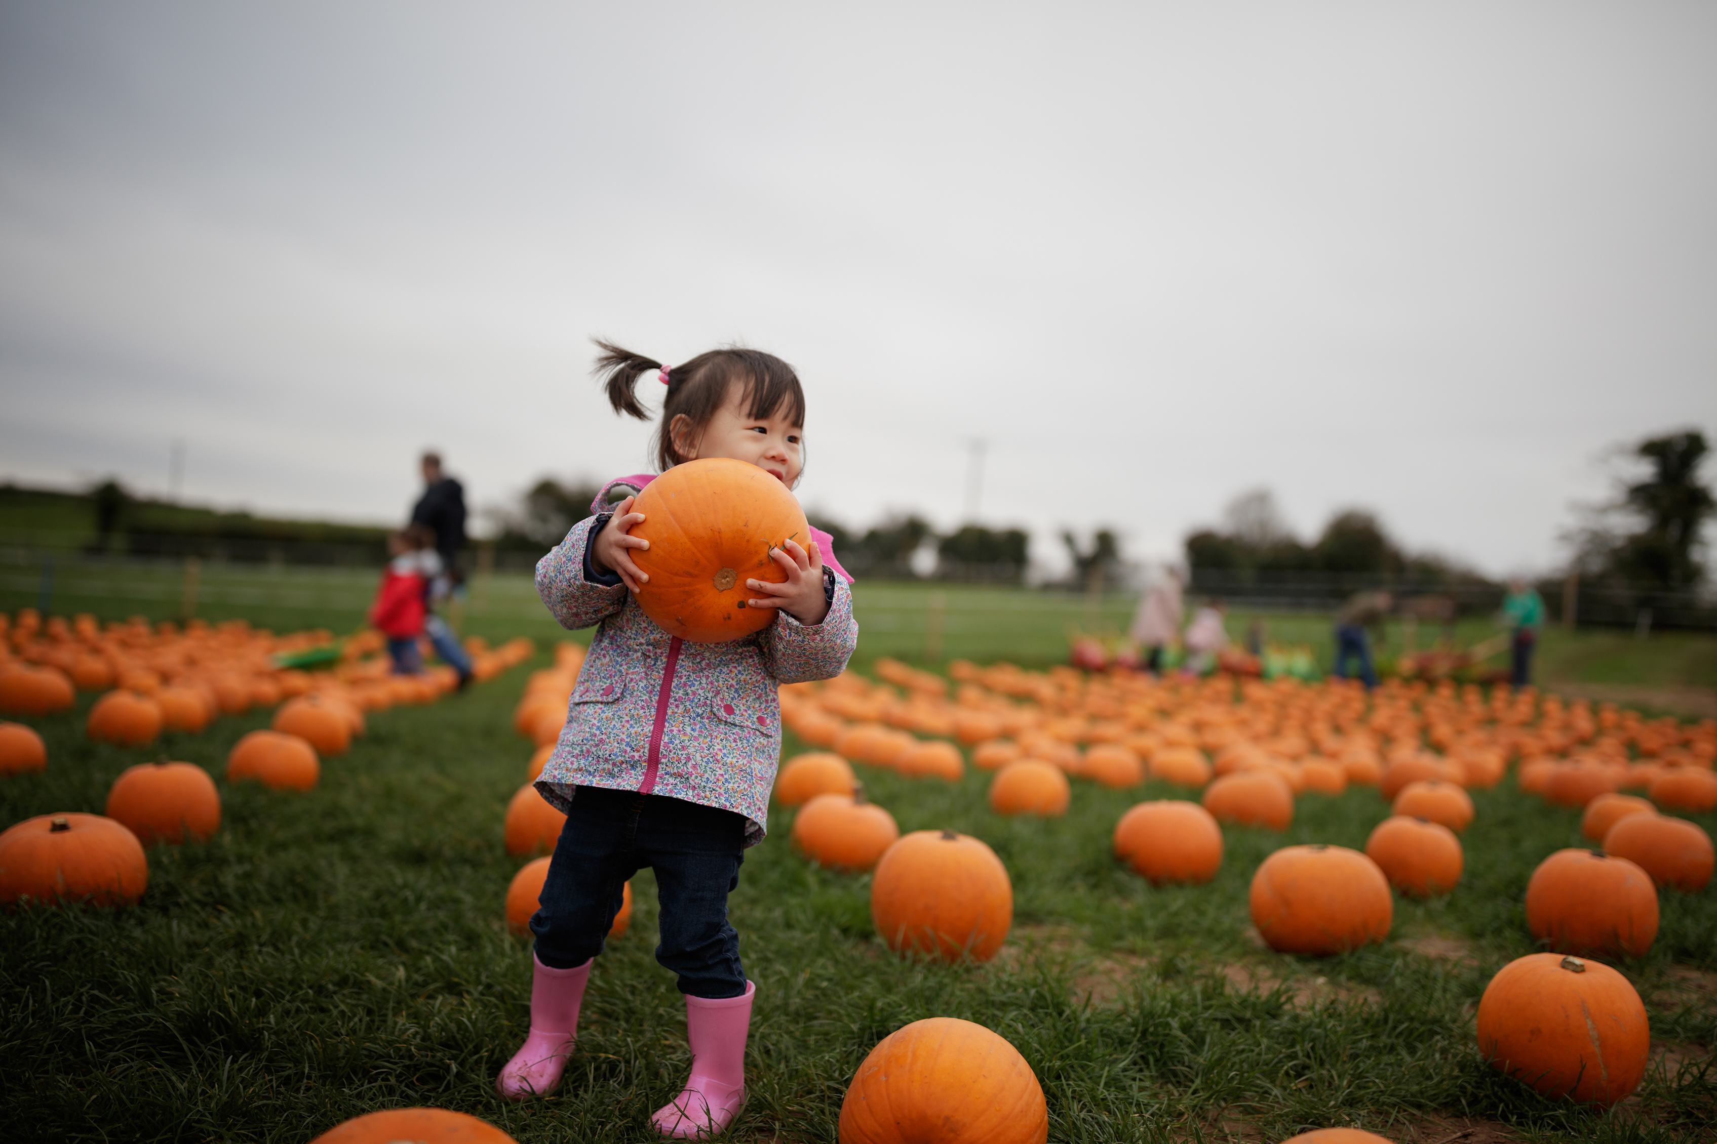
Next Steps

Slide 20
Final Action Period
Session 1: Introduction to Gardening
Session 2: Benefits of Gardening with Young Children
Session 5: Maintaining Your ECE Program’s Garden
Session 6: Celebrating Success
& Sustaining Your Garden
OR
Action Period
LS 3&4
Action Period
LS 5&6
Action Period
Session 3: Gardening in ECE Programs
Session 4: Getting Started with Gardening
Notes:
We hope that you learned a lot during Learning Sessions 5 and 6. Hearing you all share about the progress you have made during this Learning Collaborative is really inspirational! Let’s chat about the final steps we need to take before we finish the Gardening Learning Collaborative.

Slide 21
Action Period Tasks
Finish working through your program’s action plan steps.
Create two additional action plans to keep making progress.
Check the resources shared during this Learning Collaborative.
Complete the Farm to ECE self-assessment again by *insert date*
Notes:
Coaches should review and update the “Action Period Tasks” slides at the end of each Session to ensure accuracy, align tasks with your Learning Collaborative timeline, and reduce repetitive tasks.

Slide 22
Key Dates
Final Technical Assistance “visit”: ____
Final Action Period dates:
Action Period 3:
Notes:
Coaches should add in dates for all upcoming sessions.
Review the timeline. Share dates for all Learning Sessions so providers will know what to expect and to reduce barriers to participation. Be sure to provide a list of actions for each program to complete before and after each Learning Session. The goal is to ensure participants know when they need to complete each action item.
Today was our final Learning Session! Now we will begin our final Action Period, and you will complete a few final tasks, which includes creating 2 additional action plans to keep making progress.

Slide 23
Questions?

Slide 24
Coach Information
Insert Coach Contact Information Here

Slide 25
Coach Reminders
After Session 6, coaches should:
Meet with ECE programs and provide TA to help “complete” their action plans.
Help programs create two additional action plans to keep making progress.
Ensure participating programs complete the Farm to ECE self-assessment again by *insert date*
Share any final resources.
Notes:
This “Coach Reminder” slide gives you, the coach, reminders for the Action Periods and next steps for facilitating the Learning Collaborative. They are hidden in the PowerPoint. They are not intended to be shared with ECE providers. Do not include them in any printed versions of the slides you provide to ECE providers.
After Session 6, coaches should:
Meet with ECE programs and provide TA to help “complete” their action plans.
Help programs create two additional action plans to keep making progress.
Ensure participating programs complete the Farm to ECE self-assessment again by [insert date].
Share any final resources.

