Slide 2
NC AHEC Overview
This slide deck can be used as an orientation tool for new staff or as a helpful resource for staff who want to learn more about other areas within NC AHEC.
For presentations with partners, check out About NC AHEC

Slide 3
NC AHEC
The mission of the NC AHEC Program is to provide and support educational activities and services with a focus on primary care in rural communities and those with less access to resources to recruit, train, and retain the workforce needed to create a healthy North Carolina.
Our vision is a state where everyone in North Carolina is healthy and supported by an appropriate and well-trained health workforce that reflects the communities it serves.
3

Slide 4
NC AHEC MAP

Slide 5
NC AHEC – CORE STRATEGIES
NC AHEC provides and coordinates services and support to achieve our results.
Recruit
Train
Retain
To ensure an appropriate supply of trainees/students to pursue health careers, particularly those who reflect their communities
To encourage health professions trainees/students and healthcare professionals to practice in interprofessional and primary care settings in rural and under-resourced communities
To retain the health workforce with a focus on the diversity of providers, interprofessional teams, and primary care settings in rural and under-resourced communities
5

Slide 6
NC AHEC – ORIGINATION
NC AHEC evolved to leverage NC’s medical schools and community hospitals to respond to national and state concerns with the supply, distribution, retention, and quality of health professionals
A national focus on the health care workforce coincided with a growing effort in NC to establish statewide community training for health professionals and to reverse a trend toward shortages and uneven distribution of primary care physicians in the state’s rural areas.
Interview with Dr. Cutchin on AHEC’s History
The NC General Assembly approved and funded a plan to create a statewide network of nine AHEC regions in partnership with NC medical schools and community hospitals.
The NC AHEC Program began in 1972 with three AHEC regions under a federal AHEC contract with the UNC Chapel Hill School of Medicine.
By 1975, all nine AHECs were operational.
1970s
1972
1974
1975
There are AHECs across the country in other states- to find out more about national efforts visit NAO
6

Slide 7
REGIONAL AHECS – GOVERNANCE & EXPENDITURES
AHEC | 501(c)(3) or Contractual Agreement
Area L | 501(c)(3)
Eastern | 501(c)(3)
Piedmont | Moses H. Cone Memorial Hospital
Mountain | 501(c)(3)
Northwest | Wake Forest University Health Sciences
South East | Novant Health New Hanover Regional Medical Center, LLC
South Piedmont | Wake Forest University Health Sciences/Atrium Health
Southern Regional | 501(c)(3)
Wake | WakeMed
Duke AHEC Program Office | Supports Southern Regional AHEC
7

Slide 8
NC AHEC PROGRAM – STATE FUNDING EXPENSES, FY23
Total NC AHEC Expenditure = $48,730,103
8

Slide 9
Operating More Like A System
Define the use of state funds: 5-year operating contract
Define the work: Annual Work Statement
Measure the work: Performance Measures
Improve the work: RBA and our Strategic Plan
Align finances and the work: Unallocated funds & Budget Guidelines
This positions us to:
respond to opportunities
understand gaps and opportunities for alignment and efficiency
demonstrate need for additional funding
FY23-25
Strategic Plan

Slide 10
Infusing Results-Based Accountability (RBA) Concepts in NC AHEC
The NC AHEC Strategic Plan adopted Results-Based Accountability as our framework to translate strategies into program results.
RBA teaches there are two types of accountability: population accountability and performance accountability. Being accountable for the performance of our programs is our direct responsibility. We use data and disciplined thinking to tell how much we do, how well we do it, and most importantly, if anyone is better off from the service(s) we provide.
RBA “turn the curve thinking” ensures accountability for the performance of our programs and demonstrates our contribution toward achieving the NC AHEC population result: “Everyone in North Carolina is healthy and supported by an appropriate and highly competent health workforce that reflects the communities it serves.”
Each AHEC and the Program Office have at least one certified RBA professional as their in-house resource.
Notes:
Claire
What is RBA?
RBA is a straightforward method of measuring impact that starts with the aim in mind and works backward to the means. It is a method of thinking and doing that can be used to enhance the lives in communities, cities, counties, states, countries, and program performance.
RBA was developed by Mark Friedman and described in his book Trying Hard is Not Good Enough.
RBA is being used in all 50 States and in more than a dozen countries around the world to create measurable change in people’s lives, communities, and organizations.
Give examples of who using it
Where is RBA being used in North Carolina?
SHA -SHIP
CHA-CHIP-SOTCH
Strategic Plans
Hospitals/health systems beginning to use it in their community health improvement work
Funders

Slide 11
NC AHEC – CORE SERVICE LINES
NC AHEC weaves through all sectors of health care education and workforce.
Health Careers & Workforce Diversity
Student Services
Graduate Medical Education Support
Continuing Professional Development
Practice Support
Library Services
11

Slide 12
STUDENT SERVICES

Slide 13
Student Services
NC AHEC supports students, clinical instructors, preceptors, and health science schools.
13
NC AHEC

Slide 14
Definitions of Student Services Activities
AHEC student housing – started in the 1980s to make community training sites more accessible to health science students on clinical rotations. AHEC housing is open to all health science students, but preference is given to students from affiliated partners (below).
Affiliated Academic Partners (for housing purposes) – in-state four-year health science schools that have elected to pay for their students’ use of housing at a lower rate (currently $7 night).
AHEC Consortium for Clinical Education and Practice (CCEP) - formed in 2008 by Wake AHEC to streamline and enhance the clinical placement process for health science students in NC. (note: CCEP is not gatekeeping, it does not decide where or when students are placed but simplifies the process for schools and sites to follow)
Interprofessional education (IPE) - two or more professions (students, residents and health workers) learn with, about, and from each other to enable effective collaboration and improve health outcomes
Interprofessional education and practice (IPEP) - occurs when multiple health workers from different professional backgrounds work together with patients, families and communities to deliver the highest quality of care.
Onboarding – the processes in which new participants are integrated into an organization including various types of clinical learning experiences and credentialing components
Gatekeeping - when all student placements for a site processed/scheduled through a central person/organization
Preceptor Development – educational activities for health care practitioners to develop their teaching skills (adult learning principles, giving/receiving feedback, evaluation & grading, conflict resolution, etc.)
Preceptor recognition/appreciation – activities that recognize or show appreciation to providers who teach students, such as awards, plaques, appreciation dinners, etc.
Other Related Definitions:
Community precepting: Refers to teaching students “off campus” away from an academic center and could include both outpatient and inpatient sites.
Preceptor: Any healthcare provider (nurse, physician, physician assistant, pharmacist, allied health professional….) who teaches a student(s) at their practice setting.
Preceptor site (also referred to as clinical training sites or teaching sites/practices): Refers to the setting where a preceptor is based.

Slide 15
Student Services Initiatives
Nursing Grants/Awards/Partnership Allocations
Clinical Site Development: Develop training sites in priority settings and communities for both pre licensure and graduate nursing. Over 400 grants provided since 1989 legislation.
Educational Mobility Nursing Grants/Awards/Partnership Allocations: Support Licensed Practical Nurses and/or Associate Degree RNs in obtaining a higher degree (BSN+). Over 2,000 students support since 1989; primarily two schools in the last decade; re-prioritizing in current FY.
Behavioral Health Supervision
Provides funds for supervision of psychiatry residents & fellows
AHEC Student Housing
Provides 52,000 nights of short-term lodging annually for students completing clinical rotations in 51 counties across NC.
Faced with an ever-changing healthcare environment and increased pressures to see more patients, community providers are also valued teachers (or preceptors) of our future healthcare workforce. They provide a real-world experience not found on-campus.
Consortium for Clinical Education and Practice (CCEP)
Formed in May 2008 (originally called The Triangle Clinical Consortium) to identify, prioritize and address clinical placement issues for nursing students in the Triangle Region of North Carolina.
Now statewide, clinical and academic partners meet regularly to address undergraduate nursing clinical capacity issues, facilitate placement of nursing students in the region, and standardize the credentialing process.
Interprofessional Education and Practice
Efforts to prepare the health care workforce to work collaboratively

Slide 16
Nursing Partnership Allocations
Clinical Site Development (CSD)
Open to nursing programs in NCCCS, UNC System, and NCICU
Focus on developing clinical sites for prelicensure or graduate nurses in priority areas
Educational Mobility
Open to UNC System nursing schools only, encouraged to partner with a community college
Focus on mobility from LPN/ADN to BSN or LPN/ADN/BSN to MSN, DNP/PhD
Nursing Clinical Instructor Partnership (CIP) Program
Open to nursing programs in NCCCS, UNC System, and NCICU
Focus on developing academic-practice partnership for the role of CIP
For all allocations:
Regional AHEC nurses and PO work with faculty to develop proposals that meet priorities.
Proposals are submitted in April and reviewed by PO committee using standardized rubric.
AHEC Nurse Council is the statewide group for this initiative

Slide 17
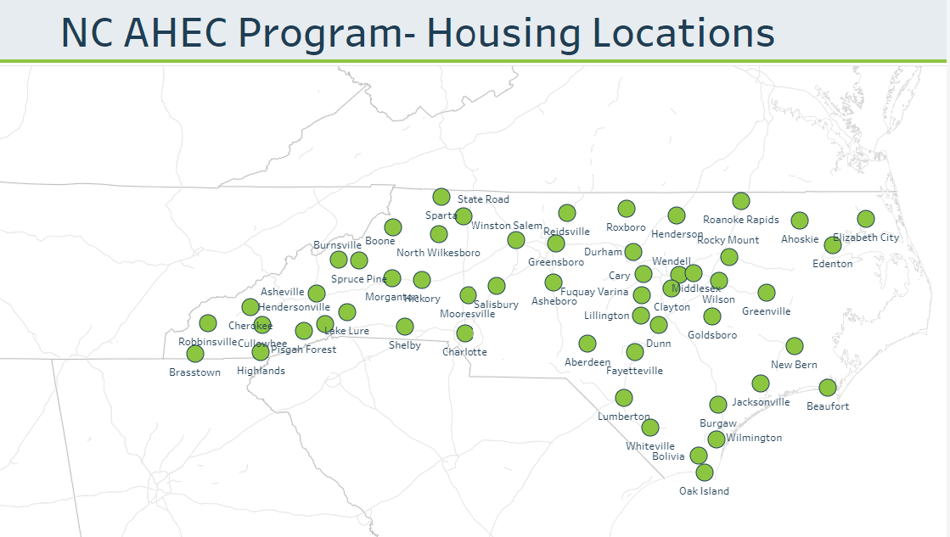
AHEC Student Housing
Purpose: All 9 regional AHECs support students across NC in distant clinical learning experiences through housing access in those areas
Description:
Housing is available to affiliated schools
Housing is owned/leased by the regional AHEC or their parent organization
Housing is maintained by the regional AHEC
Every AHEC and the PO has a housing coordinator
Process:
Statewide housing database managed by the PO
Reservations made through MyAHEC by student. Requests over 60 nights are considered on a case-by-case basis (average is 35 nights).
Regional AHEC manages the logistics of the reservation
Every year in December and June, Program Office (PO) sends invoices to the affiliated schools for their students. Sometimes the school then charges the student.
*Statewide Housing Coordinators meet twice per year for alignment

Slide 18
Student Housing: AHEC Affiliated Schools
“AHEC Affiliated” schools:
Students receive preference over students from non-affiliated schools
Affiliated status applies to students from all programs, including allied heath, public health, dentistry, nutrition and genetic counseling (it’s more than just medicine, nursing, physician assistant and pharmacy). For example, a nutrition student from an affiliated university is given the same housing preference as a medical student from that same university.
Affiliate schools/programs are charged $7/night rate. Rate changes to $14/night in FY25.
Funds go into a statewide Trust that is used by regions to maintain housing/access new housing
Unaffiliated schools:
Unaffiliated schools (usually outside NC or non-student) are charged approximately $25/night. Rate may change in FY25.
Unaffiliated fees are coordinated and billed by the regional AHEC (they work with the student, not the school).
All 17 UNC System Universities and Campuses are considered AHEC Affiliated, but many of them have not had students request AHEC housing so their Universities do not currently have MYAHEC accounts (and some do not have relevant programs).
Affiliations are made with the PO. PO updates the list and notifies AHECs as new schools come onboard.
Current AHEC-Affiliated Schools with Housing Accounts

Slide 19
Consortium of Clinical Education and Practice (CCEP)
Mission: The primary mission of the consortium is to support and grow the healthcare workforce by addressing clinical placement issues for students’ consortium-affiliated facilities.
Objective: All health science students and faculty in NC complete a common core orientation currently endorsed by the North Carolina Hospital Association, housed on the Wake AHEC website.
Three areas:
standardizing and streamlining the clinical faculty/student credentialing process
developing a standardized common “core” orientation
streamlining the clinical placement process
Goals:
Implement the standardize credentialing process for all healthcare disciplines’ students and faculty statewide
Maintain common core orientation training for students and faculty for statewide distribution
Replicate these effective tracking mechanisms for student credentialing statewide
Maintain common clinical placement process and clinical request information for documentation
Establish supportive resources for new clinical faculty
Have representation (leaders) at each Regional AHEC participate in “CCEP Leaders Group” meetings/conference.
*A statewide coordinator for CCEP was established in 2022 at Wake AHEC, supported by PO. The second statewide CCEP meeting occurred in March.

Slide 20
NC Interprofessional Education Leaders Collaborative (NC IPELC)
Mission: To facilitate communication, partnership, and teamwork among and between existing and future healthcare-related interprofessional education initiatives within the state of North Carolina, with the goal to share, implement, and refine best practices for interprofessional education and practice.
Vision: NC IPELC is a national leader in Interprofessional Education.
Result: All students and trainees in NC health professions’ programs are inclusive, collaborative practice ready change agents
2023-2025 Strategic Plan Goals
GOAL 1: Build and organize the resources needed to develop, support, and evaluate interprofessional activities across the state.
GOAL 2: Build an infrastructure that guides and promotes the development of partnerships, collaborations, and teamwork across the state and in regions.
GOAL 3: Amplify the value and benefits of interprofessional education and advocate for the growth and development of NC IPELC.

Slide 21
Housing
IPEP
CCEP

Slide 22
Want to Learn More?
Join the NC AHEC Staff Mailing List
Visit the NC AHEC Internal Depository

