Slide 1

Shared LSP Update
January 31, 2020
www.suny.edu

Slide 2
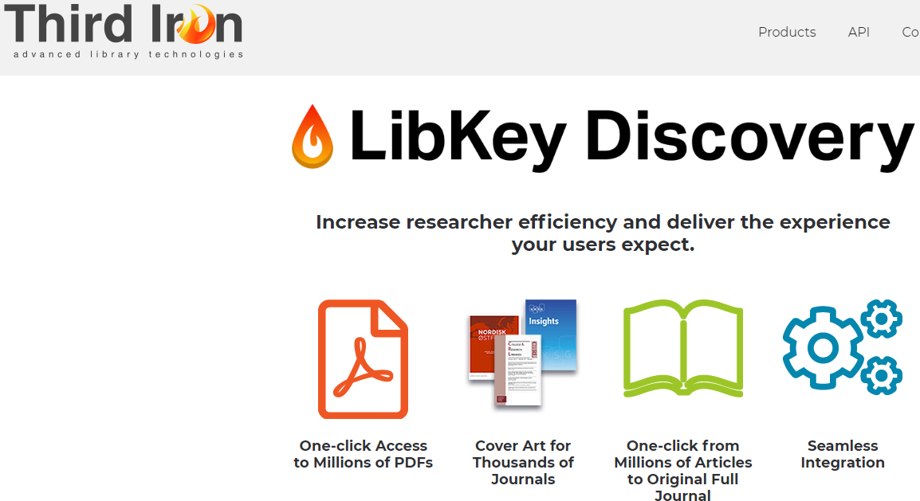
Upcoming Trial and Potential System-Wide Purchase Option
We’ve heard your feedback about how many are unhappy with the extra clicks in Primo VE/Alma Link Resolver.
SUNY is reviewing options for addons to improve access and usability.
  Reviewing:
    Libkey Discovery by Thirdiron
    Lean Library by Sage
Anticipating group contract with details about invoicing, etc. coming as soon as possible.
Will begin trial of product after webinars in the next 2-3 weeks.
Requires some set up in Alma/Primo, which SUNY will assist with.
Will be coordinating communication about this in the next 1-2 months.
www.suny.edu

Slide 3
Support Update
SLSS/SLC met with Ex Libris support managers on January 22nd
Uptime/downtime reports: SUNY requested, they'll come out quarterly, 15-20 days after end of quarter
Continue to pursure support for initiatives
Reviewing cases across institutions, including campus ability to accidentally complete borrowing RS requests, ghost eBook records in NZ, etc.
Received updated Primo performance data, which we’ll share via Basecamp.
Shannon and Tim met with Ex Libris Support and Customer Success at ALA Midwinter.
Reviewing trends on support responsiveness and communication.
Dedicated customer support staff working with SUNY on:
  Extending RS beyond SUNY
  Article resource sharing testing.
www.suny.edu

Slide 4
Update on Planned Initiatives
Network E-Resources Task Force
Membership approved by LSP Advisory Group:
  Michelle Eichelberger, SLSS, co-chair
  Susan Davis, UB, co-chair
  Noah Roth, Broome
  Liz Simmons, Genesee
  Jen Parker, Cortland
  Ken Wierzbowski, Brockport
Meeting 2/4/20 to review charge and begin work
www.suny.edu

Slide 5
Accessibility
We're investigating certification programs for accessibility for SLSS staff
SUNY EIT:
  Michelle is serving on the EIT Policy Implementation – Libraries Committee
  The SUNY Electronic and Information Technology (EIT) Accessibility Policy Implementation Team is offering a series of webinars to serve as a resource for campuses and System Administration.
  Katie Bertel (Buff State), chair of EIT Policy Implementation – Libraries, and Michelle will be presenting on the Libraries Accessibility Guidelines on Friday, February 14 at noon. Registration info.
www.suny.edu

Slide 6
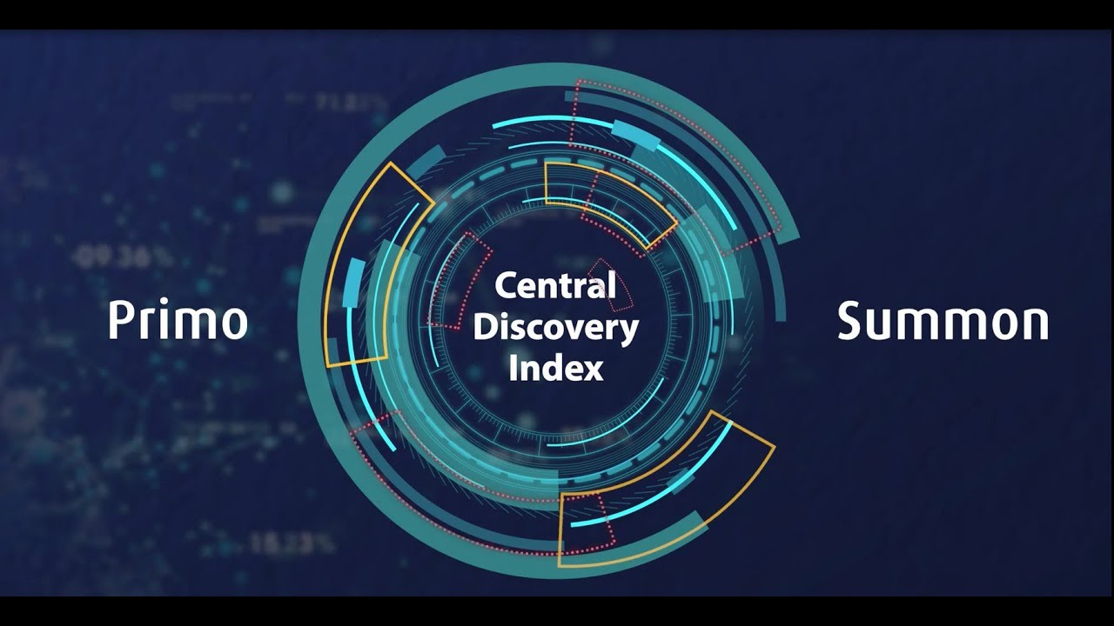
Central Discovery Index Update
Decision was made to wait until May to go-live
Many aspects of CDI won't be updated until February release
After February release, CDI Task Force will create and deliver training documentation and web sessions
Campuses will have several months to test and configure CDI. Will continue to run in parallel to PCI
Minutes and Ex Libris Documentation
Ex Libris YouTube https://www.youtube.com/watch?v=9k-JZdtSuo8
www.suny.edu

Slide 7

February Release: Discovery Highlights
Primo Release Notes
Voice search assistant
Improved mobile UX
Improved Saved Search letter format
All export options (print, send to, etc) will now show on the brief and full records
Refworks has been added to the sign-on menu
Preferred name will now show in user account
Improved JAWS navigation of search result pages (accessibility)
https://pixabay.com/vectors/groundhog-animal-winter-rodent-153207/
www.suny.edu

Slide 8

February Release: Alma Highlights
Alma Release Notes
Local Extensions for Community Zone-Linked Bibliographic Records - Are you using the Community Zone? Did you always want to add your own proprietary information to Community Zone Bibliographic records? You can now achieve this by using local extensions. For more information see Working with Local Extension Fields.
"Quick Printing" Option for Multiple Records - Multi Select Quick printing support was added to the 'Pick From Shelf' task list.
DARA Recommends Local Standalone Portfolios and Local Electronic Collection to Link to the Community Zone
www.suny.edu

Slide 9

Café Alma:
February will be Acquisitions & Cataloging month.
February 13 | Acquisitions & Cataloging - Ordering
February 20 | Acquisitions & Cataloging - Receiving
February 27 | Acquisitions & Cataloging - Cataloging
March 5 | Acquisitions & Cataloging - Open Call
Visit Café Alma online for sign up info, session links, presenter and host guidelines, and other details.
www.suny.edu

Slide 10

Resource Sharing Update
Timothy Jackson
www.suny.edu

Slide 11
January Resource Sharing Volumes
Top 10 Borrowers |  | Top 10 Lenders
Campus | Volume | Campus | Volume
1. University at Buffalo | 799 | 1. University at Albany | 236
2. University at Albany | 307 | 2. Binghamton University | 209
3. Binghamton University | 198 | 3. University at Buffalo | 175
4. SUNY Purchase | 88 | 4. SUNY New Paltz | 113
5. SUNY New Paltz | 65 | 5. SUNY Oswego | 81
6. SUNY Geneseo | 57 | 6. The College at Brockport | 80
7. SUNY Brockport | 50 | 7. Buffalo State College | 72
8. SUNY Oswego | 35 | 8. Alfred University | 56
9. FIT | 33 | 9. Erie Community College | 53
10. Tompkins Cortland CC | 29 | 10. SUNY Oneonta | 45

Slide 12
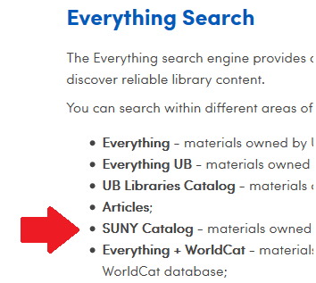
January Resource Sharing Volume Takeaways
The University at Buffalo is still the biggest borrower in SUNY by a wide margin, but the overall percentage of borrowing requests coming from Buffalo has decreased from 50% to 41%
Encouraging libraries to direct RS requests coming from WorldCat to Alma has helped boost borrowing volumes at some campuses
  FAQ: https://slcny.libanswers.com/faq/278349
Using customized rotas to divert more lending requests to Buffalo
  Thank you to Binghamton, Brockport, and Fredonia
www.suny.edu

Slide 13
Resource Sharing Turnaround Time and Fill Rate Statistics
Month | Fill Rate | Turnaround Time
August | 50.2% | 4.7 days
September | 54.0% | 4.3 days
October | 56.1% | 4.3 days
November | 60.0% | 3.9 days
December | 55.1% | 3.8 days
January | 57.8% | 4.4 days
www.suny.edu

Slide 14
Resource Sharing Turnaround Time and Fill Rate Takeaways
Fill rates continue to hover between 55% and 60%
Testing the removal of OCLC number from locate profile, which may help with instances where SUNY holdings are spread out over multiple OCLC records
Turnaround time increased slightly, but that's not surprising given the time of year
Comparison of Alma vs. ILLiad Turnaround Times at Buffalo for January
  Looked only at ILLiad born requests that were filled by ELD libraries
  ILLiad: 5.6 days
  Alma: 4.5 days
www.suny.edu

Slide 15
Other Resource Sharing Issues
Feb 2020 Alma Release: Quick Print capable of printing multiple items
  I will test this and share results once Feb release is available
Troubleshooting problem with Alma API export to ILLiad
  Upgrading to ILLiad 9.1 may fix the issue
Working on new version of Borrowing NCIP Addon
  New version allows you to pick which ILLiad field is used as the barcode in Alma
  Also passes the lender's OCLC symbol and the number of pieces to Alma
  Capable of updating an Alma request that was exported to ILLiad, but we're having problems with getting Alma to accept the ILLiad due date
IDS Slips is now available to IDS Libraries
  https://slcny.libanswers.com/faq/269140
  Non-IDS libraries can email help@idsproject.libanswers.com if interested
www.suny.edu

Slide 16
Other Resource Sharing Issues
There is no need to manually enter a due date for lending RS requests
Alma is configured to automatically assign the SLC loan period and transmit that due date to the borrower
That due date is used to assign the appropriate Item Policy ("RS Long Loan" or "RS Short Loan") once the item arrives at the borrowing library, and that Item Policy determines the loan period (16 weeks or 30 days)
If you manually enter a lending due date that doesn't match the SLC policy, no Item Policy is assigned when the borrower received the item and the item can’t be checked out
www.suny.edu

Slide 17
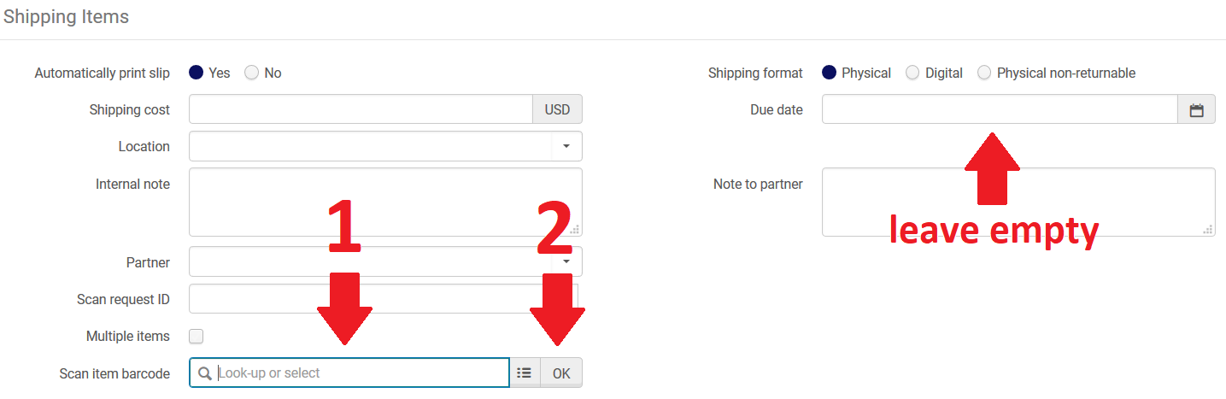
Other Resource Sharing Issues
www.suny.edu

Slide 18
Network Zone
Maggie McGee
www.suny.edu

Slide 19

OCLC Import Profile Updates
January 2020 sandbox release updated S/FTP definitions to allow for the absolute path
  The absolute is required to send OCLC publishing profiles files to the correct directory and subdirectory
Testing the ftp connection in a sandbox with OCLC's new server was successful!
The February 2020 release will allow the absolute path to be used in our production environment. Once testing has been successful in the production environment:
  Instructions will be posted to the Institutional Leads Basecamp and an email will be sent to Cataloging contacts
  The SLC will update the OCLC publishing profiles S/FTP definitions for campuses we configured their publishing profiles
www.suny.edu
Notes:
Good attendance and engagement for all sessions. A successful switch to registration-based training, which makes it easier to communicate with and count participants.

Slide 20
Local Holding Records (LHRs) Publishing Profiles
The SLSS is in the process of configuring and activating LHR publishing profiles for campuses that are responsible for configuring
  Please submit the LHR questionnaire for your campus
For campuses configuring their own LHR publishing profiles, please be aware the slides have been updated to reflect changes to the LHR data sync collection on slides 3 and 4
  Strongly suggest running the baseline prior to flagging serials to "publish holdings" to avoid any issue with LHRs being published to OCLC
  February 2020 release allows duplicate 004s from being sent in LHR publishing profiles. Set the 'fix_multiple_004_in_oclc_publishing' customer parameter to 'true' to address this issue.
www.suny.edu
Notes:
Good attendance and engagement for all sessions. A successful switch to registration-based training, which makes it easier to communicate with and count participants.

Slide 21
Local Subject Headings Initiative
In January, an initiative was approved by SMSP and LSP Adv. Board to allow for SUNY local subject headings to be used to replace dated Library of Congress (LC) subject headings that alienate members of our academic community.
  The initiative will begin with changing "Illegal aliens" to "Undocumented immigrants"
The most effective ways to used local subject headings is currently being investigated
  Normalization Rules
  PrimoVE local display rules
A Task Force will be created to develop SUNY local subject headings to replace other LC subject headings that are not currently being updated and/or for LC subject headings alienating members of our academic community
www.suny.edu
Notes:
Good attendance and engagement for all sessions. A successful switch to registration-based training, which makes it easier to communicate with and count participants.

Slide 22
New Order API Task Force Update
As of the January 2020 Oasis now allows new order APIs to match ebooks to the CZ
GOBI is working with Ex Libris to also allow new order APIs to match ebooks to the CZ
  SUNY will be working with GOBI to test the new functionality
The task force has been adapting to the new order API changes that have been rapidly taking place over the past few months
  Creating a policy
  Creating best practices workflows
www.suny.edu
Notes:
Good attendance and engagement for all sessions. A successful switch to registration-based training, which makes it easier to communicate with and count participants.

Slide 23

Alma February Release Notes
Acquisitions – Enhancements
  Real time ordering- Purchase Type License Upgrade as an Additional PO Line: PO lines with a Purchase Type of License Upgrade created via New Order API will be associated to the relevant portfolio as an additional PO line. Previously, PO lines with a Purchase Type of License Upgrade were associated to the relevant portfolio as a main PO line. Now, the main PO line reflects the original PO line that initiated the order, while the PO line with a purchase type of License Upgrade complements the main PO line. See video: Real Time Order
  Suppress Access to PO Line Summary Information: You can now disable access to review a PO line and view in-depth acquisitions information for users with the roles of Repository Manager, Physical Inventory Operator, or Electronic Inventory Operator. To do so, contact Ex Libris customer support.
www.suny.edu
Notes:
Good attendance and engagement for all sessions. A successful switch to registration-based training, which makes it easier to communicate with and count participants.

Slide 24
Alma February Release Notes
Acquisitions – Enhancements
  Improved Claiming Functionality for Continuous PO Lines: For those using claiming for continuous PO Lines, it will mail the vendor with a cumulative list of claimed items. Previously, if an item's due date arrived and the item was not received, a claim letter was sent to the vendor. Now, if the next expected item also does not arrive, you can send an additional letter to the vendor which includes details for both items which did not arrive. In order to use this new functionality, you need to set the following configuration:
    claim_continuous_item_level to true
  Entering PO Line Number in Item Editor: You can type in the POL # and it will be validated in the field, instead of needing to select it from a list. See the video: Entering PO Line from the Item Editor
www.suny.edu
Notes:
Good attendance and engagement for all sessions. A successful switch to registration-based training, which makes it easier to communicate with and count participants.

Slide 25
Alma February Release Notes
Resource Management – Enhancements
  Local Extensions for Community Zone-Linked Bibliographic Records - you will be able to add your own campus specific information to the community zone by using local extension. All institutions can now create and maintain local extensions to Community Zone bibliographic records in order to record their own proprietary information. Institutions can enter and maintain local information in the MARC 21 77X/78X, 09X, 59X, 69X, and 9XX fields. This can be done with the MD Editor for one record at a time, or for multiple records by running a job with a normalization process that updates local extension fields. Local extension data can be searched, exported, published (general publishing and to Primo) and handled using APIs (see Bibliographic Records and Inventory in the Developer Network). When linked bibliographic records are synchronized during Community Zone updates, the local extension content is not overridden. Click here for more information:
www.suny.edu
Notes:
Good attendance and engagement for all sessions. A successful switch to registration-based training, which makes it easier to communicate with and count participants.

Slide 26
Alma February Release Notes
Resource Management – Enhancements
  Search Indexes for Specific OCLC Numbers - this allows you to be able to perform any type of titles search for OCLC numbers in MARC field 019, 035 $a, 035 $a + $z and 035 $z.
  Support ability to change to an absolute path in the S/FTP Definition - The S/FTP definitions have been enhanced to support absolute paths in addition to the relative paths already supported. This is needed to support file transfer with specific systems provided by OCLC, which recently changed how they transfer files.
www.suny.edu
Notes:
Good attendance and engagement for all sessions. A successful switch to registration-based training, which makes it easier to communicate with and count participants.

Slide 27
Training Update
Jennifer Koerber
www.suny.edu

Slide 28
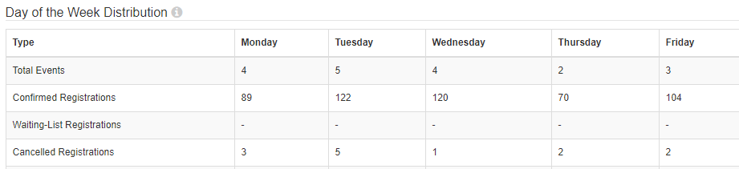
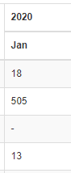
Training Statistics
www.suny.edu
Notes:
Good attendance and engagement for all sessions. A successful switch to registration-based training, which makes it easier to communicate with and count participants.

Slide 29
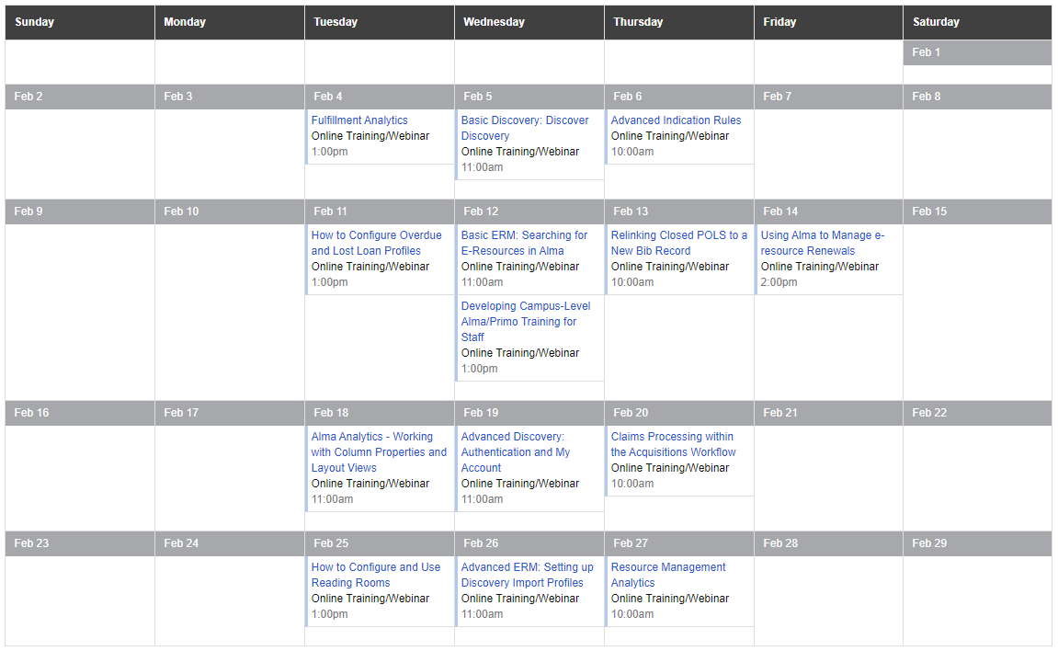
February Sessions https://slcny.libcal.com/calendar/training/
www.suny.edu
Notes:
As trainings are scheduled, we'll add them to the training calendar, which is where all registration information, pre-requisites or pre-work, and webinar information will be.

Slide 30
Upcoming Training
In-Person Training
Online Training Highlights
Cataloging/Resource Management
    March 18 – SUNY New Paltz
    March 20 – SUNY Poly
E-Resources Management
    April 6 – UAlbany
    April 7 – SUNY Genesee
    April 9 – SUNY New Paltz
Fulfillment Units Configuration
    April 22 – SUNY Genesee
    April 28 – SUNY New Paltz
Weekly Discovery/eResources Sessions, Wednesdays @ 11a
How to Configure Overdue and Lost Loan Profiles, 2/11, 1p
Relinking Closed POLS to a New Bib Record, 2/13, 10a
Alma Analytics - Working with Column Properties and Layout Views, 2/18, 11a
How to Configure and Use Reading Rooms, 2/25, 1p
www.suny.edu

Slide 31
Developing Local Alma/Primo Training
"Developing Campus-Level Alma/Primo Training for Staff," Feb 12, 1p
https://slcny.libcal.com/event/6404954
Learn about current and upcoming offerings from SLSS
Walk through Alma/Primo training guides
Learn how to develop local hands-on training for staff
If you have local training handouts or documents you're particularly pleased with, please share them with me at jennifer.koerber@suny.edu
www.suny.edu

Slide 32
eResources Online Course
Coming in March 2020
Six-week course, two sessions per week
Registration required, with fee
Interactive, small group work
Learn about the lifecycle of eResources and managing them in Alma
Led by Alana Nuth
www.suny.edu

Slide 33
Training Guides
Available Now
Available by February 29th
Basecamp Basics: https://slcny.libguides.com/basecamp
Alma/Primo VE Training Guide:
https://slcny.libguides.com/lsptraining
Search and Navigation:
https://slcny.libguides.com/training-search-navigation
Sets & Jobs: https://slcny.libguides.com/training-sets-jobs
Fulfillment: https://slcny.libguides.com/training-fulfillment
Analytics: https://slcny.libguides.com/training-analytics
Discovery/Primo VE: https://slcny.libguides.com/training-primo-discovery
eResources
Resource Sharing
Resource Management
Available Later in the Spring
Acquisitions
Configuration/Systems Librarian guide
www.suny.edu

Slide 34
Additional Updates
www.suny.edu

Slide 35

Collaborating Across SUNY Libraries (CASL) 2020
July 14-15 Albany, NY
Join your colleagues across SUNY for an engaging two days focused on envisioning SUNY Libraries in a shared environment. Hear from nationally and regionally-recognized speakers and leave with a plan of action for moving your library collections, services and infrastructure forward.
www.suny.edu

Slide 36

SLSS Taking Stock of Needs and Capacity
SLSS staff will be making campus visits to learn more about:
  Training needs
  Capacity for more Alma/Primo work
  Hear general feedback on Alma/Primo
Engaging
Overwhelming
www.suny.edu

Slide 37

Upcoming Renewal
OCLC SUNY-wide contract ends in June 2020.
SUNY has been working on issues since 8/2019.
Cross-sector group formed to review issues and system approach to renewal and contracting.
www.suny.edu

Slide 38


Questions or Discussion?
www.suny.edu

