Slide 1
What is Program Launch?
Information and resources that can assist your Unit plan for the upcoming Scouting year. This includes:
Program planning tips
Dates for George Mason District events/FCPS Holiday
Unit resources and tools
Camping information, and
District and Program contacts

Slide 2
Vendor Fair
Ace Adventure Resort
Aquatics Adventure Scuba Academy
Campaign Pay It Forward
Good Wolf Gear
River & Trail Outfitters
Tree Trekkers
Trout Unlimited
Vertical Rock Climbing and Fitness

Slide 3
George Mason District Program
Vice Chair for Program – John Drisco
Advancement – Matt Burns
Merit Badge Day – John Drisco
Merit Badge Dean – Margee Egan
Special Needs – Scott Willey
Camping and Outdoor Programs – Kurt Legenhausen
Aquatics – Rus Pittman
Conservation – Joe Knecht
Cope/Climbing – John Lesko
Health and Safety – TBD
High Adventure – Brian Heath
Outdoor Ethics/LNT – Joe Knecht
Shooting Sports – Brian Summers
Activities and Civic Service – Pat Berney
Camporee – Andy Zaso
Flags In – Rus Pittman
Hike-O-Ree – John Drisco
International – Hector Uranga
Pinewood Derby – TBD
Scouting for Food – Scott Willey
STEM – John Drisco, Acting
Training: Roy DeLauder
NYLT: Cullen Bengtson
Woodbadge: TBD

Slide 4
Pack Resources
Family Talent Survey: https://filestore.scouting.org/filestore/CubScoutMeetingGuide/PDF/Appendix/34362.pdf
Pack Budget Worksheet: https://public.3.basecamp.com/p/HXYMaHqSnQpBKXUK2tdJvMtm
Selecting Cub Pack Leadership: http://www.scouting.org/wp-content/uploads/2019/09/510-50018-SelCubScoutLdrshp_WEB.pdf
Sample Pack Meeting Plans: https://www.scouting.org/programs/cub-scouts/pack-meeting-resources/pack-meeting-plans/
See many additional materials at: https://www.scouting.org/programs/cub-scouts/pack-committee-resources/

Slide 5
Pack Resources (cont.)
Video for new den leaders: https://vimeo.com/569858696
Welcome booklet for new Lion and Tiger den leaders: https://www.scouting.org/wpcontent/uploads/2019/02/510-23318- LionTigerDenLdr_WEB.pdf
Welcome booklet for new Wolf and Bear den leaders: https://www.scouting.org/wpcontent/uploads/2019/02/510-23918- WolfBearDenLdr_WEB.pdf
Welcome booklet for new Webelos and Arrow of Light den leaders: https://www.scouting.org/wpcontent/uploads/2019/02/510- 24718WebeloDenLdr_WEB.pdf
Cub Chat Live podcast for Cub Scout leaders on Facebook each Friday at 3:00 pm (Eastern) https://blog.scoutingmagazine.org/cubchatlive/

Slide 6
Troop Resources
Annual Planning Guide https://filestore.scouting.org/filestore/membership/zip/BSA_Troop_Annual_Program_Planning_Conference_Guide.zip
Troop Operating Budget Worksheet https://public.3.basecamp.com/p/Gr4uTAckKk9t7Xi2azcBFfhj
Budget Planning Tool https://filestore.scouting.org/filestore/boyscouts/pdf/510-275.pdf
Additional information/resources: https://troopleader.scouting.org/annual-planning-conference/

Slide 7
Crew Resources
Annual Program Planning:
https://www.scouting.org/programs/venturing/crew-resources/annual-program-planning/

Slide 8

Summer/Fall 2023 GM Calendar
2nd Thursday of the month – Roundtable (7:30pm), Thoreau MS, Vienna, VA
2nd Thursday of the month – OA Meeting (7:30pm), Thoreau MS, Vienna, VA
07/16/23 – 07/22/23 – Camp Snyder Specialty Week (Merit Badges), Haymarket, VA
07/19/23 – 07/29/23 – National Jamboree, Summit, Bechtel Reservation, WV
08/10/23 – Join Scouting Night/Roundtable, 7:30pm, Thoreau MS, Vienna, VA
08/16/23 – 08/18/23 – Lodge Summer Ordeal, Camp Snyder, Haymarket, VA
08/17/23 – 08/20/23 – Powder Horn, Camp St. Charles, Newburg, MD
09/08/23 – 09/10/23 – 2023 OA Fall Fellowship, Camp Goshen, Goshen, VA
09/14/23 – Roundtable, 7:30pm, Thoreau MS, Vienna, VA
09/23/23 – Scouts Night – Nationals vs Atlanta Braves, 1:05pm, Nationals Park
09/23/23 – Life to Eagle Seminar, St James Catholic Church, Falls Church, VA
09/23/23 – Paddle Craft Safety (Still Water), Camp Snyder, Haymarket, VA
09/24/23 – Paddle Craft Safety (Moving Water), Riley’s Lock, MD
09/28/23 – 10/01/23 – VA Central Ordeal, Camp Snyder, Haymarket, VA
09/30/23 – Scout day at Nationals Game
10/XX/23 – Aquatics Partial Merit Badge Completion Clinic, Location TBD
10/06/23 – 10/09/23 – Climb-o-ree
10/12/23 – Roundtable, 7:30pm, Thoreau MS, Vienna, VA
10/20/23 – 10/22/23 – Fall Camporee, Camp Rock Enon, Gore, VA
10/21/23 – 10/22/23 – Jamboree on the Air/Jamboree on the Internet (JOTA/JOTI)
10/27/23 – 10/29/23 – Hike-o-ree
10/27/23 – 10/29/23 – Fall Festival at Camp Snyder, Haymarket, VA
10/28/23 – Scouting for Food (Tags)
11/04/23 – Scouting for Food (Collection)
11/09/23 – Scout Expo/Roundtable, 7:00pm, Thoreau MS, Vienna, VA
11/11/23 – Veterans Day Flags In, National Memorial Park, Falls Church, VA
11/25/23 – 5K Trot & Ride at Camp Snyder, Haymarket, VA
11/01/23 – OA Election Season Opens
12/06/23 – 12/07/23 – OA Trade-o-ree, Camp Snyder, Haymarket, VA
12/XX/23 – Peace Light distribution

Slide 9

Current Spring 2024 GM Calendar
01/06/24 – OA Lodge Banquet, College Park, MD
02/24/24 – University of Scouting, Hayfield Secondary School, Alexandria, VA
03/09/24 – Commissioner College
04/05/24 – 04/06/24 – 2024 OA Spring Fellowship, Camp Snyder, Haymarket, VA
04/11/24 – District Court of Honor, Thoreau MS, Vienna, VA
05/04/24 – 19th NCAC Scout Orienteering Meet, PWD, Triangle, VA
05/XX/23 – 05/XX/23 – GMD Spring Camporee
05/XX/23 – 05/XX/23 – GMD Hike-O-Ree
05/11/24 - Jamboree on the Trail (JOTT)
05/17/24 – 05/19/24 – Section E10 OA Section Conclave, Camp Snyder, Haymarket, VA
05/27/24 – Memorial Day Flags In, National Memorial Park, Falls Church
05/31/24 – OA Election Season Closes
06/13/24 – Program Launch, Thoreau MS, Vienna, VA

Slide 10
FCPS Fall
2023 Schedule
August 14-18 | Professional Wordays for Staff
August 21 | First Day of School
September 1-4 | Holidays | Labor Day Break
September 16 | Religious and Cultural Observance | Rosh Hashanah (begins sundown 9/15 – sundown 9/17)
September 25 | Holiday | Yom Kippur
October 9 | Student Holiday | Indigenous Peoples’ Day (Professional Workday for Staff)
November 1-2 | Religious and Cultural Observance | All Saints Day / Día de los Muertos
November 3 | End of First Quarter – 2-hour Early Release
November 6 | Student Holiday (Professional Workday for Staff)
November 7 | Student Holiday (Professional Workday for Staff) | Election Day
November 11 | Veterans Day
November 12 | Diwali
November 22-24 | Holidays | Thanksgiving Break
December 7 | Religious and Cultural Observance | Chanukah (begins sundown 12/7-sundown 12/15)
December 8 | Religious and Cultural Observance | Bodhi Day
December 18-31 | Holidays | Winter Break
December 25 | Christmas

Slide 11
FCPS Spring 2024 Schedule
January 1, 2024 | Holiday | New Year’s Day
January 6 | Three Kings Day/Epiphany
January 7 | Orthodox Christmas
January 15 | Holiday | Martin Luther King Jr.’s Birthday
January 19 | Religious and Cultural Observance | Orthodox Epiphany
January 25 | End of Second Quarter – 2-hour Early Release
January 26 | Student Holiday (Professional Workday for Staff)
February 10 | Lunar New Year
February 14 | Ash Wednesday
February 19 | Holiday | Washington’s Birthday and Presidents’ Day
March 5 | 5 Presidential Primary (tentative)
March 11 | Religious and Cultural Observance | First Full Day of Ramadan (begins sundown 3/10 and continues with daily fast and nightly prayer until 4/9)
March 20 | Orthodox Ash Wednesday
March 22 | End of Third Quarter
March 25-29 | Holidays | Spring Break
March 29 | Good Friday
March 31 | Easter
April 1 | Student Holiday (Professional Workday for Staff)
April 2 | Student Holiday (Professional Workday for Staff)
April 9 | Religious and Cultural Observance | Eid al Fitr (begins sundown 4/9 – sundown 4/10)
April 10 | Holiday | Eid al Fitr (begins sundown 4/9 – sundown 4/10)
April 22 | Religious and Cultural Observance | First evening of Passover (begins sundown 4/22 – sundown 4/30)
April 23 | Religious and Cultural Observance | Second evening of Passover
April 24 | Religious and Cultural Observance | Theravada New Year
May 3 | Student Holiday (Professional Workday for Staff)
May 5 | Orthodox Easter
May 27 | Holiday | Memorial Day
June 12 | Last Day of School / Early Release (time of early release determined by each school)
June 13-14 | Professional Workdays for Staff
June 17 | Holiday | Eid-al-Adha (begins sundown 6/16 – sundown 6/17)
June 18 | Professional Workday for Staff
June 19 | Holiday | Juneteenth

Slide 12
FCPS Facilities https://www.fcps.edu/resources/community-use-school-facilities
The priority for community use of facilities is assigned in the following order per Regulation 8420:
  FCPS instructional and extracurricular programs.
  School-related groups such as PTA, PTO, booster club, private tutoring, and school-business Ignite Partners operating under special provisions.
  Fairfax County Department of Neighborhood and Community Services and Fairfax County Park Authority.
  Others, when space is available, including youth groups; Fairfax County employee organizations; cultural and civic groups; colleges and universities; religious organizations; state and federal agencies; private organizations and individuals; and commercial entities.
Once you have registered and have been approved as an organization event coordinator (OEC) in the online reservation system, CommunityUse, you can request space for any FCPS facility. Please note per Regulation 8420, requests must be submitted at least fifteen (15) business days prior to the event date. Once your schedule has been approved, the OEC cannot make any adjustments to the schedule, including cancellations. Please contact the community use school contact, see below list, if changes are necessary. Please refer to the helpful user's guide provided below.

Slide 13
Other Calendars
NCAC Council Calendar
https://www.ncacbsa.org/calendar or https://bit.ly/2TdII7Y
BSA’s Calendar of Religious Observations https://www.scouting.org/resources/relationships/religious-observances/calendar-of-religious-observances-2023/
Order of the Arrow Lodge Calendar
https://wipit470.org/calendar.html

Slide 14
Service Projects
Many Units put their proposed service projects in the Unit Calendar (in addition to the ones that come up throughout the year).
Service projects can be found with your Chartering Organization, Camp Snyder (call Ryan Alford), Fairfax County Park Authority, etc.
Be sure to record the hours for your Unit in Internet Advancement - Units should log service hours via the Scoutbook redirect when they click “Activity Logs” (under either the individual or ‘Quick Entry’) or directly in Internet Advancement.

Slide 15
Other Planning Opportunities
Journey to Excellence
Cub Scout Awards – Also, don’t forget the Pack Summertime Award
Scouts BSA Awards
Religious Awards
Scouter (Adult) Awards

Slide 16
Camping Sites
Pack Overnighter Approve Camping Sites https://www.ncacbsa.org/approved-camp-sites/
OA Camping Site List
  https://www.ncacbsa.org/wp-content/uploads/2020/12/Approved-Camp-Sites.pdf
Want to add a campground to the list?
  The unit would fill out a Pack Overnight Campout Site Appraisal Form and submit to NCAC Director of Camping Services (eric.smith@scouting.org) for review.

Slide 17
Camp Snyder 2024 (Registration opens Oct ‘23)
Cub Scout Camp – Rising Tigers to rising Webelos/AOL
    Day Camp
          Session 1: June 24 – June 28, 2024
          Session 2: July 8 – July 12, 2024
          Resident Weekends
          Session 1: June 20 – June 23, 2024
          Session 2: June 27 – June 30, 2024
          Session 3: July 11 – July 14, 2024
          Scouts BSA Camps
          Specialty Weeks (Merit Badges)
          Session 1: July 15 – July 19, 2024
          Session 2: July 22 – July 26, 2024
          Family Camping (All Ages!)
          July 5-7, 2024
Fall Expos/Family Camping
Session 1: October 20-22, 2023
Session 2: November 17-19, 2023

Slide 18
Goshen
    Family Camp
          Labor Day: September 1 - 4, 2024
          Service Weekend
          September 22-24, 2023
          Webelos/Scouts BSA Camps
Week 1: June 23-29, 2024
Week 2: June 30-July 6, 2024
Week 3: July 7-13, 2024
Week 4: July 14 -20, 2024
Week 5: July 21-27, 2024
Week 6 (Ross only): July 28-August 3, 2024
Lenhok’sin High Adventure (13 years old by 9/1/24)
Week 1: June 23-29, 2024
Week 2: June 30-July 6, 2024
Week 3: July 7-13, 2024
Week 4: July 14 -20, 2024
Week 5: July 21-27, 2024

Slide 19
Scouting Youth Deserve a Trained Leader
George Mason Training site:
https://www.ncacbsa.org/george-mason/training/
Cub Leader Position Specific (C40)
  Available on-line (117 min)
  06/10/23 – Alexandria, VA
Cub Scout Den Leader Specific (C42)
  Available on-line (125 min)
  06/10/23 – Alexandria, VA
Basic Adult Leader Outdoor Orientation (BALOO;C32)
  06/17/23 – 06/18/23 – Lorton, VA
Scoutmaster Position Specific Training(S24)
  Available on-line (192 min)
  06/10/23 – Alexandria, VA
Introduction to Outdoor Leadership Skills (IOLS; S11)
  06/17/23 – 06/18/23 – Lorton, VA
  Goshen Summer Camp will offer IOLS – Check with the Camp Director
Back Country Outdoor Leadership Skills (BCOLS)
  09/23/23 (Alexandria, VA) & 10/21/23-10/22/23 (Markham, VA)
  03/23/24 & 04/27/24-04/28/24
Outdoor Ethics/Leave No Trace (D78)
06/10/23 – Brandywine, MD
09/09/23 – Brandywine, MD
12/03/23 – Brandywine, MD
Outdoor Ethics Newsletter
Powder Horn (P50)
08/17/23 – 08/19/23 – Newburg, MD
Trainer’s Edge – 08/05/23, 12/02/23, 08/10/24, & 12/07/24
Wood Badge (A90)
09/08/23 - 09/10/23 & 10/07/23 - 10/08/23 - Camp Snyder, Haymarket, VA
04/12/24 - -4/14/24 & 05/04/24 – 05/5/24

Slide 20
Roundtable
Roundtables provide unit leaders with the skill to do and the will to do what is needed to ensure that every member of every unit has a great Scouting experience. They build upon the foundation provided by position-specific basic training and each leader’s commitment to serving youth through Scouting.
  Meets monthly on second Thursday at 7:30pm
  Contact brian.summers@verizon.net for more information or visit the Roundtable web site (password is GMDRT)

Slide 21



Stay Safe

Slide 22
National BSA Annual Fees (Council Fees announced on or about July 1)
Effective August 1, 2023, the BSA will implement the following national membership fees which were approved by the National Executive Committee:
$80 for Cub Scouts, Scouts BSA, Venturing and Sea Scouting participants ($5 increase)
$60 for all adult volunteers ($15 increase to provide general liability insurance and enhanced background checks)
$25 one-time joining fee for new program participants in Cub Scouts, Scouts BSA, Venturing, and Sea Scouting (Not prorated and no change in fee)
$30 for Scoutreach (Not prorated)
$25 for Merit Badge Counselors (New Fee applies only for Merit Badge Counselors not already registered as leaders)
$50 for Exploring participants Youth & Adult ($5 increase)
$100 for a unit charter/affiliation fee (no change in fee)
$15 for Scout Life magazine
New Annual Membership Fee Process Announced – BSA Will No Longer Prorate Fees for New Members beginning August 1, 2023
Beginning August 1, 2023, all new youth and adult members who join Scouting will be enrolled in a 12-month membership cycle and BSA will cease prorating fees. Both youth and adults will pay the full annual membership fee and will renew their membership on the anniversary date of joining Scouting. All proration of membership fees will be eliminated. Each registered member of the BSA will receive an email notification with a registration renewal link beginning 60 days before the anniversary date they joined Scouting. Unit leaders will receive a copy of the email and should stay engaged in the membership renewal process just like rechartering.
It is important to note, existing members will renew their membership during their normal registration/recharter cycle through March 2024. Moving forward all members will renew on their anniversary date.
Existing members’ Anniversary date will be their unit recharter month.
New members’ Anniversary date will be the month they joined.
This new process will help streamline the rechartering and membership renewal process for units and councils. Additional information on this membership renewal process will be forthcoming in the very near future.

Slide 23
How District Can Support You

Slide 24

District Committee
Purpose
To work through chartered organizations and community groups to organize and support successful units.
Functions
Membership - The membership function strives for growth through the organization of new Scouting units, through new members and adult volunteers joining existing units, and through the retention of current members.
Fund Development - The fund development function sees that the district provides its share of funds to the total council operating budget.
Program - The program function concentrates on helping Scouting units with camp promotion, special activities including community service, training adult volunteers, and youth advancement and recognition.
Unit service - The unit service function provides direct coaching and consultation for unit volunteers to help ensure the success of every Scouting unit.

Slide 25
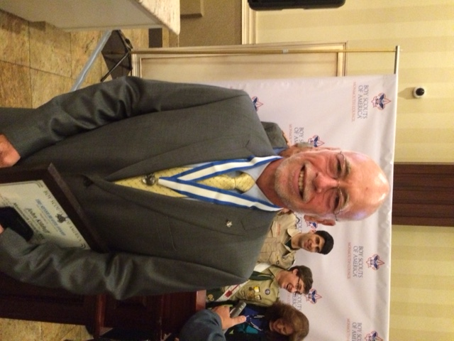
District Chair
Contact:
Mr. John Kilduff
johnkilduff42@gmail.com
Photo

Slide 26



Commissioners
OUR MISSION
  As commissioners, we share the BSA’s mission: To prepare youth to make ethical and moral choices over their lifetimes by instilling in them the values of the Scout Oath and Law.
OUR VISION
Every member of the BSA has a great Scouting experience.
OUR OBJECTIVES
  Supporting unit growth and retention through the journey to excellence.
  Contacting units and capturing in commissioner tools their strengths, needs, and a unit service plan that enables continuing improvement.
  Linking unit needs to district operating committee and other resources.
  Supporting timely unit, district, and council charter renewals.
  Supporting unit leaders by collecting and distributing information, enabling program training, and providing networking opportunities.

Slide 27
Commissioners
District Commissioner: Rus Pittman
Asst. District Commissioner: Pat Berney, Justine Podolny, Mark Serfass
Roundtable Commissioners:
  Steve Banowit (Cubs)
  Brian Summers (Scouts)
Unit Commissioners:
  - Eric Assur - Julia Lesko - Mark Serfass
  - Steve Banowit - Tom McMillen - Brian Summers
  - Pat Burney - Jim Miller - Hector Uranga
  - Jerry Driscoll - Justine Podolny
  - Hunter Jonsson - Rus Pittman

Slide 28
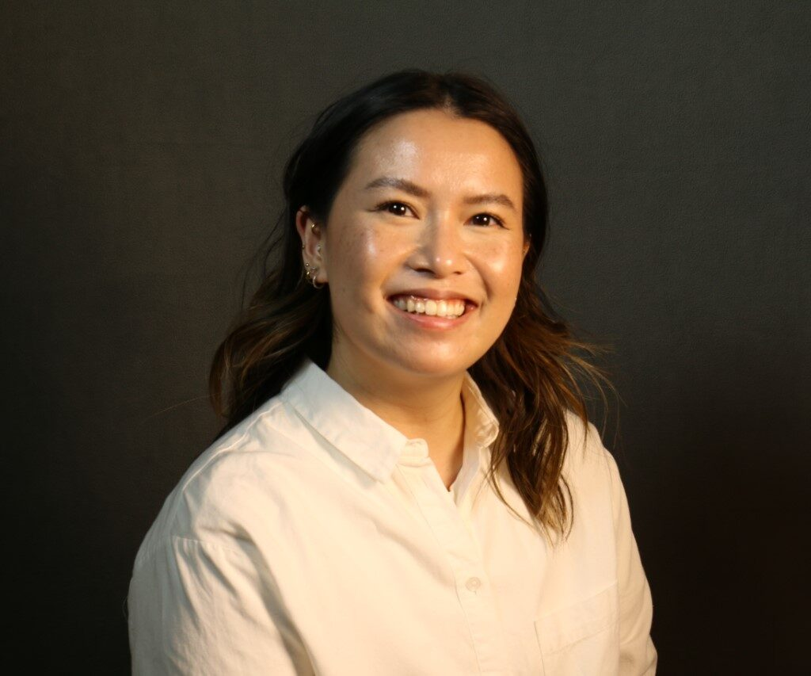
District Executive
While most paperwork and questions can be addressed by your Unit Commissioner, if there is a need, Liz’s contact information is:
Ms. Liz Kohler
District Executive
NCAC, Marriot Scout Service Center
9190 Rockville Pike, Bethesda, MD 20814
301-214-9147
elizabeth.kohler@scouting.org

Slide 29
Program Team
Vice Chair for Program – John Drisco
Deputy Vice Chair – Matt Burns
Activities & Civic Service
Chair, Pat Berney
Camporee – Andy Zaso
Flags In – Rus Pittman
George Mason Hike-O-Ree - TBD
International – Hector Uranga
Pinewood Derby – TBD
Scouting for Food – Scott Willey
STEM Coordinator – Andrew Meikle
Advancement
Chair, Matt Burns
Eagle Board – Jack Lundin
Eagle Dinner – TBD
George Mason District Court of Honor – TBD
Merit Badge Day – John Drisco
Merit Badge Dean – Margee Egan
Special Needs Scouts – Scott Willey
Camping & Outdoor Programs
Chair, Mike Schenaker
Aquatics – Rus Pittman
Conservation – TBD
COPE and Climbing – John Lesko
Cub Scout Day Camp – TBD
High Adventure – Joe Knecht
Health and Safety – TBD
Outdoor Ethics/Leave No Trace – TBD
Shooting Sports – Brian Summers
Training
Chair, Roy DeLauder
IOLS – Julia Lesko
NYLT – Cullen Bengtson
Wood Badge – Julia Lesko

Slide 30
Relationships
Builds and maintains relationships with religious organizations and service organizations to:
  Encourage youth members to join Scouting
  Encourage organizations to charter Scout units
  Offer opportunities for religious and service awards
Contact:
Mr. Pat Berney
patberney4scouts@gmail.com

Slide 31
Program Launch Closing
How to have a successful planning effort
  Set a date for your annual planning meeting
  Provide materials/links listed to those that will lead the meeting
  Be sure to include the stakeholders
    Cubs – include the den leaders/parents
    Scouts/Crews – Encourage youth-leadership
    Consider inviting your Unit Commissioner and/or COR
  Match your planned activities to your anticipated budget
  Plan the appropriate number of Service Projects and Outings/Campouts/Adventures
  Make it FUN!

