Slide 1
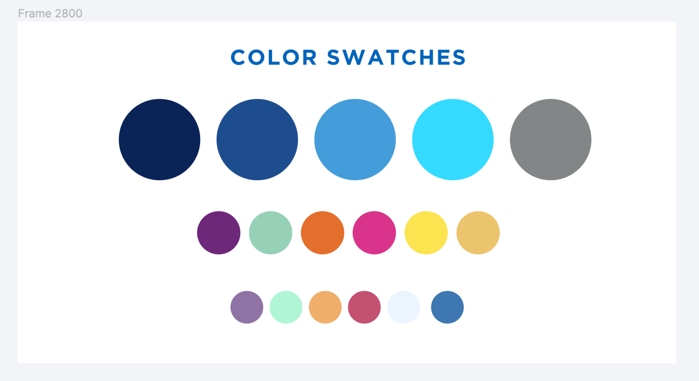
Alma Resource Sharing – Physical Lending Workflows
April 30, 2024

Slide 2
Alma Physical Resource Sharing – Borrowing Workflows
Topics to be covered:
Printing Pull Slips
Shipping Items
Cancelling Requests
Completing Requests
Processing Locate Failures
Sending and Responding to General Messages
Turning Lending Off

Slide 3
Alma Resource Sharing – Other Training Resources
Additional Training Sessions:
Digital Borrowing and Lending
Thursday, May 2 at 11:00am
Registration: https://sunyolis.libcal.com/calendar/training/digitalRS
Alma Resource Sharing Training Guide: https://sunyolis.libguides.com/training-resource-sharing

Slide 4
Alma Physical Resource Sharing – Roles Needed
Roles Needed to Process Lending Requests:
Circulation Desk Operator - scoped to library & circulation desk
Fulfillment Services operator - scoped to library
Requests Operator - scoped to library & circulation desk
Role Needed to Turn Lending Off:
Fulfillment Administrator – scoped to institution

Slide 5
Alma Physical Resource Sharing – Lending Workflows
When you receive a lending request, Alma attempts to attach the request to the record for the requested item
Search uses author, title, ISBN, LCCN, OCLC number
Successful the vast majority of the time
If successful, requested item will be added to your Pick From Shelf list, and the request will go into the Being Processed Status
If unsuccessful, the request will go into the Locate Failed status, and you will need to manually attach the request to a record
Alma’s lending locate process does occasionally make mistakes
Title on pull slip will not match title on shipping slip
Email info@sunyolis.libanswers.com if this happens

Slide 6
Alma Physical Resource Sharing – Lending Workflows
Request Terms of Use determine whether items can be requested by other libraries via Alma resource sharing
Deflections for non-lendable locations, material types, etc. can be configured
FAQ: https://sunyolis.libanswers.com/faq/273344
Lending loan periods are determined by SUNY’s lending loan period policy
Alma automatically sets request due dates
Policy: https://sunyolis.libguides.com/ld.php?content_id=40225585
Alma is configured to automatically approve renewal requests
Renewal requests that aren’t permitted by policy are automatically blocked

Slide 7
Alma Physical Resource Sharing – Lending Workflows
Lending requests are automatically cancelled if they are not filled within a set period of time
Most SUNY libraries have an expiry period of 4 days
SUNY libraries with multiple branches have an expiry period of 6 days
Lending can be turned off in your resource sharing library settings
Any requests received while lending is turned off are automatically rejected
Please turn off your library’s lending if you cannot fill requests for more than 3 consecutive days
FAQ: https://sunyolis.libanswers.com/faq/266453

