Slide 1

OLIS Quarterly Update: May 2021
May 4, 2021
www.suny.edu

Slide 2

OLIS Overview Updates
Mark McBride
www.suny.edu

Slide 3
Budget Update
Next year's 2021-2022 budget has been released.
Essential Opportunity programs – EOP and EOC – both saw increased investment with 20 percent additional support being provided to EOP.
Capital investment in the State-operated Campuses and Statutory Colleges was increased significantly, with $100.0M in Bonded Capital Support being provided on top of the $550.0M.
The Community College Funding Floor was re-instated and per FTE Funding increased by $50, allowing the Community Colleges to see the greater of per FTE funding or 98 percent of Approved 2020/21 Base Aid.
$4 million in OER Funding is in place for 2021-2022.
OLIS budget for 2021-2022 is still be decided; reduction from 2020-2021 over just over 5%, however spending restrictions are still in place.
www.suny.edu

Slide 4
SUNY Connect/SUNY Library Services
We are making the case to keep the $600,000 once used as subsidy for Elsevier ScienceDirect contract.
OLIS is preparing a model to present to SLC Board to specify how this money is allocated.
Rationale we are using for funding model:
  Grow Shared Collections strategies and activities with input from SSCC
  Maintain baseline services at SLS with no additional charge to campuses.
  Seek opportunities to increase collaboration with campuses.
We will present model to community after we discuss and receive input from Board.
www.suny.edu

Slide 5
DEI Funding and Initiative
EBSCO provided funding for a system-wide DEI initiative.
Focus of initiative will be on reviewing DEI in the context of:
  Collections Strategies
  Talent Management
SUNY will also be partnering with ESLN on this, but still developing details.
www.suny.edu

Slide 6
OER Services
Mike Daly
www.suny.edu

Slide 7

Top Percentage of General Education Course Sections utilizing OER – Fall 2020
www.suny.edu
Notes:
Fall 2020: 17 campuses reported in SIRIS that greater than 10% of their total General Education course section offerings were utilizing OER.
Using a cross-analysis of know OER course sections via LMS integration and data reported in SIRS of campuse coded OER sections, only 44% percent of OER course sections are being reportd to SIRIS.
Blue – community colleges
Green – non community colleges

Slide 8
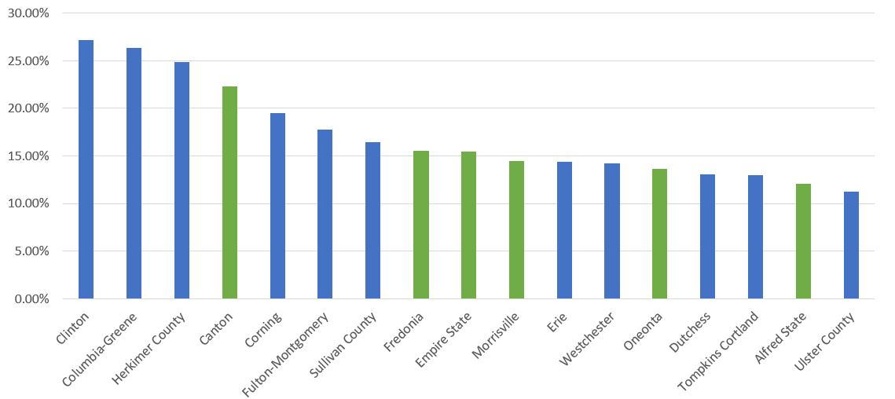
Fall 2020 “C or better” Comparison of those General Education Course Sections using OER. AKA the "Course Throughput Rate."
C or better rate in General Education OER Course Sections | C or better rate in General Education Course sections not using OER
64.59% | 62.84%
Let's remember, OER isn't the thing, it's a thing that can connect other things.
www.suny.edu
Notes:
Why does this matter? The standards of measurement that tell the story of SUNY's OER efforts are being defined. As we strive toward being a data-informed, data-accountable culture....

Slide 9
Continuously Improving
  Available at oer.suny.edu
  General Chemistry (OLI)
  Physics I (OLI)
  Public Speaking
  Student Cognition Toolbox (OLI)
  Managerial Accounting (OHM) - June 2021
  Calculus I (OHM) - July 2021
Focus on Diversity, Equity and Inclusion
  OLI's Anatomy & Physiology courses recently underwent significant revisions focused on expanding the diversity of images used in the course
    Interested in collaborating with SUNY Community Colleges on National Science Foundation Grant aimed at STEM attrition
  Lumen Learning recently released VPAT for Waymaker and OHM that aligns with WCAG 2.1
    Lumen Learning recently partnered with Perkins School for the Blind faculty and students for on-going analysis and accessibility-focused reviews of its courseware
  New Lumen Circle focused on Inclusive Teaching starts in Summer 2021

Slide 10
Mapping SUNY OER to new General Education Knowledge Areas
Proposed revisions to SUNY General Education
Knowledge Areas | Potential SUNY OER Content
Communication - Writing | https://oer.suny.edu/topics/english-and-communication/
Mathematics and Quantitative Reasoning | https://oer.suny.edu/topics/mathematics/
Natural Science | https://oer.suny.edu/topics/natural-science/
Humanities | https://oer.suny.edu/topics/Humanities-and-Languages/
Social Science | https://oer.suny.edu/topics/social-science/
The Arts | Art Appreciation, Visual Design
U.S Historical and Civic Engagement | https://oer.suny.edu/topics/social-science/
World Languages | https://oer.suny.edu/topics/Humanities-and-Languages/
www.suny.edu
Notes:
Fall 2020: 17 campuses reported in SIRIS that greater than 10% of their total General Education course section offerings were utilizing OER.
Blue – community colleges
Green – non community colleges

Slide 11
Mapping SUNY OER to new General Education Competencies
Proposed revisions to SUNY General Education
Competencies | Potential SUNY OER Content
Communication Oral | Public Speaking, Business Communications
Critical Thinking and Reasoning | Argument Diagramming, CollaborativeU, ConflictU,
Diversity | infused throughout content and focus of on-going updates
Global Learning | SUNY Create & SUNY COIL
Information Literacy | iSucceed College Success, Learning to Learn Online, Student Cognition Toolbox
Technological Competency | https://oer.suny.edu/topics/technology/
www.suny.edu
Notes:
Fall 2020: 17 campuses reported in SIRIS that greater than 10% of their total General Education course section offerings were utilizing OER.
Blue – community colleges
Green – non community colleges

Slide 12
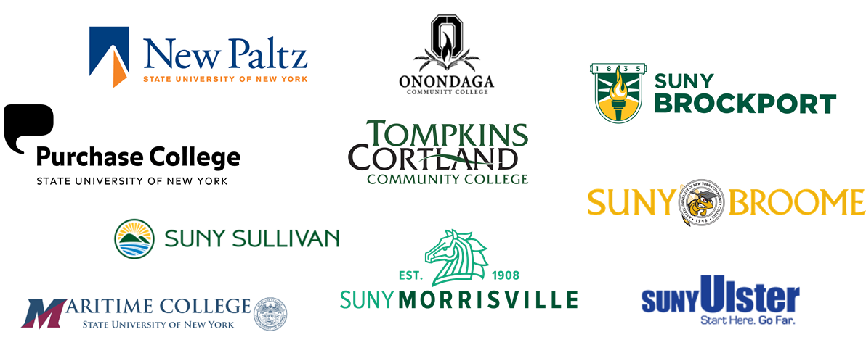

OER Sustainability Cohort II

Slide 13
Trending / Events
OER Contribution Matrix for Tenure and Promotion
Lumen Circles for SUNY faculty accepting applications
SUNY Conference on Instruction and Technology (CIT)
Northeast OER Conference (free!)
Notes:
https://www.doers3.org/uploads/1/3/2/2/132273765/the_oer_contributions_matrix.pdf
https://info.lumenlearning.com/circles-suny
https://sunycpd.eventsair.com/QuickEventWebsitePortal/cit2021/21cit/Agenda
https://docs.google.com/spreadsheets/d/1Q8TiMlL9zA8E3lGWUcRT43u5ImtblcxdZqb18SIQC9U/edit#gid=0

Slide 14
SUNY Library Services
Shannon Pritting
www.suny.edu

Slide 15
LARS Coordination
Community Colleges don’t submit this form.
SLS will be working to verify a report for those campuses using acquisitions in Alma.
After this year, OLIS will pull automatically and share with IR/Controller’s Office.
Will need to consider “shelf capacity” question as well.
www.suny.edu

Slide 16
Library Accessibility Reviewing
Cohort formally ending soon.
  May continue as open-ended discussion meeting group coordinated by campus participants.
SLS working with a few campuses to develop “ratings,” exceptions, Equally Effective Alt. Access Plans, and “VPATless” reviews.
SLS continuing to review and update product reviews.
We think this is the most we can move in this area now, but please reach out if things are happening at your campus that are going beyond this type of activity now.
www.suny.edu

Slide 17
OCLC Update
Working on finalizing contract.
Meeting with stakeholders on both sides on May 6 to try to get this out of SUNY review by mid-May, then go to AG and OSC.
Will likely be approved right at, or a little after the expiration of current agreement.
OCLC indicated price increase is 3% for some/most products and 2% for others.
www.suny.edu

Slide 18
Thirdiron (Libkey)
Working on 5-year contract.
Security Audit happening now, and this is taking a little longer than anticipated.
PIAs for recharge have been sent to interested campuses.
If any campuses are interested in adding Thirdiron, please reach out.
www.suny.edu

Slide 19
Upcoming Alma/Primo Data Migration
Alma/Primo will be down for migration of data to new data center.
Estimated Down Time 5/29-5/30 (9:00 pm to 9:00 pm)
SLS will have a preparation webinar in near future
www.suny.edu

Slide 20
Repositories and Open Access
Maureen Zajkowski
www.suny.edu

Slide 21


SUNY Open Repositories
https://soar.suny.edu
SUNY Faculty and Students Scholarly and Creative Works
published articles, post-prints, preprints, monographs, conference papers, dissertations, theses, honors projects, and creative works
https://dspace.sunyconnect.suny.edu/
Historical and special collections from SUNY campuses and System Admin
OER Collections
IITG reports
Campus Open Access Policies

Slide 22
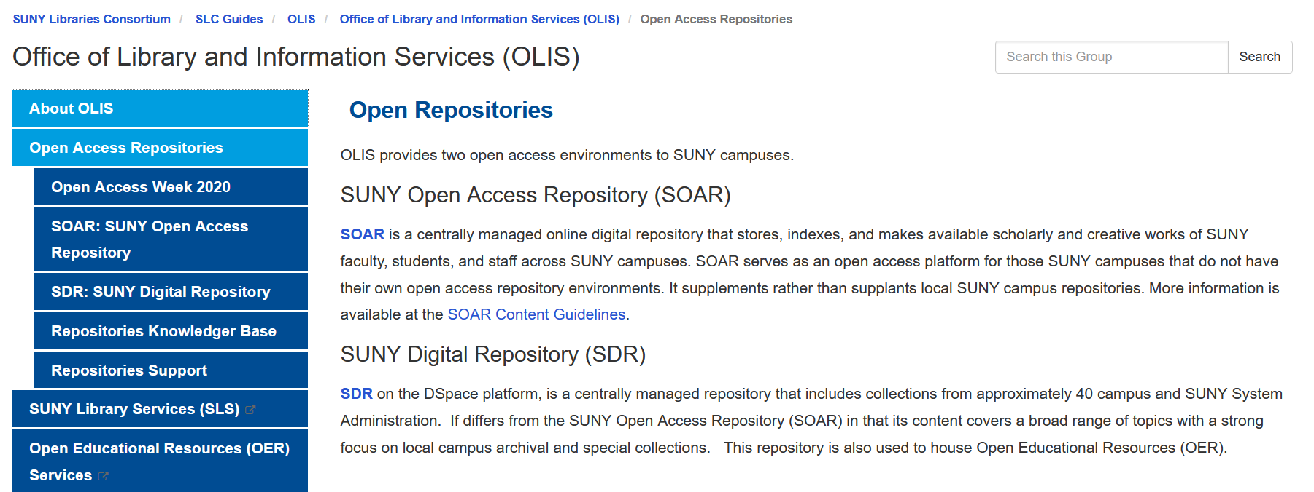
Open Repositories LibGuide
www.suny.edu

Slide 23


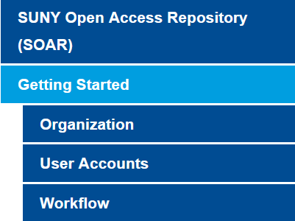
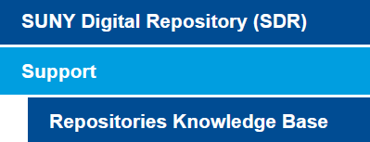
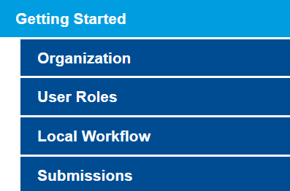
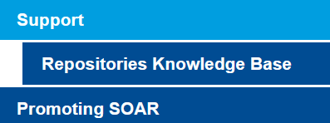
https://slcny.libguides.com/olis/openaccess
SOAR@suny.edu
SDR@suny.edu

Slide 24

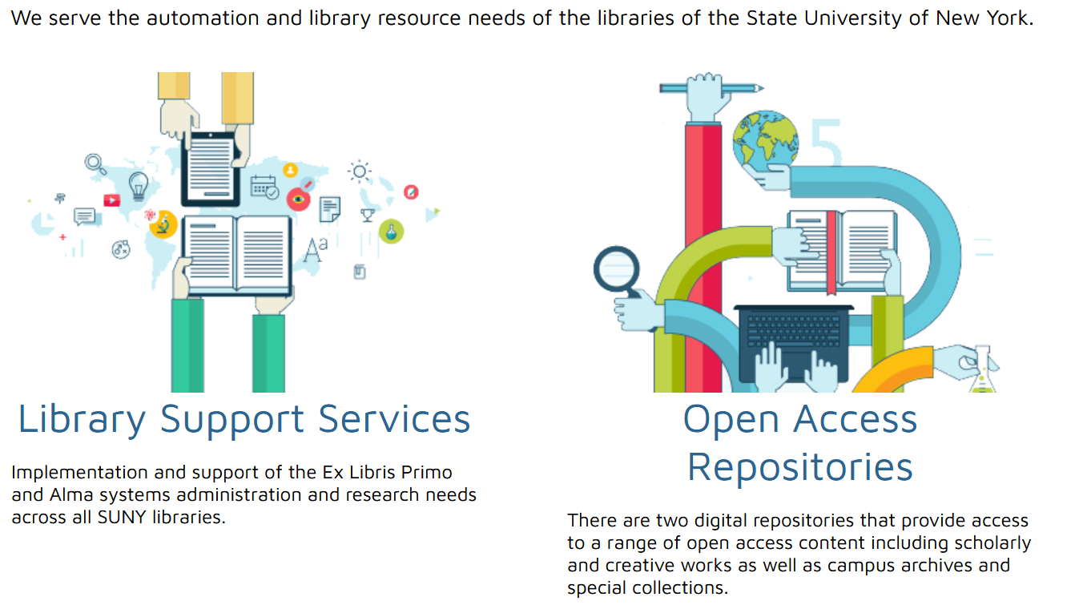
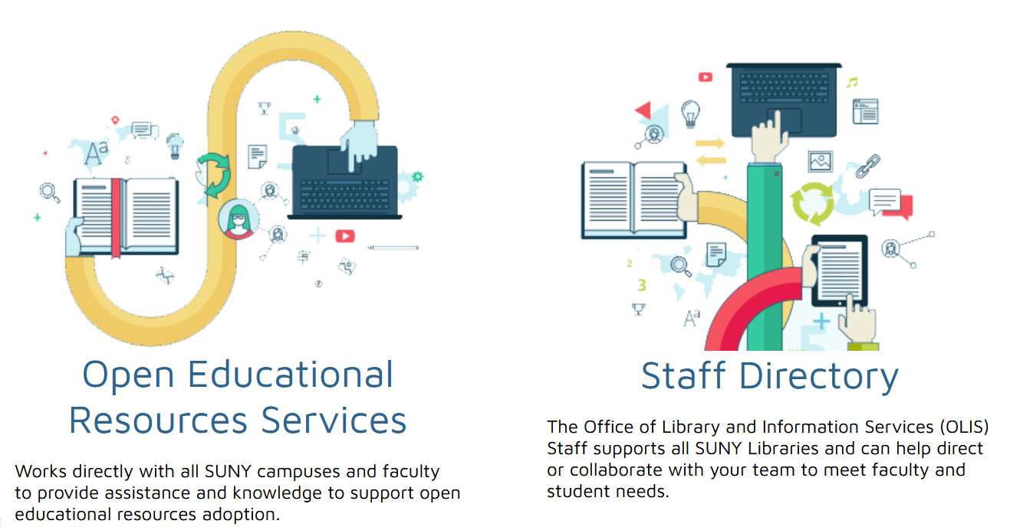
https://sunyconnect.suny.edu
Library Support Services
Open Access Repositories
OER Services
Staff Directory

Slide 25
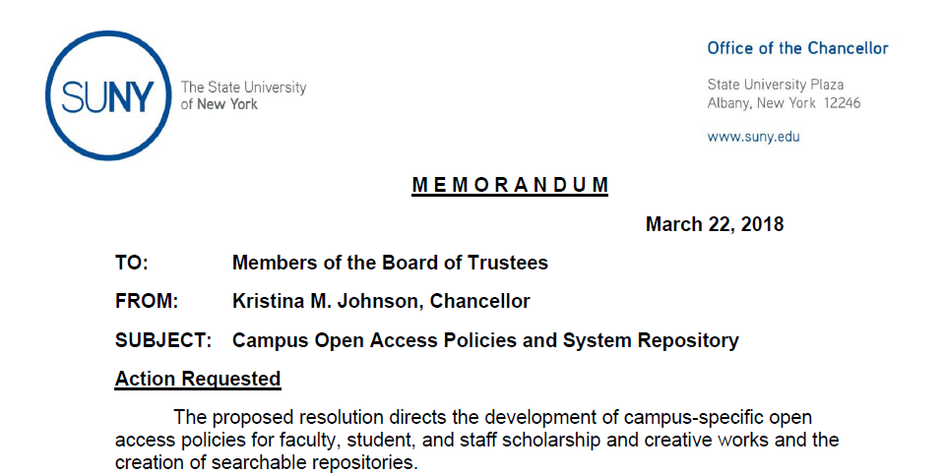




    Resolved that
    State Operated campuses shall develop an Open Access policy
    Each Community College is encouraged to develop an Open Access policy of their own
    All SUNY faculty and students have access to
    An open-access scholarly repository
www.suny.edu
Notes:
SUNY Board of Trustees Open Access resolution was informed by actions of the SUNY University Faculty Senate on open access and a System-wide Open Access Taskforce.
This was a consultative process with System Administration receiving guidance and input from library deans, vice presidents of research, provosts, UFS, FCCC, the SUNY Student Assembly, and campus review which informed the final version of the Resolution presented by the Chancellor to the SUNY BoT
The policy does not ask faculty, students, and staff to stop pursuing publication in peer-reviewed journals, monographs, proceedings, books etc., but to increase access to scholarly work

Slide 26
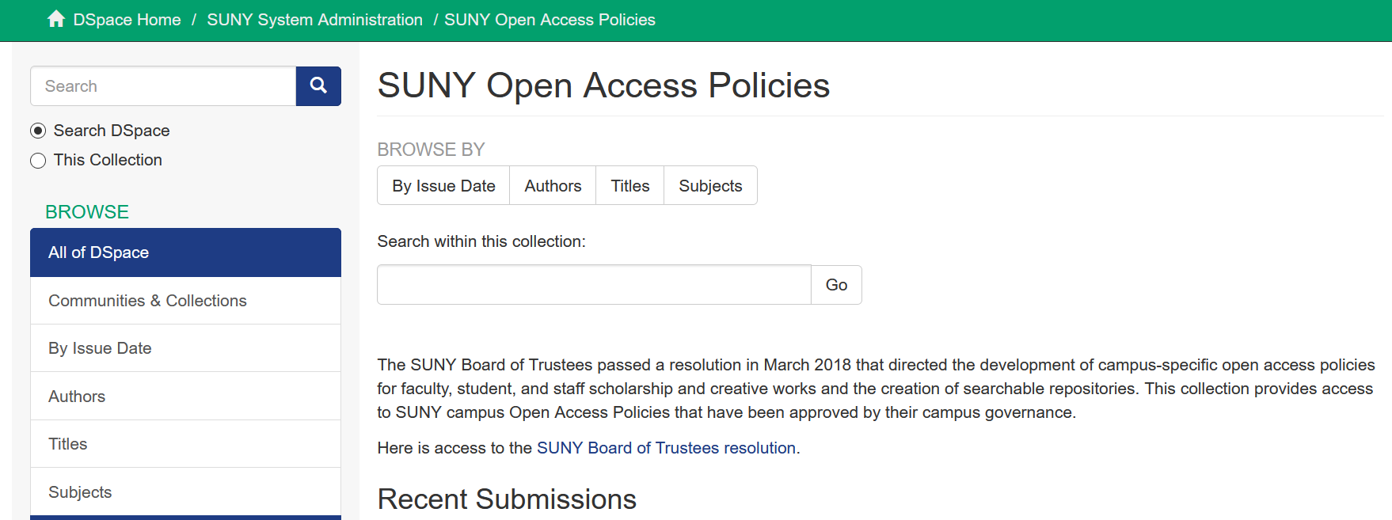
SUNY Open Access Policies
www.suny.edu

Slide 27

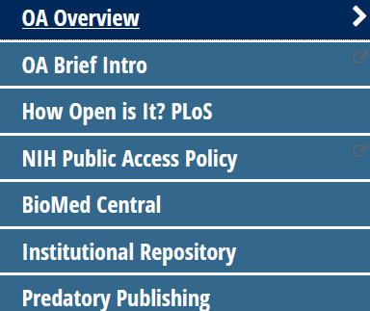





https://guides.upstate.edu/openaccess
www.suny.edu

Slide 28
Information
Who to Contact?
  SOAR SOAR@suny.edu
  SDR SDR@suny.edu
Open Repositories LibGuide https://slcny.libguides.com/olis/openaccess
Repository Links
  SUNY Open Access Repository (SOAR) https://soar.suny.edu/
  SUNY Digital Repository (SDR) https://dspace.sunyconnect.suny.edu/
www.suny.edu

Slide 29
Shared Collections
Esta Tovstiadi
www.suny.edu

Slide 30
Invitation for Bids
Master Agreements are being reviewed by SUNY Counsel
Estimated immediate cost savings: at least $120,000
  Savings could be more with more participation
Longer term savings include reduced price escalators, efficiencies in procurement process
Opportunities for future consortial agreements as we build relationships with vendors
PIAs must be signed by all participants in order to move contracts forward
  Chronicle: 29/43 received
  JSTOR: 23/38 received
  ProQuest: 8/28 received
www.suny.edu
Notes:
JSTOR - $67,500
PQ - $40,000
West - $23,700
NYTimes - $2,000

Slide 31
Other procurement updates
SpringerNature Exemption Request
  Awaiting review of draft agreement by S-N
CQ Researcher Exemption Request
  Contract almost completed
Working with Shared Collections Committee to prioritize future central procurements
www.suny.edu

Slide 32
SUNYConnect EBSCO Package Renewal
SUNY-wide EBSCO package of 35 databases up for renewal June 30, 2022
Campuses pay subscription fee via annual direct charge
SLS working with the Shared Collections Committee to form a group to review current package and provide recommendations on next steps
  In-depth communication forthcoming
www.suny.edu

Slide 33

Questions or Discussion?
www.suny.edu

