Slide 1
Rhode Island Cardiovascular Disease Learning Collaborative
Best Practice Sharing Meeting
Please put your name and organization in the chat
January 29, 2025

Slide 2
Agenda
Welcome and Opening
Clinic Data Overview
Clinic Panel Discussion
EHR Consultant – Z Codes
WISEWOMAN Update and Overview
CHN Updates / HHA
Ready for Health / CHW Cross-Training
Questions, Closing, Adjournment

Slide 3
Justan Baker
Evaluator/Epidemiologist
Clinic Data Overview
Quarter 4 - 2024

Slide 4
Current Data
Date range: 1/1/2024 - 12/31/2024
Measure | RIFC Source=MIPS | CE Source=Registry
Hypertension control | 63% (Δ+10%) | 62% (Δ+4%)
Statin therapy | 82% (Δ-1%) | 72%(Δ+4%)
Undiagnosed hypertension | #N/A | 1%(Δ-4%)

Slide 5
Difficulty of using MIPS and Registry
Tracking changes in MIPS values from quarter to quarter is problematic.
  MIPS documentation shows it only considers the most recent blood pressure reading.
  Includes many types of encounters, some of which you might not normally consider a valid blood pressure reading.
Registry report requires substantial coding to account for the inclusion and exclusion criteria used in MIPS measure.
  Ex: CE Quarter 4 data has denominator of 718 for registry and 839 for MIPS.
Notes:
Tracking MIPS data from quarter to quarter can be problematic and confusing.
MIPS only looks at the most recent blood pressure reading, so a given patient may be in the numerator one quarter and not in the next.
Ultimately, the MIPS report from the end of the year is the "gold standard" but we need data more often than once a year in order to make strategic changes within the clinic.
MIPS also includes many encounter types, some of which you wouldn’t normally think count as a valid blood pressure reading. For example, a blood pressure taken at a dental visit. (BP probably plenty high if patient is going to have a root canal.)
Registry requires A TON of coding in order to mimic the validated measure used under MIPS.
This is obvious by the fact that the denominators are off between the MIPS and Registry for CE.
However, CE demonstrates that the Registry is a good proxy since both of their percentages are identical.
These difficulties can be entirely or largely eliminated using more robust EHR reporting packages.

Slide 6
ZIP Code Data
Preliminary of combined ZIP code data shows some expected and unexpected results.
Top three cities:
  Providence (3,007)
  Pawtucket (373)
  Central Falls (305)
Unexpected cities:
  Cumberland (56)
  Newport (11) (Geographically Unexpected)
  East Greenwich (7)
  Barrington (7)
Notes:
Bottom three cities not show due to RIDOH's small numbers policy.

Slide 7
The Cost of Hypertension and CVD
As we head into Heart Month, its important to remember the value of our work.
Annual medical costs for people with high blood pressure were $2,759 higher than for people without high blood pressure
About 1 in every 8 health care dollars is spent on cardiovascular disease (about 12% in 2019–2020)
Data source: www.cdc.gov/nccdphp/priorities/high-blood-pressure.html

Slide 8
Jayne Daylor
QI Consultant
CEHC/RIFC
Clinic and QI Updates from Clínica Esperanza and Rhode Island Free Clinic

Slide 9


Clinic Updates from Clínica Esperanza/Hope Clinic and R.I. Free Clinic
Describe the overall process and challenges that occurred to access the PRAPARE, SDOH screening tool, in your EHR?
What domain questions from the PRAPARE tool did you decide to use, and why?
Describe the “pilot phase” process of implementing the PRAPARE tool and current SDOH policy?
How are you using team-based care to implement SDOH screening?
Describe how are adhering to your SDOH policy?

Slide 10

Adrian Bishop
EHR Consultant

Slide 11
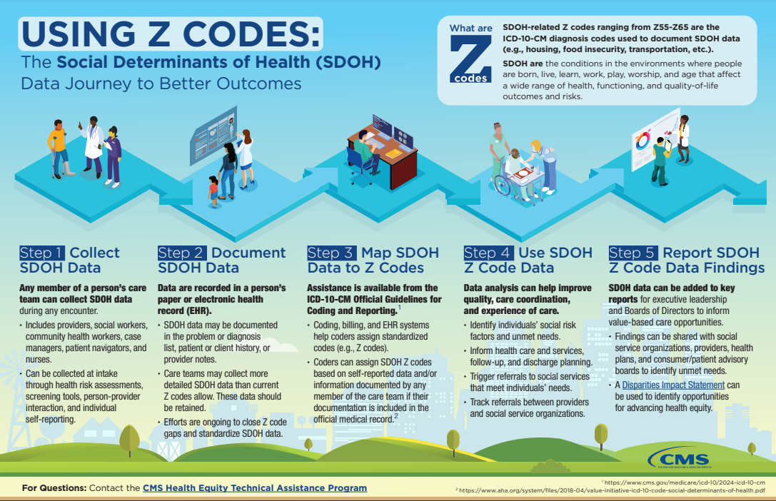
Z Codes
https://www.cms.gov/files/document/zcodes-infographic.pdf

Slide 12
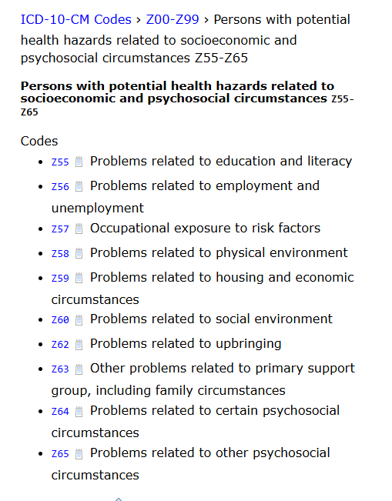
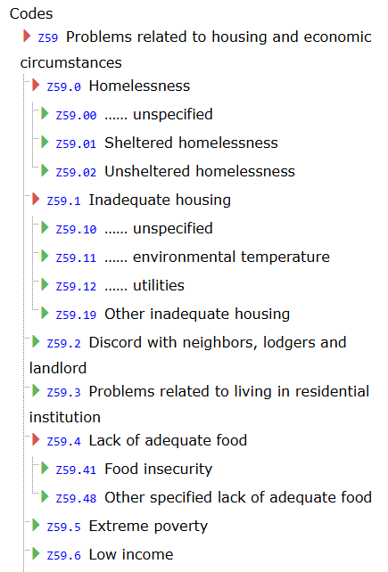
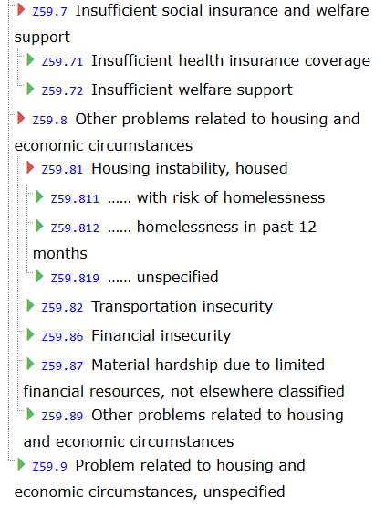
SDOH Z Codes Z55-Z65
https://www.icd10data.com/ICD10CM/Codes/Z00-Z99/Z55-Z65/Z59-

Slide 13
Z Code Mapping
Question | Question ID | Answer | Z Code | SNOMED Code
Are you worried about losing your housing? | 93033-9 | Yes | Z59.1 Inadequate Housing Z59.811 Housing instability, house, with risk of homelessness Z59.812 Housing instability, housed, homelessness in the past 12 months Z59.819 Housing instability, housed unspecified Z59.89 Other problems related to housing and economic circumstances Z59.81 Housing instability, housed (new subcategory) | 1148447008 - Assessment for housing insecurity 105531004 - Housing unsatisfactory (finding) 185957008 - Awaiting housing improvement (finding) 160729004 - Lives in sheltered housing (finding) 160751007 - Eviction from dwelling (finding) 5549007 - Living in temporary quarters 224211003 - Does not own home 406132007 - Living temporarily with relatives (finding) 161036002 - Housing adequate 1156191002 - Housing instability 1156195006 - Housing instability due to being behind on payments for place of residence 1156193004 - Housing instability due to frequent change in place of residence 1156192009 - Housing instability due to imminent risk of homelessness 1156196007 - Housing instability due to threat of eviction 1156194005 - Housing instability following recent homelessness

Slide 14

Cindy Ariza
RIDOH WISEWOMAN Program Manager

Slide 15
Rhode Island WISEWOMAN
9 Social Determinants of Health Measures
  Computer Use
  Internet Access
  Food insecurity
  Transportation Barriers
  Childcare
  Barriers to accessing childcare
  Housing
  Intimate partner violence
  Medication taking Adherence
WISEWOMAN is compiling a list of Community Resources to address these Social Determinants of Health. Please share lists of resources used within your clinics.

Slide 16
Rhode Island WISEWOMAN
Total assessments (baseline and Reassessment) in year 2 (as of January 24, 2025)
Year 2 Total Goal: 368 Achieved: 54
  CEHC = 23/ Goal is 158
  RIFC = 29 / Goal is 158
  Jenks Park = 2/ Goal is 52
Year 2 Follow-ups completed
  CEHC = 4
  RIFC = 5
  JENKS = 0
What SDOHs have been used in year 2
  Farm Fresh = 8
  Bus passes = 10
  Market Mobile = 9
  CEHC bodega = 2

Slide 17
Rhode Island WISEWOMAN
WISEWOMAN Clinics in Year 2
Clínica Esperanza Health Clinic (CEHC)
Rhode Island Free Clinic (RIFC)
Jenks Park (JENKS) - onboarded Jan 2025
Open Door Health (ODH) - onboarding Feb 2025

Slide 18
For questions contact Cindy Ariza
Cindy Ariza, MPA
WISEWOMAN Program Manager
Rhode Island Department of Health
cindy.ariza@health.ri.gov
Notes:
Erica Hanson

Slide 19

Community Health Network
Your patients' connection to free and low-cost health programs
Erica Hanson
RIDOH Community Health Network Manager

Slide 20


CHN Agenda
HHA BPSM Train the Trainer Recap
Healthy Heart Ambassador Blood Pressure Self-Monitoring Program 204 Recap and 2025 Plans
CHN SDoH Update
Rhode Island Public Health Summit - Save the date for the 3rd Annual Public Health Summit on April 28, 2025, "Innovative Approaches to Advance Public Health: A Call to Collective Action." If you are interested in learning about sponsorship, volunteering, speaking opportunities, and other ways to get involved, go to Public Health Summit 2025: Interest Form.
Notes:
Erica Hanson

Slide 21
2024 HHA BPSM Recap
HHA BPSM 2024 cohorts
2 Oasis International, Newport County Prevention Coalition
26 participants
Nutrition education seminars, availability and accessibility
BP data being reviewed currently
Notes:
Erica Hanson

Slide 22

CHN Q&A
Notes:
Erica Hanson

Slide 23

Notes:
Erica Hanson

Slide 24
CHN and HHA BPSM
Contact Information
Erica Hanson
Erica.Hanson@health.ri.gov
401-222-7954
Notes:
Erica Hanson

Slide 25
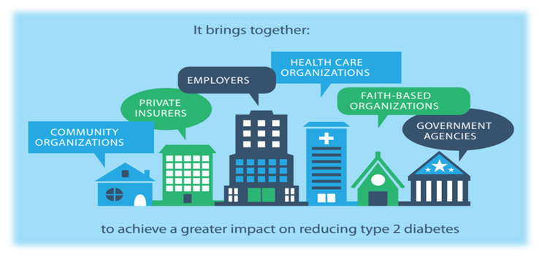
Benvinda Santos, Sustainability Manager
Katlynn Kisla, DPP Specialist
Ready for Health (formerly National DPP)

Slide 26
Learning Objectives
Be able to describe the Ready for Health Program, eligibility, delivery site landscape, and participation benefits.
Be able to describe Ready for Health sustainability approaches.
Be able to list health outcomes of the Ready for Health program related to CVD risk.
Learning Objectives
By the end of this session, participants will:

Slide 27
How Common is Prediabetes? Let's See with a Show of Hands
Would 1/3 of attendees raise their hands?
Does this seem like a lot?
Now consider each raised hand represents someone with prediabetes.
Does that seem like a lot?
Notes:
Erica Hanson

Slide 28
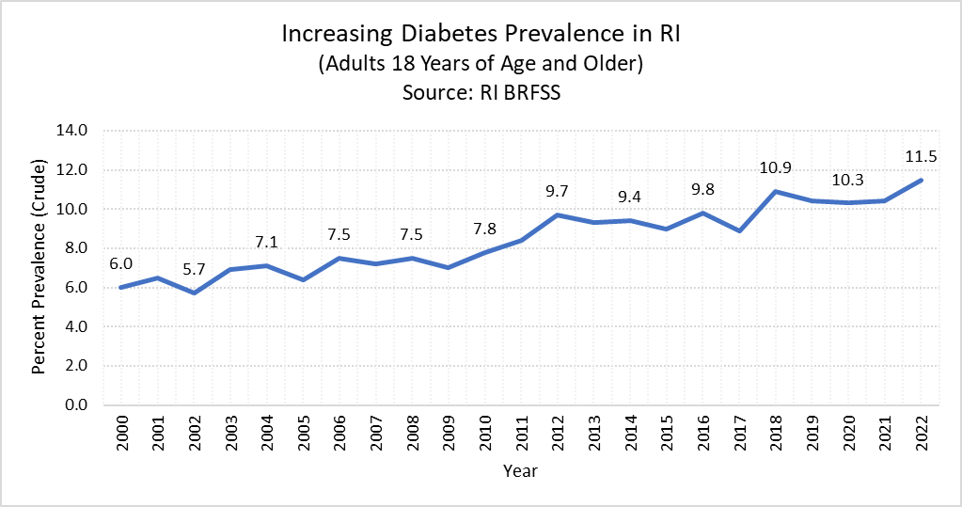
Increasing diabetes prevalence in RI (Adults age 18+)
Diabetes prevalence has been increasing over the last two decades. Around 1 in 10 Rhode Islanders report having been diagnosed with diabetes.
11.75
2023
Data source: RI BRFSS
Notes: Percentages are crude and have not been adjusted for age.
Notes:
DANAI
Data source: CDC Places PLACES: Local Data for Better Health | CDC

Slide 29
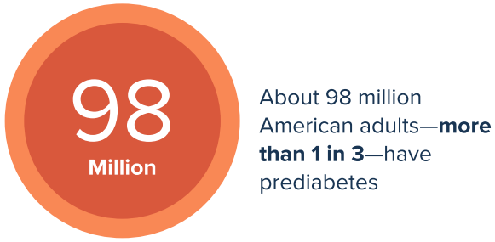
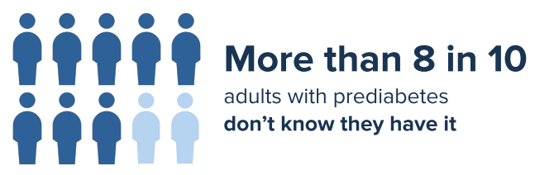
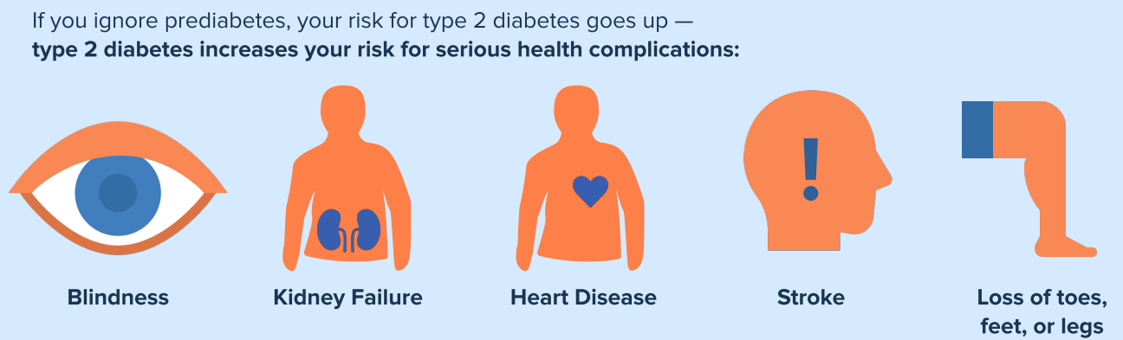
Prediabetes
Data Source: Centers for Disease Control and Prevention. (2022, August 11). Prediabetes: Could It Be You? Retrieved from https://www.cdc.gov/diabetes/basics/prediabetes.html

Slide 30
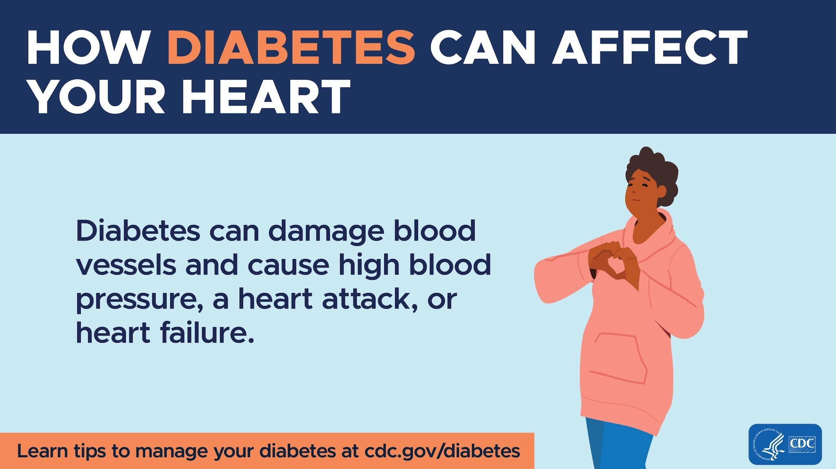
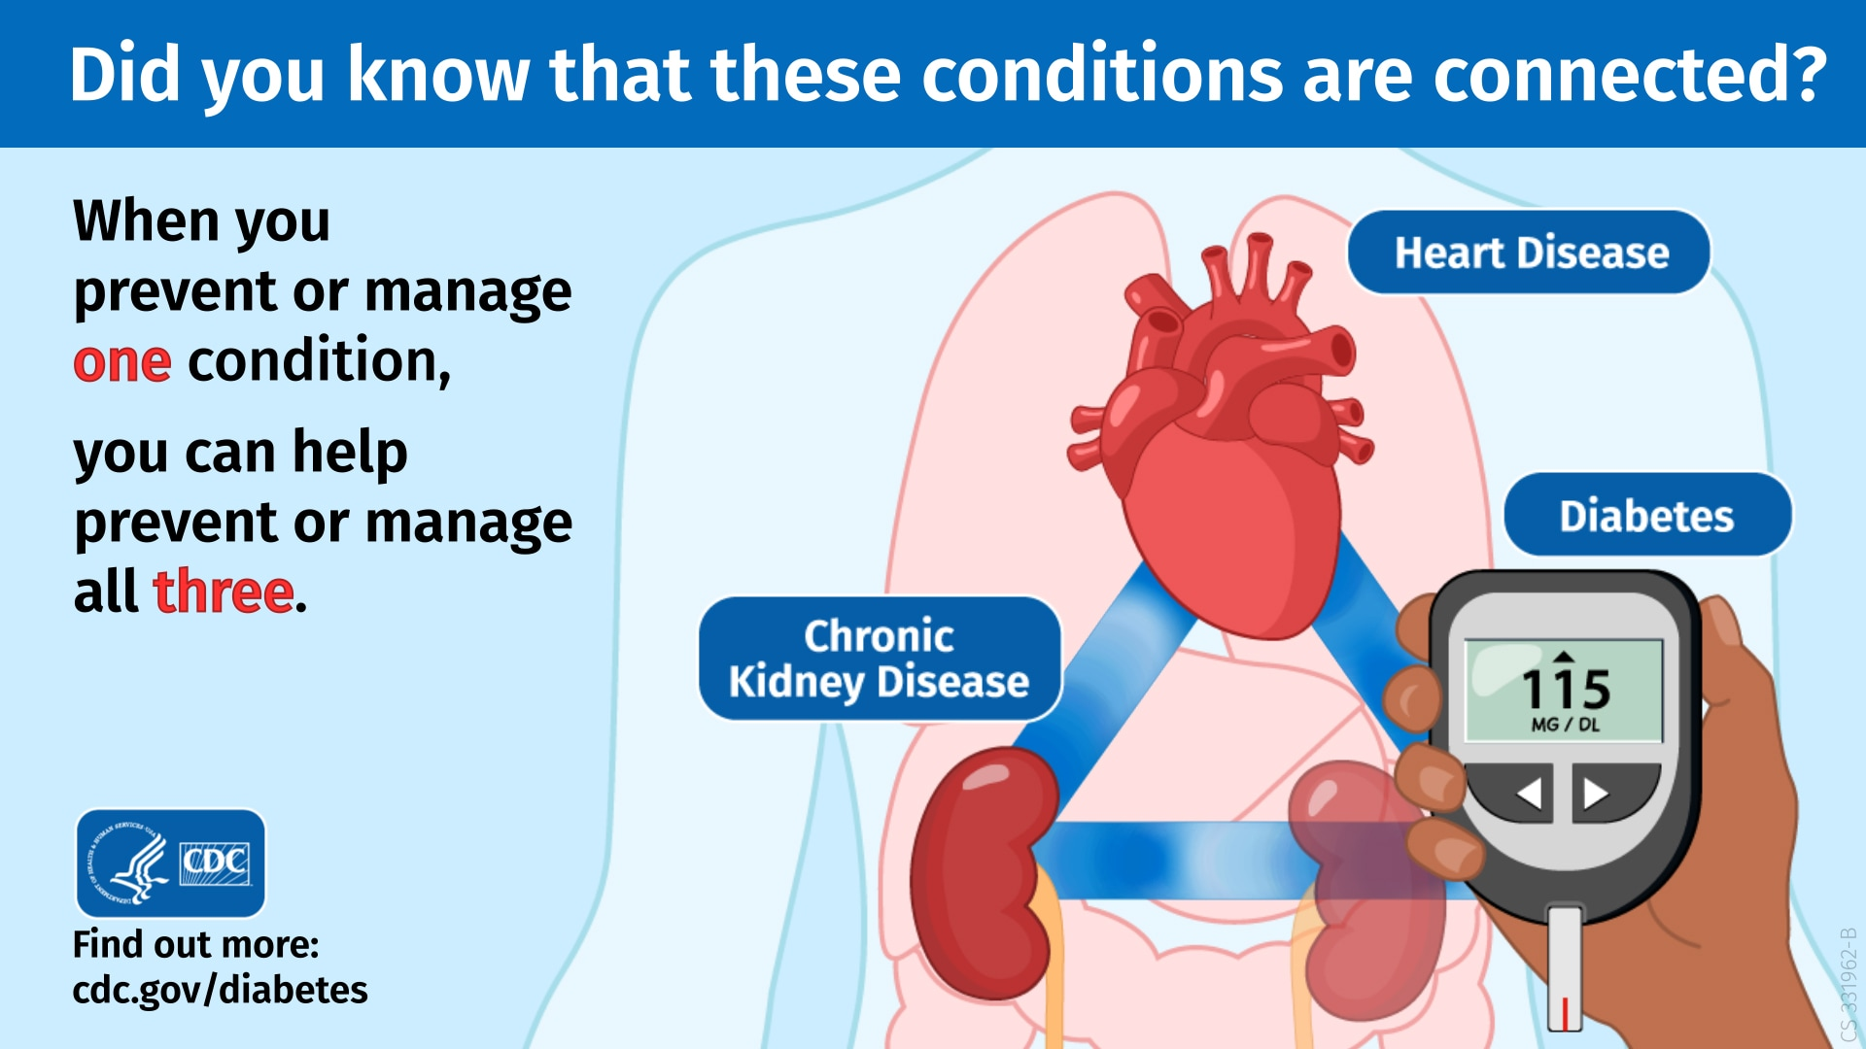
Prevent Progression to Diabetes for Cardiovascular Health
Addressing Prediabetes can prevent progression to Diabetes, and other related chronic disease(s).
Diabetes doubles risk for Heart Disease
Diabetes, Heart Disease, and Chronic Kidney Disease "triangle"
Image and data source: CDC/Diabetes and Your Heart
Image and data source: CDC/Diabetes, Heart Disease, and CKD Triangle
Notes:
Data source: CDC Places PLACES: Local Data for Better Health | CDC

Slide 31
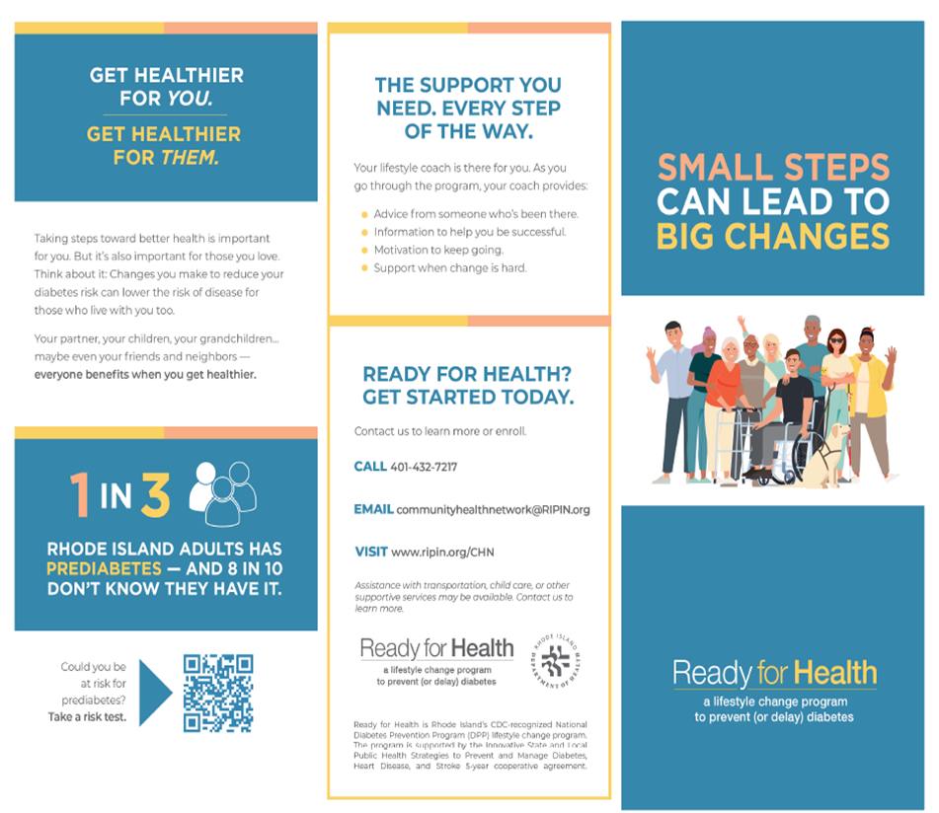

Diabetes Prevention Program Ready for Health
Notes:
Direct audience to the print outs

Slide 32

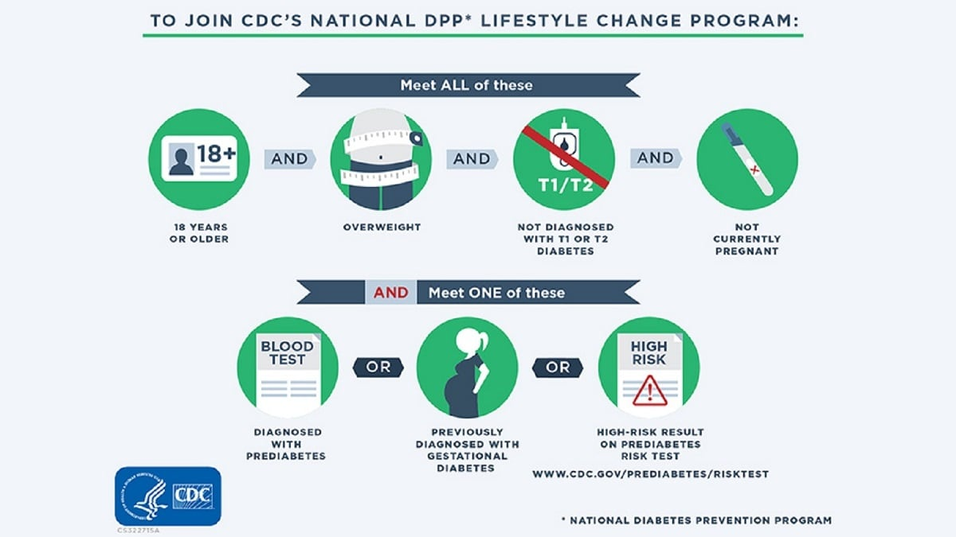
Program Eligibility and Referrals
Community Health Network
ALL
+ ONE
Community Health Network - RIPIN
Notes:
Erica Hanson

Slide 33

Diabetes Alert Day® - March 25, 2025
Raise awareness for Diabetes risk, and the chance to reduce risk with the Ready for Health program.
Diabetes Alert Day® - March 25, 2025
Annual observation (Fourth Tuesday in March) by the American Diabetes Association
Could you or someone you know be at risk? Take the pre-test:

Slide 34







Community Partners Offering Diabetes Prevention Programs
Programs Offered:
In-Person
Virtual
Hybrid

Slide 35
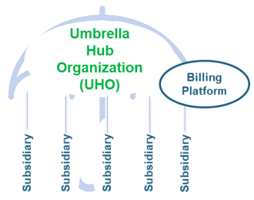


Ready for Health Sustainability Approaches
Build capacity and provide technical assistance for diabetes prevention delivery sites to seek available reimbursements (Medicare/Medicaid).
Leverage funds to cross train Lifestyle Coaches and Community Health Workers.
Work with the State Medicaid Office and MCOs to expand access to Ready for Health and coverage.
Explore the feasibility of innovative payment models bundling Ready for Health with other evidence-based programs, services and reimbursements through an Umbrella Hub Arrangement or small Community Care Hub.
Referring Health System
or Practice(s)
health-social-care-coordination.pdf (hhs.gov)
Umbrella Hub Arrangements - National DPP Coverage Toolkit

Slide 36
Ready for Health
Contact Information
Benvinda Santos, Sustainability Manager
Benvinda.santos@health.ri.gov
Katlynn Kisla, DPP Specialist
Katlyn.Kisla.CTR@health.ri.gov
Ready for Health, A Diabetes Prevention Program | Department of Health
Notes:
Erica Hanson

Slide 37
Questions and Closing
Thank you all for taking time out of your day to attend this best practice sharing meeting!
See you for the next quarterly best practice sharing meeting in March!
All slides will be emailed to attendees with resources

